Slide 1
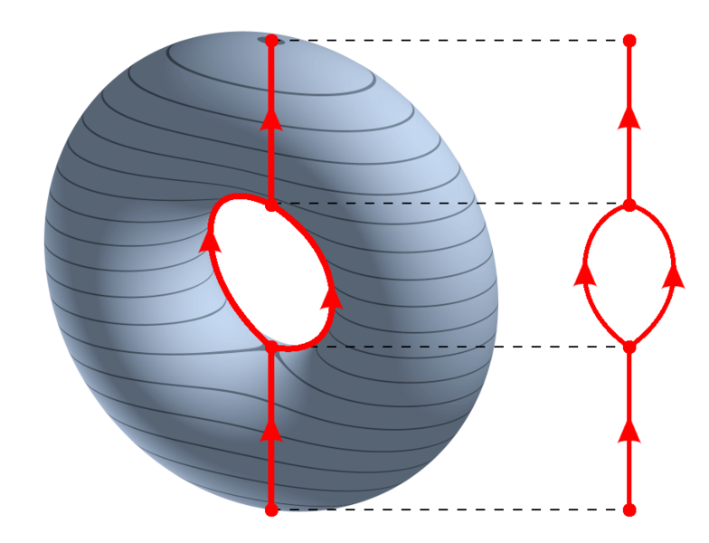
https://en.wikipedia.org/wiki/Reeb_graph

Slide 2
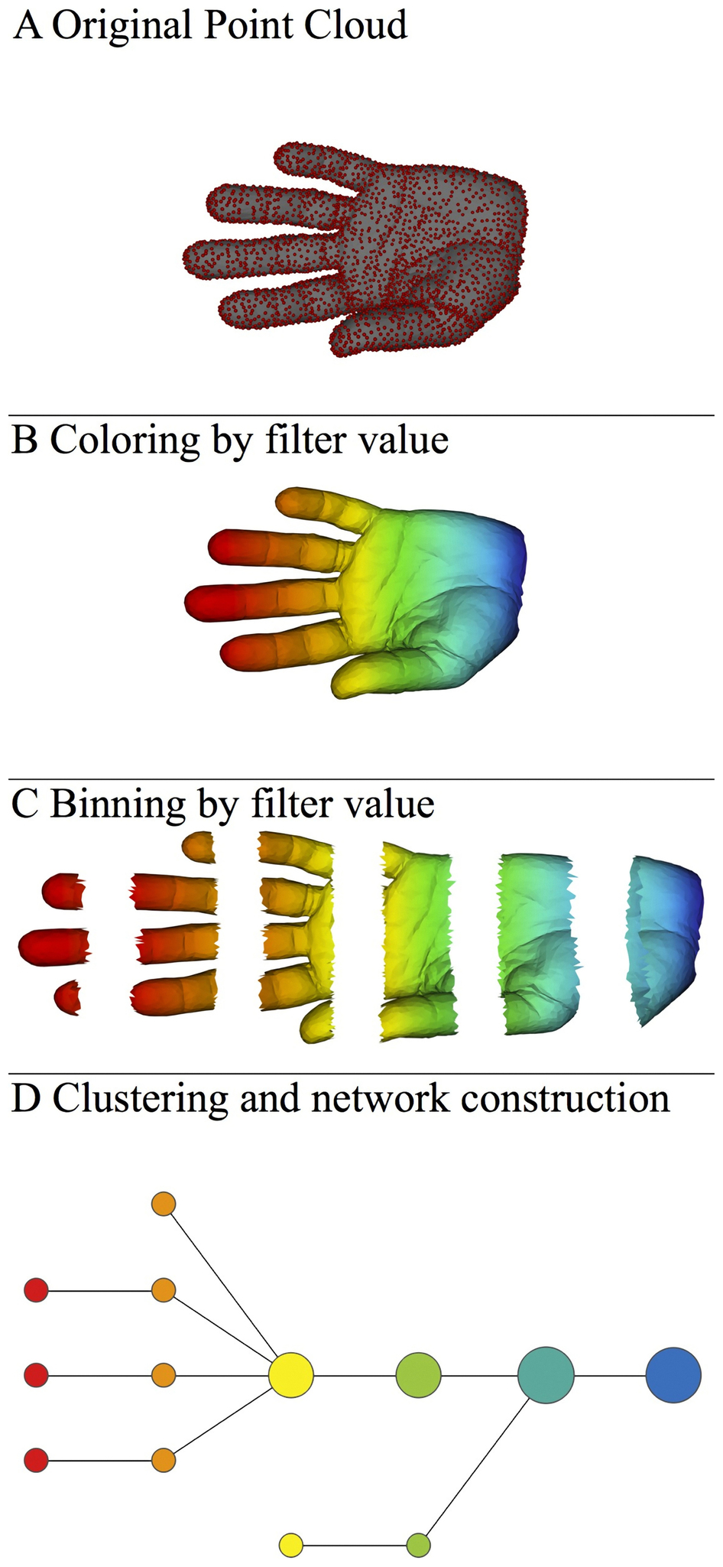
https://en.wikipedia.org/wiki/Reeb_graph
http://www.nature.com/srep/2013/130207/srep01236/full/srep01236.html

