Slide 2
Topological Data Analysis (TDA): Three key ideas of topology that make extracting of patterns via shape possible.
1.) coordinate free.
No dependence on the coordinate system chosen.
Can compare data derived from different platforms
vital when one is studying data collected with different technologies, or from different labs when the methodologies cannot be standardized.
http://www.nature.com/srep/2013/130207/srep01236/full/srep01236.html

Slide 3
Topological Data Analysis (TDA): Three key ideas of topology that make extracting of patterns via shape possible.
2.) invariant under “small” deformations.
less sensitive to noise
Topological Methods for the Analysis of High Dimensional
Data Sets and 3D Object Recognition, Singh, Mémoli, Carlsson
Figure from http://comptop.stanford.edu/u/preprints/mapperPBG.pdf
http://www.nature.com/srep/2013/130207/srep01236/full/srep01236.html

Slide 4
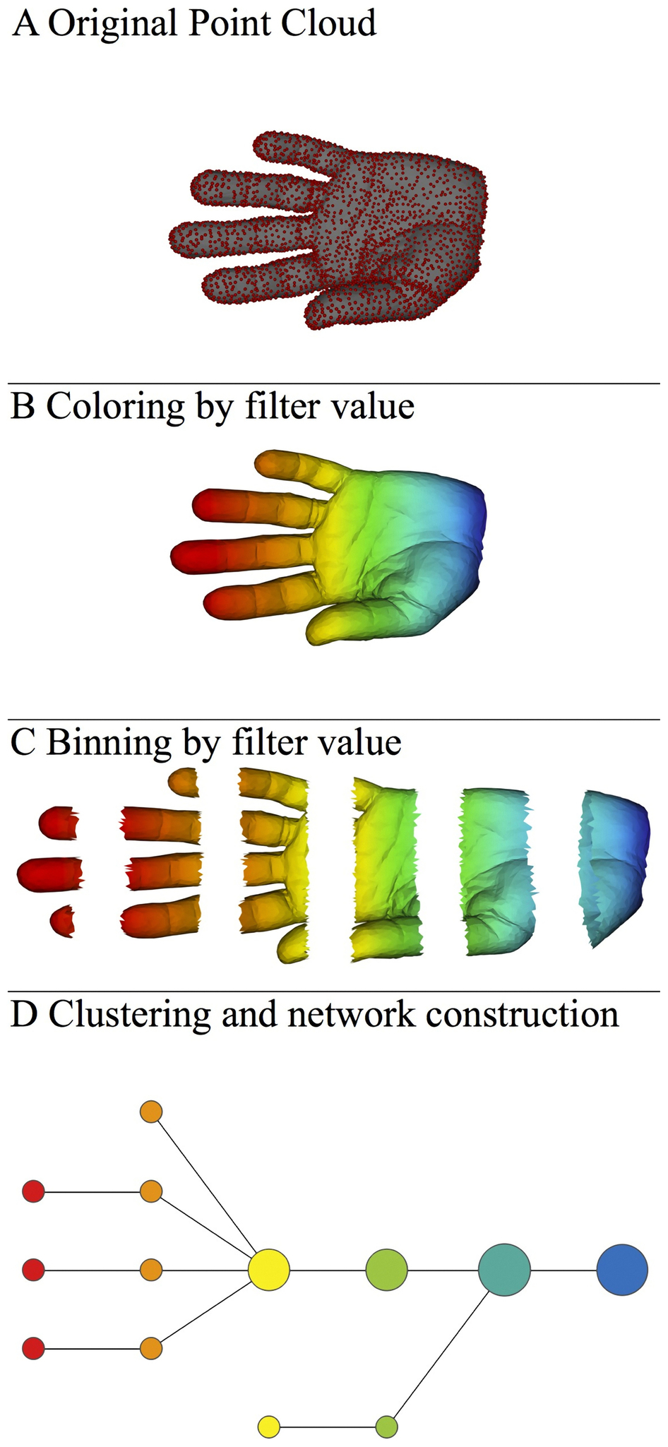
Topological Data Analysis (TDA): Three key ideas of topology that make extracting of patterns via shape possible.
3.) compressed representations of shapes.
Input: dataset with thousands of points
Output: network with
13 vertices and 12 edges.
http://www.nature.com/srep/2013/130207/srep01236/full/srep01236.html

Slide 5
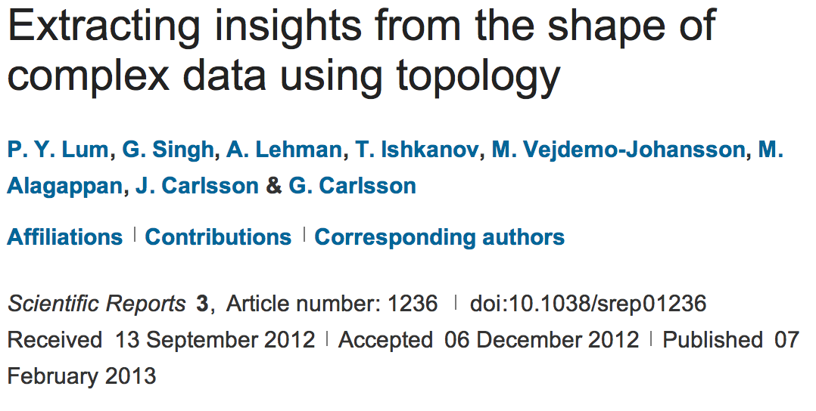
http://www.nature.com/srep/2013/130207/srep01236/full/srep01236.html

Slide 6
Chose filter
Only need to cover the data points.
http://www.nature.com/srep/2013/130207/srep01236/full/srep01236.html

Slide 7
Chose filter
http://www.nature.com/srep/2013/130207/srep01236/full/srep01236.html

Slide 8
Chose filter
http://www.nature.com/srep/2013/130207/srep01236/full/srep01236.html

Slide 9
Application 3 (in paper): Basketball
Data: rates (per minute played) of rebounds, assists, turnovers, steals, blocked shots, personal fouls, and points scored for 452 players.
➔ Input: 452 points in R⁷
For each player, we have a vector
= (r, a, t, s, b, f, p) in R⁷
Distance: variance normalized Euclidean distance.
Clustering: Single linkage.
( min , min , min , min , min , min , min )
rebounds assists turnovers steals blocked shots personal fouls points scored
http://www.nature.com/srep/2013/130207/srep01236/full/srep01236.html

Slide 10
Filters: principle and secondary SVD values.
http://commons.wikimedia.org/wiki/File:SVD_Graphic_Example.png
Data
http://www.nature.com/srep/2013/130207/srep01236/full/srep01236.html

Slide 11
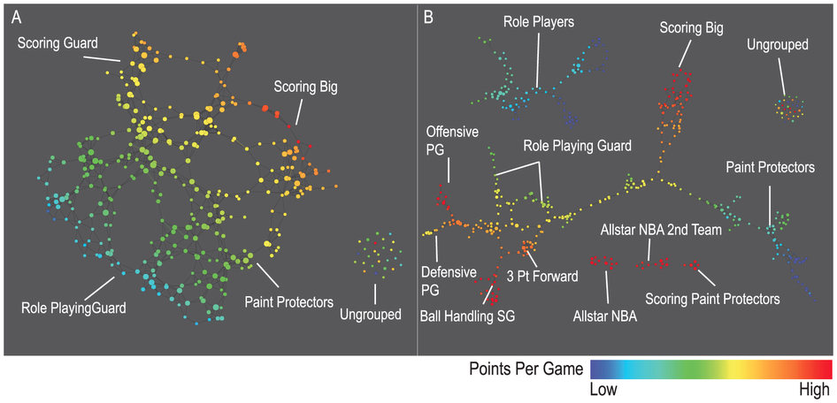
A) Low resolution map at 20 intervals for each filter B) High resolution map at 30 intervals for each filter. The overlap is such at that each interval overlaps with half of the adjacent intervals, the graphs are colored by points per game, and a variance normalized Euclidean distance metric is applied. Metric: Variance Normalized Euclidean; Lens: Principal SVD Value (Resolution 20, Gain 2.0x, Equalized) and Secondary SVD Value (Resolution 20, Gain 2.0x, Equalized). Color: red: high values, blue: low values.
http://www.nature.com/srep/2013/130207/srep01236/full/srep01236.html

Slide 12
LeBron James , Kobe Bryant, Brook Lopez
A) Low resolution map at 20 intervals for each filter B) High resolution map at 30 intervals for each filter. The overlap is such at that each interval overlaps with half of the adjacent intervals, the graphs are colored by points per game, and a variance normalized Euclidean distance metric is applied. Metric: Variance Normalized Euclidean; Lens: Principal SVD Value (Resolution 20, Gain 2.0x, Equalized) and Secondary SVD Value (Resolution 20, Gain 2.0x, Equalized). Color: red: high values, blue: low values.
http://www.nature.com/srep/2013/130207/srep01236/full/srep01236.html
Notes:
Compare how graphs drawn. Note disconnected means not close Don’t be mislead by graph drawing

Slide 13
Application 2: US House of Representatives Voting records
Data: (aye, abstain, nay, …. )
= ( +1 , 0 , -1 , … )
Distance: Pearson correlation
Filters: principal and secondary metric SVD
Clustering: Single linkage.
http://www.nature.com/srep/2013/130207/srep01236/full/srep01236.html

Slide 14
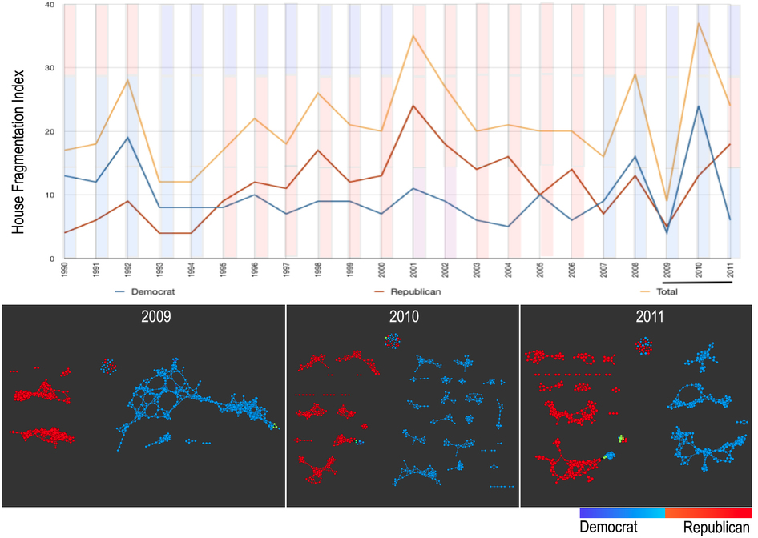
number of sub-networks formed each year per political party.
X-axis: 1990–2011. Y-axis: Fragmentation index. Color bars denote, from top to bottom, party of the President, party for the House, party for the Senate (red: republican; blue: democrat; purple: split). The bottom 3 panels are the actual topological networks for the members. Networks are constructed from voting behavior of the member of the house, with an “aye” vote coded as a 1, “abstain” as zero, and “nay” as a -1. Each node contains sets of members. Each panel labeled with the year contains networks constructed from all the members for all the votes of that year. Note high fragmentation in 2010 in both middle panel and in the Fragmentation Index plot (black bar). The distance metric and filters used in the analysis were Pearson correlation and principal and secondary metric SVD. Metric: Correlation; Lens: Principal SVD Value (Resolution 120, Gain 4.5x, Equalized) and Secondary SVD Value (Resolution 120, Gain 4.5x, Equalized). Color: Red: Republican; Blue: Democrats.
http://www.nature.com/srep/2013/130207/srep01236/full/srep01236.html

Slide 15
They determined what issues divided Republicans into the two main sub-groups in 2009:
The Credit Cardholders' Bill of Rights,
To reauthorize the Marine Turtle Conservation Act of 2004,
Generations Invigorating Volunteerism and Education (GIVE) Act,
To restore sums to the Highway Trust Fund and for other purposes,
Captive Primate Safety Act, Solar Technology Roadmap Act, Southern Sea Otter Recovery and Research Act.
http://www.nature.com/srep/2013/130207/srep01236/full/srep01236.html

Slide 16
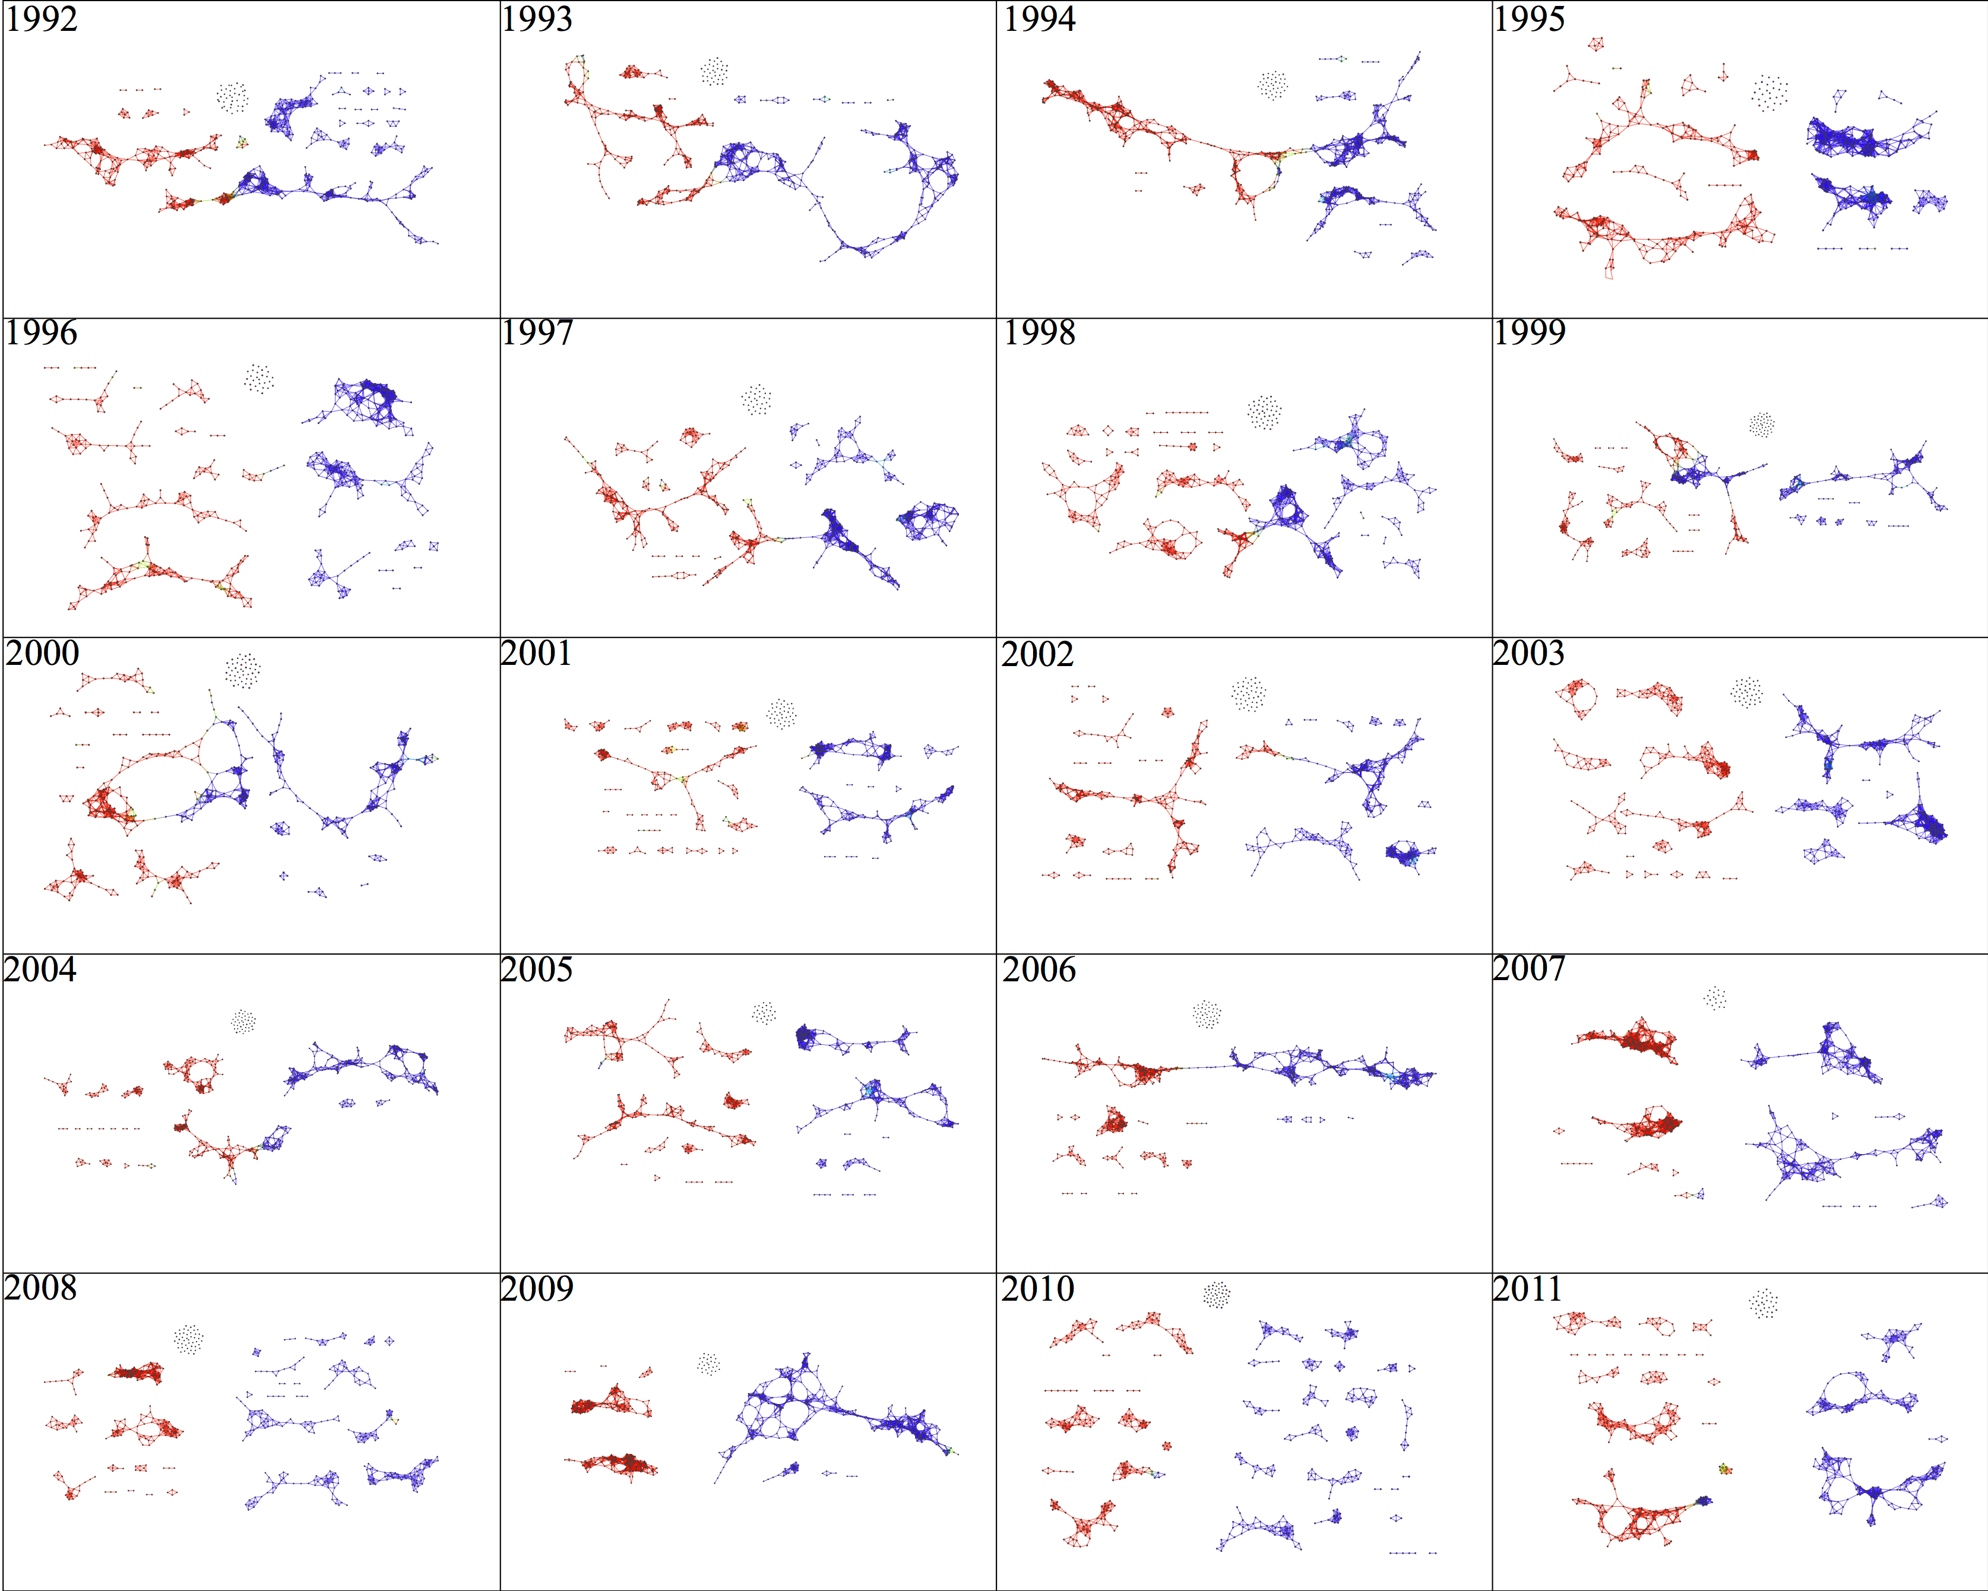

Slide 17
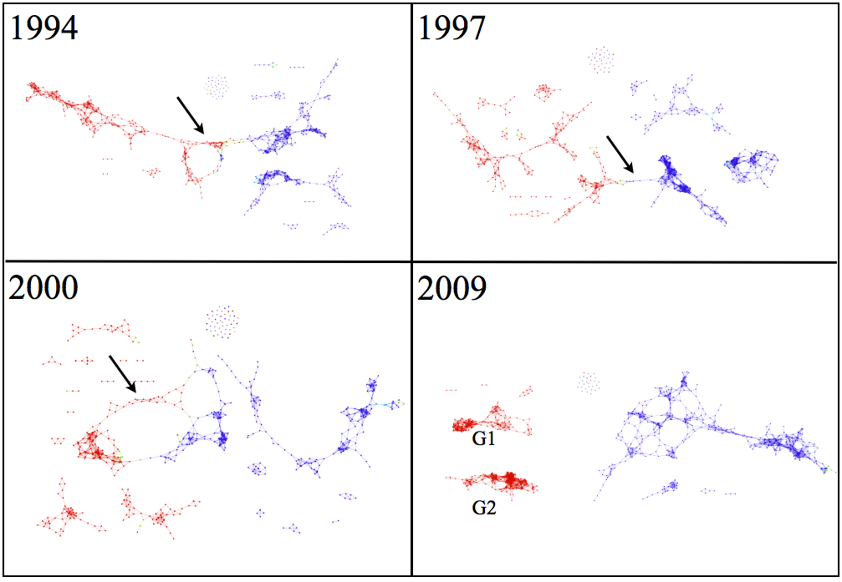

Slide 18
Application 1: breast cancer gene expression
Data: microarray gene expression data from 2 data sets, NKI and GSE2034
Distance: correlation distance
Filters: (1) L-infinity centrality:
f(x) = max{d(x, p) : p in data set}
captures the structure of the points far removed from the center or norm.
(2) NKI: survival vs. death
GSE2034: no relapse vs. relapse
Clustering: Single linkage.

Slide 19
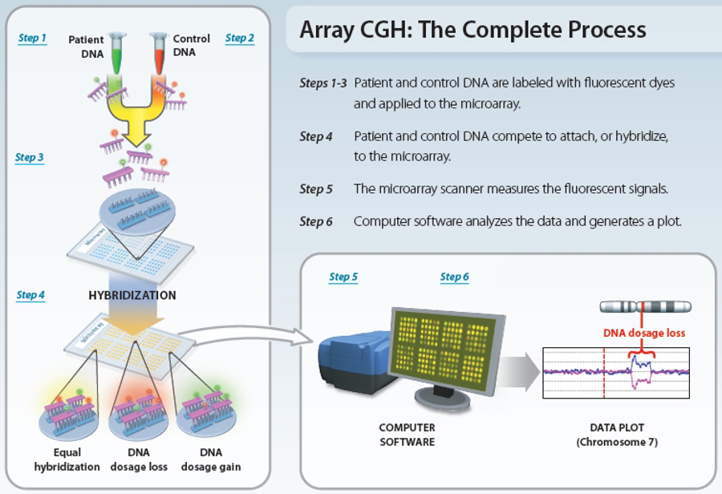
www.nature.com/scitable/topicpage/microarray-based-comparative-genomic-hybridization-acgh-45432

Slide 20
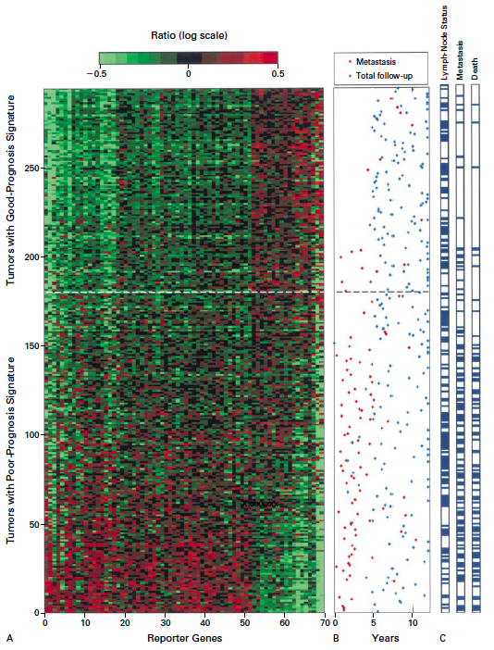
Gene expression profiling predicts clinical outcome of breast cancer
van 't Veer LJ, Dai H, van de Vijver MJ, He YD, Hart AA, Mao M, Peterse HL, van der Kooy K, Marton MJ, Witteveen AT, Schreiber GJ, Kerkhoven RM, Roberts C, Linsley PS, Bernards R, Friend SH
Nature. 2002 Jan 31;415(6871):530-6.

Slide 21
2 breast cancer data sets:
1.) NKI (2002):
gene expression levels of 24,000 from 272 tumors. Includes node-negative and node-positive patients, who had or had not received adjuvant systemic therapy. Also includes survival information.
2.) GSE203414 (2005)
expression of 22,000 transcripts from total RNA of frozen tumour samples from 286 lymph-node-negative patients who had not received adjuvant systemic treatment. Also includes time to relapse information.

Slide 22
Fig. S1. Shape of the data becomes more distinct as the analysis columns are restricted to the top
varying genes.
24K: all the genes on the microarray were used in the analysis;
11K: 10,731 top most varying genes were used in the analysis;
7K: 6.688 top most varying genes were used in the analysis;
3K: 3212 top most varying genes were used in the analysis;
1.5K: 1553 top most varying genes were used in the analysis.
Graphs colored by the L-infinity centrality values. Red: high; Blue: low
http://www.nature.com/srep/2013/130207/srep01236/full/srep01236.html

Slide 23
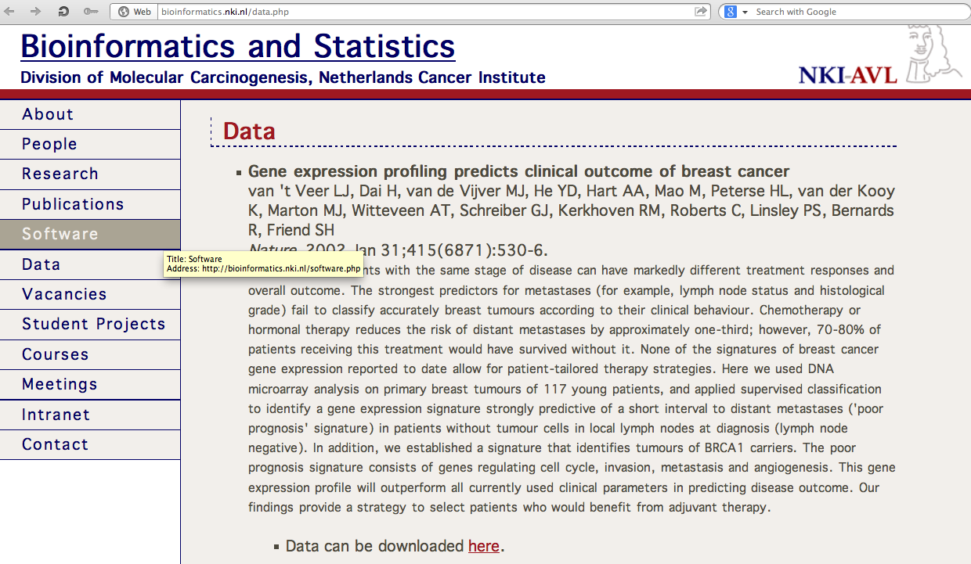
http://bioinformatics.nki.nl/data.php

Slide 24
Comparison of our results with those of Van de Vijver and colleagues is difficult because of differences in patients, techniques, and materials used.
Their study included node-negative and node-positive patients, who had or had not received adjuvant systemic therapy, and only women younger than 53 years.
microarray platforms used in the studies differ—Affymetrix and Agilent.
Of the 70 genes in the study by van't Veer and co-workers, 48 are present on the Affymetrix U133a array, whereas only 38 of our 76 genes are present on the Agilent array. There is a three-gene overlap between the two signatures (cyclin E2, origin recognition complex, and TNF superfamily protein).
Despite the apparent difference, both signatures included genes that identified several common pathways that might be involved in tumour recurrence. This finding supports the idea that although there might be redundancy in gene members, effective signatures could be required to include representation of specific pathways.
From: Gene-expression profiles to predict distant metastasis of lymph-node-negative primary breast cancer, Yixin Wang et al, The Lancet, Volume 365, Issue 9460, 19–25 February 2005, Pages 671–679

Slide 25
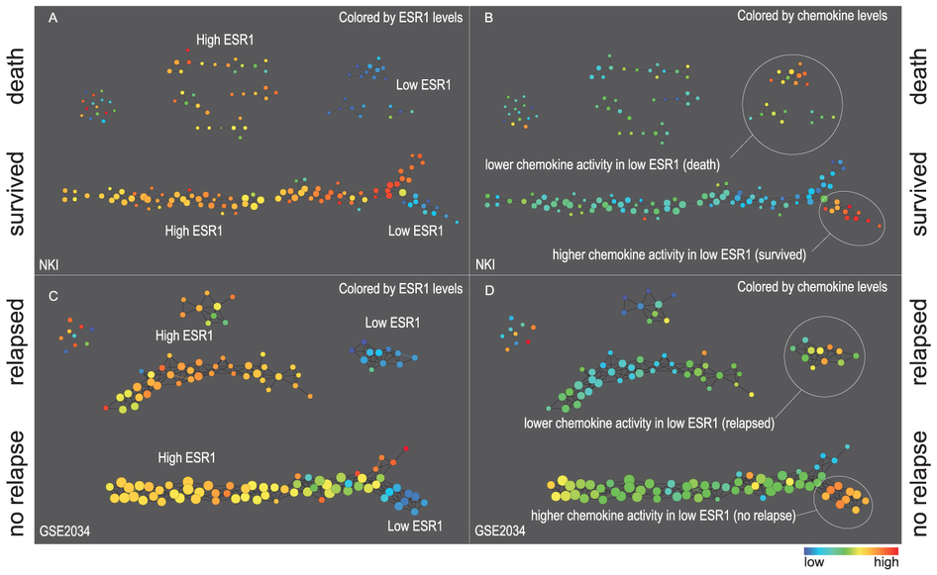
Two filter functions, L-Infinity centrality and survival or relapse were used to generate the networks. The top half of panels A and B are the networks of patients who didn't survive, the bottom half are the patients who survived. Panels C and D are similar to panels A and B except that one of the filters is relapse instead of survival. Panels A and C are colored by the average expression of the ESR1 gene. Panels B and D are colored by the average expression of the genes in the KEGG chemokine pathway. Metric: Correlation; Lens: L-Infinity Centrality (Resolution 70, Gain 3.0x, Equalized) and Event Death (Resolution 30, Gain 3.0x). Color bar: red: high values, blue: low values.
http://www.nature.com/srep/2013/130207/srep01236/full/srep01236.html

Slide 26
Identifying subtypes of cancer in a consistent manner is a challenge in the field since sub-populations can be small and their relationships complex
High expression level of the estrogen receptor gene (ESR1) is positively correlated with improved prognosis, given that this set of patients is likely to respond to standard therapies.
But , there are still sub-groups of high ESR1 that do not respond well to therapy.
Low ESR1 levels are strongly correlated with poor prognosis
But there are patients with low ESR1 levels but high survival rates
Many molecular sub-groups have been identified,
But often difficult to identify the same sub-group in a broader setting, where data sets are generated on different platforms, on different sets of patients and at a different times, because of the noise and complexity in the data.
http://www.nature.com/srep/2013/130207/srep01236/full/srep01236.html

Slide 27
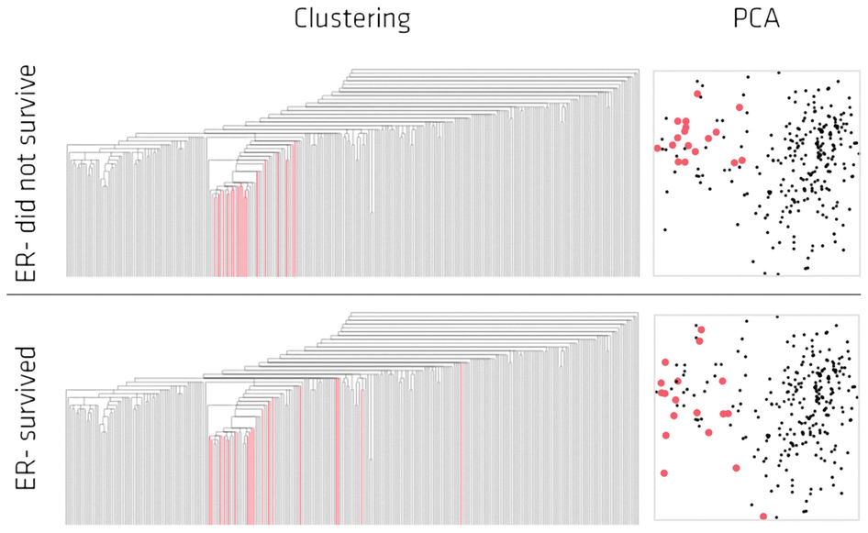
Highlighted in red are the lowERNS (top panel) and the lowERHS (bottom panel) patient sub-groups.
http://www.nature.com/srep/2013/130207/srep01236/full/srep01236.html

Slide 28
http://www.pnas.org/content/early/2011/04/07/1102826108

Slide 29
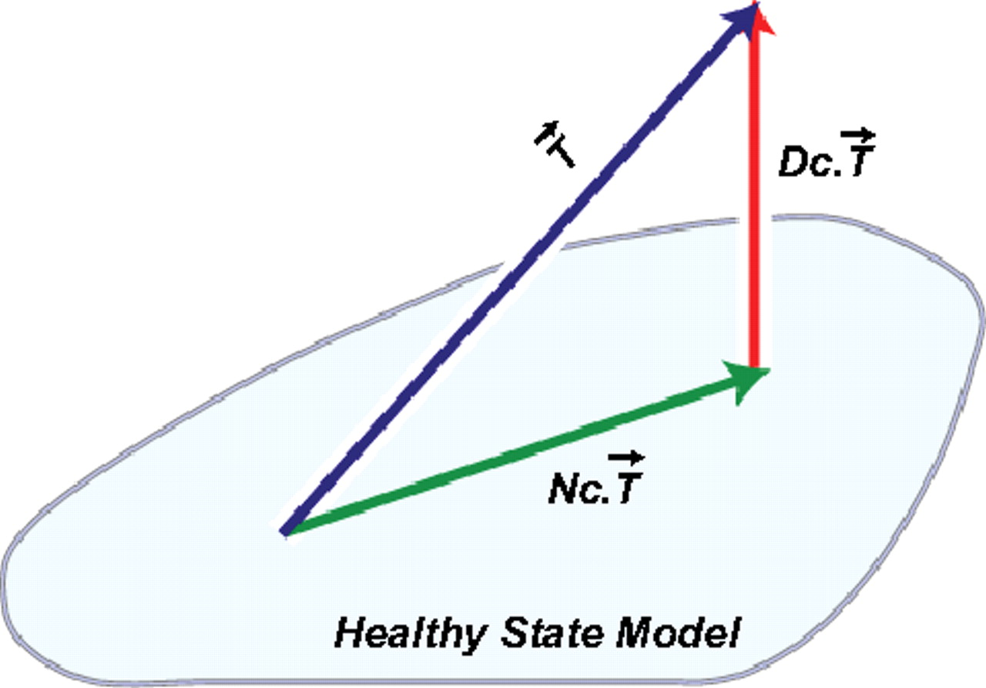
DSGA decomposition of the original tumor vector into the Normal component its linear models fit onto the Healthy State Model and the Disease component vector of residuals.
Nicolau M et al. PNAS 2011;108:7265-7270
©2011 by National Academy of Sciences
Notes:
DSGA decomposition of the original tumor vector into the Normal component its linear models fit onto the Healthy State Model and the Disease component vector of residuals.

Slide 30
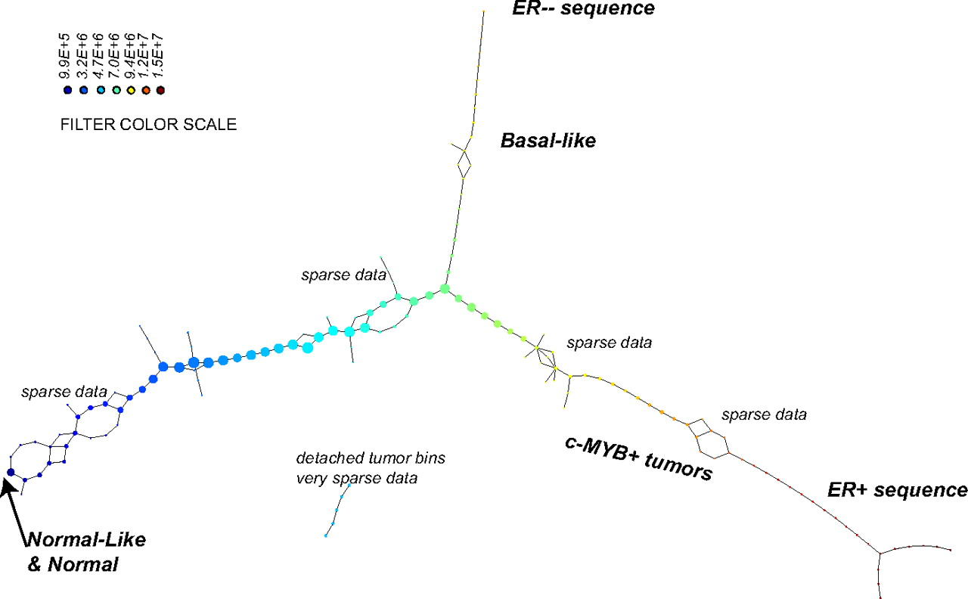
PAD analysis of the NKI data. The output has three progression arms, because tumors (data points) are ordered by the magnitude of deviation from normal (the HSM). Each bin is colored by the mean of the filter map on the points. Blue bins contain tumors whose total deviation from HSM is small (normal and Normal-like tumors). Red bins contain tumors whose deviation from HSM is large. The image of f was subdivided into 15 intervals with 80% overlap. All bins are seen (outliers included). Regions of sparse data show branching. Several bins are disconnected from the main graph. The ER− arm consists mostly of Basal tumors. The c-MYB+ group was chosen within the ER arm as the tightest subset, between the two sparse regions.
PAD analysis of the NKI data.
Nicolau M et al. PNAS 2011;108:7265-7270
©2011 by National Academy of Sciences
Notes:
PAD analysis of the NKI data. The output has three progression arms, because tumors (data points) are ordered by the magnitude of deviation from normal (the HSM). Each bin is colored by the mean of the filter map on the points. Blue bins contain tumors whose total deviation from HSM is small (normal and Normal-like tumors). Red bins contain tumors whose deviation from HSM is large. The image of f was subdivided into 15 intervals with 80% overlap. All bins are seen (outliers included). Regions of sparse data show branching. Several bins are disconnected from the main graph. The ER− arm consists mostly of Basal tumors. The c-MYB+ group was chosen within the ER arm as the tightest subset, between the two sparse regions.

Slide 31
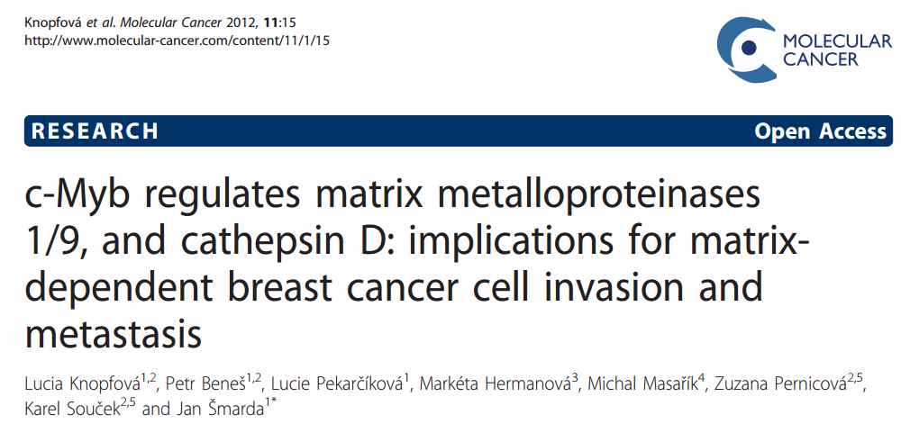

Slide 32
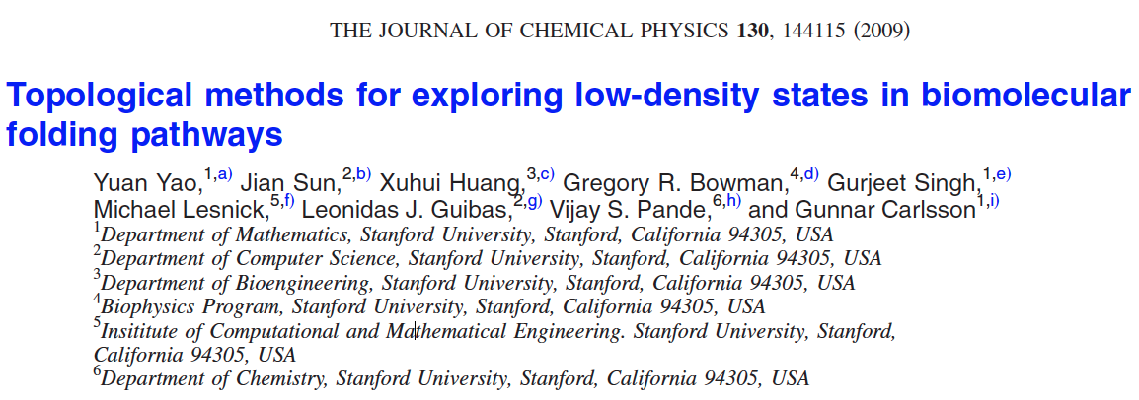
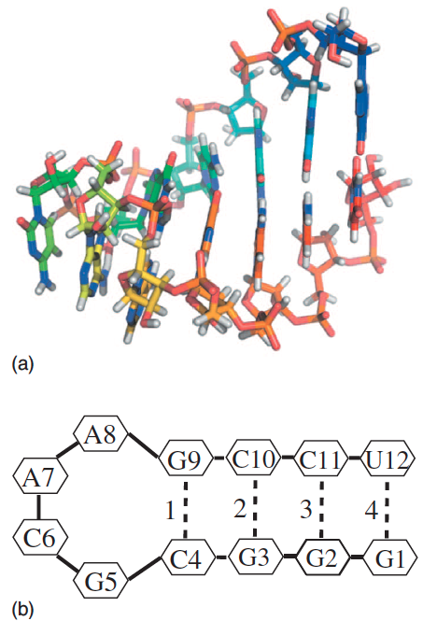
http://scitation.aip.org/content/aip/journal/jcp/130/14/10.1063/1.3103496

Slide 33
Data: Contact maps from 2,800 Serial Replica Exchange Molecular Dynamics (SREMD) simulations of the GCAA tetraloop on the Folding@home distributed computing platform.
760 trajectories with a complete unfolding event
550 trajectories with a complete refolding event.
Goal: To determine secondary structure pathways between folded and unfolded state

Slide 34
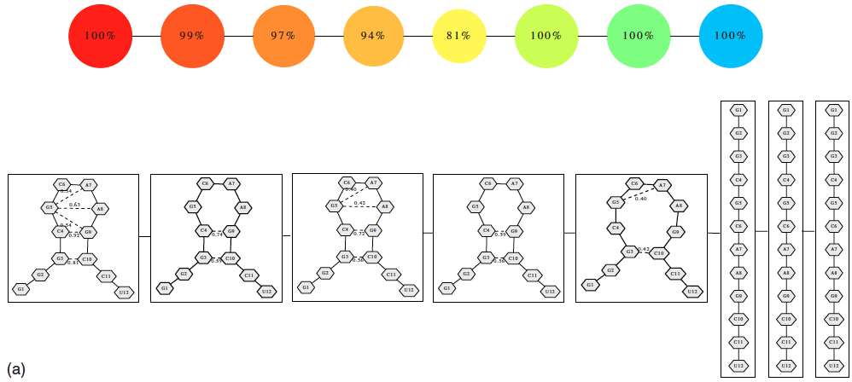
Problem: Many more folded and unfolded conformations than intermediate conformations
How to distinguish intermediate conformations from noise?
Solution
Choose f: space of conformations → R
f(conformation) = density

Slide 35
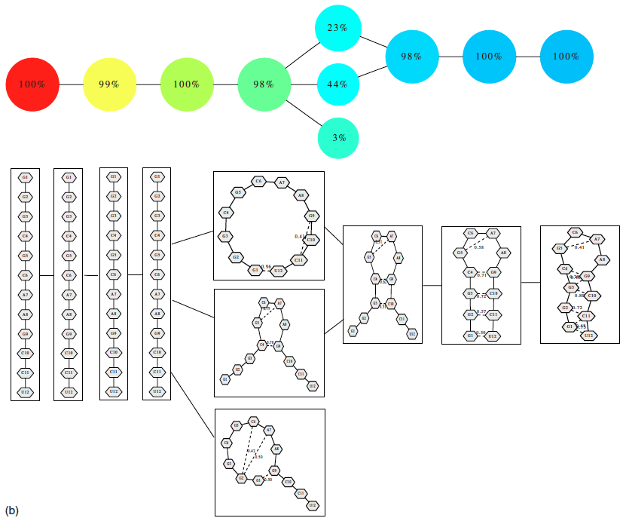
550 trajectories with a complete refolding event
2952 configurations

Slide 36
Distance = Hamming distance

Slide 37
550 trajectories with a complete refolding event
2952 configurations

Slide 38
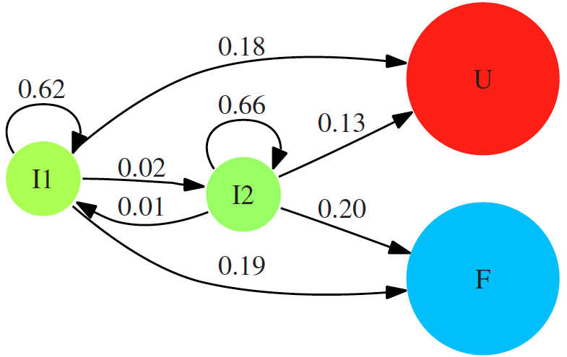

Slide 39
760 trajectories with a complete refolding event
4330 configurations

Slide 40
An eQTL biological data visualization challenge and approaches from the visualization community,
Bartlett et al.
BMC Bioinformatics
2012, 13(Suppl 8):S8
Mapper applied
to SNP data:
http://www.biomedcentral.com/1471-2105/13/S8/S8

Slide 41
http://www.ayasdi.com/

Slide 42
From: http://www.ayasdi.com/company/media/seriesc/
Customers Discover Breakthrough Insights That Deliver Significant ROI
Ayasdi currently does business with three of the five largest financial institutions in the world. The company’s financial services customers use Ayasdi to enhance their consumer credit decisions, accelerate the development and accuracy of risk and regulatory models, optimize services for private banking clients, and improve fraud detection models. In each case, financial institutions are finding critical insights and patterns that return hundreds of millions of dollars in ROI.

Slide 43
From: http://www.ayasdi.com/company/media/seriesc/
Ayasdi expanded its healthcare portfolio with client wins in both the provider and payer space. Healthcare service providers rely upon Ayasdi to analyze extensive clinical records to identify best practices that will improve both patient and financial outcomes. Ayasdi can analyze a broad set of data types (e.g. lab tests, pharmaceuticals, patient records and billing information) to find important patterns that reduce costs while delivering a higher quality of care. Additionally, healthcare payers are leveraging their data to improve their revenue cycle through better identification of fraud, waste and abuse within their claims processing operations.
"Our mission is to detect and help diagnose disabling spinal cord and brain injuries, that would not necessarily show up on a standard MRI,” said Adam Ferguson, Assistant Professor and Wings for Life and GE-NFL Head-Health challenge Principal Investigator, Brain and Spinal Injury Center at the University of California San Francisco Medical Center. "By analyzing brain image scans and clinical information, Ayasdi’s intelligent analytics software helps us quickly find critical patterns in our data that would be extremely difficult to identify with conventional statistical tools."

Slide 44
Mapper Software

Slide 45
http://comptop.stanford.edu/pad/

Slide 46
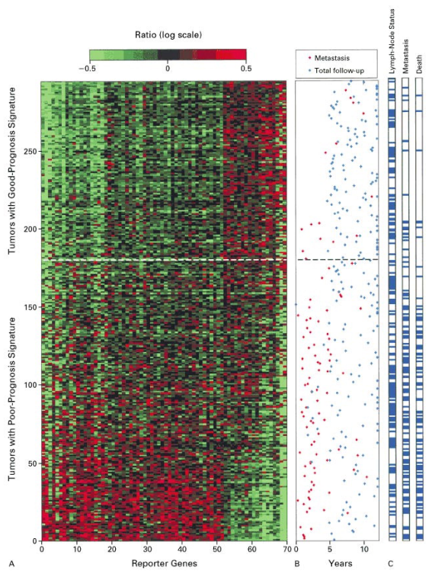
DSGA decomposition of the original tumor vector into the Normal component its linear models fit onto the Healthy State Model and the Disease component vector of residuals.
Nicolau M et al. PNAS 2011;108:7265-7270
©2011 by National Academy of Sciences
Notes:
DSGA decomposition of the original tumor vector into the Normal component its linear models fit onto the Healthy State Model and the Disease component vector of residuals.

Slide 47
Basal tumors occupy most of the bins in the tumor sequence denoted as ER− sequence. They are immediately visible and stand out with large value (red) in the filter function
Normal tissue samples all fall in the same bin together with 15 additional ER+ tumors.
The known group of her2+ tumors is not yet visible, owing to the well-understood problem that only a small number of genes (on 17q) identify it, making them mathematically less visible, despite the fact that the small number of coordinates (17q genes) are biologically important.
A long tumor sequence on the graph, the ER+ sequence showing large deviation from normal, is visible, as defined by the filter. This tumor sequence also consists of ER+ tumors, but unlike the first (blue) group of tumors, these are distinct from normal tissue in that the value of the filter function—the Lp magnitudes of the tumor vectors in these bins—is very large.

Slide 48
http://math.stanford.edu/~muellner/mapper/

Slide 49
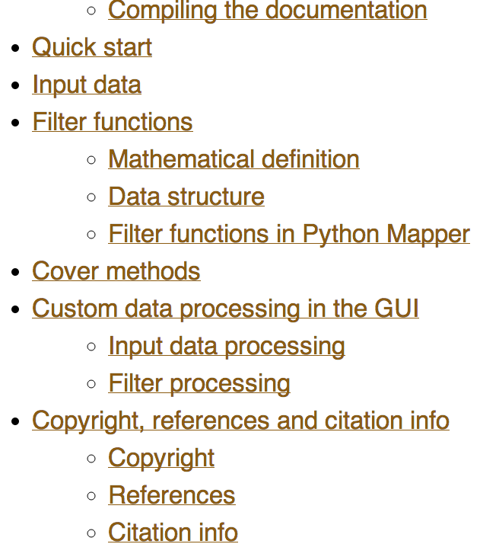

Slide 50
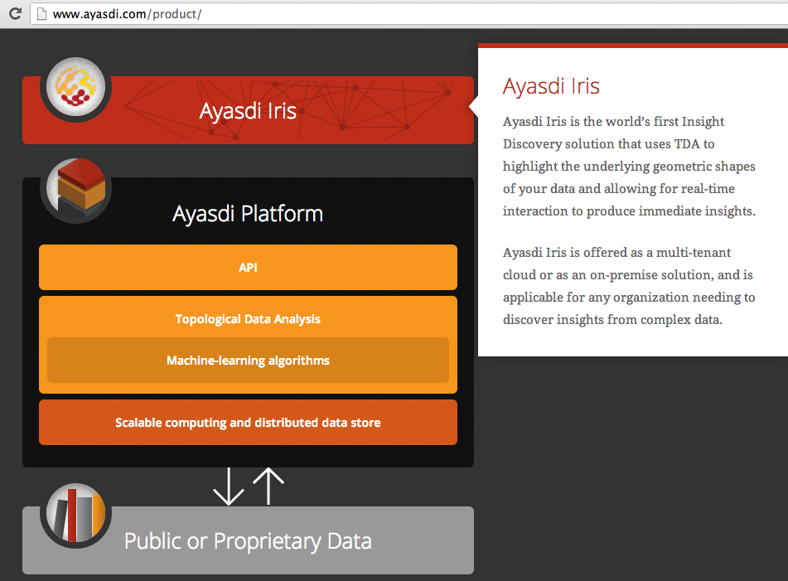
www.ayasdi.com/
product/

Slide 51
http://www.ayasdi.com/inquiry/academic-trial.html

Slide 52
Matlab version demonstration

Slide 53
Fig. S1. Shape of the data becomes more distinct as the analysis columns are restricted to the top
varying genes.
24K: all the genes on the microarray were used in the analysis;
11K: 10,731 top most varying genes were used in the analysis;
7K: 6.688 top most varying genes were used in the analysis;
3K: 3212 top most varying genes were used in the analysis;
1.5K: 1553 top most varying genes were used in the analysis.
Graphs colored by the L-infinity centrality values. Red: high; Blue: low
http://www.nature.com/srep/2013/130207/srep01236/full/srep01236.html

Slide 54
http://bioinformatics.nki.nl/data.php

Slide 55
Comparison of our results with those of Van de Vijver and colleagues12 is difficult because of differences in patients, techniques, and materials used.
Their study included node-negative and node-positive patients, who had or had not received adjuvant systemic therapy, and only women younger than 53 years.
microarray platforms used in the studies differ—Affymetrix and Agilent.
Of the 70 genes in the study by van't Veer and co-workers, 48 are present on the Affymetrix U133a array, whereas only 38 of our 76 genes are present on the Agilent array. There is a three-gene overlap between the two signatures (cyclin E2, origin recognition complex, and TNF superfamily protein).
Despite the apparent difference, both signatures included genes that identified several common pathways that might be involved in tumour recurrence. This finding supports the idea that although there might be redundancy in gene members, effective signatures could be required to include representation of specific pathways.
From: Gene-expression profiles to predict distant metastasis of lymph-node-negative primary breast cancer, Yixin Wang et al, The Lancet, Volume 365, Issue 9460, 19–25 February 2005, Pages 671–679

Slide 56
Two filter functions, L-Infinity centrality and survival or relapse were used to generate the networks. The top half of panels A and B are the networks of patients who didn't survive, the bottom half are the patients who survived. Panels C and D are similar to panels A and B except that one of the filters is relapse instead of survival. Panels A and C are colored by the average expression of the ESR1 gene. Panels B and D are colored by the average expression of the genes in the KEGG chemokine pathway. Metric: Correlation; Lens: L-Infinity Centrality (Resolution 70, Gain 3.0x, Equalized) and Event Death (Resolution 30, Gain 3.0x). Color bar: red: high values, blue: low values.
http://www.nature.com/srep/2013/130207/srep01236/full/srep01236.html

Slide 57
Identifying subtypes of cancer in a consistent manner is a challenge in the field since sub-populations can be small and their relationships complex
High expression level of the estrogen receptor gene (ESR1) is positively correlated with improved prognosis, given that this set of patients is likely to respond to standard therapies.
But , there are still sub-groups of high ESR1 that do not respond well to therapy.
Low ESR1 levels are strongly correlated with poor prognosis
But there are patients with low ESR1 levels but high survival rates
Many molecular sub-groups have been identified,
But often difficult to identify the same sub-group in a broader setting, where data sets are generated on different platforms, on different sets of patients and at a different times, because of the noise and complexity in the data.
http://www.nature.com/srep/2013/130207/srep01236/full/srep01236.html

Slide 58
Highlighted in red are the lowERNS (top panel) and the lowERHS (bottom panel) patient sub-groups.
http://www.nature.com/srep/2013/130207/srep01236/full/srep01236.html

Slide 59
Clustering vs.
Nicolau M et al. PNAS 2011;108:7265-7270
©2011 by National Academy of Sciences
Notes:
Clustering vs. PAD. Can Mapper extract something new from the data that clustering does not? We compare the outputs of clustering (average linkage) vs. Mapper as applied to the same exact data matrix (DSGA-transformed NKI) to show that these two procedures are different. The bins defining the c-MYB+ group were marked on the cluster dendrogram (red for the tighter—no outliers—group, and orange for the larger c-MYB+ group containing outliers) The c-MYB+ tumors are scattered among different clusters, but PAD has been able to extract this group that turns out to be both statistically and biologically/clinically coherent.

Slide 60
http://www.pnas.org/content/early/2011/04/07/1102826108

Slide 61
DSGA decomposition of the original tumor vector into the Normal component its linear models fit onto the Healthy State Model and the Disease component vector of residuals.
Nicolau M et al. PNAS 2011;108:7265-7270
©2011 by National Academy of Sciences
Notes:
DSGA decomposition of the original tumor vector into the Normal component its linear models fit onto the Healthy State Model and the Disease component vector of residuals.

Slide 62
PAD analysis of the NKI data. The output has three progression arms, because tumors (data points) are ordered by the magnitude of deviation from normal (the HSM). Each bin is colored by the mean of the filter map on the points. Blue bins contain tumors whose total deviation from HSM is small (normal and Normal-like tumors). Red bins contain tumors whose deviation from HSM is large. The image of f was subdivided into 15 intervals with 80% overlap. All bins are seen (outliers included). Regions of sparse data show branching. Several bins are disconnected from the main graph. The ER− arm consists mostly of Basal tumors. The c-MYB+ group was chosen within the ER arm as the tightest subset, between the two sparse regions.
PAD analysis of the NKI data.
Nicolau M et al. PNAS 2011;108:7265-7270
©2011 by National Academy of Sciences
Notes:
PAD analysis of the NKI data. The output has three progression arms, because tumors (data points) are ordered by the magnitude of deviation from normal (the HSM). Each bin is colored by the mean of the filter map on the points. Blue bins contain tumors whose total deviation from HSM is small (normal and Normal-like tumors). Red bins contain tumors whose deviation from HSM is large. The image of f was subdivided into 15 intervals with 80% overlap. All bins are seen (outliers included). Regions of sparse data show branching. Several bins are disconnected from the main graph. The ER− arm consists mostly of Basal tumors. The c-MYB+ group was chosen within the ER arm as the tightest subset, between the two sparse regions.

Slide 63
Basal tumors occupy most of the bins in the tumor sequence denoted as ER− sequence. They are immediately visible and stand out with large value (red) in the filter function
Normal tissue samples all fall in the same bin together with 15 additional ER+ tumors.
The known group of her2+ tumors is not yet visible, owing to the well-understood problem that only a small number of genes (on 17q) identify it, making them mathematically less visible, despite the fact that the small number of coordinates (17q genes) are biologically important.
A long tumor sequence on the graph, the ER+ sequence showing large deviation from normal, is visible, as defined by the filter. This tumor sequence also consists of ER+ tumors, but unlike the first (blue) group of tumors, these are distinct from normal tissue in that the value of the filter function—the Lp magnitudes of the tumor vectors in these bins—is very large.

Slide 64
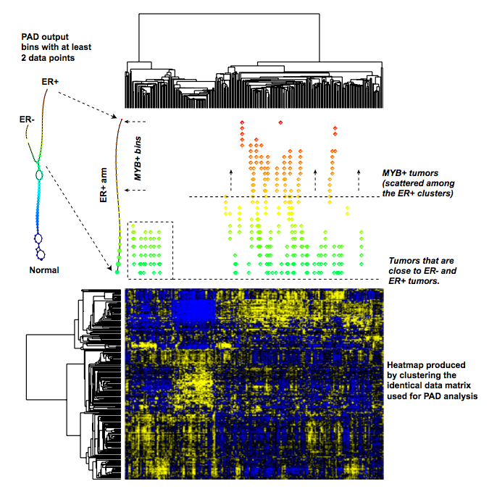
Fig. S4. Comparison between cluster analysis and PAD. Speciﬁcally, PAD consists of two major steps: the ﬁrst step, DSGA, deﬁnes a transformation of the original data to detect extent of deviation from normal. It also provides a means to threshold genes so that only genes that deviate signiﬁcantly from normal are retained. The second step, Mapper, involves detecting the shape of the data points in space. Cluster analysis is a different method to detect the shape of the data in space. This ﬁgure shows the difference between using cluster analysis as opposed to using Mapperto detect the shape of the same data matrix. We took the matrix whose columns are the disease components of the DSGA-transformed data, with only the 262 genes obtained by thresholding genes according to deviation from normal. This matrix was analyzed to detect its shape in space in two distinct ways: (i) it was clustered with associated heatmap and dendrograms shown, and (ii) it was processed with Mapper, with the output shown. The ER+ arm is magniﬁed, and the position of each tumor in each consecutive bin is shown relative to its placement in the clustering dendrogram. It is easily visible that whereas the c-MYB+ group of tumors are close to one another in the PAD output, they are scattered throughout the ER+ portion of the clustering diagrams. It is important to note that the same matrix was fed into the Mapper and the cluster analysis. The ﬁgure shows these outputs to be very distinct. The ﬁgure does not and cannot identify which output is identifying features that deserve to be noticed: cluster analysis did not identify the c-MYB+ group, but it is not clear, simply on the basis of this ﬁgure, that the group is a real feature rather than an artifact of Mapper. It is through subsequent analysis methods that we see that the c-MYB+ group is indeed both mathematically and biologically distinct. Thus, the PAM analysis shows the group to be mathematically coherent and easily distinct, and functional exploration of the genes identiﬁed by SAM analysis, along with survival analysis of the group, show it to be a biologically coherent and meaningful group of tumors. This ﬁgure shows that the shape analysis provided by clustering is different from that provided by Mapper.

Slide 65
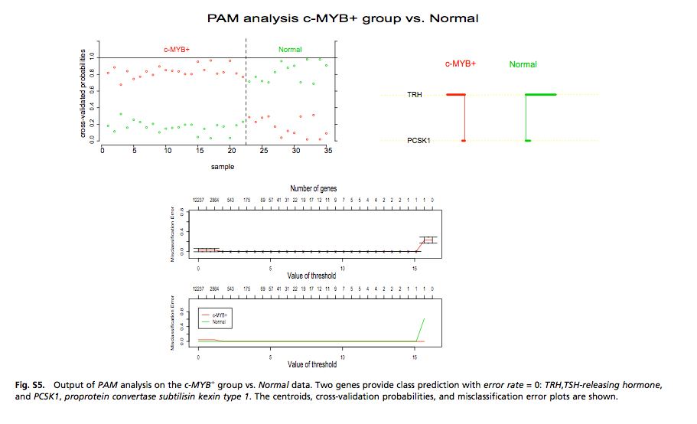

Slide 66
Mapper is able to find long gradual progressions.
Can use different filters or combine filter
e.g. – just use over-expression and omit under-expression and vice versa
but probably not biologically relevant choice
The central problem of robustness of output can be addressed in a rigorous manner, using the concept of persistence

Slide 67
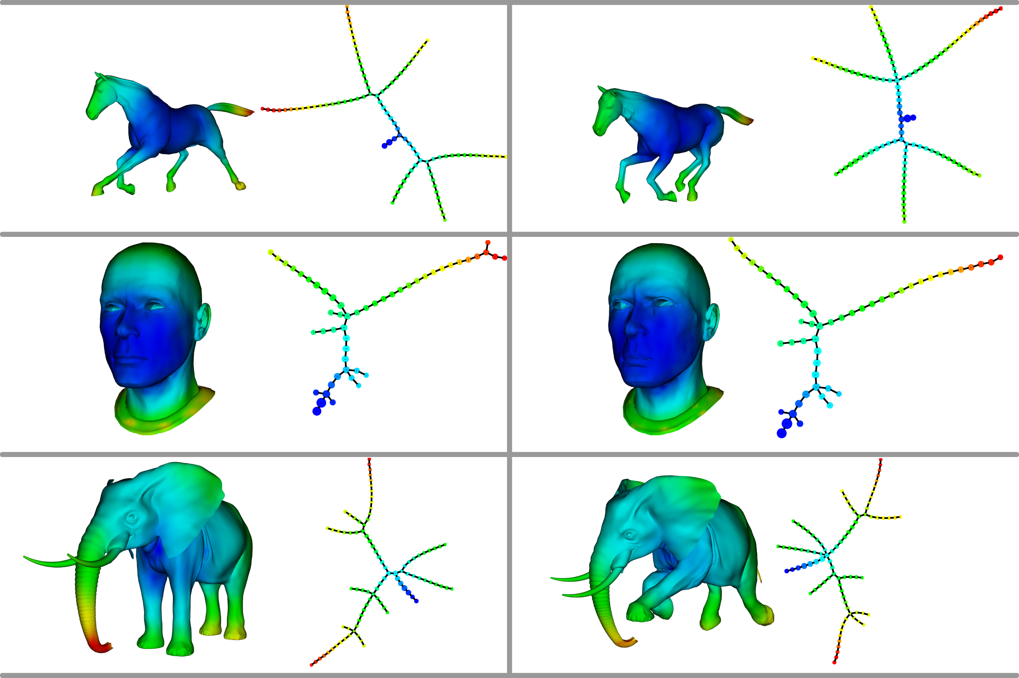
Topological Methods for the Analysis of High Dimensional Data Sets and 3D Object Recognition
Singh, Gurjeet; Memoli, Facundo; Carlsson, Gunnar
http://diglib.eg.org/handle/10.2312/SPBG.SPBG07.091-100

