Slide 2
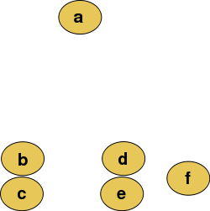
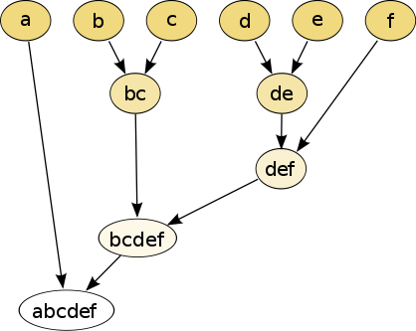
Hierarchical clustering
Isabel K. Darcy
Mathematics Department/Applied Math & Computational Sciences
University of Iowa
http://www.math.uiowa.edu/~idarcy/
This material is based upon work supported by the National Science Foundation under Grant No. DMS-1407216: EXTREEMS-QED: Large Data Analysis and Visualization at the University of Iowa
Any opinions, findings, and conclusions or recommendations expressed in this material are those of the author(s) and do not necessarily reflect the views of the National Science Foundation.
Notes:
data points.
In this very simplified case my data points lie in a two-dimensional plane. Normally data points are high dimensional.
For example, I may be comparing the expression or thousands of genes in tumor cells to healthy cells using microarray data. OR I might be comparing politicians voting records. Or I might be comparing the stats of basketball players. These three applications were all, by the way, published by Lum et al this past February in Nature’s Scientific Reports. I have included a link to their paper on my youtube site.
http://www.nature.com/srep/2013/130207/srep01236/full/srep01236.html

Slide 3
Hierarchical clustering
Data
Dendrogram
http://en.wikipedia.org/wiki/File:Clusters.svg
http://en.wikipedia.org/wiki/File:Hierarchical_clustering_simple_diagram.svg

Slide 4
Increasing threshold
Connect vertices whose distance is less than a given threshold
single linkage hierarchical clustering

Slide 5
Hierarchical clustering
Data
Dendrogram
http://en.wikipedia.org/wiki/File:Clusters.svg
http://en.wikipedia.org/wiki/File:Hierarchical_clustering_simple_diagram.svg

Slide 6
Increasing threshold
Connect vertices (or clusters) whose distance is less than a given threshold

Slide 7
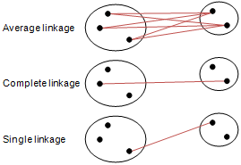
Different type of hierarchical clustering
What is the distance between 2 clusters?
http://en.wikipedia.org/wiki/File:Hierarchical_clustering_simple_diagram.svg
http://www.multid.se/genex/hs515.htm

Slide 8
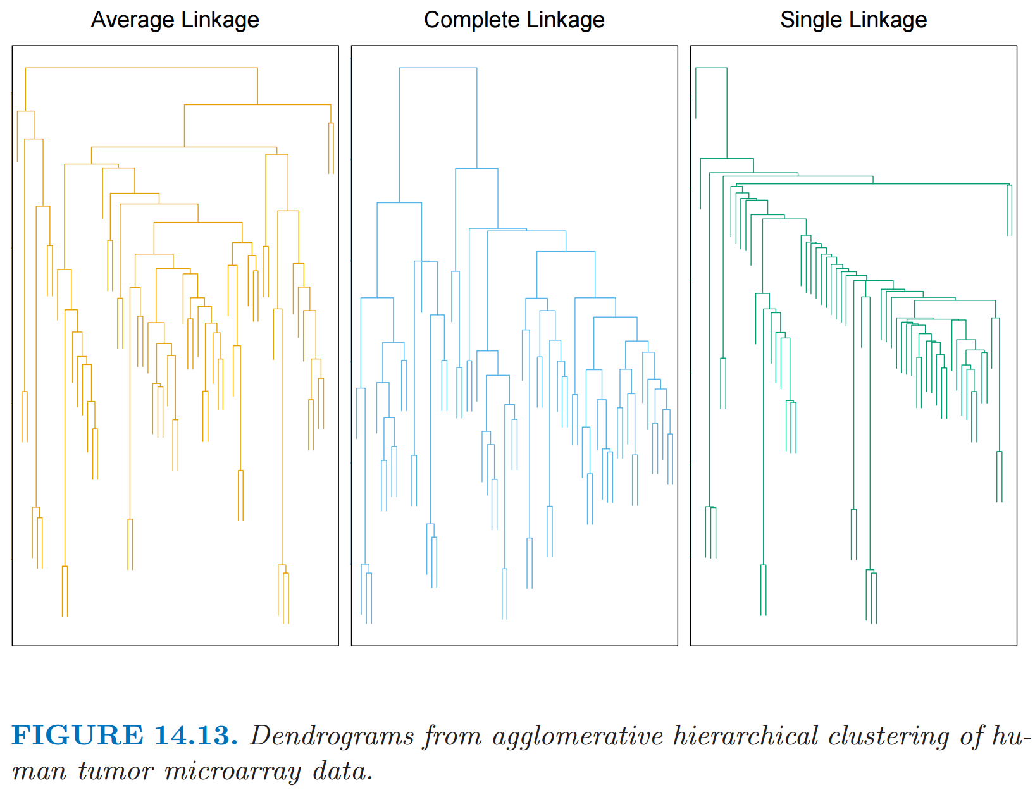
http://statweb.stanford.edu/~tibs/ElemStatLearn/
The Elements of Statistical Learning (2nd edition) Hastie, Tibshirani and Friedman

Slide 9
Discussion and Summary Gurjeet Singh , Facundo Mémoli and Gunnar Carlsson’s Mapper Algorithm
Guest lecturer: Isabel K. Darcy
Mathematics Department/Applied Mathematical & Computational Sciences
University of Iowa
http://www.math.uiowa.edu/~idarcy/
This material is based upon work supported by the National Science Foundation under Grant No. DMS-1407216: EXTREEMS-QED: Large Data Analysis and Visualization at the University of Iowa
Any opinions, findings, and conclusions or recommendations expressed in this material are those of the author(s) and do not necessarily reflect the views of the National Science Foundation.

Slide 10
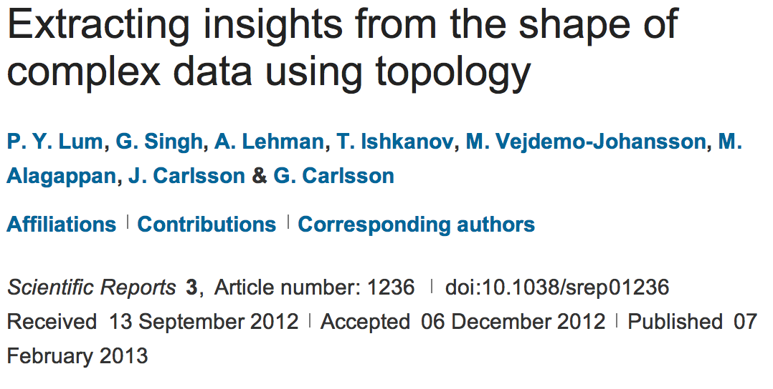
http://www.nature.com/srep/2013/130207/srep01236/full/srep01236.html

Slide 11
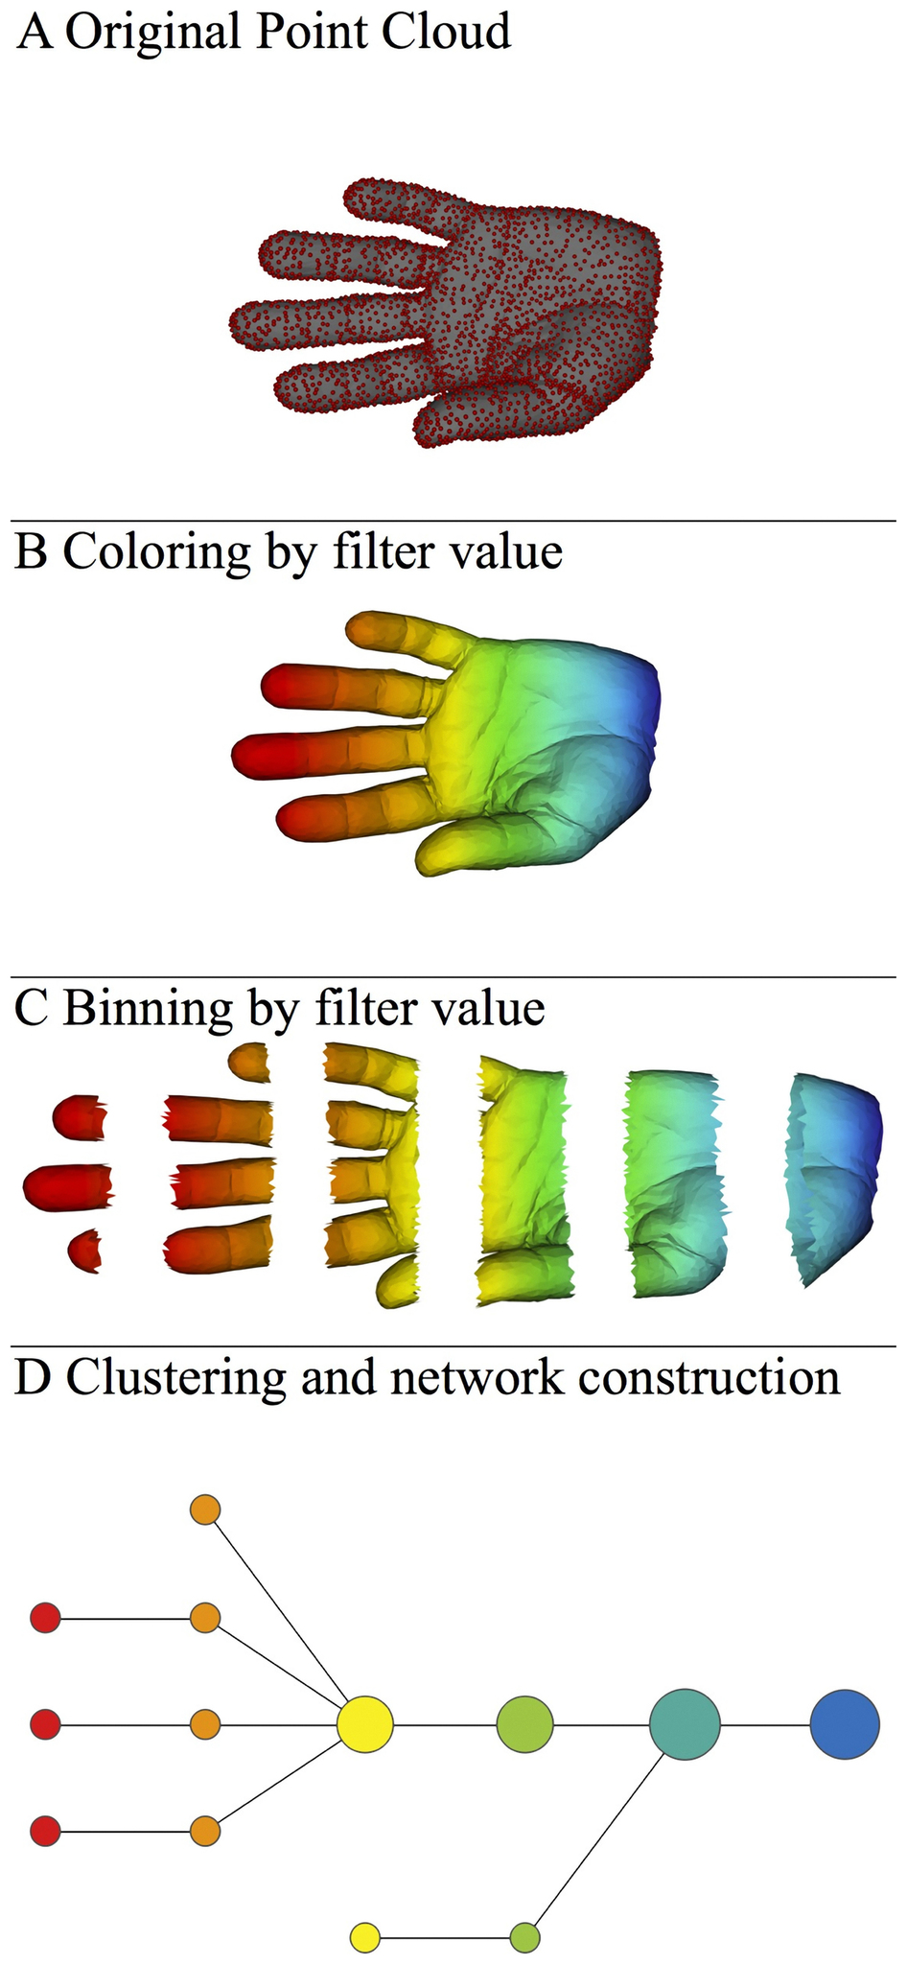
A) Data Set
Example: Point cloud data
representing a hand.
B) Function f : Data Set → R
Example: x-coordinate
f : (x, y, z) → x
Put data into overlapping bins.
Example: f⁻¹(a_{i}, b_{i})
Cluster each bin & create network.
Vertex = a cluster of a bin.
Edge = nonempty intersection
between clusters
http://www.nature.com/srep/2013/130207/srep01236/full/srep01236.html

Slide 12
Note: we made many, many choices
It helps to know what you are doing when you make choices, so collaborating with others is highly recommended.

Slide 13
We chose how to model the data set
A) Data Set
Example: Point cloud data
representing a hand.
http://www.nature.com/srep/2013/130207/srep01236/full/srep01236.html
Notes:
Be creative. Use ideas from pure and applied math (including stat) as well as area of application
Missing data, noise

Slide 14
Function f : Data Set → R
Ex 1: x-coordinate
f : (x, y, z) → x
Chose filter function
http://www.nature.com/srep/2013/130207/srep01236/full/srep01236.html

Slide 15
Function f : Data Set → R
Ex 1: x-coordinate
f : (x, y, z) → x
Ex 2: y-coordinate
g : (x, y, z) → y
Chose filter function
http://www.nature.com/srep/2013/130207/srep01236/full/srep01236.html

Slide 16
Function f : Data Set → R
Ex 1: x-coordinate
f : (x, y, z) → x
Chose filter function
Possible filter functions:
Principle component analysis
L-infinity centrality:
f(x) = max{d(x, p) : p in data set}
Norm: f(x) = ||x || = length of x
http://www.nature.com/srep/2013/130207/srep01236/full/srep01236.html
Notes:
Need distance
Depends on what prop you want to explore
Can also choose any co-domain

Slide 17
Chose bins
Put data into overlapping bins.
Example: f⁻¹(a_{i}, b_{i})
If equal length intervals:
Choose length.
Choose % overlap.
http://www.nature.com/srep/2013/130207/srep01236/full/srep01236.html
Notes:
Need covering Resolution multiscale

Slide 18
Create overlapping bins:
http://www.nature.com/srep/2013/130207/srep01236/full/srep01236.html

Slide 19
Chose how to cluster.
Normally need a definition of distance between data points
Cluster each bin & create network.
Vertex = a cluster of a bin.
Edge = nonempty intersection
between clusters
http://www.nature.com/srep/2013/130207/srep01236/full/srep01236.html

Slide 20
Note: Many, many choices were made
It helps to know what you are doing when you make choices, so collaborating with others is highly recommended.

Slide 21
Note: Many, many choices were made
“It is useful to think of it as a camera, with lens adjustments and other settings. A different filter function may generate a network with a different shape, thus allowing one to explore the data from a different mathematical perspective.”
http://www.nature.com/srep/2013/130207/srep01236/full/srep01236.html

Slide 22
Note: we made many, many choices
“It is useful to think of it as a camera, with lens adjustments and other settings. A different filter function may generate a network with a different shape, thus allowing one to explore the data from a different mathematical perspective.”
False positives???
http://www.nature.com/srep/2013/130207/srep01236/full/srep01236.html

Slide 23
False Positives will occur
https://xkcd.com/882/

Slide 24
Note: Many, many choices were made
“It is useful to think of it as a camera, with lens adjustments and other settings. A different filter function may generate a network with a different shape, thus allowing one to explore the data from a different mathematical perspective.”
False positives vs. robustness
http://www.nature.com/srep/2013/130207/srep01236/full/srep01236.html

Slide 25
Three key ideas of topology that make extracting of patterns via shape possible.
1.) coordinate free.
No dependence on the coordinate system chosen.
Can compare data derived from different platforms
2.) invariant under “small” deformations.
less sensitive to noise
3.) compressed representations of shapes.
Input: dataset with thousands of points
Output: network with 13 vertices and 12 edges.
http://www.nature.com/srep/2013/130207/srep01236/full/srep01236.html

Slide 26
Topological Data Analysis (TDA): Three key ideas of topology that make extracting of patterns via shape possible.
1.) coordinate free.
No dependence on the coordinate system chosen.
Can compare data derived from different platforms
vital when one is studying data collected with different technologies, or from different labs when the methodologies cannot be standardized.
http://www.nature.com/srep/2013/130207/srep01236/full/srep01236.html

Slide 27
Topological Data Analysis (TDA): Three key ideas of topology that make extracting of patterns via shape possible.
2.) invariant under “small” deformations.
less sensitive to noise
Topological Methods for the Analysis of High Dimensional
Data Sets and 3D Object Recognition, Singh, Mémoli, Carlsson
Figure from http://comptop.stanford.edu/u/preprints/mapperPBG.pdf
http://www.nature.com/srep/2013/130207/srep01236/full/srep01236.html

Slide 28
Topological Data Analysis (TDA): Three key ideas of topology that make extracting of patterns via shape possible.
3.) compressed representations of shapes.
Input: dataset with thousands of points
Output: network with
13 vertices and 12 edges.
http://www.nature.com/srep/2013/130207/srep01236/full/srep01236.html

Slide 29
http://www.nature.com/srep/2013/130207/srep01236/full/srep01236.html

Slide 30
Chose filter
Only need to cover the data points.
http://www.nature.com/srep/2013/130207/srep01236/full/srep01236.html

Slide 31
Chose filter
http://www.nature.com/srep/2013/130207/srep01236/full/srep01236.html

Slide 32
Chose filter
http://www.nature.com/srep/2013/130207/srep01236/full/srep01236.html

Slide 33
Application 3 (in paper): Basketball
Data: rates (per minute played) of rebounds, assists, turnovers, steals, blocked shots, personal fouls, and points scored for 452 players.
➔ Input: 452 points in R⁷
For each player, we have a vector
= (r, a, t, s, b, f, p) in R⁷
Distance: variance normalized Euclidean distance.
Clustering: Single linkage.
( min , min , min , min , min , min , min )
rebounds assists turnovers steals blocked shots personal fouls points scored
http://www.nature.com/srep/2013/130207/srep01236/full/srep01236.html

Slide 34
Filters: principle and secondary SVD values.
http://commons.wikimedia.org/wiki/File:SVD_Graphic_Example.png
Data
http://www.nature.com/srep/2013/130207/srep01236/full/srep01236.html

Slide 35
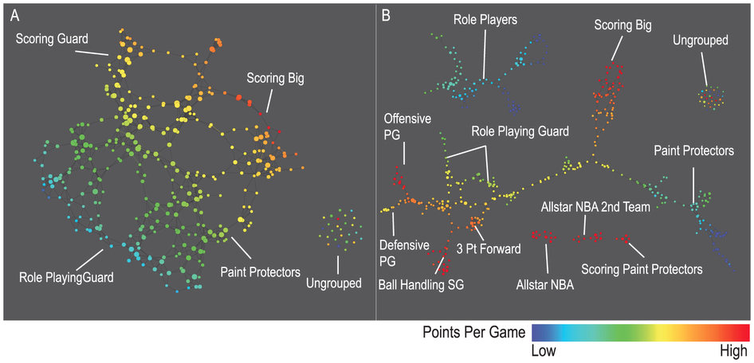
A) Low resolution map at 20 intervals for each filter B) High resolution map at 30 intervals for each filter. The overlap is such at that each interval overlaps with half of the adjacent intervals, the graphs are colored by points per game, and a variance normalized Euclidean distance metric is applied. Metric: Variance Normalized Euclidean; Lens: Principal SVD Value (Resolution 20, Gain 2.0x, Equalized) and Secondary SVD Value (Resolution 20, Gain 2.0x, Equalized). Color: red: high values, blue: low values.
http://www.nature.com/srep/2013/130207/srep01236/full/srep01236.html

Slide 36
LeBron James , Kobe Bryant, Brook Lopez
A) Low resolution map at 20 intervals for each filter B) High resolution map at 30 intervals for each filter. The overlap is such at that each interval overlaps with half of the adjacent intervals, the graphs are colored by points per game, and a variance normalized Euclidean distance metric is applied. Metric: Variance Normalized Euclidean; Lens: Principal SVD Value (Resolution 20, Gain 2.0x, Equalized) and Secondary SVD Value (Resolution 20, Gain 2.0x, Equalized). Color: red: high values, blue: low values.
http://www.nature.com/srep/2013/130207/srep01236/full/srep01236.html
Notes:
Compare how graphs drawn. Note disconnected means not close Don’t be mislead by graph drawing

Slide 37
Application 2: US House of Representatives Voting records
Data: (aye, abstain, nay, …. )
= ( +1 , 0 , -1 , … )
Distance: Pearson correlation
Filters: principal and secondary metric SVD
Clustering: Single linkage.
http://www.nature.com/srep/2013/130207/srep01236/full/srep01236.html

Slide 38
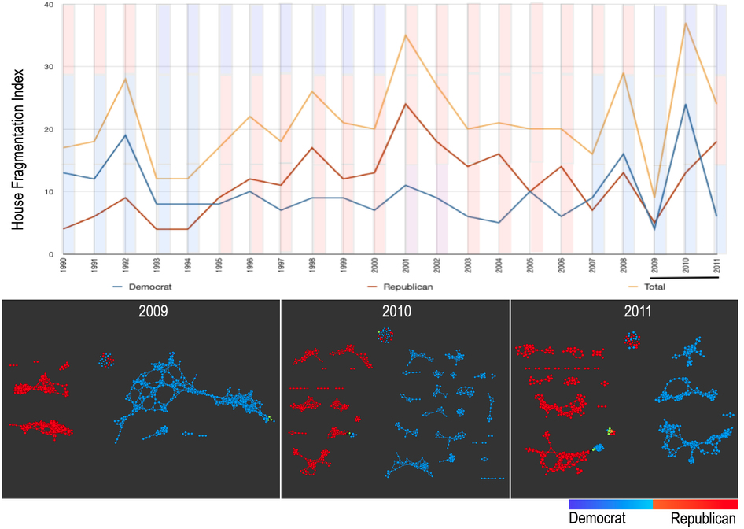
number of sub-networks formed each year per political party.
X-axis: 1990–2011. Y-axis: Fragmentation index. Color bars denote, from top to bottom, party of the President, party for the House, party for the Senate (red: republican; blue: democrat; purple: split). The bottom 3 panels are the actual topological networks for the members. Networks are constructed from voting behavior of the member of the house, with an “aye” vote coded as a 1, “abstain” as zero, and “nay” as a -1. Each node contains sets of members. Each panel labeled with the year contains networks constructed from all the members for all the votes of that year. Note high fragmentation in 2010 in both middle panel and in the Fragmentation Index plot (black bar). The distance metric and filters used in the analysis were Pearson correlation and principal and secondary metric SVD. Metric: Correlation; Lens: Principal SVD Value (Resolution 120, Gain 4.5x, Equalized) and Secondary SVD Value (Resolution 120, Gain 4.5x, Equalized). Color: Red: Republican; Blue: Democrats.
http://www.nature.com/srep/2013/130207/srep01236/full/srep01236.html

Slide 39
They determined what issues divided Republicans into the two main sub-groups in 2009:
The Credit Cardholders' Bill of Rights,
To reauthorize the Marine Turtle Conservation Act of 2004,
Generations Invigorating Volunteerism and Education (GIVE) Act,
To restore sums to the Highway Trust Fund and for other purposes,
Captive Primate Safety Act, Solar Technology Roadmap Act, Southern Sea Otter Recovery and Research Act.
http://www.nature.com/srep/2013/130207/srep01236/full/srep01236.html

Slide 40
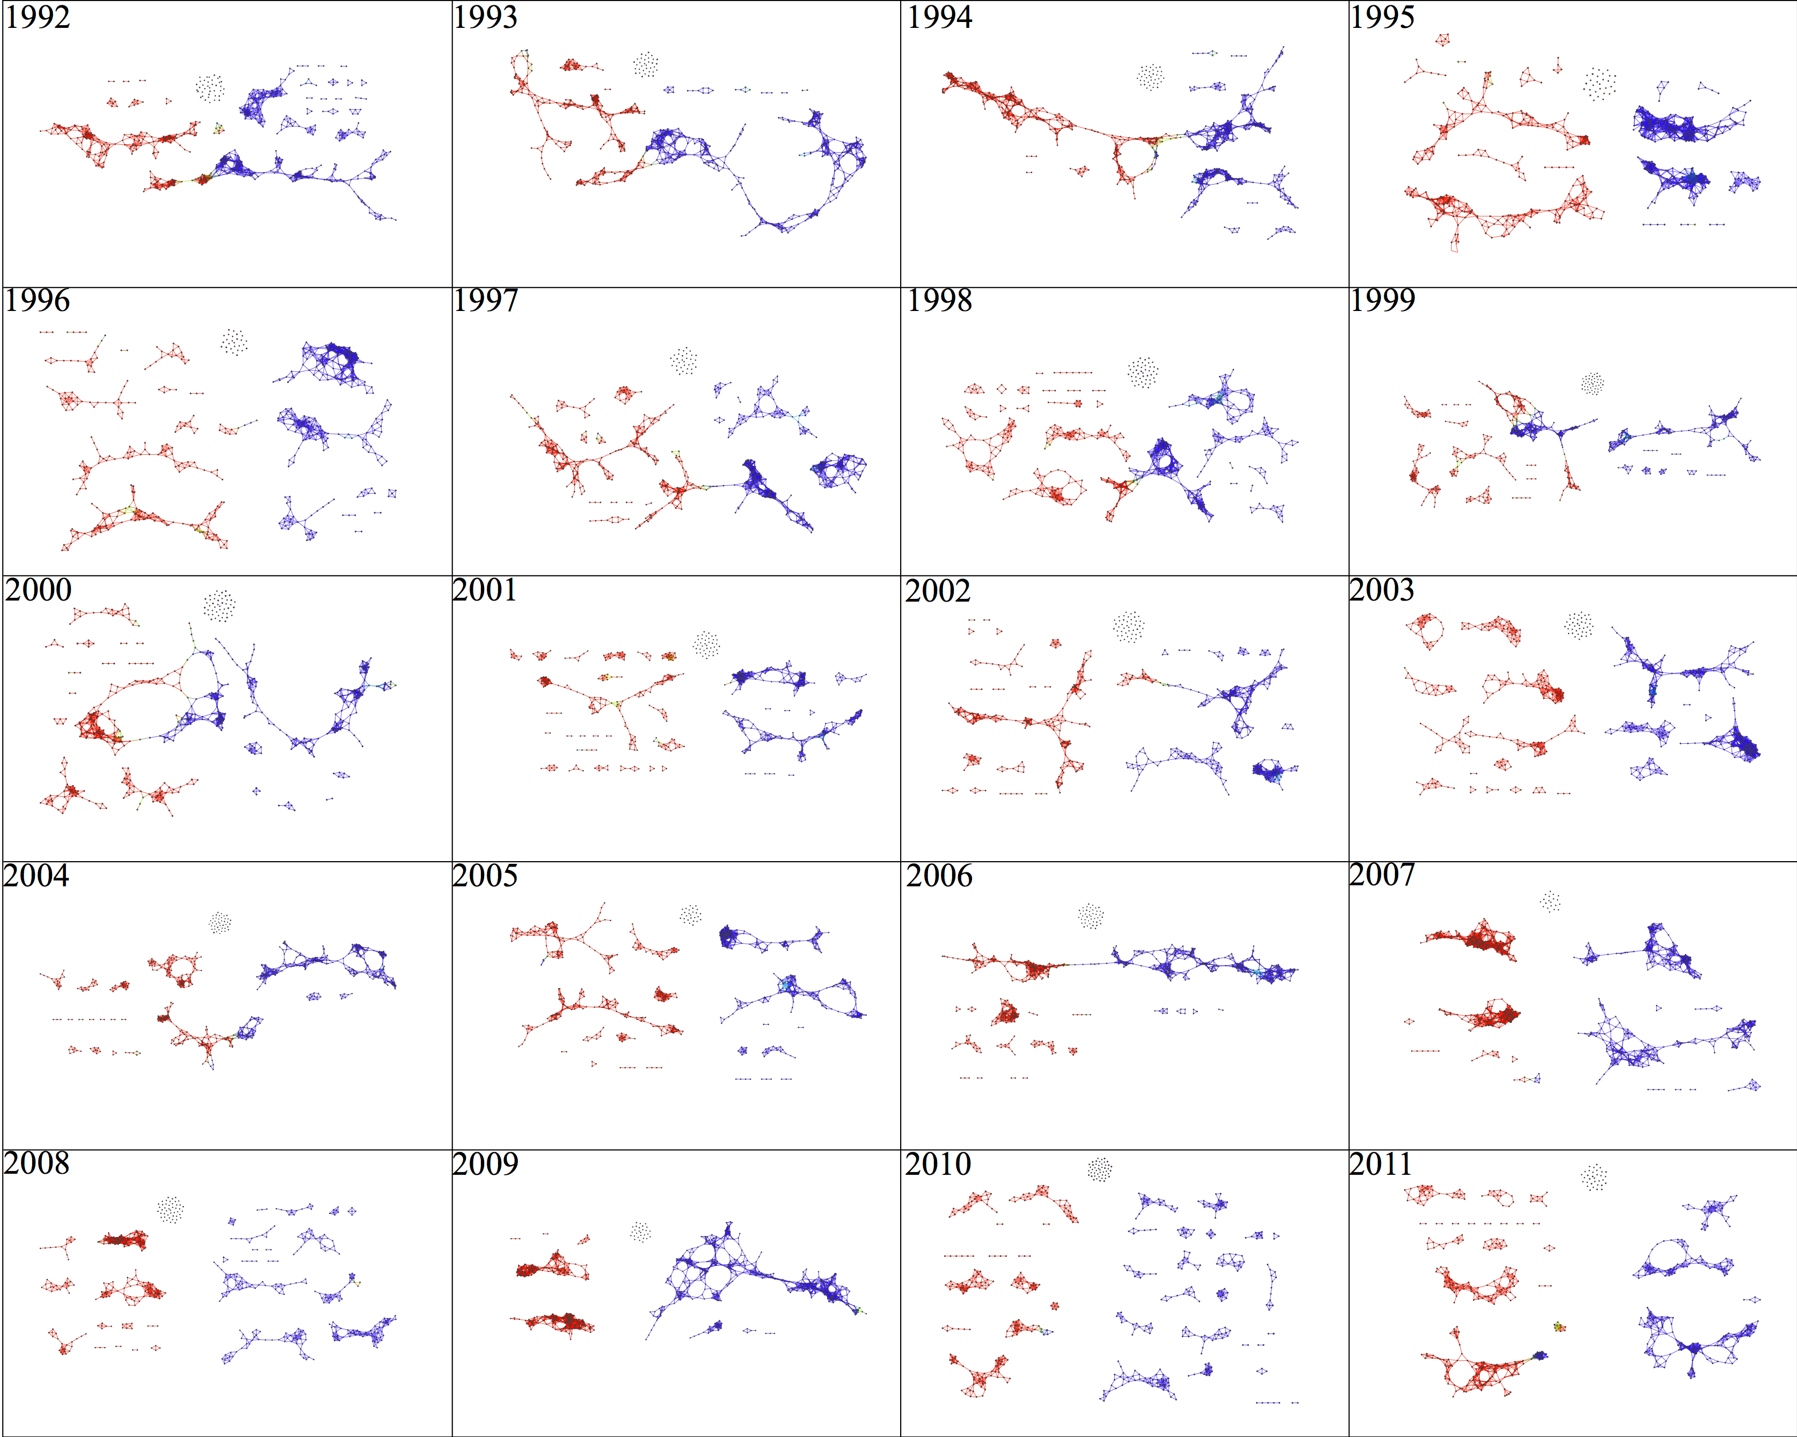

Slide 41
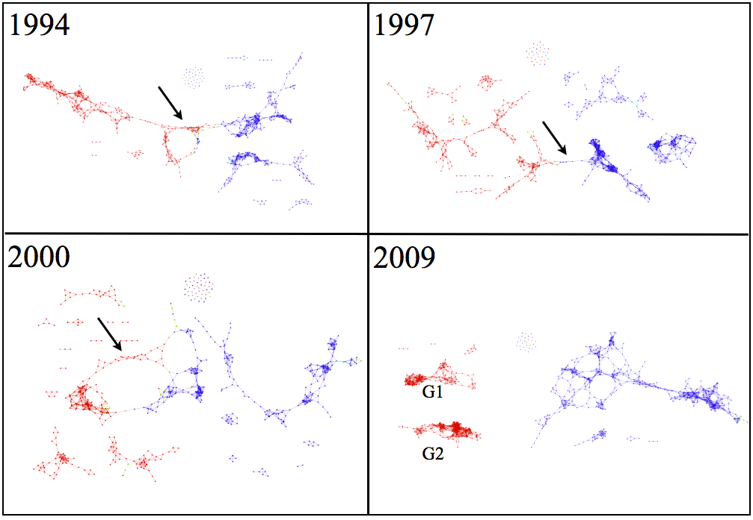

Slide 42
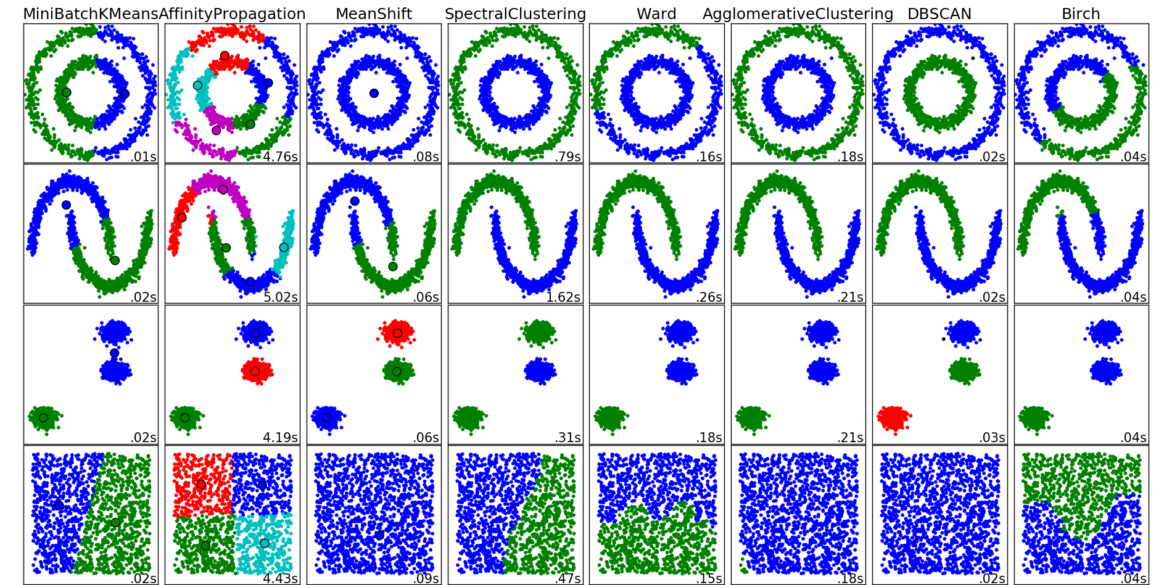
http://scikit-learn.org/stable/auto_examples/cluster/plot_cluster_comparison.html

