Slide 1
Multivariable Linear and Logistic Regression:
One normally must perform feature (variable) selection if you have too many variables and/or if they are not independent.
Some methods for feature selection:
• Subset Selection. This approach involves identifying a subset of the p predictors that we believe to be related to the response. We then fit a model using least squares on the reduced set of variables.
• Shrinkage. This approach involves fitting a model involving all p predictors. However, the estimated coefficients are shrunken towards zero relative to the least squares estimates. This shrinkage (also known as regularization) has the effect of reducing variance. Depending on what type of shrinkage is performed, some of the coefficients may be estimated to be exactly zero. Hence, shrinkage methods can also perform
variable selection.
• Dimension Reduction. This approach involves projecting the p predictors into an M-dimensional subspace, where M <p. This is achieved by computing M different linear combinations, or projections, of the variables. Then these M projections are used as predictors to fit a linear regression model by least squares.
An Introduction to Statistical Learning https://www.statlearning.com/

Slide 2
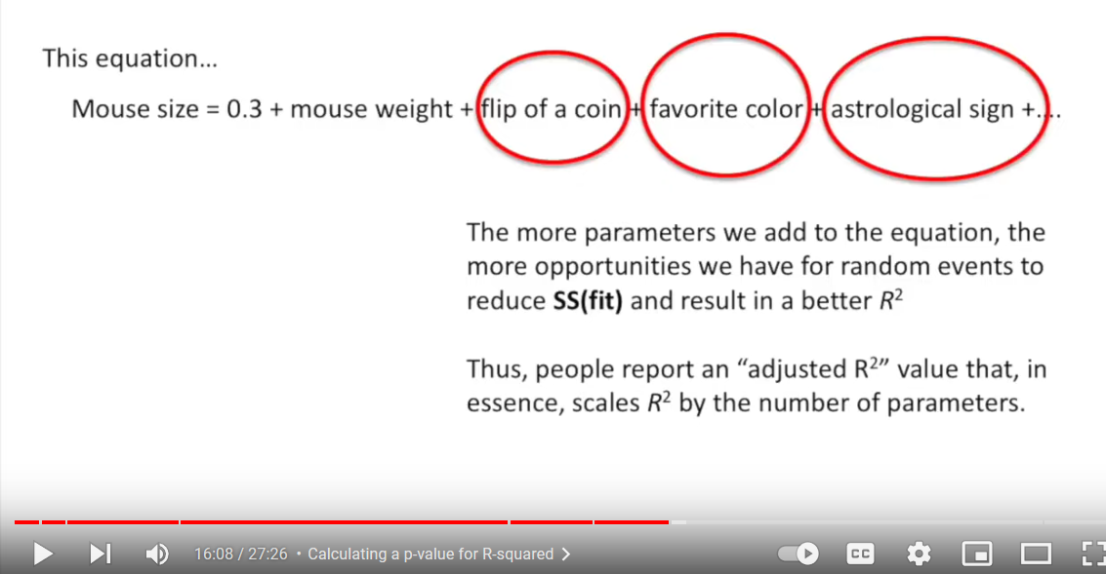
$$f\left(x\right)=a_{0}+a_{1}x_{1}+ax_{2}+⋯+a_{n}x_{n}$$
Many variables: low bias,
can find a good fit given enough variables.
But High Variance:
Coin flip will improve fit for training set, but will usually result in a bad fit for the testing data set. Thus there will be high variance in sum of squares for different testing sets.
StatQuest: Linear Models Pt.1 - Linear Regression https://www.youtube.com/watch?v=nk2CQITm_eo

Slide 3
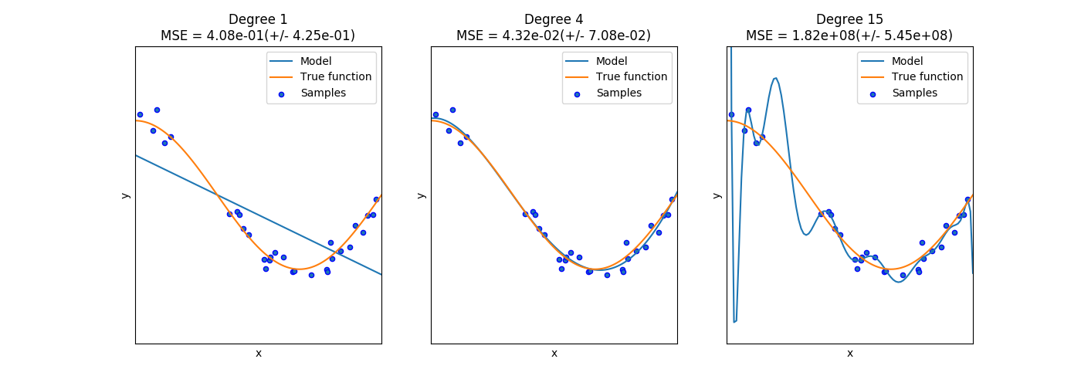
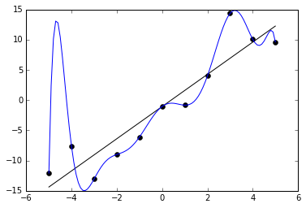
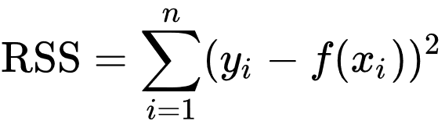
Ivan Meza http://turing.iimas.unam.mx/~ivanvladimir/slides/rpyaa/02_regression.html#/60
High bias High variance
Underfitting versus overfitting
$$Ex: f\left(x\right)=a_{0}+a_{1}x+…+a_{n}x^{n}$$
https://it.wikipedia.org/wiki/Overfitting

Slide 4
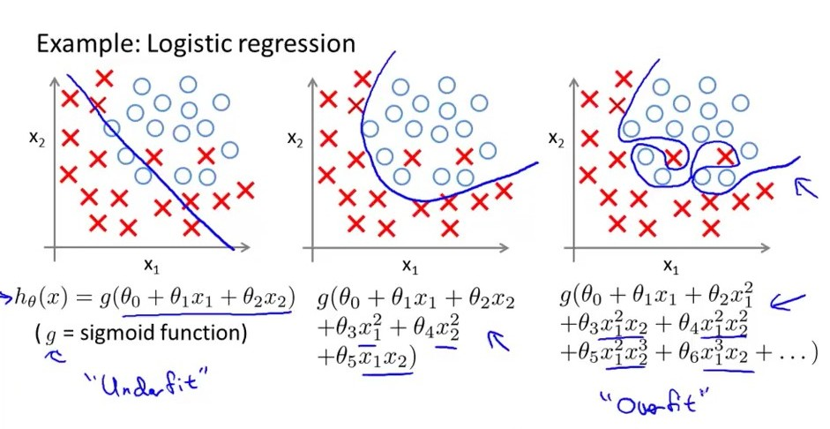
Underfitting versus overfitting
https://stats.stackexchange.com/questions/71946/overfitting-a-logistic-regression-model

Slide 5
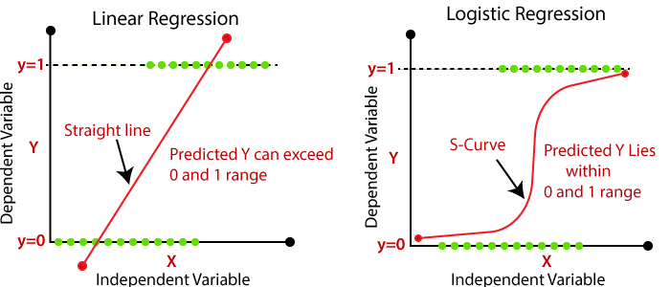
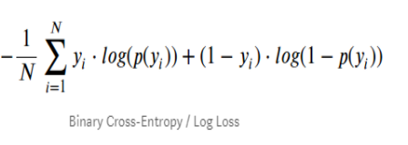
Devopedia. 2022. "Logistic Regression." Version 10, January 19. Accessed 2023-02-11. https://devopedia.org/logistic-regression
Linear model General linear model
Cost function for linear regression Cost function for logistic regression (maximum likelihood)
Minimize cost function to find best function f
(eg: if f(x) = mx + b, find m and b that minimizes Minimize cost function to find best probability function. This
cost function RSS. corresponds to finding best m and b that minimizes cost for
p(x) = 1/[1 + exp(-b - mx)]
Validating model: R², F-statistic, p-value, etc

Slide 6
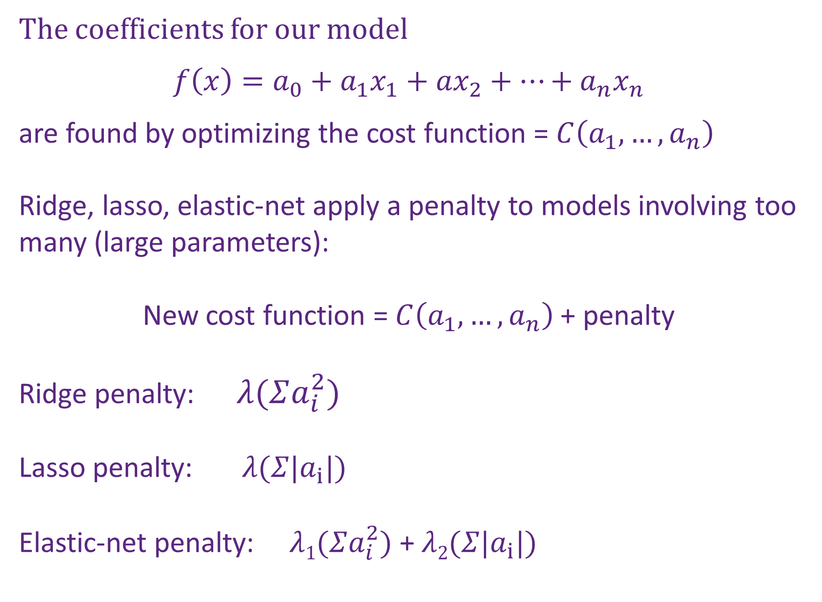
The coefficients for our model
$$f\left(x\right)=a_{0}+a_{1}x_{1}+ax_{2}+⋯+a_{n}x_{n}$$
are found by optimizing the cost function = $C\left(a_{1},…,a_{n}\right)$
Ridge, lasso, elastic-net apply a penalty to models involving too many (large parameters):
New cost function = $C\left(a_{1},…,a_{n}\right)$ + penalty
Ridge penalty: $λ(Σa_{i}^{2})$
Lasso penalty: $λ(Σ|a_{i}|)$
Elastic-net penalty: $λ1(Σa_{i}^{2})$ + $λ2(Σ|a_{i}|)$
Shrinkage: the estimated coefficients are shrunken towards zero

Slide 7
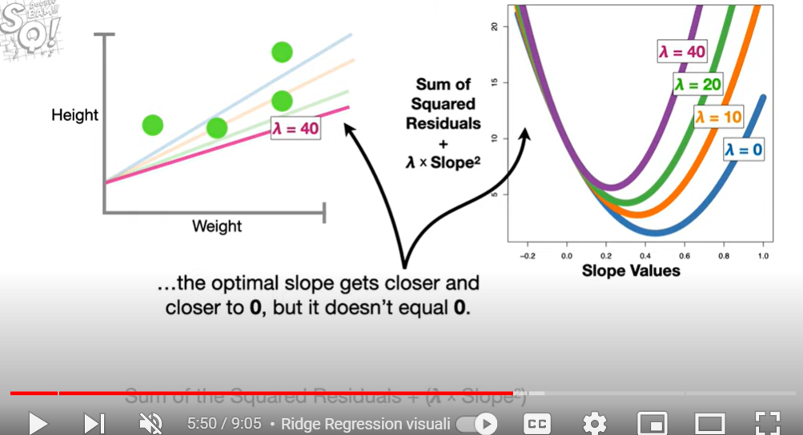
Ridge Regression

Slide 8
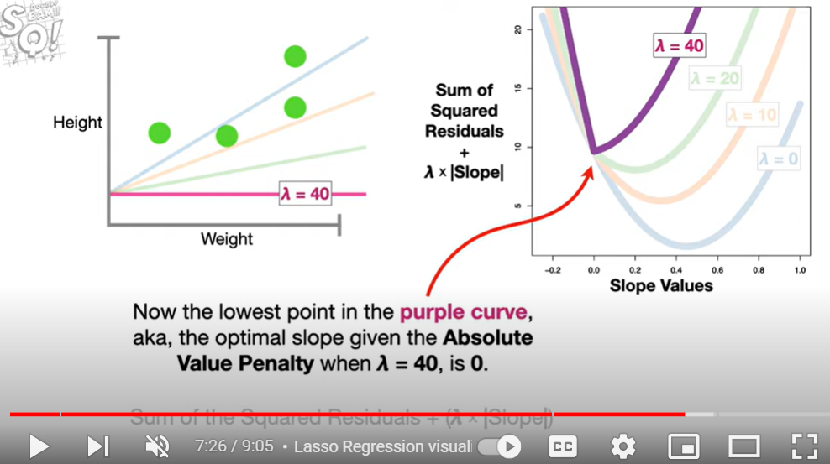
Lasso Regression

Slide 9
The coefficients for our model
$$f\left(x\right)=a_{0}+a_{1}x_{1}+ax_{2}+⋯+a_{n}x_{n}$$
are found by optimizing the cost function = $C\left(a_{1},…,a_{n}\right)$
Ridge, lasso, elastic-net apply a penalty to models involving too many (large parameters):
New cost function = $C\left(a_{1},…,a_{n}\right)$ + penalty
Ridge penalty: $λ(Σa_{i}^{2})$
Lasso penalty: $λ(Σ|a_{i}|)$
Elastic-net penalty: $λ1(Σa_{i}^{2})$ + $λ2(Σ|a_{i}|)$
Shrinkage: the estimated coefficients are shrunken towards zero

Slide 10
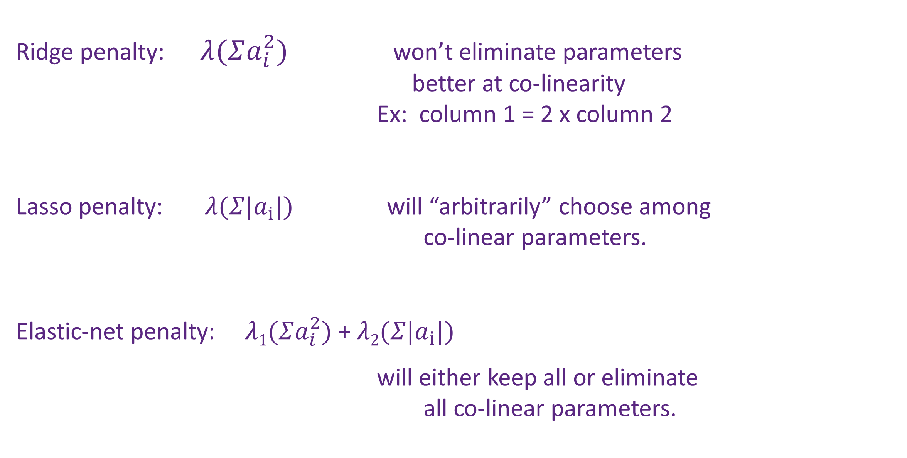
Ridge penalty: $λ(Σa_{i}^{2})$ won’t eliminate parameters
better at co-linearity
Ex: column 1 = 2 x column 2
Lasso penalty: $λ(Σ|a_{i}|)$ will “arbitrarily” choose among
co-linear parameters.
Elastic-net penalty: $λ1(Σa_{i}^{2})$ + $λ2(Σ|a_{i}|)$
will either keep all or eliminate
all co-linear parameters.

Slide 11
Multivariable Linear and Logistic Regression:
One normally must perform feature (variable) selection if you have too many variables and/or if they are not independent.
Some methods for feature selection:
• Subset Selection. This approach involves identifying a subset of the p predictors that we believe to be related to the response. We then fit a model using least squares on the reduced set of variables.
• Shrinkage. This approach involves fitting a model involving all p predictors. However, the estimated coefficients are shrunken towards zero relative to the least squares estimates. This shrinkage (also known as regularization) has the effect of reducing variance. Depending on what type of shrinkage is performed, some of the coefficients may be estimated to be exactly zero. Hence, shrinkage methods can also perform
variable selection.
• Dimension Reduction. This approach involves projecting the p predictors into an M-dimensional subspace, where M <p. This is achieved by computing M different linear combinations, or projections, of the variables. Then these M projections are used as predictors to fit a linear regression model by least squares.
An Introduction to Statistical Learning https://www.statlearning.com/

