Slide 1
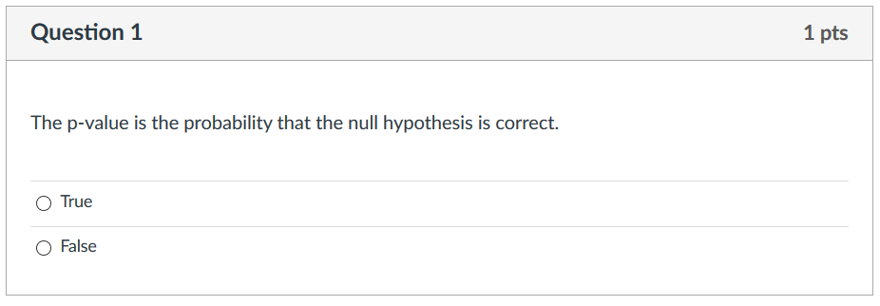
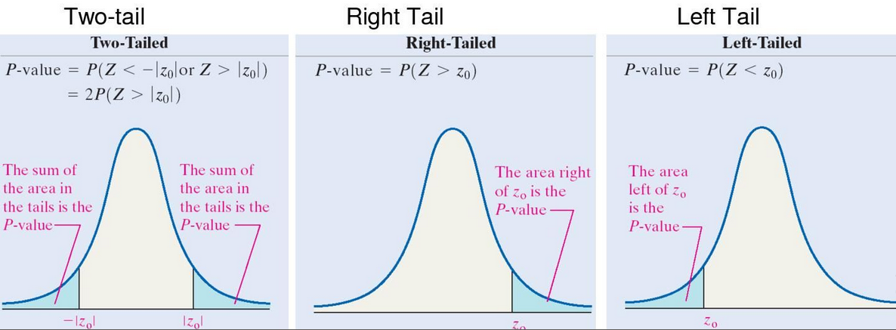
Attendance quiz 6
https://i.pinimg.com/originals/4d/96/f0/4d96f07215c63818917df1be3ec4b79c.jpg

Slide 2
The answer is false per the references below.
The p value is the probability of a result at least as extreme as the sample result if the null hypothesis were true.
Note the hypothesis is that the null hypothesis is true.
Given this hypothesis (that the null hypothesis is true), then the p-value gives you the probability of obtaining the sample result.
But we need the assumption that the null hypothesis is true.
To calculate the p-value, we first generate a distribution of some statistic (such as the F-statistic) using data where the null hypothesis is true. We can then compare the sample result (the data we are testing) to this distribution to see how extreme it is compared to the data where the null hypothesis is true.
https://opentext.wsu.edu/carriecuttler/chapter/13-1-understanding-null-hypothesis-testing/
https://www.ncbi.nlm.nih.gov/pmc/articles/PMC5804470/
and https://lsc.cornell.edu/wp-content/uploads/2016/01/P-value.pdf

Slide 3
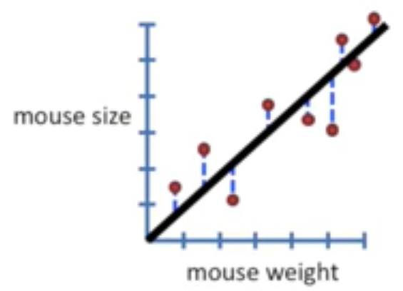
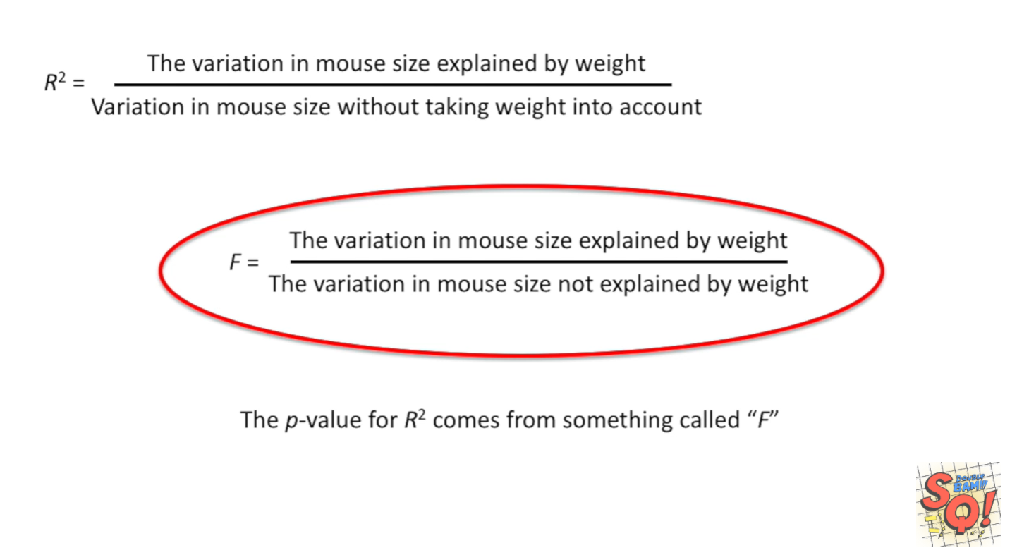
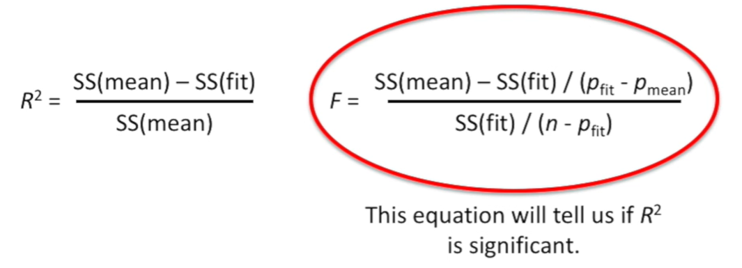
StatQuest: Linear Models Pt.1 - Linear Regression https://www.youtube.com/watch?v=nk2CQITm_eo

Slide 4
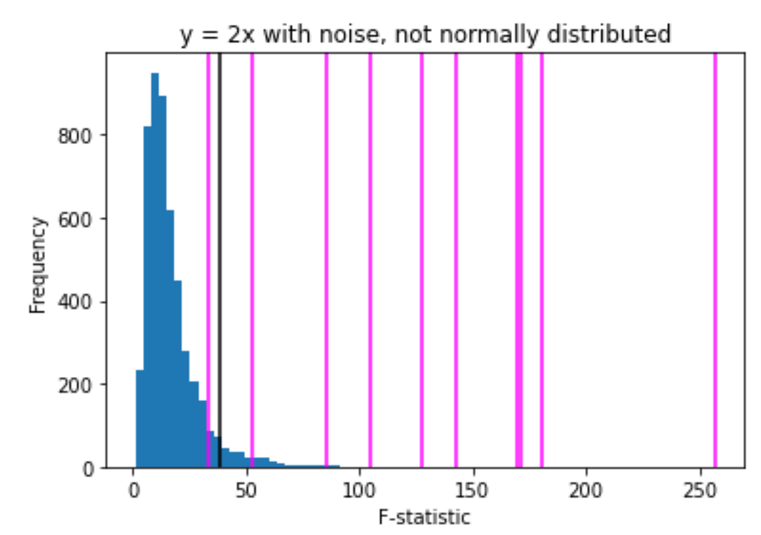
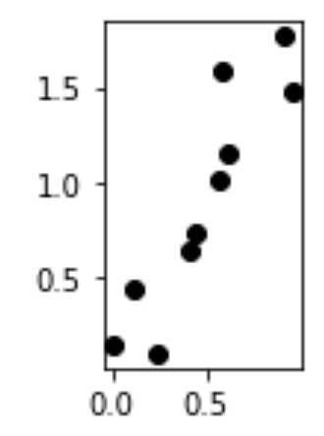
The P value is the probability of obtaining a test statistic at least as extreme as the one that was actually observed, assuming that the null hypothesis is true.
Null hypothesis: the probability that there is no relationship between x and y (i.e. the relationship is null)
False negatives:
There is a relationship between x and y
and
the F-statistic indicates that there is no relationship between x and y
True positive:
There is a relationship between x and y
and
the F-statistic indicates that there is a relationship between x and y

Slide 5
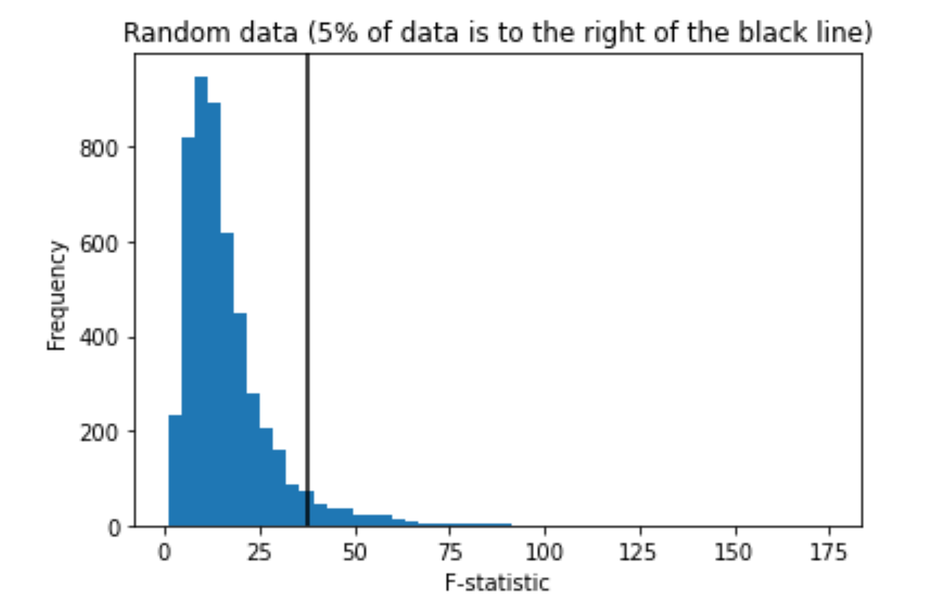
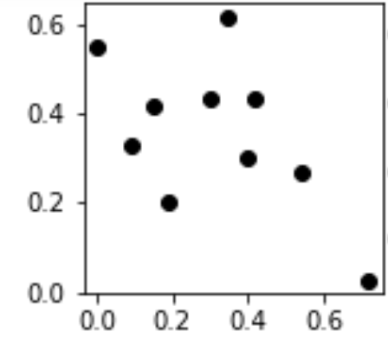
Negative: x does not predict y. There is no relationship between x and y.
The data used to generate the histogram below was randomly generated.
Thus there is no relationship between x and y. Thus the null hypothesis is true for these data sets
True negatives:
There is no relationship between x and y
and
the F-statistic indicates that there is no relationship between x and y
False positive:
There is no relationship between x and y
and
the F-statistic indicates that there is a relationship between x and y

Slide 6
17.4 Error Variable: Required Conditions
The error ε is a critical part of the regression model.
Four requirements involving the distribution of ε must be satisfied.
The probability distribution of ε is normal.
The mean of ε is zero: E(ε) = 0.
The standard deviation of ε is σ_{ε} for all values of x.
The set of errors associated with different values of y are all independent.
https://web.stanford.edu/class/msande247s/kchap17.ppt

Slide 7
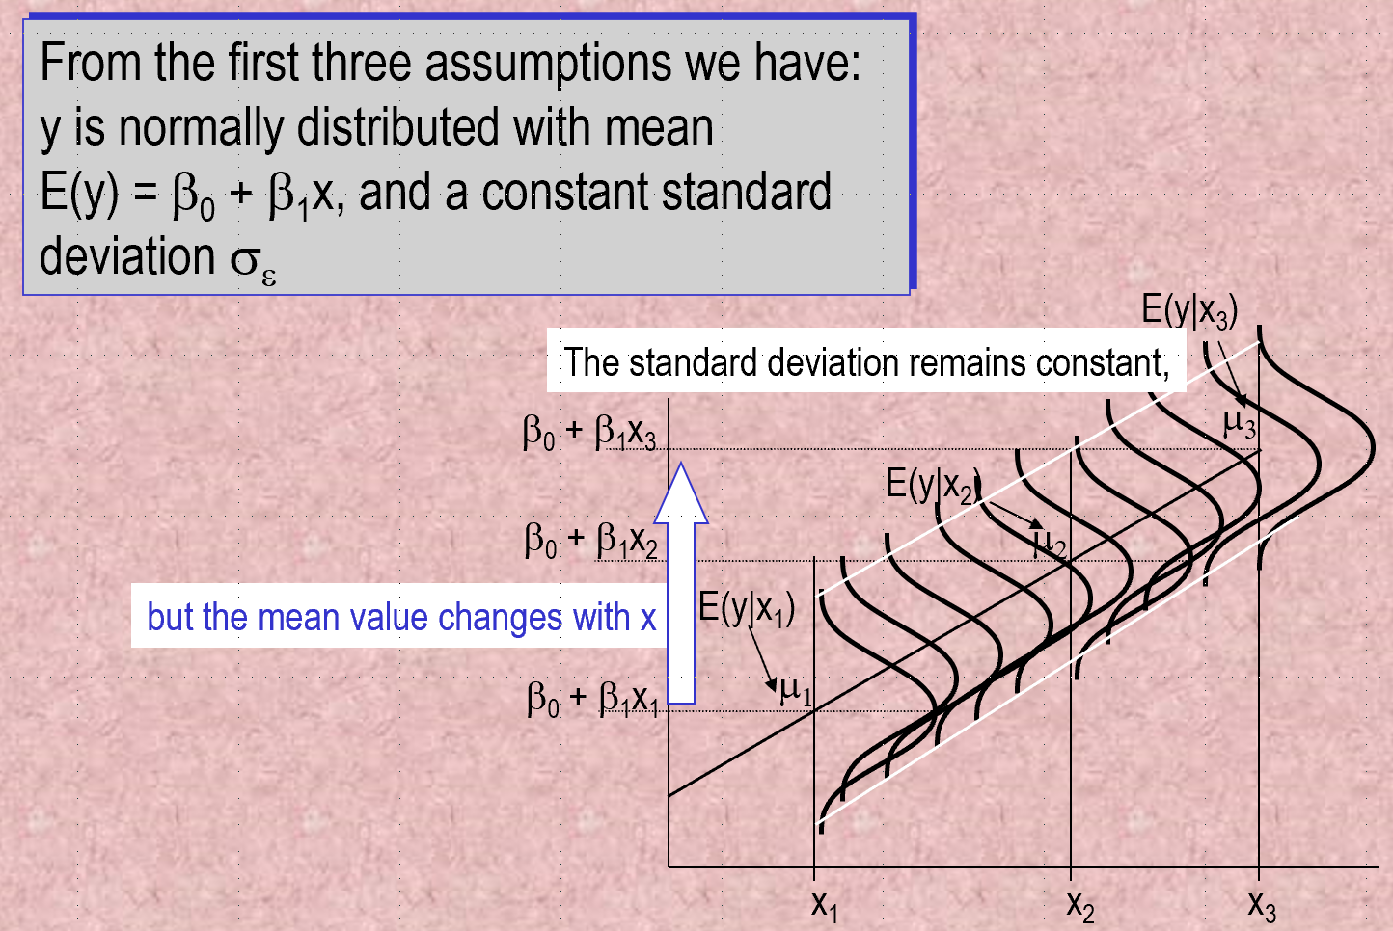
https://web.stanford.edu/class/msande247s/kchap17.ppt

Slide 8
6533
0
No data
The intercept is b₀ = 6533.
This is the slope of the line.
For each additional mile on the odometer,
the price decreases by an average of $0.0312
Do not interpret the intercept as the
“Price of cars that have not been driven”
https://web.stanford.edu/class/msande247s/kchap17.ppt

Slide 9
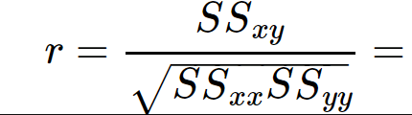
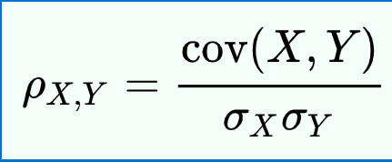
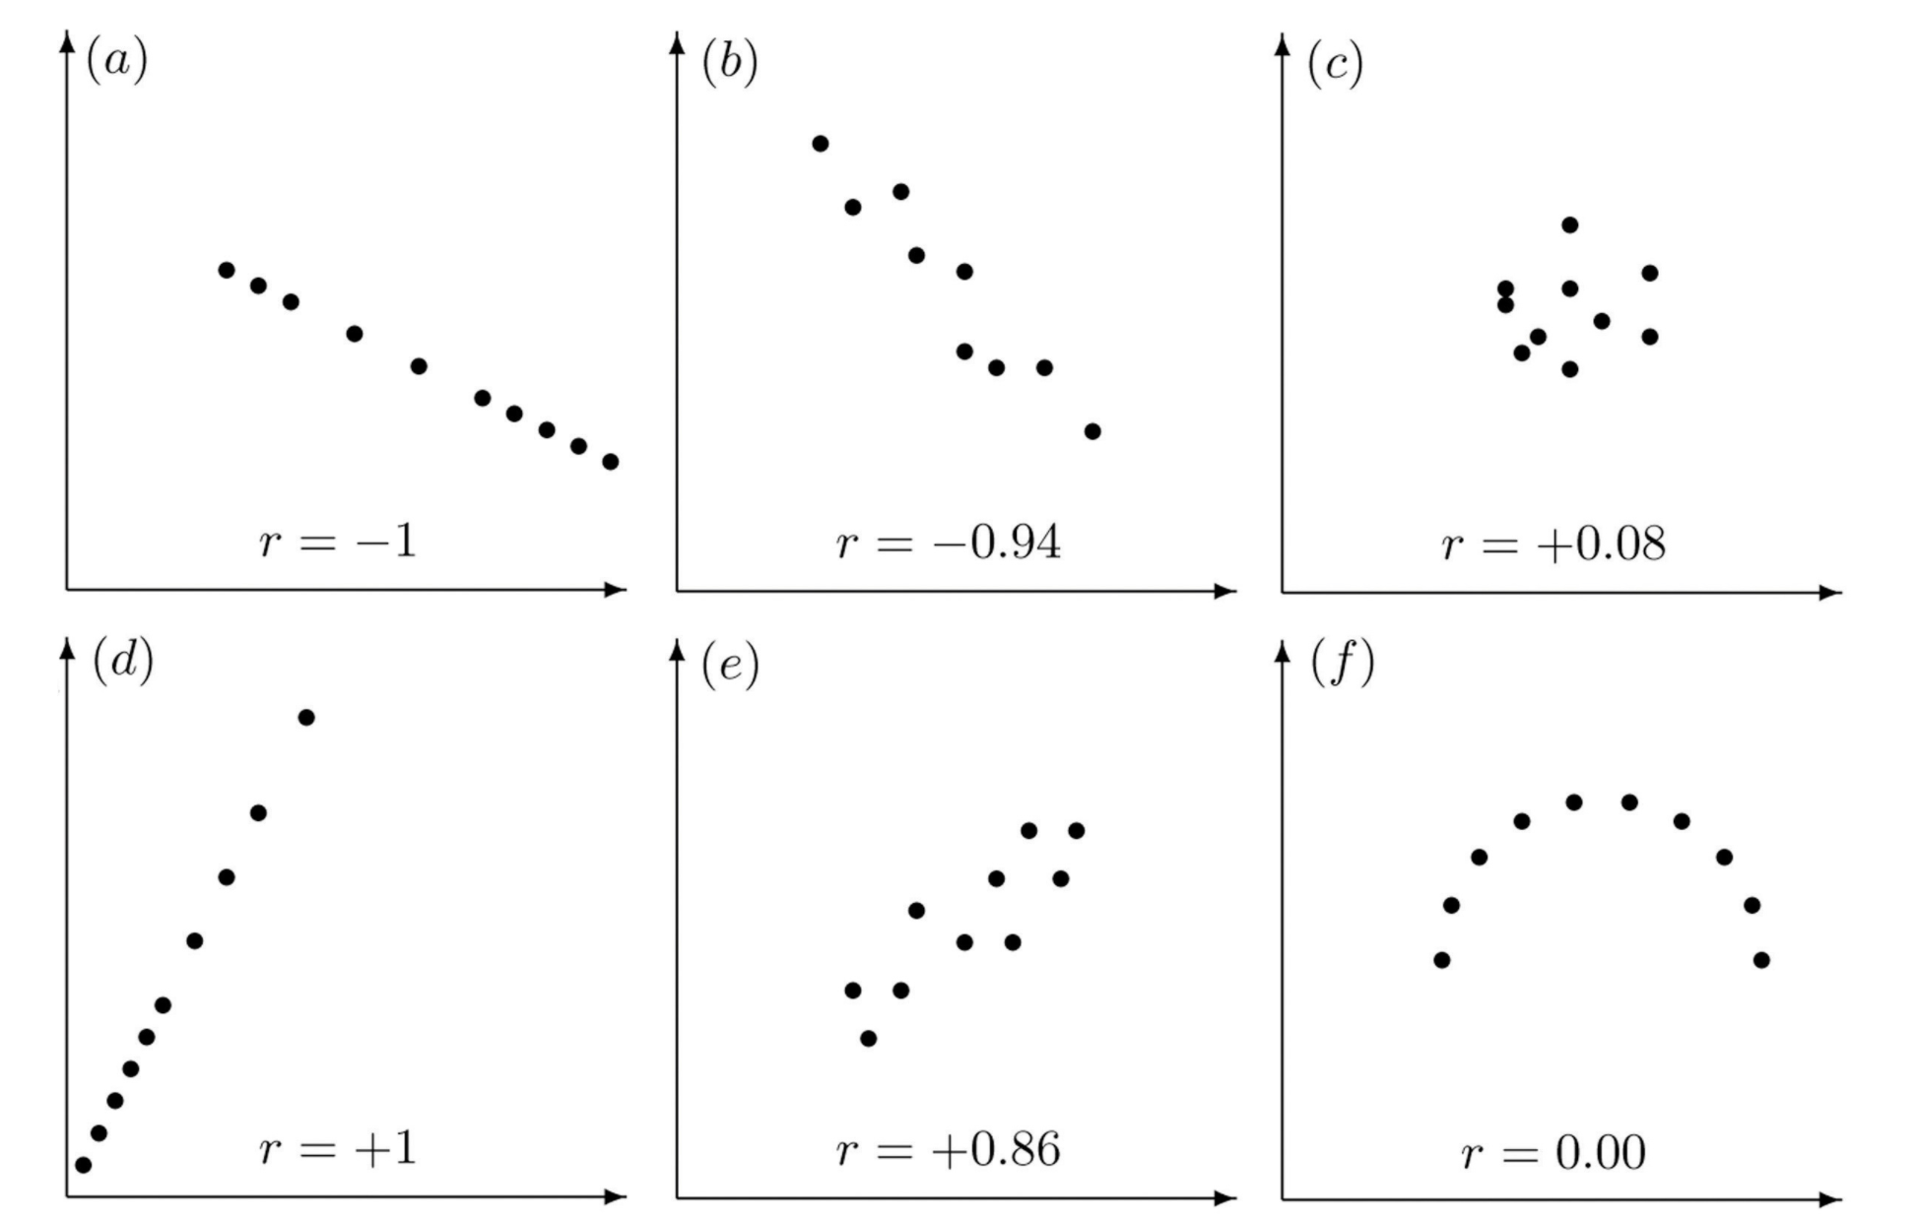
Properties of Linear Correlation Coefficients
https://emunix.emich.edu/~schu/MATH_170/Fall09_170/Evening%20session/Unit%203.ppt
Some properties of the linear correlation coefficient
r is a unitless measure (so that r would be the same for a data set whether x and y are measured in feet, inches, meters etc.)
r is always between –1 and +1.
r = -1 : perfect negative correlation
r = +1: perfect positive correlation
Positive values of r correspond to positive relations
Negative values of r correspond to negative relations
https://en.wikipedia.org/wiki/Pearson_correlation_coefficient
https://stats.libretexts.org/Bookshelves/Introductory_Statistics/Book%3A_Introductory_Statistics_(Shafer_and_Zhang)/10%3A_Correlation_and_Regression/10.02%3A_The_Linear_Correlation_Coefficient

Slide 10
Lurking Variable
Sometimes it is not clear which variable is the explanatory variable and which is the response variable
Sometimes the two variables are related without either one being an explanatory variable
Sometimes the two variables are both affected by a third variable, a lurking variable, that had not been included in the study
Correlation does NOT imply causation
https://emunix.emich.edu/~schu/MATH_170/Fall09_170/Evening%20session/Unit%203.ppt

Slide 11
Example 1
An example of a lurking variable
A researcher studies a group of elementary school children
Y = the student’s height
X = the student’s shoe size
It is not reasonable to claim that shoe size causes height to change
The lurking variable of age affects both of these two variables
https://emunix.emich.edu/~schu/MATH_170/Fall09_170/Evening%20session/Unit%203.ppt

Slide 12
More Examples
Some other examples
Rainfall amounts and plant growth
Explanatory variable – rainfall
Response variable – plant growth
Possible lurking variable – amount of sunlight
Exercise and cholesterol levels
Explanatory variable – amount of exercise
Response variable – cholesterol level
Possible lurking variable – diet
https://emunix.emich.edu/~schu/MATH_170/Fall09_170/Evening%20session/Unit%203.ppt

Slide 13
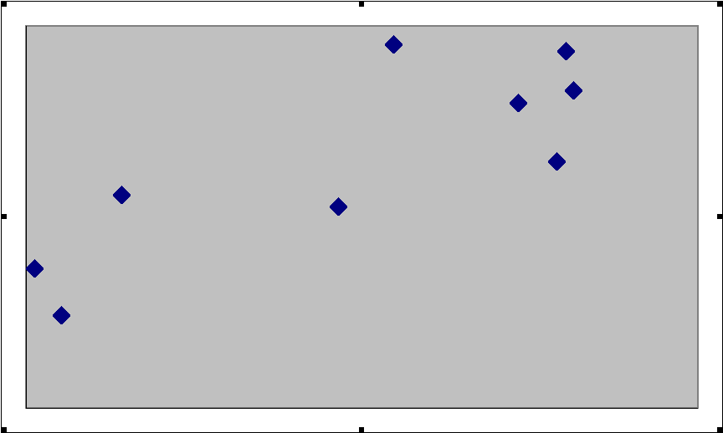
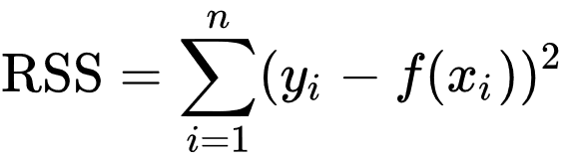
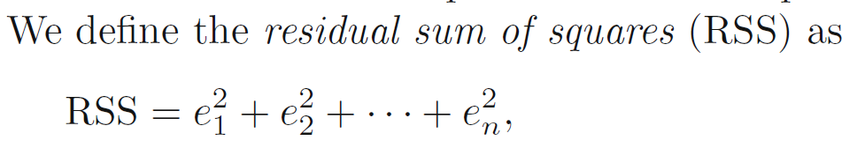
https://emunix.emich.edu/~schu/MATH_170/Fall09_170/Evening%20session/Unit%203.ppt
Here shows a residual on the scatter diagram
The residual
The regression line
The observed value y
The predicted value y
The x value of interest

Slide 14
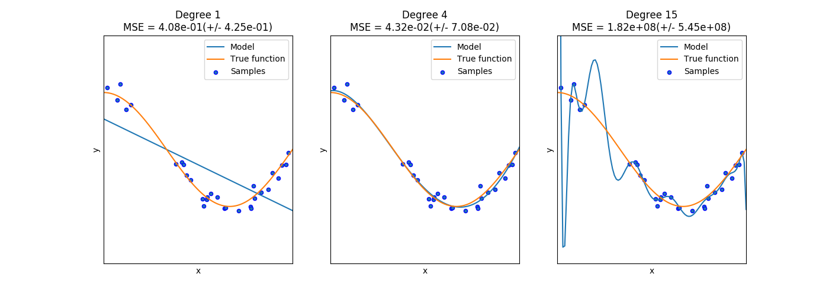
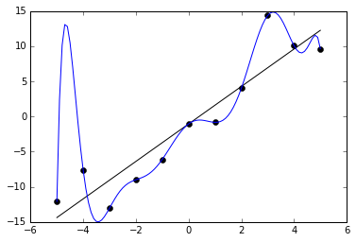
Ivan Meza http://turing.iimas.unam.mx/~ivanvladimir/slides/rpyaa/02_regression.html#/60
Underfitting versus overfitting
Overfitting: Too many parameters in model
https://it.wikipedia.org/wiki/Overfitting

Slide 15
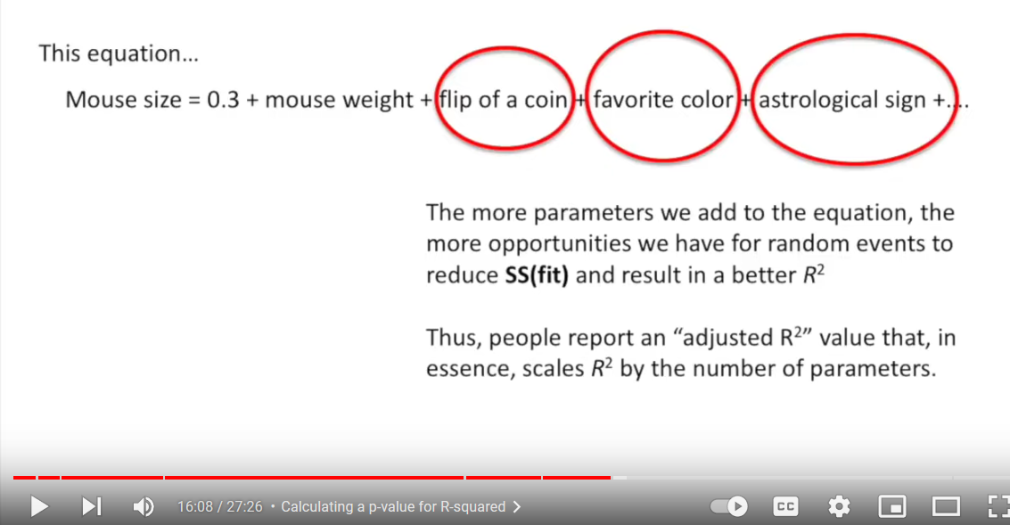
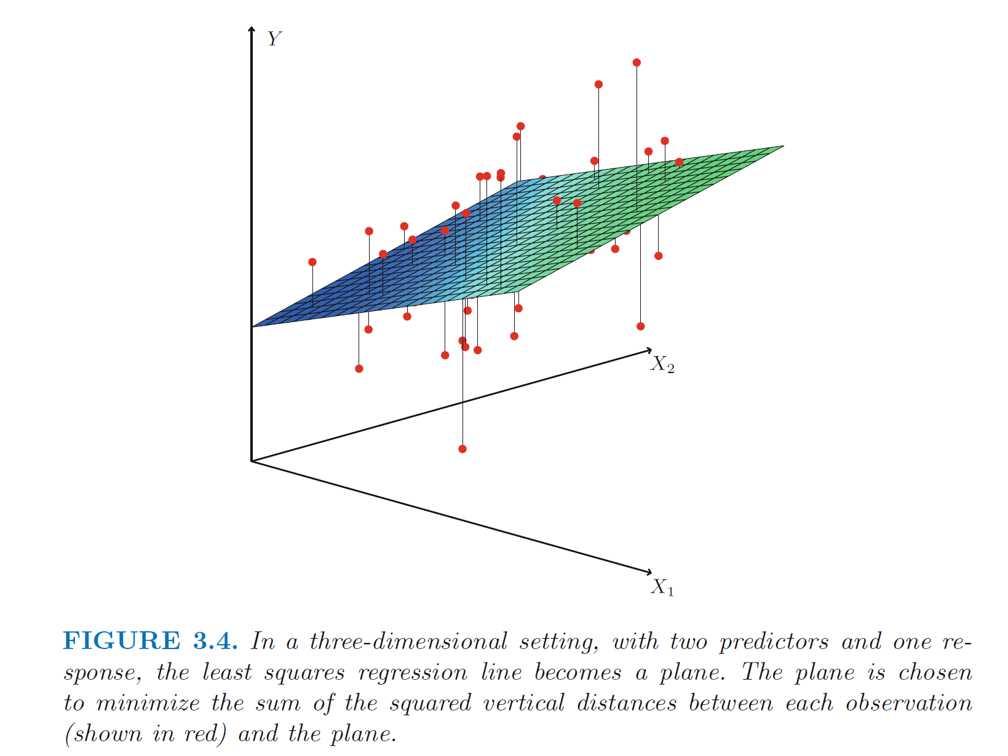
https://www.statlearning.com/
Overfitting: Too many variables used to determine model
StatQuest: Linear Models Pt.1 - Linear Regression https://www.youtube.com/watch?v=nk2CQITm_eo

Slide 16
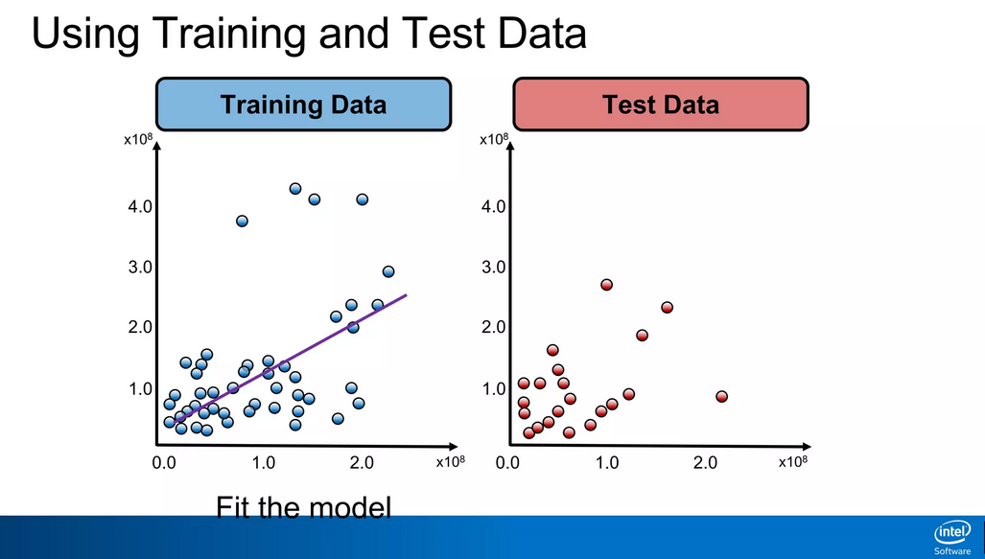
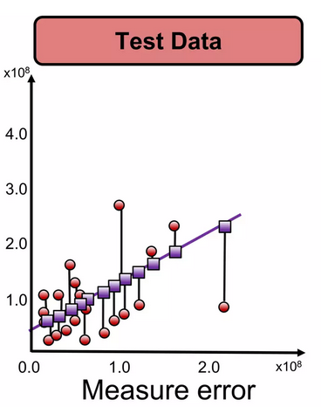
To avoid overfitting due to too many parameters:
https://www.slideshare.net/ankit_ppt/ml2-train-testsplitsvalidationlinearregression

Slide 17
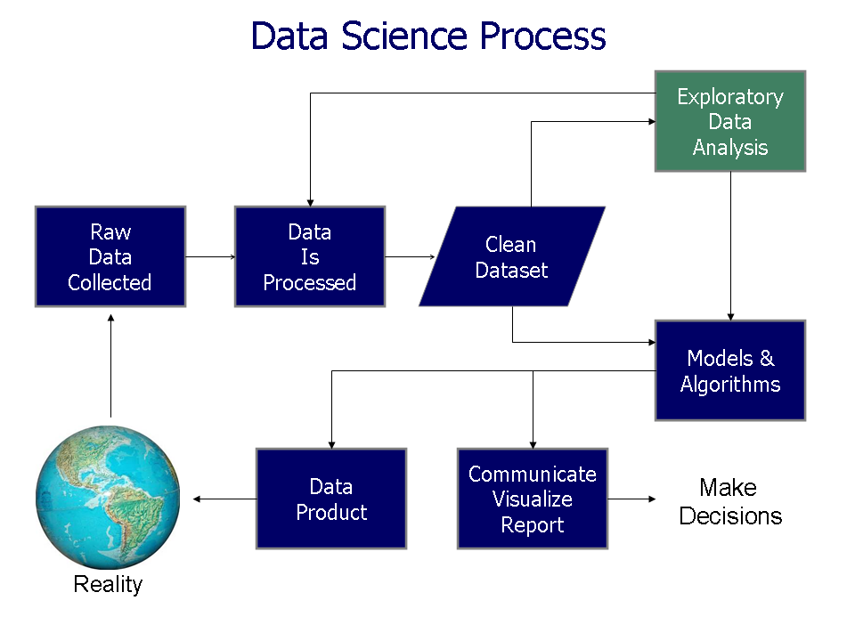
> 90% of work is usually preparing and cleaning the data
https://commons.wikimedia.org/wiki/File%3AData_visualization_process_v1.png

Slide 18
Why normalization (re-scaling)
https://www.cs.odu.edu/~sampath/courses/f18/cs795/files/slides/Lecture%204%20-%20Data%20Wrangling.pptx
height_inch height_cm weight
A 63 160.0 150
B 67 170.2 160
C 70 177.8 171
from scipy.spatial import distance
a = df2.iloc[0, [0,2]]
b = df2.iloc[1, [0,2]]
c = df2.iloc[2, [0,2]]
print("%.2f" % distance.euclidean(a,b)) #10.77
print("%.2f" % distance.euclidean(a,c)) # 22.14
print("%.2f" % distance.euclidean(b,c)) #11.40

Slide 19
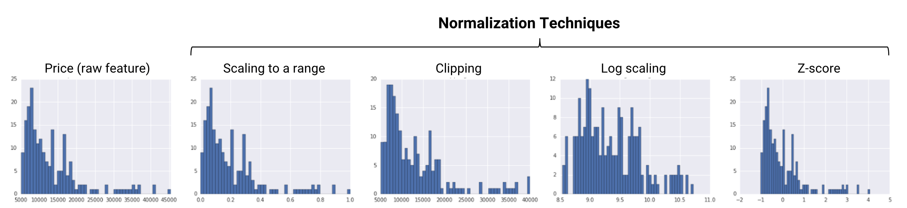
https://developers.google.com/machine-learning/data-prep/transform/normalization

Slide 20

Min-max
https://developers.google.com/machine-learning/data-prep/transform/normalization

Slide 21
Remove outliers by clipping
https://developers.google.com/machine-learning/data-prep/transform/normalization

Slide 22
Remove outliers by clipping
https://developers.google.com/machine-learning/data-prep/transform/normalization

Slide 23

Standard score or Standardization
https://developers.google.com/machine-learning/data-prep/transform/normalization

Slide 24
Rescaling:
https://developers.google.com/machine-learning/data-prep/transform/normalization

Slide 25
When should you not normalize:
Ex: Iris data set since all features are measured in centimeters
Ex: Gene expression data since units are all identical
Ex: The scale of each feature is important.
When should you normalize:
Ex: Iris and gene expression data so that all features have the same range.
For example, a feature with low variance can be significant. This significance can be found if you make all features have the same range.
Ex: Normalize if the scale depends on the feature.

Slide 26
Removing variables:
A common method to reduce the number of features is to remove features with low variance, especially if this low variance is less than the expected noise.

Slide 27
Multivariable Linear and Logistic Regression:
One normally must perform feature (variable) selection if you have too many variables and/or if they are not independent.
Some methods for feature selection:
• Subset Selection. This approach involves identifying a subset of the p predictors that we believe to be related to the response. We then fit a model using least squares on the reduced set of variables.
• Shrinkage. This approach involves fitting a model involving all p predictors. However, the estimated coefficients are shrunken towards zero relative to the least squares estimates. This shrinkage (also known as regularization) has the effect of reducing variance. Depending on what type of shrinkage is performed, some of the coefficients may be estimated to be exactly zero. Hence, shrinkage methods can also perform
variable selection.
• Dimension Reduction. This approach involves projecting the p predictors into an M-dimensional subspace, where M <p. This is achieved by computing M different linear combinations, or projections, of the variables. Then these M projections are used as predictors to fit a linear regression model by least squares.
An Introduction to Statistical Learning https://www.statlearning.com/

Slide 28

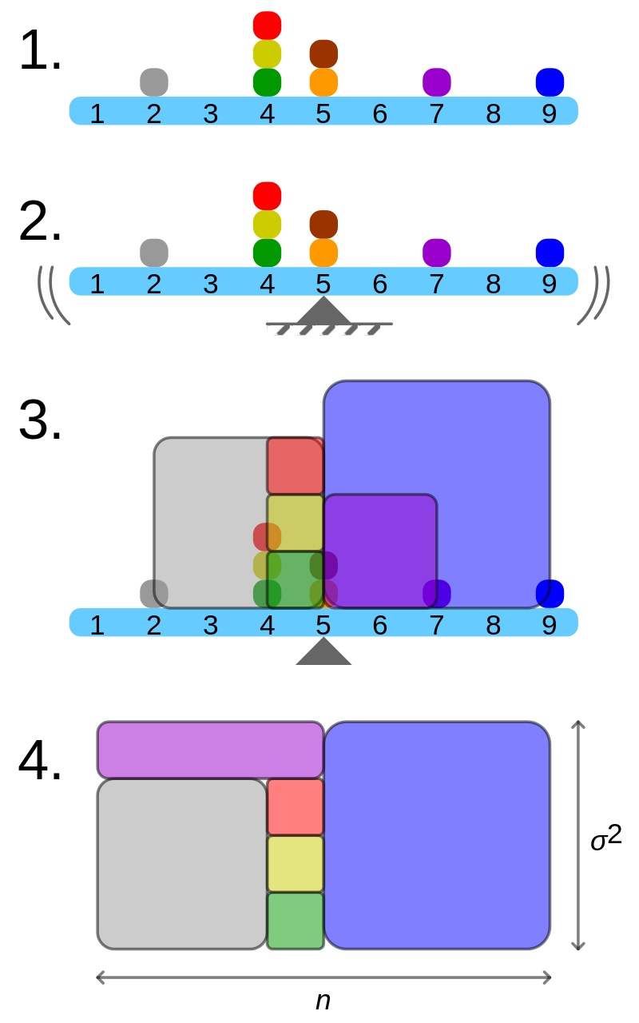
Population variance when size of your population = n
Geometric visualisation of the variance of an arbitrary distribution (2, 4, 4, 4, 5, 5, 7, 9): A frequency distribution is constructed.
The centroid of the distribution gives its mean.
A square with sides equal to the difference of each value from the mean is formed for each value.
Arranging the squares into a rectangle with one side equal to the number of values, n, results in the other side being the distribution's variance, σ².
By Cmglee - Own work, CC BY-SA 3.0, https://commons.wikimedia.org/w/index.php?curid=39472834

Slide 29
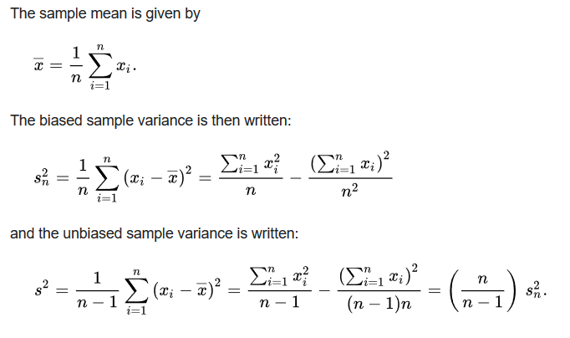
https://en.wikipedia.org/wiki/Bessel's_correction#Source_of_bias
Too small
when sampling
n data points from a larger population

Slide 30
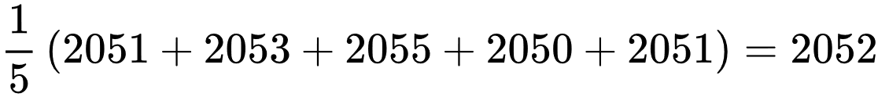
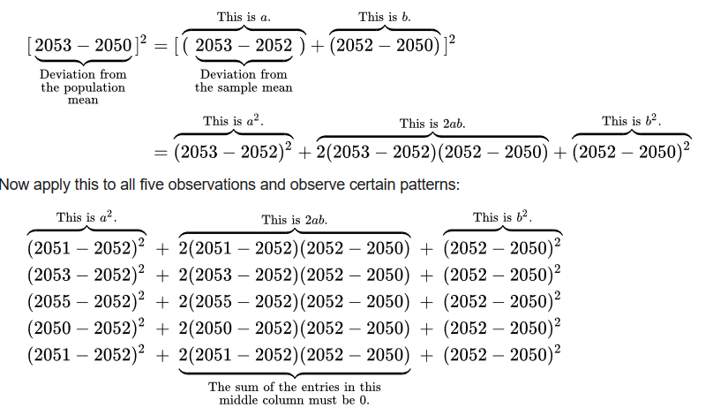
Small sample chosen randomly from the population:
Sample mean is , but suppose population mean is actually 2050.
https://en.wikipedia.org/wiki/Bessel's_correction#Source_of_bias
(5*sample mean – 5*sample mean)

Slide 31
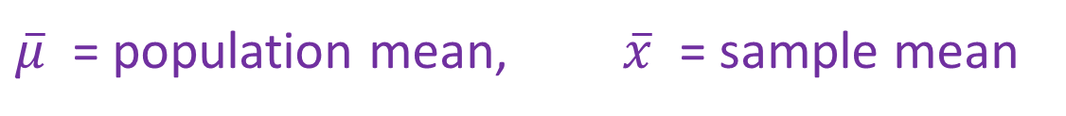
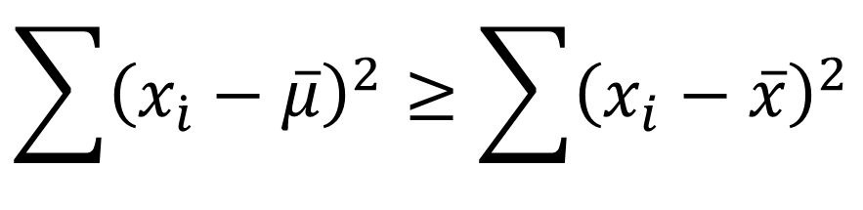

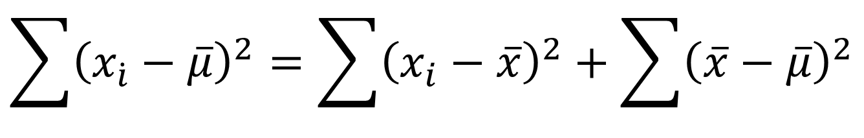
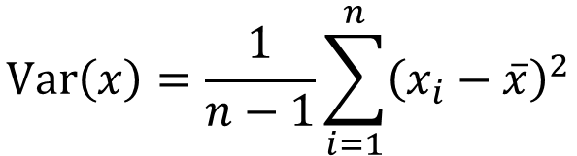
$\overline{μ}$ = population mean, $\overline{x}$ = sample mean
$$\sum{{\left(x_{\dot{i}}−\overline{μ}\right)}^{2}}=\sum{{\left(x_{i}−\overline{x}\right)}^{2}}+\sum{{\left(\overline{x}−\overline{μ}\right)}^{2}}$$
$$\sum{{\left(x_{\dot{i}}−\overline{μ}\right)}^{2}}≥\sum{{\left(x_{i}−\overline{x}\right)}^{2}}$$
Variance on entire population : vs Variance of sample of population:
$$\operatorname{Var}\left(x\right)=\frac{1}{n−1}\sum_{i=1}^{n}{{\left(x_{i}−\overline{x}\right)}^{2}}$$
$$\frac{n}{n−1}$$
https://en.wikipedia.org/wiki/Bessel's_correction#Source_of_bias

Slide 32
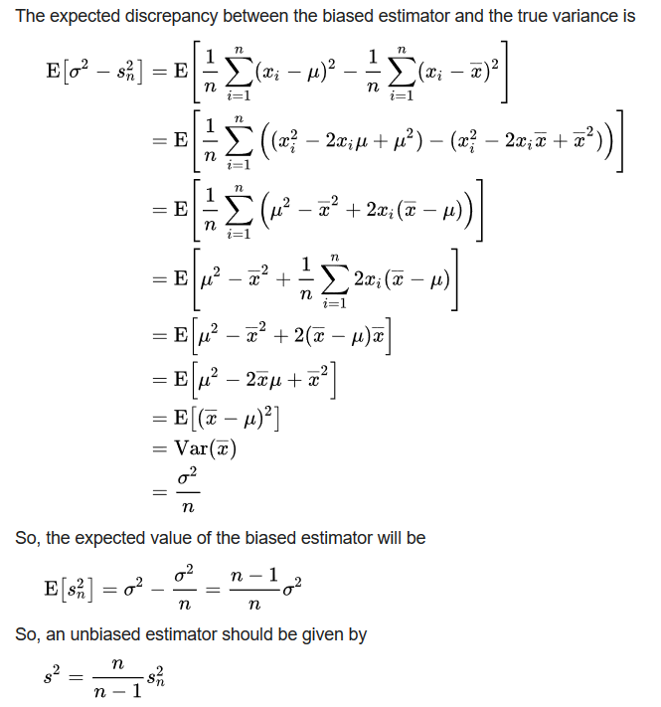

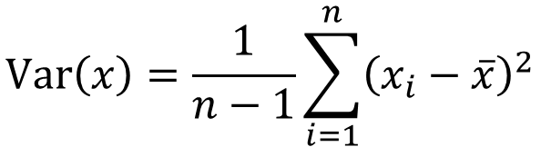
$$\operatorname{Var}\left(x\right)=\frac{1}{n−1}\sum_{i=1}^{n}{{\left(x_{i}−\overline{x}\right)}^{2}}$$
One can understand Bessel's correction as the degrees of freedom in the residuals vector (residuals, not errors, because the population mean is unknown):
While there are n independent observations in the sample, there are only n − 1 independent residuals, as they sum to 0
For 1 data point: Variance does not make sense
https://en.wikipedia.org/wiki/Bessel's_correction#Source_of_bias

Slide 33
Dimensionality Reduction: Given dataset D R^{N}
Want: embedding f: D → R^{n} where n << N
which “preserves” the structure of the data.
Many reduction methods:
f₁: D → R, f₂: D → R, … f_{n}: D → R
(f₁, f₂, … f_{n}): D → R^{n}
Many are linear, M: R^{N} → R^{n}, Mx = y
But there are also non-linear dimensionality reduction algorithms.
U

Slide 34
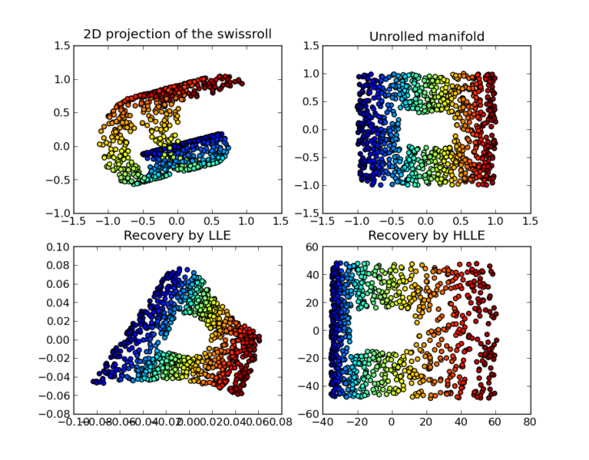
https://en.wikipedia.org/wiki/Nonlinear_dimensionality_reduction

Slide 35
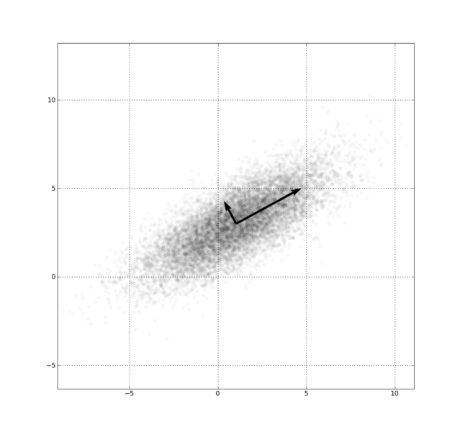
Example: Principal component analysis (PCA)
x_{i} → z_{i} = linear combination of x_{i}
http://en.wikipedia.org/wiki/File:GaussianScatterPCA.png

Slide 36
PCA on all Genes Leukemia data, precursor B and T
Plot of 34 patients, dimension of 8973 genes reduced to 2
Example:Using PCA as a visualization tool. Not eliminating variables via PCA
www.cse.buffalo.edu/faculty/azhang/data-mining/pca.ppt

Slide 37
PCA on 100 top significant genes Leukemia data, precursor B and T
Plot of 34 patients, dimension of 100 genes reduced to 2
Note how reducing the dimension of the data set, nicely affects the result.
Low variance variables removed (not via PCA),
Visualized via PCA
www.cse.buffalo.edu/faculty/azhang/data-mining/pca.ppt

Slide 38
Principal Component Analysis
The central idea of principal component analysis (PCA) is
to reduce the dimensionality of a data set consisting of a
large number of interrelated variables, while retaining as
much as possible of the variation present in the data set.
This is achieved by transforming to a new set of variables,
the principal components (PCs), which are uncorrelated,
and which are ordered so that the first few retain most of
the variation present in all of the original variables.
[Jollie, Principal Component Analysis, 2nd edition]
www.stat.columbia.edu/~fwood/Teaching/w4315/Fall2009/pca.pdf

Slide 39
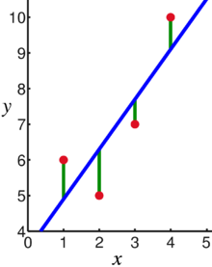
Linear regression = Least squares line (single variable x)
(or hyperplane for multiple variables)
LABELED DATA
Supervised learning
Data: x_{i} = input data with no noise
y_{i} = labels
Find function
f: R → R
f(x) = mx + b
x = independent variable
y = dependent variable
(x, y) → (x, y’)
https://en.wikipedia.org/wiki/Linear_regression

Slide 40
PCA: perturb all variables (x, y) → (x’, y’)
UNLABELED DATA
1st PCA component
= direction of most variance
direction = eigenvector with
largest eigenvalue.
2nd PCA
= direction of 2nd most variance,
perpendicular to first.
direction = eigenvector with
2nd largest eigenvalue.
Modified from
https://en.wikipedia.org/wiki/Linear_regression

Slide 41
Why use PCA in data analysis?
Consider the points (0, 0, …, 0), (1, 0, …, 0), (10, 0, …, 0)
Add noise to first point (0, 0, …, 0) → (0, 1, …, 1)
In R¹⁰⁰, d((0, 1, …, 1), (1, 0, …, 0)) = 10 > 9.
Add small noise to first point (0, 0, …, 0) → (0, 0.1, …, 0.1)
In R^{39,900}, d((0, 0.1, …, 0.1), (1, 0, …, 0)) = 20 > 9.
0 1 10

Slide 42
Why use PCA in data analysis:
Reduce dimension.
Reduce noise.
Visualization.
Fewer variables = less memory (data compression).
Fewer variables = faster computing time (usually).
Possible problem/advantage with PCA in data analysis:
You have changed the basis.
If you find that PCA2 is significant, what does that tell you about the individual features?
Features may be acting together to produce the result.

Slide 43
https://en.wikipedia.org/wiki/Bessel's_correction#Source_of_bias
Too small

Slide 44
Principal Component Analysis: one attribute first
Temperature
42
40
24
30
15
18
15
30
15
30
35
30
40
30
Question: how much spread is in the data along the axis? (distance to the mean)
Variance=Standard deviation^2
www.cse.buffalo.edu/faculty/azhang/data-mining/pca.ppt

Slide 45
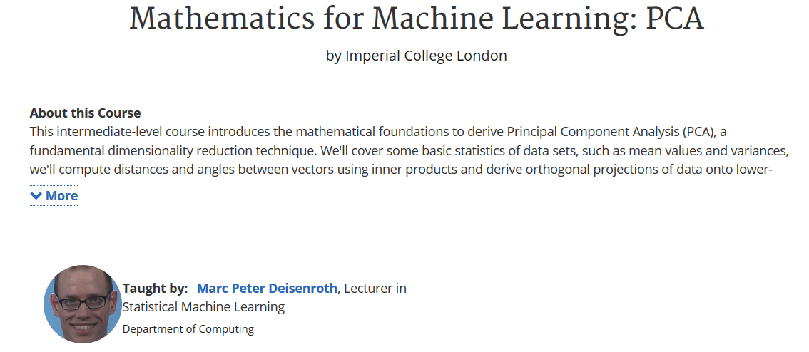
https://www.coursera.org/learn/pca-machine-learning/home/info

Slide 46
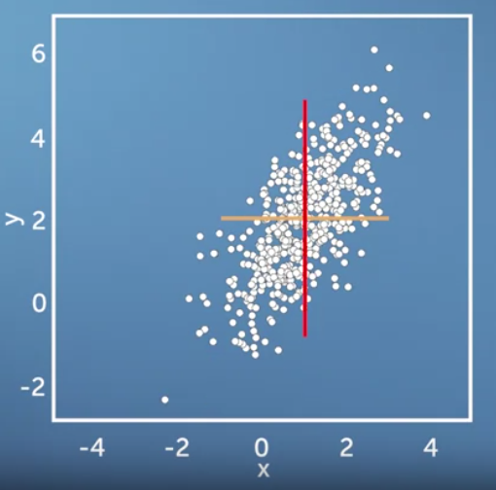
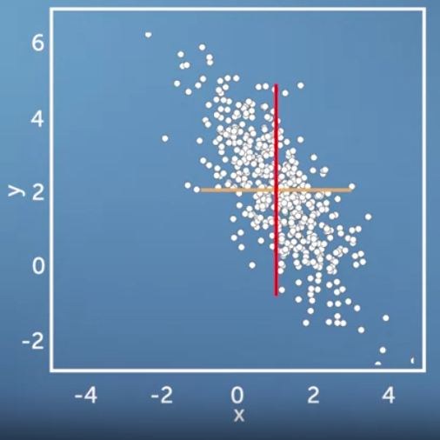
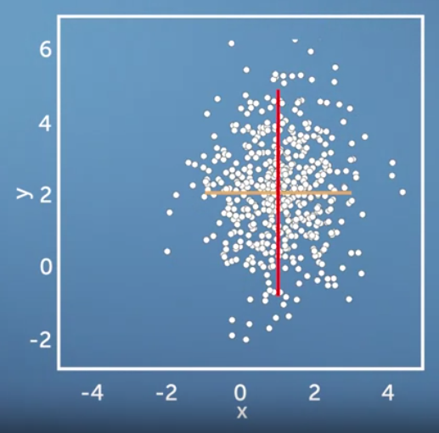
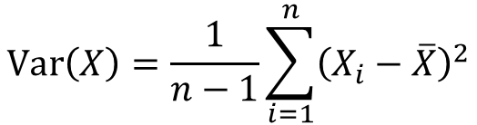
Same variance in x and y direction, but different co-variances
$$\operatorname{Var}\left(X\right)=\frac{1}{n−1}\sum_{i=1}^{n}{{\left(X_{i}−\overline{X}\right)}^{2}}$$
https://www.coursera.org/learn/pca-machine-learning/home/info

Slide 47
Now consider two dimensions
X=Temperature | Y=Humidity
40 | 90
40 | 90
40 | 90
30 | 90
15 | 70
15 | 70
15 | 70
30 | 90
15 | 70
30 | 70
30 | 70
30 | 90
40 | 70
30 | 90
Covariance: measures the correlation between X and Y
cov(X,Y)=0: independent
Cov(X,Y)>0: move same dir
Cov(X,Y)<0: move oppo dir
www.cse.buffalo.edu/faculty/azhang/data-mining/pca.ppt

Slide 48
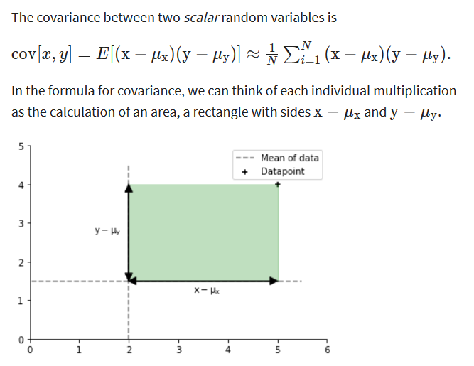
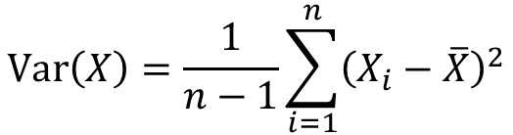
$$\operatorname{Var}\left(X\right)=\frac{1}{n−1}\sum_{i=1}^{n}{{\left(X_{i}−\overline{X}\right)}^{2}}$$
https://www.coursera.org/learn/pca-machine-learning/home/info

Slide 49
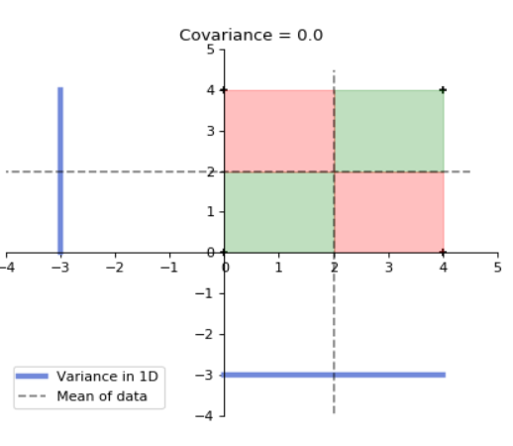
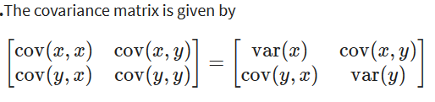
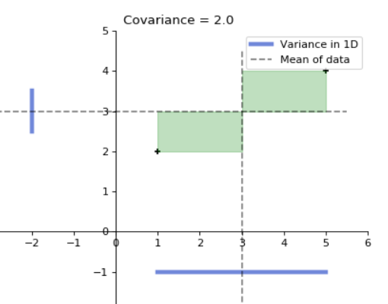
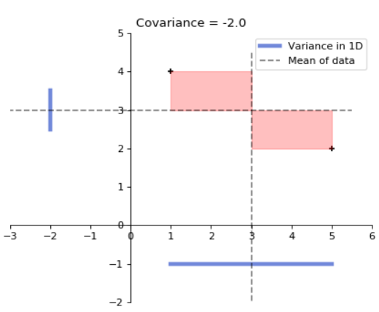
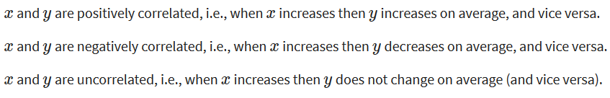
for 4 data points
for 2 data points
for 2 data points
https://www.coursera.org/learn/pca-machine-learning/home/info

Slide 50
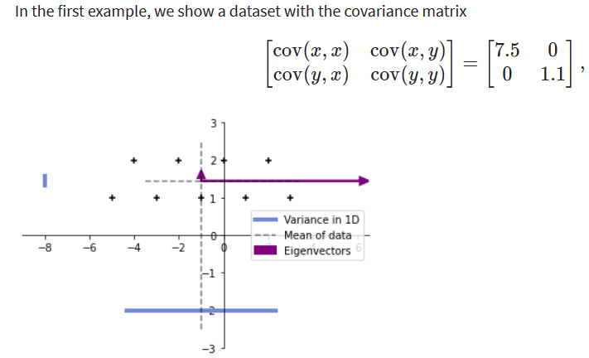


9 data points
$$\operatorname{Var}\left(X\right)=\frac{1}{n}\sum_{i=1}^{n}{{\left(X_{i}−\overline{X}\right)}^{2}}$$
https://www.coursera.org/learn/pca-machine-learning/home/info

Slide 51
More than two attributes: covariance matrix
Contains covariance values between all possible dimensions (=attributes):
Example for three attributes (x,y,z):
dxd
d = dimension
= # of attributes
or features.
www.cse.buffalo.edu/faculty/azhang/data-mining/pca.ppt

Slide 52
https://www.coursera.org/learn/pca-machine-learning/home/info

Slide 53
Eigenvalues
Calculate eigenvalues λ and eigenvectors x for covariance matrix:
Eigenvalues λ_{j} are used for calculation of [% of total variance] (V_{j}) for each component j:
www.cse.buffalo.edu/faculty/azhang/data-mining/pca.ppt

Slide 54
https://www.coursera.org/learn/pca-machine-learning/home/info

Slide 55
for 2 data points
https://www.coursera.org/learn/pca-machine-learning/home/info

Slide 56
Principal components
1. principal component (PC1)
The eigenvalue with the largest absolute value will indicate that the data have the largest variance along its eigenvector, the direction along which there is greatest variation
2. principal component (PC2)
the direction with maximum variation left in data, orthogonal to the 1. PC
In general, only few directions manage to capture most of the variability in the data.
www.cse.buffalo.edu/faculty/azhang/data-mining/pca.ppt

Slide 57
Eigenvalues
Calculate eigenvalues λ and eigenvectors x for covariance matrix:
Eigenvalues λ_{j} are used for calculation of [% of total variance] (V_{j}) for each component j:
www.cse.buffalo.edu/faculty/azhang/data-mining/pca.ppt

Slide 58
Principal components - Variance
www.cse.buffalo.edu/faculty/azhang/data-mining/pca.ppt

Slide 59

A more challenging example
data from research on habitat definition in the endangered Baw Baw frog
16 environmental and structural variables measured at each of 124 sites
correlation matrix used because variables have different units
Philoria frosti
http://www.csce.uark.edu/~xintaowu/5073/PCA1.ppt

Slide 60
Eigenvalues
Axis | Eigenvalue | % of Variance | Cumulative % of Variance
1 | 5.855 | 36.60 | 36.60
2 | 3.420 | 21.38 | 57.97
3 | 1.122 | 7.01 | 64.98
4 | 1.116 | 6.97 | 71.95
5 | 0.982 | 6.14 | 78.09
6 | 0.725 | 4.53 | 82.62
7 | 0.563 | 3.52 | 86.14
8 | 0.529 | 3.31 | 89.45
9 | 0.476 | 2.98 | 92.42
10 | 0.375 | 2.35 | 94.77
http://www.csce.uark.edu/~xintaowu/5073/PCA1.ppt

Slide 61
Interpreting Eigenvectors
 | 1 | 2 | 3
Altitude | 0.3842 | 0.0659 | -0.1177
pH | -0.1159 | 0.1696 | -0.5578
Cond | -0.2729 | -0.1200 | 0.3636
TempSurf | 0.0538 | -0.2800 | 0.2621
Relief | -0.0765 | 0.3855 | -0.1462
maxERht | 0.0248 | 0.4879 | 0.2426
avERht | 0.0599 | 0.4568 | 0.2497
%ER | 0.0789 | 0.4223 | 0.2278
%VEG | 0.3305 | -0.2087 | -0.0276
%LIT | -0.3053 | 0.1226 | 0.1145
%LOG | -0.3144 | 0.0402 | -0.1067
%W | -0.0886 | -0.0654 | -0.1171
H1Moss | 0.1364 | -0.1262 | 0.4761
DistSWH | -0.3787 | 0.0101 | 0.0042
DistSW | -0.3494 | -0.1283 | 0.1166
DistMF | 0.3899 | 0.0586 | -0.0175
correlations between variables and the principal axes are known as loadings
each element of the eigenvectors represents the contribution of a given variable to a component
http://www.csce.uark.edu/~xintaowu/5073/PCA1.ppt

Slide 62
Steps of PCA
Let be the mean vector (taking the mean of all rows)
Adjust the original data by the mean
X’ = X –
Compute the covariance matrix C of adjusted X
Find the eigenvectors and eigenvalues of C.
For matrix C, vectors e (=column vector) having same direction as Ce :
eigenvectors of C is e such that Ce=λe,
λ is called an eigenvalue of C.
Ce=λe ⇔ (C-λI)e=0
Most data mining packages do this for you.
www.cse.buffalo.edu/faculty/azhang/data-mining/pca.ppt

Slide 63


Translate data so mean is at the origin. Let v be a unit vector
https://ekamperi.github.io/mathematics/2020/11/01/principal-component-analysis-lagrange-multiplier.html

Slide 64

https://ekamperi.github.io/mathematics/2020/11/01/principal-component-analysis-lagrange-multiplier.html

Slide 65

https://ekamperi.github.io/mathematics/2020/11/01/principal-component-analysis-lagrange-multiplier.html

Slide 66

By taking the transpose of the first equation since C is symmetric.
https://ekamperi.github.io/mathematics/2020/11/01/principal-component-analysis-lagrange-multiplier.html

Slide 67
Example: Principle component analysis (PCA)
x_{i} → z_{i} = linear combination of x_{i}
http://en.wikipedia.org/wiki/File:GaussianScatterPCA.png

Slide 68


www.stat.columbia.edu/~fwood/Teaching/w4315/Fall2009/pca.pdf

Slide 69

A
A
B
B
A
B
B
A
https://www.kdnuggets.com/2022/10/classification-metrics-walkthrough-logistic-regression-accuracy-precision-recall-roc.html

Slide 70

https://www.math.purdue.edu/~goldberg/Math453/eqi-slides-web.pdf
https://www.kdnuggets.com/2022/10/classification-metrics-walkthrough-logistic-regression-accuracy-precision-recall-roc.html

Slide 71
https://www.kdnuggets.com/2022/10/classification-metrics-walkthrough-logistic-regression-accuracy-precision-recall-roc.html

