Slide 1
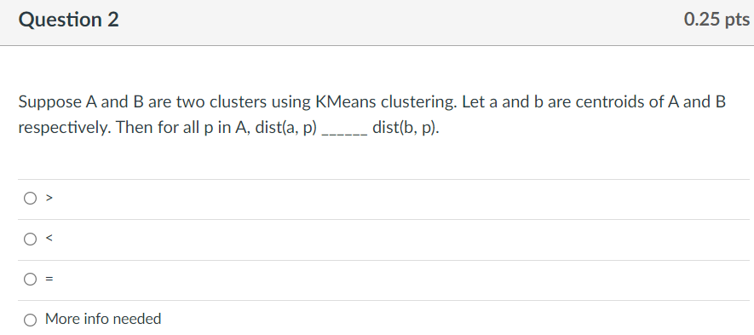
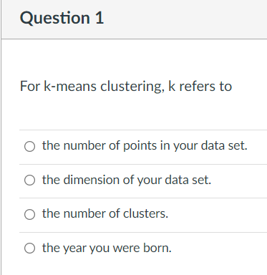

Slide 2
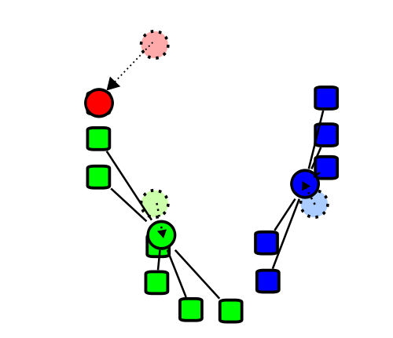
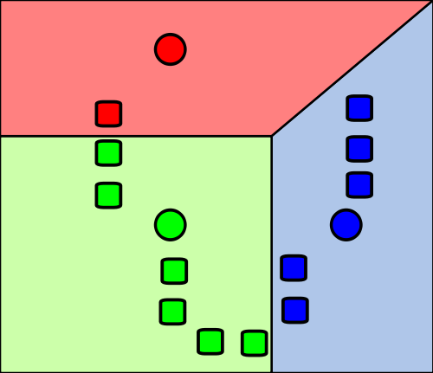
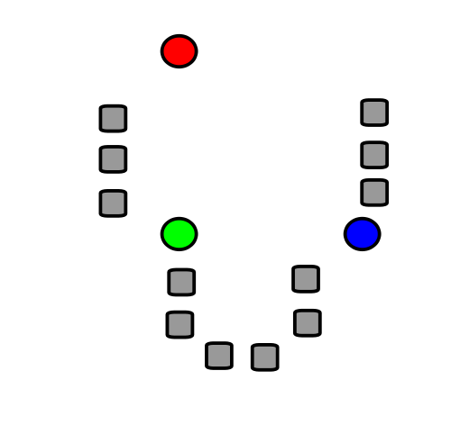
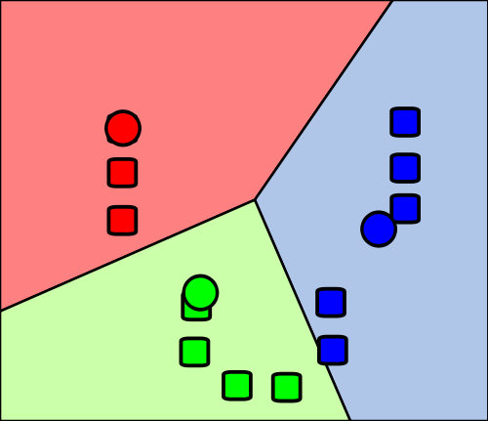
Re-partition data set into 3 voronoi cells corresponding to the 3 centroids
Repeat
Figure modified from https://en.wikipedia.org/wiki/File:K_Means_Example_Step_1.svg

Slide 3
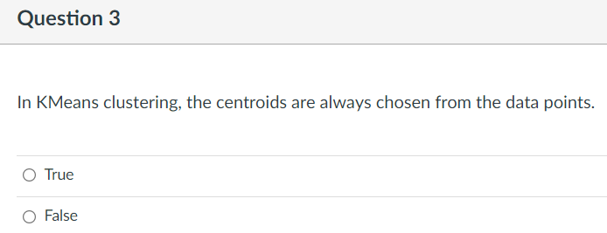
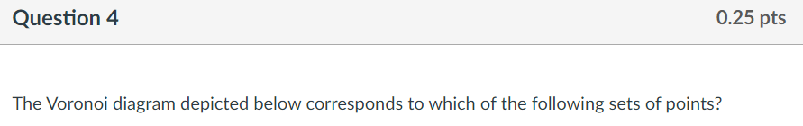
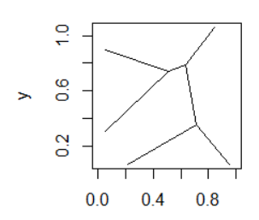
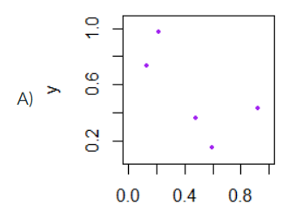

Slide 4
k-means clustering
k = desired number of clusters
Data set = boxes. Let k = 3.
Randomly choose 3 points (circles) to partition data set into 3 voronoi cells corresponding to randomly chosen points (points need not be in data set)
Re-partition data set into 3 voronoi cells corresponding to the 3 centroids
Repeat
Figure modified from https://en.wikipedia.org/wiki/File:K_Means_Example_Step_1.svg

Slide 5
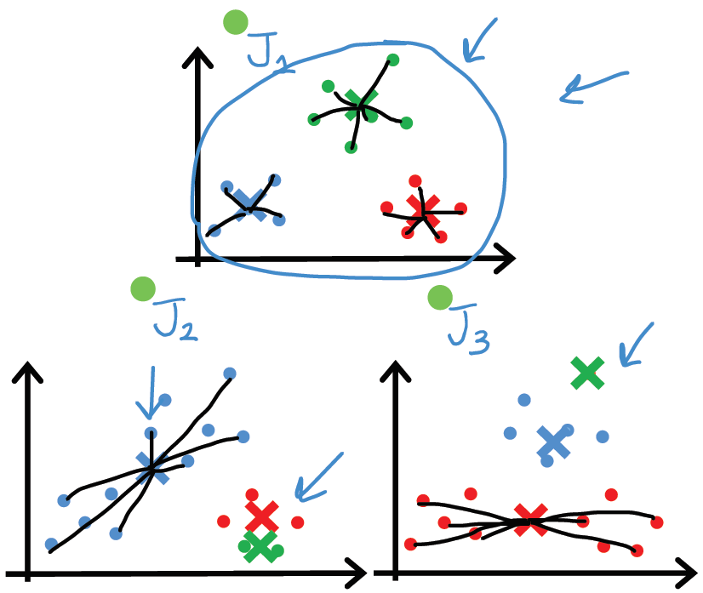
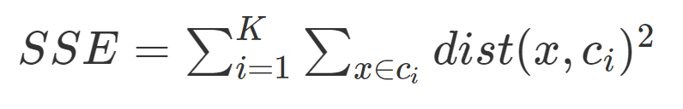
Depending on initial choice of points, can get stuck in a local minimum:
In practice run k-means 50 – 1000 times, and then choose optimal clustering
https://www.deeplearning.ai/courses/machine-learning-specialization/

Slide 6
x
x
x
x
How many clusters?
x
x
x
x
x
x
x
x
x
x
x
x
x
x
x
x
x
x
x
x
x
x
x
x
x
x
x
x
x
x
x
x
x
x
x
x
x
x
x
x
x
x
x
x
x
x
x
x
x
x
x
x
x
x
x
x
x
x
x
x

Slide 7
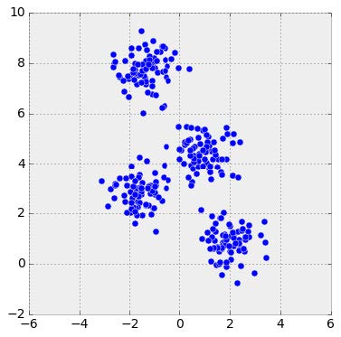
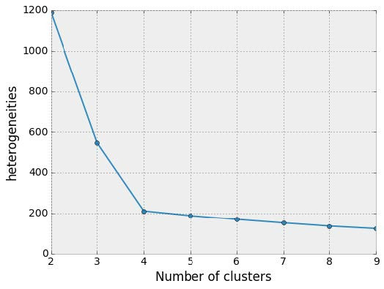
Choosing k:
Elbow method
http://sites.northwestern.edu/msia/2016/12/
08/k-means-shouldnt-be-our-only-choice/

Slide 8
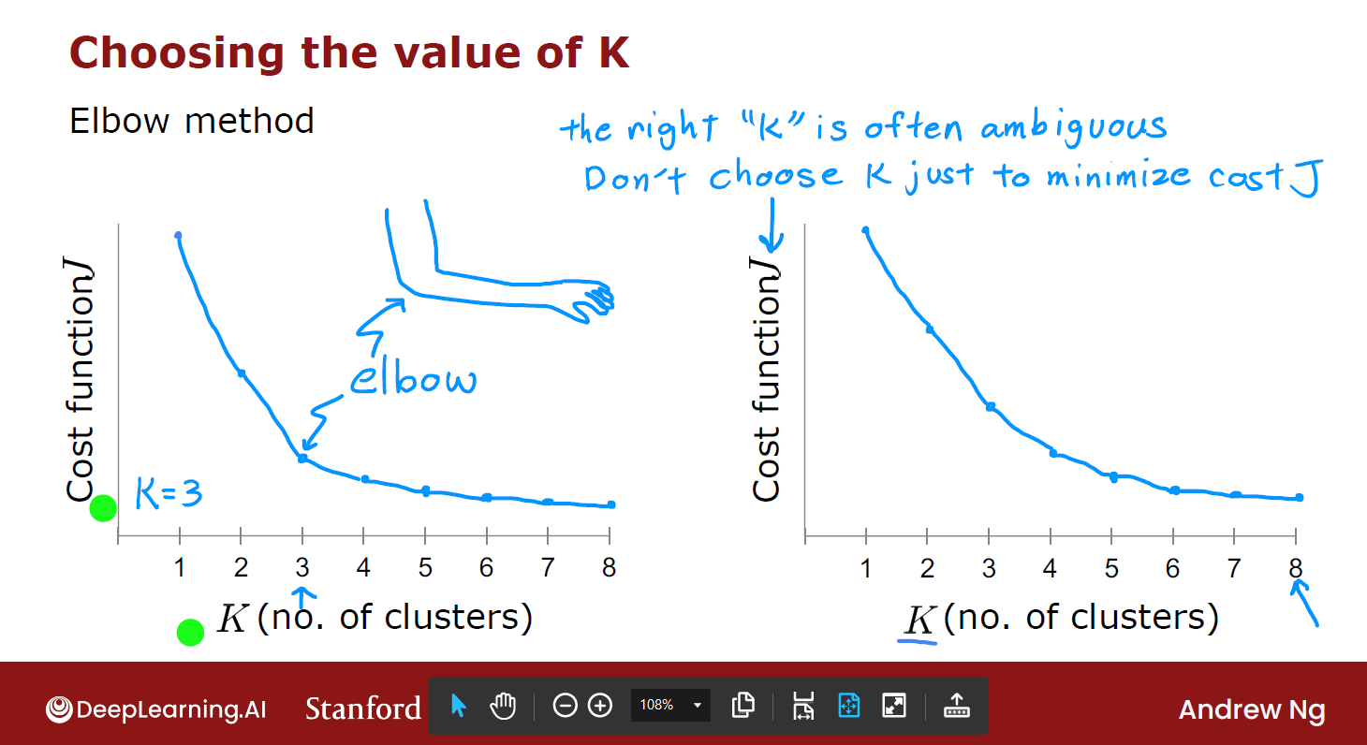
https://www.deeplearning.ai/courses/machine-learning-specialization/

Slide 9
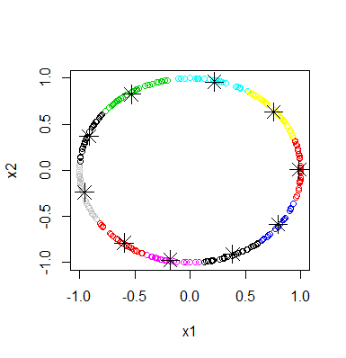
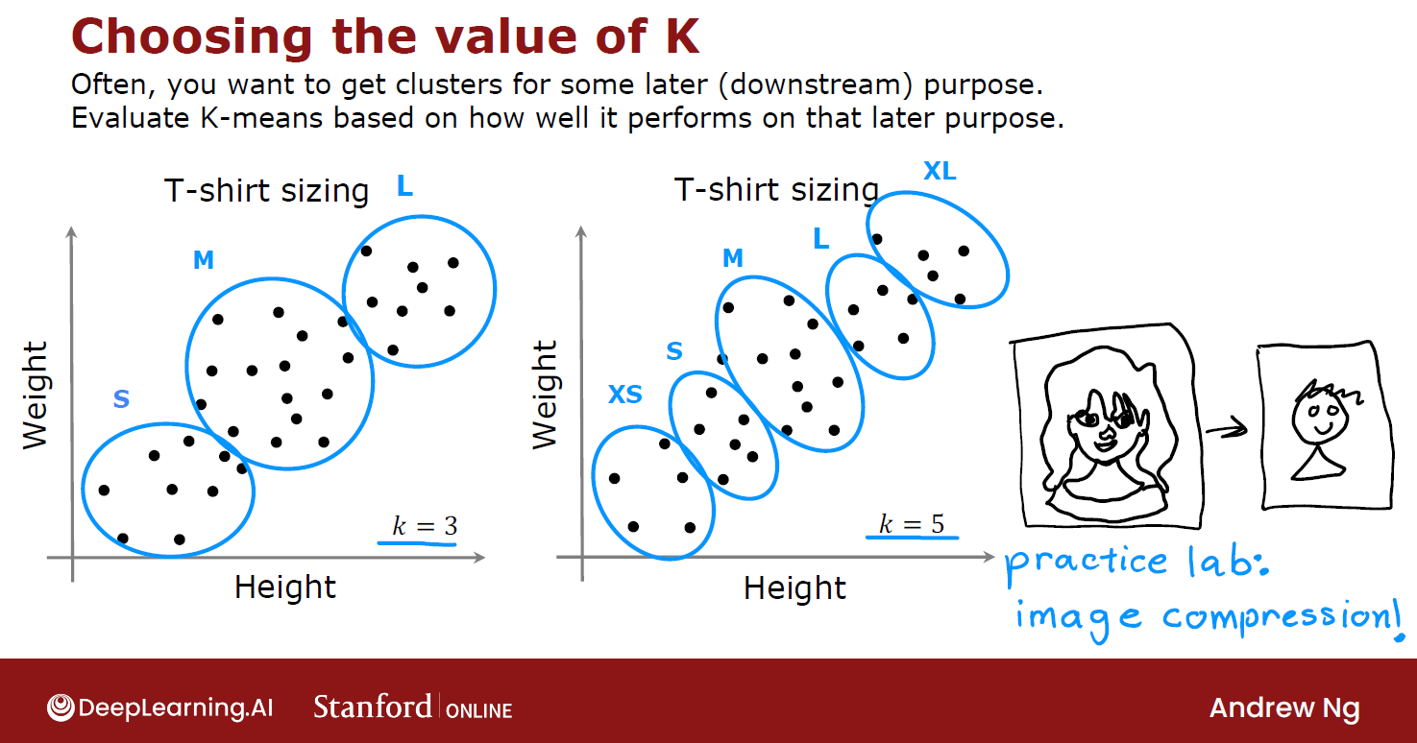
https://www.deeplearning.ai/courses/machine-learning-specialization/

Slide 10
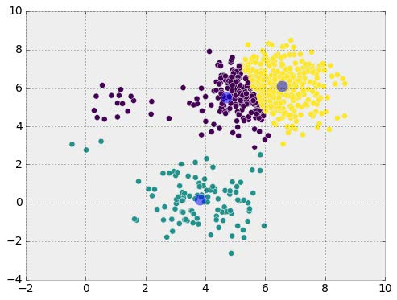

Clusters are not normally distributed around their centroids
Many algorithms work best with normal distributions. But often data does NOT follow a normal distribution
https://commons.wikimedia.org/wiki/File:Standard_deviation_diagram.svg

Slide 11
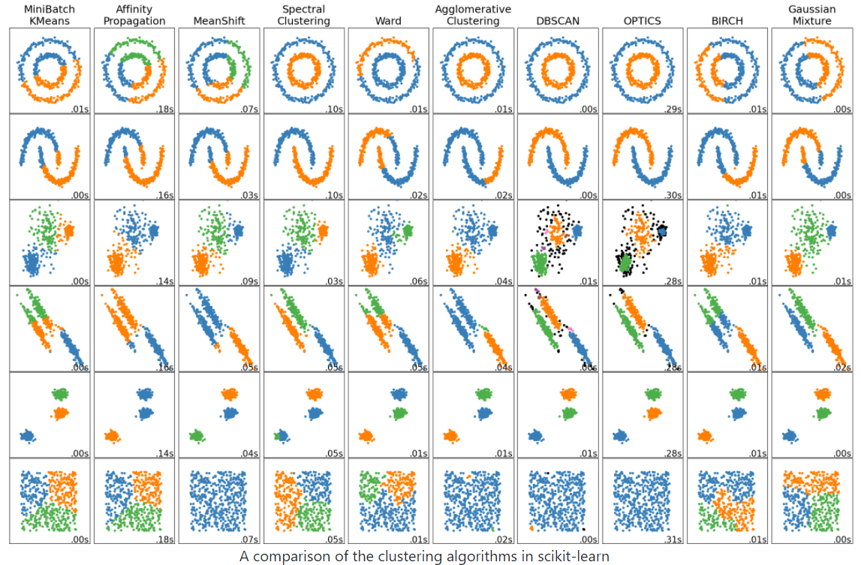
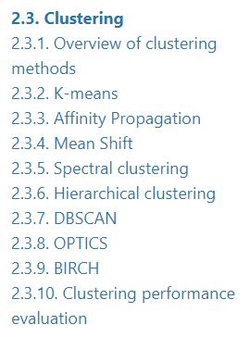
http://scikit-learn.org/stable/auto_examples/cluster/plot_cluster_comparison.html
Maybe start with: Ward’s linkage hierarchical clustering, k-means, etc.
2.3. Clustering — scikit-learn 1.2.2 documentation

Slide 12
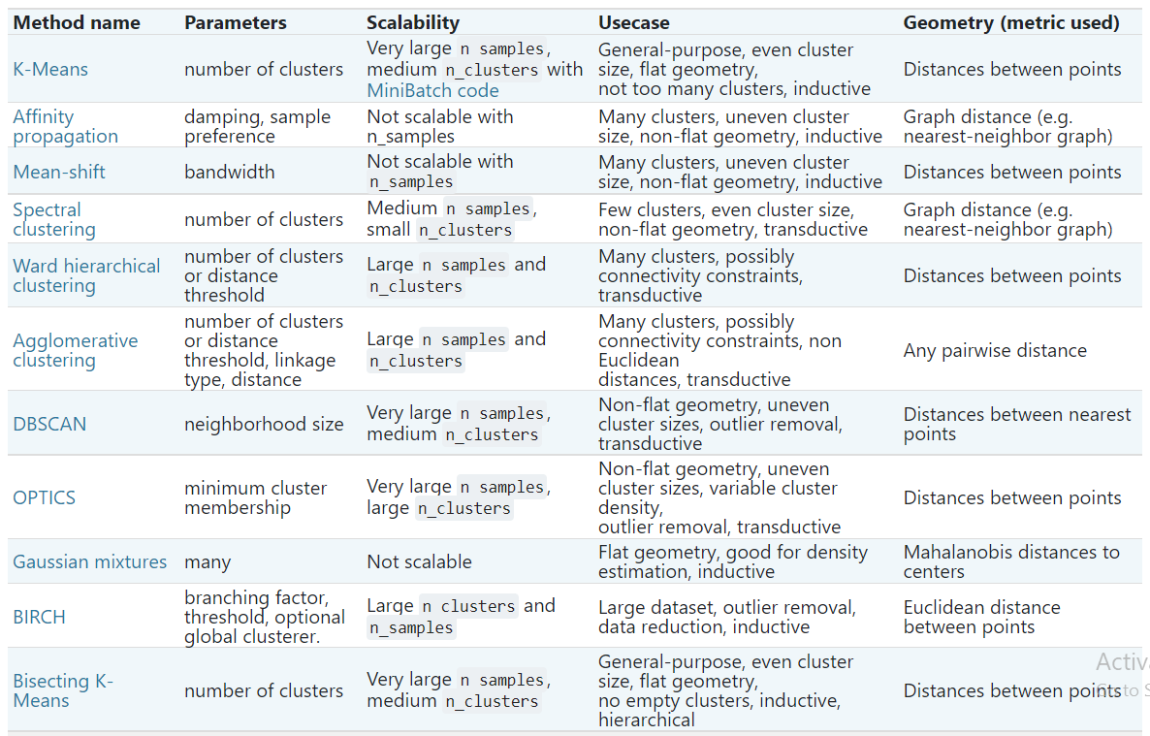
Maybe start with: Ward’s linkage hierarchical clustering, k-means, etc.
2.3. Clustering — scikit-learn 1.2.2 documentation

Slide 13
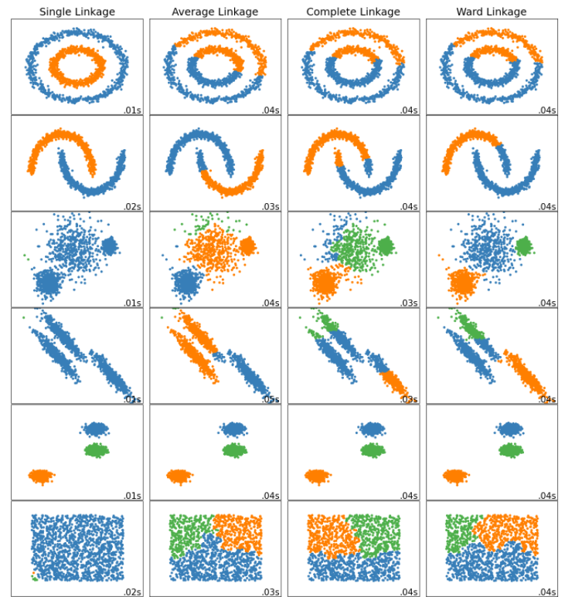
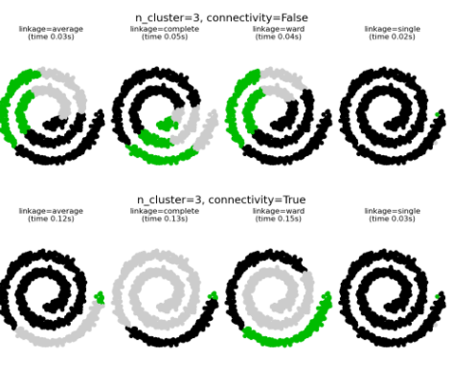
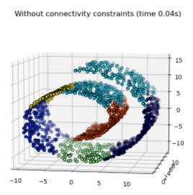
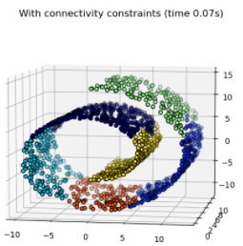
Ward minimizes the sum of squared differences within all clusters. It is a variance-minimizing approach and in this sense is similar to the k-means objective function but tackled with an agglomerative hierarchical approach.
Warning: Connectivity constraints with single, average and complete linkage can enhance the ‘rich getting richer’…

Slide 14
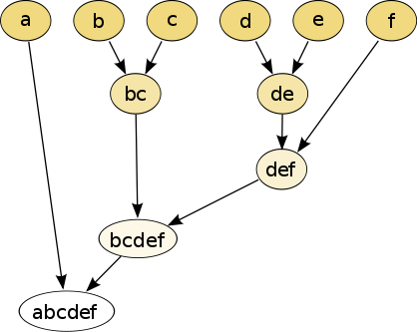
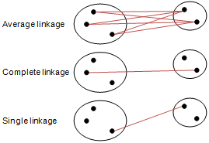
Different type of hierarchical clustering
What is the distance between 2 clusters?
http://en.wikipedia.org/wiki/File:Hierarchical_clustering_simple_diagram.svg
http://www.multid.se/genex/hs515.htm

Slide 15
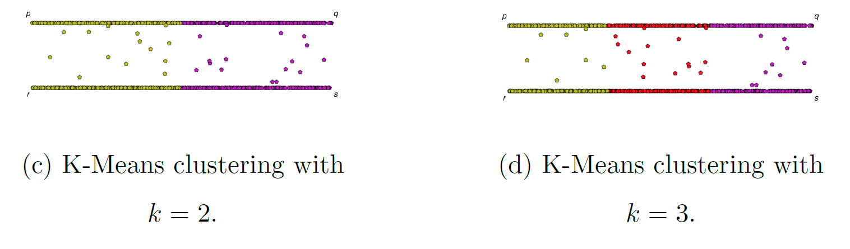
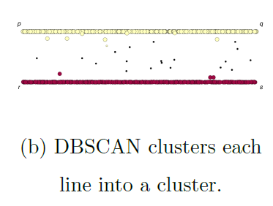
If you care about closeness:
Complete linkage
Average linkage
Ward’s linkage
K-means
If you care about connected components:
  Single linkage
  DBscan
Figures courtesy of Wako Bungula

Slide 16
Examples of unsupervised learning:
PCA
Clustering
since NO labels
Lab 2: Clustering (labels not needed)
Example of supervised learning:
Lab 3: Linear regression (labels needed)
In lab 3, we will do 1-variable linear regression.
Thus you will choose one variable column and the label column.

Slide 17
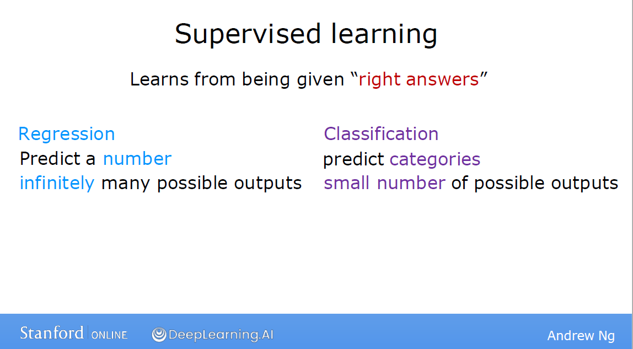
https://www.deeplearning.ai/courses/machine-learning-specialization/
See also Coursera
Currently using python (but octave material is still available).

Slide 18
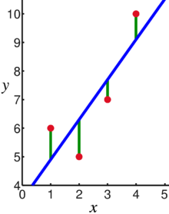
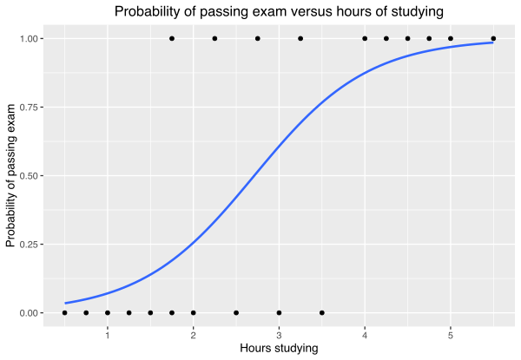
Supervised Learning: Use labeled data to predict unlabeled data.
2 types of supervised learning:
Regression: Predict continuous values.
    Ex: Linear regression.
F(x_{new}) = b₀ + b₁x_{new}
2. Classification: Predict discrete values.
    Ex: Logistic regression
https://en.wikipedia.org/wiki/Linear_regression
https://en.wikipedia.org/wiki/Logistic_regression

Slide 19
Supervised Learning: Use labeled data to predict unlabeled data.
2 types of supervised learning:
Regression: Predict continuous LABELS.
    Ex: Linear regression.
F(x_{new}) = b₀ + b₁x_{new}
2. Classification: Predict discrete LABELS.
    Ex: Logistic regression
https://en.wikipedia.org/wiki/Linear_regression
What are your labels?
https://en.wikipedia.org/wiki/Logistic_regression

Slide 20
Linear regression = Least squares line (single variable x)
(or hyperplane for multiple variables)
Supervised learning
Data: x_{i} = input data with no noise
y_{i} = labels
Find function
f: R → R
f(x) = mx + b
x = independent variable
y = dependent variable
(x, y) → (x, y’)
https://en.wikipedia.org/wiki/Linear_regression

Slide 21
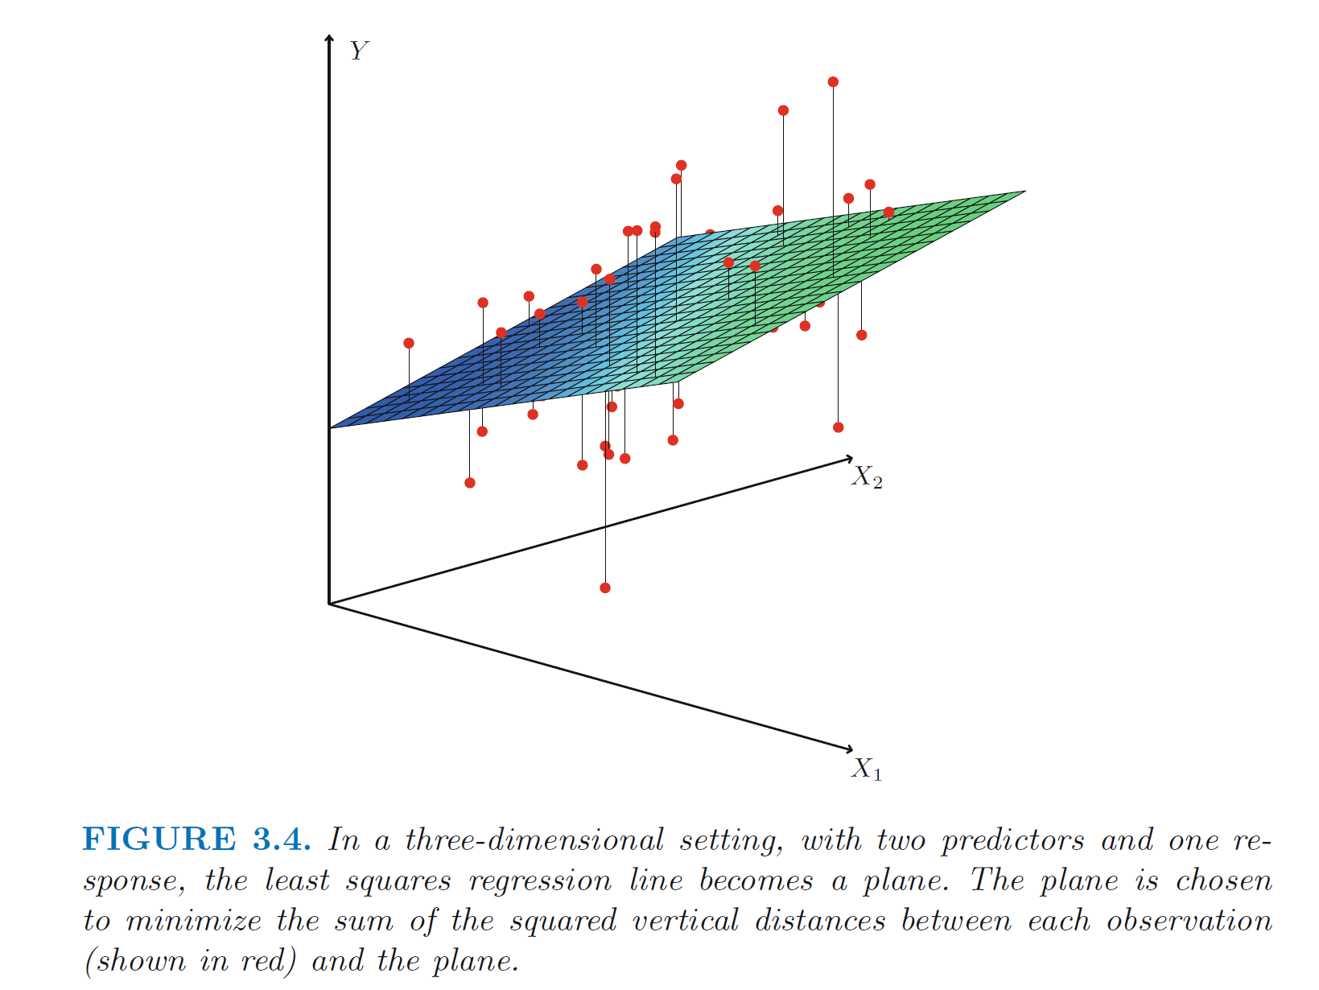
https://en.wikipedia.org/wiki/Linear_regression
https://www.statlearning.com/

Slide 22
PCA: perturb all variables (x, y) → (x’, y’)
1st PCA component (purple line)
= direction of most variance
direction = eigenvector with
largest eigenvalue.
= best fit line, but using
perpendicular distance
Not the same line as 1 variable
linear regression line (blue).
2nd PCA (not needed in this example since data is 2D)
= direction of 2nd most variance,
perpendicular to first.
direction = eigenvector with
2nd largest eigenvalue.
PCA hyperplane not the same plane as multivariable regression hyperplane.
Modified from
https://en.wikipedia.org/wiki/Linear_regression

Slide 23
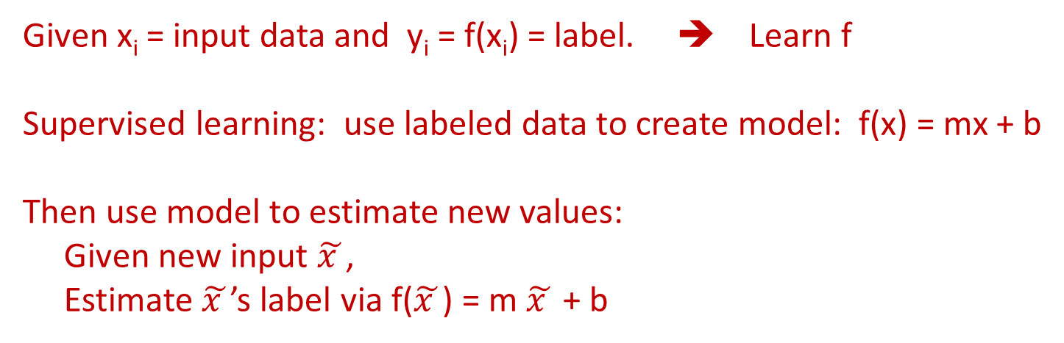
Linear regression (Supervised learning)
Given x_{i} = input data and y_{i} = f(x_{i}) = label. ➔ Learn f
Supervised learning: use labeled data to create model: f(x) = mx + b
Then use model to estimate new values:
Given new input $\tilde{x }$,
Estimate $\tilde{x }$’s label via f($\tilde{x }$) = m $\tilde{x }$ + b
https://en.wikipedia.org/wiki/Linear_regression

Slide 24




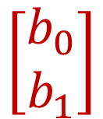


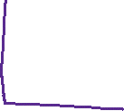

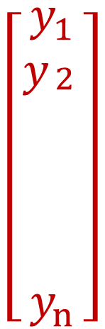



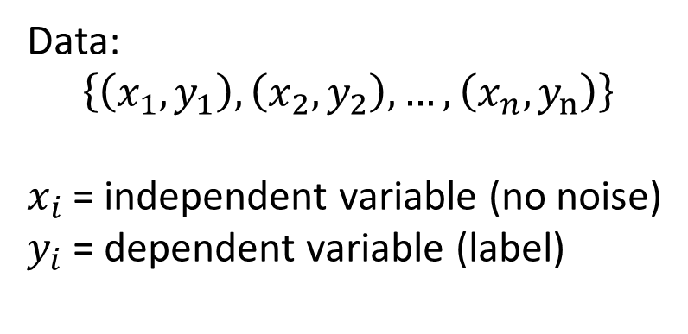


Solve
$$b_{0}+b_{1}x_{1}=y_{1}$$
$$1 x_{1}$$
$$\left[\begin{matrix}y_{1} \\ y_{\begin{aligned}2 \\ \\ \\ \\ \\ \end{aligned}} \\ y_{n}\end{matrix}\right]$$
$$b_{0}+b{1x}_{2}=y_{2}$$
$$1 x_{2}$$
$$\left[\begin{matrix}b_{0} \\ b_{1}\end{matrix}\right]$$
=
$$b_{0}+b_{1}x_{n}=y_{n}$$
$$1 x_{n}$$
Data:
$$\left\{\left(x_{1},y_{1}\right),\left(x_{2},y_{2}\right), …,\left(x_{n},y_{n}\right)\right\}$$
$x_{i}$= independent variable (no noise)
$y_{i}$= dependent variable (label)
Too many equations, so find best solution
= least squares solution

Slide 25
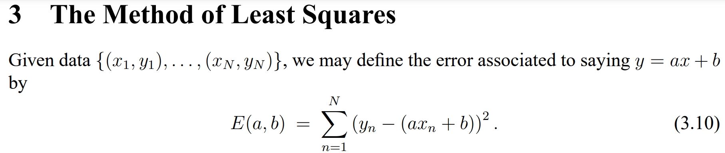
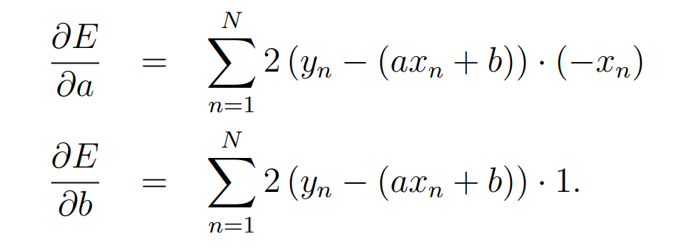
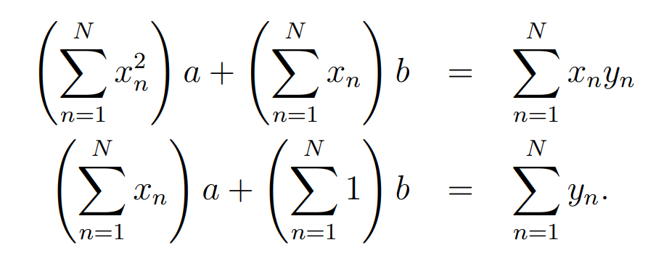
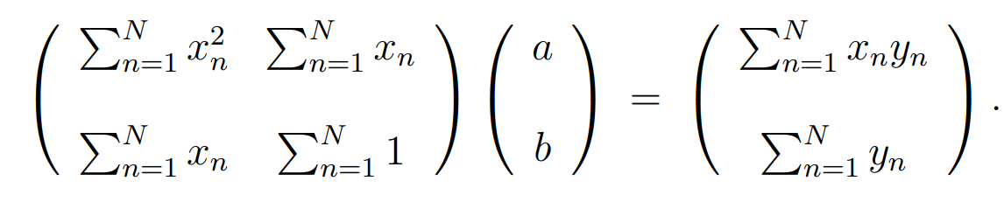
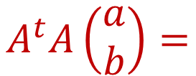

E = RSS = residual sum of squared errors = SSE = sum of squared errors.
= 0 ➔
= 0 ➔
$$A^{t}A\left(\begin{matrix}a \\ b\end{matrix}\right)=$$
$${=A}^{t}\vec{y}$$
https://web.williams.edu/Mathematics/sjmiller/public_html/BrownClasses/54/handouts/MethodLeastSquares.pdf

Slide 26
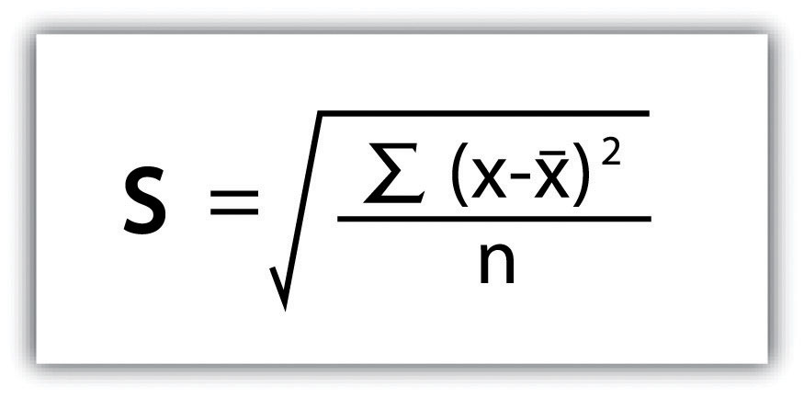
Find the Equation of a Linear Regression Line
The equation is determined by:
  b₀: y-intercept
  b₁: slope
Values that satisfy the least squares criterion:
Standard deviation
-1
Variance = sd
2

Slide 27
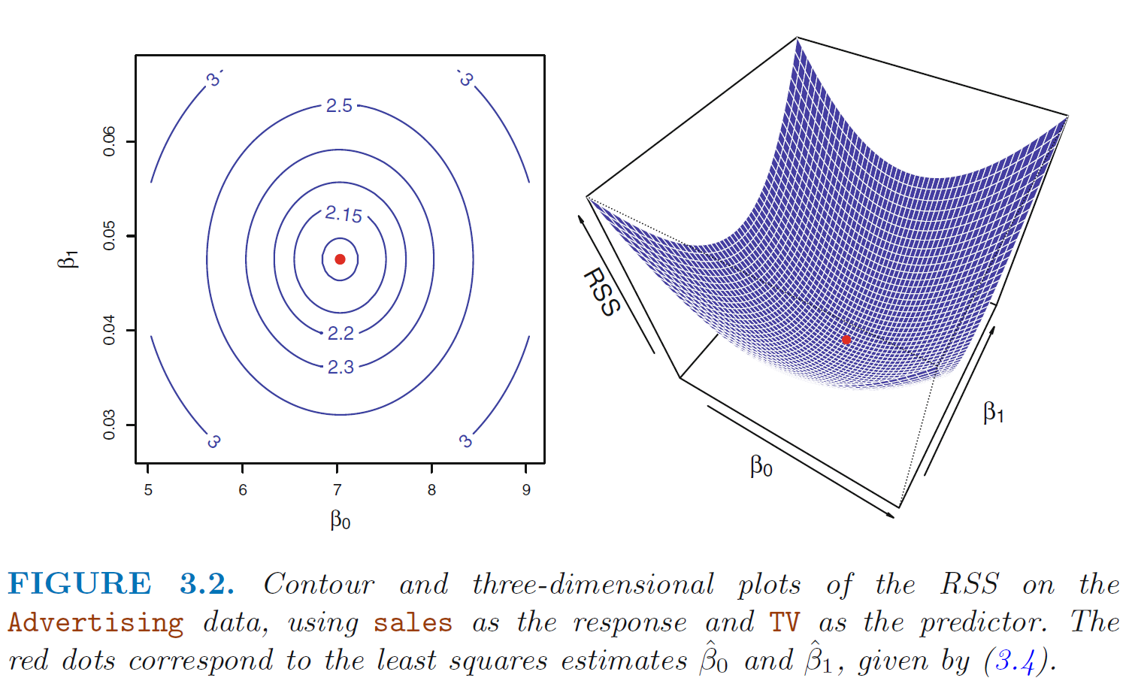
https://www.statlearning.com/

Slide 28
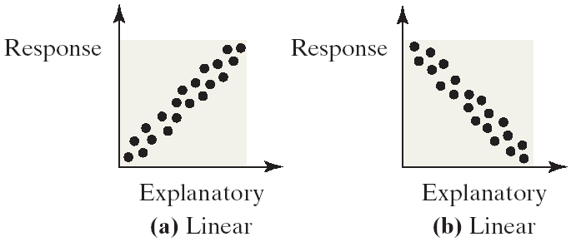
Linear Correlations
Linear relations or linear correlations have points that cluster around a line
Linear relations can be either positive (the points slants upwards to the right) or negative (the points slant downwards to the right)
https://emunix.emich.edu/~schu/MATH_170/Fall09_170/Evening%20session/Unit%203.ppt

Slide 29
Please Note
The slope b₁ represents
the predicted change in y per unit increase in x
The y-intercept is the value of y where the line of best fit intersects the y-axis. That is, it is the predicted value of y when x is zero.
The line of best fit will always pass through the point

Slide 30
6533
0
No data
The intercept is b₀ = 6533.
This is the slope of the line.
For each additional mile on the odometer,
the price decreases by an average of $0.0312
Do not interpret the intercept as the
“Price of cars that have not been driven”
https://web.stanford.edu/class/msande247s/kchap17.ppt

Slide 31
Please Note
Perfect positive correlation: all the points lie along a line with positive slope
Perfect negative correlation: all the points lie along a line with negative slope
If the points lie along a horizontal or vertical line: no correlation
If the points exhibit some other nonlinear pattern: nonlinear relationship
Need some way to measure the strength of correlation

Slide 32
Coefficient of determination
https://web.stanford.edu/class/msande247s/kchap17.ppt
RSS = SSE is very affected by outliers, thus use
  When we want to measure the strength of the linear relationship, we use the coefficient of determination.

Slide 33
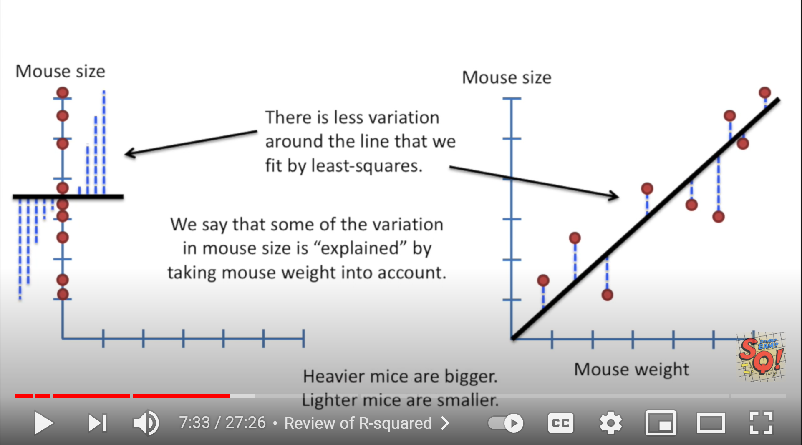
StatQuest: Linear Models Pt.1 - Linear Regression https://www.youtube.com/watch?v=nk2CQITm_eo

Slide 34
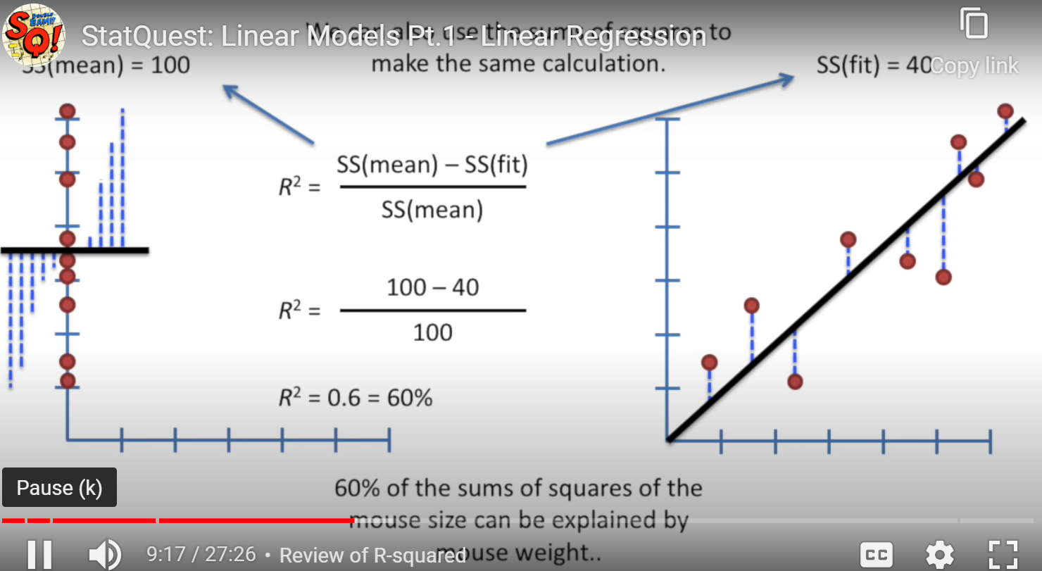

Slide 35
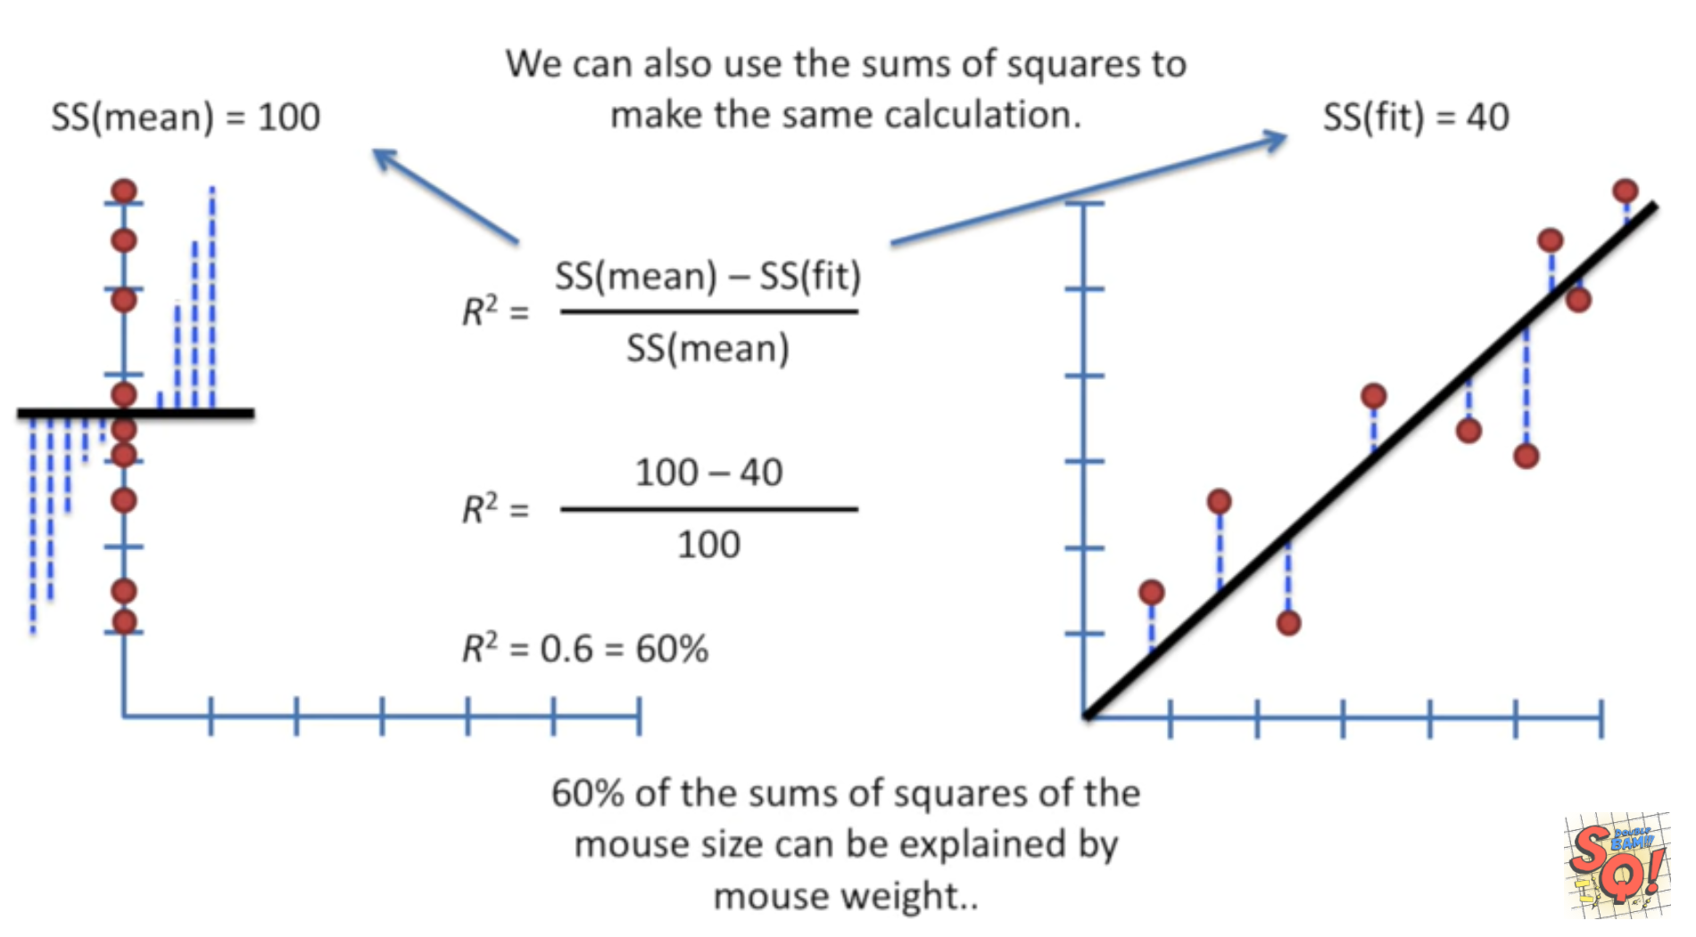
StatQuest: Linear Models Pt.1 - Linear Regression https://www.youtube.com/watch?v=nk2CQITm_eo

Slide 36
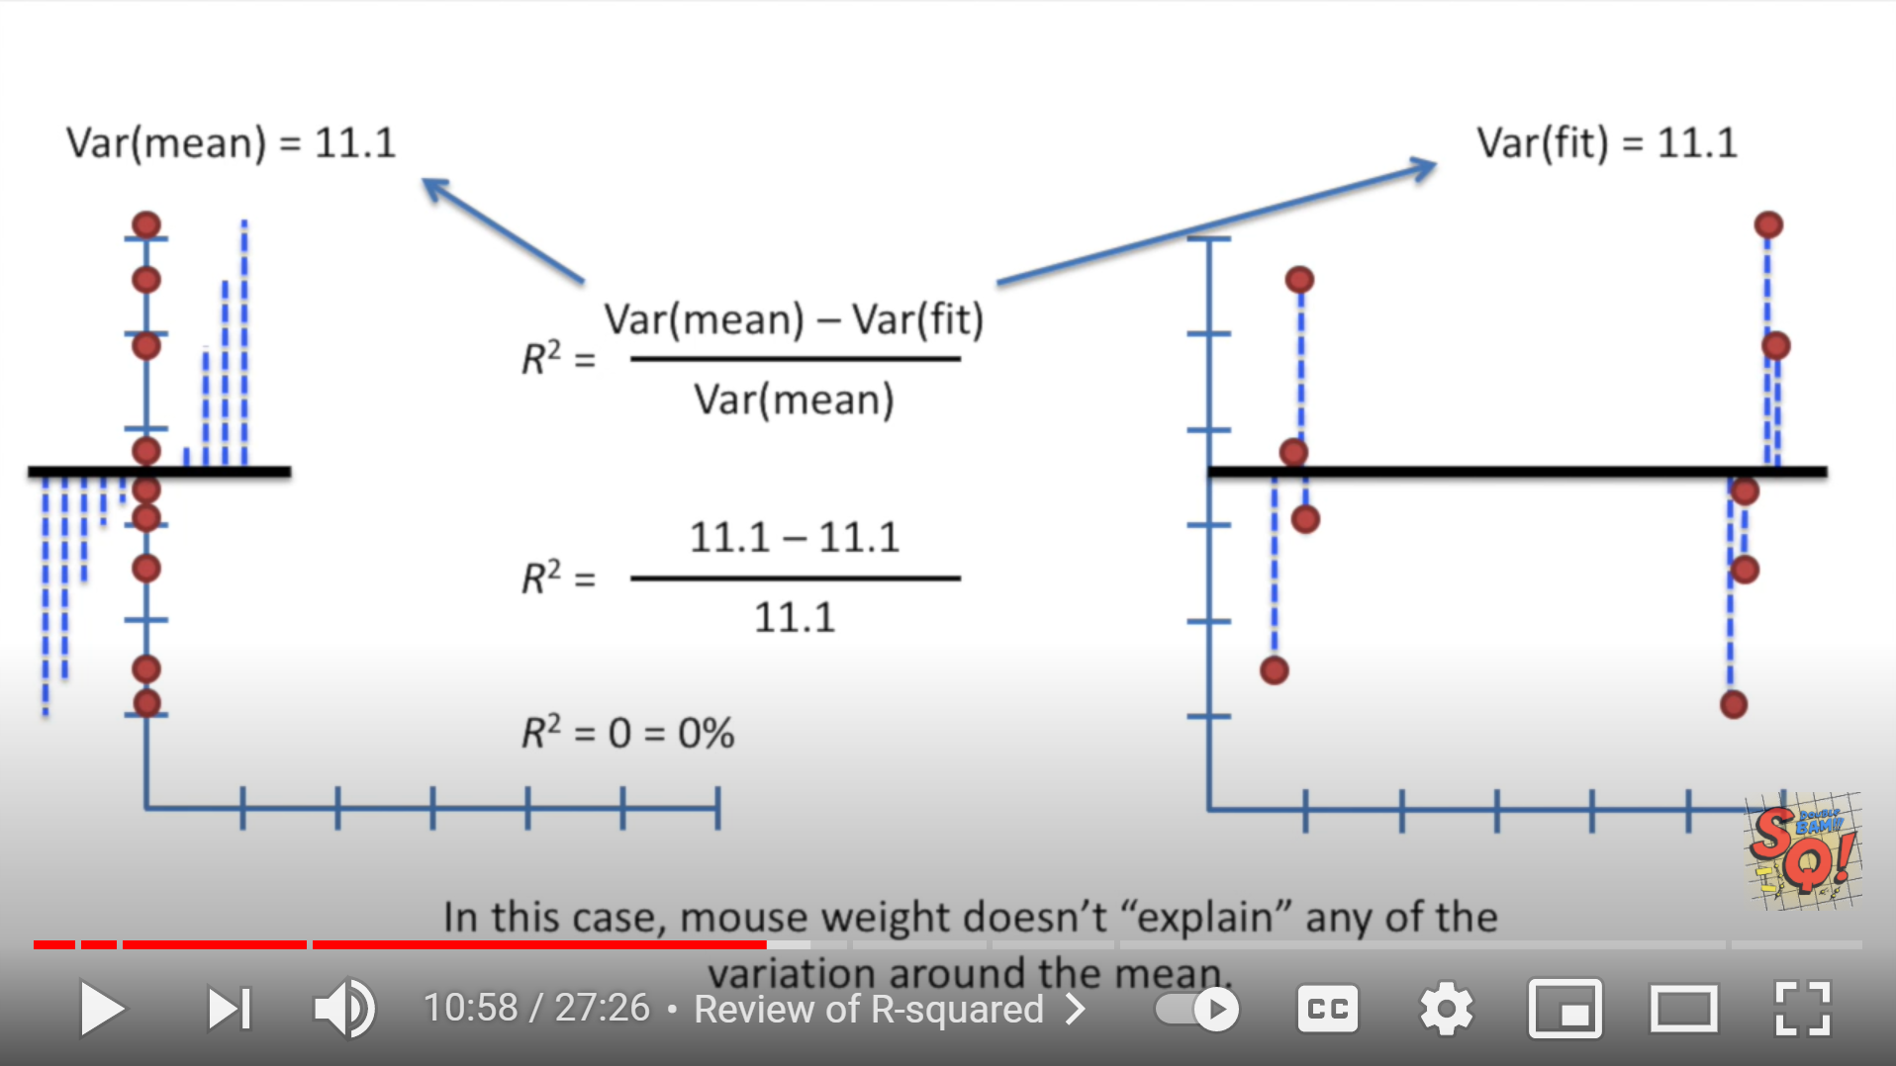
StatQuest: Linear Models Pt.1 - Linear Regression https://www.youtube.com/watch?v=nk2CQITm_eo

Slide 37

StatQuest: Linear Models Pt.1 - Linear Regression https://www.youtube.com/watch?v=nk2CQITm_eo

Slide 38

StatQuest: Linear Models Pt.1 - Linear Regression https://www.youtube.com/watch?v=nk2CQITm_eo

Slide 39

Suppose you only have 2 data points:
StatQuest: Linear Models Pt.1 - Linear Regression https://www.youtube.com/watch?v=nk2CQITm_eo

Slide 40

StatQuest: Linear Models Pt.1 - Linear Regression https://www.youtube.com/watch?v=nk2CQITm_eo

Slide 41
Lurking Variable
Sometimes it is not clear which variable is the explanatory variable and which is the response variable
Sometimes the two variables are related without either one being an explanatory variable
Sometimes the two variables are both affected by a third variable, a lurking variable, that had not been included in the study
https://emunix.emich.edu/~schu/MATH_170/Fall09_170/Evening%20session/Unit%203.ppt

Slide 42
Example 1
An example of a lurking variable
A researcher studies a group of elementary school children
  Y = the student’s height
  X = the student’s shoe size
It is not reasonable to claim that shoe size causes height to change
The lurking variable of age affects both of these two variables
https://emunix.emich.edu/~schu/MATH_170/Fall09_170/Evening%20session/Unit%203.ppt

Slide 43
More Examples
Some other examples
Rainfall amounts and plant growth
  Explanatory variable – rainfall
  Response variable – plant growth
  Possible lurking variable – amount of sunlight
Exercise and cholesterol levels
  Explanatory variable – amount of exercise
  Response variable – cholesterol level
  Possible lurking variable – diet
https://emunix.emich.edu/~schu/MATH_170/Fall09_170/Evening%20session/Unit%203.ppt

Slide 44
Find the Equation of a Linear Regression Line
The equation is determined by:
  b₀: y-intercept
  b₁: slope
Values that satisfy the least squares criterion:

