Slide 1
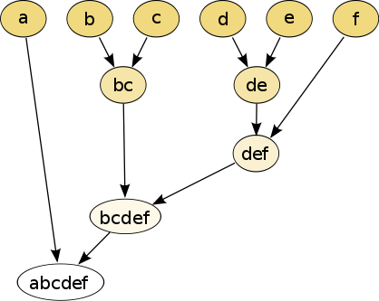
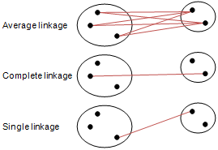
Different type of hierarchical clustering
What is the distance between 2 clusters?
http://en.wikipedia.org/wiki/File:Hierarchical_clustering_simple_diagram.svg
http://www.multid.se/genex/hs515.htm

Slide 2
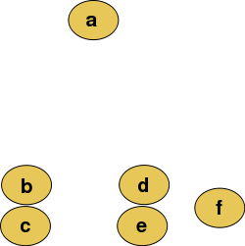
Increasing threshold
Connect vertices (or clusters) whose distance is less than a given threshold

Slide 3
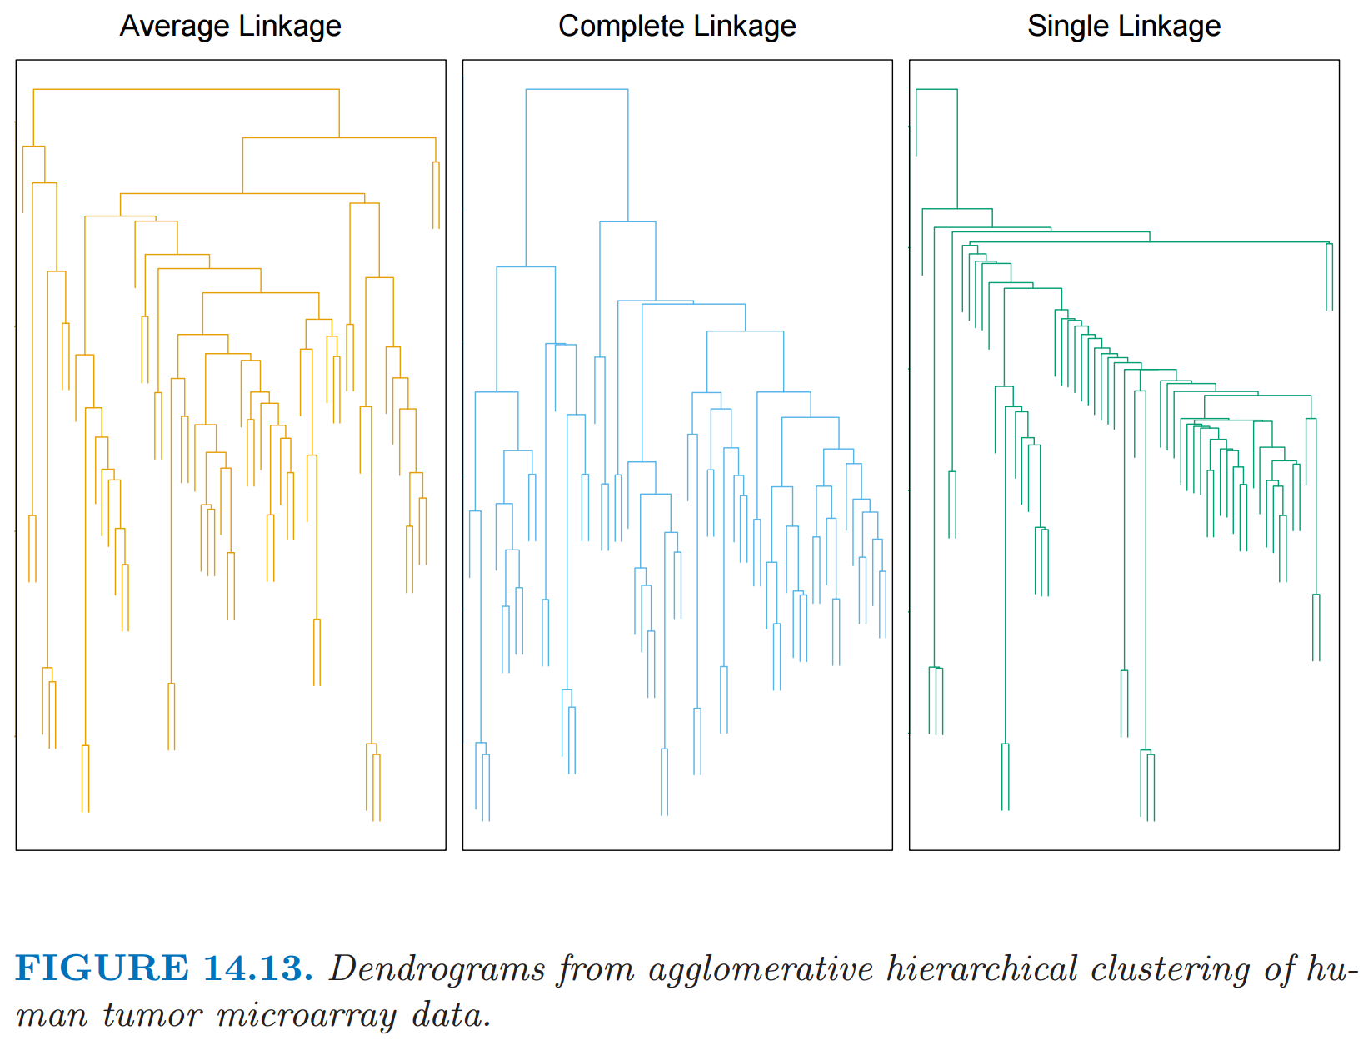
http://statweb.stanford.edu/~tibs/ElemStatLearn/
The Elements of Statistical Learning (2nd edition) Hastie, Tibshirani and Friedman

Slide 4
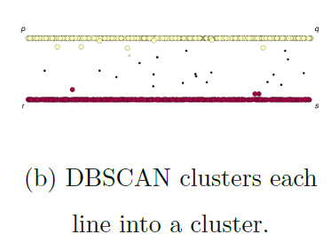
If you care about closeness:
Complete linkage
Average linkage
Ward’s linkage
K-means
If you care about connected components:
Single linkage
DBscan
Figures courtesy of Wako Bungula

Slide 5
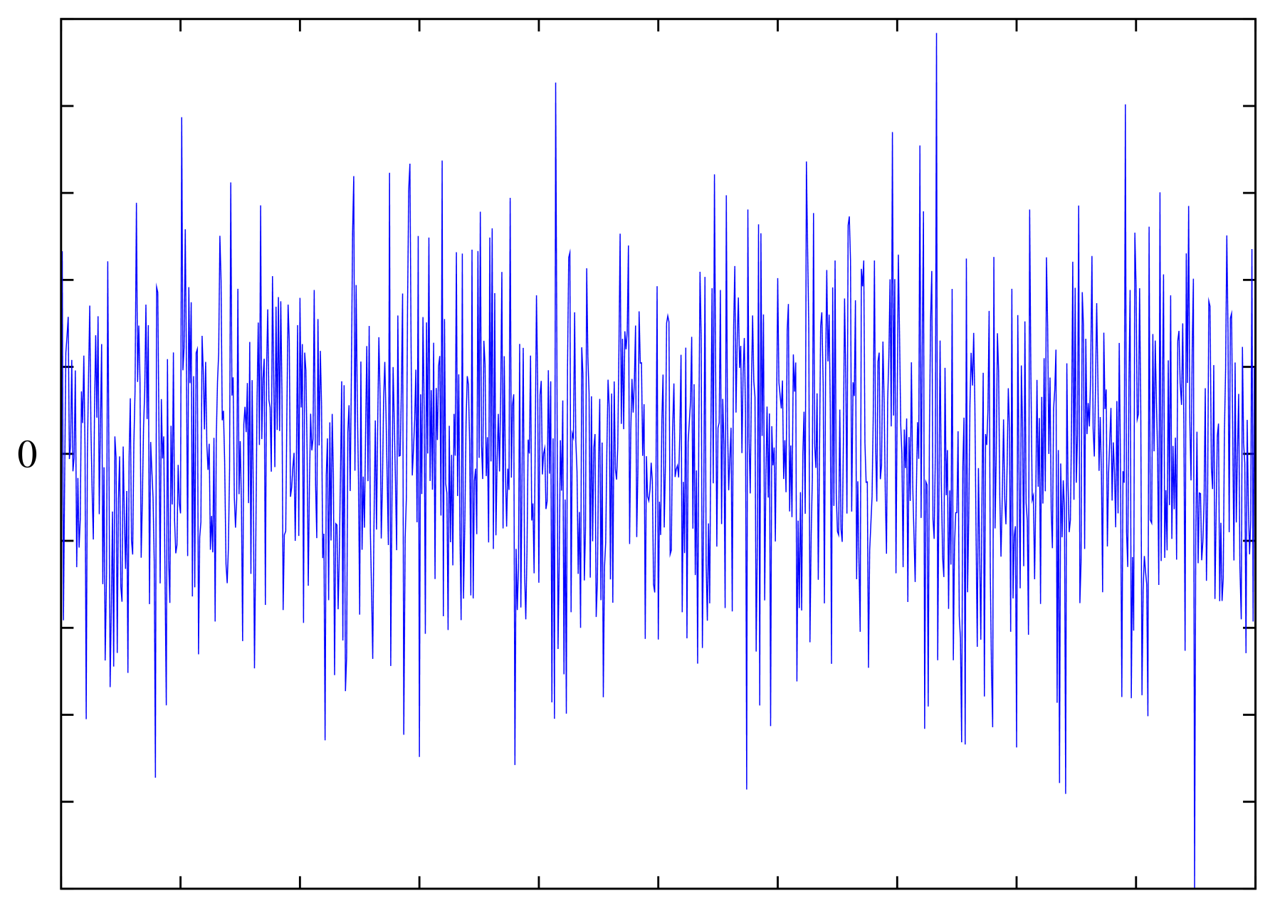
Background noise
Examples: images
and sound
Supercoiled DNA-directed knotting by T4 topoisomerase.
Wasserman SA, Cozzarelli NR. J Biol Chem. 1991
Can also have extra spikes or missing spikes in neuronal and heartbeat data.
https://upload.wikimedia.org/wikipedia/commons/d/d6/White-noise.png

Slide 6
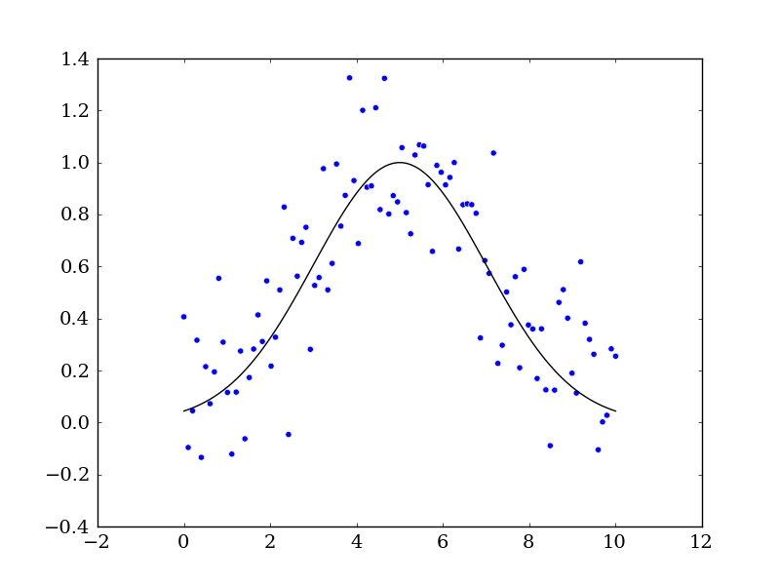
Simple Gaussian We will generate fake data first and compare it to the real data:
import numpy as np
from scipy.optimize import curve_fit
import matplotlib.pyplot as mpl
# Let's create a function to model and create data
def func(x, a, x0, sigma):
return a*np.exp(-(x-x0)**2/(2*sigma**2))
# Generating clean data
x = np.linspace(0, 10, 100)
y = func(x, 1, 5, 2)
# Adding noise to the data
yn = y + 0.2 * np.random.normal(size=len(x))
# Plot out the current state of the data and model
fig = mpl.figure()
ax = fig.add_subplot(111)
ax.plot(x, y, c='k', label='Function')
ax.scatter(x, yn)
fig.savefig('model_and_noise.png')
From https://python4esac.github.io/fitting/examples1d.html
# Generates 100 points between 0 and 10 (no noise)
# y = $1ⅇ^{−{{\left(x−5\right)}^{2}}/{\left(2⋅2^{2}\right)}}$
# Add noise to y (not x)

Slide 7
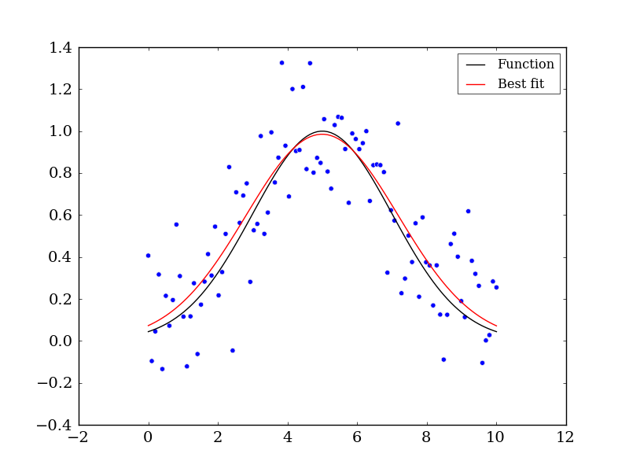
Simple Gaussian We will generate fake data first and compare it to the real data:
# Executing curve_fit on noisy data
popt, pcov = curve_fit(func, x, yn)
# popt returns the best fit values for parameters of the
# given model (func)
print popt
ym = func(x, popt[0], popt[1], popt[2])
ax.plot(x, ym, c='r', label='Best fit’)
ax.legend()
fig.savefig('model_fit.png')
Measurement noise distorts Gaussian.
Not red curve assumed Gaussian curve and noise normally distributed.

Slide 8
If you care about closeness:
Complete linkage
Average linkage
Ward’s linkage
K-means
If you care about connected components:
Single linkage
DBscan
Figures courtesy of Wako Bungula

Slide 10
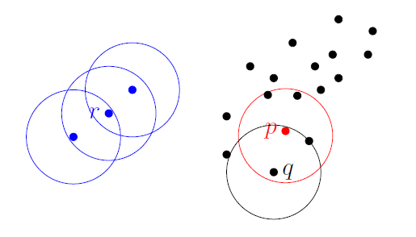
Dbscan (Density-based spatial clustering of applications with noise )
Figures courtesy of Wako Bungula

Slide 11
Figures courtesy of Wako Bungula

Slide 12
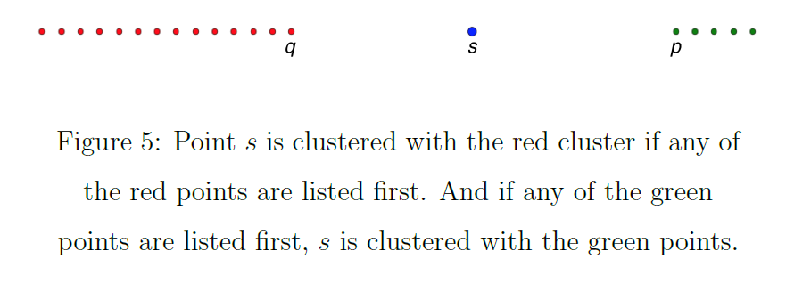
Figures courtesy of Wako Bungula

Slide 13
If you care about closeness:
Complete linkage
Average linkage
Ward’s linkage
K-means
If you care about connected components:
Single linkage
DBscan
Figures courtesy of Wako Bungula

Slide 14
Figures courtesy of Wako Bungula

Slide 15
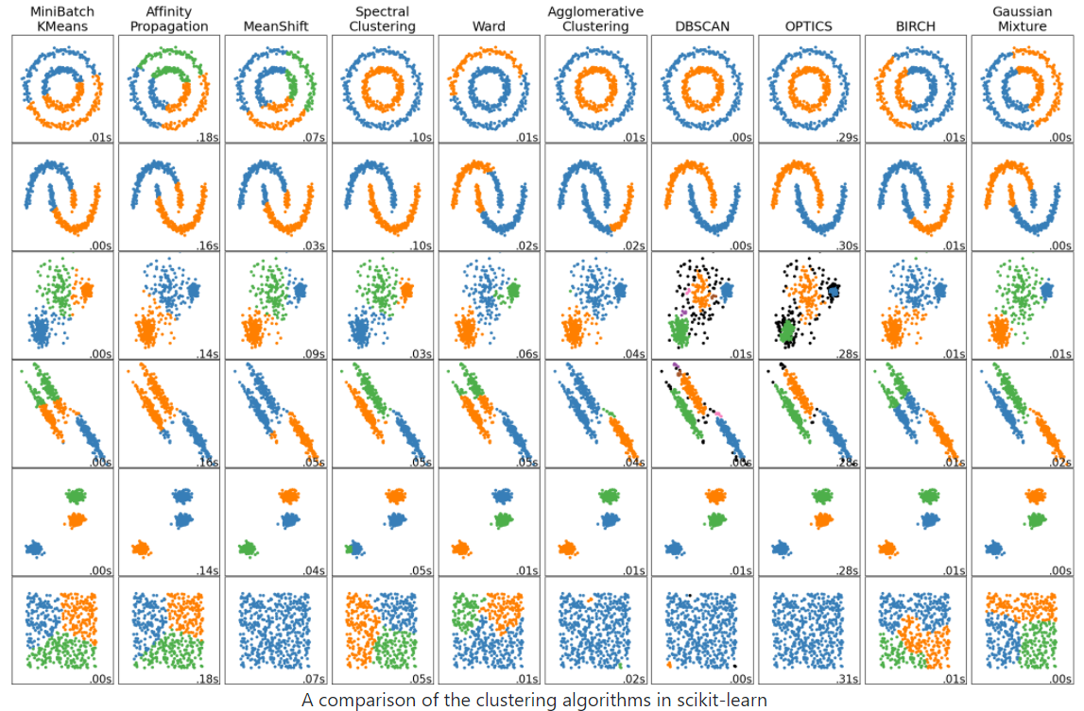
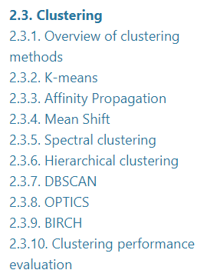
http://scikit-learn.org/stable/auto_examples/cluster/plot_cluster_comparison.html
Maybe start with: Ward’s linkage hierarchical clustering, k-means, etc.
2.3. Clustering — scikit-learn 1.2.2 documentation

Slide 16
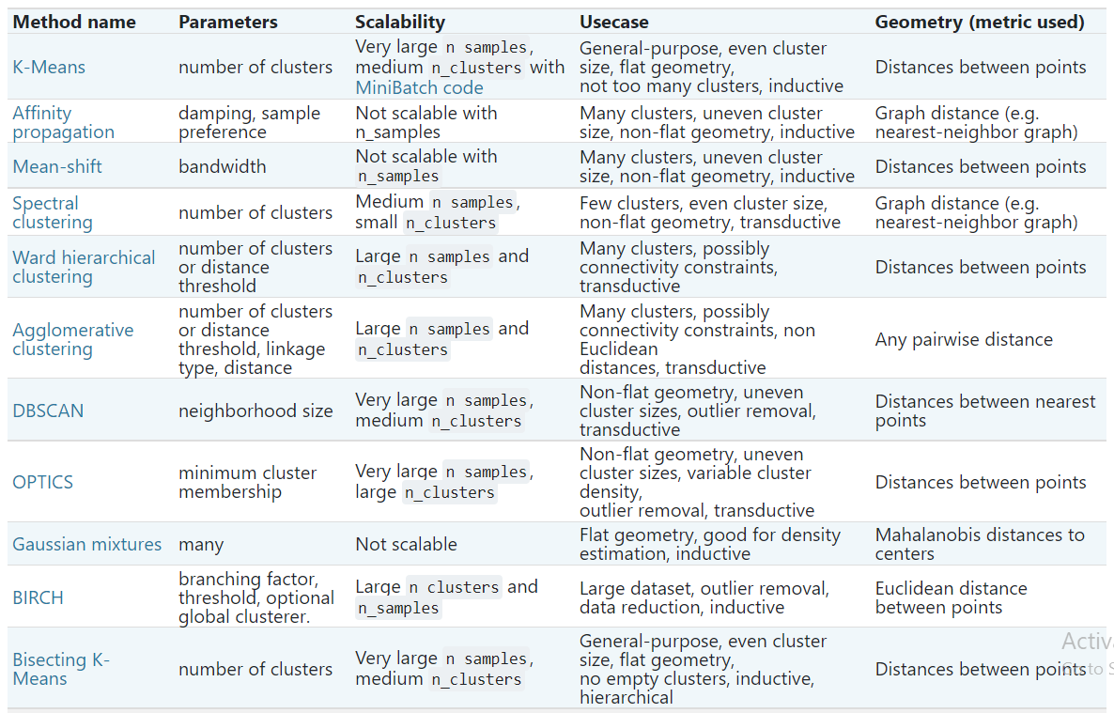
Maybe start with: Ward’s linkage hierarchical clustering, k-means, etc.
2.3. Clustering — scikit-learn 1.2.2 documentation

Slide 17
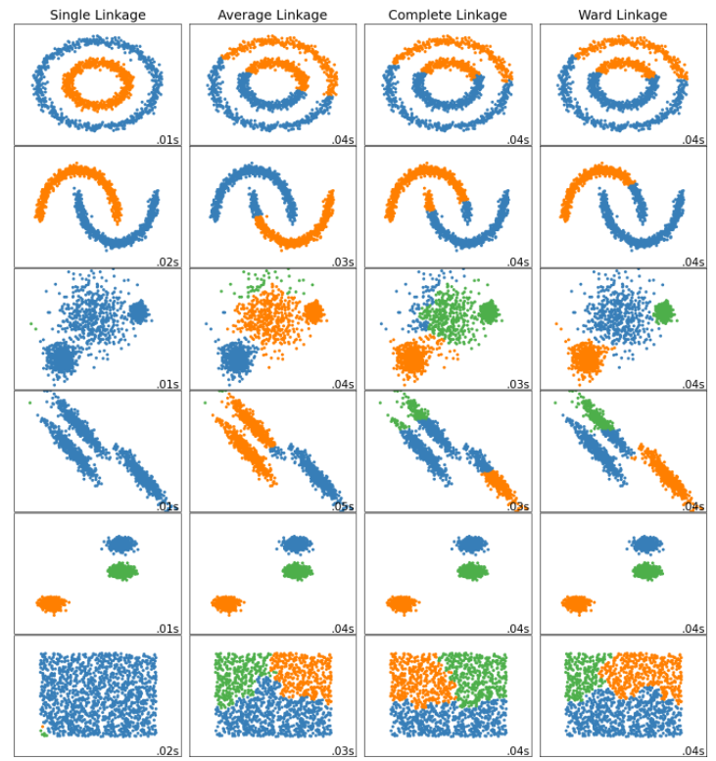
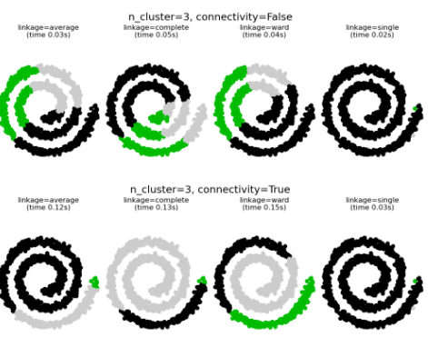
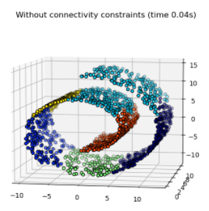
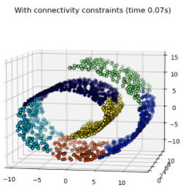
Ward minimizes the sum of squared differences within all clusters. It is a variance-minimizing approach and in this sense is similar to the k-means objective function but tackled with an agglomerative hierarchical approach.
Warning: Connectivity constraints with single, average and complete linkage can enhance the ‘rich getting richer’…

Slide 18
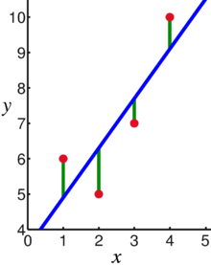
Linear regression = Least squares line (single variable x)
(or hyperplane for multiple variables)
Supervised learning
Data: x_{i} = input data with no noise
y_{i} = labels
Find function
f: R → R
f(x) = mx + b
x = independent variable
y = dependent variable
(x, y) → (x, y’)
https://en.wikipedia.org/wiki/Linear_regression

Slide 19
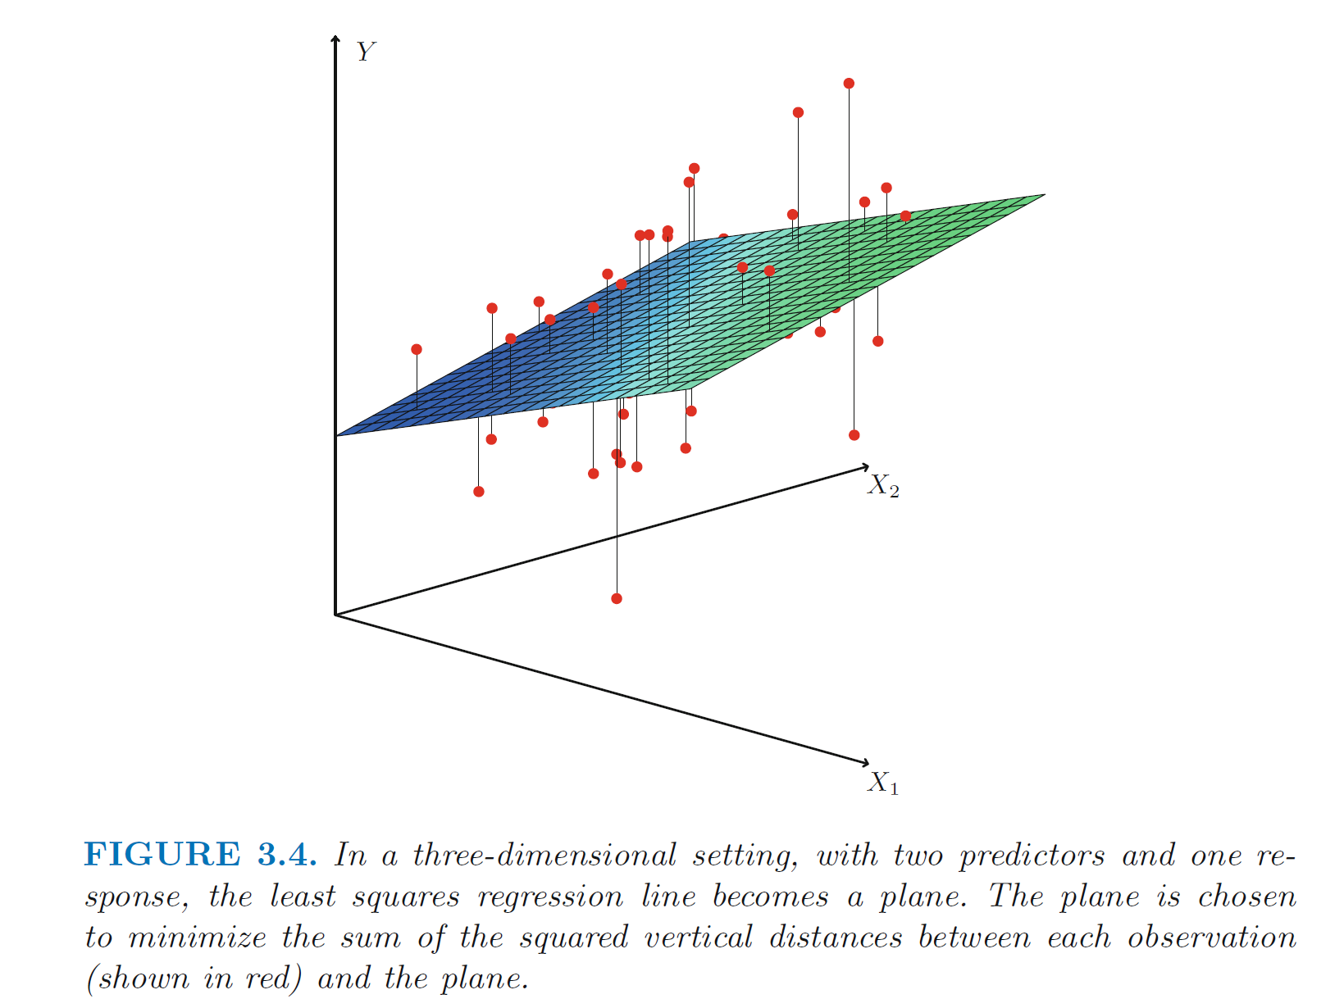
https://en.wikipedia.org/wiki/Linear_regression
https://www.statlearning.com/

Slide 20
PCA: perturb all variables (x, y) → (x’, y’)
1st PCA component
= direction of most variance
direction = eigenvector with
largest eigenvalue.
2nd PCA
= direction of 2nd most variance,
perpendicular to first.
direction = eigenvector with
2nd largest eigenvalue.
Modified from
https://en.wikipedia.org/wiki/Linear_regression

Slide 21
Linear regression
Given x_{i} = input data and y_{i} = f(x_{i}) = label. ➔ Learn f
Supervised learning: use labeled data to create model: f(x) = mx + b
Then use model to estimate new values:
Given new input $\tilde{x }$,
Estimate $\tilde{x }$’s label via f($\tilde{x }$) = m $\tilde{x }$ + b
https://en.wikipedia.org/wiki/Linear_regression

Slide 22
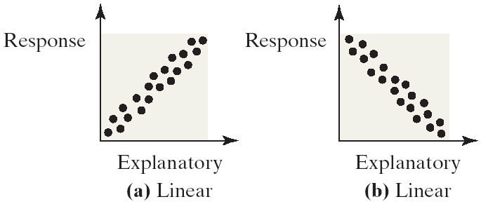
Linear Correlations
Linear relations or linear correlations have points that cluster around a line
Linear relations can be either positive (the points slants upwards to the right) or negative (the points slant downwards to the right)
https://emunix.emich.edu/~schu/MATH_170/Fall09_170/Evening%20session/Unit%203.ppt

Slide 24
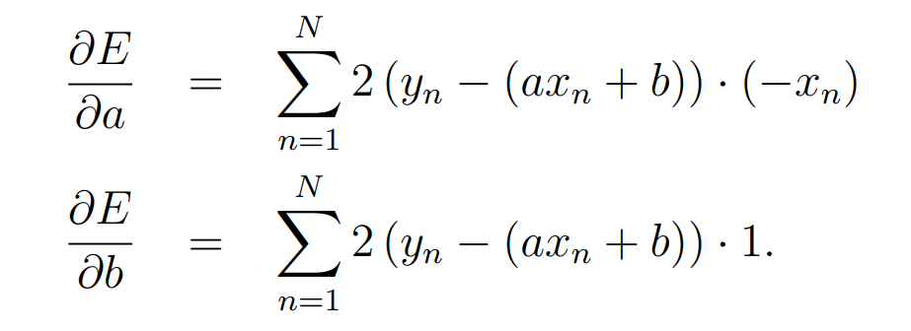
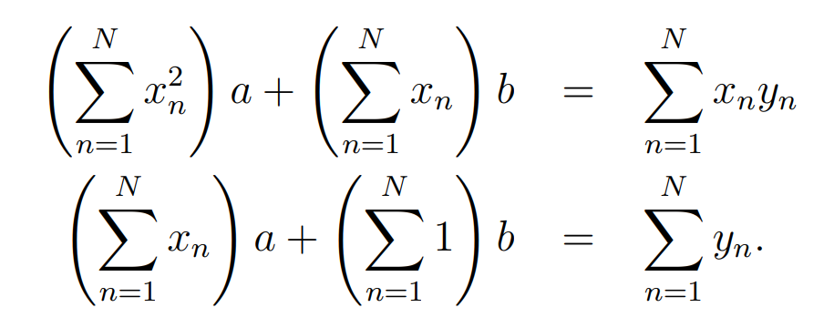
https://web.williams.edu/Mathematics/sjmiller/public_html/BrownClasses/54/handouts/MethodLeastSquares.pdf

Slide 25
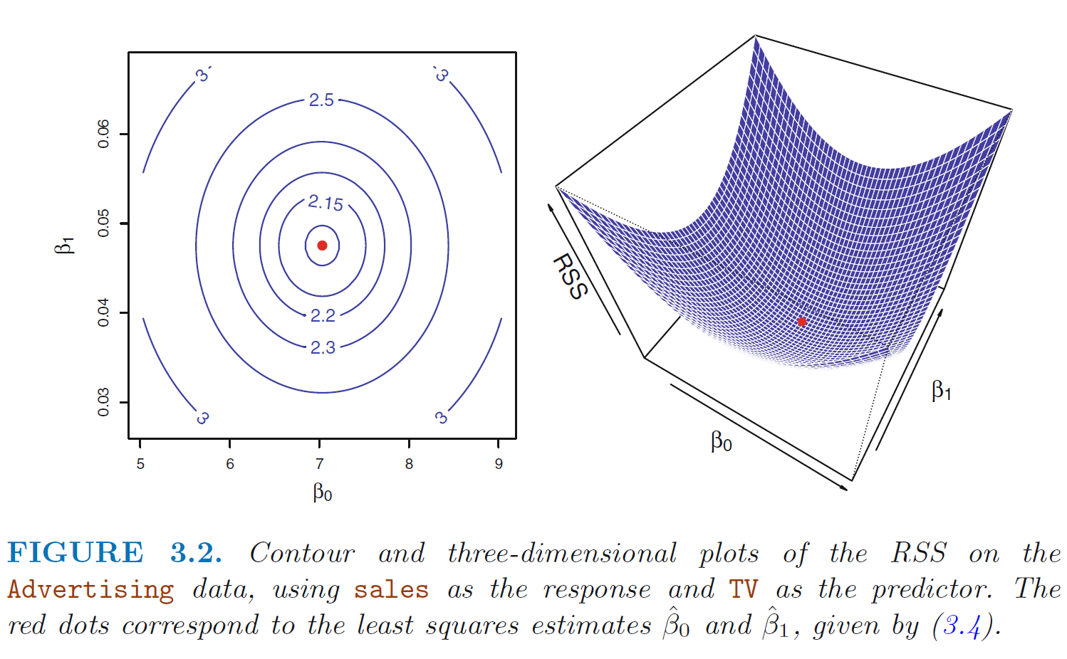
https://www.statlearning.com/

Slide 26
6533
0
No data
The intercept is b₀ = 6533.
This is the slope of the line.
For each additional mile on the odometer,
the price decreases by an average of $0.0312
Do not interpret the intercept as the
“Price of cars that have not been driven”
https://web.stanford.edu/class/msande247s/kchap17.ppt

