Slide 1
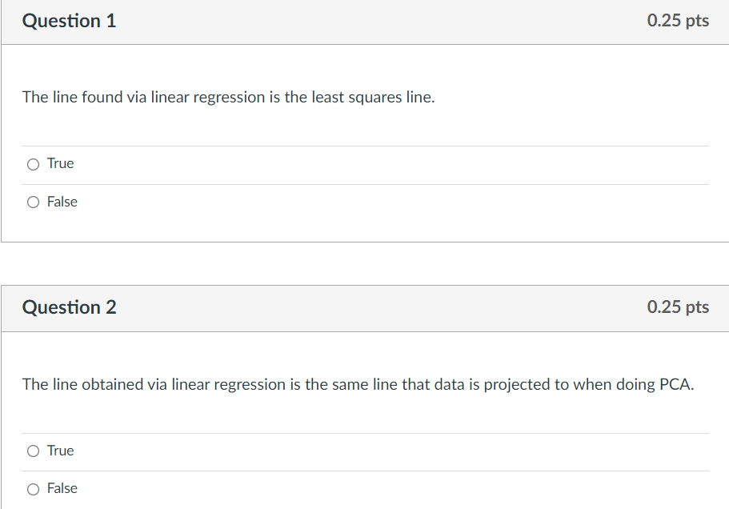

Slide 2
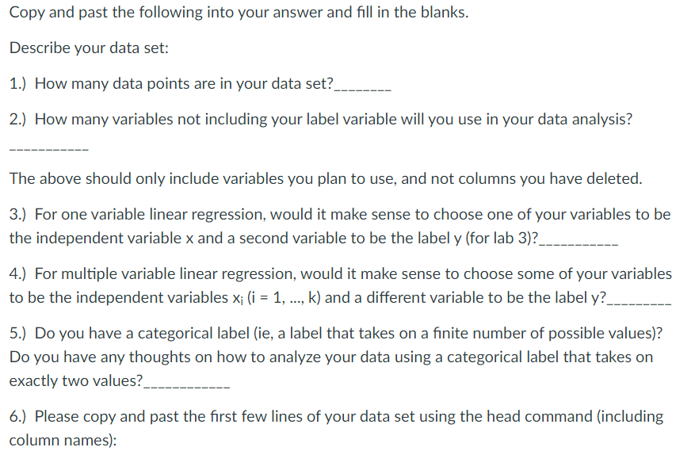

Slide 3
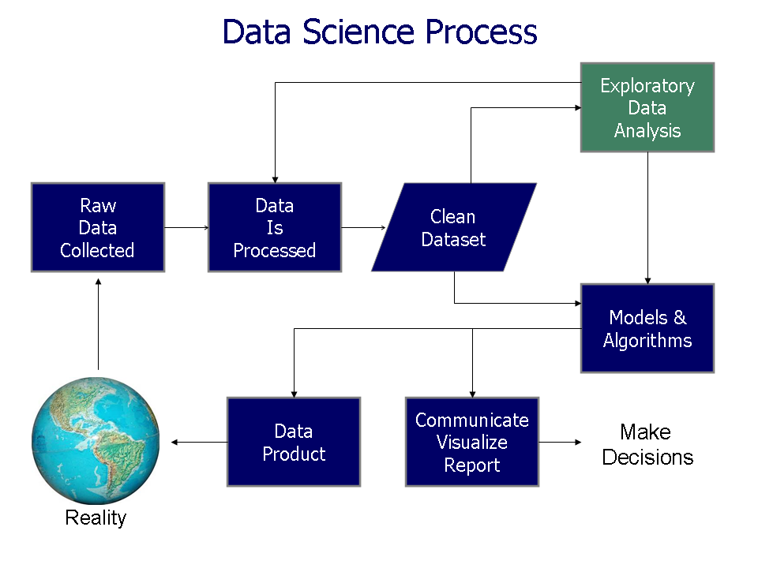
> 90% of work is usually preparing and cleaning the data
https://commons.wikimedia.org/wiki/File%3AData_visualization_process_v1.png

Slide 4

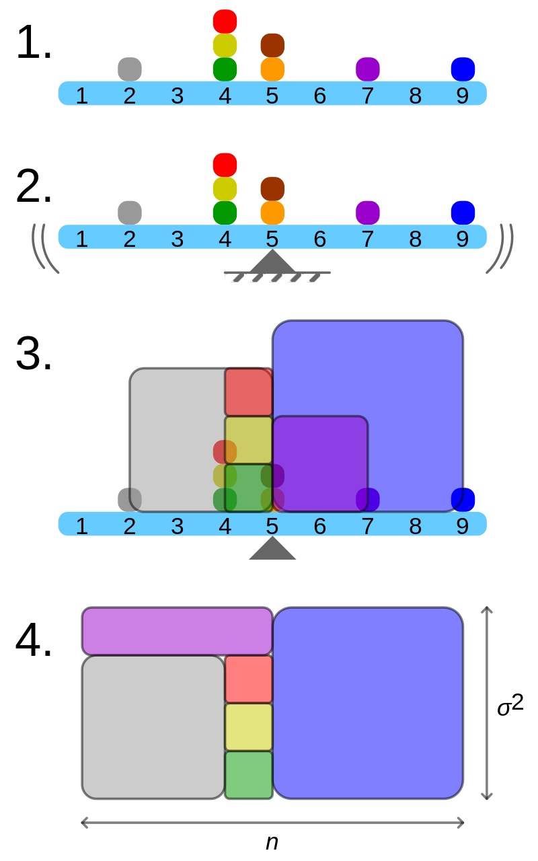
Geometric visualisation of the variance of an arbitrary distribution (2, 4, 4, 4, 5, 5, 7, 9): A frequency distribution is constructed.
The centroid of the distribution gives its mean.
A square with sides equal to the difference of each value from the mean is formed for each value.
Arranging the squares into a rectangle with one side equal to the number of values, n, results in the other side being the distribution's variance, σ².
By Cmglee - Own work, CC BY-SA 3.0, https://commons.wikimedia.org/w/index.php?curid=39472834

Slide 5
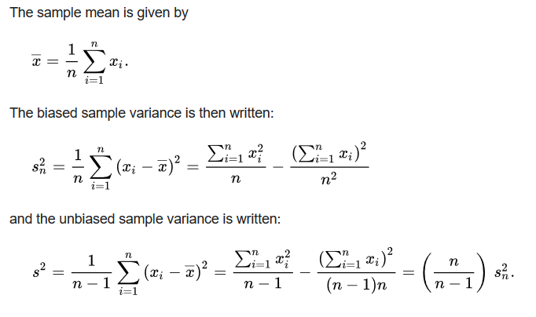
https://en.wikipedia.org/wiki/Bessel's_correction#Source_of_bias
Too small

Slide 6
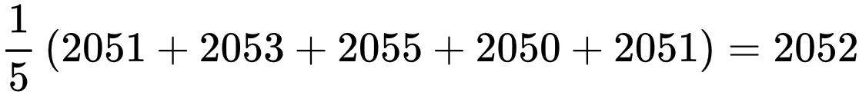
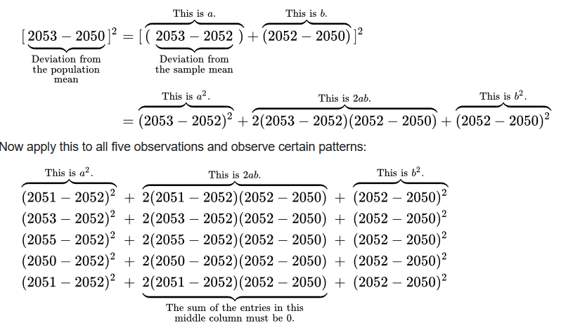
Small sample chosen randomly from the population:
Sample mean is , but suppose population mean is actually 2050.
https://en.wikipedia.org/wiki/Bessel's_correction#Source_of_bias

Slide 7
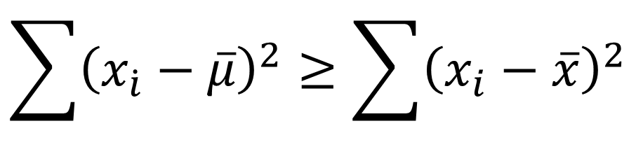

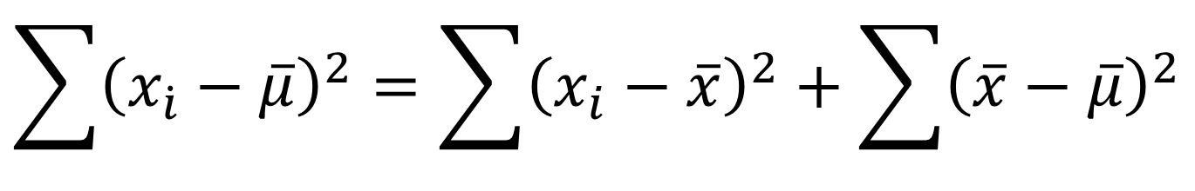
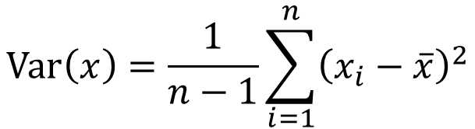
$$\sum{{\left(x_{\dot{i}}−\overline{μ}\right)}^{2}}=\sum{{\left(x_{i}−\overline{x}\right)}^{2}}+\sum{{\left(\overline{x}−\overline{μ}\right)}^{2}}$$
$$\sum{{\left(x_{\dot{i}}−\overline{μ}\right)}^{2}}≥\sum{{\left(x_{i}−\overline{x}\right)}^{2}}$$
Variance on entire population : vs Variance of sample of population:
$$\operatorname{Var}\left(x\right)=\frac{1}{n−1}\sum_{i=1}^{n}{{\left(x_{i}−\overline{x}\right)}^{2}}$$
$$\frac{n}{n−1}$$
https://en.wikipedia.org/wiki/Bessel's_correction#Source_of_bias

Slide 8
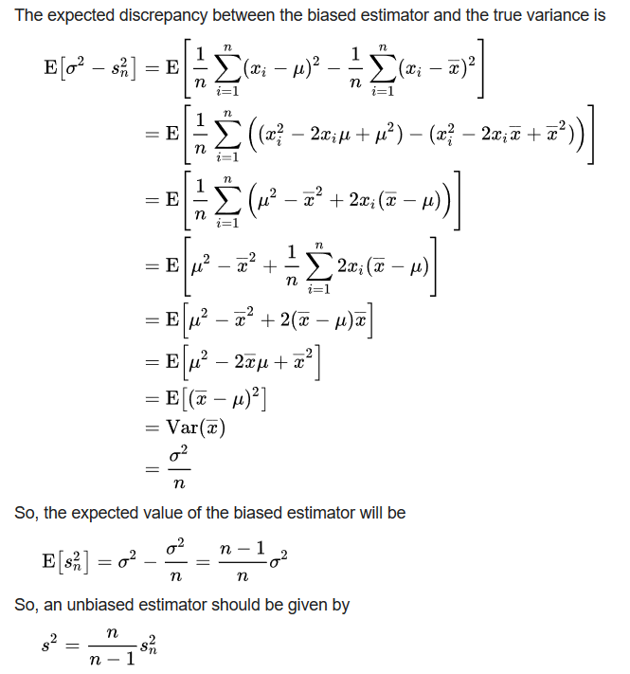

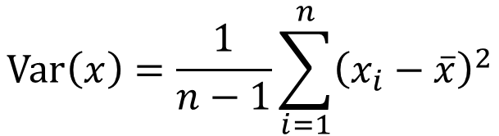
$$\operatorname{Var}\left(x\right)=\frac{1}{n−1}\sum_{i=1}^{n}{{\left(x_{i}−\overline{x}\right)}^{2}}$$
One can understand Bessel's correction as the degrees of freedom in the residuals vector (residuals, not errors, because the population mean is unknown):
While there are n independent observations in the sample, there are only n − 1 independent residuals, as they sum to 0
For 1 data point: Variance does not make sense
https://en.wikipedia.org/wiki/Bessel's_correction#Source_of_bias

Slide 9
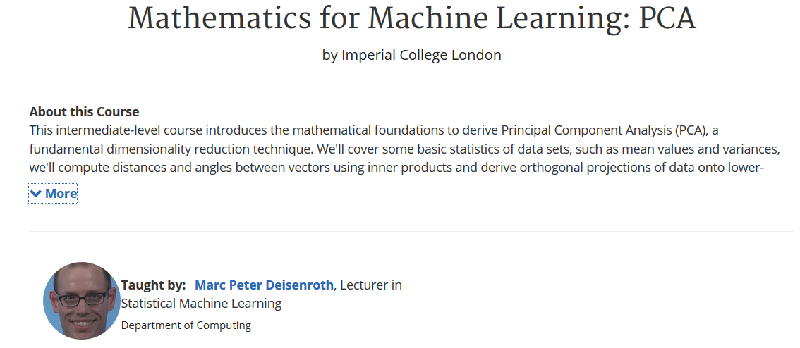
https://www.coursera.org/learn/pca-machine-learning/home/info

Slide 10
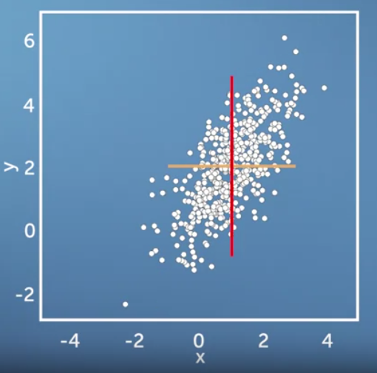
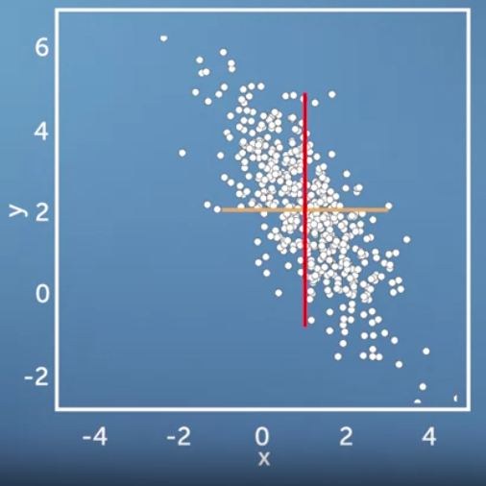
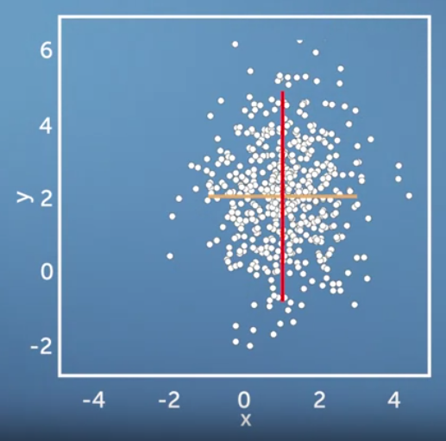
Same variance in x and y direction, but different co-variances

Slide 11
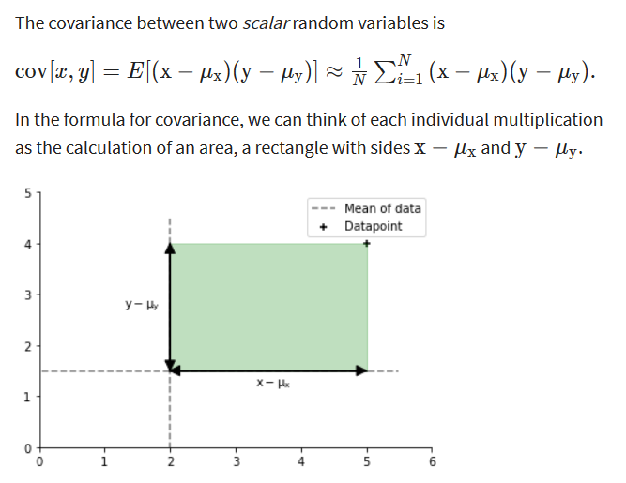

Slide 12
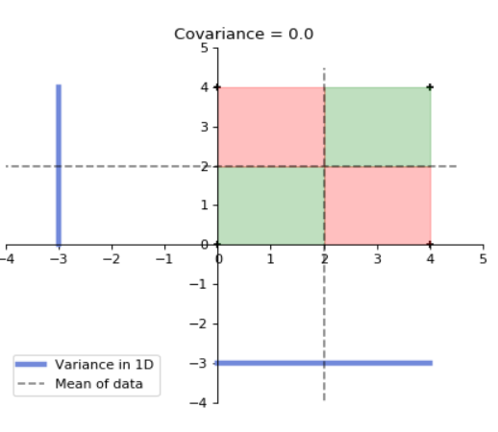
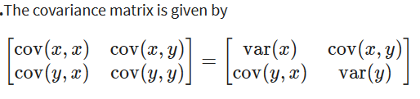
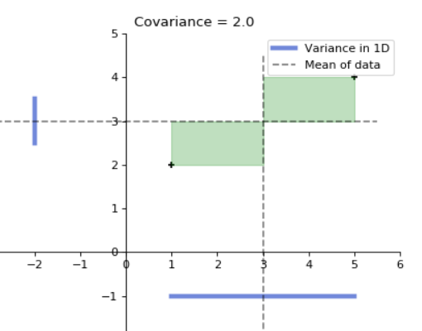
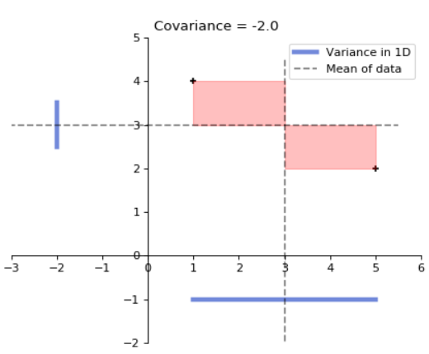
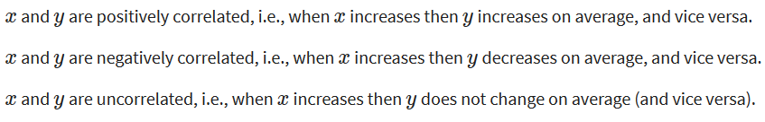
for 2 data points x, y

Slide 13
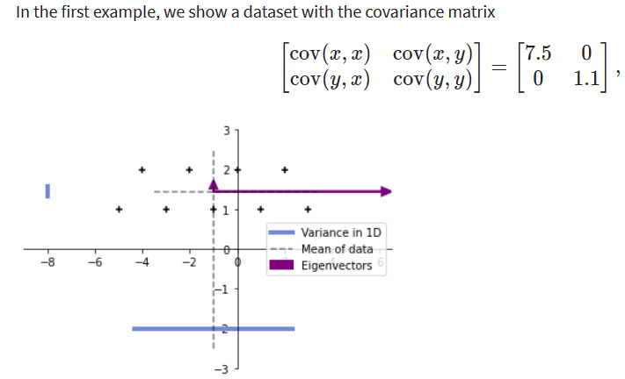
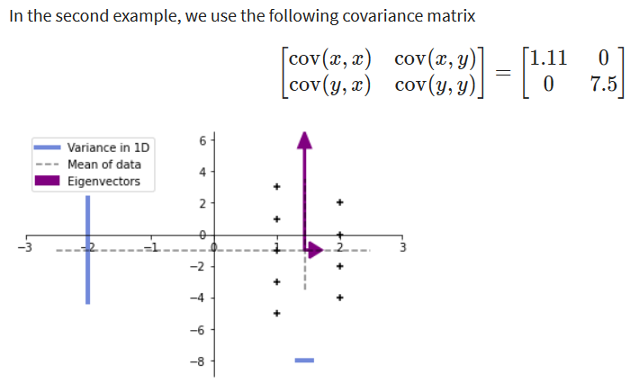

Slide 14
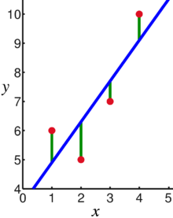
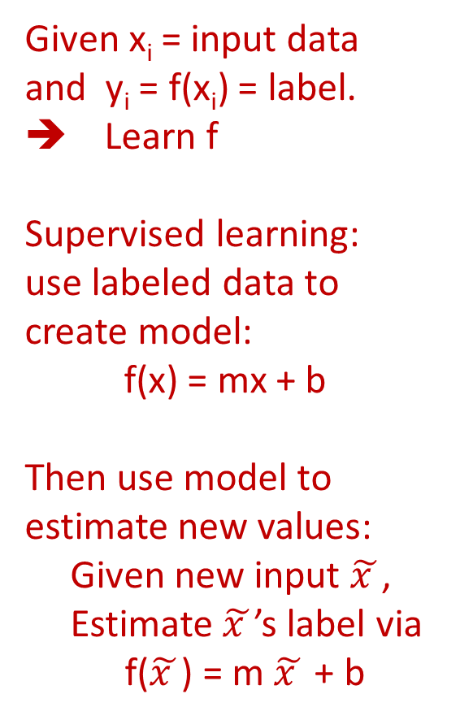
Linear regression = Least squares line (single variable x)
(or hyperplane for multiple variables)
Given x_{i} = input data and y_{i} = f(x_{i}) = label. ➔ Learn f
Supervised learning: use labeled data to create model:
f(x) = mx + b
Then use model to estimate new values:
Given new input $\tilde{x }$,
Estimate $\tilde{x }$’s label via
f($\tilde{x }$) = m $\tilde{x }$ + b
Supervised learning
Data: x_{i} = input data with no noise
y_{i} = labels
Find function
f: R → R
f(x) = mx + b
x = independent variable
y = dependent variable
(x, y) → (x, y’)
https://en.wikipedia.org/wiki/Linear_regression

Slide 15
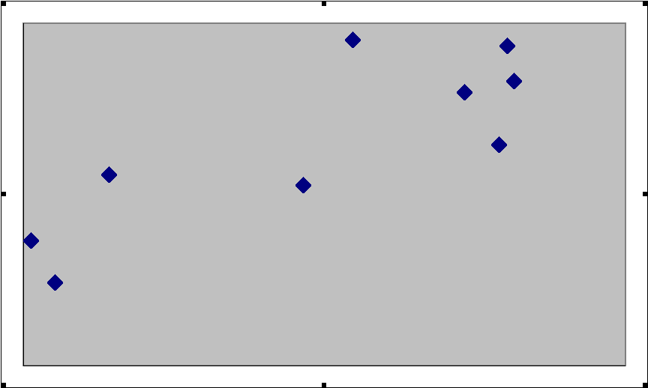
What is a Residual?
Here shows a residual on the scatter diagram
The residual
The regression line
The observed value y
The predicted value y
The x value of interest
https://emunix.emich.edu/~schu/MATH_170/Fall09_170/Evening%20session/Unit%203.ppt

Slide 16
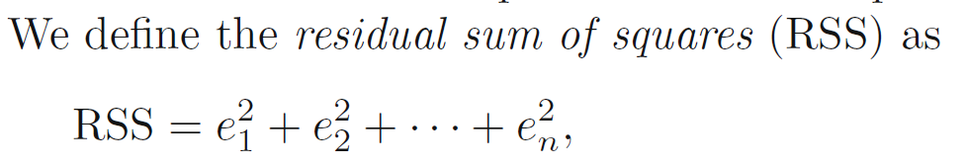
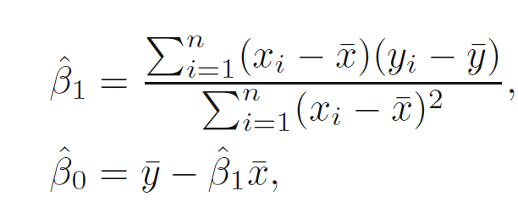
https://en.wikipedia.org/wiki/Linear_regression
https://www.statlearning.com/

Slide 17
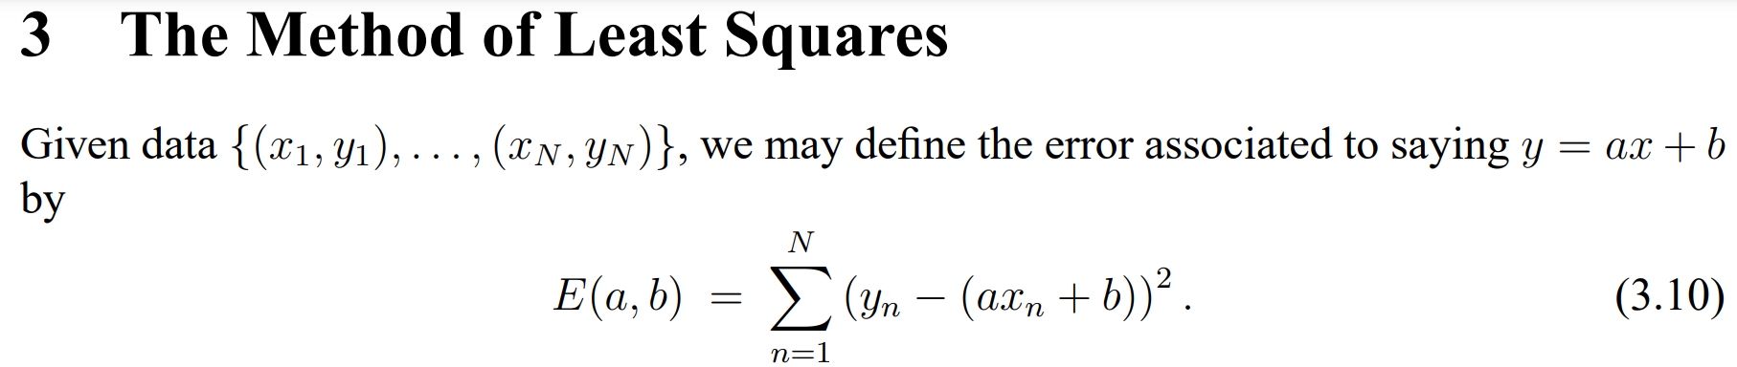
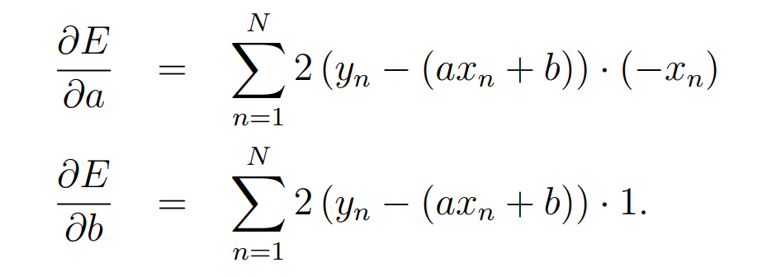
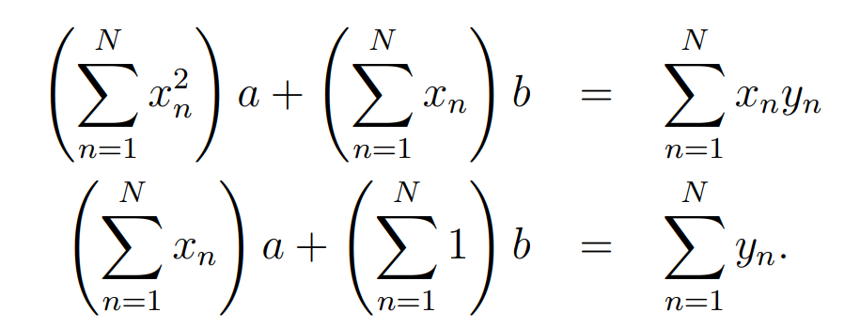
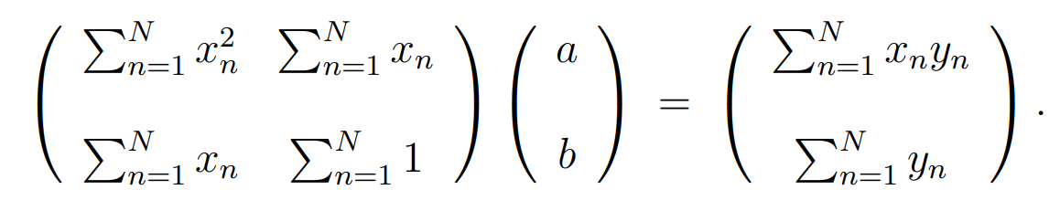
➔
https://web.williams.edu/Mathematics/sjmiller/public_html/BrownClasses/54/handouts/MethodLeastSquares.pdf

Slide 18
Find the Equation of a Linear Regression Line
The equation is determined by:
  b₀: y-intercept
  b₁: slope
Values that satisfy the least squares criterion:
https://en.wikipedia.org/wiki/Linear_regression

Slide 19
Coefficient of determination
https://web.stanford.edu/class/msande247s/kchap17.ppt
  When we want to measure the strength of the linear relationship, we use the coefficient of determination.

Slide 20
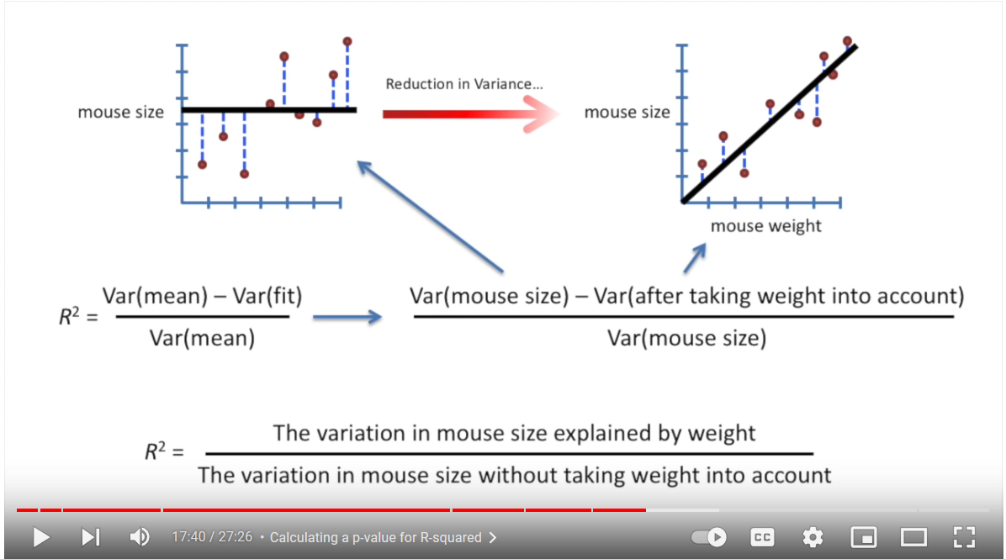

Slide 21
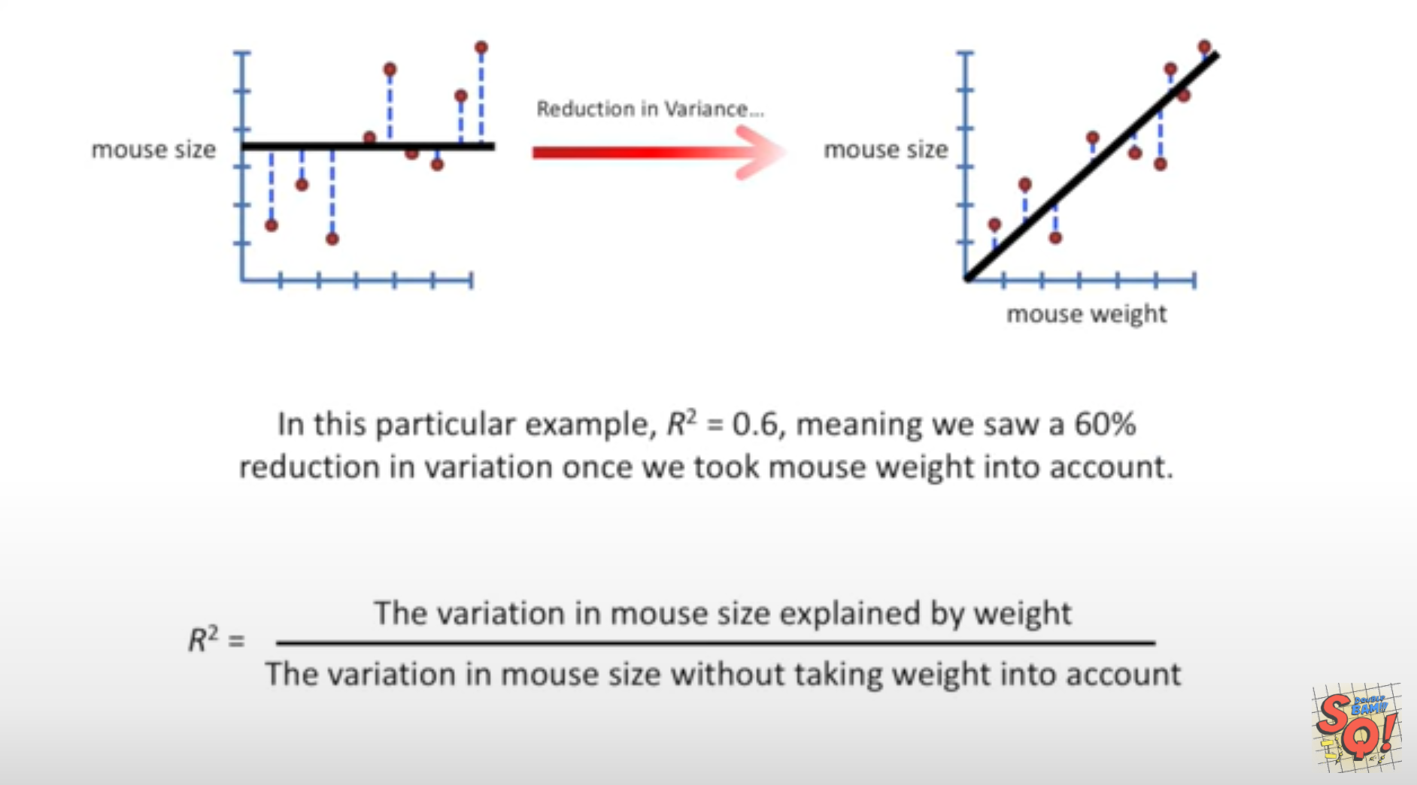
StatQuest: Linear Models Pt.1 - Linear Regression https://www.youtube.com/watch?v=nk2CQITm_eo

Slide 22
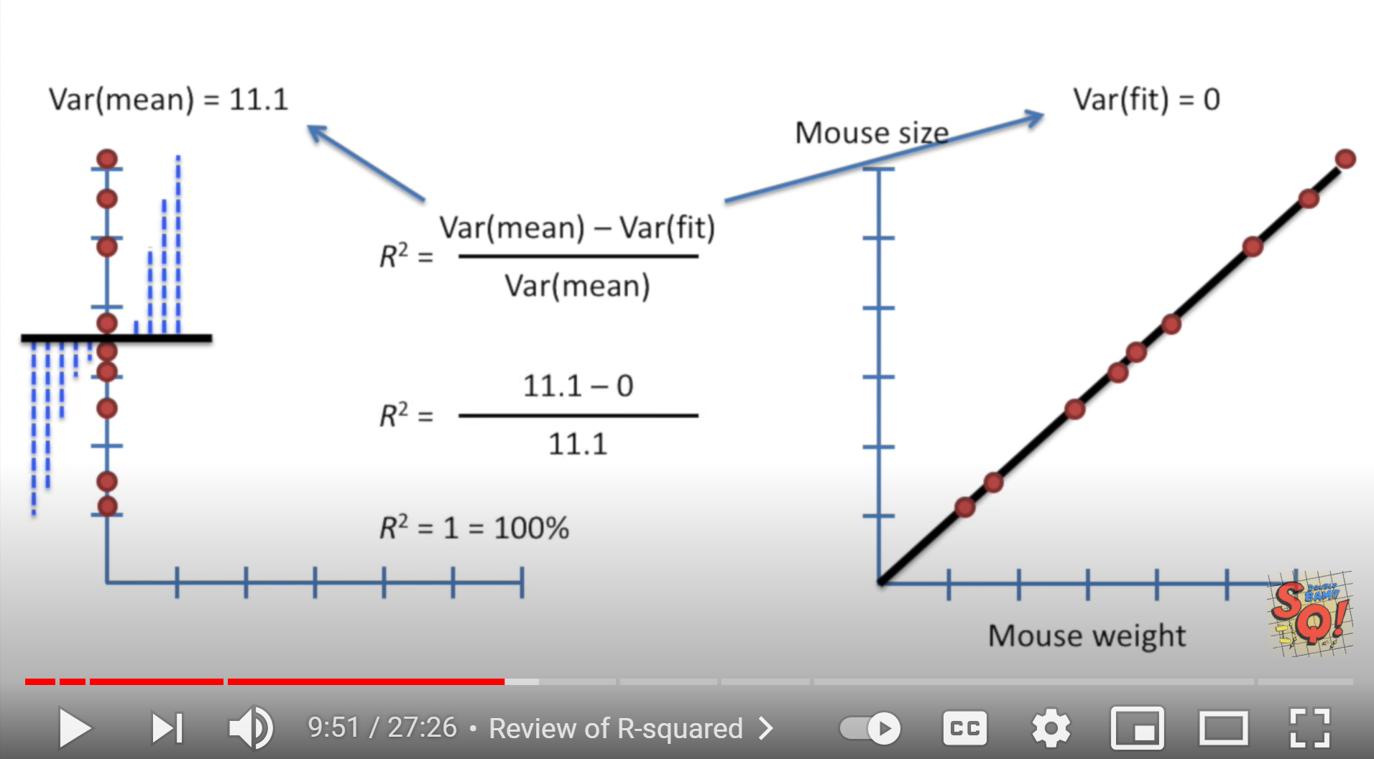
StatQuest: Linear Models Pt.1 - Linear Regression https://www.youtube.com/watch?v=nk2CQITm_eo

Slide 23
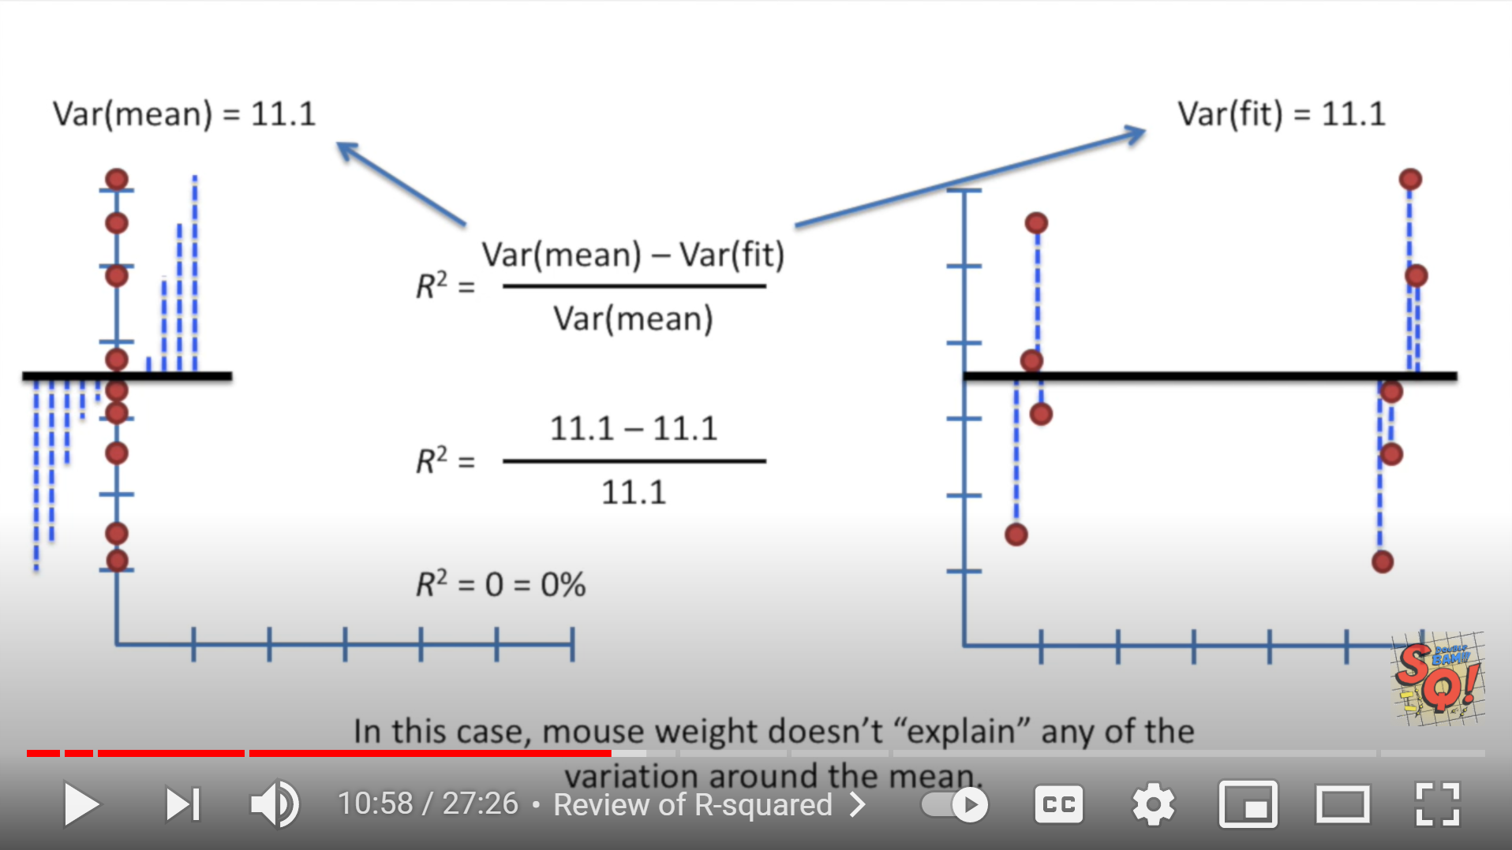
StatQuest: Linear Models Pt.1 - Linear Regression https://www.youtube.com/watch?v=nk2CQITm_eo

Slide 24
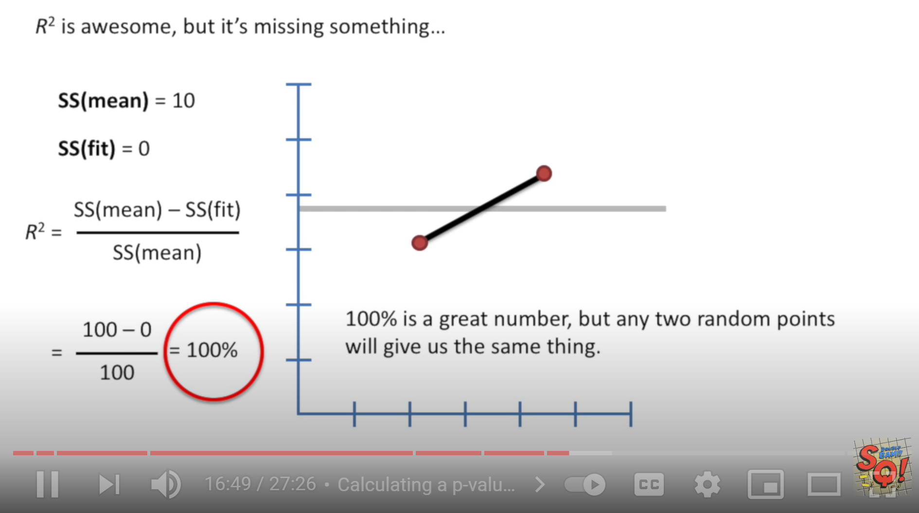
Suppose your data set contains exactly 2 points:
StatQuest: Linear Models Pt.1 - Linear Regression https://www.youtube.com/watch?v=nk2CQITm_eo

Slide 25
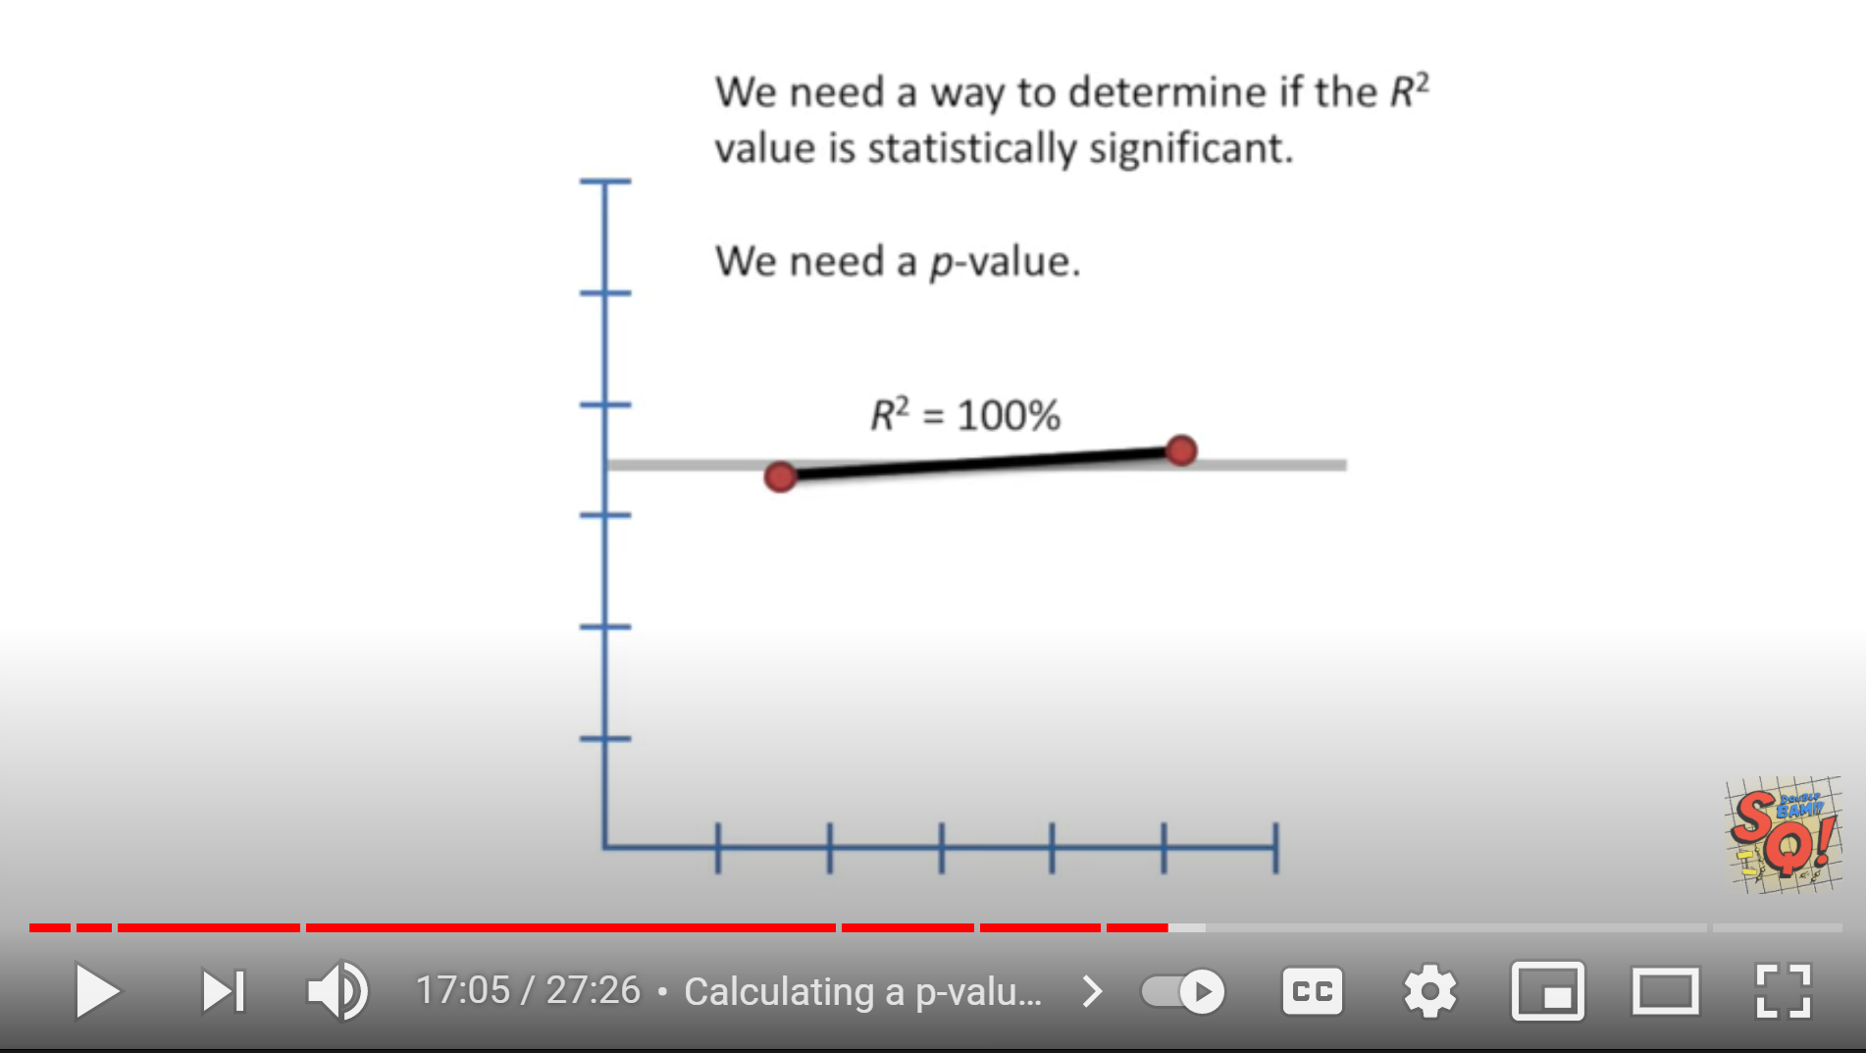
StatQuest: Linear Models Pt.1 - Linear Regression https://www.youtube.com/watch?v=nk2CQITm_eo

Slide 26
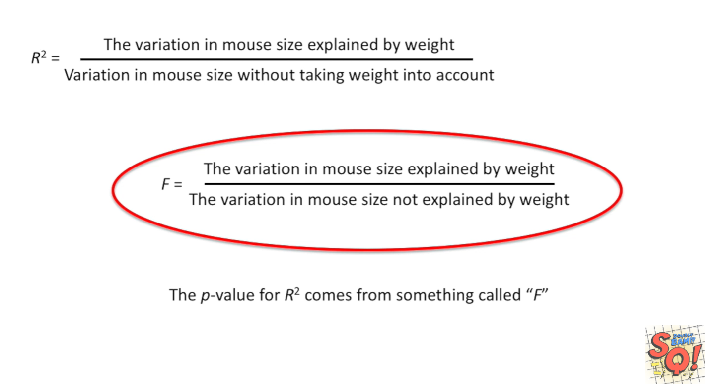
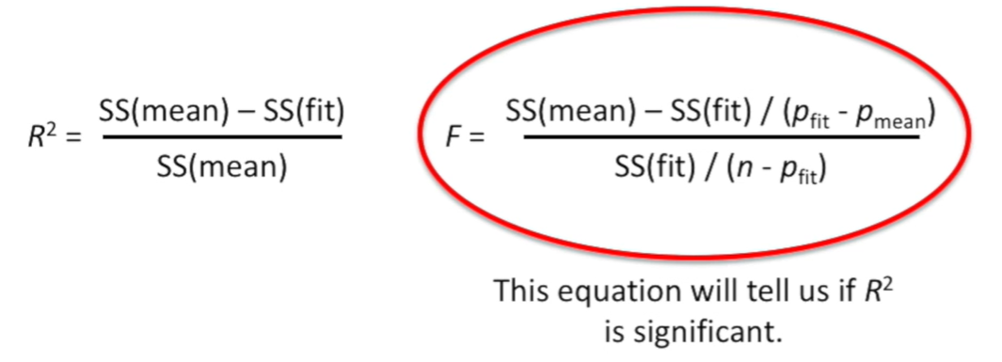

Slide 27
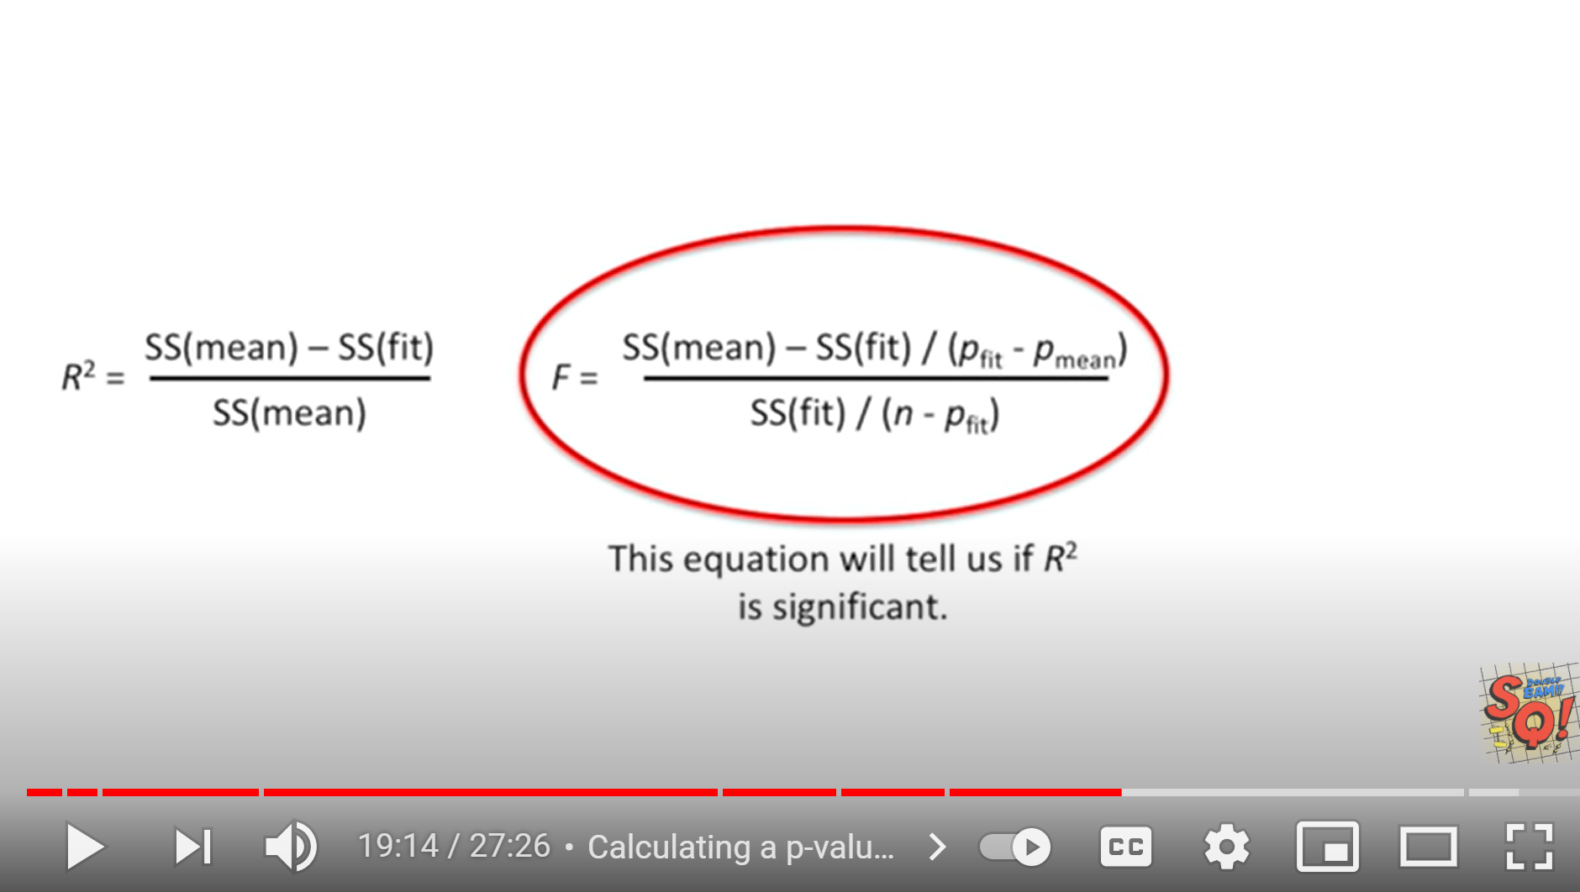
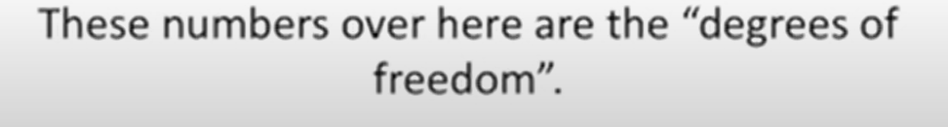
StatQuest: Linear Models Pt.1 - Linear Regression https://www.youtube.com/watch?v=nk2CQITm_eo

Slide 28
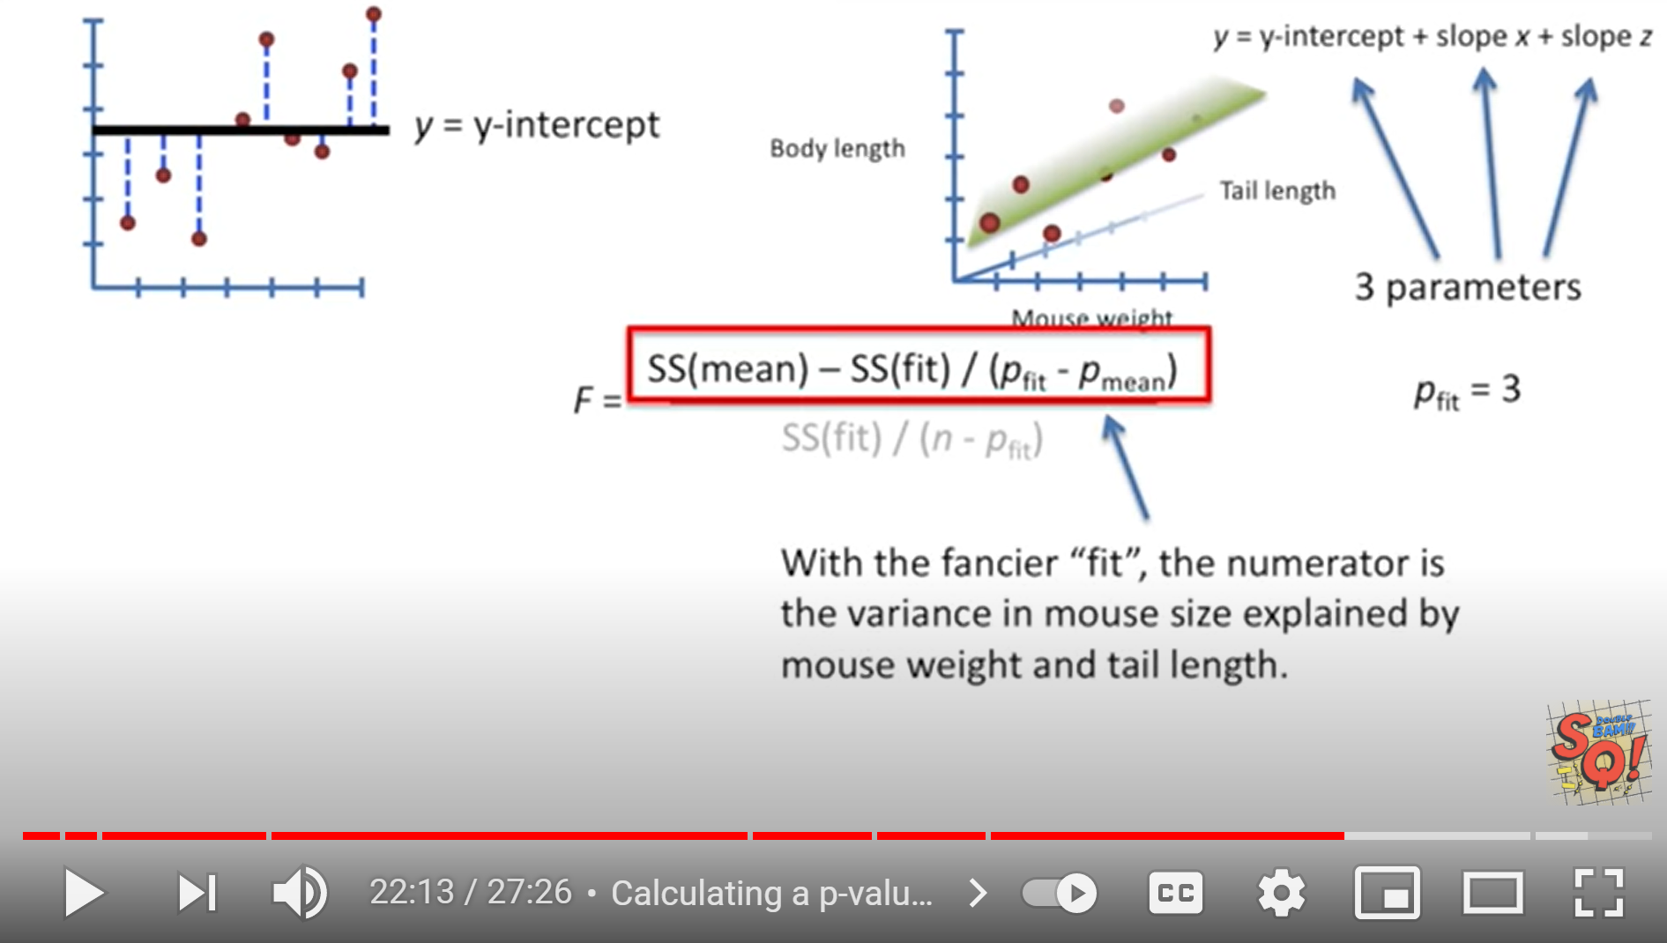
StatQuest: Linear Models Pt.1 - Linear Regression https://www.youtube.com/watch?v=nk2CQITm_eo

Slide 29
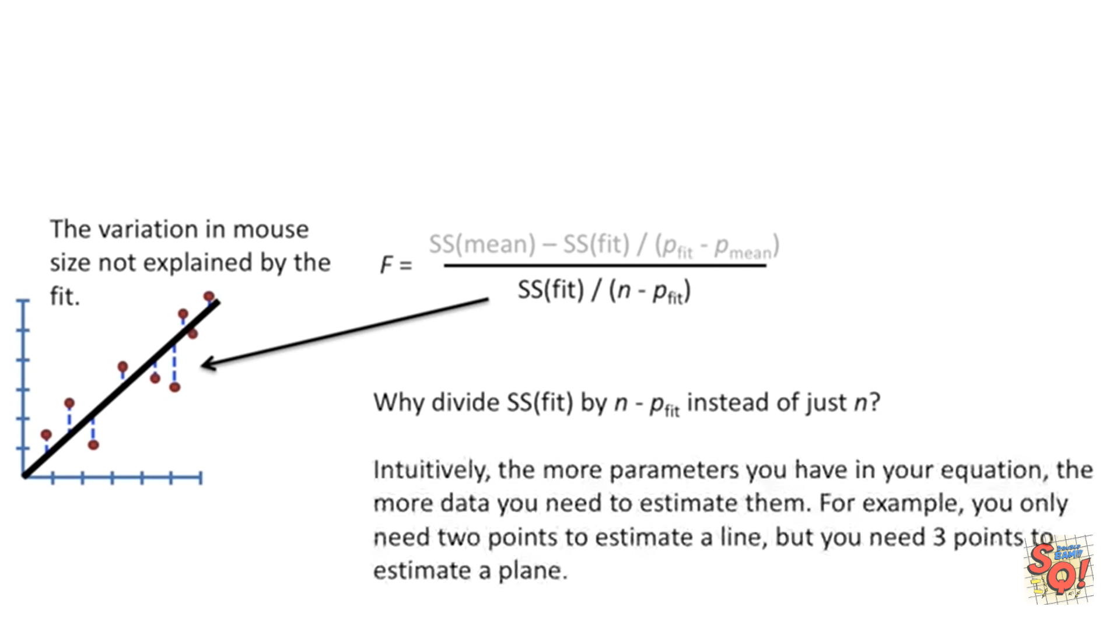
StatQuest: Linear Models Pt.1 - Linear Regression https://www.youtube.com/watch?v=nk2CQITm_eo

Slide 30
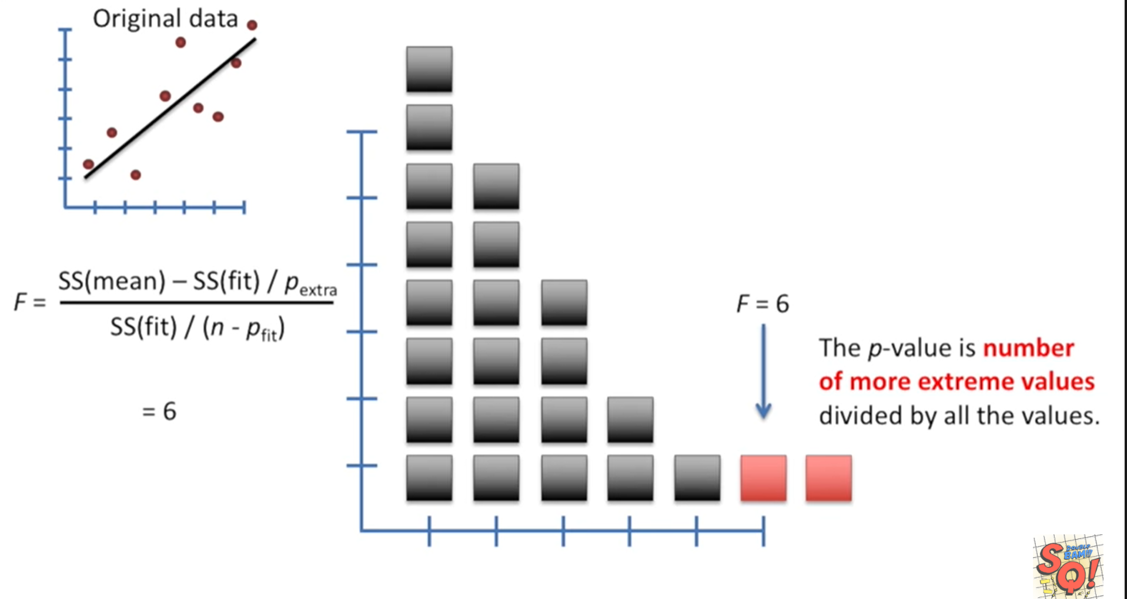
StatQuest: Linear Models Pt.1 - Linear Regression https://www.youtube.com/watch?v=nk2CQITm_eo

Slide 31
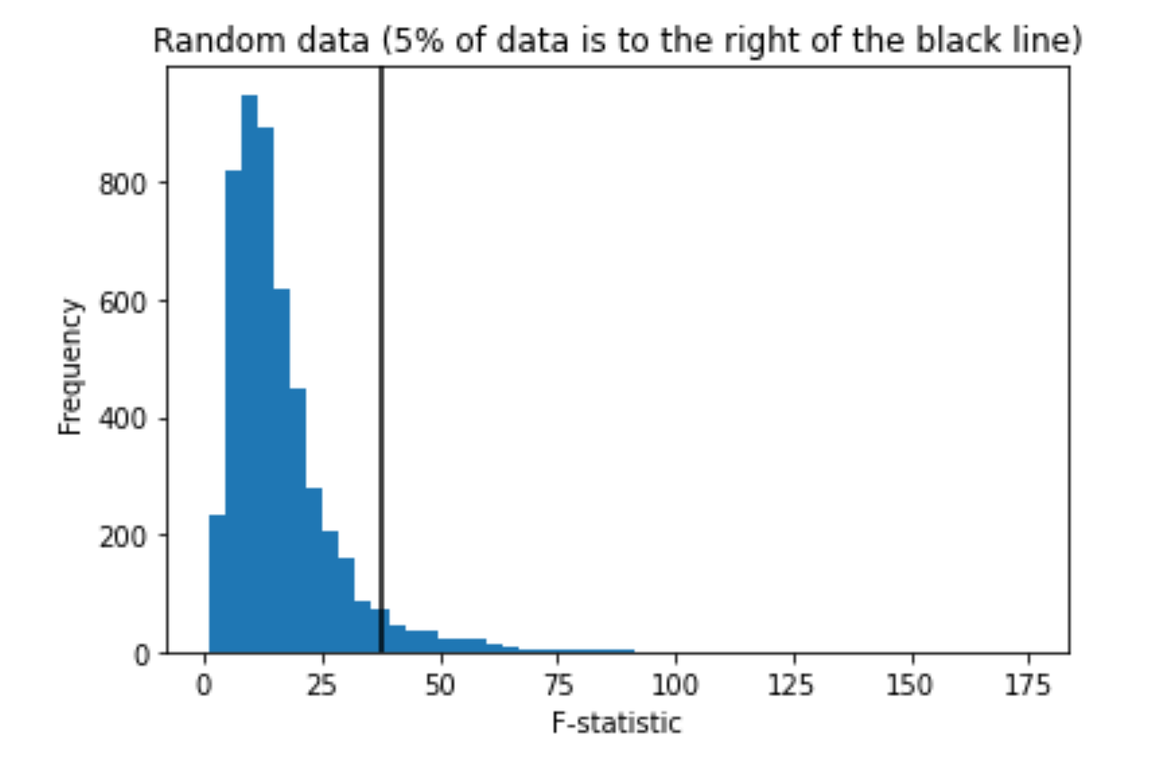
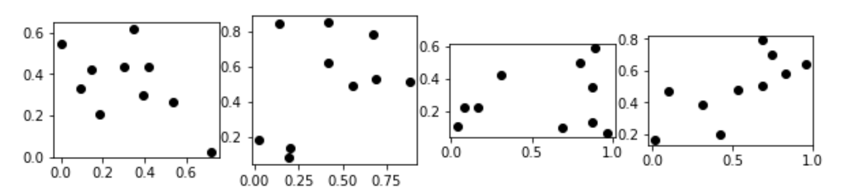
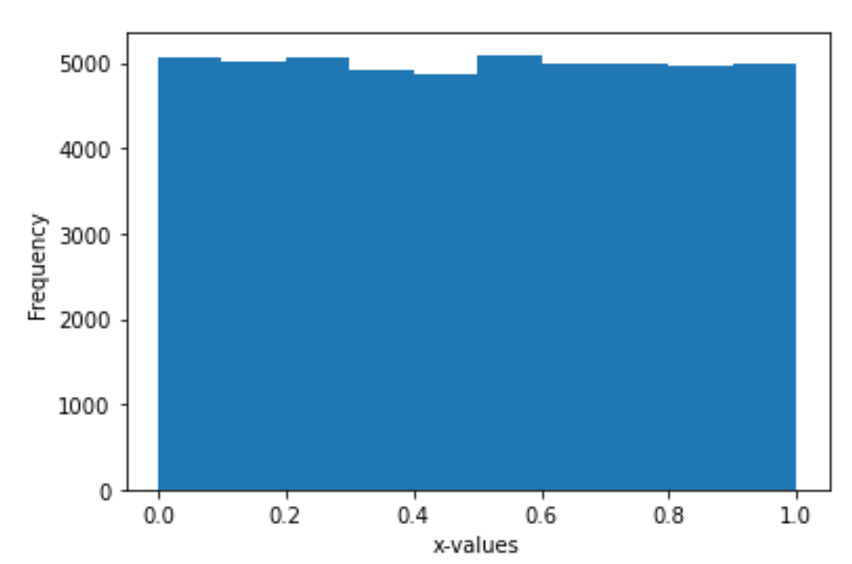
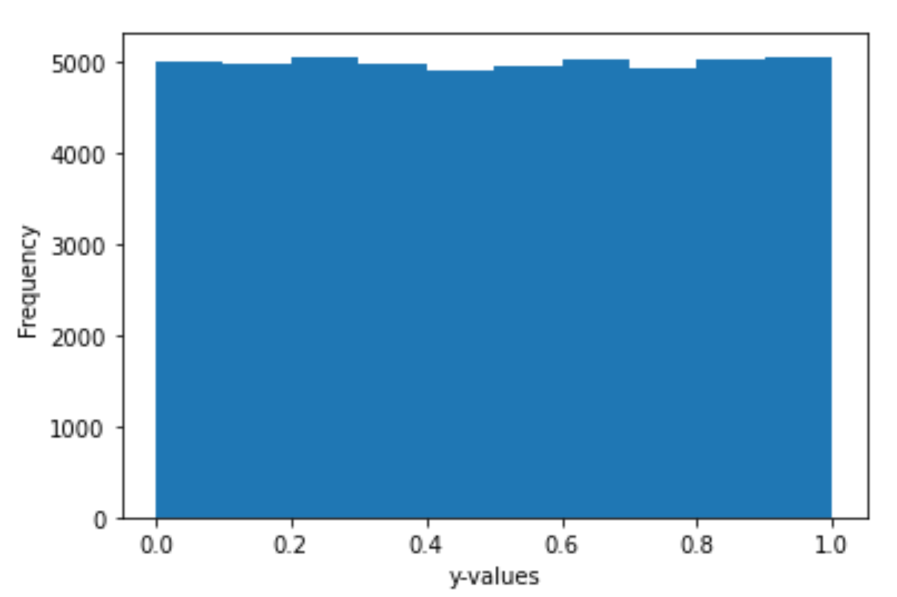
The P value is the probability of obtaining a test statistic at least as extreme as the one that was actually observed, assuming that the null hypothesis is true.
Null hypothesis: the probability that there is no relationship between x and y (i.e. the relationship is null)
The “magic p-value” is sometimes thought to be 0.05 = 5%
x and y generated independently.
Statistical Literacy of Obstetrics-Gynecology Residents
https://meridian.allenpress.com/jgme/article/5/2/272/200601/Statistical-Literacy-of-Obstetrics-Gynecology (2013)
Helping Doctors and Patients Make Sense of Health Statistics
https://journals.sagepub.com/doi/10.1111/j.1539-6053.2008.00033.x?url_ver=Z39.88-2003&rfr_id=ori%3Arid%3Acrossref.org&rfr_dat=cr_pub++0pubmed& (2007)

Slide 32


np.random.seed(1)
x = np.random.random((K,N))
np.random.seed(2)
y = np.random.random((K, N))

Slide 33
Negative: x does not predict y. There is no relationship between x and y.
The data used to generate the histogram below was randomly generated.
Thus there is no relationship between x and y. Thus the null hypothesis is true for these data sets
True negatives:
There is no relationship between x and y
and
the F-statistic indicates that there is no relationship between x and y
False positive:
There is no relationship between x and y
and
the F-statistic indicates that there is a relationship between x and y

Slide 34

Confusion matrix
https://en.wikipedia.org/wiki/Confusion_matrix

Slide 35
Negative: x does not predict y. There is no relationship between x and y.
The data used to generate the histogram below was randomly generated.
Thus there is no relationship between x and y. Thus the null hypothesis is true for these data sets
True negatives:
There is no relationship between x and y
and
the F-statistic indicates that there is no relationship between x and y
False positive:
There is no relationship between x and y
and
the F-statistic indicates that there is a relationship between x and y

Slide 36



np.random.seed(4)
Noise = np.random.random((K, N)) - 0.5
y_NOISY = 2*x + 1.2*Noise

Slide 37


Positive: x predicts y. There is a relationship between x and y.
The data used to generate the pink lines below was NOT randomly generated.
Noise = np.random.random((K, N)) - 0.5
y_NOISY = 2*x + 1.2*Noise
False negatives:
There is a relationship between x and y
and
the F-statistic indicates that there is no relationship between x and y
True positive:
There is a relationship between x and y
and
the F-statistic indicates that there is a relationship between x and y

Slide 38
The P value is the probability of obtaining a test statistic at least as extreme as the one that was actually observed, assuming that the null hypothesis is true.
Null hypothesis: the probability that there is no relationship between x and y (i.e. the relationship is null)
False negatives:
There is a relationship between x and y
and
the F-statistic indicates that there is no relationship between x and y
True positive:
There is a relationship between x and y
and
the F-statistic indicates that there is a relationship between x and y

Slide 39
Noise = np.random.random((K, N)) - 0.5
y_NOISY = 2*x + 1.2*Noise

Slide 40
17.4 Error Variable: Required Conditions
The error ε is a critical part of the regression model.
Four requirements involving the distribution of ε must be satisfied.
  The probability distribution of ε is normal.
  The mean of ε is zero: E(ε) = 0.
  The standard deviation of ε is σ_{ε} for all values of x.
  The set of errors associated with different values of y are all independent.
https://web.stanford.edu/class/msande247s/kchap17.ppt

Slide 41

https://web.stanford.edu/class/msande247s/kchap17.ppt

Slide 42
6533
0
No data
The intercept is b₀ = 6533.
This is the slope of the line.
For each additional mile on the odometer,
the price decreases by an average of $0.0312
Do not interpret the intercept as the
“Price of cars that have not been driven”
https://web.stanford.edu/class/msande247s/kchap17.ppt

Slide 43



Properties of Linear Correlation Coefficients
https://emunix.emich.edu/~schu/MATH_170/Fall09_170/Evening%20session/Unit%203.ppt
Some properties of the linear correlation coefficient
  r is a unitless measure (so that r would be the same for a data set whether x and y are measured in feet, inches, meters etc.)
  r is always between –1 and +1.
        r = -1 : perfect negative correlation
        r = +1: perfect positive correlation
  Positive values of r correspond to positive relations
  Negative values of r correspond to negative relations
https://en.wikipedia.org/wiki/Pearson_correlation_coefficient
https://stats.libretexts.org/Bookshelves/Introductory_Statistics/Book%3A_Introductory_Statistics_(Shafer_and_Zhang)/10%3A_Correlation_and_Regression/10.02%3A_The_Linear_Correlation_Coefficient

