Slide 1
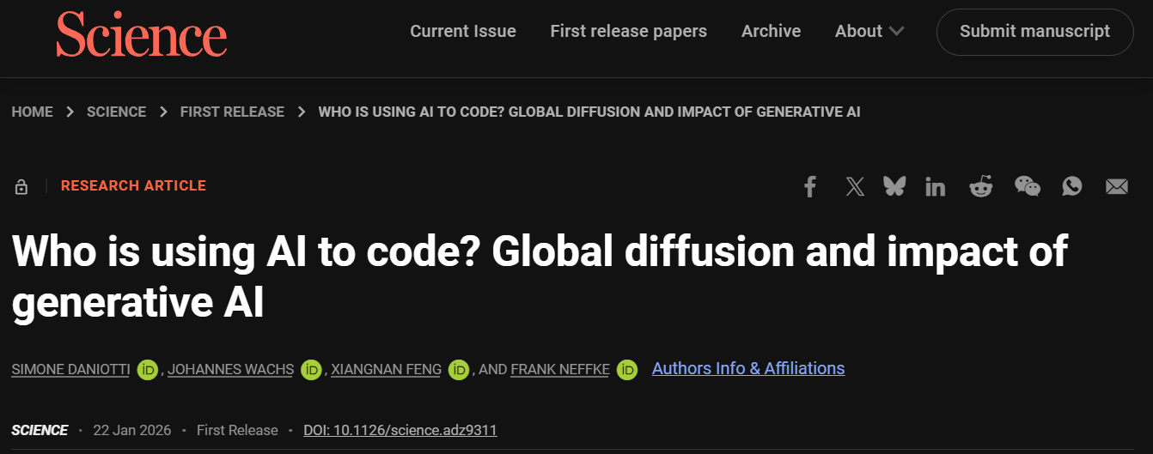

Slide 2

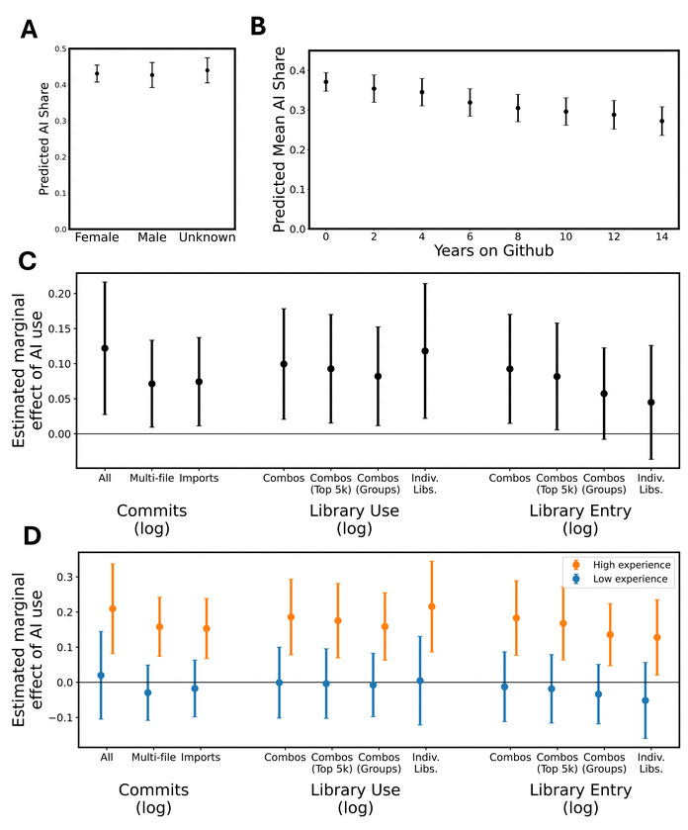
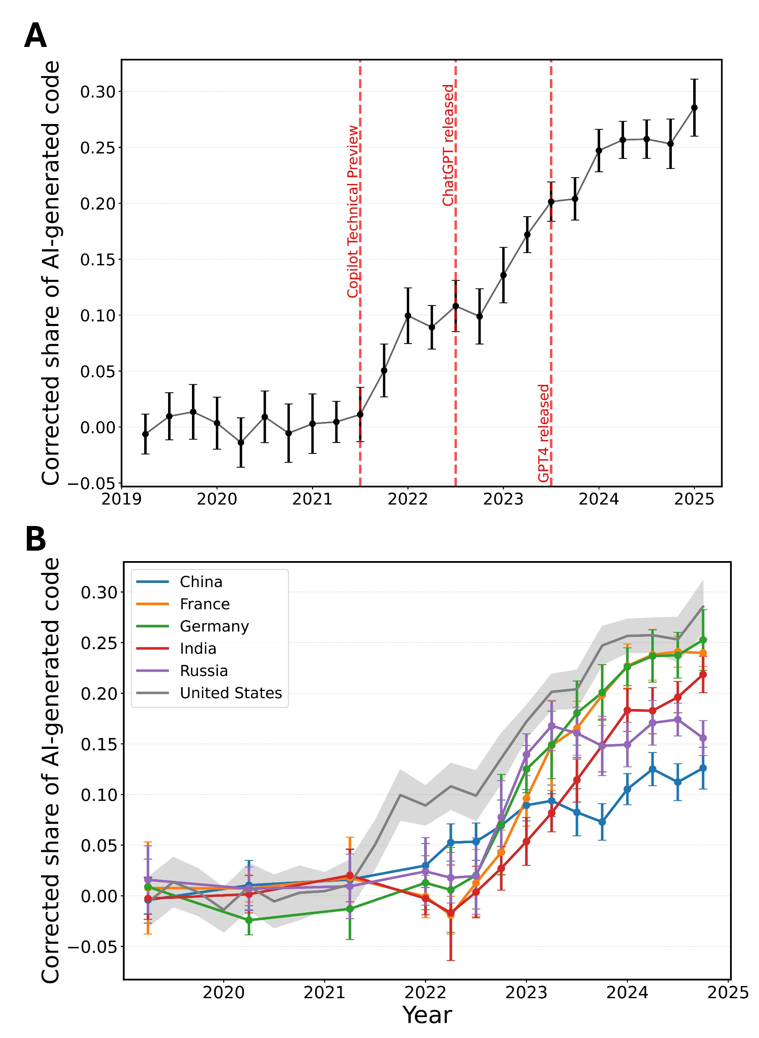
Who is using AI to code? Global diffusion and impact of generative AI, DOI: (10.1126/science.adz9311)

Slide 3
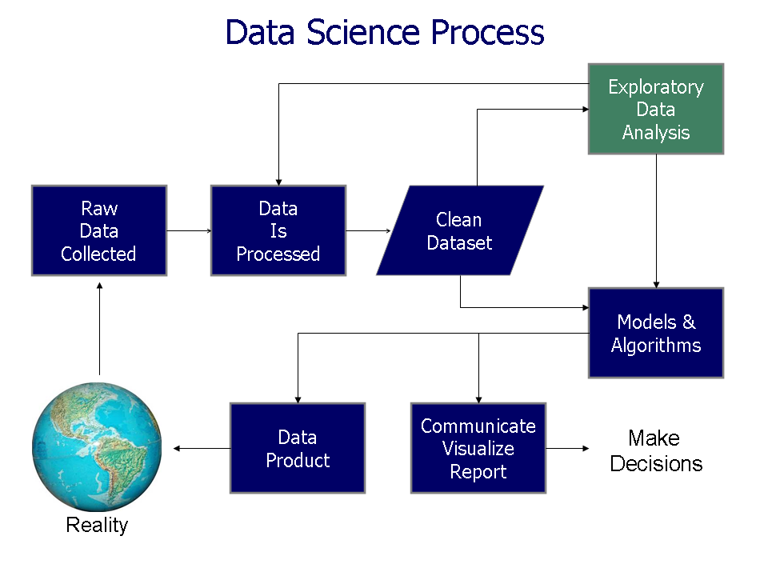
https://commons.wikimedia.org/wiki/File%3AData_visualization_process_v1.png

Slide 4
Dimensionality Reduction: Given dataset D R^{N}
Want: embedding f: D → R^{n} where n << N
    which “preserves” the structure of the data.
Many reduction methods:
f₁: D → R, f₂: D → R, … f_{n}: D → R
(f₁, f₂, … f_{n}): D → R^{n}
Many are linear, M: R^{N} → R^{n}, Mx = y
But there are also non-linear dimensionality reduction algorithms.
U

Slide 5
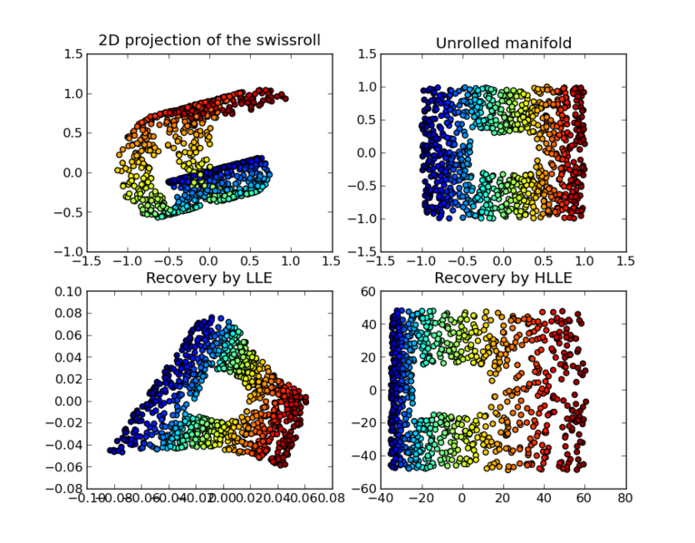
https://en.wikipedia.org/wiki/Nonlinear_dimensionality_reduction

Slide 6
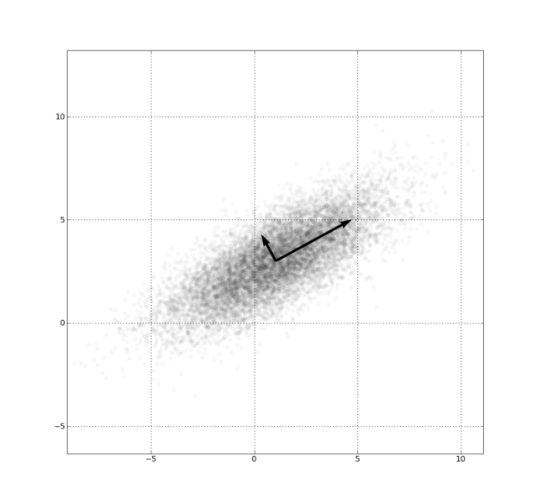
Example: Principal component analysis (PCA)
x_{i} → z_{i} = linear combination of x_{i}
http://en.wikipedia.org/wiki/File:GaussianScatterPCA.png

Slide 7
Why reduce the dimension in data analysis?
Visualization.
Fewer variables = less memory (data compression).
Fewer variables = faster computing time (usually).

Slide 8
https://www.geeksforgeeks.org/machine-learning/curse-of-dimensionality-in-machine-learning/
Curse of Dimensionality refers to the phenomenon where the efficiency and effectiveness of algorithms deteriorate as the dimensionality of the data increases exponentially.

Slide 9
https://www.datacamp.com/blog/curse-of-dimensionality-machine-learning
Curse of Dimensionality
What problems does it cause?
Data sparsity. As mentioned, data becomes sparse, meaning that most of the high-dimensional space is empty. This makes clustering and classification tasks challenging.
Increased computation. More dimensions mean more computational resources and time to process the data.
Overfitting. With higher dimensions, models can become overly complex, fitting to the noise rather than the underlying pattern. This reduces the model's ability to generalize to new data.
Distances lose meaning. In high dimensions, the difference in distances between data points tends to become negligible, making measures like Euclidean distance less meaningful.
Performance degradation. Algorithms, especially those relying on distance measurements like k-nearest neighbors, can see a drop in performance.
Visualization challenges. High-dimensional data is hard to visualize, making exploratory data analysis more difficult.

Slide 10
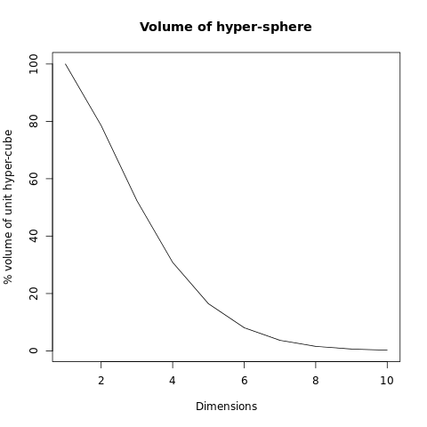
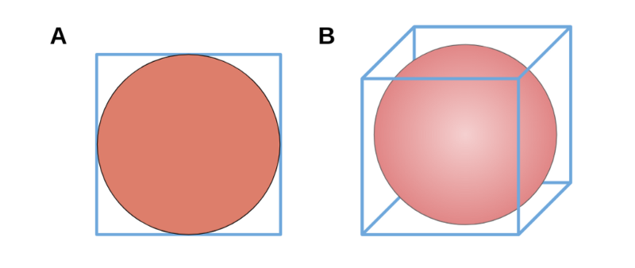
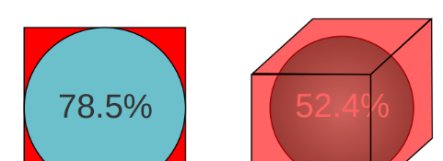
https://www.freecodecamp.org/news/the-curse-of-dimensionality-how-we-can-save-big-data-from-itself-d9fa0f872335/
Courtesy of Jacob Miller

Slide 11
Why reduce the dimension in data analysis?
Consider the points (0, 0, …, 0), (1, 0, …, 0), (10, 0, …, 0)
Add noise to first point (0, 0, …, 0) → (0, 1, …, 1)
In R¹⁰⁰, d((0, 1, …, 1), (1, 0, …, 0)) = 10 > 9.
Add small noise to first point (0, 0, …, 0) → (0, 0.1, …, 0.1)
In R^{39,900}, d((0, 0.1, …, 0.1), (1, 0, …, 0)) = 20 > 9.
0 1 10

Slide 12
PCA on all Genes
Leukemia data, precursor B and T
Plot of 34 patients, dimension of 8973 genes reduced to 2
www.cse.buffalo.edu/faculty/azhang/data-mining/pca.ppt

Slide 13
PCA on 100 top significant genes
Leukemia data, precursor B and T
Plot of 34 patients, dimension of 100 genes reduced to 2
www.cse.buffalo.edu/faculty/azhang/data-mining/pca.ppt

Slide 14
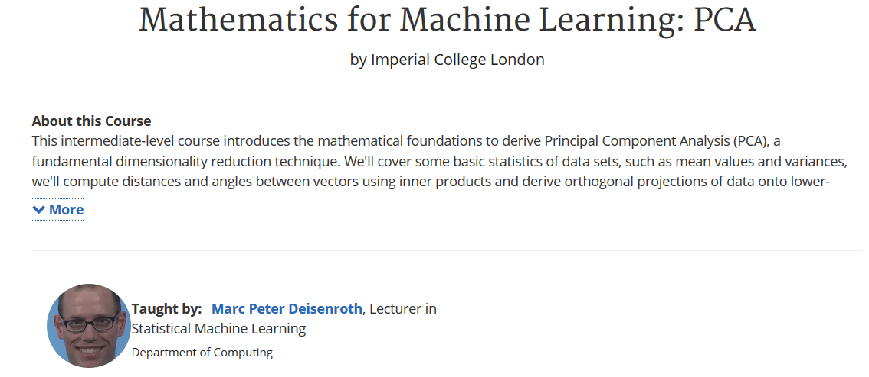
https://www.coursera.org/learn/pca-machine-learning/home/info

Slide 15
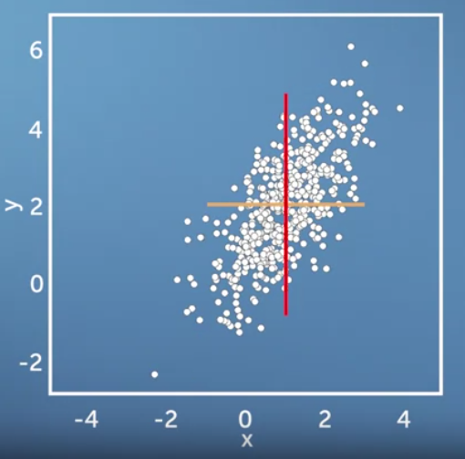
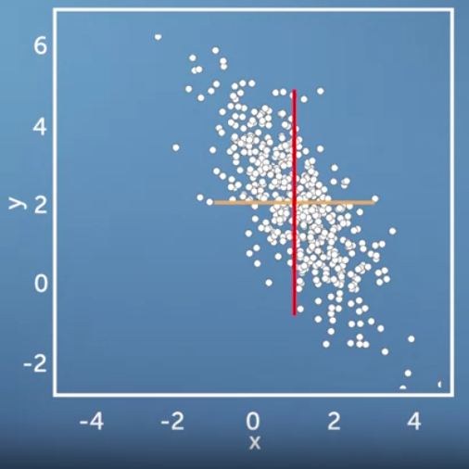
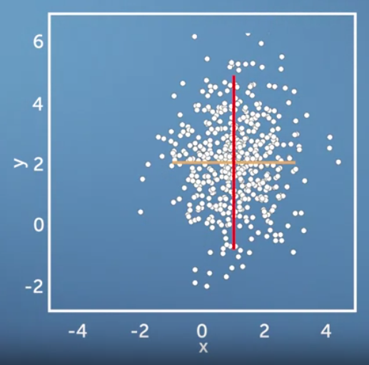
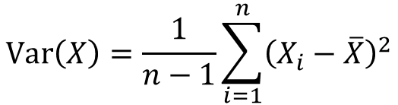
Same variance in x and y direction, but different co-variances
$$\operatorname{Var}\left(X\right)=\frac{1}{n−1}\sum_{i=1}^{n}{{\left(X_{i}−\overline{X}\right)}^{2}}$$
https://www.coursera.org/learn/pca-machine-learning/home/info

Slide 16
Now consider two dimensions
X=Temperature | Y=Humidity
40 | 90
40 | 90
40 | 90
30 | 90
15 | 70
15 | 70
15 | 70
30 | 90
15 | 70
30 | 70
30 | 70
30 | 90
40 | 70
30 | 90
Covariance: measures the
correlation between X and Y
cov(X,Y)=0: independent
Cov(X,Y)>0: move same dir
Cov(X,Y)<0: move oppo dir
www.cse.buffalo.edu/faculty/azhang/data-mining/pca.ppt

Slide 17
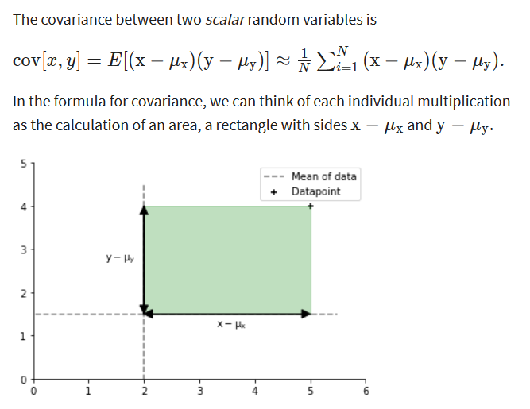
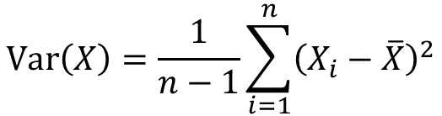
$$\operatorname{Var}\left(X\right)=\frac{1}{n−1}\sum_{i=1}^{n}{{\left(X_{i}−\overline{X}\right)}^{2}}$$
https://www.coursera.org/learn/pca-machine-learning/home/info

Slide 18
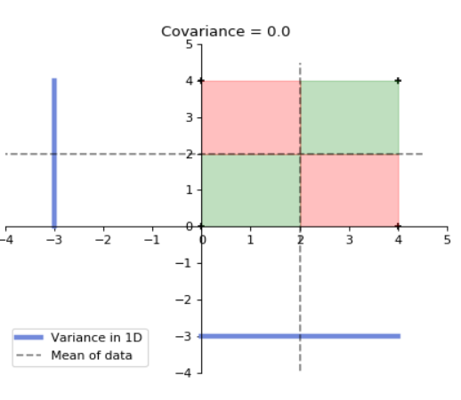
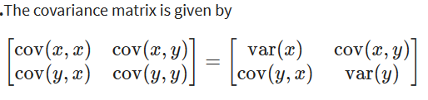
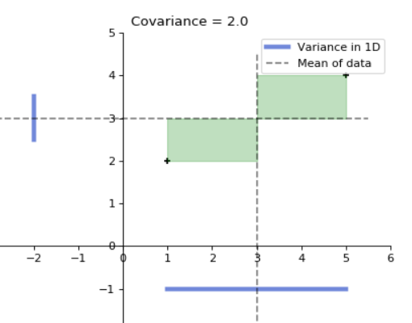
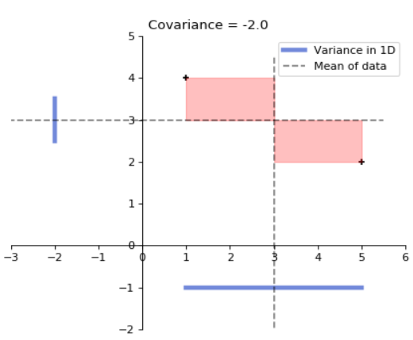
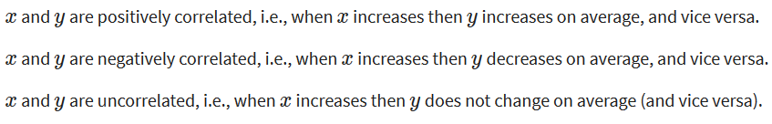
for 4 data points
for 2 data points
for 2 data points
https://www.coursera.org/learn/pca-machine-learning/home/info

Slide 20
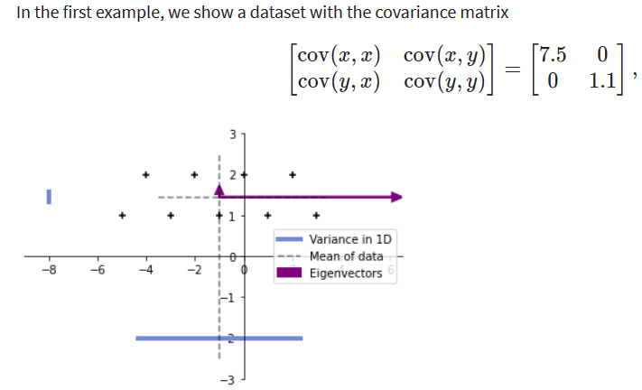
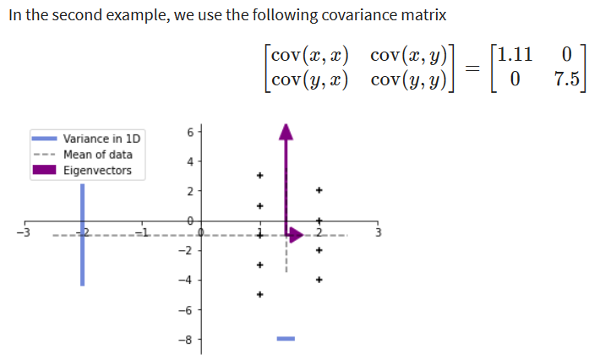
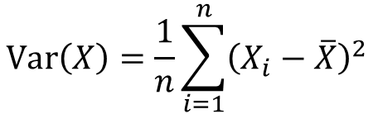
9 data points
$$\operatorname{Var}\left(X\right)=\frac{1}{n}\sum_{i=1}^{n}{{\left(X_{i}−\overline{X}\right)}^{2}}$$
https://www.coursera.org/learn/pca-machine-learning/home/info

Slide 21
More than two attributes: covariance matrix
Contains covariance values between all possible dimensions (=attributes):
Example for three attributes (x,y,z):
dxd
d = dimension
= # of attributes
or features.
www.cse.buffalo.edu/faculty/azhang/data-mining/pca.ppt

Slide 22



9 data points
= (0.963855, 0.0361446)
https://www.coursera.org/learn/pca-machine-learning/home/info

Slide 23
9 data points
Equal aspect ratio in python:
https://matplotlib.org/stable/gallery/subplots_axes_and_figures/axis_equal_demo.html
= (0.963855, 0.0361446)
https://www.coursera.org/learn/pca-machine-learning/home/info

Slide 24
9 data points
= (0.963855, 0.0361446)
https://www.coursera.org/learn/pca-machine-learning/home/info

Slide 25
Eigenvalues
Calculate eigenvalues λ and eigenvectors x for covariance matrix:
  Eigenvalues λ_{j} are used for calculation of [% of total variance] (V_{j}) for each component j:
www.cse.buffalo.edu/faculty/azhang/data-mining/pca.ppt

Slide 26
for 2 data points
https://www.coursera.org/learn/pca-machine-learning/home/info

Slide 27
Principal components
1. principal component (PC1)
  The eigenvalue with the largest absolute value will indicate that the data have the largest variance along its eigenvector, the direction along which there is greatest variation
2. principal component (PC2)
  the direction with maximum variation left in data, orthogonal to the 1. PC
In general, only few directions manage to capture most of the variability in the data.
www.cse.buffalo.edu/faculty/azhang/data-mining/pca.ppt

Slide 28
Eigenvalues
Calculate eigenvalues λ and eigenvectors x for covariance matrix:
  Eigenvalues λ_{j} are used for calculation of [% of total variance] (V_{j}) for each component j:
www.cse.buffalo.edu/faculty/azhang/data-mining/pca.ppt

Slide 29
Principal components - Variance
www.cse.buffalo.edu/faculty/azhang/data-mining/pca.ppt

Slide 30
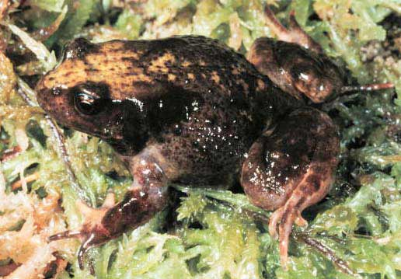
A more challenging example
data from research on habitat definition in the endangered Baw Baw frog
16 environmental and structural variables measured at each of 124 sites
correlation matrix used because variables have different units
Philoria frosti
http://www.csce.uark.edu/~xintaowu/5073/PCA1.ppt

Slide 31
Eigenvalues
Axis | Eigenvalue | % of Variance | Cumulative % of Variance
1 | 5.855 | 36.60 | 36.60
2 | 3.420 | 21.38 | 57.97
3 | 1.122 | 7.01 | 64.98
4 | 1.116 | 6.97 | 71.95
5 | 0.982 | 6.14 | 78.09
6 | 0.725 | 4.53 | 82.62
7 | 0.563 | 3.52 | 86.14
8 | 0.529 | 3.31 | 89.45
9 | 0.476 | 2.98 | 92.42
10 | 0.375 | 2.35 | 94.77
http://www.csce.uark.edu/~xintaowu/5073/PCA1.ppt

Slide 32
Interpreting Eigenvectors
 | 1 | 2 | 3
Altitude | 0.3842 | 0.0659 | -0.1177
pH | -0.1159 | 0.1696 | -0.5578
Cond | -0.2729 | -0.1200 | 0.3636
TempSurf | 0.0538 | -0.2800 | 0.2621
Relief | -0.0765 | 0.3855 | -0.1462
maxERht | 0.0248 | 0.4879 | 0.2426
avERht | 0.0599 | 0.4568 | 0.2497
%ER | 0.0789 | 0.4223 | 0.2278
%VEG | 0.3305 | -0.2087 | -0.0276
%LIT | -0.3053 | 0.1226 | 0.1145
%LOG | -0.3144 | 0.0402 | -0.1067
%W | -0.0886 | -0.0654 | -0.1171
H1Moss | 0.1364 | -0.1262 | 0.4761
DistSWH | -0.3787 | 0.0101 | 0.0042
DistSW | -0.3494 | -0.1283 | 0.1166
DistMF | 0.3899 | 0.0586 | -0.0175
correlations between variables and the principal axes are known as loadings
each element of the eigenvectors represents the contribution of a given variable to a component
http://www.csce.uark.edu/~xintaowu/5073/PCA1.ppt

Slide 33
Steps of PCA
Let be the mean vector (taking the mean of all rows)
Adjust the original data by the mean
  X’ = X –
Compute the covariance matrix C of adjusted X
Find the eigenvectors and eigenvalues of C.
For matrix C, vectors e (=column vector) having same direction as Ce :
  eigenvectors of C is e such that Ce=λe,
  λ is called an eigenvalue of C.
Ce=λe ⇔ (C-λI)e=0
  Most data mining packages do this for you.
www.cse.buffalo.edu/faculty/azhang/data-mining/pca.ppt

Slide 34
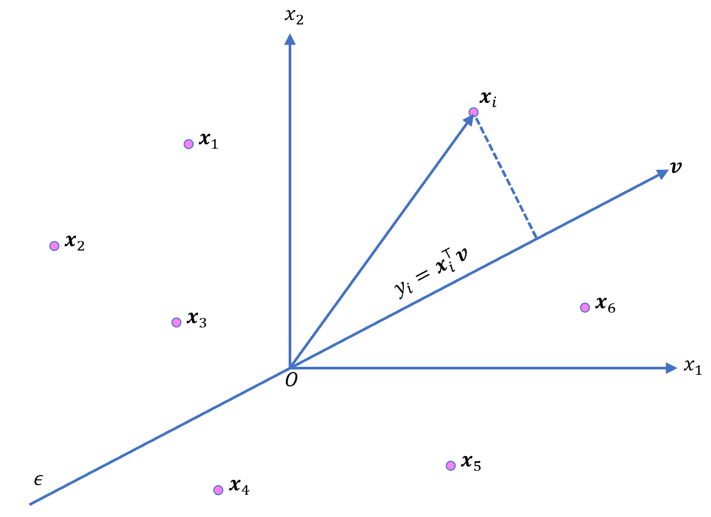
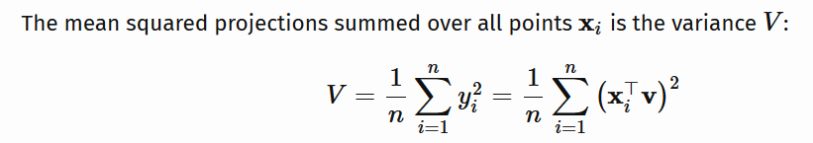
Translate data so mean is at the origin. Let v be a unit vector
https://ekamperi.github.io/mathematics/2020/11/01/principal-component-analysis-lagrange-multiplier.html

Slide 35
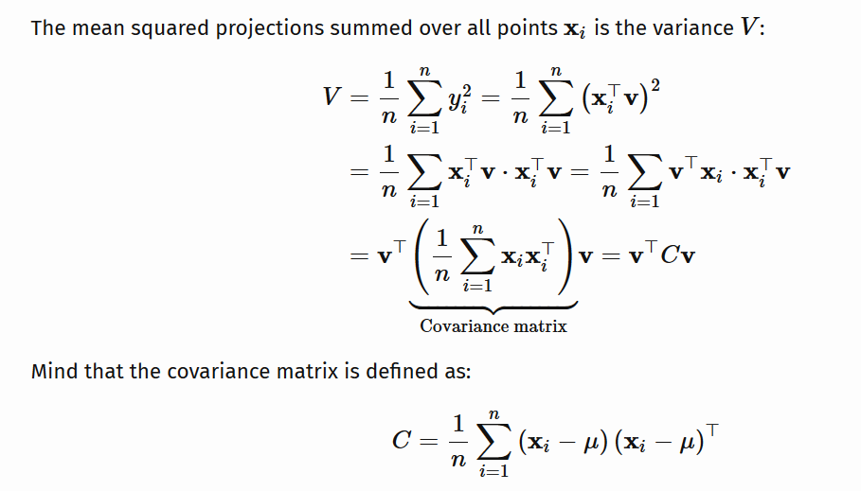
https://ekamperi.github.io/mathematics/2020/11/01/principal-component-analysis-lagrange-multiplier.html

Slide 36
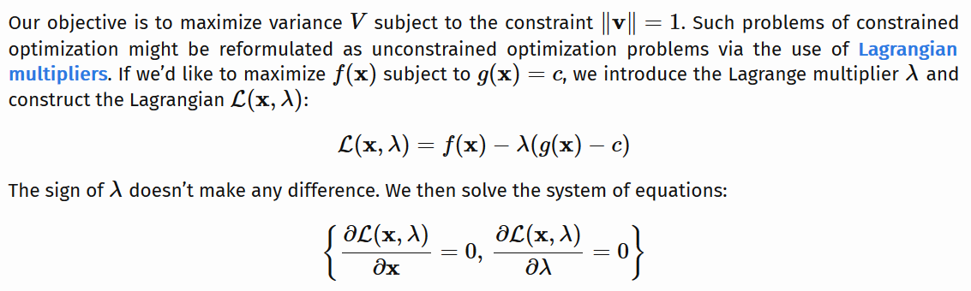
https://ekamperi.github.io/mathematics/2020/11/01/principal-component-analysis-lagrange-multiplier.html

Slide 37
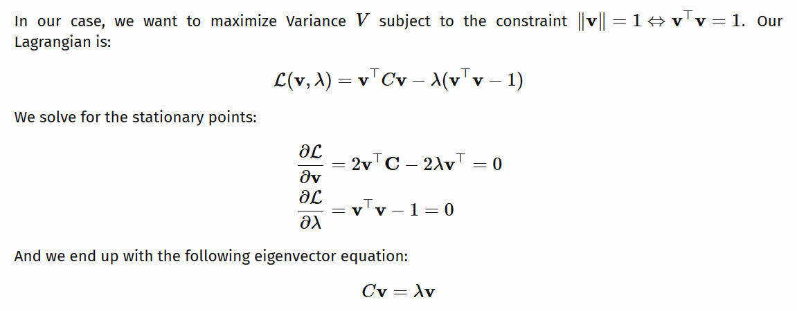
By taking the transpose of the first equation since C is symmetric.
https://ekamperi.github.io/mathematics/2020/11/01/principal-component-analysis-lagrange-multiplier.html

Slide 38
Example: Principle component analysis (PCA)
x_{i} → z_{i} = linear combination of x_{i}
http://en.wikipedia.org/wiki/File:GaussianScatterPCA.png

Slide 39
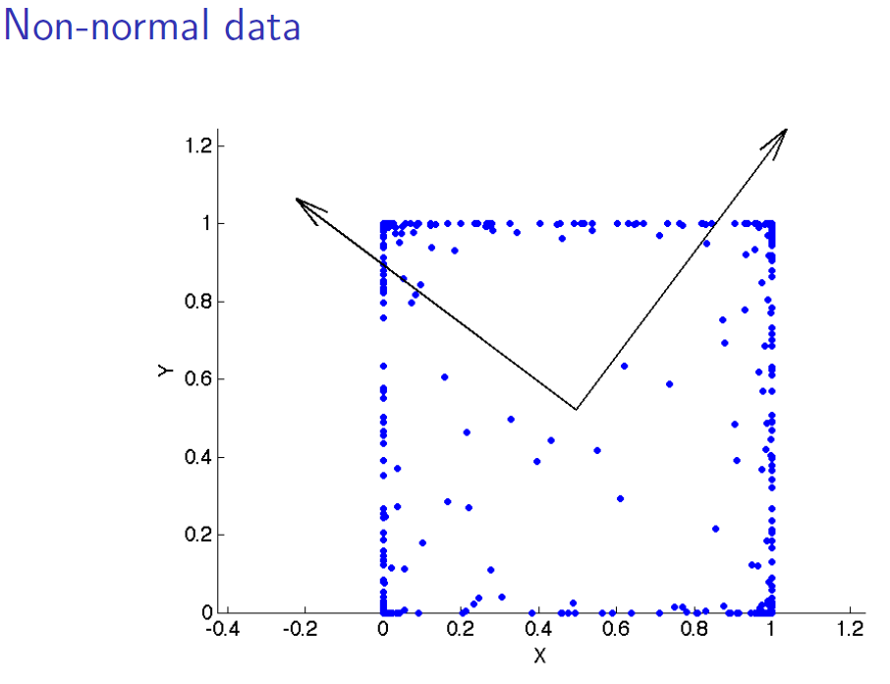
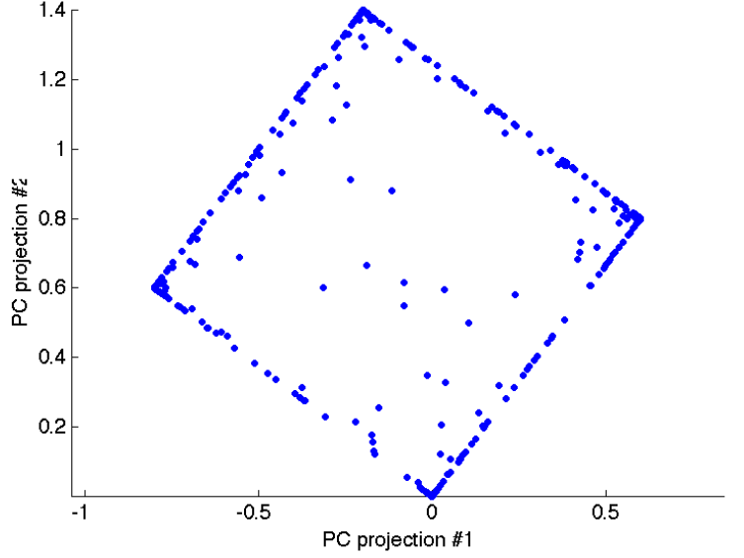
www.stat.columbia.edu/~fwood/Teaching/w4315/Fall2009/pca.pdf

Slide 40
If you do NOT want to change your basis, you can calculate standard deviation for each variable and only keep the variables with high standard deviation.
You can then visualize your dataset using PCA.

Slide 41
https://www.kdnuggets.com/2022/10/classification-metrics-walkthrough-logistic-regression-accuracy-precision-recall-roc.html

