Slide 1
Poster Title
Authors
Affiliations
Introduction
Results
Conclusions
Include lots of figures and detailed figure captions.
Bullet points are much better than long paragraphs.
You do not need to use the headings in this sample.
Teach us one thing.
You can do that using your data (ie from written project) or if you have a good artificial data example, you can use that.
You can easily resize the columns if (for example) a wider middle column better accommodates your figures.
If you are working in a group:
Both names should be listed as authors. However,
You should each turn in a different poster as you will be giving different presentations
Posters can be related, but there should be an important difference. For example, you may each cover a different technique.
Bullet point is too small

Slide 2
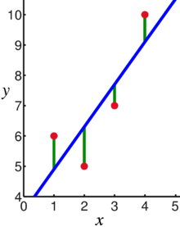
Linear regression = Least squares line (single variable x)
(or hyperplane for multiple variables)
LABELED DATA
$$RSS = \sum{{\left(y_{i}−f\left(x_{i}\right)\right)}^{2}}$$
Supervised learning
Data: x_{i} = input data with no noise
y_{i} = labels
Find function
f: R → R
f(x) = mx + b
x = independent variable
y = dependent variable
(x, y) → (x, y’)
https://en.wikipedia.org/wiki/Linear_regression

Slide 3
PCA: perturb all variables (x, y) → (x’, y’)
UNLABELED DATA
Not the least squares line.
1st PCA component
= direction of most variance
direction = eigenvector with
largest eigenvalue.
2nd PCA
= direction of 2nd most variance,
perpendicular to first.
direction = eigenvector with
2nd largest eigenvalue.
Modified from
https://en.wikipedia.org/wiki/Linear_regression

Slide 4
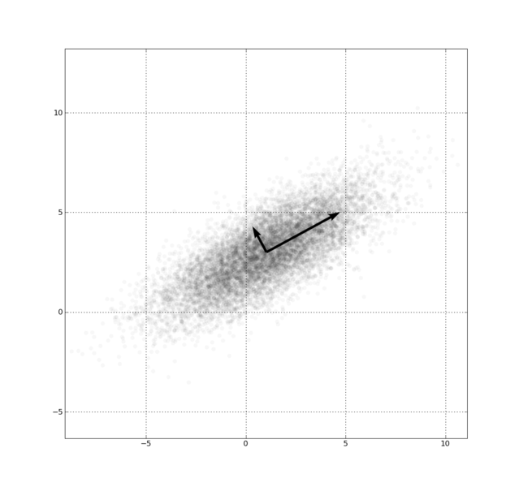
Example: Principal component analysis (PCA)
x_{i} → z_{i} = linear combination of x_{i}
http://en.wikipedia.org/wiki/File:GaussianScatterPCA.png

Slide 5
https://www.coursera.org/learn/pca-machine-learning/home/info

Slide 6
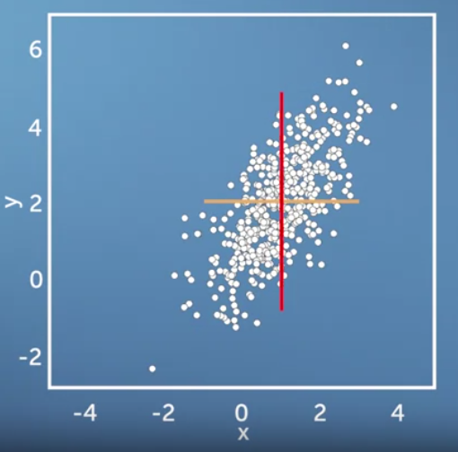
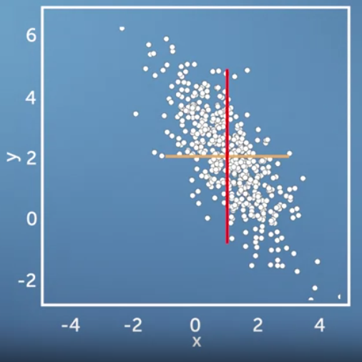
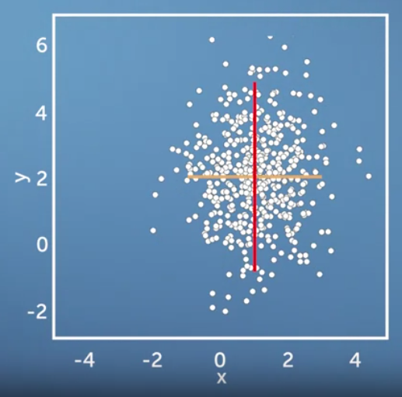
Same variance in x and y direction, but different co-variances
$$\operatorname{Var}\left(X\right)=\frac{1}{n−1}\sum_{i=1}^{n}{{\left(X_{i}−\overline{X}\right)}^{2}}$$
https://www.coursera.org/learn/pca-machine-learning/home/info

Slide 7
Now consider two dimensions
X=Temperature | Y=Humidity
40 | 90
40 | 90
40 | 90
30 | 90
15 | 70
15 | 70
15 | 70
30 | 90
15 | 70
30 | 70
30 | 70
30 | 90
40 | 70
30 | 90
Covariance: measures the correlation between X and Y
cov(X,Y)=0: independent
Cov(X,Y)>0: move same dir
Cov(X,Y)<0: move oppo dir
www.cse.buffalo.edu/faculty/azhang/data-mining/pca.ppt

Slide 8
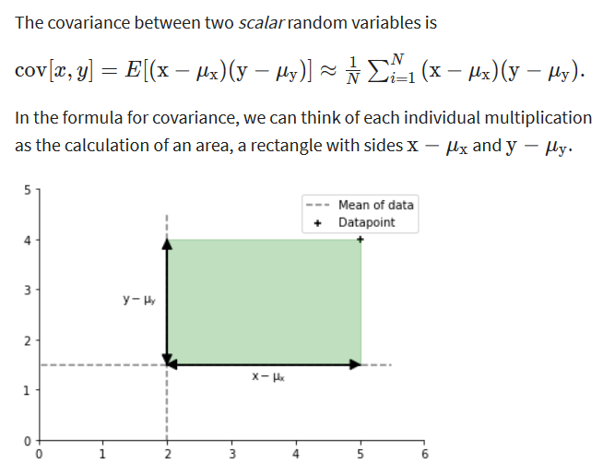
$$\operatorname{Var}\left(X\right)=\frac{1}{n−1}\sum_{i=1}^{n}{{\left(X_{i}−\overline{X}\right)}^{2}}$$
https://www.coursera.org/learn/pca-machine-learning/home/info

Slide 9
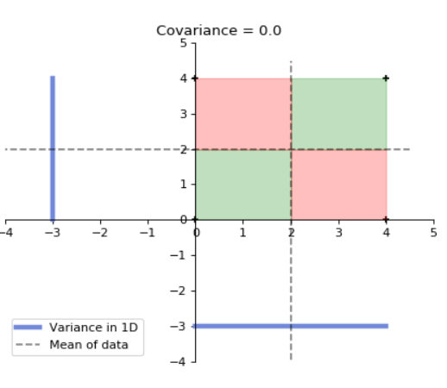
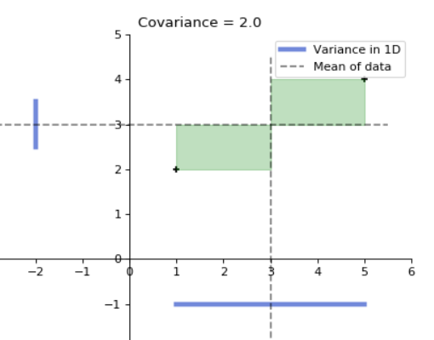
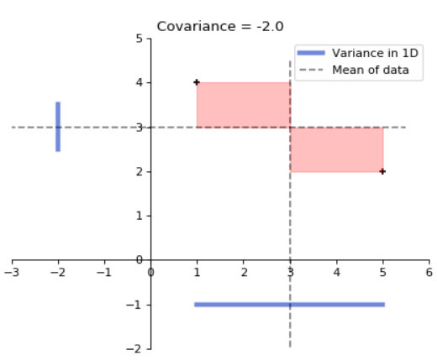
for 4 data points
for 2 data points
for 2 data points
https://www.coursera.org/learn/pca-machine-learning/home/info

Slide 11
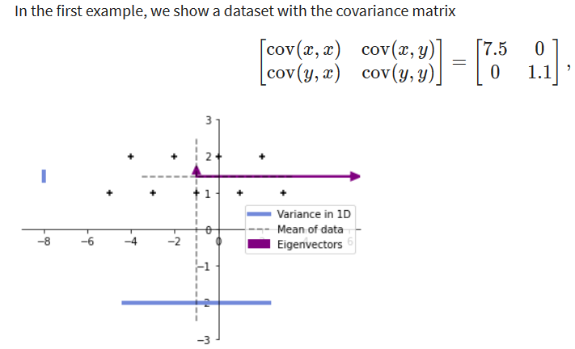
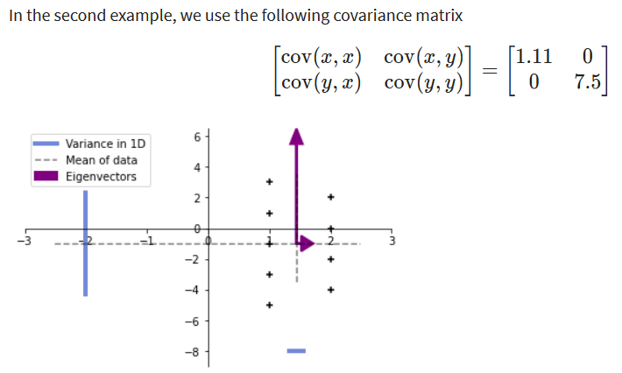
9 data points
$$\operatorname{Var}\left(X\right)=\frac{1}{n}\sum_{i=1}^{n}{{\left(X_{i}−\overline{X}\right)}^{2}}$$
https://www.coursera.org/learn/pca-machine-learning/home/info

Slide 12
More than two attributes: covariance matrix
Contains covariance values between all possible dimensions (=attributes):
Example for three attributes (x,y,z):
dxd
d = dimension
= # of attributes
or features.
www.cse.buffalo.edu/faculty/azhang/data-mining/pca.ppt

Slide 13
9 data points
= (0.963855, 0.0361446)
https://www.coursera.org/learn/pca-machine-learning/home/info

Slide 14
9 data points
Equal aspect ratio in python:
https://matplotlib.org/stable/gallery/subplots_axes_and_figures/axis_equal_demo.html
= (0.963855, 0.0361446)
https://www.coursera.org/learn/pca-machine-learning/home/info

Slide 15
9 data points
= (0.963855, 0.0361446)
https://www.coursera.org/learn/pca-machine-learning/home/info

Slide 16
Eigenvalues
Calculate eigenvalues λ and eigenvectors x for covariance matrix:
Eigenvalues λ_{j} are used for calculation of [% of total variance] (V_{j}) for each component j:
www.cse.buffalo.edu/faculty/azhang/data-mining/pca.ppt

Slide 17
for 2 data points
https://www.coursera.org/learn/pca-machine-learning/home/info

Slide 18
Principal components
1. principal component (PC1)
The eigenvalue with the largest absolute value will indicate that the data have the largest variance along its eigenvector, the direction along which there is greatest variation
2. principal component (PC2)
the direction with maximum variation left in data, orthogonal to the 1. PC
In general, only few directions manage to capture most of the variability in the data.
www.cse.buffalo.edu/faculty/azhang/data-mining/pca.ppt

Slide 19
Eigenvalues
Calculate eigenvalues λ and eigenvectors x for covariance matrix:
Eigenvalues λ_{j} are used for calculation of [% of total variance] (V_{j}) for each component j:
www.cse.buffalo.edu/faculty/azhang/data-mining/pca.ppt

Slide 20
Principal components - Variance
www.cse.buffalo.edu/faculty/azhang/data-mining/pca.ppt

Slide 21
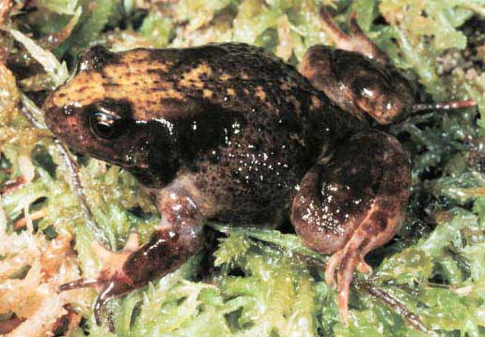
A more challenging example
data from research on habitat definition in the endangered Baw Baw frog
16 environmental and structural variables measured at each of 124 sites
correlation matrix used because variables have different units
Philoria frosti
http://www.csce.uark.edu/~xintaowu/5073/PCA1.ppt

Slide 22
Eigenvalues
Axis | Eigenvalue | % of Variance | Cumulative % of Variance
1 | 5.855 | 36.60 | 36.60
2 | 3.420 | 21.38 | 57.97
3 | 1.122 | 7.01 | 64.98
4 | 1.116 | 6.97 | 71.95
5 | 0.982 | 6.14 | 78.09
6 | 0.725 | 4.53 | 82.62
7 | 0.563 | 3.52 | 86.14
8 | 0.529 | 3.31 | 89.45
9 | 0.476 | 2.98 | 92.42
10 | 0.375 | 2.35 | 94.77
http://www.csce.uark.edu/~xintaowu/5073/PCA1.ppt

Slide 23
Interpreting Eigenvectors
 | 1 | 2 | 3
Altitude | 0.3842 | 0.0659 | -0.1177
pH | -0.1159 | 0.1696 | -0.5578
Cond | -0.2729 | -0.1200 | 0.3636
TempSurf | 0.0538 | -0.2800 | 0.2621
Relief | -0.0765 | 0.3855 | -0.1462
maxERht | 0.0248 | 0.4879 | 0.2426
avERht | 0.0599 | 0.4568 | 0.2497
%ER | 0.0789 | 0.4223 | 0.2278
%VEG | 0.3305 | -0.2087 | -0.0276
%LIT | -0.3053 | 0.1226 | 0.1145
%LOG | -0.3144 | 0.0402 | -0.1067
%W | -0.0886 | -0.0654 | -0.1171
H1Moss | 0.1364 | -0.1262 | 0.4761
DistSWH | -0.3787 | 0.0101 | 0.0042
DistSW | -0.3494 | -0.1283 | 0.1166
DistMF | 0.3899 | 0.0586 | -0.0175
correlations between variables and the principal axes are known as loadings
each element of the eigenvectors represents the contribution of a given variable to a component
http://www.csce.uark.edu/~xintaowu/5073/PCA1.ppt

Slide 24
Steps of PCA
Let be the mean vector (taking the mean of all rows)
Adjust the original data by the mean
X’ = X –
Compute the covariance matrix C of adjusted X
Find the eigenvectors and eigenvalues of C.
For matrix C, vectors e (=column vector) having same direction as Ce :
eigenvectors of C is e such that Ce=λe,
λ is called an eigenvalue of C.
Ce=λe ⇔ (C-λI)e=0
Most data mining packages do this for you.
www.cse.buffalo.edu/faculty/azhang/data-mining/pca.ppt

Slide 25
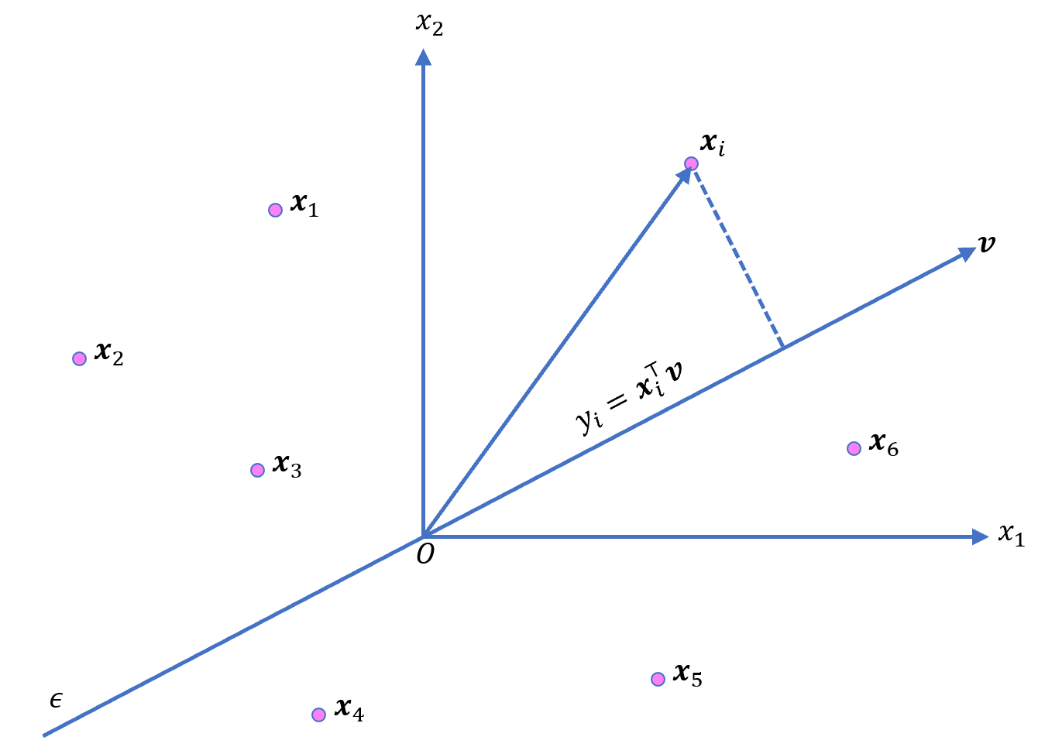
Translate data so mean is at the origin. Let v be a unit vector
https://ekamperi.github.io/mathematics/2020/11/01/principal-component-analysis-lagrange-multiplier.html

Slide 26
https://ekamperi.github.io/mathematics/2020/11/01/principal-component-analysis-lagrange-multiplier.html

Slide 27
https://ekamperi.github.io/mathematics/2020/11/01/principal-component-analysis-lagrange-multiplier.html

Slide 28
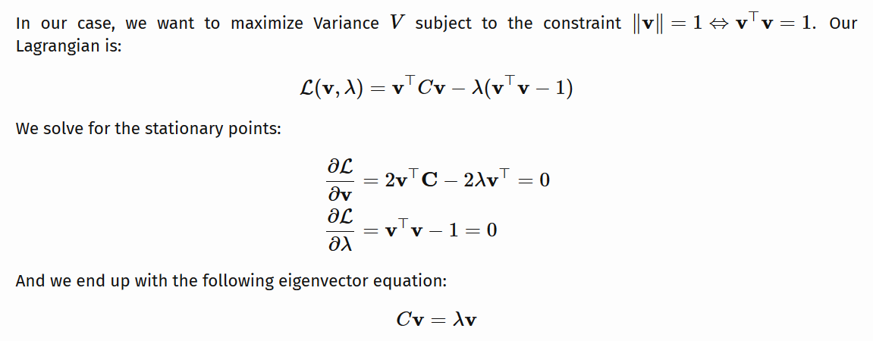
By taking the transpose of the first equation since C is symmetric.
https://ekamperi.github.io/mathematics/2020/11/01/principal-component-analysis-lagrange-multiplier.html

Slide 29
Example: Principle component analysis (PCA)
x_{i} → z_{i} = linear combination of x_{i}
http://en.wikipedia.org/wiki/File:GaussianScatterPCA.png

Slide 30
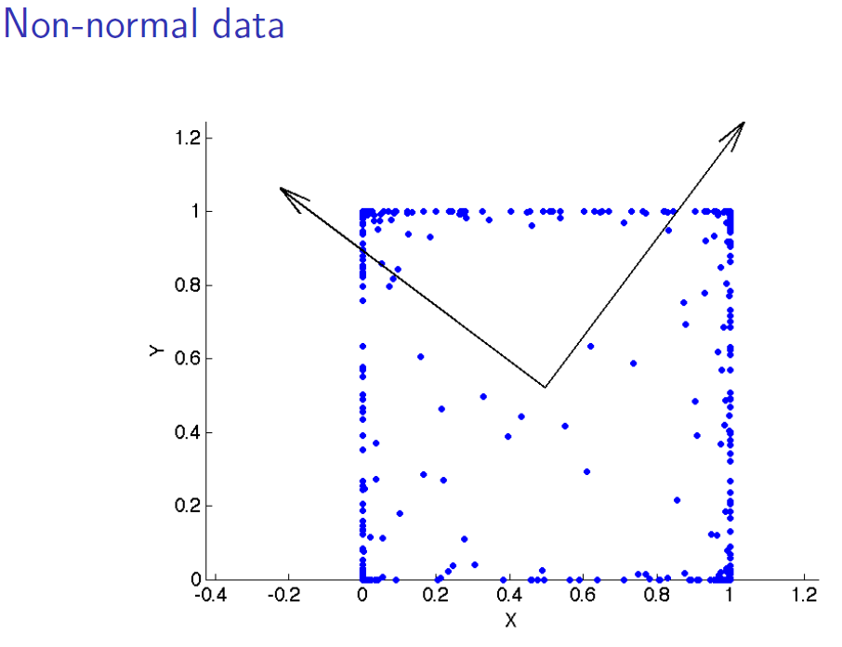
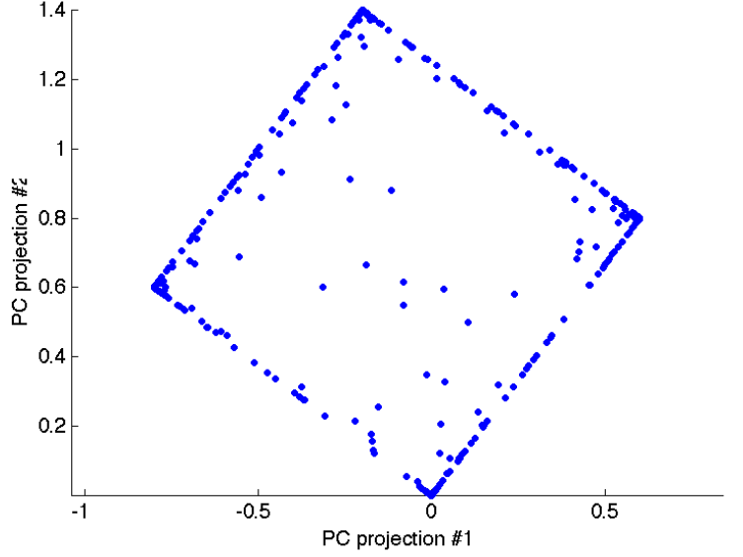
www.stat.columbia.edu/~fwood/Teaching/w4315/Fall2009/pca.pdf

Slide 31
https://www.kdnuggets.com/2022/10/classification-metrics-walkthrough-logistic-regression-accuracy-precision-recall-roc.html

