Slide 1
Please complete both
1.) Attendance survey (first question is graded)
2.) ACE survey
Both are available on ICON.

Slide 2
$$f\left(x\right)=a_{0}+a_{1}x_{1}+ax_{2}+⋯+a_{n}x_{n}$$
StatQuest: Linear Models Pt.1 - Linear Regression https://www.youtube.com/watch?v=nk2CQITm_eo

Slide 3
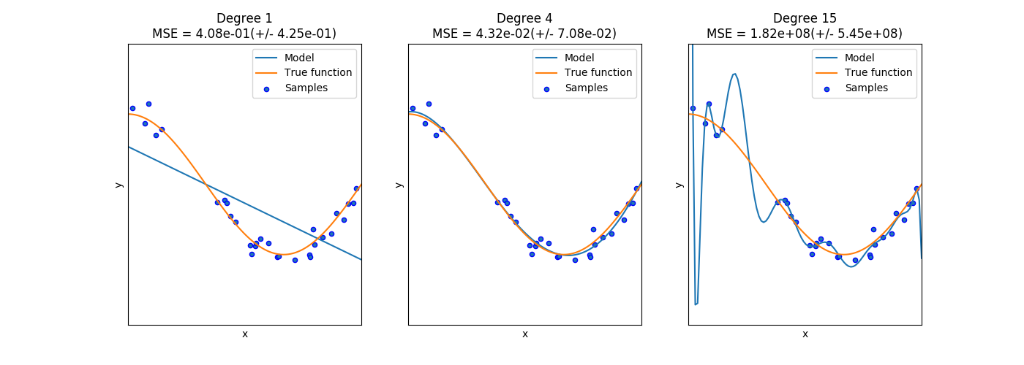
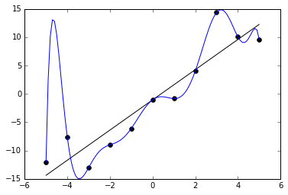
Ivan Meza http://turing.iimas.unam.mx/~ivanvladimir/slides/rpyaa/02_regression.html#/60
Underfitting versus overfitting
$$Ex: f\left(x\right)=a_{0}+a_{1}x+…+a_{n}x^{n}$$
https://it.wikipedia.org/wiki/Overfitting

Slide 4
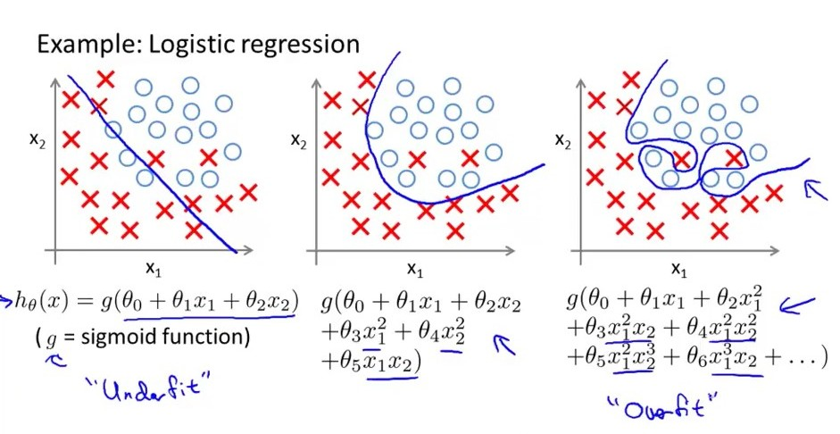
Underfitting versus overfitting
https://stats.stackexchange.com/questions/71946/overfitting-a-logistic-regression-model

Slide 5
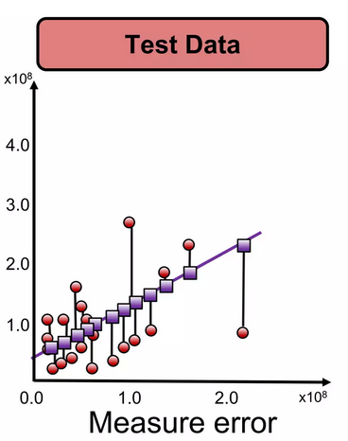
To avoid overfitting due to too many parameters:
https://www.slideshare.net/ankit_ppt/ml2-train-testsplitsvalidationlinearregression

Slide 6
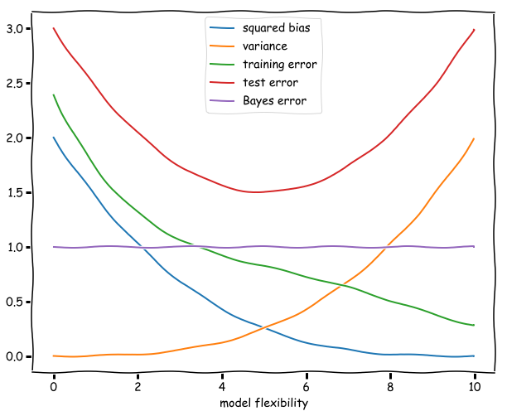
Squared bias. This is the error in our model introduced by the difference of our approximation and the true underlying function. A more flexible model will be increasingly similar, and the squared bias therefore dimishes as the flexibility increases. (It might even reach zero if for example the underlying function is a polynomial and by increasing the flexibility at a certain point we include the polynomials of this degree in our hypothesis space.)
Theoretical:
Squared bias compares the correct function to its approximation. For example, comparing the error between a function and Taylor series approximations.
https://botlnec.github.io/islp/sols/chapter2/exercise3/

Slide 7
Ivan Meza http://turing.iimas.unam.mx/~ivanvladimir/slides/rpyaa/02_regression.html#/60
Theoretical:
Squared bias compares the correct function to its approximation. For example, comparing the error between a function and Taylor series approximations.
https://botlnec.github.io/islp/sols/chapter2/exercise3/

Slide 8
Variance. In the limit of a model with no flexibility the variance will be zero, since the model fit will be independent of the data. As the flexibility increases the variance will increase as well since the noise in a particular training set will correspondingly captured by the model. The curve described by the variance is a monotonically increasing function of the flexibility of the model.
The larger the number of parameters, the larger the effect of noise.
https://botlnec.github.io/islp/sols/chapter2/exercise3/

Slide 9
Bias vs Variance trade-off
The larger the number of parameters, the larger the effect of noise.
Thus variance increases as the number of parameters increase.
Squared bias compares the correct
function to its approximation.
For example, comparing the error
between a function and its Taylor
series approximations.
Thus squared bias decreases as the
number of parameters increase.
Note the bias vs variance trade-off
https://botlnec.github.io/islp/sols/chapter2/exercise3/

Slide 10
Training error. The training error is given by the average (squared) difference between the predictions of the model and the observations. If a model if very unflexible this can be quite high, but as the flexibility increases this difference will decrease. If we consider polynomials for example increasing the flexibility of the model might mean increasing the degree of the polynomial to be fitted. The additional degrees of freedom will decrease the average difference and reduce the training error.
https://botlnec.github.io/islp/sols/chapter2/exercise3/

Slide 11
Test error. The expected test error is given by the formula: Variance + Bias + Bayes error, all of which are non-negative. The Bayes error is constant and a lower bound for the test error. The test error has a minimum at an intermediate level of flexibility: not too flexible, so that the variance does not dominate, and not too unflexible, so that the squared bias is not too high.
The plot of the test error thus resembles
sort of an upward (deformed) parabola:
high for unflexible models,
decreasing as flexibility increases
until it reaches a minimum.
Then the variance starts to dominate
and the test error starts increasing.
The distance between this minimum
and the Bayes irreducible error gives
us an idea of how well the best
function in the hypothesis space will fit.
https://botlnec.github.io/islp/sols/chapter2/exercise3/

Slide 12
Test error. The expected error when measuring the test data set
The test error has a minimum at an intermediate level of flexibility: not too flexible, so that the variance does not dominate, and not too unflexible, so that the squared bias is not too high.
https://botlnec.github.io/islp/sols/chapter2/exercise3/

Slide 13
Test error. The expected error when measuring the test data set
The test error has a minimum at an
intermediate level of flexibility: not too
flexible, so that the variance does not
dominate, and not too unflexible, so
that the squared bias is not too high.
The plot of the test error thus resembles
sort of an upward (deformed) parabola:
high for unflexible models, decreasing as
flexibility increases until it reaches a minimum.
Then the variance starts to dominate and
the test error starts increasing.
https://botlnec.github.io/islp/sols/chapter2/exercise3/

Slide 14
Ivan Meza http://turing.iimas.unam.mx/~ivanvladimir/slides/rpyaa/02_regression.html#/60
Underfitting versus overfitting
$$Ex: f\left(x\right)=a_{0}+a_{1}x+…+a_{n}x^{n}$$
https://botlnec.github.io/islp/sols/chapter2/exercise3/

Slide 15
How do you split the data?

Slide 16
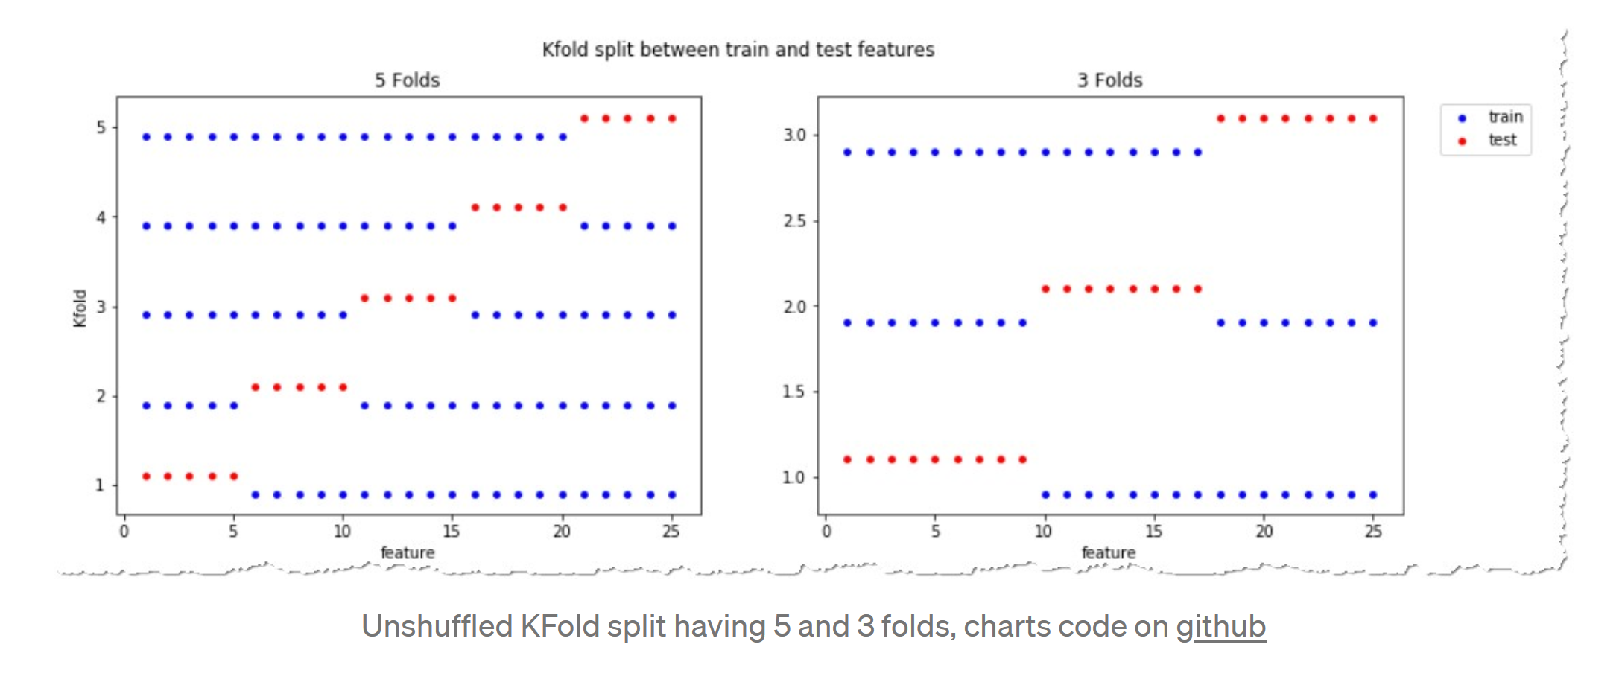
https://towardsdatascience.com/complete-guide-to-pythons-cross-validation-with-examples-a9676b5cac12

Slide 17
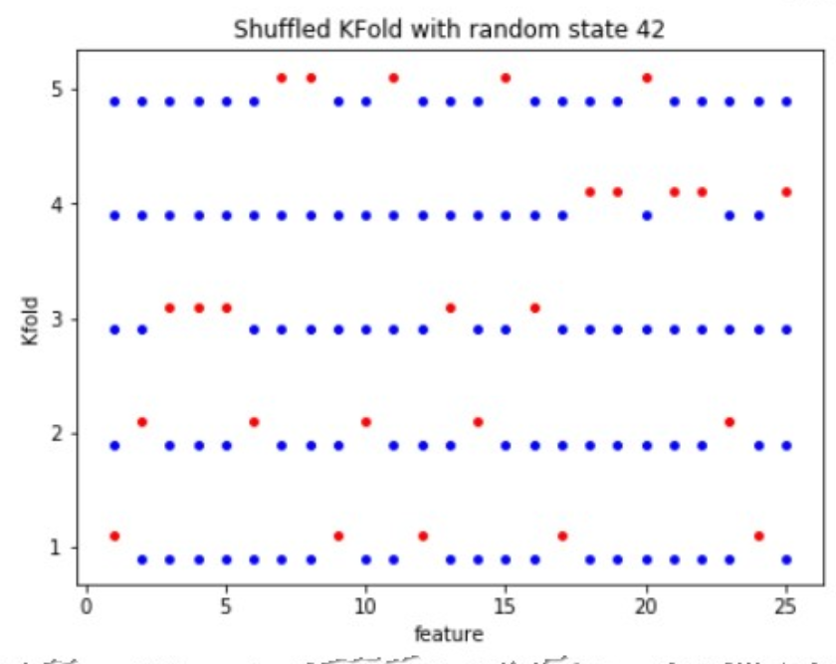
https://towardsdatascience.com/complete-guide-to-pythons-cross-validation-with-examples-a9676b5cac12

Slide 18
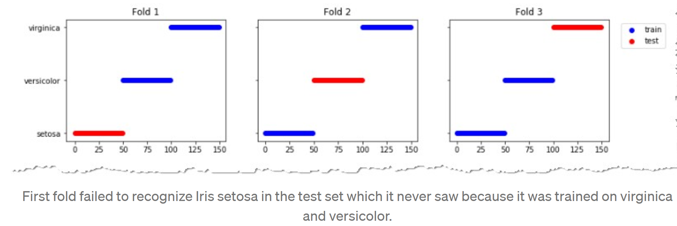
https://towardsdatascience.com/complete-guide-to-pythons-cross-validation-with-examples-a9676b5cac12

Slide 19
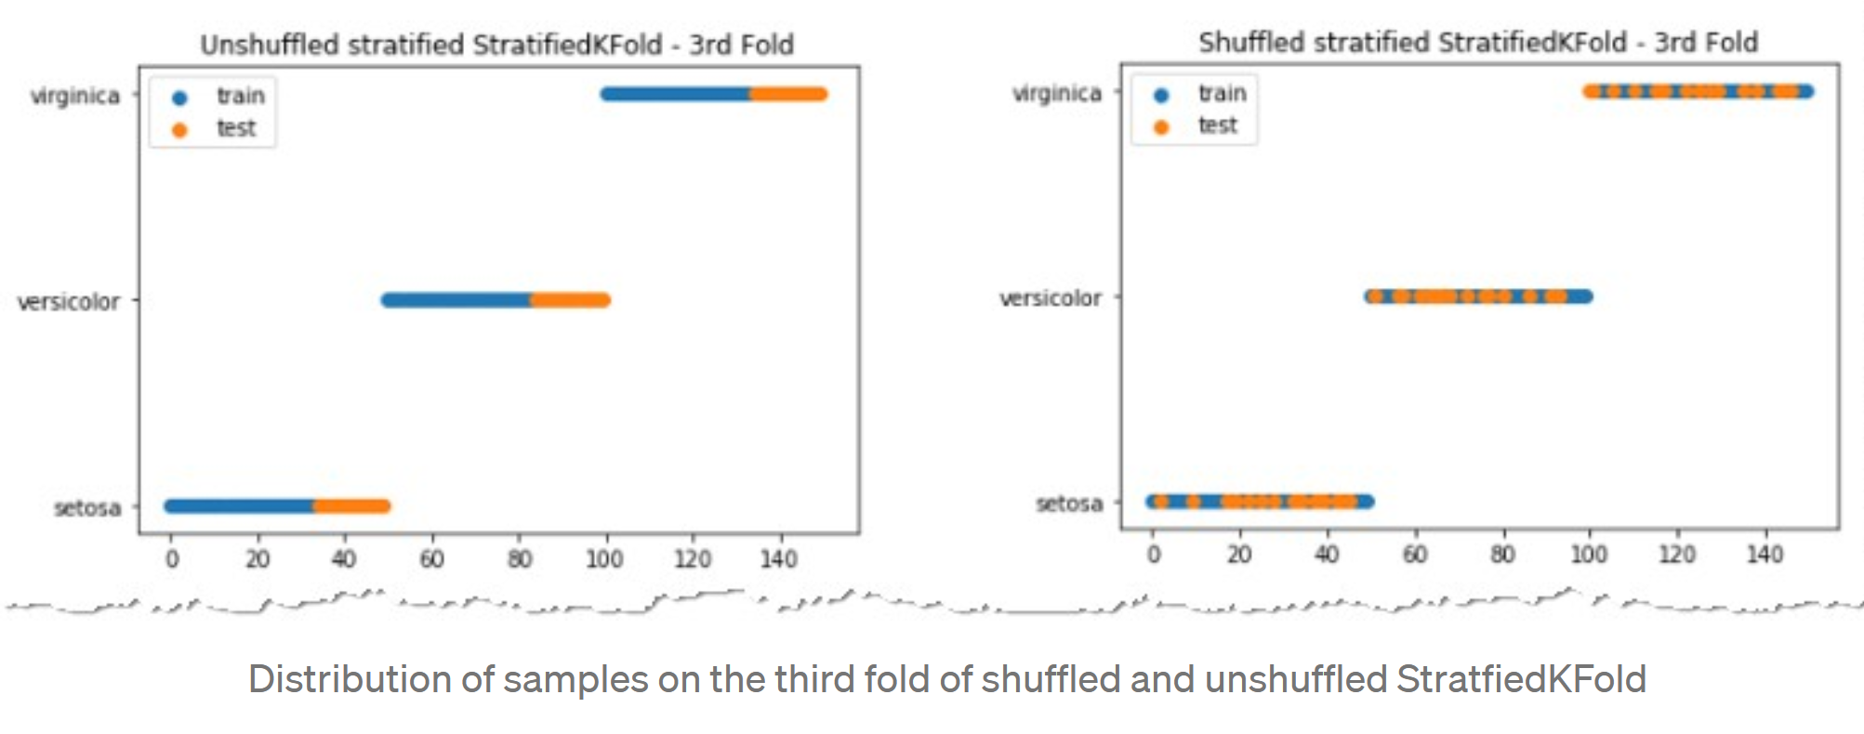
This cross-validation object is a variation of KFold that returns stratified folds. The folds are made by preserving the percentage of samples for each class.
class sklearn.model_selection.StratifiedKFold(n_splits=5, *, shuffle=False, random_state=None)
https://towardsdatascience.com/complete-guide-to-pythons-cross-validation-with-examples-a9676b5cac12

Slide 20
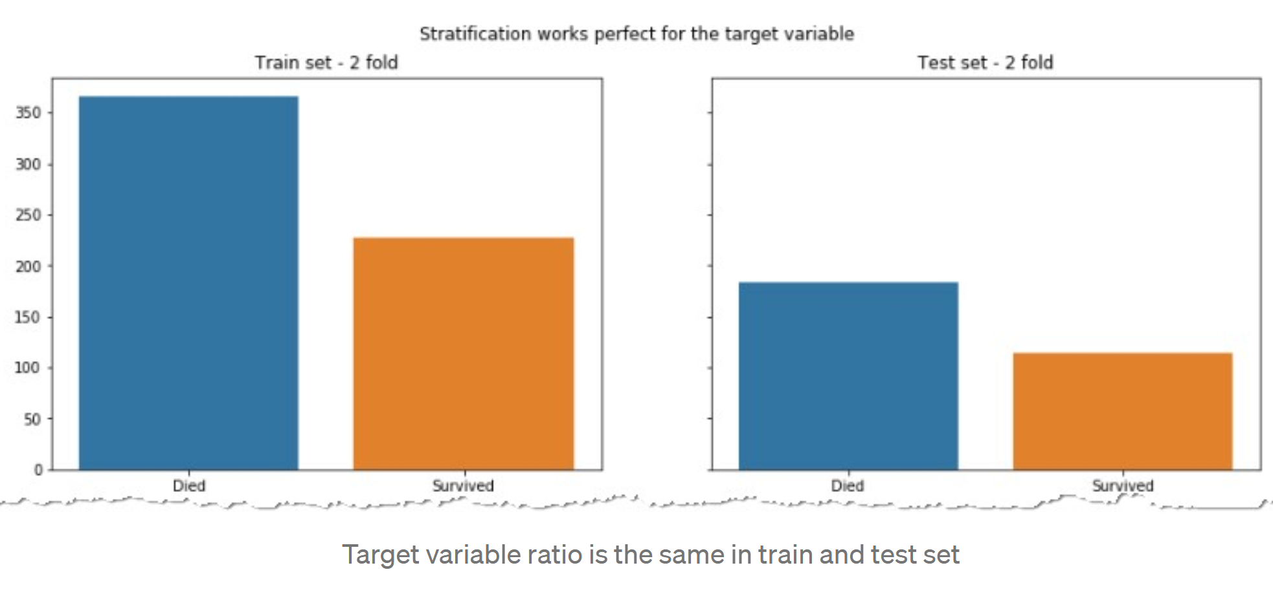
For target variable, ratio of label died vs survived is similar in both the train and test sets.
This need not be true of the input features.
https://towardsdatascience.com/complete-guide-to-pythons-cross-validation-with-examples-a9676b5cac12

Slide 21
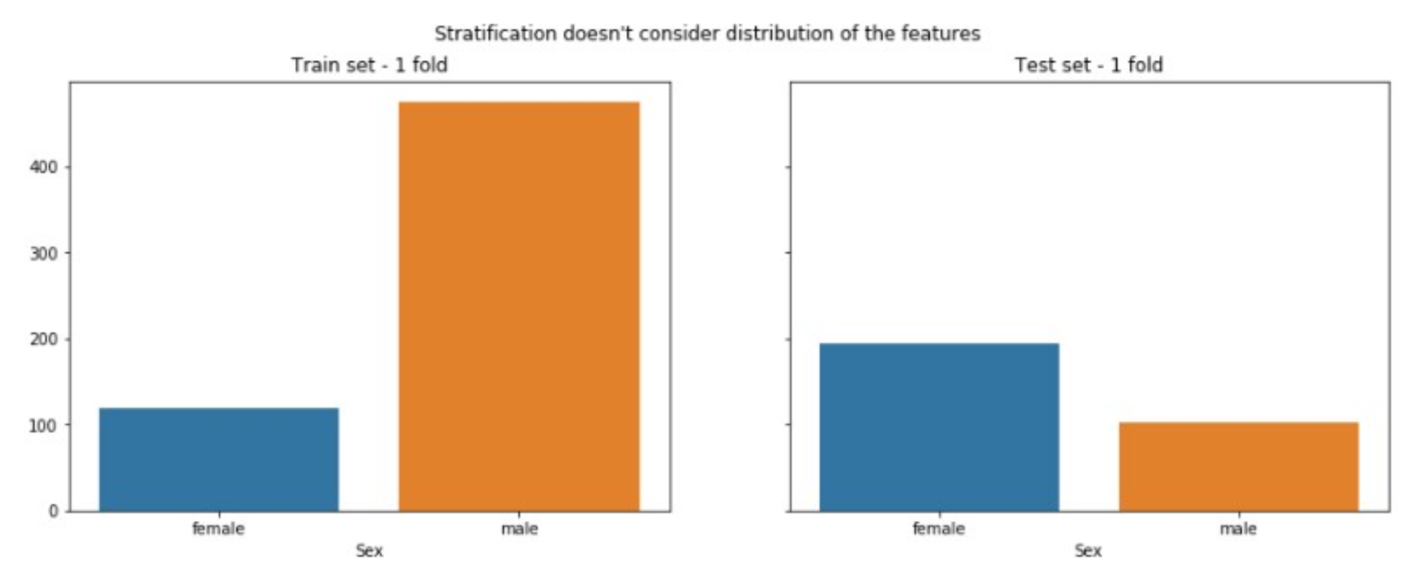
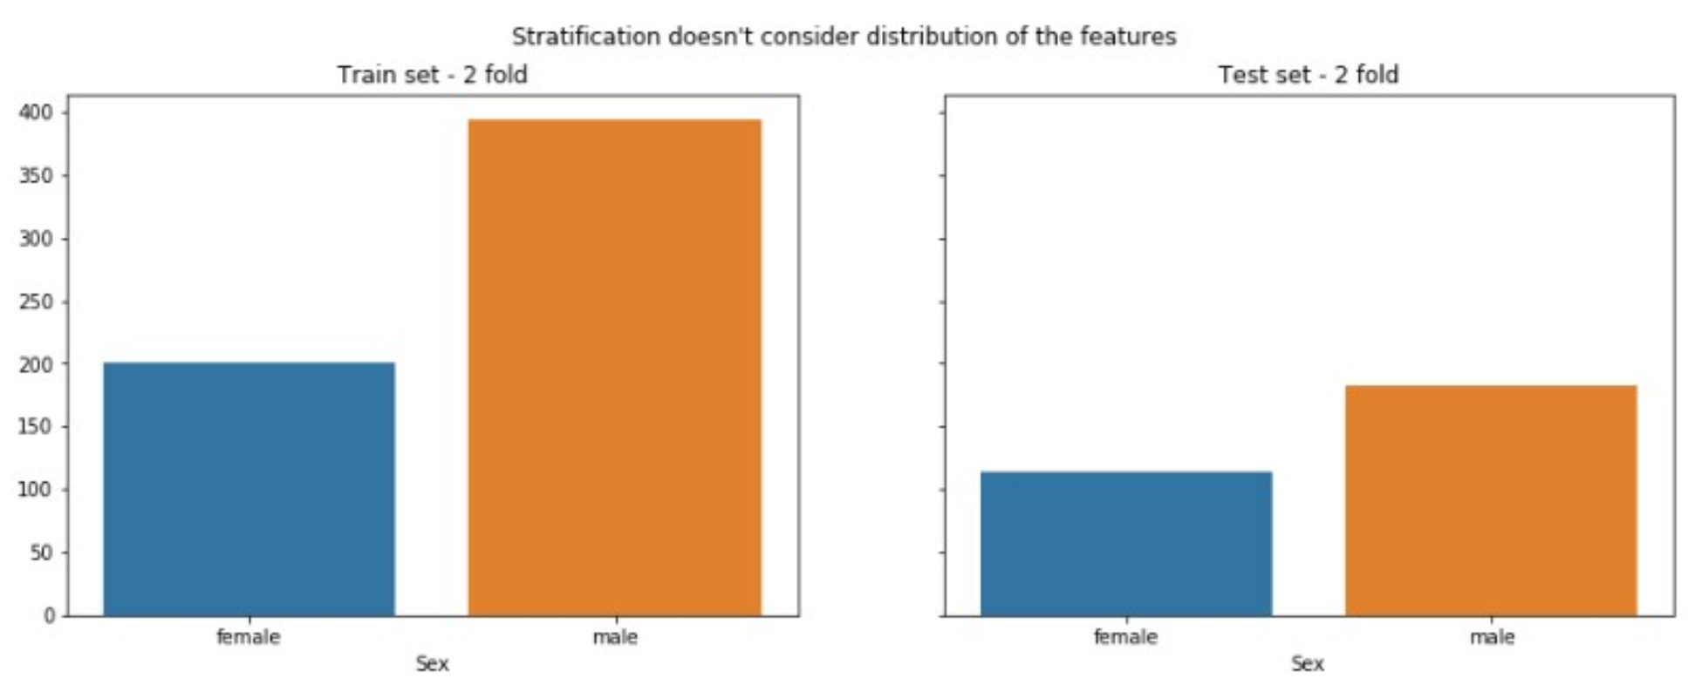
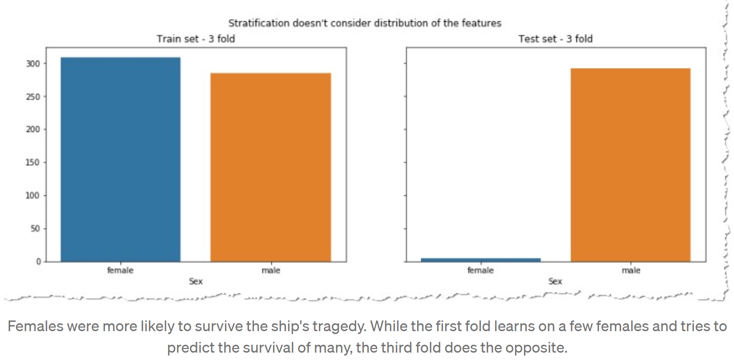
Ratio of input features may differ between train vs test.
https://towardsdatascience.com/complete-guide-to-pythons-cross-validation-with-examples-a9676b5cac12

Slide 22
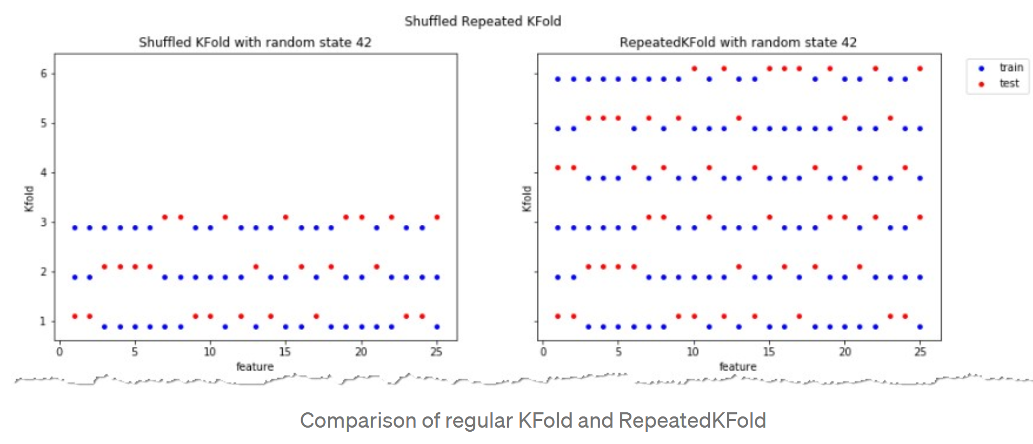
https://towardsdatascience.com/complete-guide-to-pythons-cross-validation-with-examples-a9676b5cac12

Slide 23
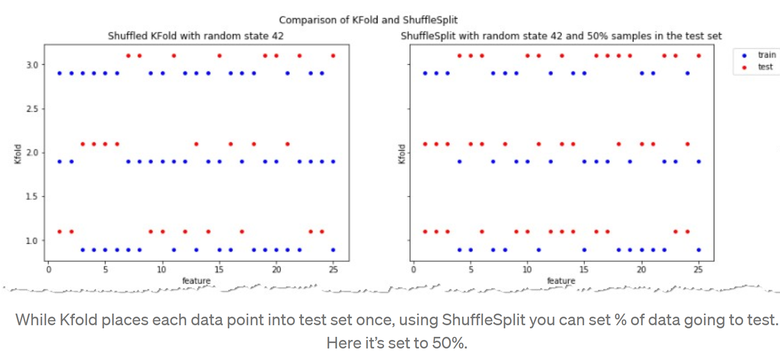
Kfold – no overlap in test sets.
Union of test sets = data set
ShuffleSplit: test sets can overlap.
Not every data point will be in a test set
https://towardsdatascience.com/complete-guide-to-pythons-cross-validation-with-examples-a9676b5cac12

Slide 24
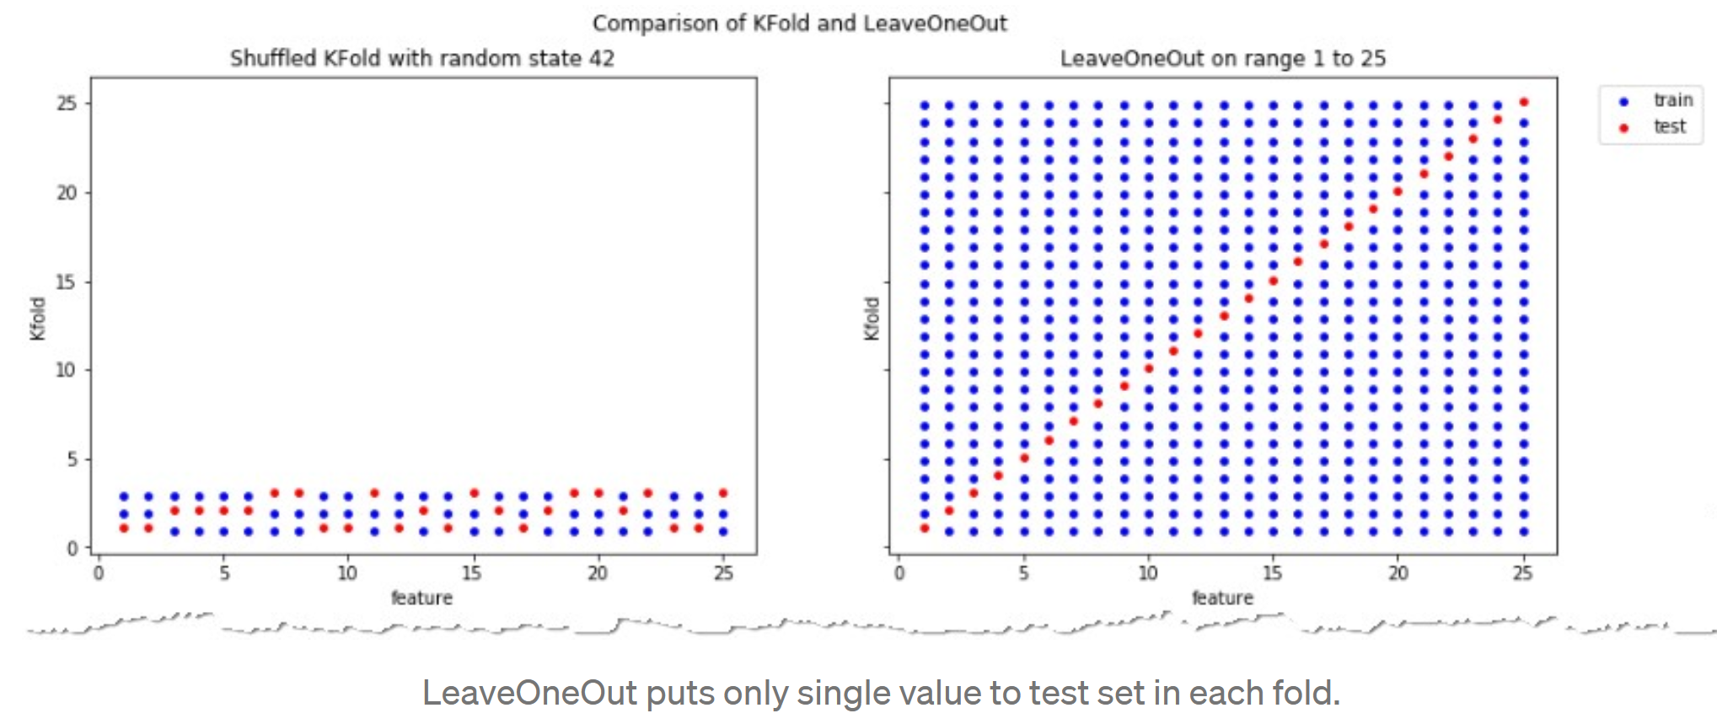
K = 3
If your data set is small consider LeaveOneOut.
Otherwise stratified shuffled Kfold works best for most data sets
https://towardsdatascience.com/complete-guide-to-pythons-cross-validation-with-examples-a9676b5cac12

Slide 25
Bias vs Variance trade-off
If your data set is small consider LeaveOneOut.
Otherwise stratified shuffled Kfold works best for most data sets
K = 3
https://towardsdatascience.com/complete-guide-to-pythons-cross-validation-with-examples-a9676b5cac12
KFold means training on fewer data points: Thus result is more biased than LOOCV.
BUT if k < n = number of data points, then Kfold has lower variance than LOOCV.
Each result of LOOCV will be highly correlated since only leaving out 1 data point, but
the test sets are not correlated since each test set contains 1 data point and these points are all different. Thus the variance of the errors will be higher with LOOCV
With KFold, one is averaging K models that are less correlated to each other than the n LOOCV models. K = 5 or 10 is often a good choice.

Slide 26
https://towardsdatascience.com/validating-your-machine-learning-model-25b4c8643fb7

Slide 27
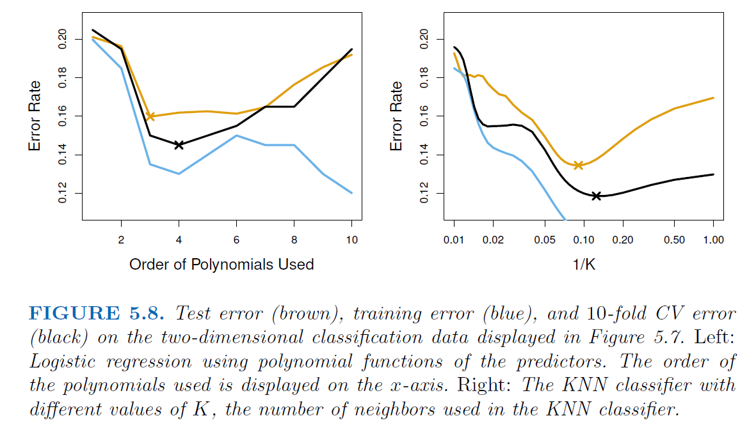
Kfold can also be used to compare different machine learning algorithms.
For example: logistic regression vs KNN classifier
Black curve = average of misclassifications over the 10 tests.
An Introduction to Statistical Learning https://www.statlearning.com/

Slide 28
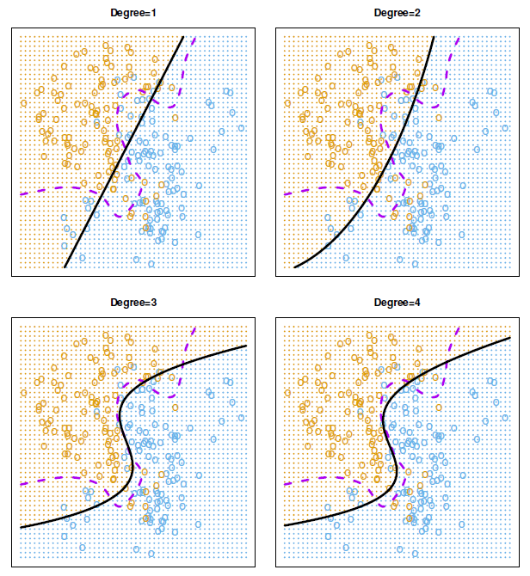
FIGURE 5.7. Logistic regression fits on the two-dimensional classification data
displayed in Figure 2.13. The Bayes decision boundary is represented using a purple dashed line. Estimated decision boundaries from linear, quadratic, cubic
and quartic (degrees 1–4) logistic regressions are displayed in black. The test error rates for the four logistic regression fits are respectively 0.201, 0.197, 0.160, and 0.162, while the Bayes error rate is 0.133.
An Introduction to Statistical Learning https://www.statlearning.com/

Slide 29
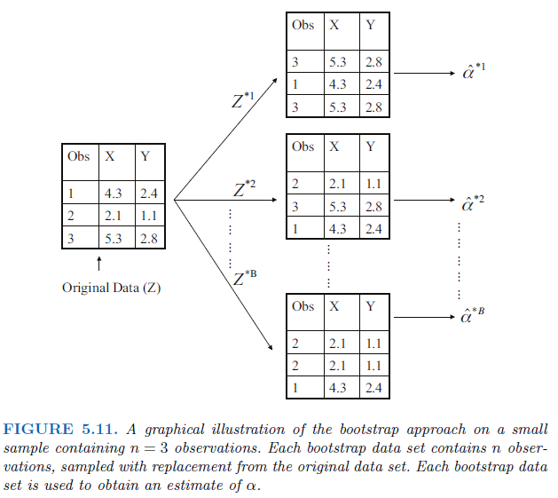
The bootstrap
The bootstrap is a widely applicable and extremely
powerful statistical tool that can be used to quantify
the uncertainty associated with a given estimator
or statistical learning method. As a simple example,
the bootstrap can be used to estimate the standard
errors of the coefficients from a linear regression fit.
In the specific case of linear regression, this is
not particularly useful, since we saw in Chapter 3
that standard statistical software such as
R outputs such standard errors automatically.
However, the power of the bootstrap lies
in the fact that it can be easily applied to
a wide range of statistical learning methods,
including some for which a measure of variability
is otherwise difficult to obtain and is not
automatically output by statistical software.
An Introduction to Statistical Learning https://www.statlearning.com/

Slide 30
Data Leakage

Slide 31
Feature leakage
Feature or column-wise leakage is caused by the inclusion of columns which are one of the following: a duplicate label, a proxy for the label, or the label itself.
Training example leakage
Row-wise leakage is caused by improper sharing of information between rows of data.
If your model is too good to be true, it may be wrong.
https://en.wikipedia.org/wiki/Leakage_(machine_learning)

Slide 32
Training example leakage Row-wise leakage is caused by improper sharing of information between rows of data. Types of row-wise leakage include:
Non-i.i.d. data (Independent and identically distributed random variables)
Time leakage (e.g. splitting a time-series dataset randomly instead of newer data in test set using a TrainTest split or rolling-origin cross validation)
Example: For time-dependent datasets, the structure of the system being studied evolves over time (i.e. it is "non-stationary"). This can introduce systematic differences between the training and validation sets. For example, if a model for predicting stock values is trained on data for a certain five-year period, it is unrealistic to treat the subsequent five-year period as a draw from the same population.
Group leakage -- not including a grouping split column
(e.g. Andrew Ng's group had 100k x-rays of 30k patients, meaning ~3 images per patient. The paper used random splitting instead of ensuring that all images of a patient was in the same split. Hence the model partially memorized the patients instead of learning to recognize pneumonia in chest x-rays.^{[3][4]})
https://en.wikipedia.org/wiki/Leakage_(machine_learning)

Slide 33
Training example leakage Row-wise leakage is caused by improper sharing of information between rows of data. Types of row-wise leakage include:
Premature featurization; leaking from premature featurization before CV/Train/Test split (must fit MinMax/ngrams/etc on only the train split, then transform the test set)
Duplicate rows between train/validation/test (e.g. oversampling a dataset to pad its size before splitting; e.g. different rotations/augmentations of a single image; bootstrap sampling before splitting; or duplicating rows to up sample the minority class)
https://en.wikipedia.org/wiki/Leakage_(machine_learning)

Slide 34
Training example leakage Row-wise leakage is caused by improper sharing of information between rows of data. Types of row-wise leakage include:
Premature featurization; leaking from premature featurization before CV/Train/Test split (must fit MinMax/ngrams/etc on only the train split, then transform the test set)
Example, if you “normalize” your data BEFORE splitting between train and test, then your test data has affected your train data.
Thus AFTER splitting between train and test data
Normalize the train data (excluding the test data).
Use the exact same formula you used to normalize the train data on the test
Min-max example: $x_{ij}=\frac{x_{ij}}{\max_{x∈A_{j}}\{x\}−\min_{x∈A_{j}}\{x\}}$ where A_{j} = { x_{kj} | x $∈$train data}
Duplicate rows between train/validation/test (e.g. oversampling a dataset to pad its size before splitting; e.g. different rotations/augmentations of a single image; bootstrap sampling before splitting; or duplicating rows to up sample the minority class)
https://en.wikipedia.org/wiki/Leakage_(machine_learning)

Slide 35
Sepal.Length Sepal.Width Petal.Length Petal.Width Species
1 5.1 3.5 1.4 0.2 setosa
2 4.9 3.0 1.4 0.2 setosa
3 4.7 3.2 1.3 0.2 setosa
4 4.6 3.1 1.5 0.2 setosa
5 5.0 3.6 1.4 0.2 setosa
6 5.4 3.9 1.7 0.4 setosa
To normalize the petal length column for these 6 data points. If highlighted rows 4 and 6 are in test data set, use only unhighlighted rows corresponding to train data set to calculate max/min.
max{x_{i3} | x in train data} = max{1.4, 1.4, 1.5, 1.4} = 1.5
min{x_{i3} | x in train data} = max{1.4, 1.4, 1.5, 1.4} = 1.4
max – min = 1.5 – 1.4 = 0.1
Sepal.Length Sepal.Width Petal.Length Petal.Width Species
1 5.1 3.5 14 0.2 setosa
2 4.9 3.0 14 0.2 setosa
3 4.7 3.2 13 0.2 setosa
4 4.6 3.1 15 0.2 setosa
5 5.0 3.6 14 0.2 setosa
6 5.4 3.9 17 0.4 setosa
For k-fold and Leave-one-out, max and min depend on fold, so normalization would need to be performed for each fold.

Slide 36
Sepal.Length Sepal.Width Petal.Length Petal.Width Species
1 5.1 3.5 1.4 0.2 setosa
2 4.9 3.0 1.4 0.2 setosa
3 4.7 3.2 1.3 0.2 setosa
4 4.6 3.1 1.5 0.2 setosa
5 5.0 3.6 1.4 0.2 setosa
6 5.4 3.9 1.7 0.4 setosa
To normalize the petal length column for these 6 data points. If highlighted rows 4 and 6 are in test data set, , use only unhighlighted rows corresponding to train data set to calculate max/min.
max = max{x_{i3} | x in train data} = max{1.4, 1.4, 1.5, 1.4} = 1.5
min = min{x_{i3} | x in train data} = max{1.4, 1.4, 1.5, 1.4} = 1.4
max – min = 1.5 – 1.4 = 0.1
Can also subtract min/(max – min) so data between 0 and 1: (P.L – min)/(max-min)
Sepal.Length Sepal.Width Petal.Length Petal.Width Species
1 5.1 3.5 0 0.2 setosa
2 4.9 3.0 0 0.2 setosa
3 4.7 3.2 -1 0.2 setosa
4 4.6 3.1 1 0.2 setosa
5 5.0 3.6 0 0.2 setosa
6 5.4 3.9 3 0.4 setosa
For k-fold and Leave-one-out, max and min depend on fold, so normalization would need to be performed for each fold.

Slide 37
For every rule, there is an exception.

Slide 38
https://towardsdatascience.com/validating-your-machine-learning-model-25b4c8643fb7

Slide 39
For small data sets, you might be exploring models, rather than learning a model.

Slide 40
Multivariable Linear and Logistic Regression:
One normally must perform feature (variable) selection if you have too many variables and/or if they are not independent.
Some methods for feature selection:
• Subset Selection. This approach involves identifying a subset of the p predictors that we believe to be related to the response. We then fit a model using least squares on the reduced set of variables.
• Shrinkage. This approach involves fitting a model involving all p predictors. However, the estimated coefficients are shrunken towards zero relative to the least squares estimates. This shrinkage (also known as regularization) has the effect of reducing variance. Depending on what type of shrinkage is performed, some of the coefficients may be estimated to be exactly zero. Hence, shrinkage methods can also perform
variable selection.
• Dimension Reduction. This approach involves projecting the p predictors into an M-dimensional subspace, where M <p. This is achieved by computing M different linear combinations, or projections, of the variables. Then these M projections are used as predictors to fit a linear regression model by least squares.
An Introduction to Statistical Learning https://www.statlearning.com/

Slide 41
https://www.coursera.org/learn/pca-machine-learning/home/info

Slide 42
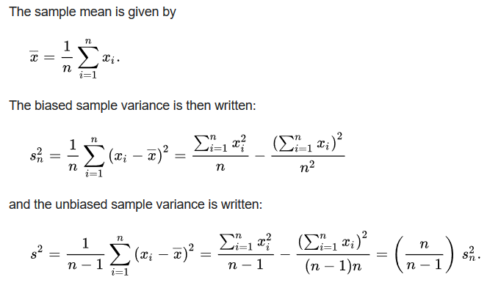
https://en.wikipedia.org/wiki/Bessel's_correction#Source_of_bias
Too small

Slide 43
$$\sum{{\left(x_{\dot{i}}−\overline{μ}\right)}^{2}}=\sum{{\left(x_{i}−\overline{x}\right)}^{2}}+\sum{{\left(\overline{x}−\overline{μ}\right)}^{2}}$$
$$\sum{{\left(x_{\dot{i}}−\overline{μ}\right)}^{2}}≥\sum{{\left(x_{i}−\overline{x}\right)}^{2}}$$
Variance on entire population : vs Variance of sample of population:
$$\operatorname{Var}\left(x\right)=\frac{1}{n−1}\sum_{i=1}^{n}{{\left(x_{i}−\overline{x}\right)}^{2}}$$
$$\frac{n}{n−1}$$
https://en.wikipedia.org/wiki/Bessel's_correction#Source_of_bias

Slide 44
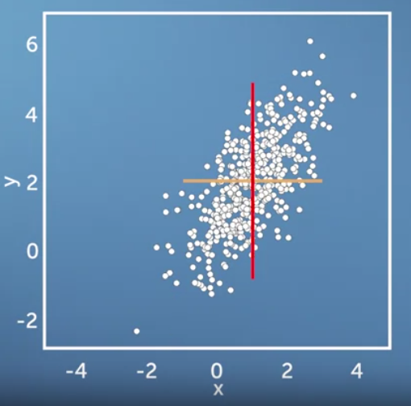
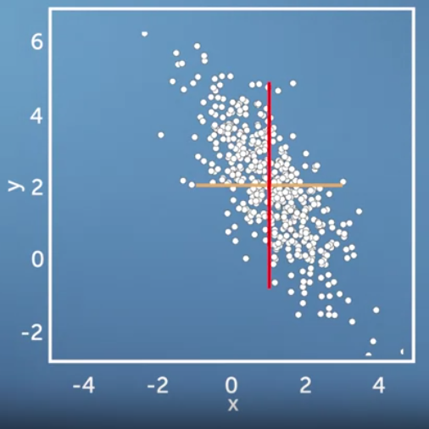
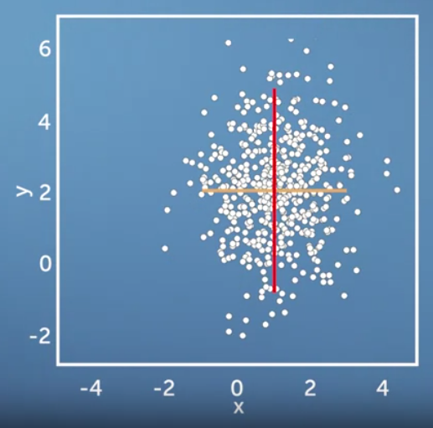
Same variance in x and y direction, but different co-variances

Slide 45
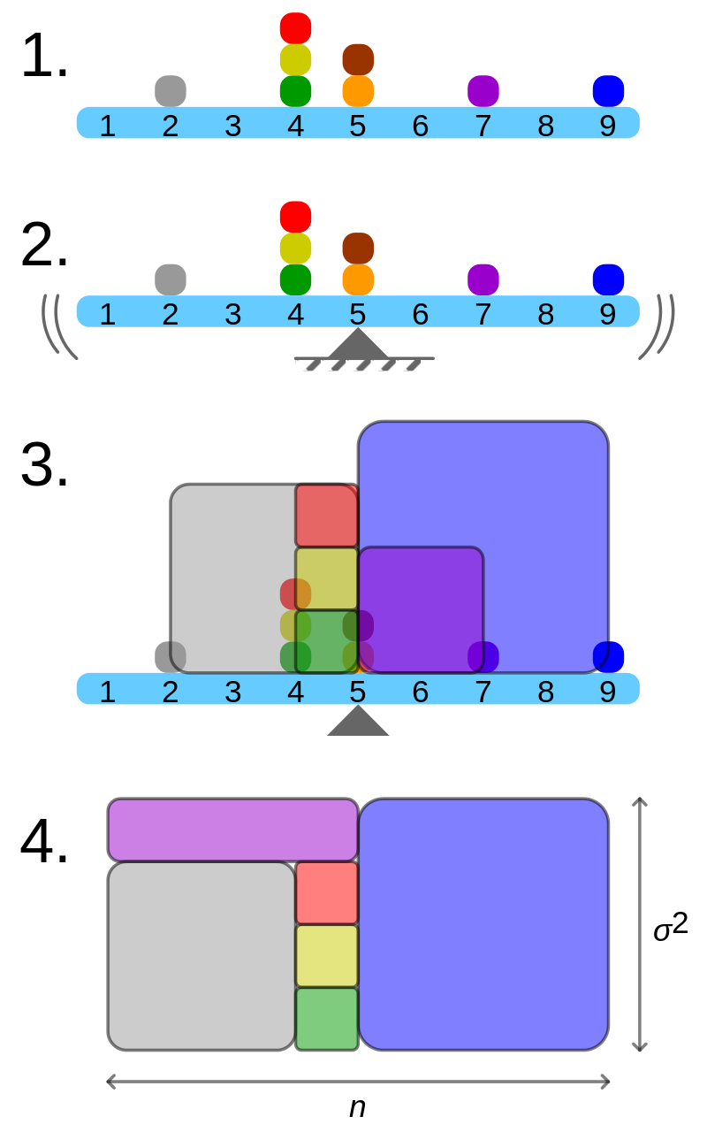
Geometric visualisation of the variance of an arbitrary distribution (2, 4, 4, 4, 5, 5, 7, 9): A frequency distribution is constructed.
The centroid of the distribution gives its mean.
A square with sides equal to the difference of each value from the mean is formed for each value.
Arranging the squares into a rectangle with one side equal to the number of values, n, results in the other side being the distribution's variance, σ².
By Cmglee - Own work, CC BY-SA 3.0, https://commons.wikimedia.org/w/index.php?curid=39472834

Slide 46
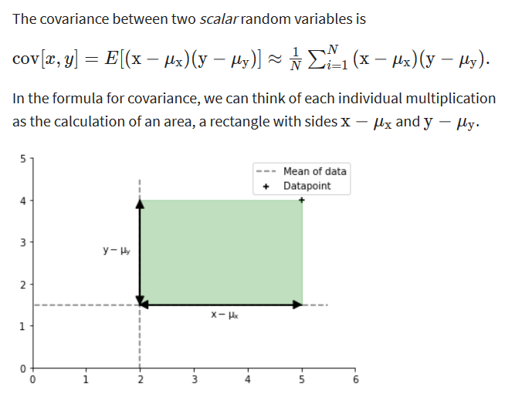

Slide 47
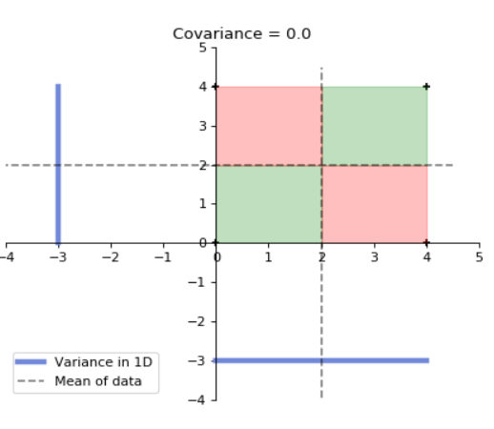
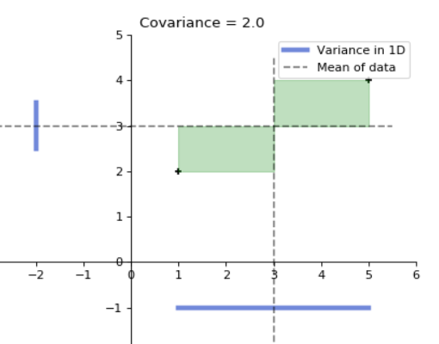
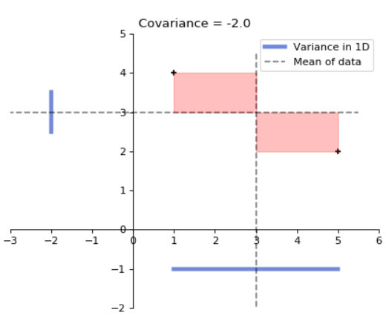
for 2 data points x, y

Slide 48
