Slide 1
Since statistics can be easily manipulated, we should not trust statistics.
True: All statistics is bad
False: It is possible to do good statistics, and that is the goal of statisticians (and other researchers).

Slide 2
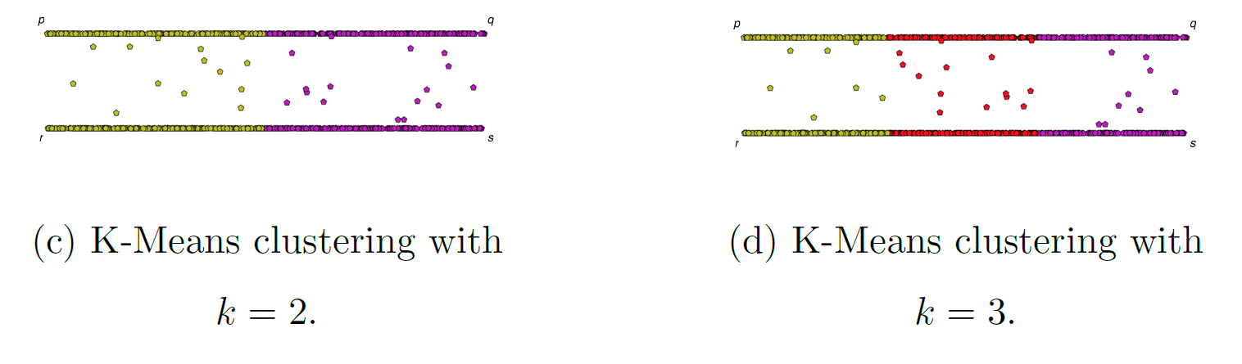
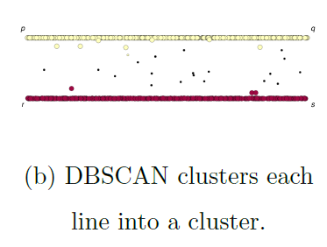
If you care about closeness:
Complete linkage
Average linkage
Ward’s linkage
K-means
If you care about connected components:
  Single linkage
  DBscan
Figures courtesy of Wako Bungula

Slide 3
Data Leakage

Slide 4
Feature leakage
Feature or column-wise leakage is caused by the inclusion of columns which are one of the following: a duplicate label, a proxy for the label, or the label itself.
Training example leakage
Row-wise leakage is caused by improper sharing of information between rows of data.
If your model is too good to be true, it may be wrong.
https://en.wikipedia.org/wiki/Leakage_(machine_learning)

Slide 5
Training example leakage Row-wise leakage is caused by improper sharing of information between rows of data. Types of row-wise leakage include:
Non-i.i.d. data (Independent and identically distributed random variables)
  Time leakage (e.g. splitting a time-series dataset randomly instead of newer data in test set using a TrainTest split or rolling-origin cross validation)
    Example: For time-dependent datasets, the structure of the system being studied evolves over time (i.e. it is "non-stationary"). This can introduce systematic differences between the training and validation sets. For example, if a model for predicting stock values is trained on data for a certain five-year period, it is unrealistic to treat the subsequent five-year period as a draw from the same population.
  Group leakage -- not including a grouping split column
    (e.g. Andrew Ng's group had 100k x-rays of 30k patients, meaning ~3 images per patient. The paper used random splitting instead of ensuring that all images of a patient was in the same split. Hence the model partially memorized the patients instead of learning to recognize pneumonia in chest x-rays.^{[3][4]})
https://en.wikipedia.org/wiki/Leakage_(machine_learning)

Slide 6
Training example leakage Row-wise leakage is caused by improper sharing of information between rows of data. Types of row-wise leakage include:
Premature featurization; leaking from premature featurization before CV/Train/Test split (must fit MinMax/ngrams/etc on only the train split, then transform the test set)
Duplicate rows between train/validation/test (e.g. oversampling a dataset to pad its size before splitting; e.g. different rotations/augmentations of a single image; bootstrap sampling before splitting; or duplicating rows to up sample the minority class)
https://en.wikipedia.org/wiki/Leakage_(machine_learning)

Slide 7
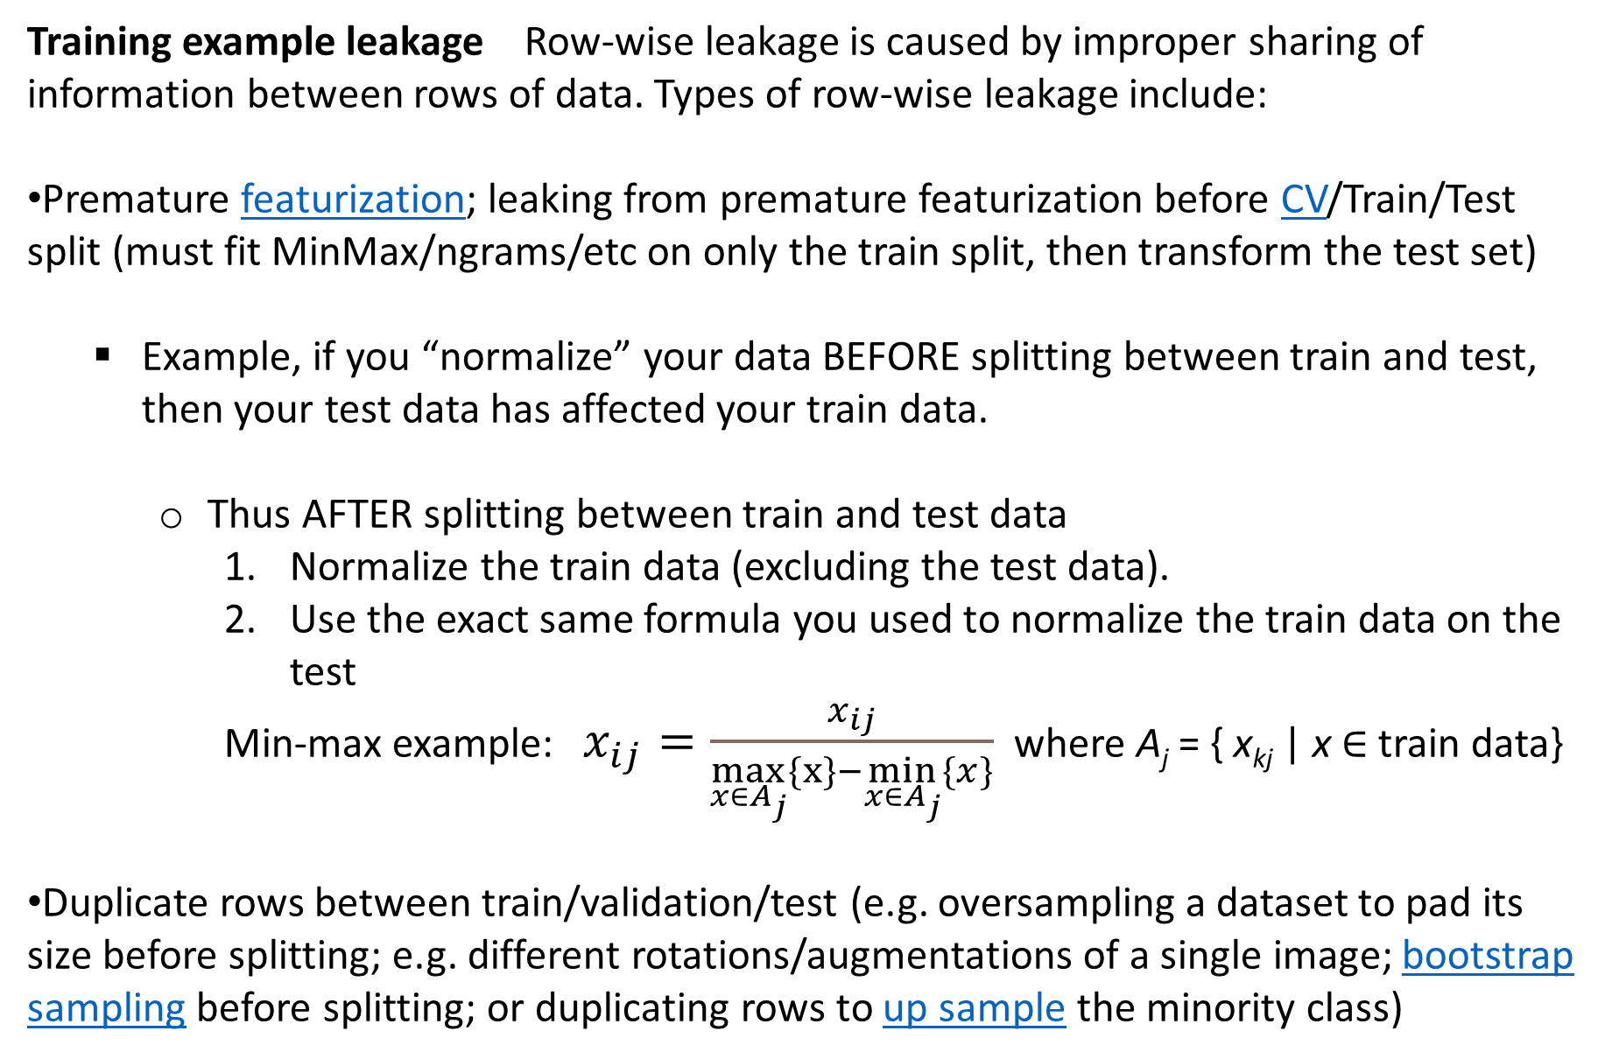
Training example leakage Row-wise leakage is caused by improper sharing of information between rows of data. Types of row-wise leakage include:
Premature featurization; leaking from premature featurization before CV/Train/Test split (must fit MinMax/ngrams/etc on only the train split, then transform the test set)
  Example, if you “normalize” your data BEFORE splitting between train and test, then your test data has affected your train data.
    Thus AFTER splitting between train and test data
      Normalize the train data (excluding the test data).
      Use the exact same formula you used to normalize the train data on the test
      Min-max example: $x_{ij}=\frac{x_{ij}}{\max_{x∈A_{j}}\{x\}−\min_{x∈A_{j}}\{x\}}$ where A_{j} = { x_{kj} | x $∈$train data}
Duplicate rows between train/validation/test (e.g. oversampling a dataset to pad its size before splitting; e.g. different rotations/augmentations of a single image; bootstrap sampling before splitting; or duplicating rows to up sample the minority class)
https://en.wikipedia.org/wiki/Leakage_(machine_learning)

Slide 8
Sepal.Length Sepal.Width Petal.Length Petal.Width Species
1 5.1 3.5 1.4 0.2 setosa
2 4.9 3.0 1.4 0.2 setosa
3 4.7 3.2 1.3 0.2 setosa
4 4.6 3.1 1.5 0.2 setosa
5 5.0 3.6 1.4 0.2 setosa
6 5.4 3.9 1.7 0.4 setosa
To normalize the petal length column for these 6 data points. If highlighted rows 4 and 6 are in test data set, use only unhighlighted rows corresponding to train data set to calculate max/min.
max{x_{i3} | x in train data} = max{1.4, 1.4, 1.5, 1.4} = 1.5
min{x_{i3} | x in train data} = max{1.4, 1.4, 1.5, 1.4} = 1.4
max – min = 1.5 – 1.4 = 0.1
Sepal.Length Sepal.Width Petal.Length Petal.Width Species
1 5.1 3.5 14 0.2 setosa
2 4.9 3.0 14 0.2 setosa
3 4.7 3.2 13 0.2 setosa
4 4.6 3.1 15 0.2 setosa
5 5.0 3.6 14 0.2 setosa
6 5.4 3.9 17 0.4 setosa
For k-fold and Leave-one-out, max and min depend on fold, so normalization would need to be performed for each fold.

Slide 9

Sepal.Length Sepal.Width Petal.Length Petal.Width Species
1 5.1 3.5 1.4 0.2 setosa
2 4.9 3.0 1.4 0.2 setosa
3 4.7 3.2 1.3 0.2 setosa
4 4.6 3.1 1.5 0.2 setosa
5 5.0 3.6 1.4 0.2 setosa
6 5.4 3.9 1.7 0.4 setosa
To normalize the petal length column for these 6 data points. If highlighted rows 4 and 6 are in test data set, , use only unhighlighted rows corresponding to train data set to calculate max/min.
max = max{x_{i3} | x in train data} = max{1.4, 1.4, 1.5, 1.4} = 1.5
min = min{x_{i3} | x in train data} = max{1.4, 1.4, 1.5, 1.4} = 1.4
max – min = 1.5 – 1.4 = 0.1
Can also subtract min/(max – min) so data between 0 and 1: (P.L – min)/(max-min)
Sepal.Length Sepal.Width Petal.Length Petal.Width Species
1 5.1 3.5 0 0.2 setosa
2 4.9 3.0 0 0.2 setosa
3 4.7 3.2 -1 0.2 setosa
4 4.6 3.1 1 0.2 setosa
5 5.0 3.6 0 0.2 setosa
6 5.4 3.9 3 0.4 setosa
For k-fold and Leave-one-out, max and min depend on fold, so normalization would need to be performed for each fold.

Slide 10
For every rule, there is an exception.

Slide 11
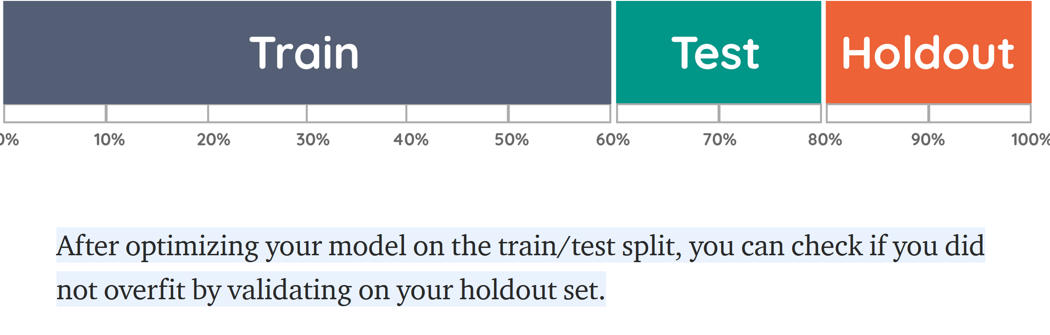
https://towardsdatascience.com/validating-your-machine-learning-model-25b4c8643fb7

Slide 12
For small data sets, you might be exploring models, rather than learning a model.

Slide 13
Why normalization (re-scaling)
https://www.cs.odu.edu/~sampath/courses/f18/cs795/files/slides/Lecture%204%20-%20Data%20Wrangling.pptx
height_inch height_cm weight
A 63 160.0 150
B 67 170.2 160
C 70 177.8 171
from scipy.spatial import distance
a = df2.iloc[0, [0,2]]
b = df2.iloc[1, [0,2]]
c = df2.iloc[2, [0,2]]
print("%.2f" % distance.euclidean(a,b)) #10.77
print("%.2f" % distance.euclidean(a,c)) # 22.14
print("%.2f" % distance.euclidean(b,c)) #11.40

Slide 14
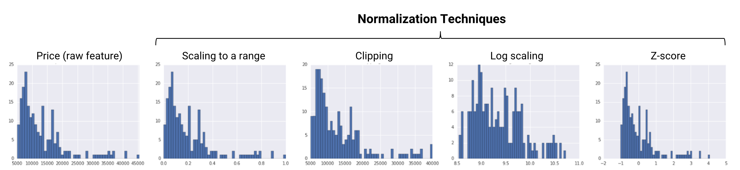
https://developers.google.com/machine-learning/data-prep/transform/normalization

Slide 15
Min-max
https://developers.google.com/machine-learning/data-prep/transform/normalization

Slide 16
Remove outliers by clipping
https://developers.google.com/machine-learning/data-prep/transform/normalization

Slide 17
Remove outliers by clipping
https://developers.google.com/machine-learning/data-prep/transform/normalization

Slide 18
https://developers.google.com/machine-learning/data-prep/transform/normalization

Slide 19

Standard score or Standardization
https://developers.google.com/machine-learning/data-prep/transform/normalization

Slide 20
Rescaling:
https://developers.google.com/machine-learning/data-prep/transform/normalization

Slide 21
When should you not normalize:
Ex: Iris data set since all features are measured in centimeters
Ex: Gene expression data since units are all identical
Ex: The scale of each feature is important.
When should you normalize:
Ex: Iris and gene expression data so that all features have the same range.
For example, a feature with low variance can be significant. This significance can be found if you make all features have the same range.
Ex: Normalize if the scale depends on the feature.

Slide 22
Multivariable Linear and Logistic Regression:
One normally must perform feature (variable) selection if you have too many variables and/or if they are not independent.
Some methods for feature selection:
• Subset Selection. This approach involves identifying a subset of the p predictors that we believe to be related to the response. We then fit a model using least squares on the reduced set of variables.
• Shrinkage. This approach involves fitting a model involving all p predictors. However, the estimated coefficients are shrunken towards zero relative to the least squares estimates. This shrinkage (also known as regularization) has the effect of reducing variance. Depending on what type of shrinkage is performed, some of the coefficients may be estimated to be exactly zero. Hence, shrinkage methods can also perform
variable selection.
• Dimension Reduction. This approach involves projecting the p predictors into an M-dimensional subspace, where M <p. This is achieved by computing M different linear combinations, or projections, of the variables. Then these M projections are used as predictors to fit a linear regression model by least squares.
An Introduction to Statistical Learning https://www.statlearning.com/

Slide 23
We will look at 2 simpler methods first (sometimes used during data cleaning):
A common method to reduce the number of features is to remove features with low variance, especially if this low variance is less than the expected noise.

Slide 24
PCA on all Genes
Leukemia data, precursor B and T
Plot of 34 patients, dimension of 8973 genes reduced to 2
Example:Using PCA as a visualization tool. Not eliminating variables via PCA
www.cse.buffalo.edu/faculty/azhang/data-mining/pca.ppt

Slide 25
PCA on 100 top significant genes
Leukemia data, precursor B and T
Plot of 34 patients, dimension of 100 genes reduced to 2
Note how reducing the dimension of the data set, nicely affects the result.
www.cse.buffalo.edu/faculty/azhang/data-mining/pca.ppt

Slide 26
Dimensionality Reduction: Given dataset D R^{N}
Want: embedding f: D → R^{n} where n << N
    which “preserves” the structure of the data.
Many reduction methods:
f₁: D → R, f₂: D → R, … f_{n}: D → R
(f₁, f₂, … f_{n}): D → R^{n}
Many are linear, M: R^{N} → R^{n}, Mx = y
But there are also non-linear dimensionality reduction algorithms.
U

Slide 27
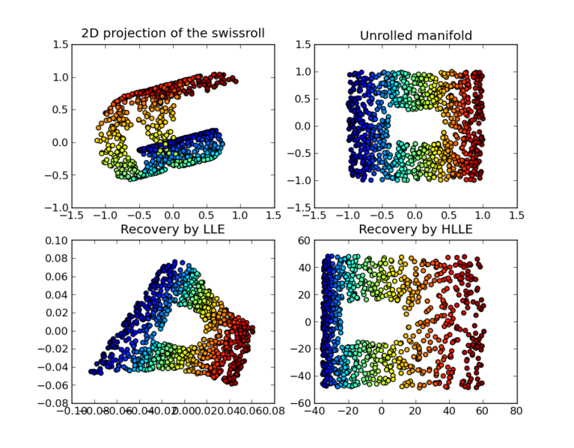
https://en.wikipedia.org/wiki/Nonlinear_dimensionality_reduction

Slide 28
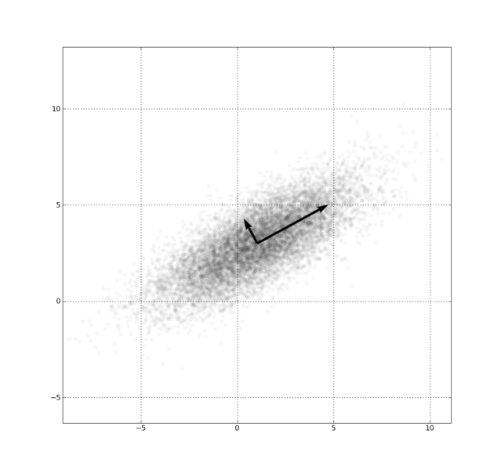
Example: Principal component analysis (PCA)
x_{i} → z_{i} = linear combination of x_{i}
http://en.wikipedia.org/wiki/File:GaussianScatterPCA.png

Slide 29
Principal Component Analysis
The central idea of principal component analysis (PCA) is
to reduce the dimensionality of a data set consisting of a
large number of interrelated variables, while retaining as
much as possible of the variation present in the data set.
This is achieved by transforming to a new set of variables,
the principal components (PCs), which are uncorrelated,
and which are ordered so that the first few retain most of
the variation present in all of the original variables.
[Jollie, Principal Component Analysis, 2nd edition]
www.stat.columbia.edu/~fwood/Teaching/w4315/Fall2009/pca.pdf

Slide 30
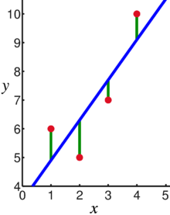
Linear regression = Least squares line (single variable x)
(or hyperplane for multiple variables)
LABELED DATA
Supervised learning
Data: x_{i} = input data with no noise
y_{i} = labels
Find function
f: R → R
f(x) = mx + b
x = independent variable
y = dependent variable
(x, y) → (x, y’)
https://en.wikipedia.org/wiki/Linear_regression

Slide 31
PCA: perturb all variables (x, y) → (x’, y’)
UNLABELED DATA
1st PCA component
= direction of most variance
direction = eigenvector with
largest eigenvalue.
2nd PCA
= direction of 2nd most variance,
perpendicular to first.
direction = eigenvector with
2nd largest eigenvalue.
Modified from
https://en.wikipedia.org/wiki/Linear_regression

Slide 32
Why use PCA in data analysis?
Consider the points (0, 0, …, 0), (1, 0, …, 0), (10, 0, …, 0)
Add noise to first point (0, 0, …, 0) → (0, 1, …, 1)
In R¹⁰⁰, d((0, 1, …, 1), (1, 0, …, 0)) = 10 > 9.
Add small noise to first point (0, 0, …, 0) → (0, 0.1, …, 0.1)
In R^{39,900}, d((0, 0.1, …, 0.1), (1, 0, …, 0)) = 20 > 9.
0 1 10

Slide 33
Why use PCA in data analysis:
Reduce dimension.
Reduce noise.
Visualization.
Fewer variables = less memory (data compression).
Fewer variables = faster computing time (usually).
Possible problem/advantage with PCA in data analysis:
You have changed the basis.
If you find that PCA2 is significant, what does that tell you about the individual features?
Features may be acting together to produce the result.

Slide 34
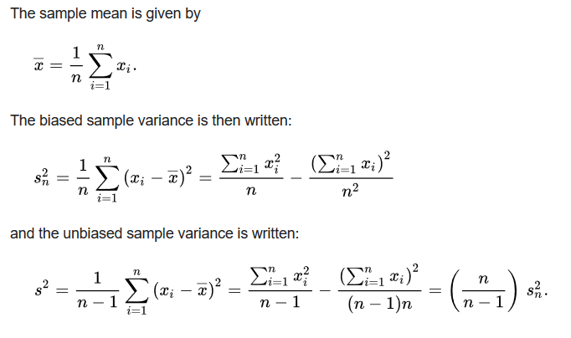
https://en.wikipedia.org/wiki/Bessel's_correction#Source_of_bias
Too small

Slide 35
Principal Component Analysis: one attribute first
Temperature
42
40
24
30
15
18
15
30
15
30
35
30
40
30
Question: how much spread is in the data along the axis? (distance to the mean)
Variance=Standard deviation^2
www.cse.buffalo.edu/faculty/azhang/data-mining/pca.ppt

Slide 36

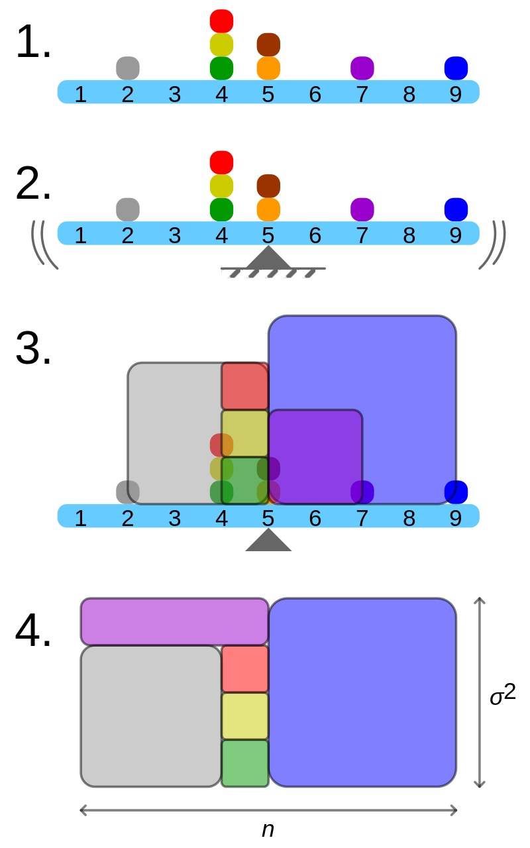
Geometric visualisation of the variance of an arbitrary distribution (2, 4, 4, 4, 5, 5, 7, 9): A frequency distribution is constructed.
The centroid of the distribution gives its mean.
A square with sides equal to the difference of each value from the mean is formed for each value.
Arranging the squares into a rectangle with one side equal to the number of values, n, results in the other side being the distribution's variance, σ².
By Cmglee - Own work, CC BY-SA 3.0, https://commons.wikimedia.org/w/index.php?curid=39472834

Slide 37
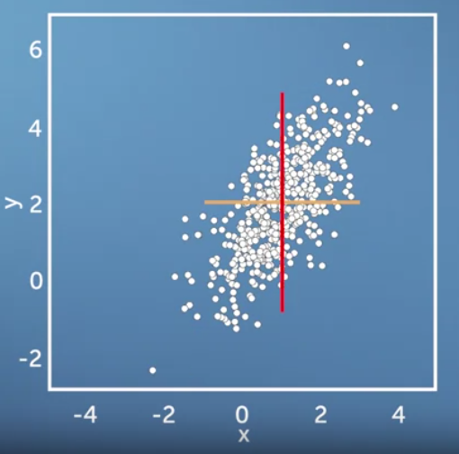
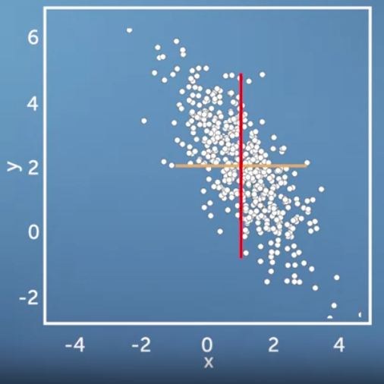
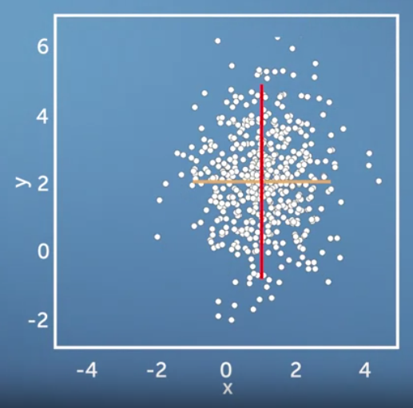
Same variance in x and y direction, but different co-variances
https://www.coursera.org/learn/pca-machine-learning/home/info

Slide 38
Now consider two dimensions
X=Temperature | Y=Humidity
40 | 90
40 | 90
40 | 90
30 | 90
15 | 70
15 | 70
15 | 70
30 | 90
15 | 70
30 | 70
30 | 70
30 | 90
40 | 70
30 | 90
Covariance: measures the
correlation between X and Y
cov(X,Y)=0: independent
Cov(X,Y)>0: move same dir
Cov(X,Y)<0: move oppo dir
www.cse.buffalo.edu/faculty/azhang/data-mining/pca.ppt

Slide 39
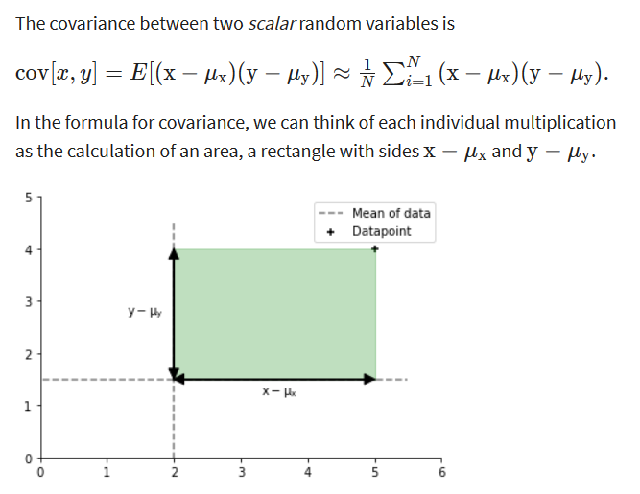
https://www.coursera.org/learn/pca-machine-learning/home/info

Slide 40
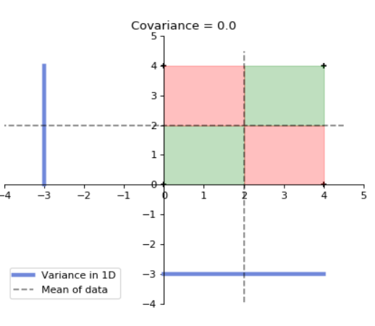
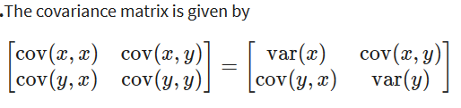
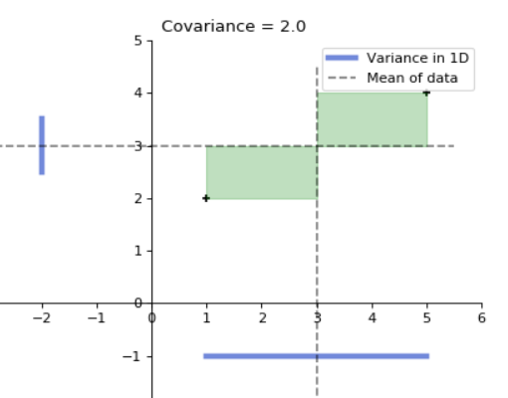
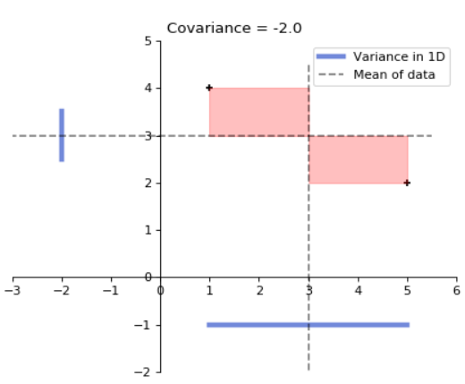
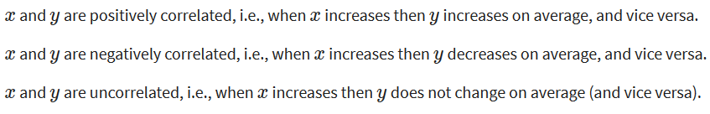
for 4 data points
for 2 data points
for 2 data points
https://www.coursera.org/learn/pca-machine-learning/home/info

Slide 41
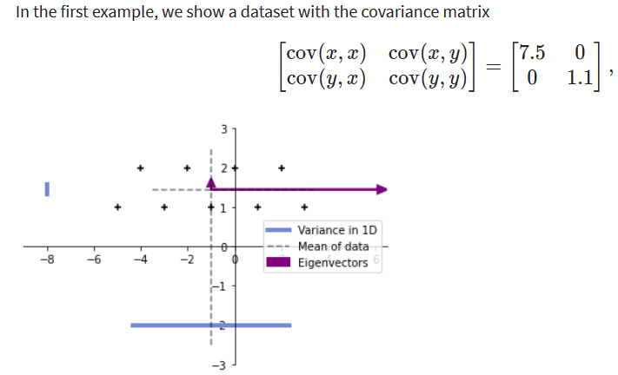
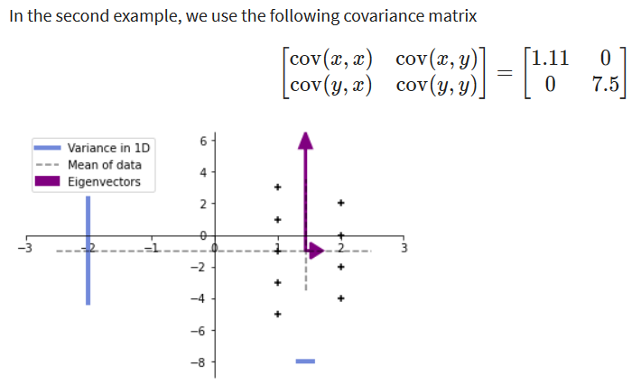
9 data points
https://www.coursera.org/learn/pca-machine-learning/home/info

Slide 42
More than two attributes: covariance matrix
Contains covariance values between all possible dimensions (=attributes):
Example for three attributes (x,y,z):
dxd
d = dimension
= # of attributes
or features.
www.cse.buffalo.edu/faculty/azhang/data-mining/pca.ppt

Slide 43
https://www.coursera.org/learn/pca-machine-learning/home/info

Slide 44
Eigenvalues
Calculate eigenvalues λ and eigenvectors x for covariance matrix:
  Eigenvalues λ_{j} are used for calculation of [% of total variance] (V_{j}) for each component j:
www.cse.buffalo.edu/faculty/azhang/data-mining/pca.ppt

Slide 45
https://www.coursera.org/learn/pca-machine-learning/home/info

Slide 46
for 2 data points
https://www.coursera.org/learn/pca-machine-learning/home/info

Slide 47
Principal components
1. principal component (PC1)
  The eigenvalue with the largest absolute value will indicate that the data have the largest variance along its eigenvector, the direction along which there is greatest variation
2. principal component (PC2)
  the direction with maximum variation left in data, orthogonal to the 1. PC
In general, only few directions manage to capture most of the variability in the data.
www.cse.buffalo.edu/faculty/azhang/data-mining/pca.ppt

Slide 48
Eigenvalues
Calculate eigenvalues λ and eigenvectors x for covariance matrix:
  Eigenvalues λ_{j} are used for calculation of [% of total variance] (V_{j}) for each component j:
www.cse.buffalo.edu/faculty/azhang/data-mining/pca.ppt

Slide 49
Principal components - Variance
www.cse.buffalo.edu/faculty/azhang/data-mining/pca.ppt

Slide 50
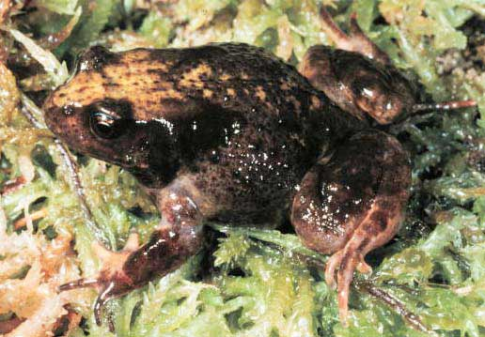
A more challenging example
data from research on habitat definition in the endangered Baw Baw frog
16 environmental and structural variables measured at each of 124 sites
correlation matrix used because variables have different units
Philoria frosti
http://www.csce.uark.edu/~xintaowu/5073/PCA1.ppt

Slide 51
Eigenvalues
Axis | Eigenvalue | % of Variance | Cumulative % of Variance
1 | 5.855 | 36.60 | 36.60
2 | 3.420 | 21.38 | 57.97
3 | 1.122 | 7.01 | 64.98
4 | 1.116 | 6.97 | 71.95
5 | 0.982 | 6.14 | 78.09
6 | 0.725 | 4.53 | 82.62
7 | 0.563 | 3.52 | 86.14
8 | 0.529 | 3.31 | 89.45
9 | 0.476 | 2.98 | 92.42
10 | 0.375 | 2.35 | 94.77
http://www.csce.uark.edu/~xintaowu/5073/PCA1.ppt

Slide 52
Interpreting Eigenvectors
 | 1 | 2 | 3
Altitude | 0.3842 | 0.0659 | -0.1177
pH | -0.1159 | 0.1696 | -0.5578
Cond | -0.2729 | -0.1200 | 0.3636
TempSurf | 0.0538 | -0.2800 | 0.2621
Relief | -0.0765 | 0.3855 | -0.1462
maxERht | 0.0248 | 0.4879 | 0.2426
avERht | 0.0599 | 0.4568 | 0.2497
%ER | 0.0789 | 0.4223 | 0.2278
%VEG | 0.3305 | -0.2087 | -0.0276
%LIT | -0.3053 | 0.1226 | 0.1145
%LOG | -0.3144 | 0.0402 | -0.1067
%W | -0.0886 | -0.0654 | -0.1171
H1Moss | 0.1364 | -0.1262 | 0.4761
DistSWH | -0.3787 | 0.0101 | 0.0042
DistSW | -0.3494 | -0.1283 | 0.1166
DistMF | 0.3899 | 0.0586 | -0.0175
correlations between variables and the principal axes are known as loadings
each element of the eigenvectors represents the contribution of a given variable to a component
http://www.csce.uark.edu/~xintaowu/5073/PCA1.ppt

Slide 53
Steps of PCA
Let be the mean vector (taking the mean of all rows)
Adjust the original data by the mean
  X’ = X –
Compute the covariance matrix C of adjusted X
Find the eigenvectors and eigenvalues of C.
For matrix C, vectors e (=column vector) having same direction as Ce :
  eigenvectors of C is e such that Ce=λe,
  λ is called an eigenvalue of C.
Ce=λe ⇔ (C-λI)e=0
  Most data mining packages do this for you.
www.cse.buffalo.edu/faculty/azhang/data-mining/pca.ppt

Slide 54
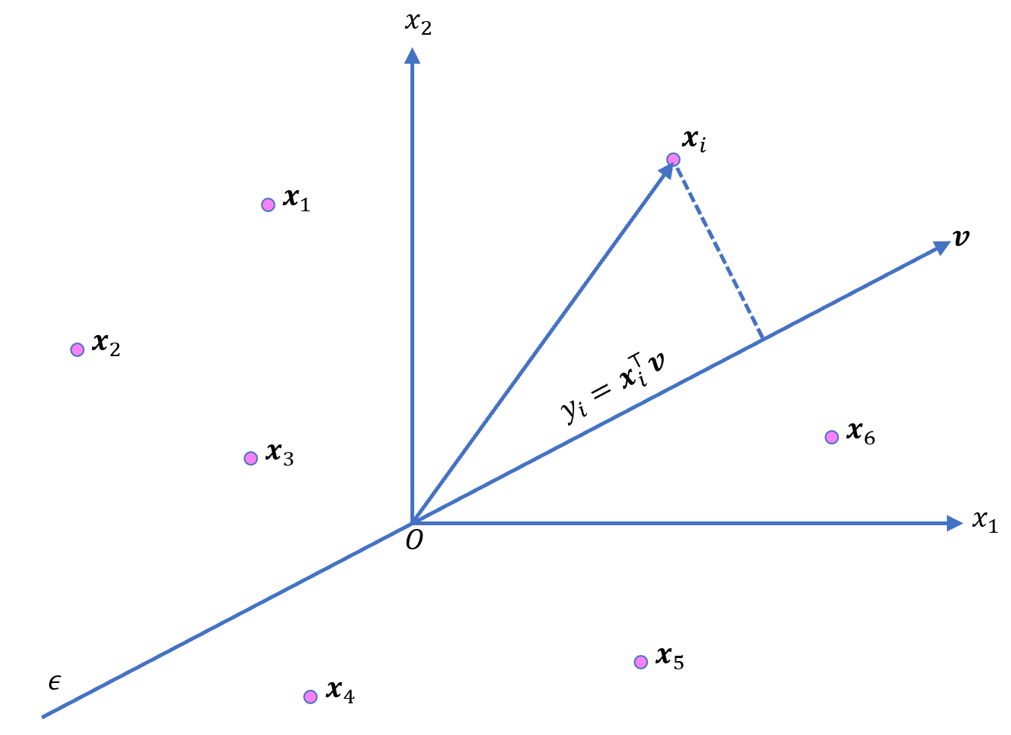
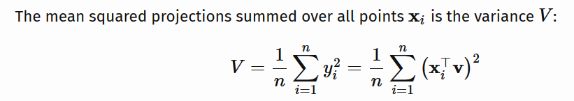
Translate data so mean is at the origin. Let v be a unit vector
https://ekamperi.github.io/mathematics/2020/11/01/principal-component-analysis-lagrange-multiplier.html

Slide 55
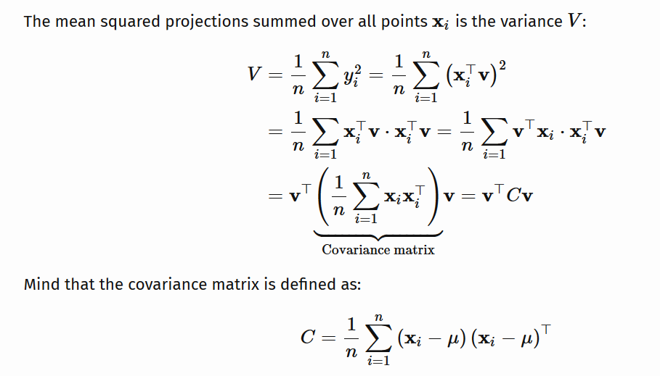
https://ekamperi.github.io/mathematics/2020/11/01/principal-component-analysis-lagrange-multiplier.html

Slide 56
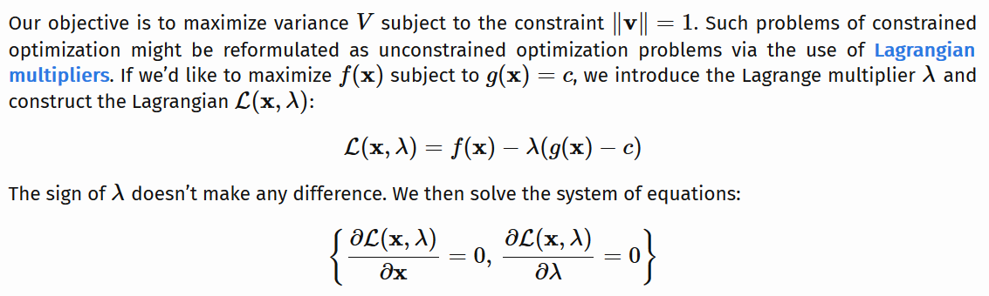
https://ekamperi.github.io/mathematics/2020/11/01/principal-component-analysis-lagrange-multiplier.html

Slide 57
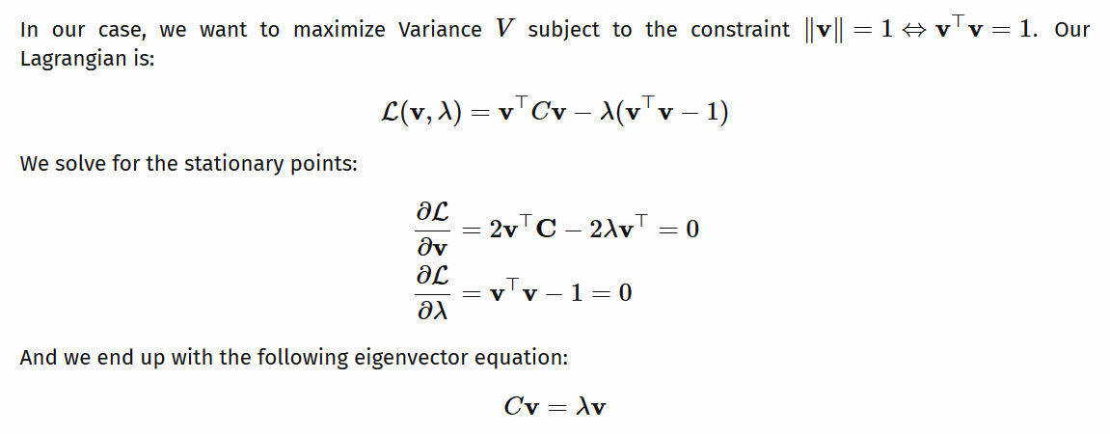
By taking the transpose of the first equation since C is symmetric.
https://ekamperi.github.io/mathematics/2020/11/01/principal-component-analysis-lagrange-multiplier.html

Slide 58
Example: Principle component analysis (PCA)
x_{i} → z_{i} = linear combination of x_{i}
http://en.wikipedia.org/wiki/File:GaussianScatterPCA.png

Slide 59
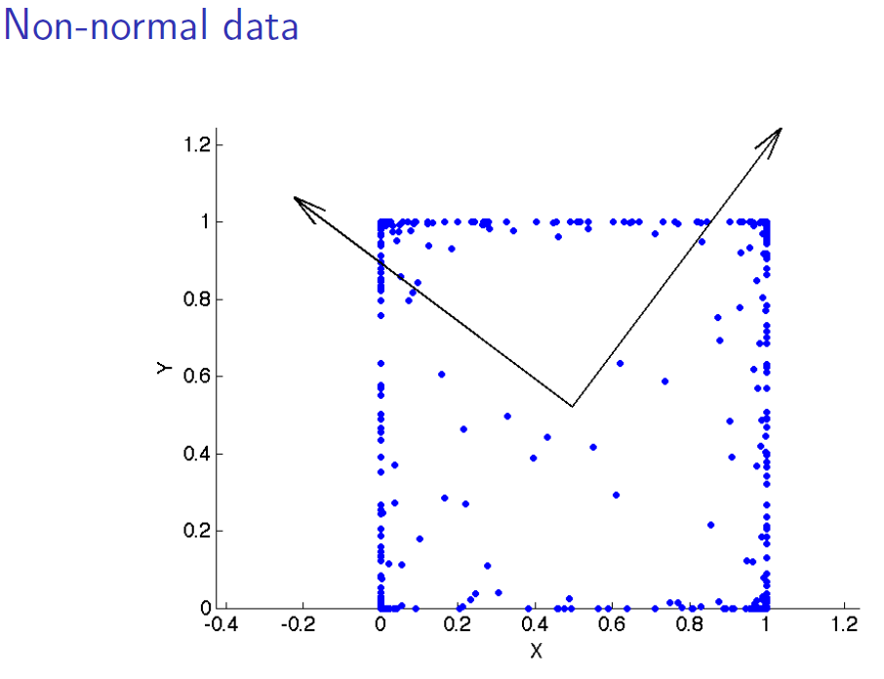
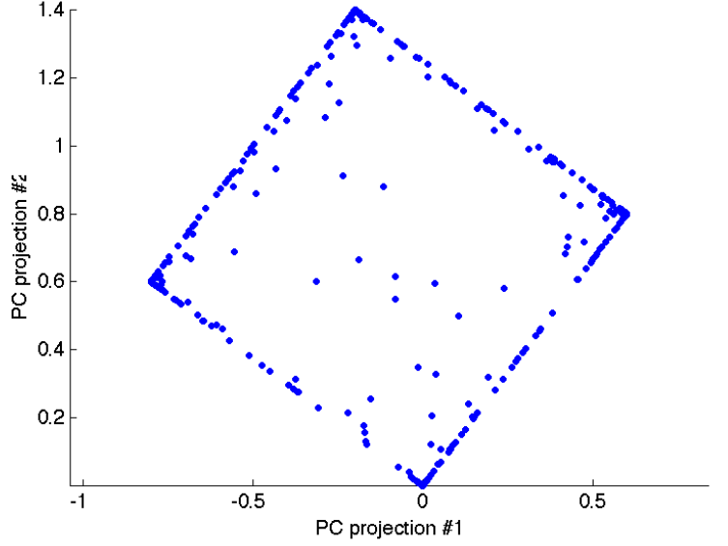
www.stat.columbia.edu/~fwood/Teaching/w4315/Fall2009/pca.pdf

