Slide 1

http://homepage.math.uiowa.edu/~idarcy/COURSES/MB/SPRING23/5760.html

Slide 2
Consider publishing your work in either a research journal or a journal aimed at students.
There is an incentive ($250 for paper submitted; $250 for paper published) but the paper must be in an Q1 or Q2 journal. Undergrad journals don't qualify.
For journal rankings see: https://www.scimagojr.com/
Avoid publishing in fake journals.

Slide 3
Some journals require an author’s contributions section. For example:
Authors' contributions
CM and JN contributed to the mathematical analysis for applying the coloring invariant. JN also drafted significant portions of the sections The coloring invariants, Tangle generation, Checking the coloring invariants . AP, JS, and TT developed the software implementing the coloring invariant calculations. RM contributed to the Non-drawable section and is responsible for the subroutine which determines if a matrix corresponds to a drawable tangle. He was assisted by ND and JS. JC, ND, SM, and JS developed equivalence moves which were implemented by ND, RM, and JS. ID conceived of and oversaw this project, drafted much of the manuscript, and contributed to the mathematical and software development. All authors read and approved the final manuscript.
https://link.springer.com/article/10.1186/1471-2105-7-435
each student will be graded individually

Slide 4
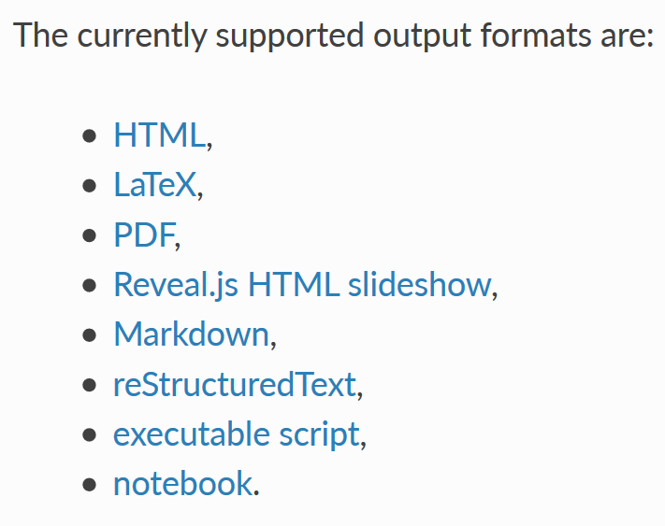
A jupyter notebook can be converted into a variety of formats per
https://nbconvert.readthedocs.io/en/latest/usage.html
You can use both Jupyter notebook and latex plus cut and paste.
Consider using different names for notebook latex output and your project writeup so you don’t accidently write over your project writeup.

Slide 5
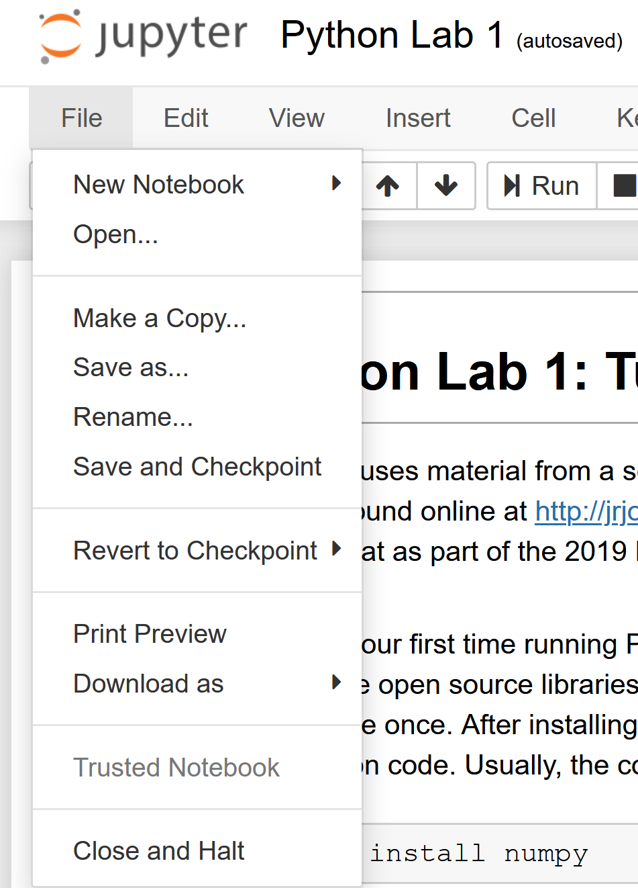
For your final exam written project, you will turn in your weekly labs into a draft of a paper.
Do not spend too much time on formatting.
You must use a bib file.

Slide 6
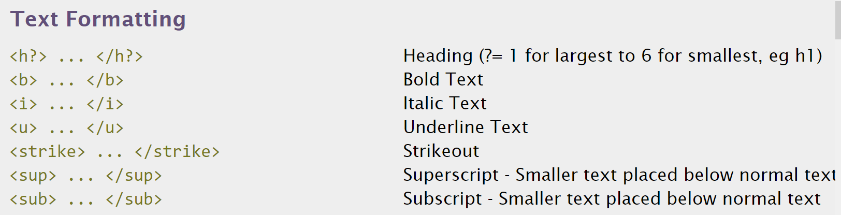
http://www.simplehtmlguide.com/cheatsheet.php

Slide 7
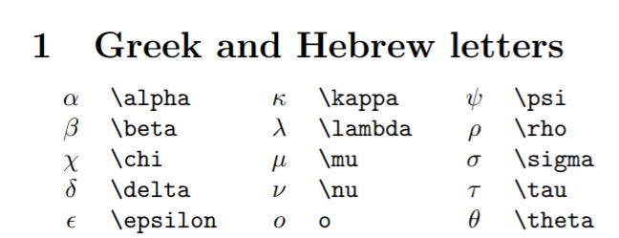
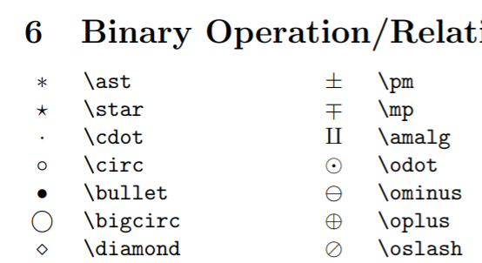
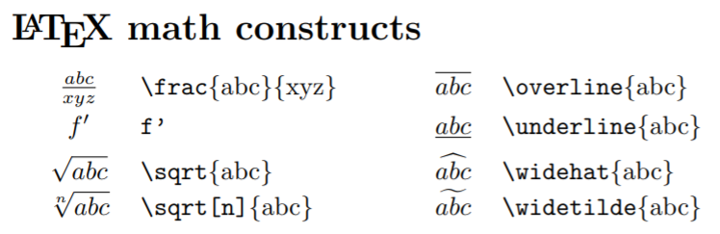
http://reu.dimacs.rutgers.edu/Symbols.pdf
Put latex command between $ signs,e.g.: $\alpha$

Slide 8

https://writingcenter.uiowa.edu/#services
Consider e-mailing your writing on a weekly basis

Slide 9

https://speakingcenter.uiowa.edu/about-us

Slide 10
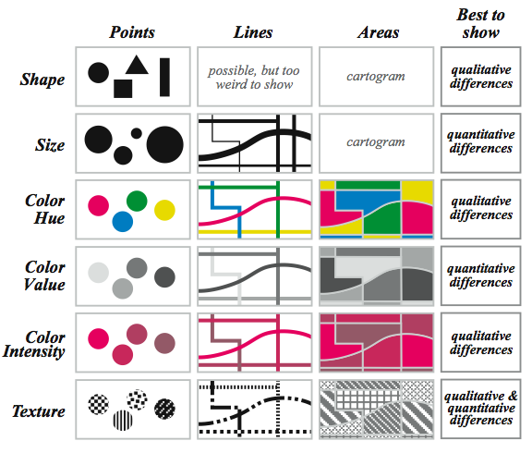
Visual variables for quantitative phenomena
Krygier and Wood, 2002
For poster use thick lines and think about accessibility.
Slide modified from: https://drive.google.com/drive/folders/0B8M300Hbnx9leDBERlhkS1JPZkE

Slide 11
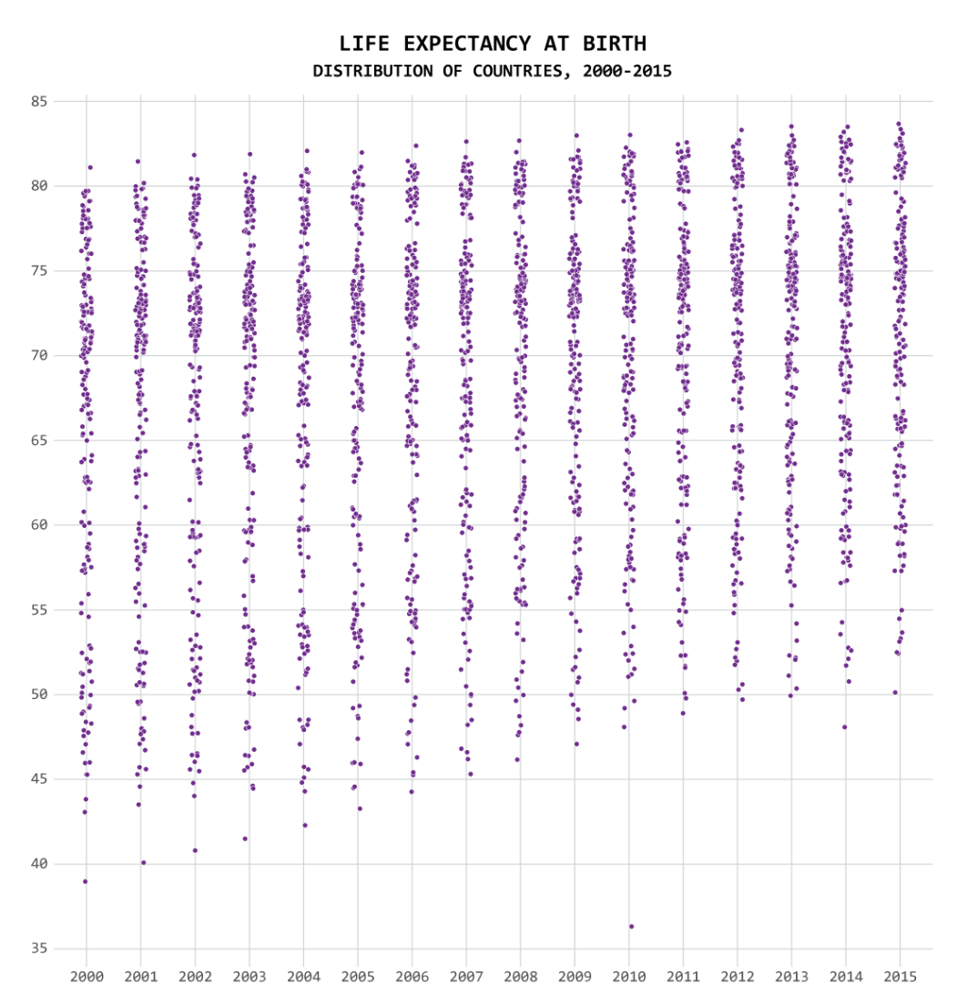
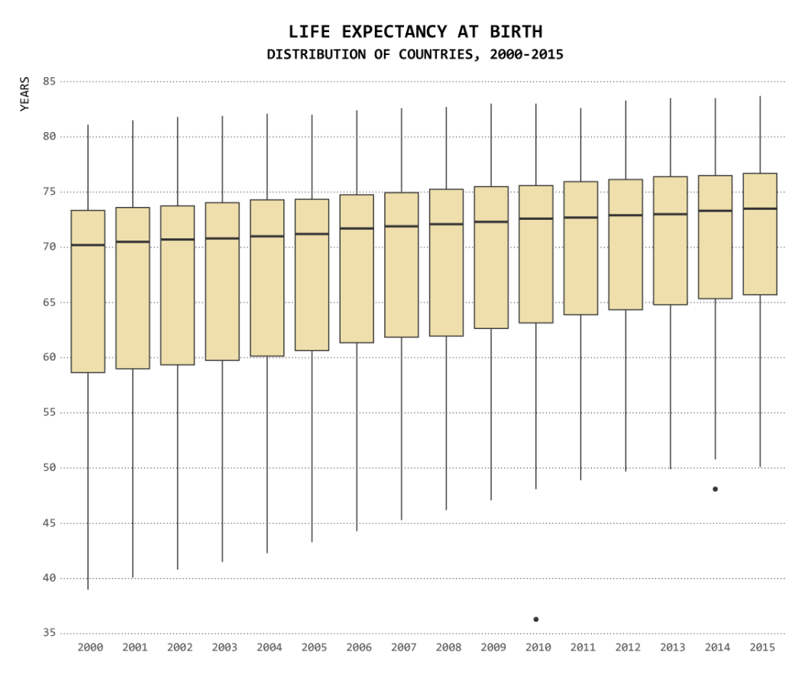
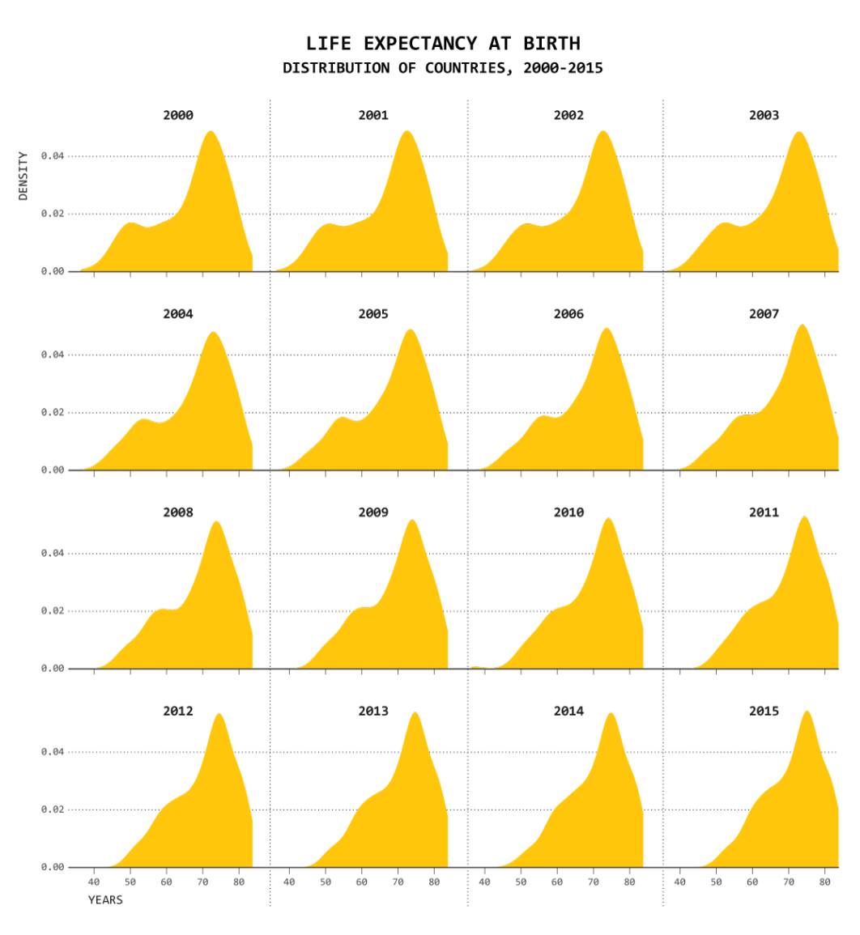
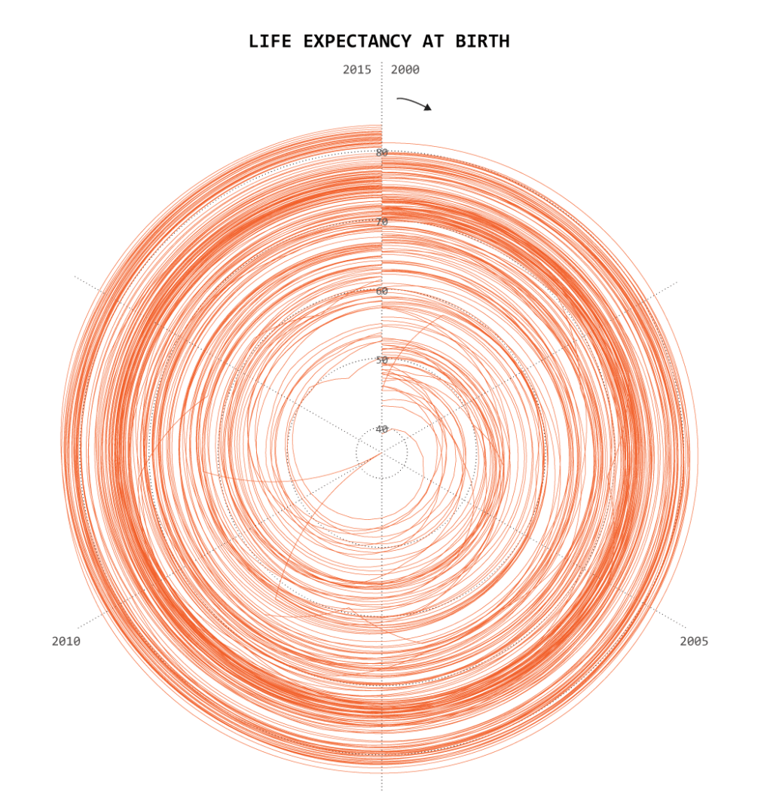
One Dataset, Visualized 25 Ways
https://flowingdata.com/2017/01/24/one-dataset-visualized-25-ways/

Slide 12
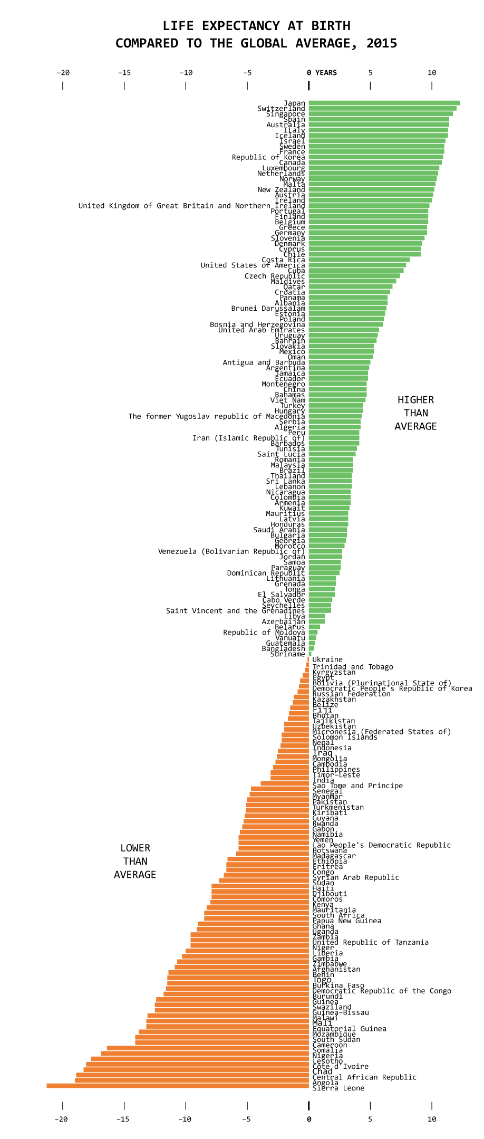
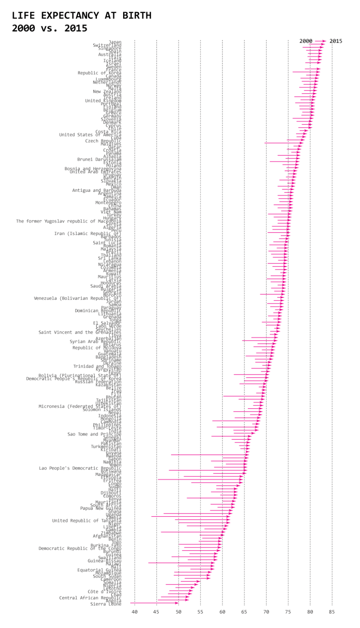
One Dataset, Visualized 25 Ways
https://flowingdata.com/2017/01/24/one-dataset-visualized-25-ways/

Slide 13
One Dataset, Visualized 25 Ways
One Dataset, Visualized 25 Ways
https://flowingdata.com/2017/01/24/one-dataset-visualized-25-ways/

Slide 14
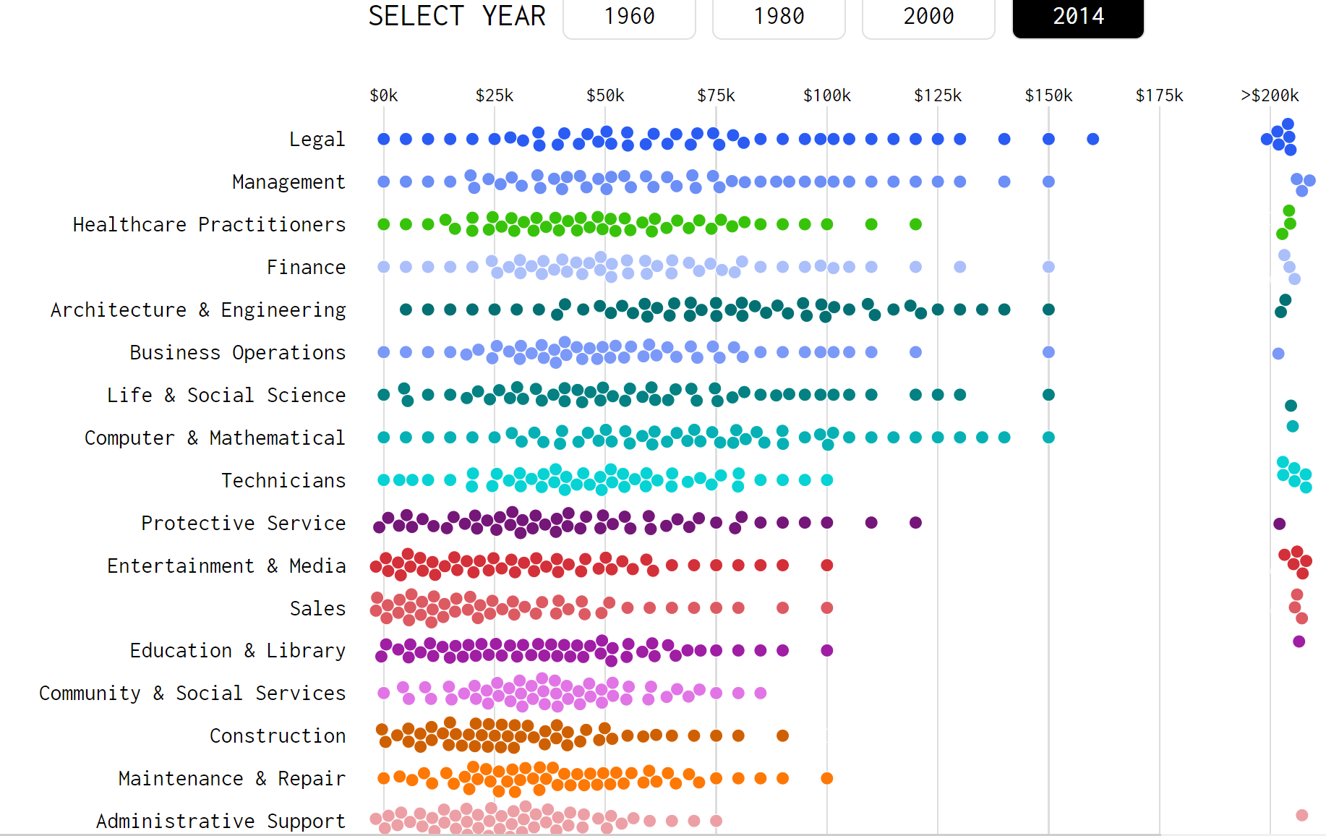
https://flowingdata.com/2016/06/28/distributions-of-annual-income/

Slide 15
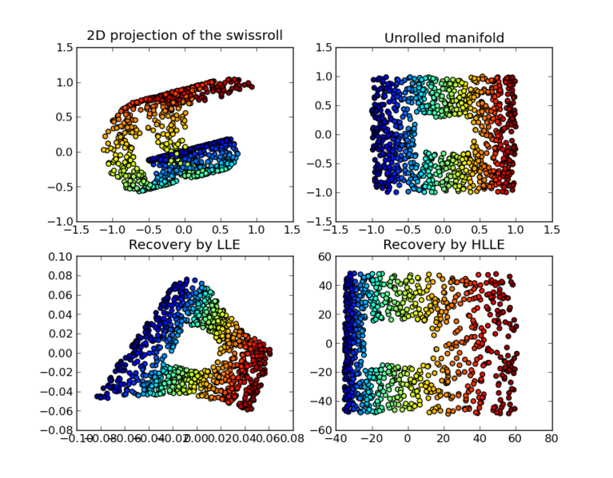
https://en.wikipedia.org/wiki/Nonlinear_dimensionality_reduction

Slide 16
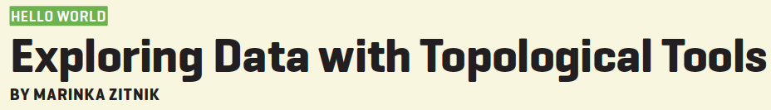
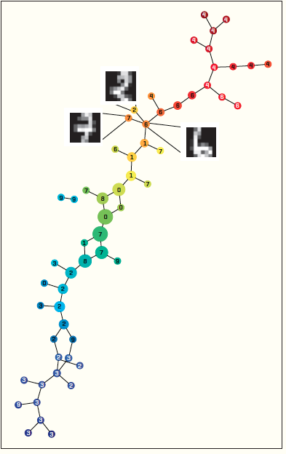
https://dl-acm-org/citation.cfm?id=2634549.2627814&coll=portal&dl=ACM
XRDS • SUMMER 2014 • VOL .20 • NO.4

Slide 17
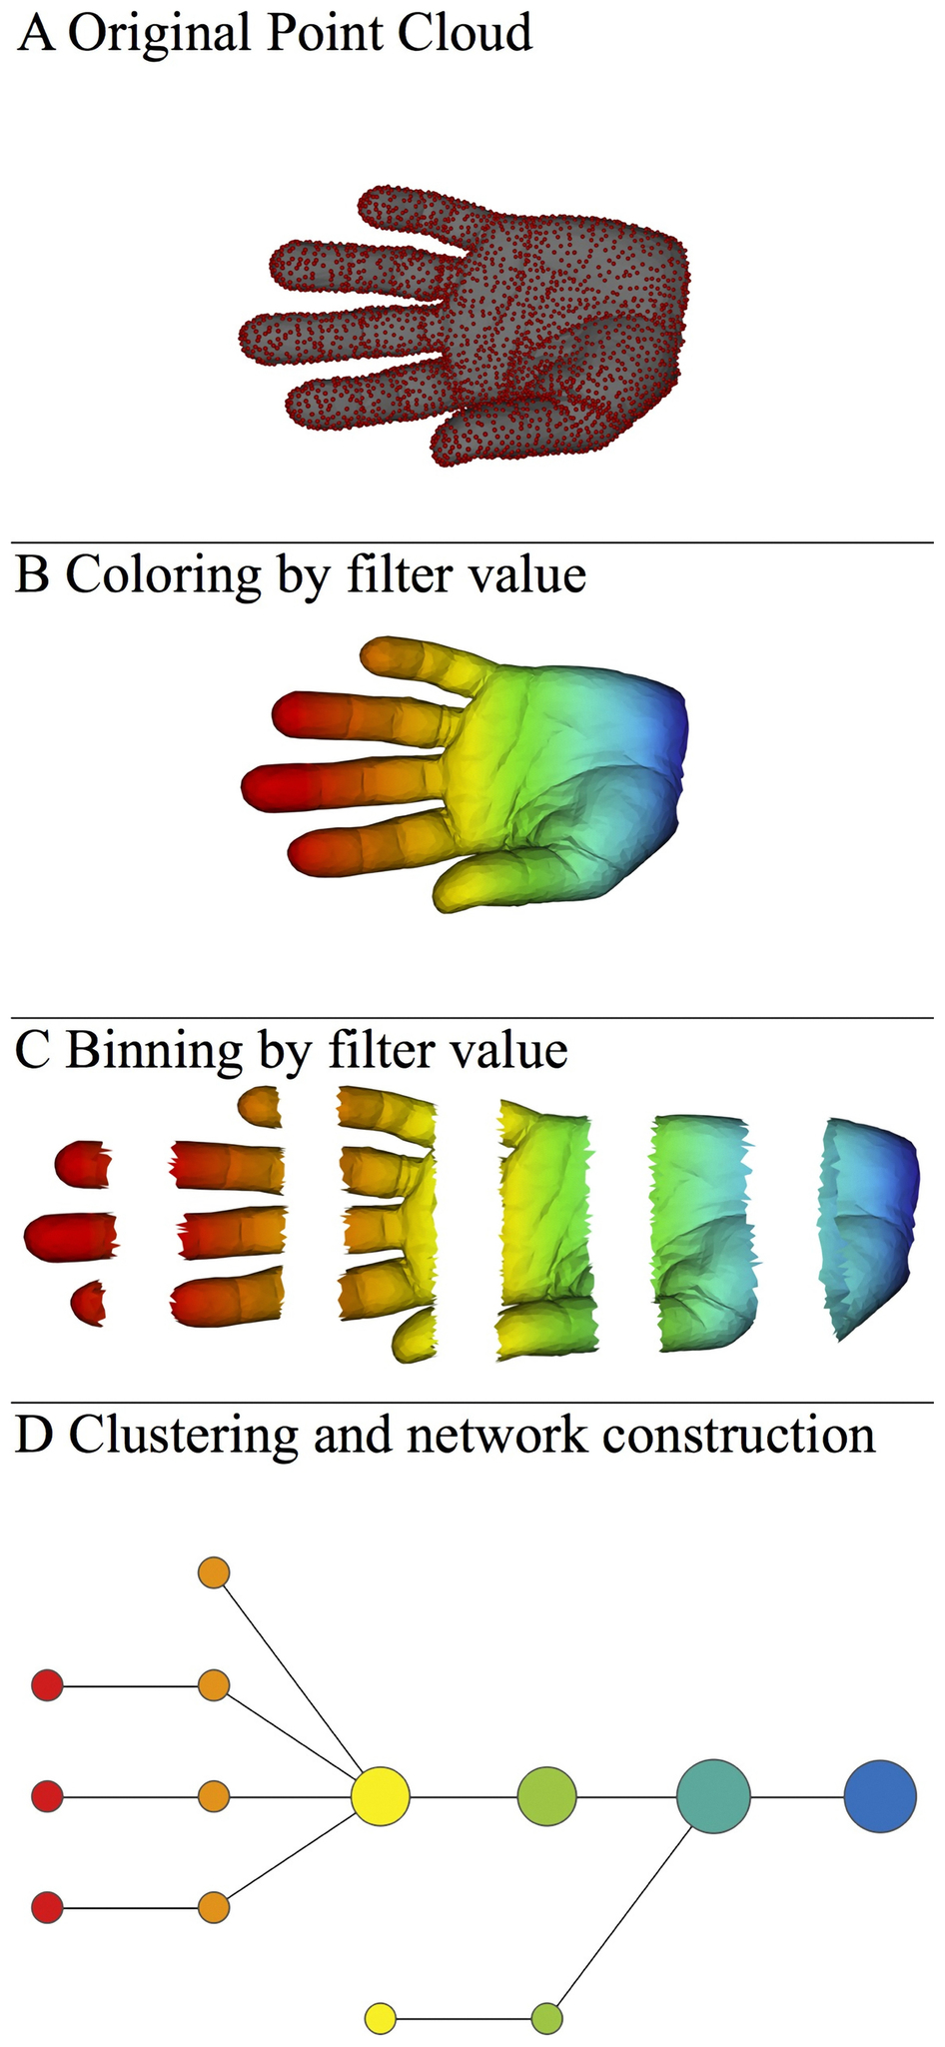
A) Data Set
Example: Point cloud data
representing a hand.
B) Function f : Data Set → R
Example: x-coordinate
f : (x, y, z) → x
Put data into overlapping bins.
Example: f⁻¹(a_{i}, b_{i})
Cluster each bin & create network.
Vertex = a cluster of a bin.
Edge = nonempty intersection
between clusters
http://www.nature.com/srep/2013/130207/srep01236/full/srep01236.html

Slide 18
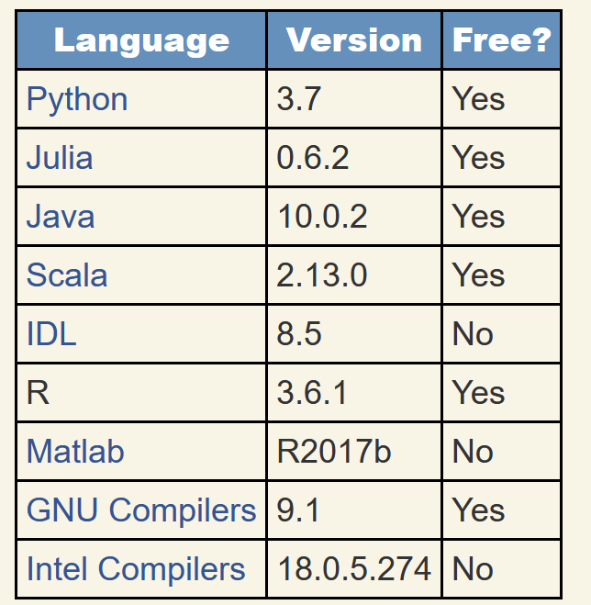
https://modelingguru.nasa.gov/docs/DOC-2783
Which programming language should you use?

Slide 19
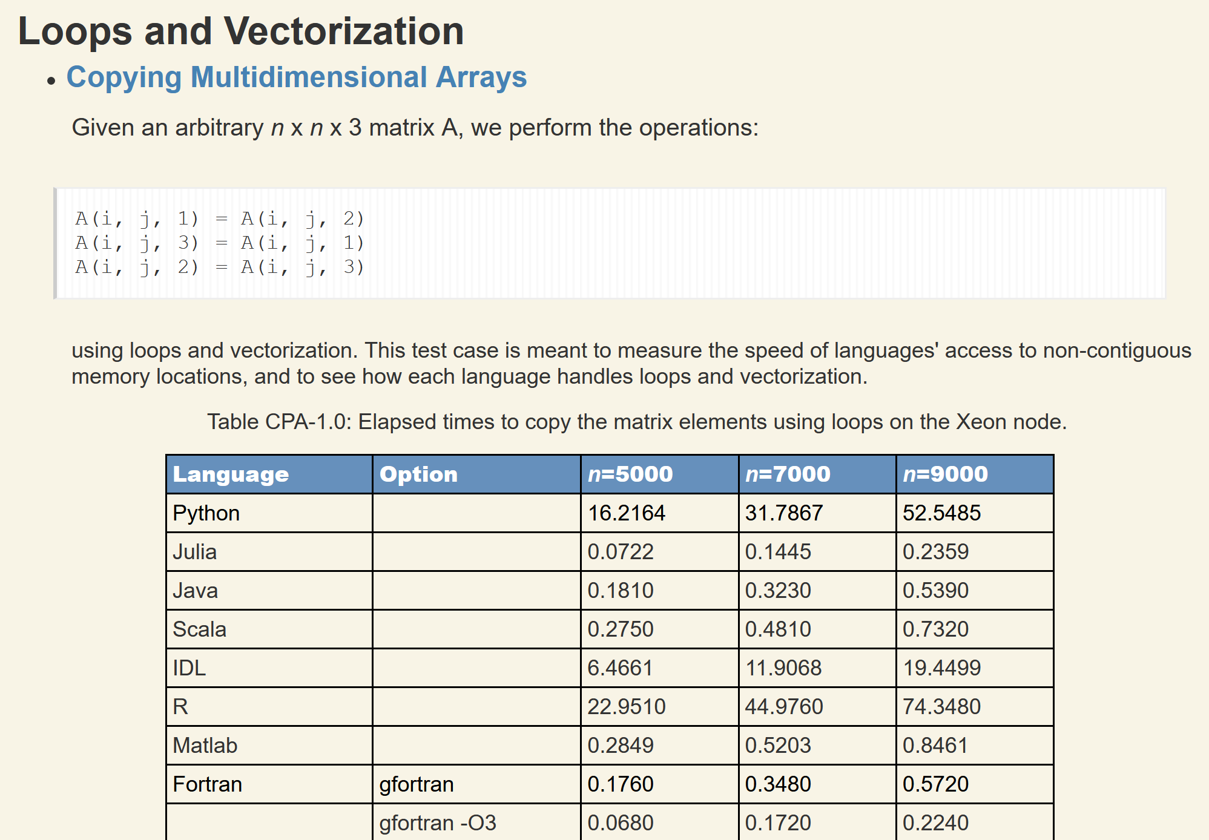
https://modelingguru.nasa.gov/docs/DOC-2783
Created on: Jul 2, 2019 2:51 PM by Alexander Medema - Last Modified: Nov 4, 2019 10:15 PM by Jules Kouatchou

Slide 20

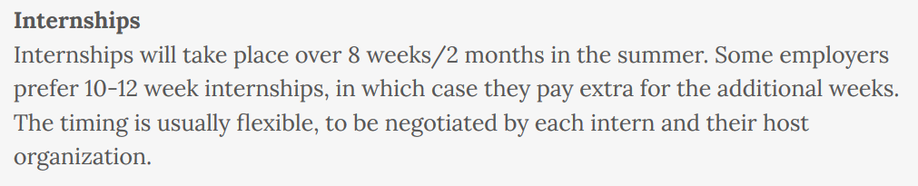
https://inmas.us/

Slide 21
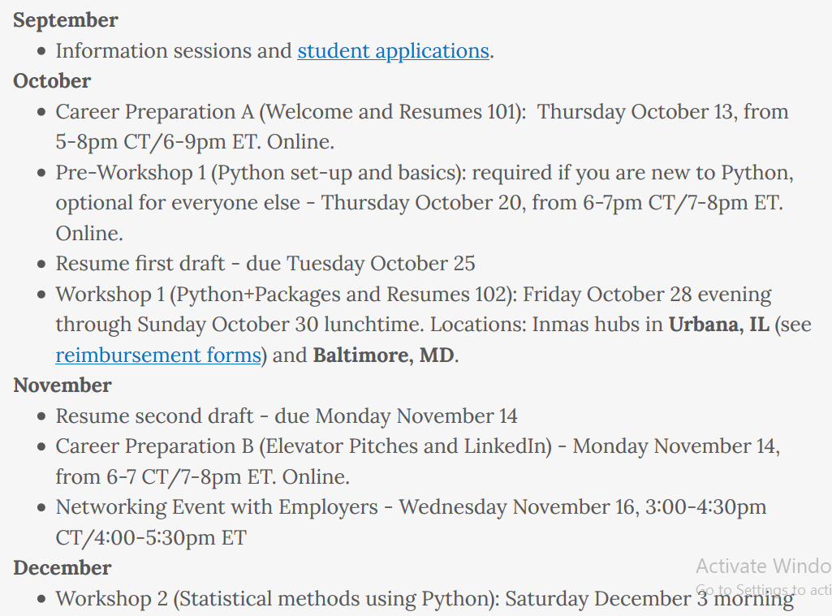
https://inmas.us/

Slide 22
A few notes from an unrelated colloquium regarding moving into industry:
https://www.datacamp.com/ Build data skills online (elementary broad overview)
Insight vs DataIncubator
Some recommended courses
Statistical Inference 1 and 2
Applied statistics 1 and 2*
*Computing and Statistics
CS:5110 Introduction to Informatics (python)
Github is your portfolio comment your code!!!!!!
Kaggle competition/Kaggle notebooks
Program using google
Social media is often not accurate including linkedin
You are all very smart people
*Rhonda 2: Applied statistics 2

Slide 23
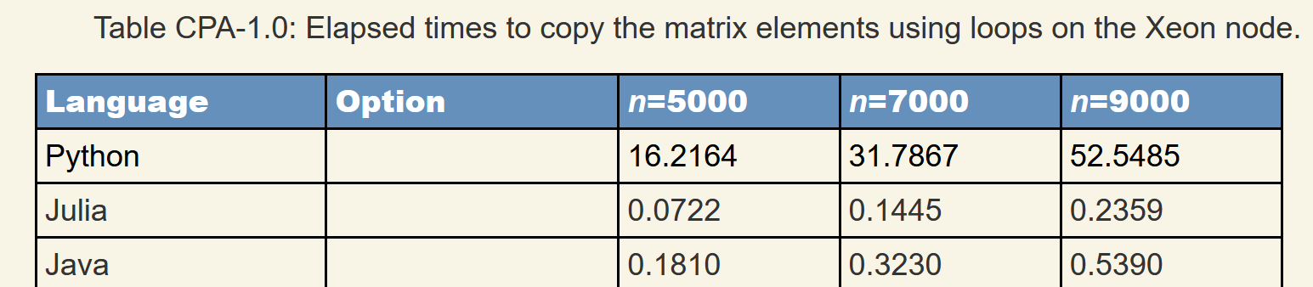
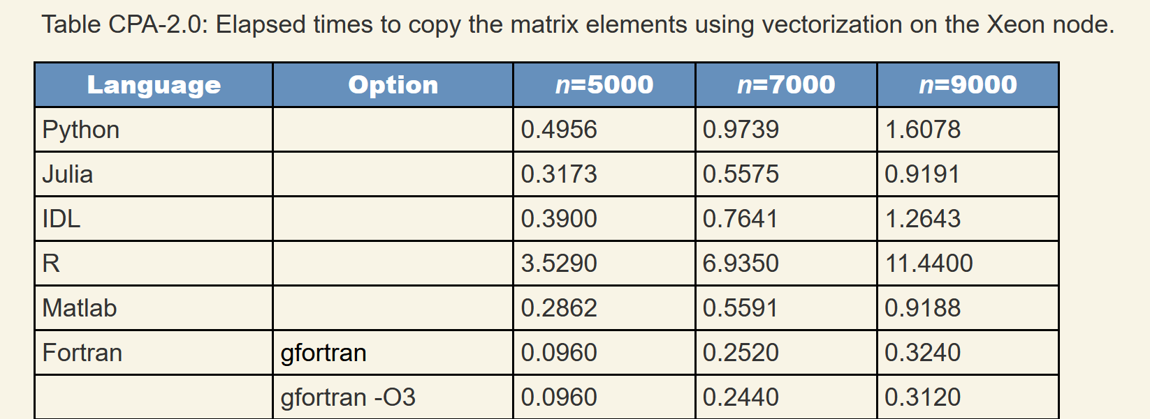
https://modelingguru.nasa.gov/docs/DOC-2783

Slide 24
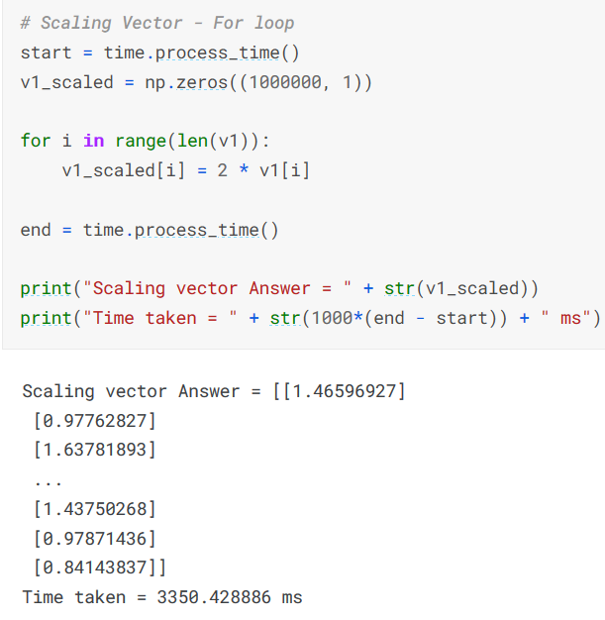
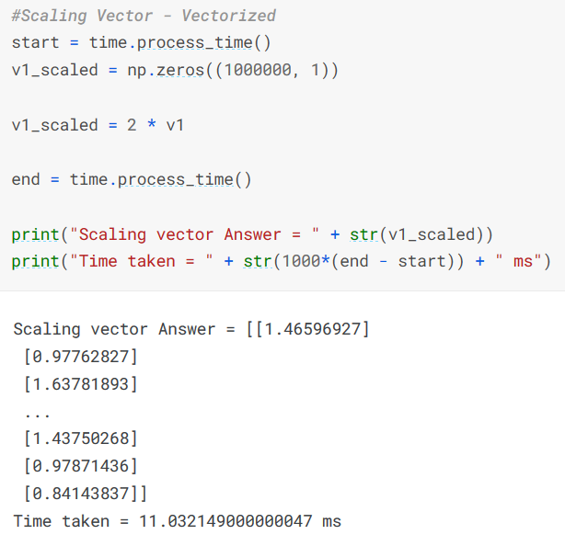
https://www.kaggle.com/code/yushg123/for-loops-vs-vectorized-who-wins-and-by-how-much

Slide 25
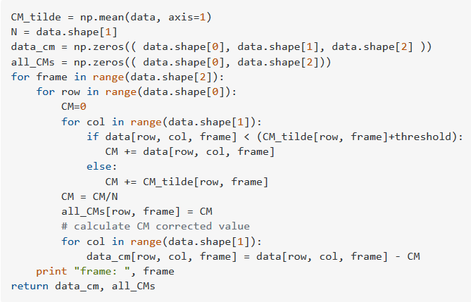
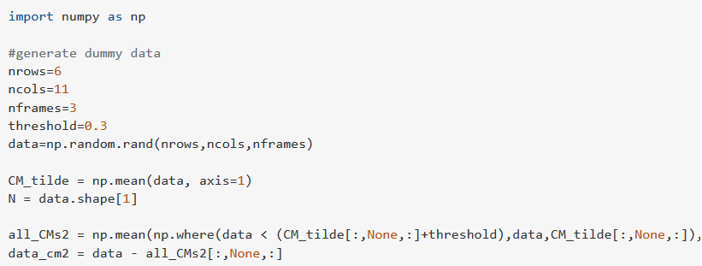

https://stackoverflow.com/questions/33792040/numpy-vectorization-instead-of-for-loops
versus

Slide 26
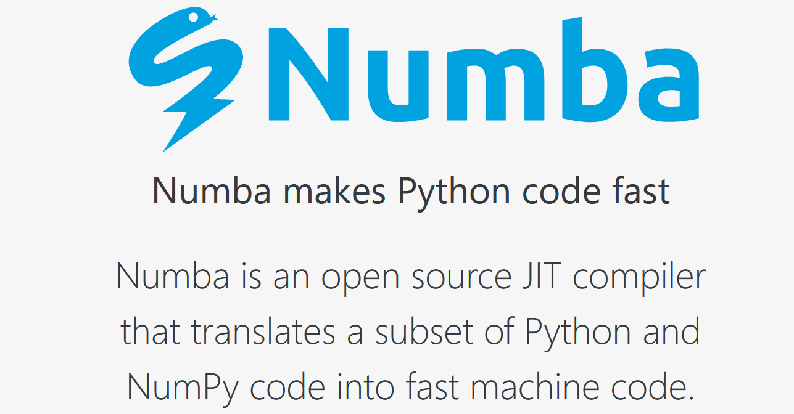
https://numba.pydata.org/

Slide 27
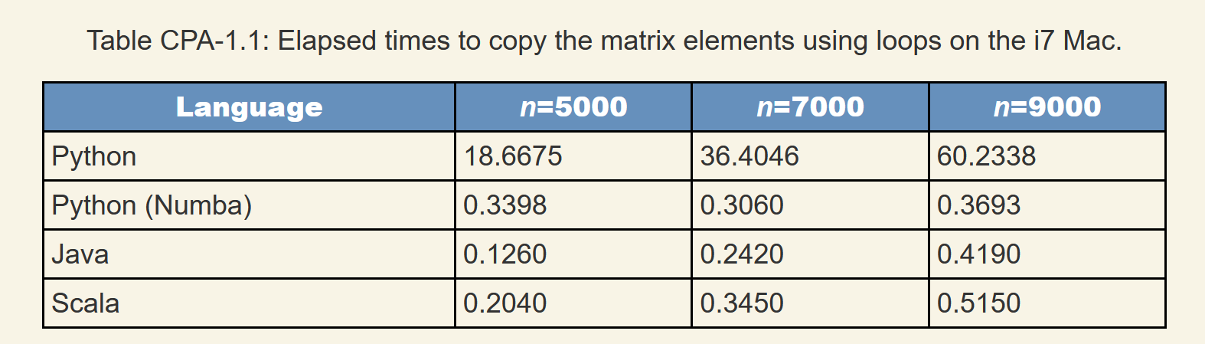
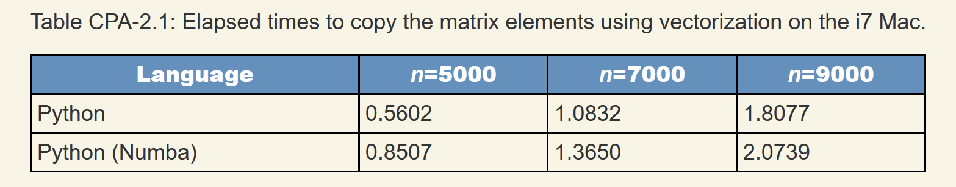
https://modelingguru.nasa.gov/docs/DOC-2783

Slide 28
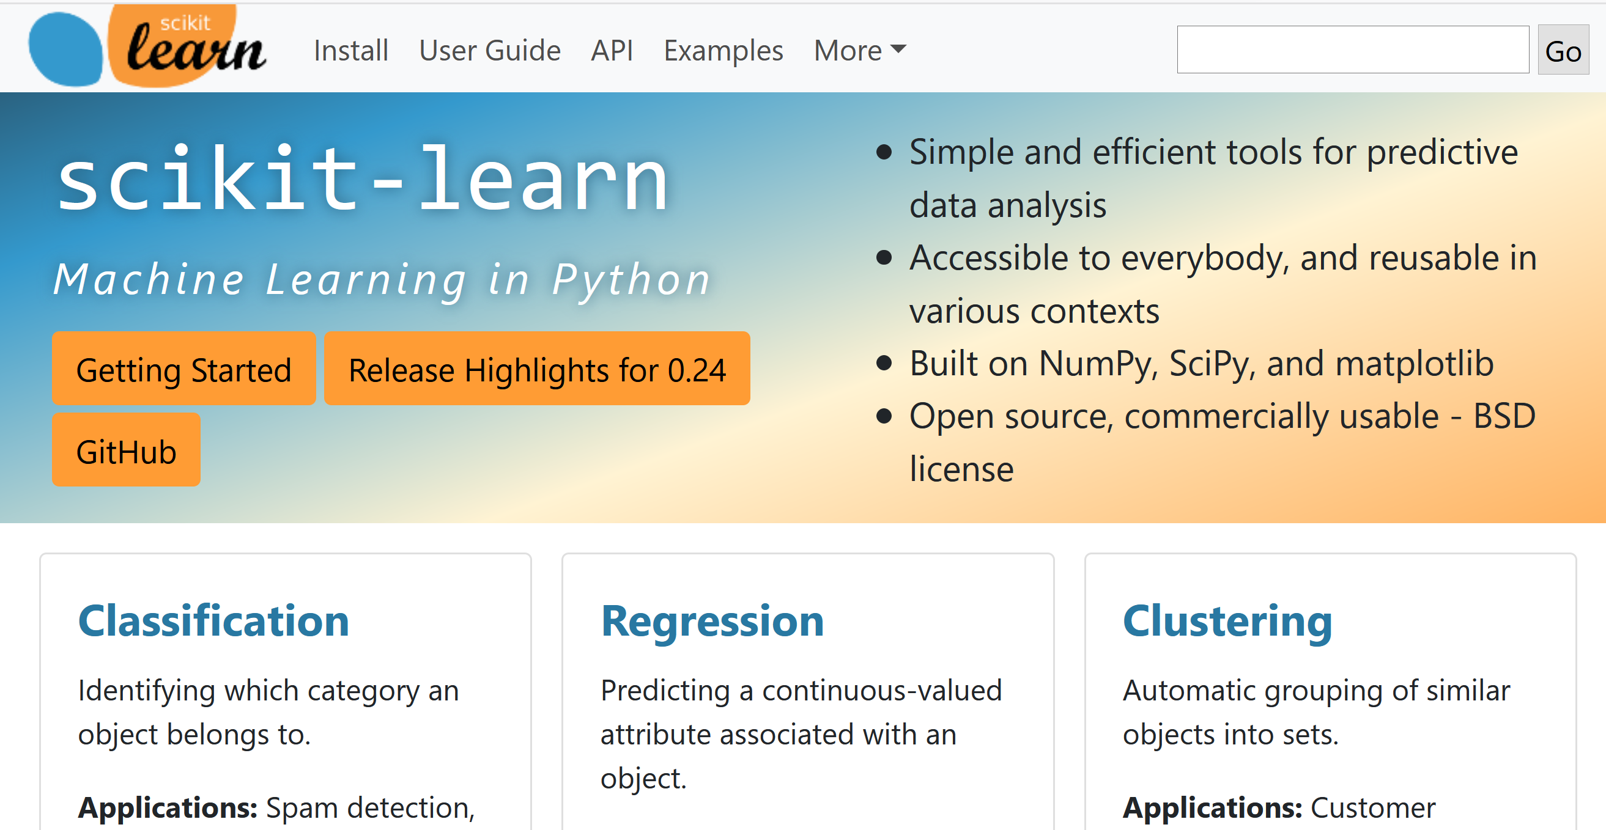
https://scikit-learn.org
Both python and R have large well-developed libraries.

Slide 29
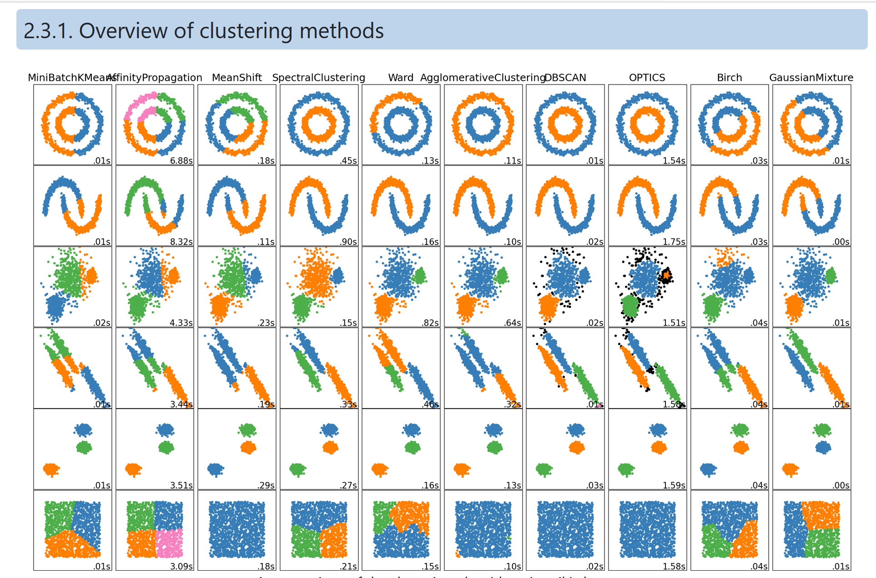
https://scikit-learn.org/stable/modules/clustering.html

Slide 30
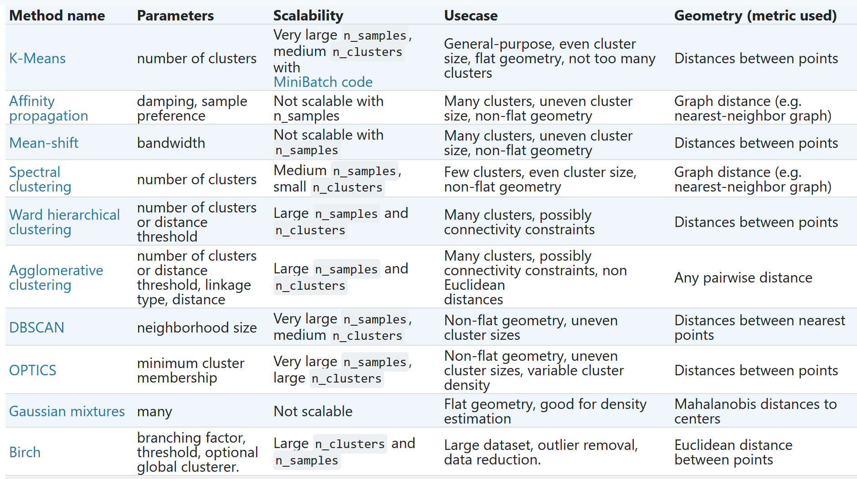
https://scikit-learn.org/stable/modules/clustering.html#clustering

Slide 31
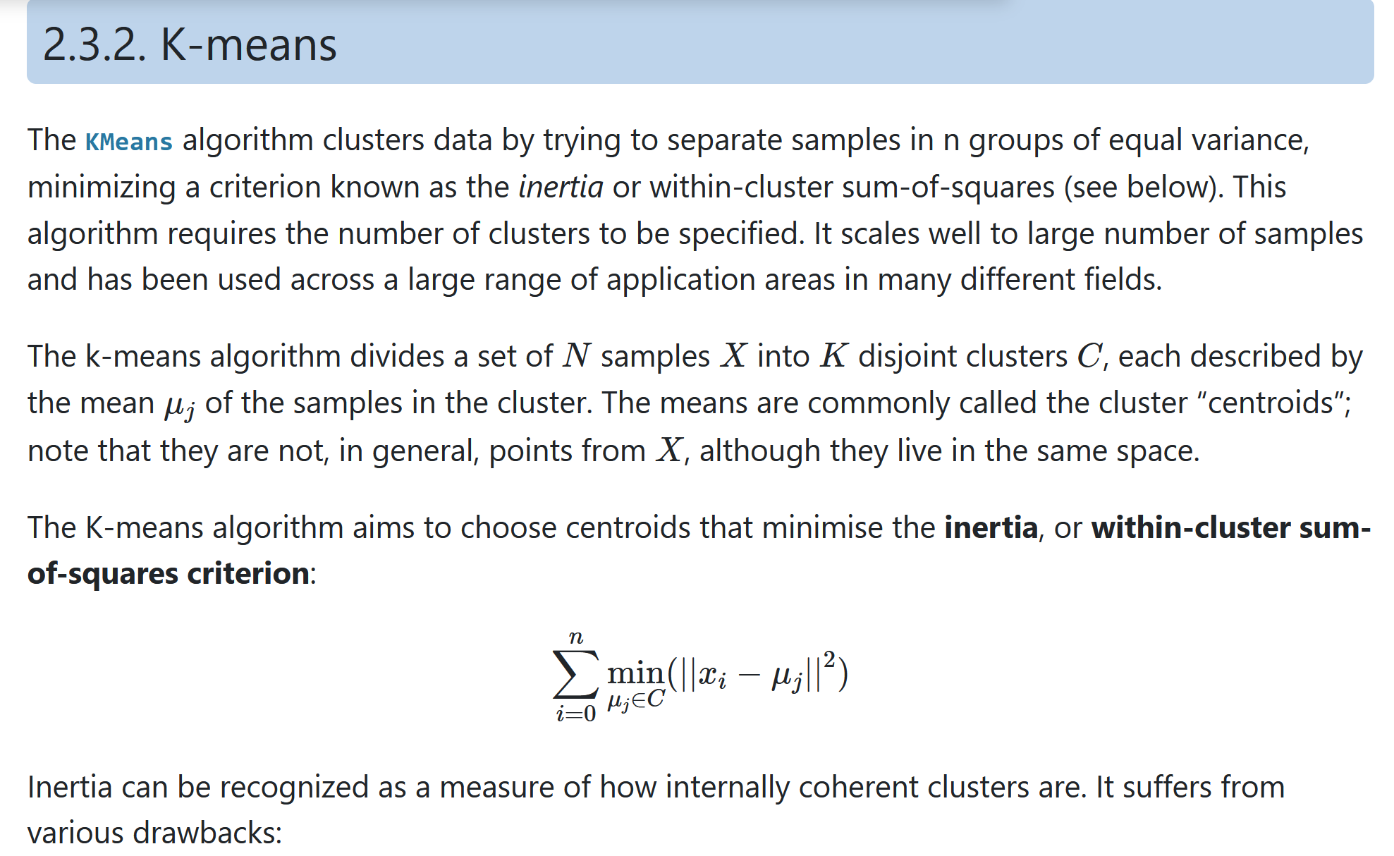
https://scikit-learn.org/stable/modules/clustering.html#k-means

Slide 32
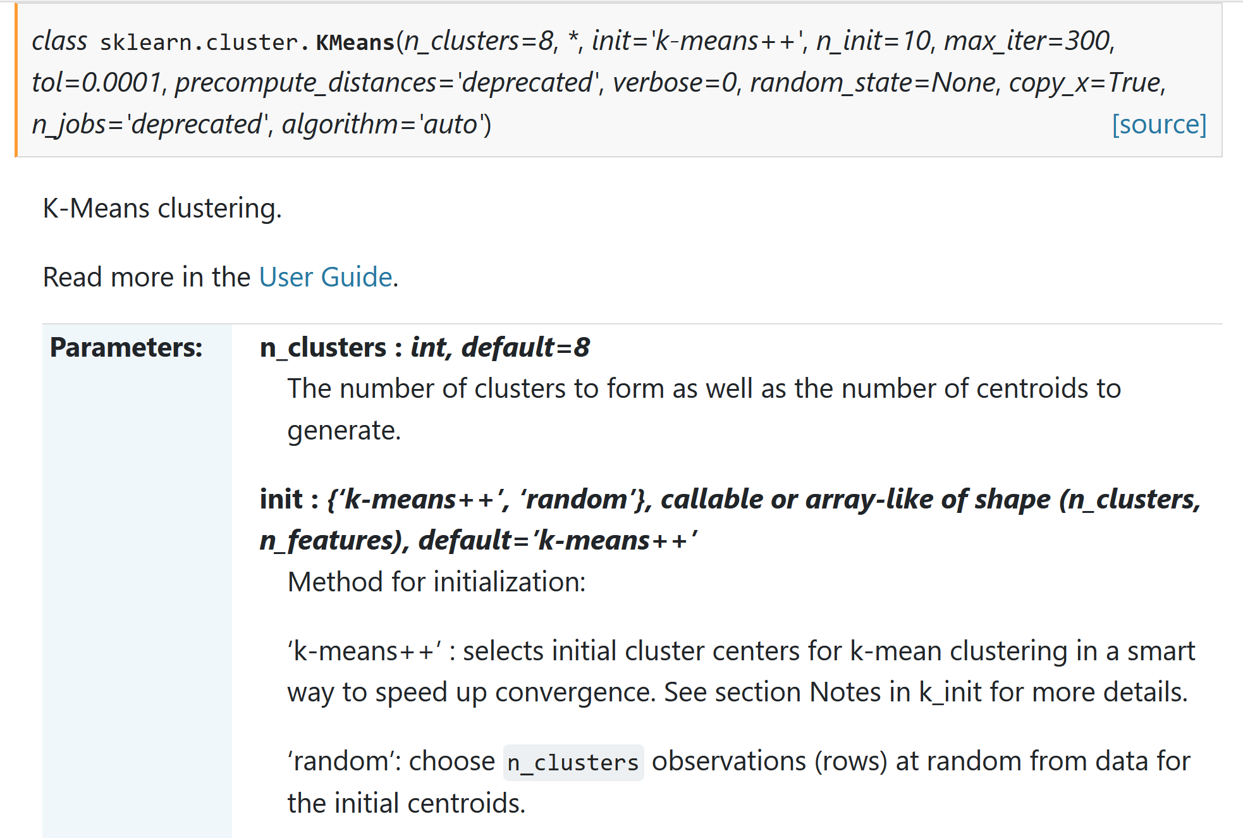

Slide 33

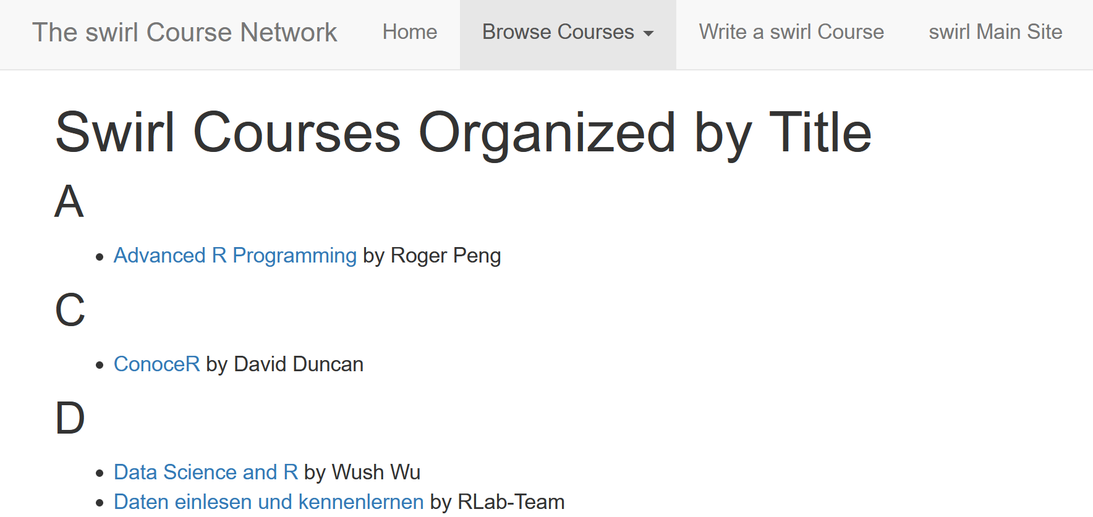
https://swirlstats.com/scn/title.html
https://www.r-project.org/

Slide 34

Additional R packages can be found at other repositories such as http://bioconductor.org/

Slide 35
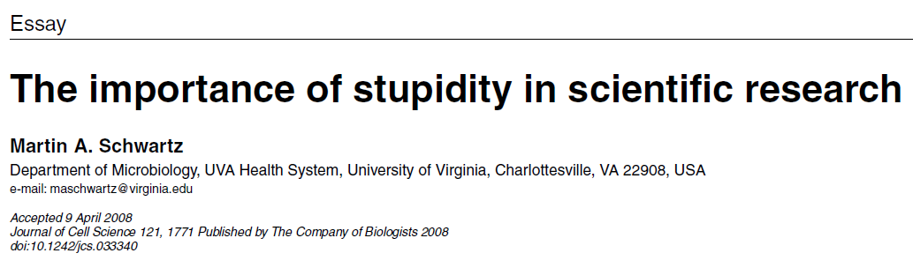
http://jcs.biologists.org/content/121/11/1771
I'd like to suggest that our Ph.D. programs often do students a disservice in two ways. First, I don't think students are made to understand how hard it is to do research. And how very, very hard it is to do important research. It's a lot harder than taking even very demanding courses. What makes it difficult is that research is immersion in the unknown. We just don't know what we're doing. We can't be sure whether we're asking the right question or doing the right experiment until we get the answer or the result.

Slide 36
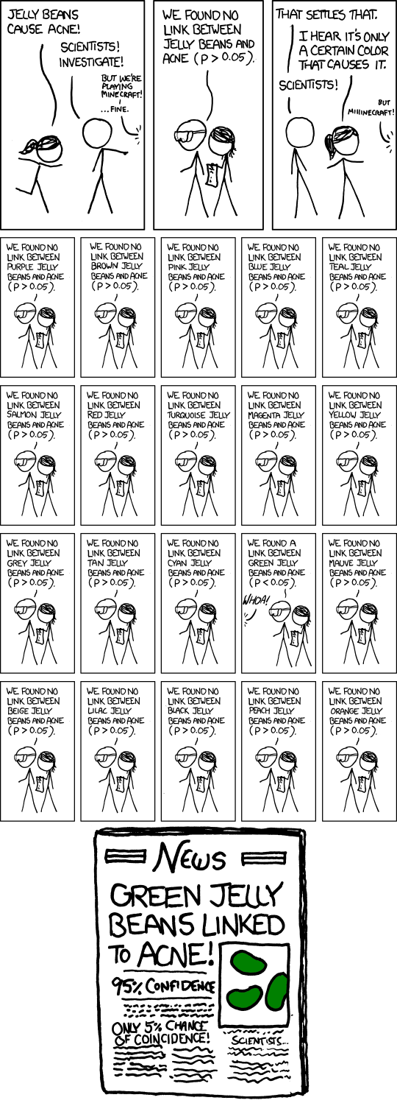
False Positives will occur
https://xkcd.com/882/

Slide 37
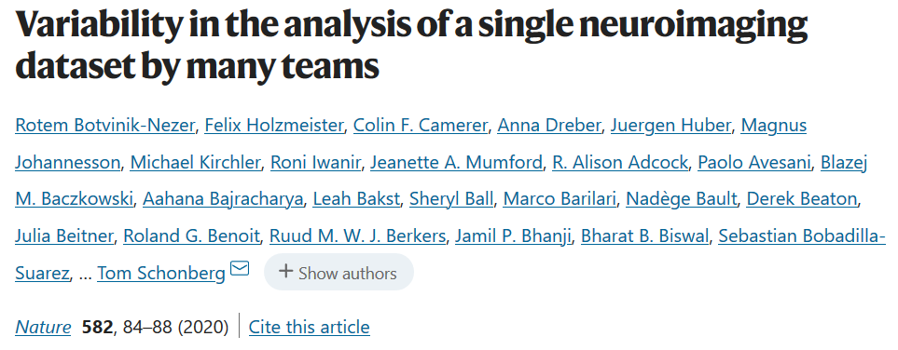
Even if you do everything right, False Positives will occur
Moreover the sample size of most biological data sets is small.
https://www.nature.com/articles/s41586-020-2314-9
“Here we assess the effect of this flexibility on the results of functional magnetic resonance imaging by asking 70 independent teams to analyse the same dataset, testing the same 9 ex-ante hypotheses”
“Our findings show that analytical flexibility can have substantial effects on scientific conclusions,”

Slide 38
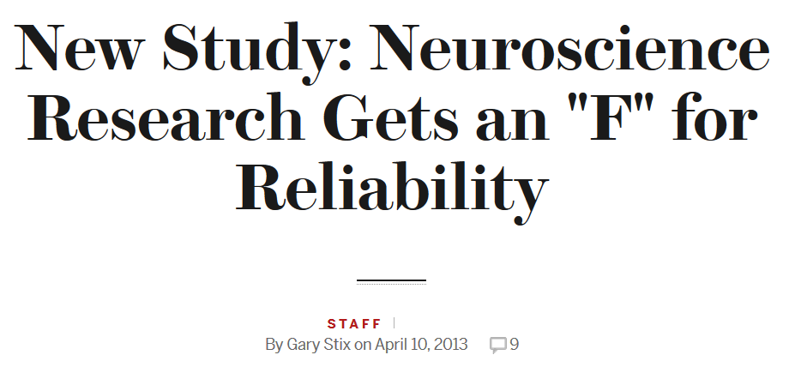

https://blogs.scientificamerican.com/talking-back/new-study-neuroscience-research-gets-an-f-for-reliability/
“The study—led by researchers at the University of Bristol—looked at 48 neuroscience meta-analyses (studies of studies) from 2011 and found that their statistical power reaches only 21 percent, meaning that there is only about a one in five chance that any effect being investigated by the researchers—whether a compound acts as an anti-depressant in rat brains, for instance—will be discovered. Anything that does turn up, moreover, is more likely to be false. The low power stems from the small size of the studies and minuscule effects.”
“other areas of biology, which also suffer from the same phenomenon—he cited studies on cancer and cardiology that are powered at 34 percent. “

Slide 39
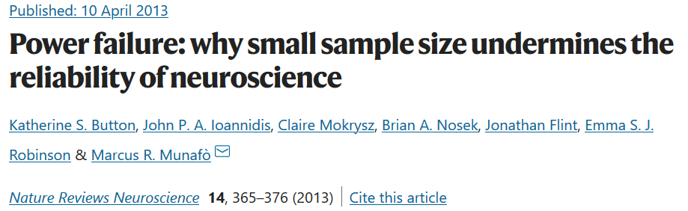
“low power also reduces the likelihood that a statistically significant result reflects a true effect”
It has been claimed and demonstrated that many (and possibly most) of the conclusions drawn from biomedical research are probably false¹. A central cause for this important problem is that researchers must publish in order to succeed, and publishing is a highly competitive enterprise, with certain kinds of findings more likely to be published than others. Research that produces novel results, statistically significant results (that is, typically p < 0.05) and seemingly 'clean' results is more likely to be published^{2,3}. As a consequence, researchers have strong incentives to engage in research practices that make their findings publishable quickly, even if those practices reduce the likelihood that the findings reflect a true (that is, non-null) effect⁴. Such practices include using flexible study designs and flexible statistical analyses and running small studies with low statistical power^{1,5}. A simulation of genetic association studies showed that a typical dataset would generate at least one false positive result almost 97% of the time⁶, and two efforts to replicate promising findings in biomedicine reveal replication rates of 25% or less^{7,8}. Given that these publishing biases are pervasive across scientific practice, it is possible that false positives heavily contaminate the neuroscience literature as well, and this problem may affect at least as much, if not even more so, the most prominent journals^{9,10}.

Slide 40
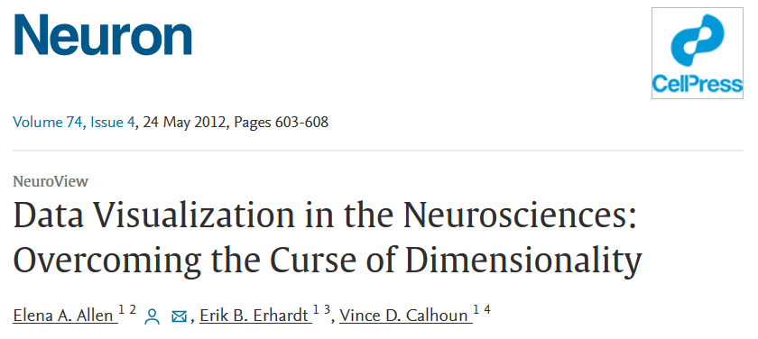
https://www.sciencedirect.com/science/article/pii/S089662731200428X

Slide 41
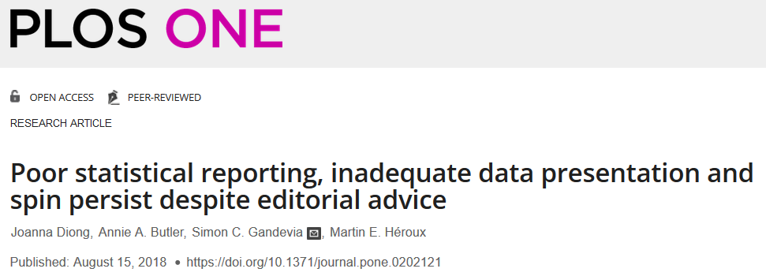
https://journals.plos.org/plosone/article?id=10.1371/journal.pone.0202121

Slide 42
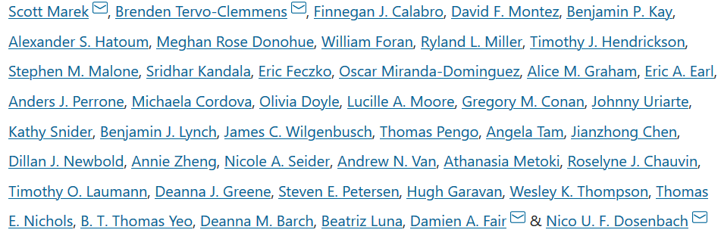
https://www.nature.com/articles/s41586-022-04492-9
Reproducible brain-wide association studies require thousands of individuals
Nature volume 603,
pages 654–660 (2022)
Magnetic resonance imaging (MRI) has transformed our understanding of the human brain through well-replicated mapping of abilities to specific structures (for example, lesion studies) and functions^{1,2,3} (for example, task functional MRI (fMRI)). Mental health research and care have yet to realize similar advances from MRI. A primary challenge has been replicating associations between inter-individual differences in brain structure or function and complex cognitive or mental health phenotypes (brain-wide association studies (BWAS)). Such BWAS have typically relied on sample sizes appropriate for classical brain mapping⁴ (the median neuroimaging study sample size is about 25), but potentially too small for capturing reproducible brain–behavioural phenotype associations^{5,6}. Here we used three of the largest neuroimaging datasets currently available—with a total sample size of around 50,000 individuals—to quantify BWAS effect sizes and reproducibility as a function of sample size. BWAS associations were smaller than previously thought, resulting in statistically underpowered studies, inflated effect sizes and replication failures at typical sample sizes. As sample sizes grew into the thousands, replication rates began to improve and effect size inflation decreased. More robust BWAS effects were detected for functional MRI (versus structural), cognitive tests (versus mental health questionnaires) and multivariate methods (versus univariate). Smaller than expected brain–phenotype associations and variability across population subsamples can explain widespread BWAS replication failures. In contrast to non-BWAS approaches with larger effects (for example, lesions, interventions and within-person), BWAS reproducibility requires samples with thousands of individuals.

Slide 43
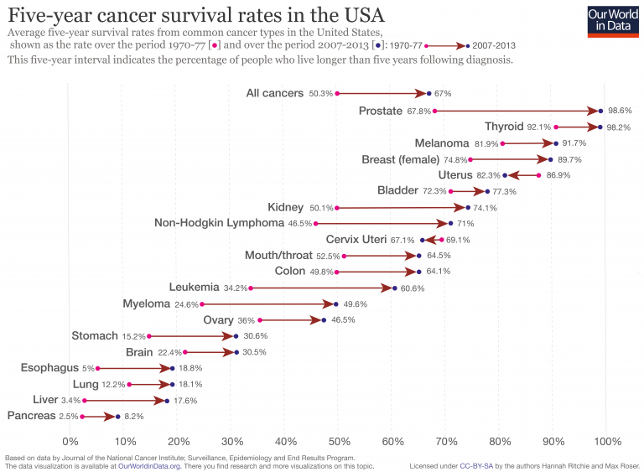
https://ourworldindata.org/cancer-death-rates-are-falling-five-year-survival-rates-are-rising
Despite the fact that we might not know what we are doing, we are making progress where some progress is due to research and others to changes in behavior.

Slide 44
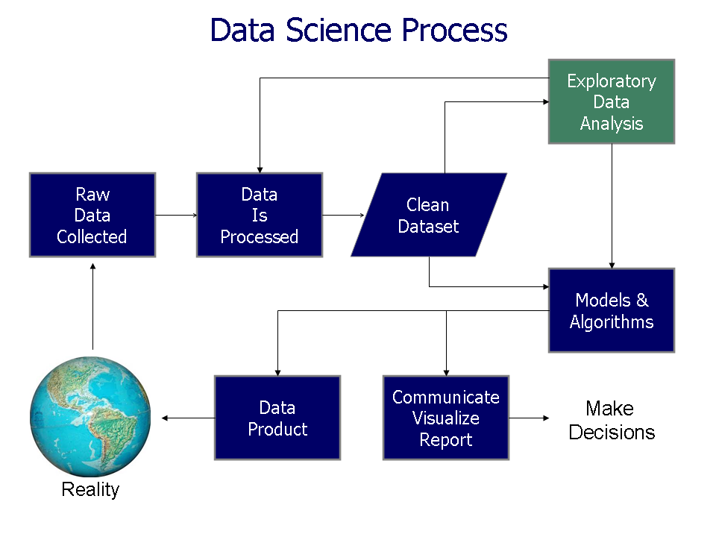
https://commons.wikimedia.org/wiki/File%3AData_visualization_process_v1.png

Slide 45
Resources for finding articles including articles about data sets:
https://mathscinet-ams-org.proxy.lib.uiowa.edu/mathscinet
https://www.ncbi.nlm.nih.gov/
https://arxiv.org/list/math/recent
https://scholar.google.com/
Can also search for excel filetype:
Duckduckgo: topic site:edu filetype:xls
Another great resource: https://www.kaggle.com/

Slide 46
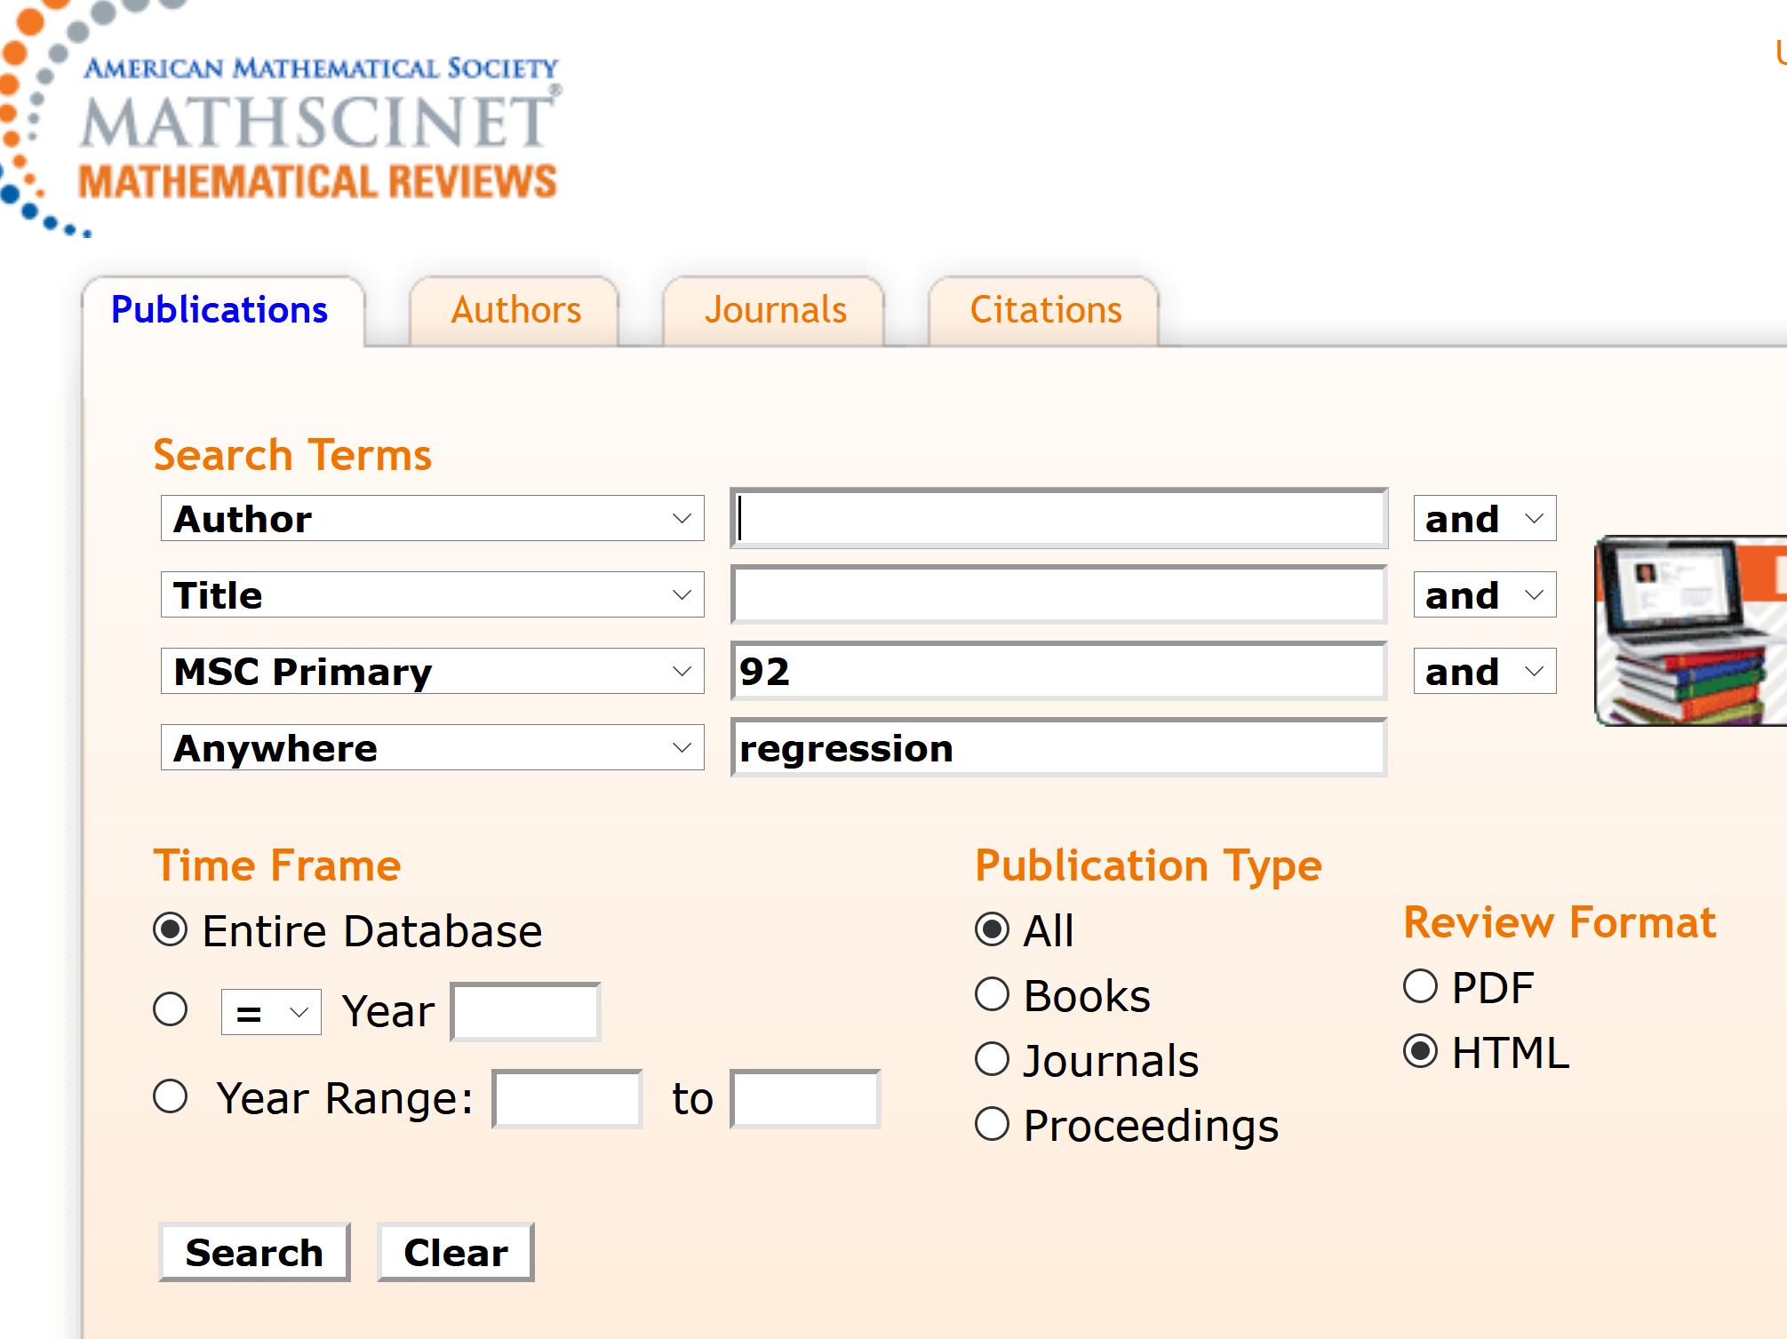
https://mathscinet-ams-org.proxy.lib.uiowa.edu/mathscinet

Slide 47
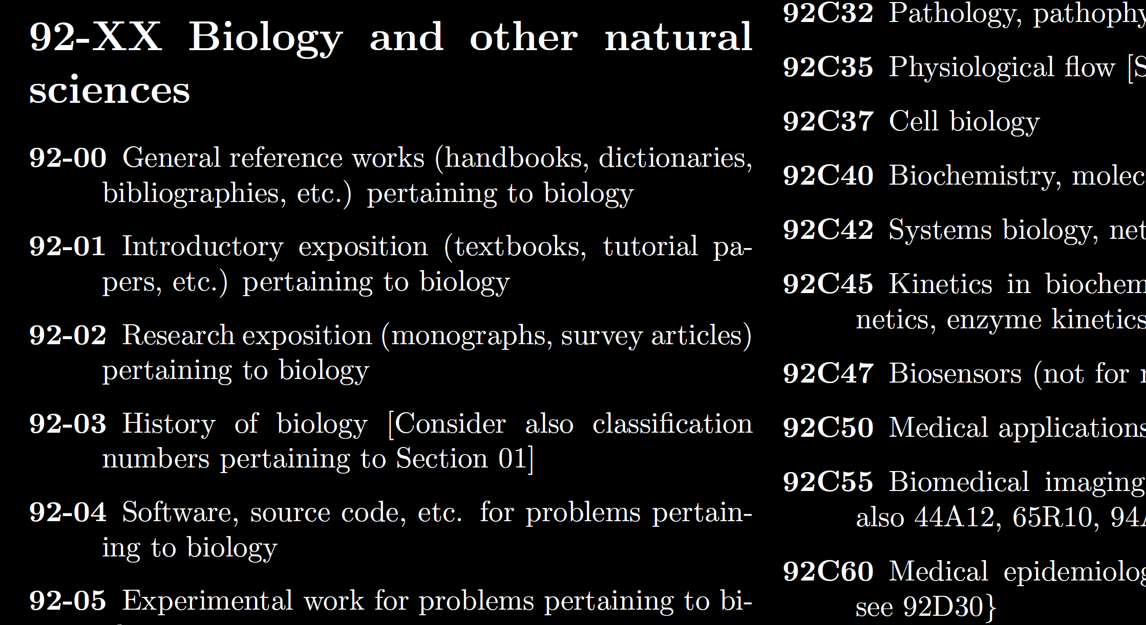
https://mathscinet-ams-org.proxy.lib.uiowa.edu/msnhtml/msc2020.pdf

Slide 48
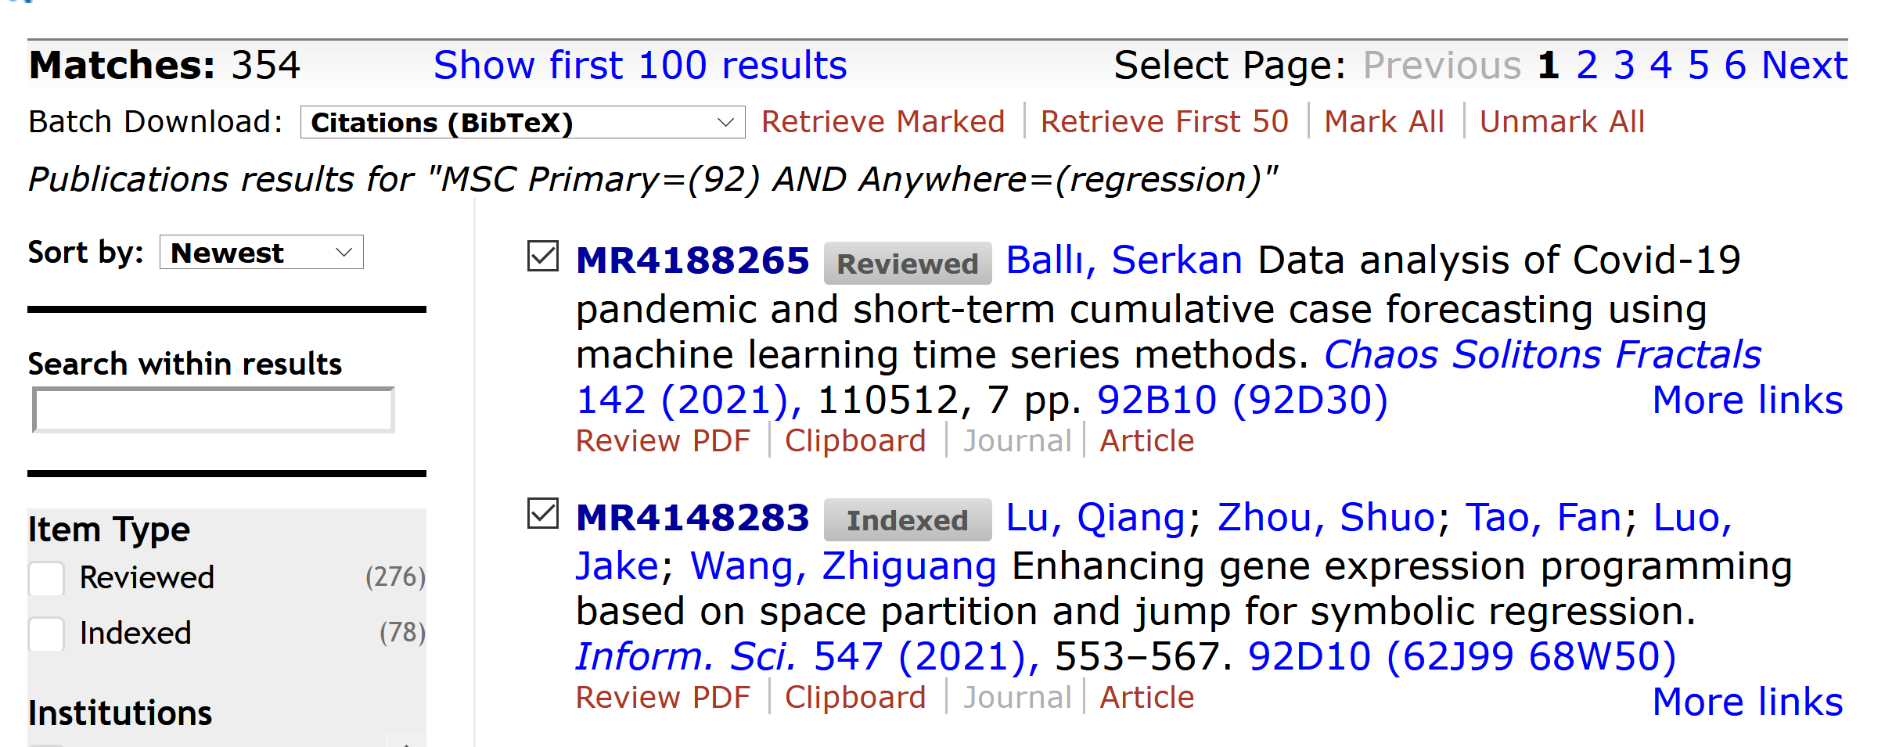


Slide 49


Slide 50



We currently maintain 412 data sets as a service to the machine learning community.
We currently maintain 622 data sets as a service to the machine learning community.
http://archive.ics.uci.edu/ml/index.php

Slide 51


Slide 52


Slide 53





q
d(p, q) = ??
Euclidean
Minkowski distance
Chebyshev distance
5
4
p
3

Slide 54
q
d(p, q) = ??
Euclidean
5
Minkowski distance (k = 1)
7
Chebyshev distance
4
5
4
p
3

Slide 55


Section 2.2.2: Distances
http://www.bigdata.uni-frankfurt.de/wp-content/uploads/2015/10/
Evaluating-Ayasdi’s-Topological-Data-Analysis-For-Big-Data_HKim2015.pdf

Slide 56
Application 3 (in paper): Basketball
Data: rates (per minute played) of rebounds, assists, turnovers, steals, blocked shots, personal fouls, and points scored for 452 players.
➔ Input: 452 points in R⁷
For each player, we have a vector
= (r, a, t, s, b, f, p) in R⁷
Distance: variance normalized Euclidean distance.
Clustering: Single linkage.
( min , min , min , min , min , min , min )
rebounds assists turnovers steals blocked shots personal fouls points scored
http://www.nature.com/srep/2013/130207/srep01236/full/srep01236.html

Slide 57
Distance: variance normalized Euclidean distance.
( min , min , min , min , min , min , min )
rebounds assists turnovers steals blocked shots personal fouls points scored

Slide 58

http://d-roger.com/2016/09/07/finding-similar-items-查找相似项/
Jacard Distance = 1 – J(A, B)

Slide 59

https://en.wikipedia.org/wiki/Jaccard_index

Slide 60


https://people.rit.edu/rmb5229/320/project3/hamming.html
http://rosalind.info/glossary/hamming-distance/
Hamming Distance = 7

Slide 61



http://www.joachimdespland.com/mammoth.html
http://bloggity.nurdz.com/gamedev-math/manhattan/
http://www.improvedoutcomes.com/docs/WebSiteDocs/Clustering/Clustering_Parameters/Manhattan_Distance_Metric.htm

Slide 62





https://onlinelibrary.wiley.com/doi/full/10.1002/jmri.25750

Slide 63

https://arxiv.org/abs/1908.06029

Slide 64
Section 2.2.2: Distances
http://www.bigdata.uni-frankfurt.de/wp-content/uploads/2015/10/
Evaluating-Ayasdi’s-Topological-Data-Analysis-For-Big-Data_HKim2015.pdf

Slide 65
In R^{n}
If n small, Euclidean distance often makes sense
If n is large, consider Chebyshev distance or
performing PCA first to project data into R^{d}, for small d
and then using Euclidean distance
Chebyshev distance:

Slide 66

Normality
How to assess/detect it
What to do if you have non-normal data
https://fs.wp.odu.edu/abraitma/workshops/

Slide 67

Assessing Normality
Skewness and Kurtosis
Negatively Skewed
Normal
Positively Skewed
Platykurtic
Normal
Leptokurtic
https://fs.wp.odu.edu/abraitma/workshops/

Slide 68






Non-Normality: Transformation
Sum of drinks past 2 weeks: positively skewed
Original square root log
https://fs.wp.odu.edu/abraitma/workshops/

Slide 69
What to do about Missing Data
Delete incomplete cases?
Complete Case Analysis (aka Listwise Deletion)
  Delete everyone from your sample who has missing data
  Final sample includes only individuals with all data
Available Case Analysis (aka Pairwise Deletion)
  Exclude people from relevant analyses who have missing data
  E.g., If missing on depressive symptoms, then missing from regression that examines influence of meditation on depressive symptoms
    Present for regression that examines influence of meditation on anxiety
https://fs.wp.odu.edu/abraitma/workshops/

Slide 70

Outliers
How to identify them
What to do about them
Start with univariate (one variable at a time)
Touch on multivariate
https://fs.wp.odu.edu/abraitma/workshops/

Slide 71
Outliers
Why do we care?
  Have a stronger influence on the data
  Can influence results of study
r = -.426
r = -.567
Same data, changed one value from 37 to 150
https://fs.wp.odu.edu/abraitma/workshops/

Slide 72
Datalogs
Date can be helpful, but not required
  Who did it an be very helpful if there are multiple hands in the project
ACTIVITIES are required, with specific details
  What you did
  Why you did it
Missing data
  What percentage for data? Each variable?
  How did you address it?
Outliers
  How many for each variable?
  Old and new values?
Recoding
  What dummy codes did you create? Why?
  What composites scores did you create? Means or sums or something else?
    Did you remember to reverse score??
Did you check linearity? Normality?
  Confirmed for which variables?
  What adjustments were made for which variables (if any)?
https://fs.wp.odu.edu/abraitma/workshops/

Slide 73
Dimensionality Reduction: Given dataset D R^{N}
Want: embedding f: D → R^{n} where n << N
    which “preserves” the structure of the data.
Many reduction methods:
f₁: D → R, f₂: D → R, … f_{n}: D → R
(f₁, f₂, … f_{n}): D → R^{n}
Many are linear, M: R^{N} → R^{n}, Mx = y
But there are also non-linear dimensionality reduction algorithms.
U

Slide 74
https://en.wikipedia.org/wiki/Nonlinear_dimensionality_reduction

Slide 75

Example: Principle component analysis (PCA)
http://en.wikipedia.org/wiki/File:GaussianScatterPCA.png

Slide 76
Why use PCA in data analysis?
Reduce dimension.
Visualization.
Fewer variables = less memory (data compression).
Fewer variables = faster computing time (usually).

Slide 77
Why use PCA in data analysis?
Consider the points (0, 0, …, 0), (1, 0, …, 0), (10, 0, …, 0)
Add noise to first point (0, 0, …, 0) → (0, 1, …, 1)
In R¹⁰⁰, d((0, 1, …, 1), (1, 0, …, 0)) = 10 > 9.
Add small noise to first point (0, 0, …, 0) → (0, 0.1, …, 0.1)
In R^{39,900}, d((0, 0.1, …, 0.1), (1, 0, …, 0)) = 20 > 9.
0 1 10

Slide 78
Example: Principle component analysis (PCA)
http://en.wikipedia.org/wiki/File:GaussianScatterPCA.png

Slide 79
Example: Principle component analysis (PCA)
x_{i} → z_{i} = linear combination of x_{i}
http://en.wikipedia.org/wiki/File:GaussianScatterPCA.png

Slide 80
In R^{n}
If n small, Euclidean distance often makes sense
If n is large, consider Chebyshev distance or
performing PCA first to project data into R^{d}, for small d
and then using Euclidean distance
Chebyshev distance:

Slide 81
PCA on all Genes
Leukemia data, precursor B and T
Plot of 34 patients, dimension of 8973 genes reduced to 2
www.cse.buffalo.edu/faculty/azhang/data-mining/pca.ppt

Slide 82
PCA on 100 top significant genes
Leukemia data, precursor B and T
Plot of 34 patients, dimension of 100 genes reduced to 2
www.cse.buffalo.edu/faculty/azhang/data-mining/pca.ppt

Slide 83
Principal Component Analysis: one attribute first
Temperature
42
40
24
30
15
18
15
30
15
30
35
30
40
30
Question: how much spread is in the data along the axis? (distance to the mean)
Variance=Standard deviation^2
www.cse.buffalo.edu/faculty/azhang/data-mining/pca.ppt

Slide 84
Now consider two dimensions
X=Temperature | Y=Humidity
40 | 90
40 | 90
40 | 90
30 | 90
15 | 70
15 | 70
15 | 70
30 | 90
15 | 70
30 | 70
30 | 70
30 | 90
40 | 70
30 | 90
Covariance: measures the
correlation between X and Y
cov(X,Y)=0: independent
Cov(X,Y)>0: move same dir
Cov(X,Y)<0: move oppo dir
www.cse.buffalo.edu/faculty/azhang/data-mining/pca.ppt

Slide 85
More than two attributes: covariance matrix
Contains covariance values between all possible dimensions (=attributes):
Example for three attributes (x,y,z):
www.cse.buffalo.edu/faculty/azhang/data-mining/pca.ppt

Slide 86
Steps of PCA
Let be the mean vector (taking the mean of all rows)
Adjust the original data by the mean
  X’ = X –
Compute the covariance matrix C of adjusted X
Find the eigenvectors and eigenvalues of C.
For matrix C, vectors e (=column vector) having same direction as Ce :
  eigenvectors of C is e such that Ce=λe,
  λ is called an eigenvalue of C.
Ce=λe ⇔ (C-λI)e=0
  Most data mining packages do this for you.
www.cse.buffalo.edu/faculty/azhang/data-mining/pca.ppt

Slide 87
Principal components
1. principal component (PC1)
  The eigenvalue with the largest absolute value will indicate that the data have the largest variance along its eigenvector, the direction along which there is greatest variation
2. principal component (PC2)
  the direction with maximum variation left in data, orthogonal to the 1. PC
In general, only few directions manage to capture most of the variability in the data.
www.cse.buffalo.edu/faculty/azhang/data-mining/pca.ppt

Slide 88
Eigenvalues
Calculate eigenvalues λ and eigenvectors x for covariance matrix:
  Eigenvalues λ_{j} are used for calculation of [% of total variance] (V_{j}) for each component j:
www.cse.buffalo.edu/faculty/azhang/data-mining/pca.ppt

Slide 89
Principal components - Variance
www.cse.buffalo.edu/faculty/azhang/data-mining/pca.ppt

Slide 90

Machine Learning overview
Chapter 19
14.1
https://www.csee.umbc.edu/courses/graduate/671/fall20/notes/14_machine_learning/14_1_intro.pptx

Slide 91
So What Is Machine Learning?
Automating automation
Getting computers to program themselves
Writing software is the bottleneck
Let the data do the work instead!
https://courses.cs.washington.edu/courses/cse446/09wi/slides/intro.ppt

Slide 92
Traditional Programming
Machine Learning
Data
Computer
Output
Program
Data
Computer
Program
Output
https://courses.cs.washington.edu/courses/cse446/09wi/slides/intro.ppt

Slide 93

Magic?
No, more like gardening
Seeds = Algorithms
Nutrients = Data
Gardener = You
Plants = Programs
https://courses.cs.washington.edu/courses/cse446/09wi/slides/intro.ppt

Slide 94
What is Machine Learning?
Machine Learning By: Jennie E. Brand, Bernard Koch & Jiahui Xu
https://methods-sagepub-com.proxy.lib.uiowa.edu/foundations/machine-learning
“Machine learning is a computational and statistical approach to extracting patterns and trends from data (Maini & Sabri, 2017). A machine learning algorithm is also defined as a computer program that learns from experience with data with respect to some class of tasks and improves its performance with greater experience (Mitchell, 1997).”
Hands-on Scikit-Learn for Machine Learning Applications by David Paper
https://link-springer-com.proxy.lib.uiowa.edu/book/10.1007%2F978-1-4842-5373-1
Machine learning is getting computers to program themselves. We use algorithms to
make this happen. An algorithm is a set of rules used to calculate or problem solve
with a computer.
Machine learning advocates create, study, and apply algorithms to improve
performance on data-driven tasks. They use tools and technology to answer questions
about data by training a machine how to learn.

Slide 95
Types of Learning
Supervised (inductive) learning
  Training data includes desired outputs
Unsupervised learning
  Training data does not include desired outputs
Semi-supervised learning
  Training data includes a few desired outputs
Reinforcement learning
  Rewards from sequence of actions
https://courses.cs.washington.edu/courses/cse446/09wi/slides/intro.ppt

Slide 96

Supervised vs Reinforcement vs Unsupervised Learning
Supervised Learning
Data: (x, y)
x is data, y is label
Goal: Learn a function to map x → y
Examples: Classification, regression, object detection, semantic segmentation, image captioning, etc.
Cat
Classification
This image is CC0 public domain
https://www.cc.gatech.edu/classes/AY2020/cs7643_fall/slides/L23_generative2.pptx
Slide Credit: Fei-Fei Li, Justin Johnson, Serena Yeung, CS 231n
Notes:
So far talked about SL
Type of problem where have Data X, Labels Y, goals is to learn a function mapping from x to y

Slide 97

Supervised vs Reinforcement vs Unsupervised Learning
Reinforcement Learning
Given: (e, r)
Environment e, Reward function r (evaluative feedback)
Goal: Maximize expected reward
Examples: Robotic control, video games, board games, etc.
https://www.cc.gatech.edu/classes/AY2020/cs7643_fall/slides/L23_generative2.pptx
Slide Credit: Fei-Fei Li, Justin Johnson, Serena Yeung, CS 231n
Notes:
So far talked about SL
Type of problem where have Data X, Labels Y, goals is to learn a function mapping from x to y

Slide 98

Supervised vs Reinforcement vs Unsupervised Learning
Unsupervised Learning
Data: x
Just data, no labels!
Goal: Learn some underlying hidden structure of the data
Examples: Clustering, dimensionality reduction, feature learning, density estimation, etc.
K-means clustering
This image is CC0 public domain
https://www.cc.gatech.edu/classes/AY2020/cs7643_fall/slides/L23_generative2.pptx
Slide Credit: Fei-Fei Li, Justin Johnson, Serena Yeung, CS 231n
Notes:
Clustering - find groups within the data that are similar through some metric

Slide 99

https://www.favouriteblog.com/wp-content/uploads/2017/07/Types-of-Learning.png

Slide 100
Supervised vs Reinforcement vs Unsupervised Learning
Supervised Learning
Data: (x, y)
x is data, y is label
Goal: Learn a function to map x → y
Examples: Classification, regression, object detection, semantic segmentation, image captioning, etc.
Unsupervised Learning
Data: x
Just data, no labels!
Goal: Learn some underlying hidden structure of the data
Examples: Clustering, dimensionality reduction, feature learning, density estimation, etc.
https://www.cc.gatech.edu/classes/AY2020/cs7643_fall/slides/L23_generative2.pptx
Slide Credit: Fei-Fei Li, Justin Johnson, Serena Yeung, CS 231n
Notes:
To summarize differences, sup uses labeled data to learn a function mapping from x to y
Unsup uses no labels, tries to learn some underlying hidden structure of the data, whether grouping, axes of variation, underlying density

Slide 101

https://en.wikipedia.org/wiki/Regression_analysis

Slide 102
Supervised vs Reinforcement vs Unsupervised Learning
Supervised Learning
Data: (x, y)
x is data, y is label
Goal: Learn a function to map x → y
Examples: Classification, regression, object detection, semantic segmentation, image captioning, etc.
Unsupervised Learning
Data: x
Just data, no labels!
Goal: Learn some underlying hidden structure of the data
Examples: Clustering, dimensionality reduction, feature learning, density estimation, etc.
https://www.cc.gatech.edu/classes/AY2020/cs7643_fall/slides/L23_generative2.pptx
Slide Credit: Fei-Fei Li, Justin Johnson, Serena Yeung, CS 231n
Notes:
To summarize differences, sup uses labeled data to learn a function mapping from x to y
Unsup uses no labels, tries to learn some underlying hidden structure of the data, whether grouping, axes of variation, underlying density

