Slide 1
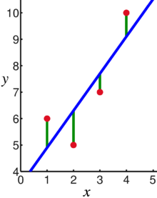
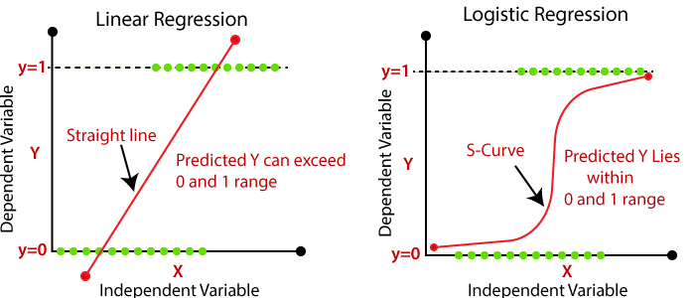
Supervised Learning: Use labeled data to predict unlabeled data.
2 types of supervised learning:
Regression: Predict continuous values.
    Ex: Linear regression.
F(x_{new}) = b₀ + b₁x_{new}
2. Classification: Predict discrete values.
    Ex: Logistic regression
https://en.wikipedia.org/wiki/Linear_regression

Slide 2
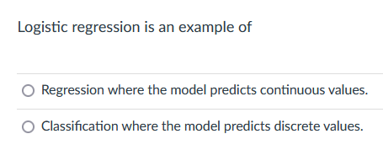

Slide 3
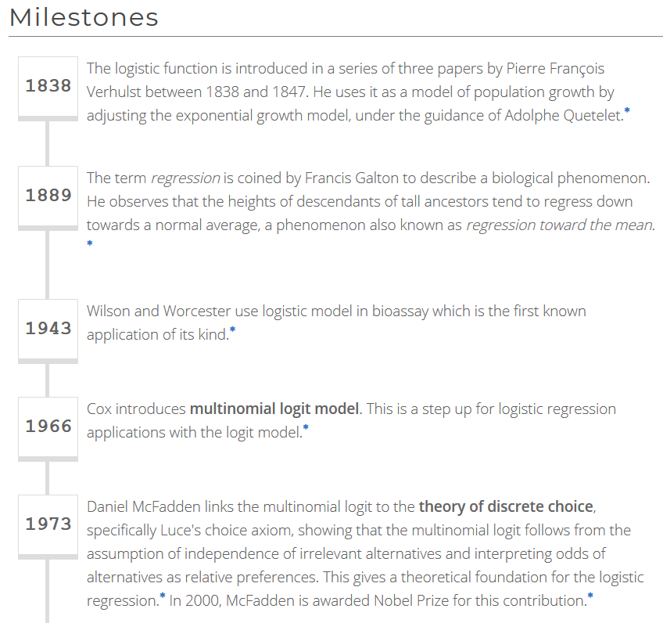
https://devopedia.org/logistic-regression
See also https://academic.oup.com/ije/article/34/1/215/638499

Slide 4
JOURNAL OF THE EXPERIMENTAL ANALYSIS OF BEHAVIOR 2012, 97, 182 NUMBER 2 (MARCH)
Quotation: Kahneman on Contingencies
I had the most satisfying Eureka experience of my career while attempting to teach flight instructors that praise is more effective than punishment for promoting skill-learning. When I had finished my enthusiastic speech, one of the most seasoned instructors in the audience raised his hand and made his own short speech, which began by conceding that positive reinforcement might be good for the birds, but went on to deny that it was optimal for flight cadets. He said, “On many occasions I have praised flight cadets for clean execution of some aerobatic maneuver, and in general when they try it again, they do worse. On the other hand, I have often screamed at cadets for bad execution, and in general they do better the next time. So please don't tell us that reinforcement works and punishment does not, because the opposite is the case.” This was a joyous moment, in which I understood an important truth about the world: because we tend to reward others when they do well and punish them when they do badly, and because there is regression to the mean, it is part of the human condition that we are statistically punished for rewarding others and rewarded for punishing them. I immediately arranged a demonstration in which each participant tossed two coins at a target behind his back, without any feedback. We measured the distances from the target and could see that those who had done best the first time had mostly deteriorated on their second try, and vice versa. But I knew that this demonstration would not undo the effects of lifelong exposure to a perverse contingency.
- Daniel Kahneman; From Les Prix Nobel. The Nobel Prizes 2002, Editor Tore Frängsmyr, [Nobel Foundation], Stockholm, 2003.
https://www.ncbi.nlm.nih.gov/pmc/articles/PMC3292229/

Slide 5
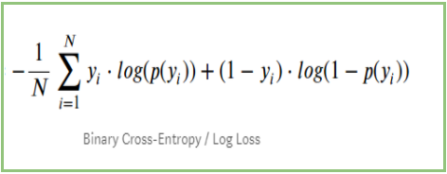
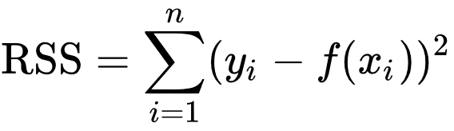
Devopedia. 2022. "Logistic Regression." Version 10, January 19. Accessed 2023-02-11. https://devopedia.org/logistic-regression
Cost functions: Solution corresponds to minimum of cost function

Slide 6
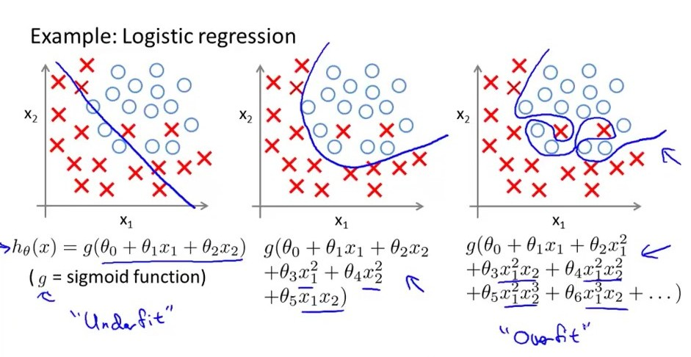
Two variables (x₁, x₂)and one label (x vs o)
Underfitting versus overfitting
https://stats.stackexchange.com/questions/71946/overfitting-a-logistic-regression-model

Slide 7
The Logistic Regression Model
The "logit" model solves these problems:
ln[p/(1-p)] = α + βX + e
p is the probability that the event Y occurs, p(Y=1)
p/(1-p) is the "odds ratio"
ln[p/(1-p)] is the log odds ratio, or "logit"
https://nlp.stanford.edu/~manning/courses/ling236/handouts/whitehead-logistic-regression.ppt

Slide 8
Probability and Odds
On coin flip, p(H) = ½
On 2 dice roll, p(7) = 6/36 =1/6
https://jmg1.psychology.msstate.edu/8803/logisticReg09.ppt

Slide 9
Odds
On coin flip, Odds(H) = 1/1
Odds are 1 to 1 that your coin flip will be “heads”
On 2 dice roll, Odds(7) = 6/(30) = 1/5
Odds(7) = p(7)/[1 - p(7)] = 1/6 / 5/6 = 1/5
Odds are “1 to 5” that you will roll “seven”
https://jmg1.psychology.msstate.edu/8803/logisticReg09.ppt

Slide 10
Problems with Odds
Asymmetry
  Possible range from 0 to “very large”
    With 1 indicating no difference
Due to asymmetry
  The same odds in opposite direction may appear different
  Odds of 5.0 (5 to 1) of losing are the same as odds of .2 of winning (1 to 5)
https://jmg1.psychology.msstate.edu/8803/logisticReg09.ppt

Slide 11
The Logistic Regression Model
The "logit" model solves these problems:
ln[p/(1-p)] = α + βX + e
p is the probability that the event Y occurs, p(Y=1)
p/(1-p) is the "odds ratio"
ln[p/(1-p)] is the log odds ratio, or "logit"
https://nlp.stanford.edu/~manning/courses/ling236/handouts/whitehead-logistic-regression.ppt

Slide 12
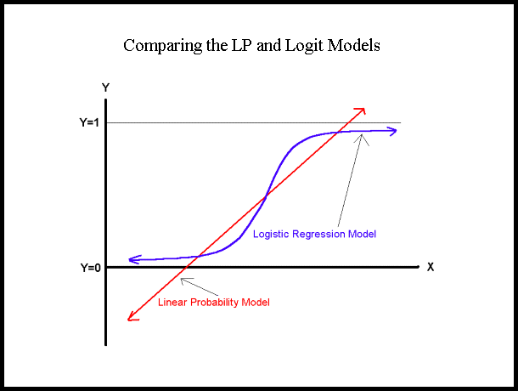
More:
The logistic distribution constrains the estimated probabilities to lie between 0 and 1.
The estimated probability is:
p = 1/[1 + exp(-α - β X)]
if you let α + β X =0, then p = .50
as α + β X gets really big, p approaches 1
as α + β X gets really small, p approaches 0
https://nlp.stanford.edu/~manning/courses/ling236/handouts/whitehead-logistic-regression.ppt

Slide 13
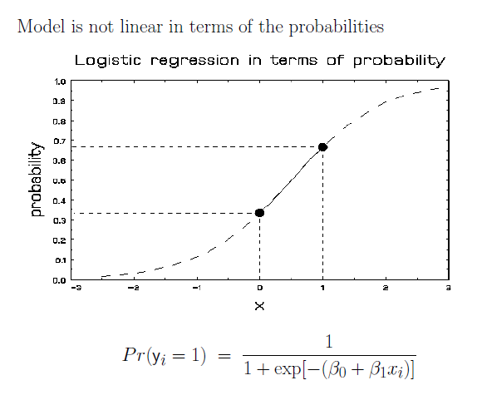
More Visualizations and Formulas
https://jmg1.psychology.msstate.edu/8803/logisticReg09.ppt

Slide 14
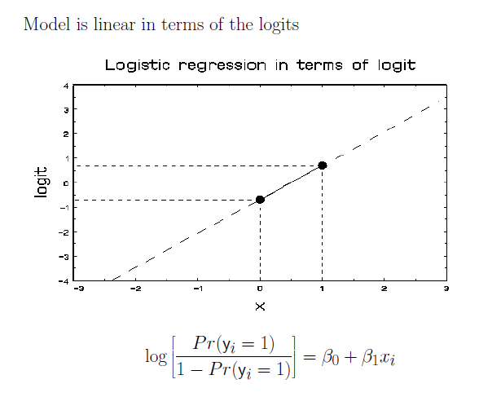
https://jmg1.psychology.msstate.edu/8803/logisticReg09.ppt

Slide 15
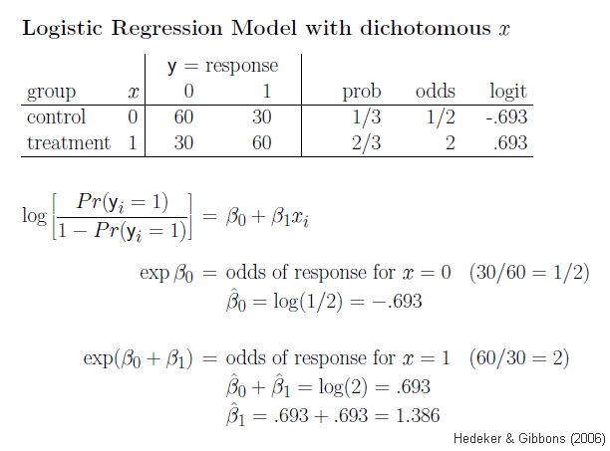
https://jmg1.psychology.msstate.edu/8803/logisticReg09.ppt

Slide 16
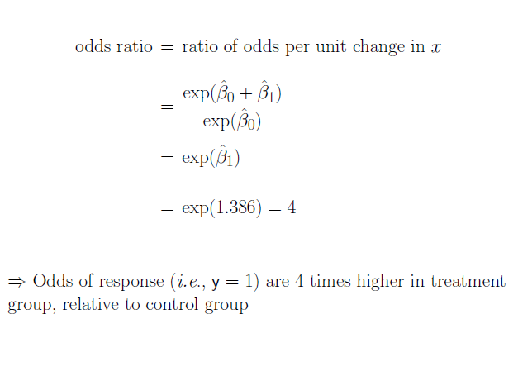
https://jmg1.psychology.msstate.edu/8803/logisticReg09.ppt

Slide 17
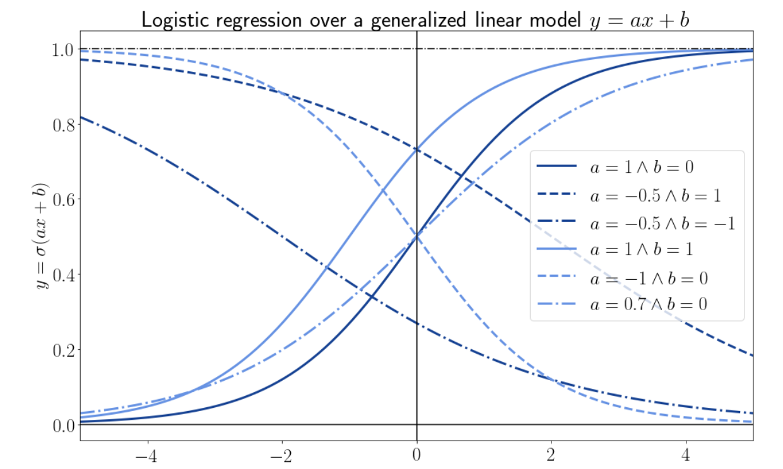
Why Does the Cost Function of Logistic Regression Have a Logarithmic Expression? | Baeldung on Computer Science

Slide 18
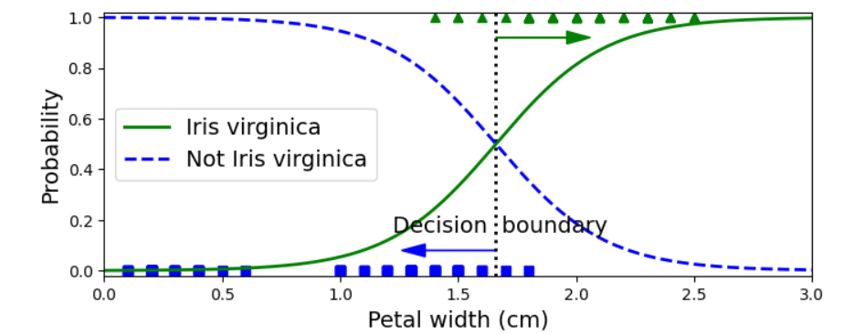
Decision Boundary: p = 0.5

Slide 19
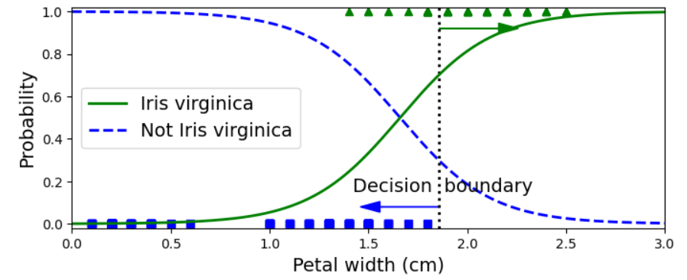
Decision Boundary: p = 0.7

Slide 20
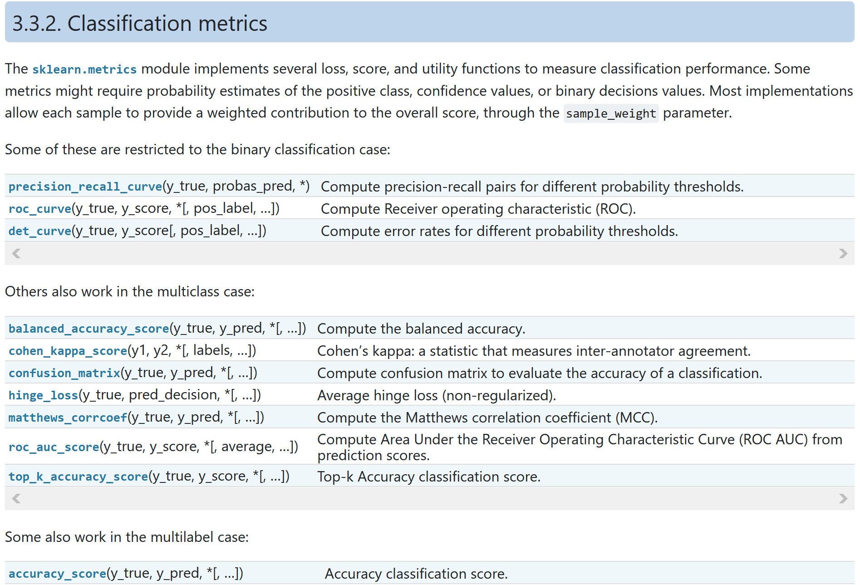
https://scikit-learn.org/stable/modules/model_evaluation.html#classification-metrics

Slide 21
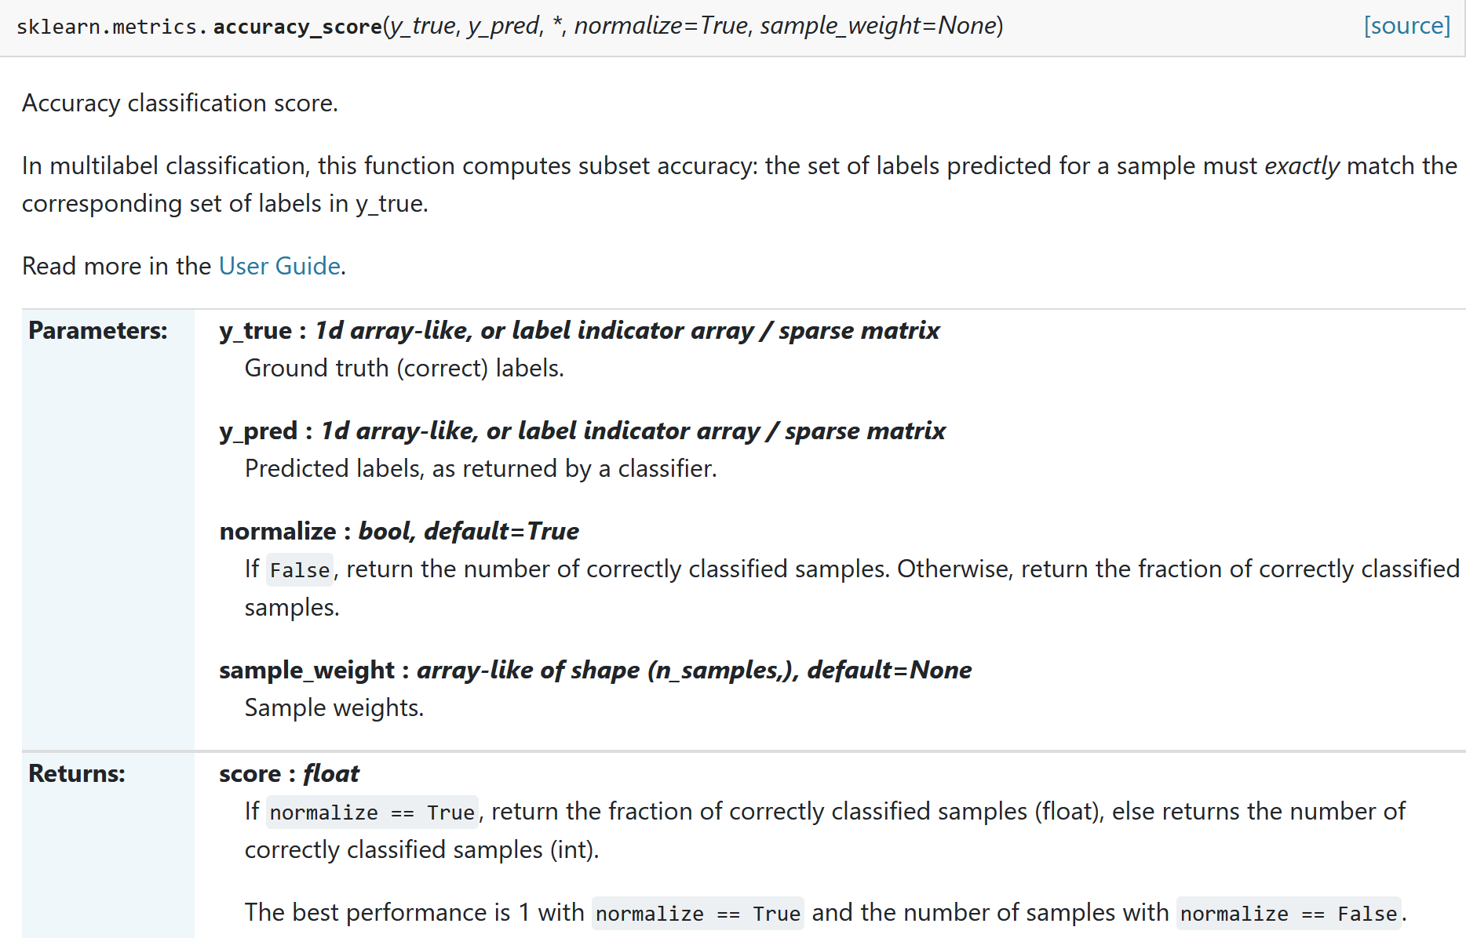

Slide 22
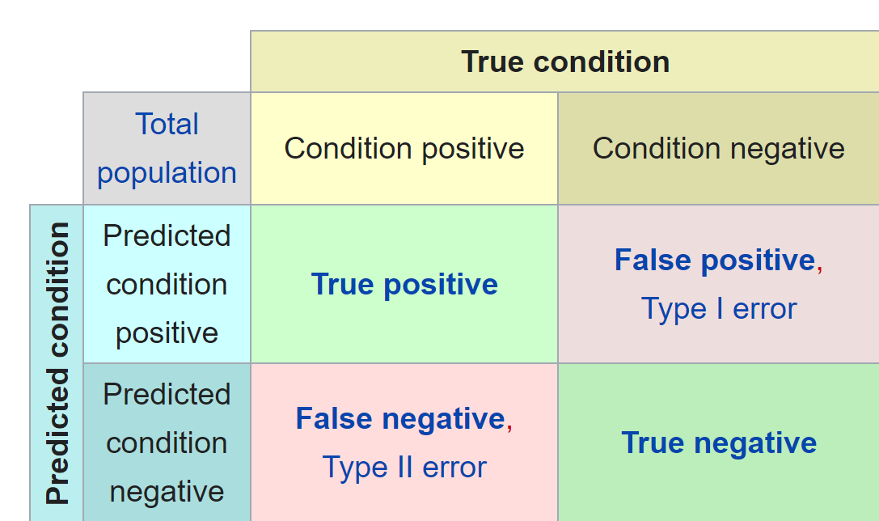
Confusion matrix
https://en.wikipedia.org/wiki/Confusion_matrix

Slide 23
Accuracy = $\frac{TP+TN}{sample population}$ = $\frac{\# of correct predictions}{total \# of predictions}$
Confusion matrix
https://en.wikipedia.org/wiki/Confusion_matrix

Slide 24

Accuracy = $\frac{TP+TN}{sample pop}$
= $\frac{\# of correct predictions}{total \# of predictions}$
=
12 + 12

Slide 25
Precision = $\frac{TP}{TP+FP}$ = proportion of true positives among all positives
Confusion matrix
https://en.wikipedia.org/wiki/Confusion_matrix

Slide 26

Increasing decision boundary increases precision
Precision = $\frac{TP}{TP+FP}$
= proportion of true positives
among all positives
=

Slide 27
Recall = $\frac{TP}{TP+FN}$ = proportion of actual positives correctly identified
Confusion matrix
https://en.wikipedia.org/wiki/Confusion_matrix

Slide 28

Increasing decision boundary decreases recall.
Recall = $\frac{TP}{TP+FN}$
= proportion of actual
positives correctly identified
=
12

Slide 29
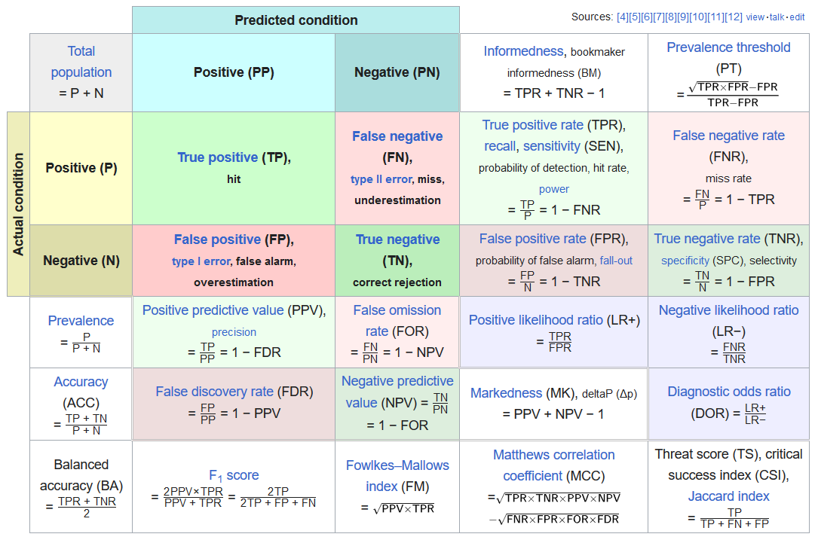
https://en.wikipedia.org/wiki/F-score#Formulation

Slide 30
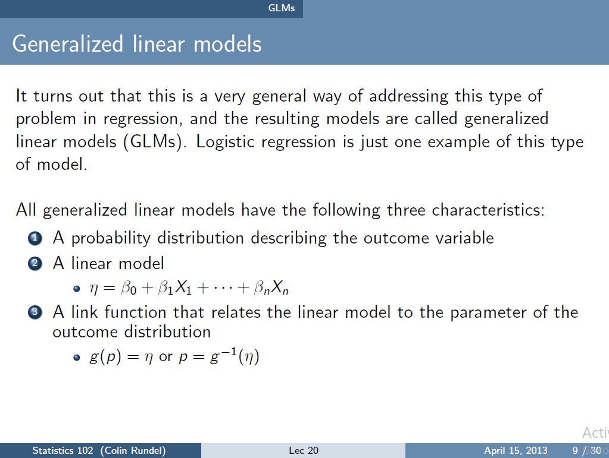
https://www2.stat.duke.edu/courses/Spring13/sta102.001/Lec/Lec20.pdf

Slide 31
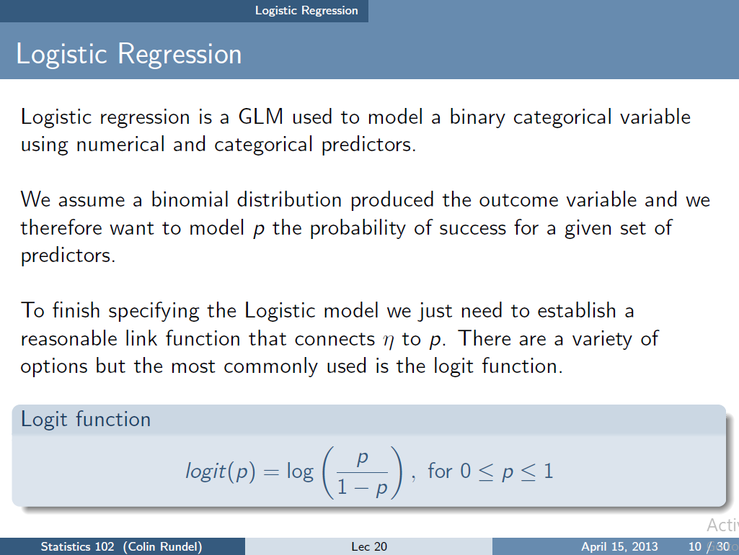
https://www2.stat.duke.edu/courses/Spring13/sta102.001/Lec/Lec20.pdf

Slide 32
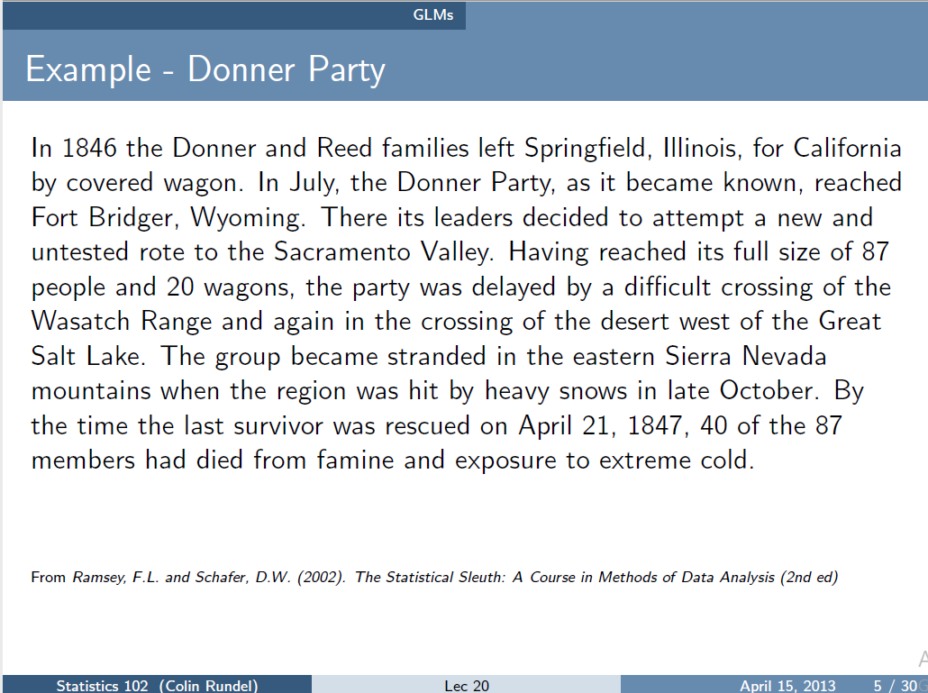
https://www2.stat.duke.edu/courses/Spring13/sta102.001/Lec/Lec20.pdf

Slide 33
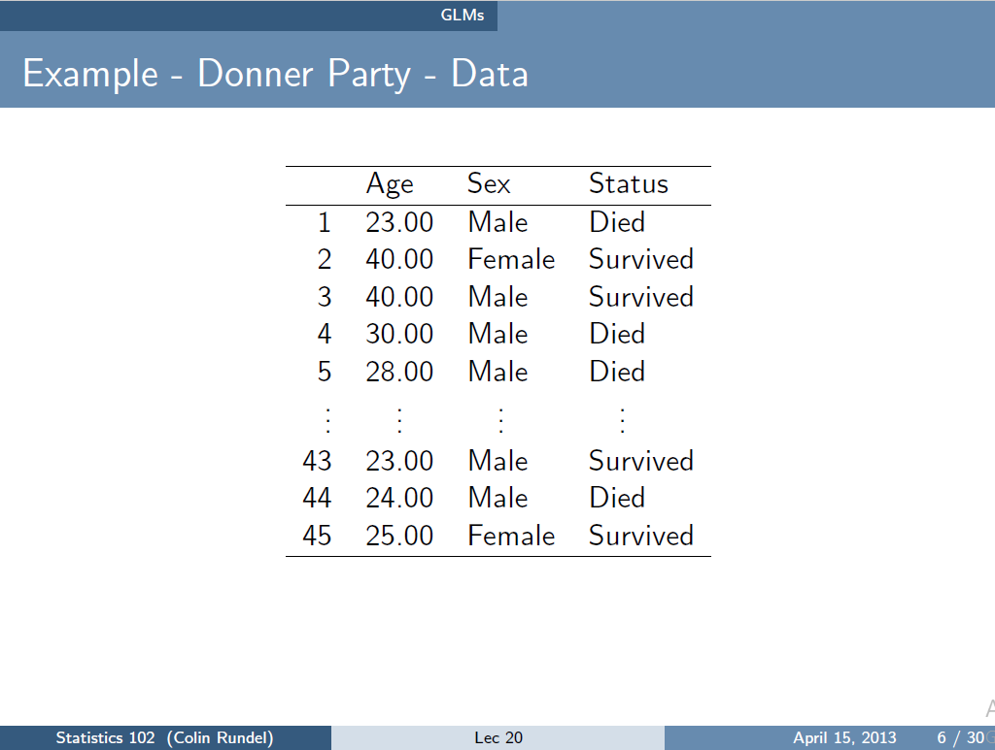
https://www2.stat.duke.edu/courses/Spring13/sta102.001/Lec/Lec20.pdf

Slide 34
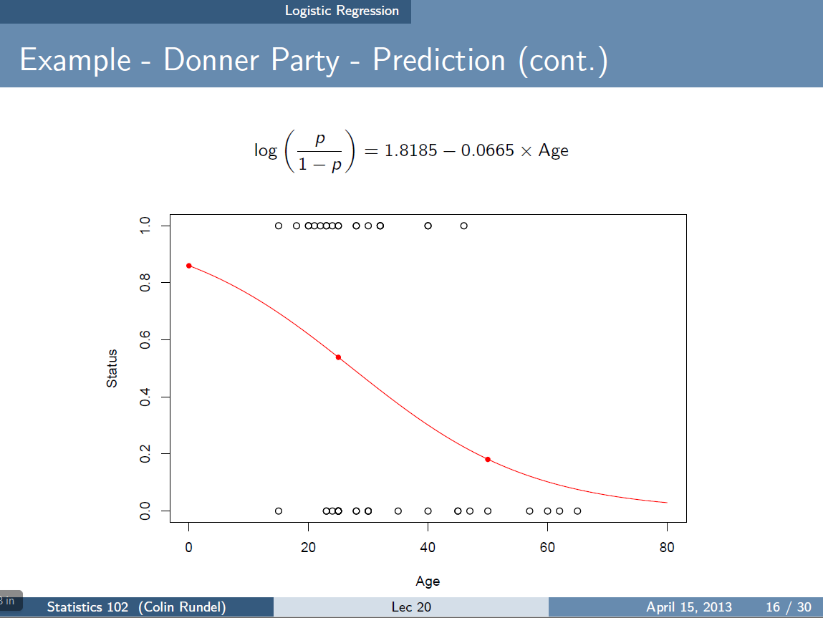
Some circles correspond to more than one data point.
https://www2.stat.duke.edu/courses/Spring13/sta102.001/Lec/Lec20.pdf

Slide 35
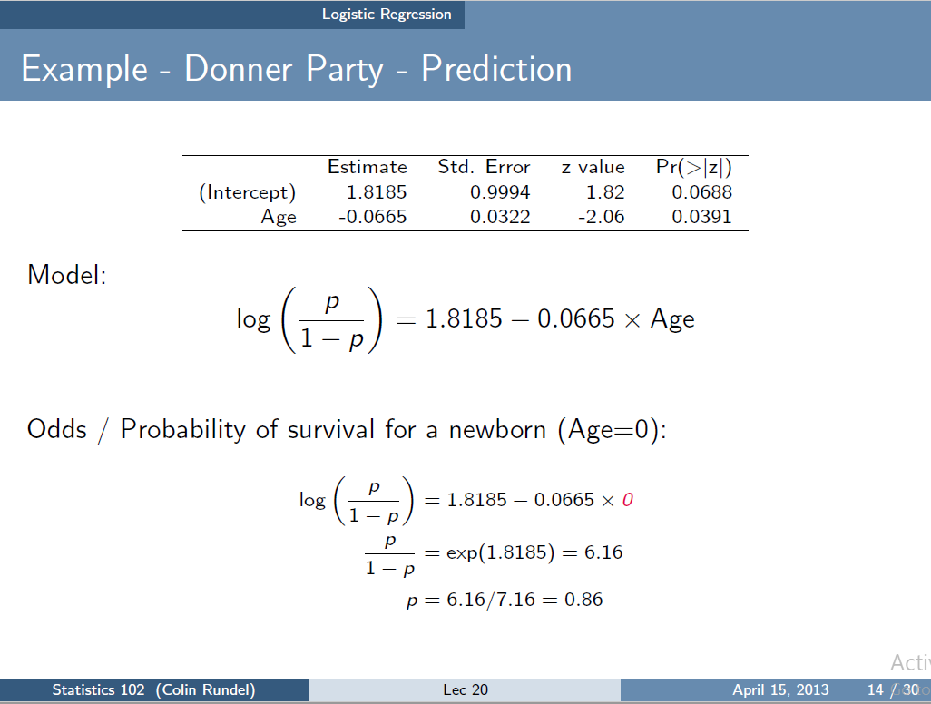
Not valid since Age = 0 is outside of included data range.
https://www2.stat.duke.edu/courses/Spring13/sta102.001/Lec/Lec20.pdf

Slide 36
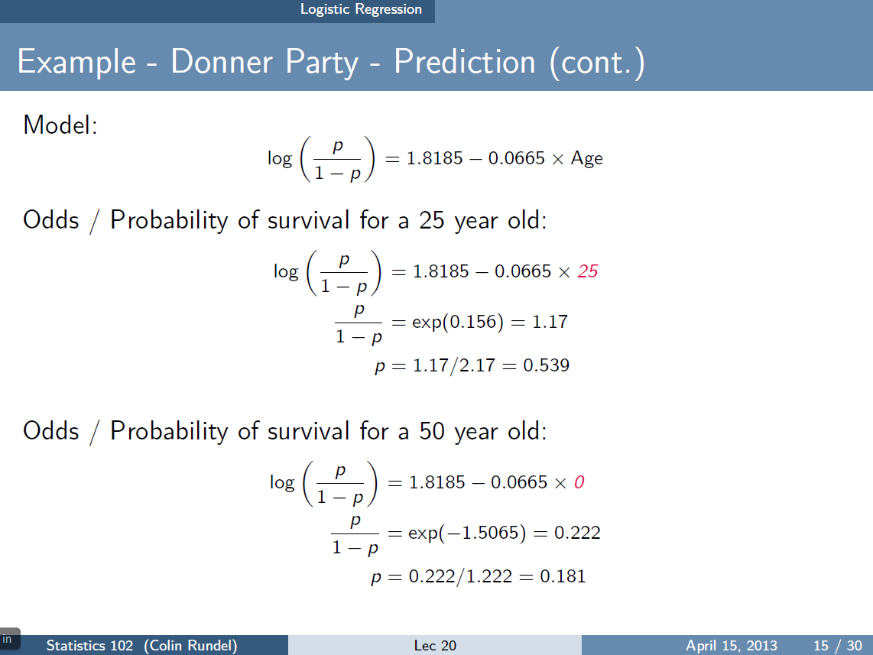
https://www2.stat.duke.edu/courses/Spring13/sta102.001/Lec/Lec20.pdf

Slide 37
Some circles correspond to more than one data point.
https://www2.stat.duke.edu/courses/Spring13/sta102.001/Lec/Lec20.pdf

Slide 38
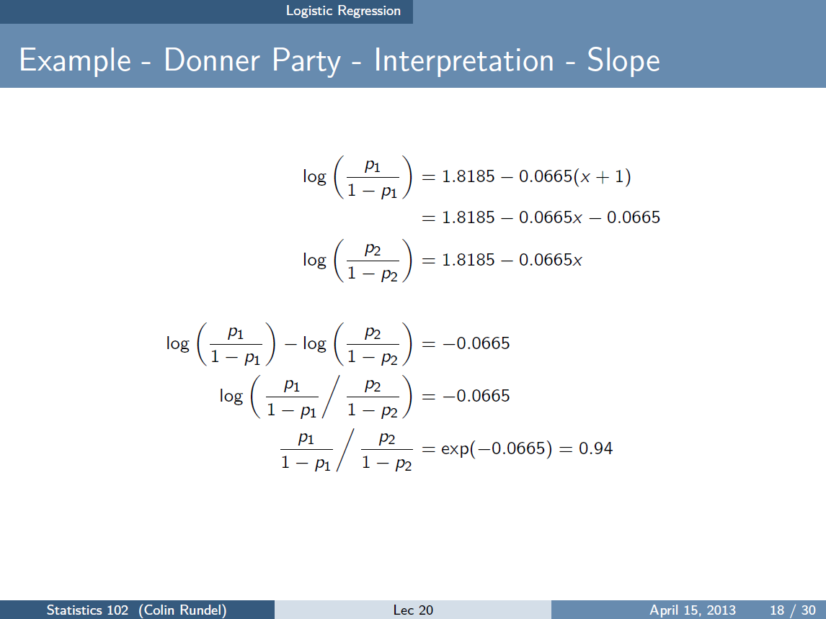
https://www2.stat.duke.edu/courses/Spring13/sta102.001/Lec/Lec20.pdf

Slide 39
since p = 1.17(1-p) → (1 + 1.17)p = 1.17
Thus for a 26 year old,
= 1.17(0.94) = 1.10 for odds
Probability = 1.1/2.1 = 0.524
https://www2.stat.duke.edu/courses/Spring13/sta102.001/Lec/Lec20.pdf

Slide 40
Devopedia. 2022. "Logistic Regression." Version 10, January 19. Accessed 2023-02-11. https://devopedia.org/logistic-regression
Cost functions: Solution corresponds to minimum of cost function

Slide 41
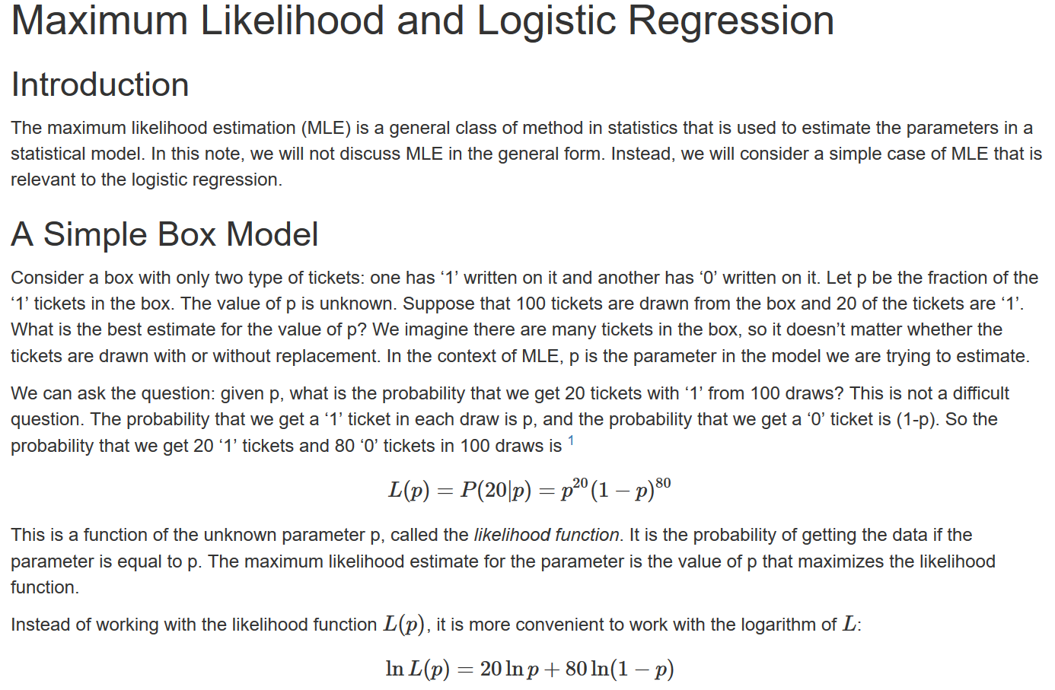
http://courses.atlas.illinois.edu/spring2016/STAT/STAT200/RProgramming/Maximum_Likelihood.html

Slide 42


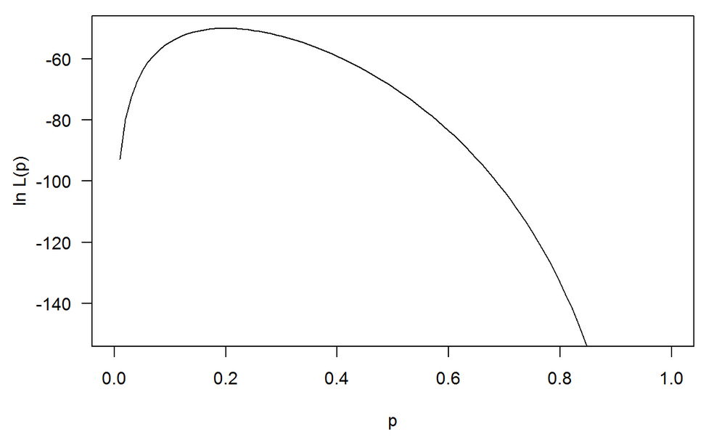
Maximum occurs at 0.2
http://courses.atlas.illinois.edu/spring2016/STAT/STAT200/RProgramming/Maximum_Likelihood.html

Slide 43
Devopedia. 2022. "Logistic Regression." Version 10, January 19. Accessed 2023-02-11. https://devopedia.org/logistic-regression
Linear model General linear model
Cost function for linear regression Cost function for logistic regression
Minimize cost function to find best function f
(eg: if f(x) = mx + b, find m and b that minimizes Minimize cost function to find best probability function. This
cost function RSS. corresponds to finding best m and b that minimizes cost for
p(x) = 1/[1 + exp(-b - mx)]

Slide 44
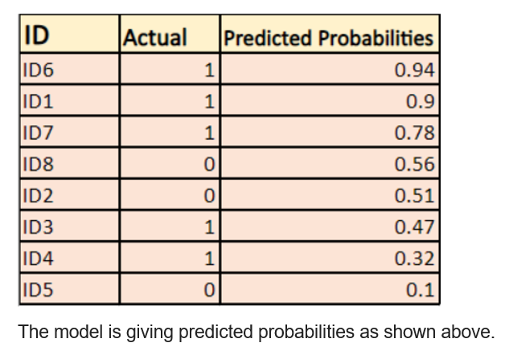
https://devopedia.org/logistic-regression
Log Loss - Logistic Regression's Cost Function for Beginners (analyticsvidhya.com)

Slide 45
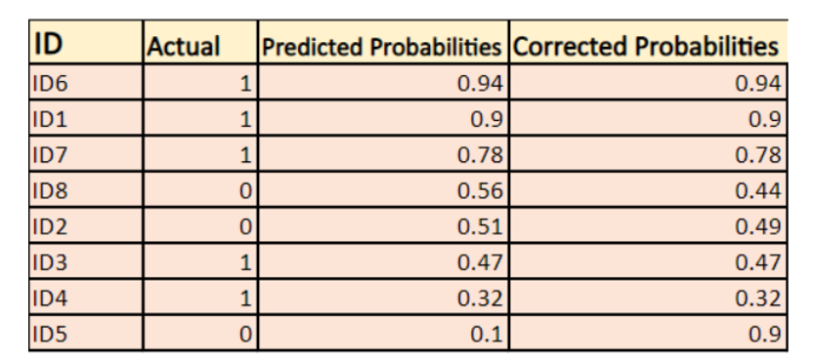
Log Loss - Logistic Regression's Cost Function for Beginners (analyticsvidhya.com)

Slide 46
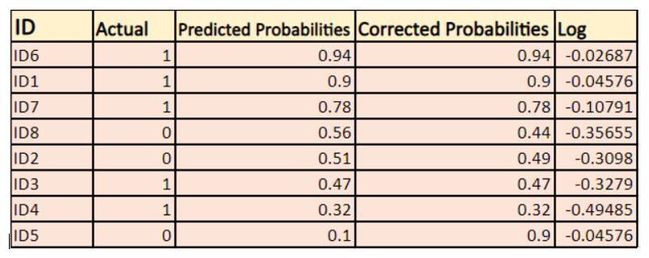

Log Loss - Logistic Regression's Cost Function for Beginners (analyticsvidhya.com)

