Slide 1
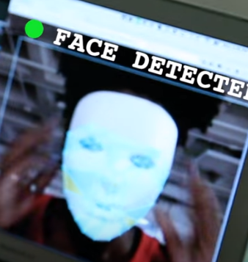
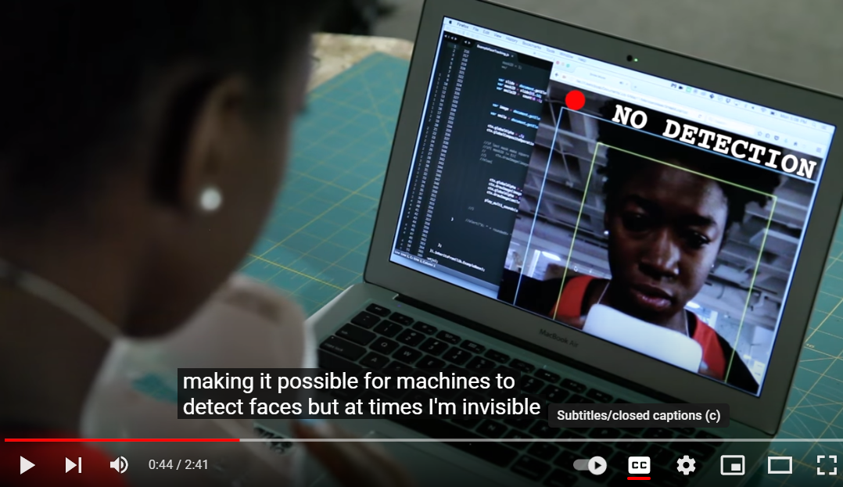
The Coded Gaze: Unmasking Algorithmic Bias - YouTube

Slide 2
https://www.ajl.org/about
THE INSPIRATION FOR THE ALGORITHMIC JUSTICE LEAGUE
Joy Buolamwini, Founder of the Algorithmic Justice League, came face to face with discrimination. From a machine. It may sound like a scene from a sci-fi movie, but it carries meaningful real-world consequences.
While working on an engineering project, a facial analysis software struggled to detect Joy’s face. She knew this was more than a technical blunder, but rather than surrender, she responded with curiosity. Her MIT peers with lighter skin color didn’t have the same issues, so Joy tried drawing a face on the palm of her hand. The machine recognized it immediately. Still, no luck with her real face, so she had to finish her project coding with a white mask over her face in order to be detected. Many questions surfaced giving Joy the motivation and insights to start the Algorithmic Justice League

Slide 3
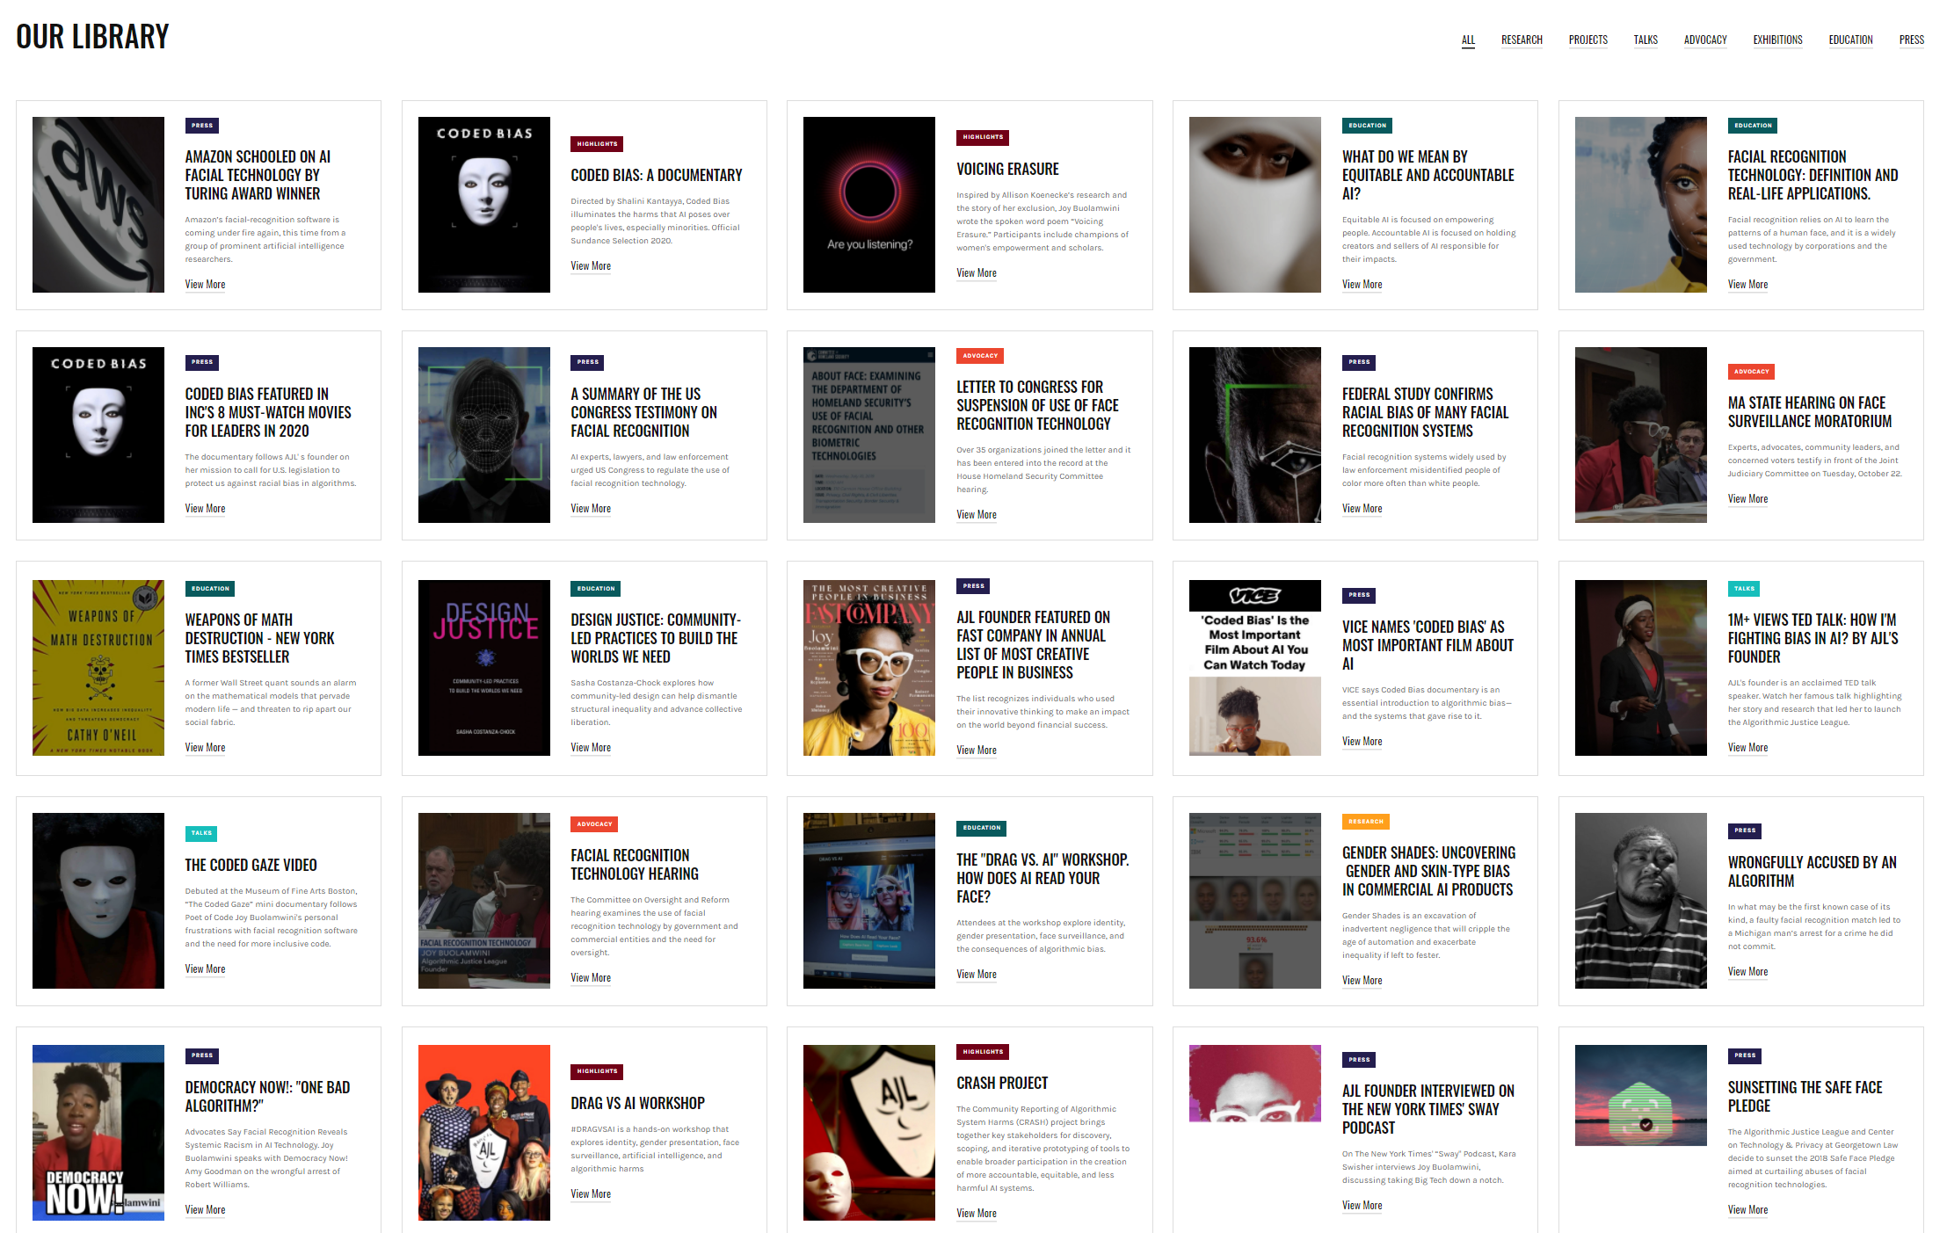
https://www.ajl.org/library/home

Slide 4
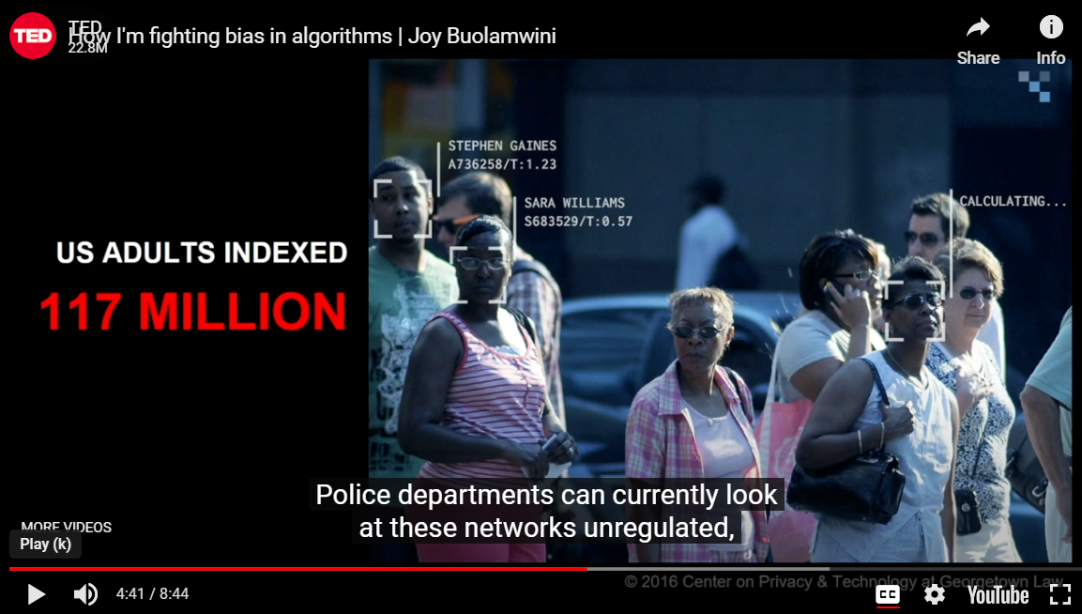
Algorithmic Justice League - Unmasking AI harms and biases (ajl.org)

Slide 5
The Hidden Role of Facial Recognition Tech in Many Arrests | WIRED
IN APRIL 2018, Bronx public defender Kaitlin Jackson was assigned to represent a man accused of stealing a pair of socks from a TJ Maxx store. The man said he couldn’t have stolen the socks because at the time the theft occurred, he was at a hospital about three-quarters of a mile away, where his son was born about an hour later.
police had identified her client from a security camera photo using facial recognition. A security guard at the store, the only witness to the theft, later told an investigator from her office that police had sent him a mugshot of her client and asked in a text message “Is this the guy?”
Jackson’s questions led a judge to order a hearing to determine whether the identification process had been unduly suggestive. Shortly afterward, Jackson says, prosecutors offered her client a deal: Plead guilty to petit larceny in exchange for a sentence of time served. The client, who had been in jail for roughly six months, agreed.
studies have shown that facial recognition systems are more likely to misidentify people who are not white men, including people with dark skin, women, and young people.

Slide 6
False Positives will occur
https://xkcd.com/882/

Slide 7
https://www.nytimes.com/2023/03/31/technology/facial-recognition-false-arrests.html
‘Thousands of Dollars for Something I Didn’t Do’
Because of a bad facial recognition match and other hidden technology, Randal Reid spent nearly a week in jail, falsely accused of stealing purses in a state he said he had never even visited.
Published March 31, 2023 Updated April 6, 2023
Mr. Reid, a transportation analyst, was booked at the DeKalb County jail, to await extradition from Georgia to Louisiana. It took days to find out exactly what he was accused of: using stolen credit cards to buy designer purses.
His parents made phone calls, hired lawyers and spent thousands of dollars to figure out why the police thought he was responsible for the crime, eventually discovering it was because Mr. Reid bore a resemblance to a suspect who had been recorded by a surveillance camera. The case eventually fell apart and the warrants were recalled, but only after Mr. Reid spent six days in jail and missed a week of work.
police were withdrawing the warrant because they had noticed a mole on Mr. Reid’s face that the alleged purse thief did not have.

Slide 8
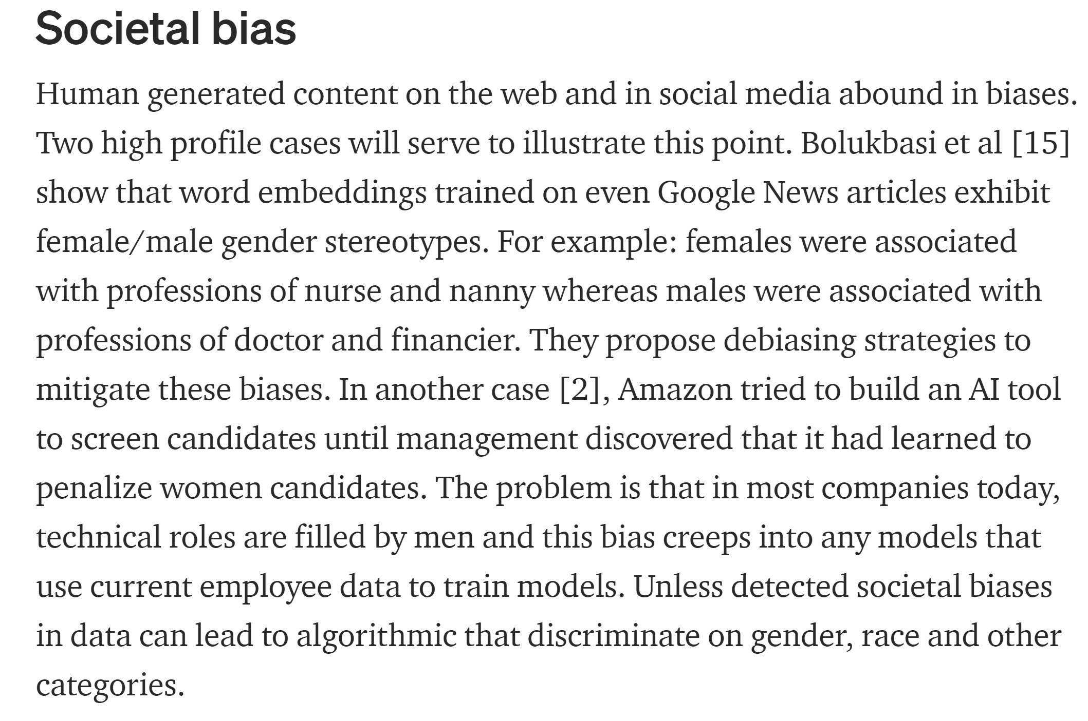
https://towardsdatascience.com/survey-d4f168791e57

Slide 9
Facebook Ads Can Still Discriminate Against Women and Older Workers, Despite a Civil Rights Settlement
New research and Facebook’s own ad archive show that the company’s new system to ensure diverse audiences for housing and employment ads has many of the same problems as its predecessor. by Ava Kofman and Ariana Tobin Dec. 13, 2019
https://www.propublica.org/article/facebook-ads-can-still-discriminate-against-women-and-older-workers-despite-a-civil-rights-settlement
Prior to the March settlement, housing, credit and employment advertisers had access to a “Lookalike audience” feature, in which they could upload a list of users, known as a “source audience,” and Facebook would reach more people who “look like” them, based on criteria that included age, race and gender. Now, if these advertisers want to upload a source audience, they use a modified version of the “lookalike feature” known as a “special ad audience.” The algorithm for the special ad audiences no longer considers the fields on a Facebook user’s profile identifying “age, gender, relationship status, religious views, school, political views, interested in, or zip code” as inputs. Nevertheless, the researchers found that Facebook’s algorithm perpetuates existing discrepancies in gender and age in a given source audience through a myriad of related characteristics.
When the special audience was generated from the source list of Facebook’s employees, the ad was delivered to a new audience that was significantly biased along age and gender lines, reaching 88% men, nearly half of whom were aged 25 to 34. These proportions roughly reflected Facebook’s workforce, which has been criticized for its lack of diversity. According to its 2019 diversity report, 77% of the company’s technical workers are male. Facebook does not disclose ages, but according to the market research firm Statista, the median age of a Facebook employee is 28. In another indication that the algorithm tends to replicate the source demographics, half of this special audience lived in California, where Facebook is headquartered. By comparison, the ad audience generated from the list of random Americans reached 54% men, of whom 15% were aged 25 to 34, and 2% lived in California.
Trying to reach diverse audience stymied:
When ProPublica told Vallebuona that Facebook’s archive indicated that the council’s ad was reaching 73% men, she was shocked. “It really is a quite alarming difference between females and males being reached,” she said, adding that far more women than men actually apply to the program.

Slide 10
https://www.propublica.org/article/facebook-ads-can-still-discriminate-against-women-and-older-workers-despite-a-civil-rights-settlement
https://www.propublica.org/article/facebook-doj-advertising-discrimination-settlement
Facebook Finally Agrees to Eliminate Tool That Enabled Discriminatory Advertising
Six years after ProPublica revealed that Facebook allowed advertisers to exclude Black users and others, the company agreed to a settlement with the Justice Department to overhaul its ad algorithm system. by Ariana Tobin and Ava Kofman June 22, 2022, 4:30 p.m. EDT
The company said in a statement that it will implement a “novel use of machine learning technology that will work to ensure the age, gender and estimated race or ethnicity of a housing ad’s overall audience matches the age, gender, and estimated race or ethnicity mix of the population eligible to see that ad.”

Slide 11
https://science.sciencemag.org/content/366/6464/447.full
Health systems rely on commercial prediction algorithms to identify and help patients with complex health needs. We show that a widely used algorithm, typical of this industry-wide approach and affecting millions of patients, exhibits significant racial bias: At a given risk score, Black patients are considerably sicker than White patients, as evidenced by signs of uncontrolled illnesses. Remedying this disparity would increase the percentage of Black patients receiving additional help from 17.7 to 46.5%. The bias arises because the algorithm predicts health care costs rather than illness, but unequal access to care means that we spend less money caring for Black patients than for White patients. Thus, despite health care cost appearing to be an effective proxy for health by some measures of predictive accuracy, large racial biases arise. We suggest that the choice of convenient, seemingly effective proxies for ground truth can be an important source of algorithmic bias in many contexts.

Slide 12
https://ils.fd.org/sites/ils.fd.org/files/uploaded_files/cja_resources/training/13.Racial%20Bias%20in%20Criminal%20Risk%20Scores.pdf
https://arxiv.org/abs/1609.05807
[Submitted on 19 Sep 2016 (v1), last revised 17 Nov 2016 (this version, v2)]
Inherent Trade-Offs in the Fair Determination of Risk Scores
Jon Kleinberg, Sendhil Mullainathan, Manish Raghavan
Recent discussion in the public sphere about algorithmic classification has involved tension between competing notions of what it means for a probabilistic classification to be fair to different groups. We formalize three fairness conditions that lie at the heart of these debates, and we prove that except in highly constrained special cases, there is no method that can satisfy these three conditions simultaneously. Moreover, even satisfying all three conditions approximately requires that the data lie in an approximate version of one of the constrained special cases identified by our theorem. These results suggest some of the ways in which key notions of fairness are incompatible with each other, and hence provide a framework for thinking about the trade-offs between them.
To appear in Proceedings of Innovations in Theoretical Computer Science (ITCS), 2017

Slide 13
https://www.propublica.org/article/bias-in-criminal-risk-scores-is-mathematically-inevitable-researchers-say
ProPublica’s analysis of bias against black defendants in criminal risk scores has prompted research showing that the disparity can be addressed — if the algorithms focus on the fairness of outcomes.
Download the data: https://www.propublica.org/datastore/dataset/compas-recidivism-risk-score-data-and-analysis
Counterpoint: https://www.brookings.edu/blog/up-front/2016/08/22/are-criminal-risk-assessment-scores-racist/
Are criminal risk assessment scores racist?
Jennifer L. Doleac and Megan Stevenson Monday, August 22, 2016
“An ideal approach to answering this question would be an experiment in which some judges are randomly assigned to use risk assessments as part of their decisions (their defendants are the treatment group), and some judges to operate as before (their defendants are the control group). We could then compare racial discrepancies in sentencing for the treatment group and the control group, to determine the effect of incorporating risk assessment scores in the decision-making process. We could use the same method to consider this policy tool’s effects on recidivism, incarceration rates, and any other outcomes we care about.”
Note their ideal approach involves comparing risk assessment scores to judge rulings where the later has also been shown to be biased: https://www.ncsl.org/civil-and-criminal-justice/racial-and-ethnic-disparities-in-the-criminal-justice-system

Slide 14
“The fact is almost all big data sets, generated by systems powered by ML/AI based models, are known to be biased.”
https://towardsdatascience.com/survey-d4f168791e57

Slide 15
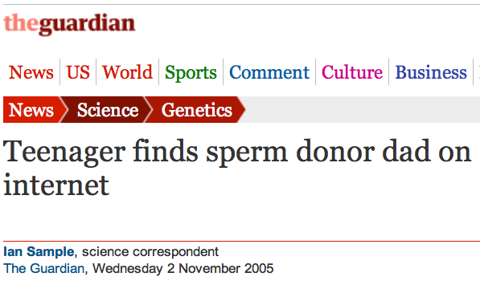
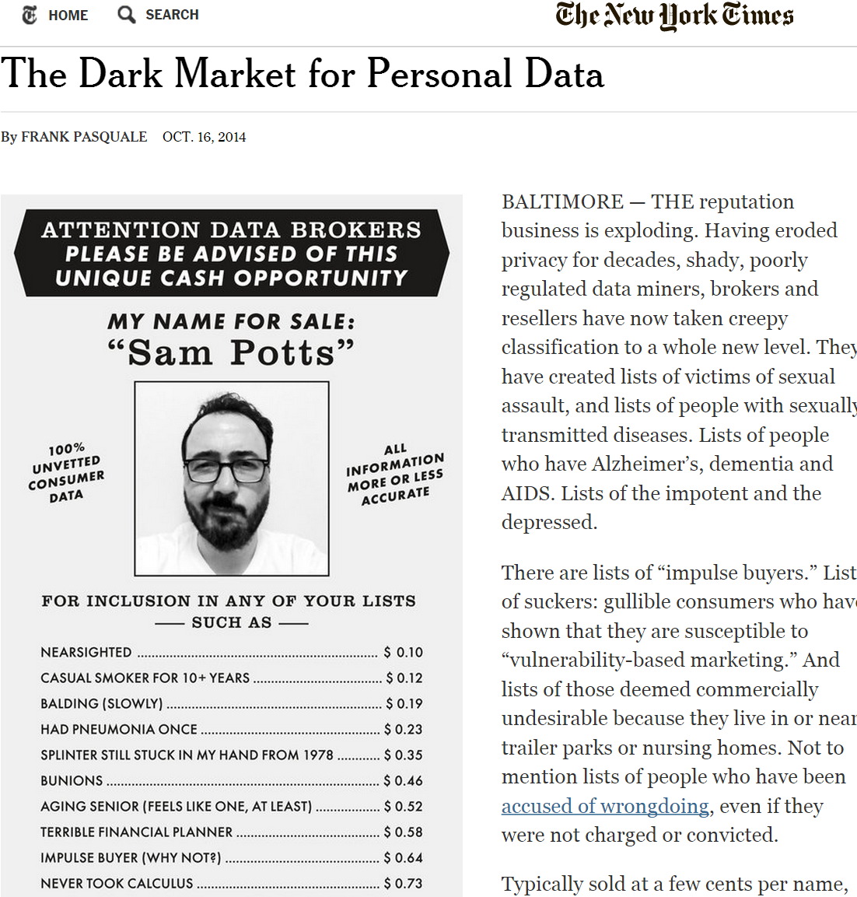
Data is NEVER fully anonymized
http://www.theguardian.com/science/2005/nov/03/genetics.news
http://www.nytimes.com/2014/10/17/opinion/the-dark-market-for-personal-data.html
http://www.nytimes.com/2006/08/09/technology/09aol.html, https://www.sciencemag.org/content/339/6117/262

Slide 16
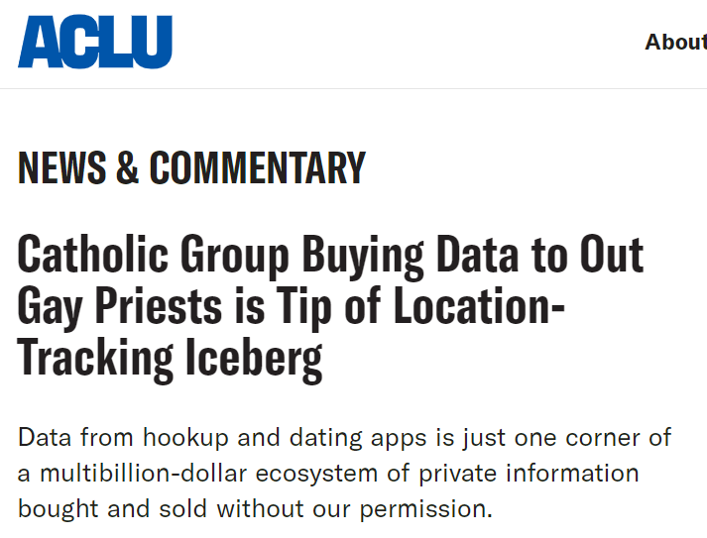
Colorado Catholic group bought app data that tracked gay priests - The Washington Post 2023/03/09
One report prepared for bishops says the group’s sources are data brokers who got the information from ad exchanges, which are sites where ads are bought and sold in real time, like a stock market. The group cross-referenced location data from the apps and other details with locations of church residences, workplaces, and seminaries to find clergy who were allegedly active on the apps…
Although no names were in the original data from brokers, it included enough identifying details and location pings that the group was able to analyze it for specific locations and narrow down likely people using the apps…
The group also focused on devices that spent multiple nights at a rectory, for example, or if a hookup app was used for a certain number of days in a row in some other church building, such as a seminary or an administrative building.
Catholic Group Buying Data to Out Gay Priests is Tip of Location-Tracking Iceberg | ACLU
April 7, 2023
we’re in a world where location data is collected about a significant proportion of us without our knowledge or permission, and bought and sold by a multibillion-dollar ecosystem of companies that specialize in such data.

Slide 17
http://www.smithsonianmag.com/science-nature/Henrietta-Lacks-Immortal-Cells.html
…HeLa cells could float on dust particles in the air & travel on unwashed hands and contaminate other cultures. It became an enormous controversy. In the midst of that, one group of scientists tracked down Henrietta’s relatives to take some samples with hopes that they could use the family’s DNA to make a map of Henrietta’s genes so they could tell which cell cultures were HeLa and which weren’t, to begin straightening out the contamination problem.

Slide 18
http://www.nature.com/news/deal-done-over-hela-cell-line-1.13511
1951 Biopsy of Henrietta Lacks’ tumour collected without her knowledge or consent. HeLa cell line soon established.
1971 The journal Obstetrics and Gynecology names Henrietta Lacks as HeLa source; word later spreads in Nature, Science and mainstream press.
1973 Lacks family members learn about HeLa cells. Scientists later collect their blood to map HeLa genes, without proper informed consent.
1996 Lacks family honored at the first annual HeLa Cancer Control Symposium, organized by former student of scientist who isolated HeLa cells.
2013 HeLa genome published without knowledge of the family, which later endorses restricted access to HeLa genome data.

Slide 19
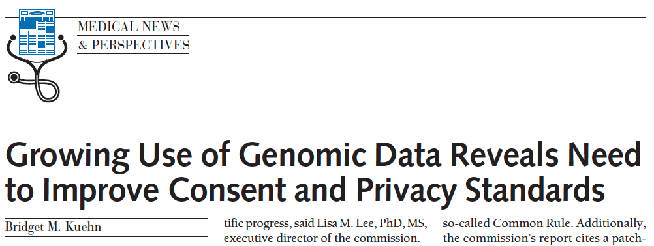
http://jama.jamanetwork.com/article.aspx?articleid=1690694
JAMA. 2013;309(20):2083-2084. doi:10.1001/jama.2013.5048
“IN MARCH, THE PUBLICATION OF THE complete genome sequence of cancer cells from a Maryland woman who died in 1951 ignited an ethical firestorm. These cells, called HeLa because they were derived from the cervical tumor of Henrietta Lacks, have been widely cultured in laboratories and used in research.”

Slide 20
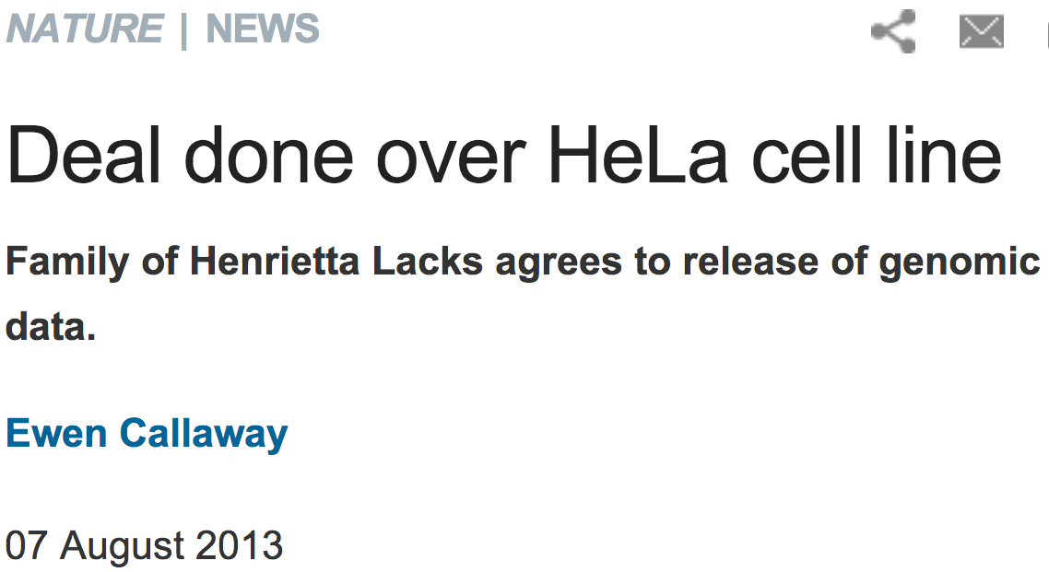
http://www.nature.com/news/deal-done-over-hela-cell-line-1.13511

Slide 21
https://en.wikipedia.org/wiki/Chester_M._Southam
Chester Milton Southam (October 4, 1919 – April 15, 2002)^{[1]} was an immunologist and oncologist at Memorial Sloan Kettering Cancer Center and Cornell University Medical College; he went to Thomas Jefferson University in 1971 and worked there until the end of his career.^{[1]} He ran many experiments involving the injection of live cancer cells into human subjects, without disclosing that they were cancer cells, and using subjects with questionable ability to consent, such as incarcerated people and senile patients in long-term care at a hospital.^{[2]} The New York State Attorney General encouraged the Board of Regents of the University of the State of New York to take away Southam's medical license.^{[2]} Regardless, he went on to be president of the American Association for Cancer Research.
In 1963, doctors Avir Kagan, David Leichter and Perry Fersko of Jewish Chronic Disease Hospital objected to the lack of consent in his experiments and reported him to the Regents of the University of the State of New York which found him guilty of fraud, deceit, and unprofessional conduct, and in the end he was placed on probation for a year

Slide 22
Tuskegee syphilis experiment
Study began in 1932 by the U.S. Public Health Service to determine the history of untreated syphilis
Subjects were some 400 Black sharecroppers in Alabama diagnosed with syphilis
Men were recruited without informed consent. Misinformed and told that some procedures (e.g., spinal taps) were actually "special free treatment."
By 1936, it was apparent that many more infected men than controls had developed complications. Death rate among those with syphilis was about twice as high as it was among the controls.
In the 1940's, when penicillin, known to be effective in the treatment of syphilis, became available, the men were neither informed, nor treated with the antibiotic.
Many died from untreated syphilis
https://people.carleton.edu/~rdobrow/Courses/115Common/Ethics.ppt

Slide 23
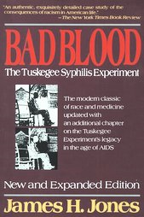
Tuskegee syphilis experiment
Study continued until it was exposed in the national press in 1972!
1996 review: “It has come to symbolize racism in medicine, ethical misconduct in human research, paternalism by physicians, and government abuse . . . “
President Clinton apologized to survivors in 1997
U.S. government continues to pay millions of dollars yearly to surviving subjects and the families of deceased subjects.
Read the book Bad Blood:
The Tuskegee Syphilis Study by James H. Jones
and see the video The Deadly Deception (Nova).
https://people.carleton.edu/~rdobrow/Courses/115Common/Ethics.ppt

Slide 24
Belmont Report
Outrage over Tuskegee and Beecher article led to some reforms in the 1970s
Congress created the National Commission for the Protection of Human Subjects of Biomedical and Behavioral Research which issued the influential Belmont Report in 1979
Lays out 3 guiding ethical principles
Respect for persons
Beneficence
Obligation to (1) Do no harm, and (2) Maximize benefits and minimize harms
Justice
Benefits of research should be distributed fairly
https://people.carleton.edu/~rdobrow/Courses/115Common/Ethics.ppt

Slide 25
Ethics of clinical trials
“There is a delicate balance between when to do or not do a randomized trial. On the one hand, there must be sufficient belief in the agent’s potential to justify exposing half the subjects to it. On the other hand, there must be sufficient doubt about its efficacy to justify withholding it from the other half of subjects who might be assigned to placebos.”
Dr. Charles Hennekens, Harvard Medical School (who directed the physician’s aspirin study)
https://people.carleton.edu/~rdobrow/Courses/115Common/Ethics.ppt

Slide 26
Basic standards of data ethics for studies involving human subjects
Informed consent
All individuals who are subjects in a study must give their informed consent before data are collected
Subjects must be informed in advanced about the nature of a study and any risk of harm it may bring
Confidentiality
All individual data must be kept confidential
Only statistical summaries for groups of subjects may be made public
Not the same as anonymity where subjects’ names are not known, even to director of study (rarely the case)
Institutional Review Boards
Organization that carries out the study must have an institutional review board that reviews all planned studies in advance in order to protect subjects from possible harm
Carleton’s IRB
https://people.carleton.edu/~rdobrow/Courses/115Common/Ethics.ppt

Slide 27
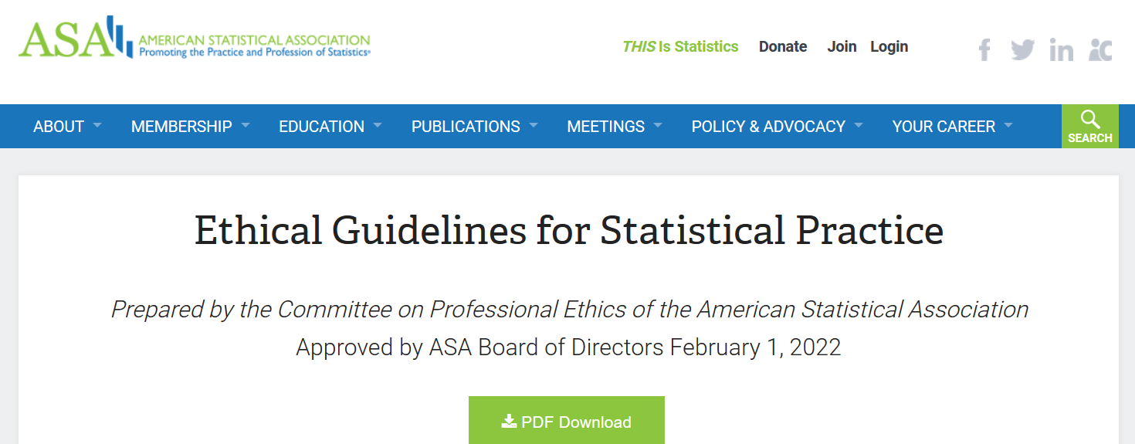
https://www.amstat.org/your-career/ethical-guidelines-for-statistical-practice

Slide 28
False Positives will occur
https://xkcd.com/882/

Slide 29
http://www.ncbi.nlm.nih.gov/pubmed/2406472?dopt=Abstract&holding=npg

Slide 30
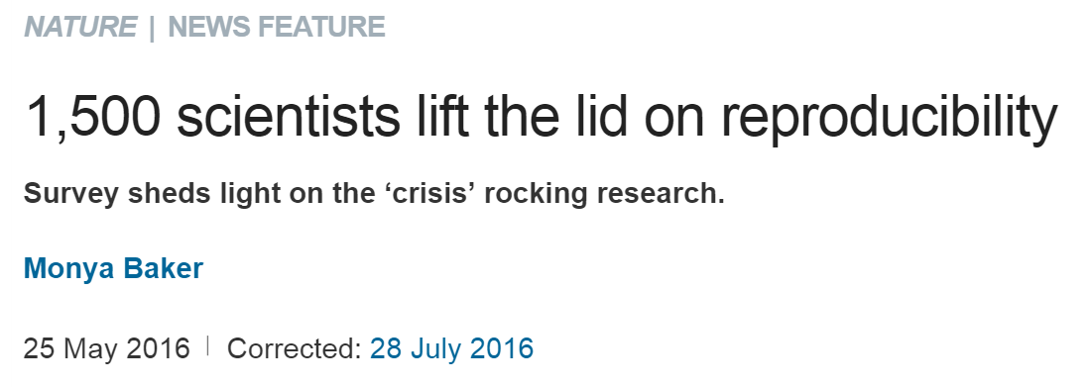
http://www.nature.com/news/1-500-scientists-lift-the-lid-on-reproducibility-1.19970
Note the following are based on researchers opinions,
not actual facts

Slide 31
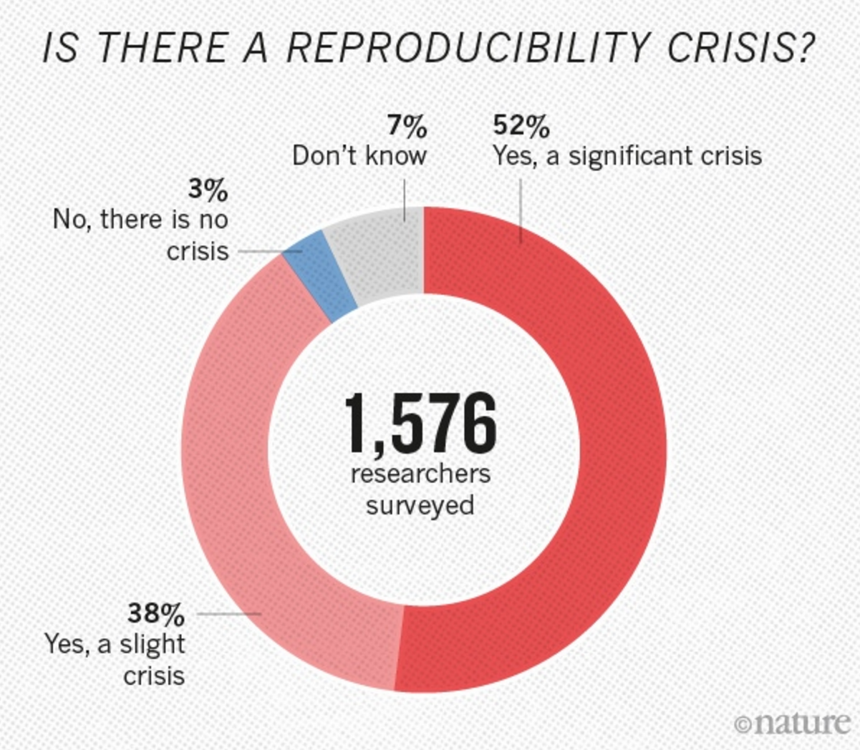
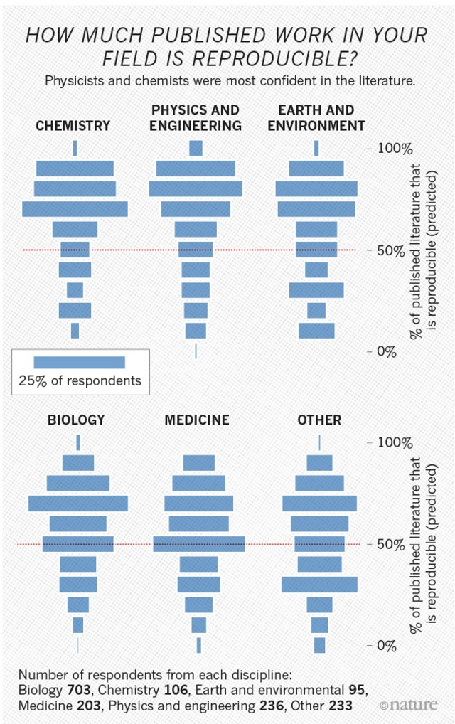

Slide 32
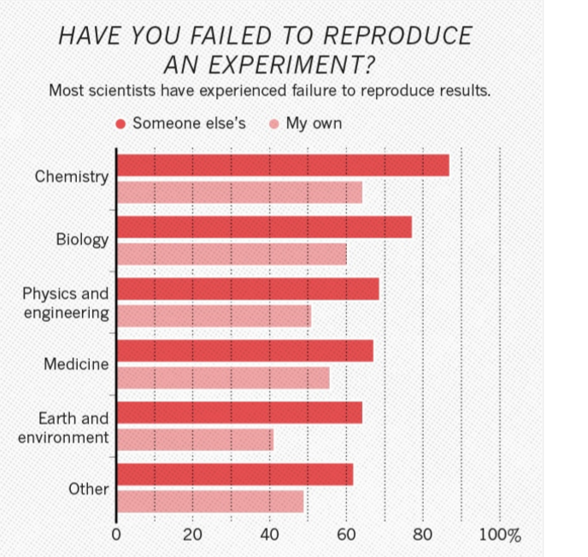

Slide 33
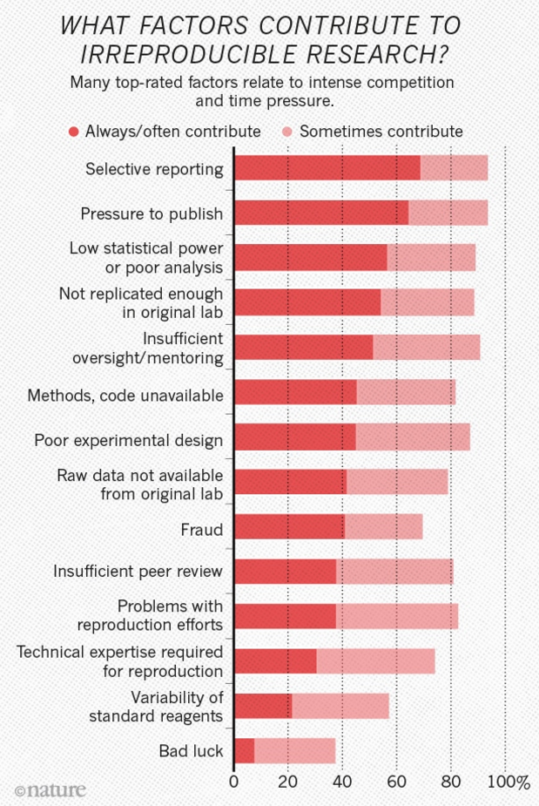
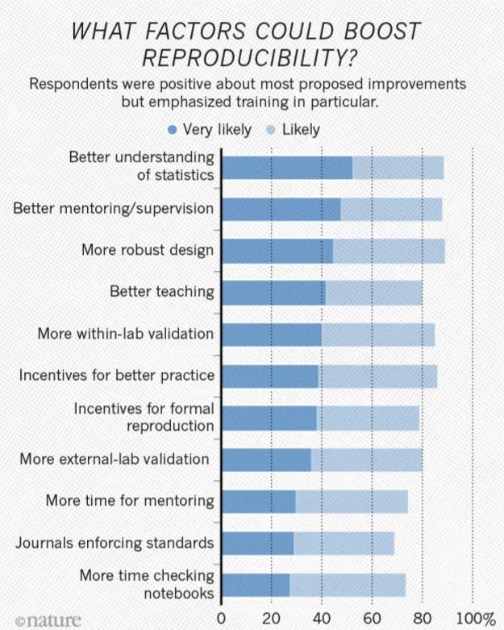

Slide 34
Cite original source.
Cite everything including figures (copywrite might not allow modifying figures – but even if modified, must still be referenced)
For more info:
http://www.biomedicalcomputationreview.org/7/2/9.pdf
ERROR! What biomedical computing can learn from its mistakes BY KRISTIN SAINANI, PhD

Slide 35
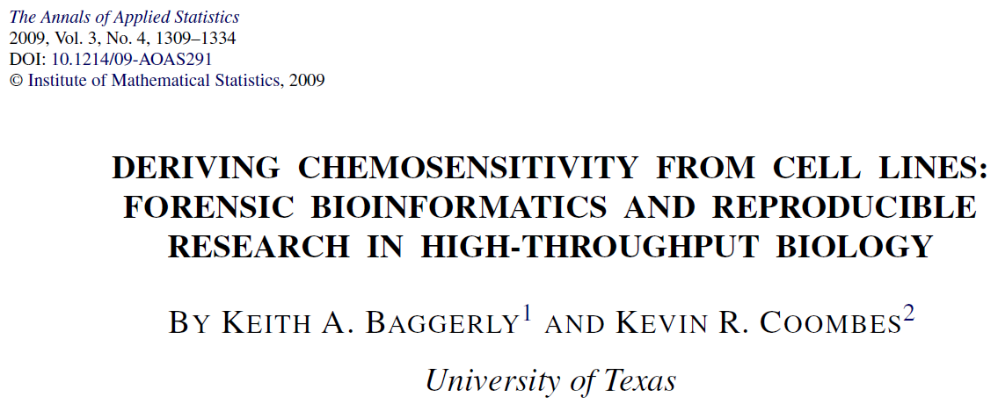
http://projecteuclid.org/download/pdfview_1/euclid.aoas/1267453942
We now require most of our reports to be written using Sweave [Leisch(2002)], a literate programming combination of LATEX source and R [R Development Core Team (2008)] code (SASweave and odfWeave are also available) so
that we can rerun the reports as needed and get the same results.
http://www.statistik.lmu.de/~leisch/Sweave/
help("Sweave", package="utils")
http://yihui.name/knitr/

Slide 36
http://projecteuclid.org/download/pdfview_1/euclid.aoas/1267453942
High-throughput biological assays such as microarrays let us ask very detailed questions about how diseases operate, and promise to let us personalize therapy. Data processing, however, is often not described well enough to allow for exact reproduction of the results, leading to exercises in “forensic bioinformatics” where aspects of raw data and reported results are used to infer what methods must have been employed. Unfortunately, poor documentation can shift from an inconvenience to an active danger when it obscures not just methods but errors. In this report we examine several related papers purporting to use microarray-based signatures of drug sensitivity derived from cell lines to predict patient response. Patients in clinical trials are currently being allocated to treatment arms on the basis of these results. However, we show in five case studies that the results incorporate several simple errors that may be putting patients at risk. One theme that emerges is that the most common errors are simple (e.g., row or column offsets); conversely, it is our experience that the most simple errors are common. We then discuss steps we are taking to avoid such errors in our own investigations.

Slide 37
https://www.sciencemagazinedigital.org/sciencemagazine/library/item/17_february_2023/4079371
Hard lessons
By Jaivime Evaristo
I had made my data and code for the Nature paper openly accessible so others could review and verify my findings, and I have a new appreciation of the value of doing so. This transparency is essential for the integrity of science, and I learned the hard way that it is better to be open and accountable, even if it means admitting mistakes. After taking a hard look at my own role in the situation, I have also realized I should have reached out to other researchers to get feedback on my methods before publishing. I can’t expect myself to know everything as a scientist and my work will be stronger if I seek out diverse expertise and opinions.
In the end, the reality is that retractions are a necessary part of the scientific process—and one that shouldn’t be viewed only through a negative lens. Retractions can also be an opportunity to learn and improve. Honest mistakes happen, and researchers should be encouraged, not punished, for doing the right thing and retracting flawed work.

Slide 38
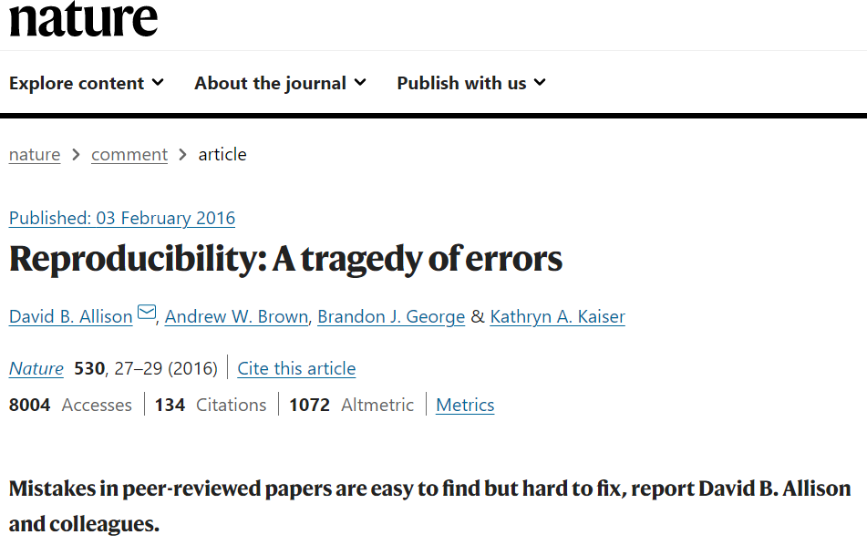
Reproducibility: A tragedy of errors | Nature

Slide 39
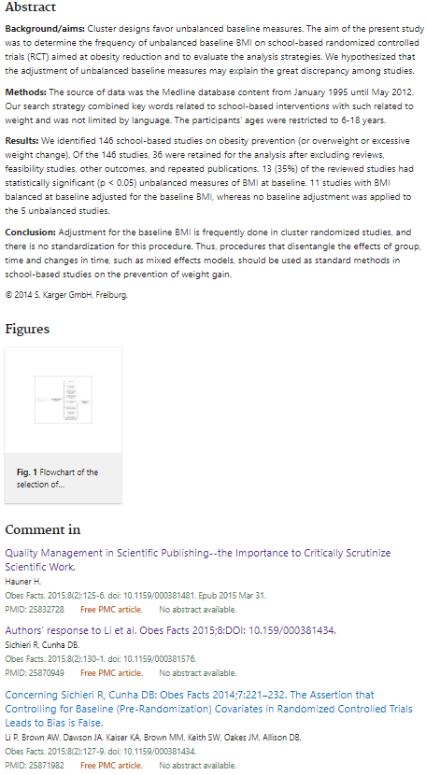
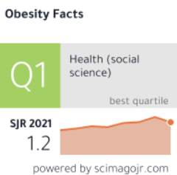
Unbalanced baseline in school-based interventions to prevent obesity: adjustment can lead to bias - a systematic review - PubMed (nih.gov)
Review. 2014;7(4):221-32. doi: 10.1159/000363438. Epub 2014 Jun 28.
Unbalanced baseline in school-based interventions to prevent obesity: adjustment can lead to bias - a systematic review Rosely Sichieri ¹, Diana Barbosa Cunha

Slide 40
Concerning Sichieri R, Cunha DB: Obes Facts 2014;7:221-232. The Assertion that Controlling for Baseline (Pre-Randomization) Covariates in Randomized Controlled Trials Leads to Bias Is False - PMC (nih.gov)
In sum, the article's[1] conclusions are at odds with established statistical principles and based on erroneous reasoning and interpretations of prior literature. The article's conclusions are not only wrong, but may inappropriately dissuade readers from powerful analytic choices and lead other readers to incorrectly conclude that published cRCTs which have used covariate adjustment are invalid or that large numbers of persons, not groups, are essential. Given the above, we believe the article should be retracted.

Slide 41
Quality Management in Scientific Publishing – the Importance to Critically Scrutinize Scientific Work - PMC (nih.gov)
As the criticism expressed in the Letter to the Editor is so severe, an independent statistician was asked to review the original article and the subsequent correspondence. The statistician agreed with the criticism raised by Li et al. [2] and concluded that the critical comments were not adequately addressed in the Authors’ Response [3].
By publishing the Letter to the Editor and the Authors’ Response together with this Editorial in the current issue of obesity facts, I would like to open the discussion that arose between the authors of the original article, the authors of the Letter to the Editor and the Editor-in-Chief to our readership and recommend reading and forming your own opinion.
Stimulated by this debate, I would like to point out that it is each author's responsibility to make sure that statistical procedures are correctly used and valid for the study submitted. Even though it would be desirable if an additional assessment of statistical methods could be established within the review process, it cannot be expected that all of our reviewers, in addition to their expertise in various aspects of obesity research, are designated experts for advanced statistical procedures.
Finally I would like to emphasize the importance of critically scrutinizing scientific papers even after their publication. Therefore, comments on articles are highly welcomed at all times to present and discuss different viewpoints concerning a controversial topic.

Slide 42
http://www.nature.com/naturejobs/science/articles/10.1038/nj7396-137a
http://journals.plos.org/plosone/article?id=10.1371/journal.pone.0005738
A pooled weighted average of 1.97% (N = 7, 95%CI: 0.86–4.45) of scientists admitted to have fabricated, falsified or modified data or results at least once –a serious form of misconduct by any standard– and up to 33.7% admitted other questionable research practices.

Slide 43
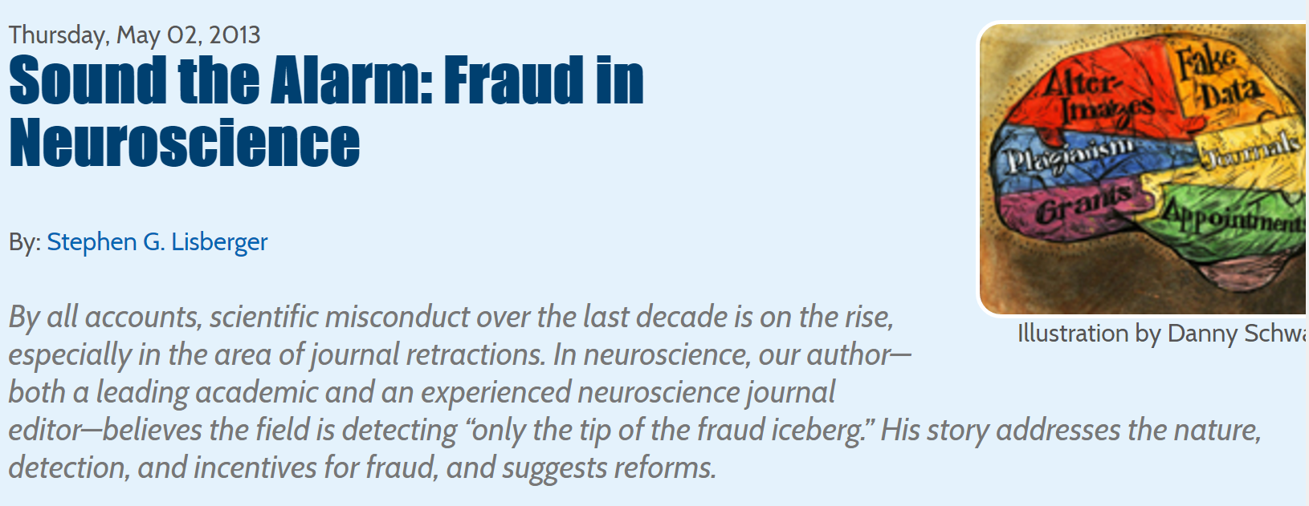
http://dana.org/Cerebrum/Default.aspx?id=39490

Slide 44
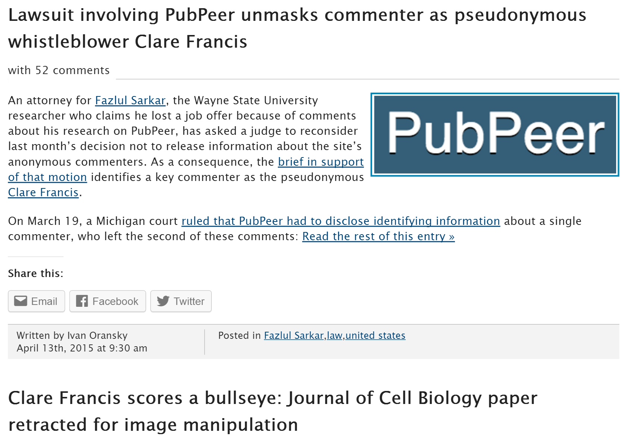
http://retractionwatch.com/?s=clare+francis

Slide 45
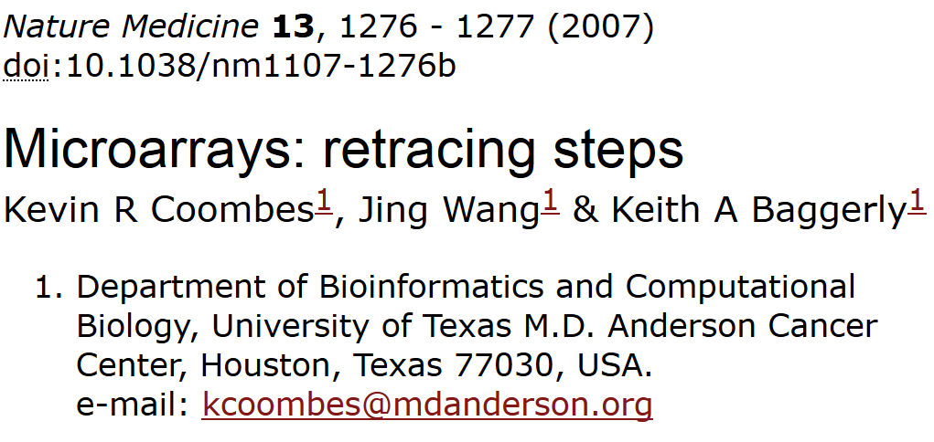
“We report here our inability to reproduce their findings.”

Slide 46
2. The lists of genes initially reported in the supplementary information on the Nature Medicine website¹ are wrong because of an 'off-by-one' indexing error.
3. Using their software and lists of cell lines, we reproduced their published heatmaps for six out of seven drugs. (We could not reproduce the heatmap for cytoxan.) However, after correcting for the off-by-one error, we matched the reported gene lists exactly for only three out of seven drugs (Supplementary Report 9). The other lists contain outliers.
5. Their software does not maintain the independence of training and test sets, and the test data alter the model.
7. When we apply the same methods but maintain the separation of training and test sets, predictions are poor (Fig. 1 and Supplementary Report 7). Simulations show that the results are no better than those obtained with randomly selected cell lines (Supplementary Report 8).

Slide 47
http://blog.ecu.edu/sites/dailyclips/blog/2015/05/04/duke-university-settles-suit-with-cancer-patients-over-clinical-trials-the-news-observer/
By Joseph Neff
Duke University has settled the lawsuit filed by the families of eight cancer patients treated in clinical trials based on bogus science, a Duke spokesman said Saturday.
The settlement ends another chapter in the long-running scandal over research conducted by Dr. Anil Potti, once a rising scientist who has retracted 11 research papers and left Duke in disgrace in 2011.
Duke spokesman Michael Schoenfeld declined to discuss the amount of settlement or any other questions about the lawsuit.
But the dollar amount of the settlement is likely to be substantial, given the depth of the research misconduct and damaging evidence discovered in the lawsuit, including a whistleblower who alerted Duke to the misconduct in 2008 but went ignored.
Duke officials shut down the trials in 2010 and flatly said they should never have been done.
Potti is now working at a cancer center in North Dakota.

Slide 48
https://cancerletter.com/free/20150109_1/ Duke Officials Silenced Med Student Who Reported Trouble in Anil Potti’s Lab
Perez, who is currently a resident at Duke, said the controversy he triggered had caused him to repeat his third year of medical school.
“In the course of my work in the Potti lab, I discovered what I perceived to be problems in the predictor models that made it difficult for me to continue working in that environment,” he said in an email to The Cancer Letter. “I raised my concerns with my laboratory peers, laboratory supervisors and medical school administrators and left it to them to determine how best to proceed. I chose to take an additional year to complete medical school in order to have a more successful research experience. My decision to stay at Duke was based on it being the best opportunity both personally and professionally.”
In raising these concerns, I have nothing to gain and much to lose. In fact, in raising these concerns, I have given up the opportunity to be included as an author on at least four manuscripts. I have also given up a Merit Award for a poster presentation at this year’s annual ASCO meeting. I have also sacrificed seven months of my own hard work and relationships that would likely have helped to further my career.
“Making this decision will make it more difficult for me to gain a residency position in radiation oncology. As a third-year medical student, these are all very important things that I have given up. As a result of these circumstances, I am spending another year of my life pursuing a more meaningful research project.
“The reason that I have made the decision to leave the lab and make these concerns known is because it is important that the work be done right for the sake of our patients and for the field of genomic medicine.”
We have now decided to go back through each and every dataset that we have posted in relation to various publications to ensure that there are no errors,” Nevins and Potti wrote. “As you might imagine, this is a laborious process that requites quite a lot of checking of data to ensure that what is reported is accurate. But we do believe this is important and in the end will be in everyone’s best interests.”
Had this been done, fraud would have become evident more than two years earlier—in 2008 instead of 2010—and Duke’s clinical trials of the predictor model would have stopped months after they began.
Eighteen months after Perez bows out, in October 2009, MD Anderson statisticians Baggerly and Coombes publish a paper claiming there is potential for patient harm in the Duke trials.

Slide 49
http://www.bna.com/patients-researchers-demand-n57982065145/
By Llewellyn Hinkes-JonesDec. 2 — Patients and researchers have harshly criticized the leniency of research misconduct findings against former Duke University cancer researcher Anil Potti and the sole focus on Potti by the Department of Health and Human Services Office of Research Integrity.
On Nov. 9, the ORI made a formal finding of research misconduct against Potti for altering data sets, falsifying grant applications and disregarding accepted scientific methodology surrounding his widely celebrated “Holy Grail” of cancer research. While Potti neither admits nor denies his guilt, the ORI banned Potti from U.S. Public Health Service-supported research for five years

Slide 50
http://www.medscape.com/viewarticle/854595
However, the Cancer Letter editorialists have damning words for Duke about the handling of the protracted scandal.
"This case is about as serious as one can imagine at the individual level. At the institutional level, it is beyond disappointing at every turn: in handing an internal whistleblower; in responding to credible, serious, and repeated external scientific queries; in managing the multiple conflicts of interest in the situation; in limiting the information available to an interim scientific review; in how its leaders testified to an IOM review committee; in its legal responses," the pair write.

Slide 51
http://retractionwatch.com/2012/08/20/anil-potti-resurfaces-with-job-at-north-dakota-cancer-center/

Slide 52
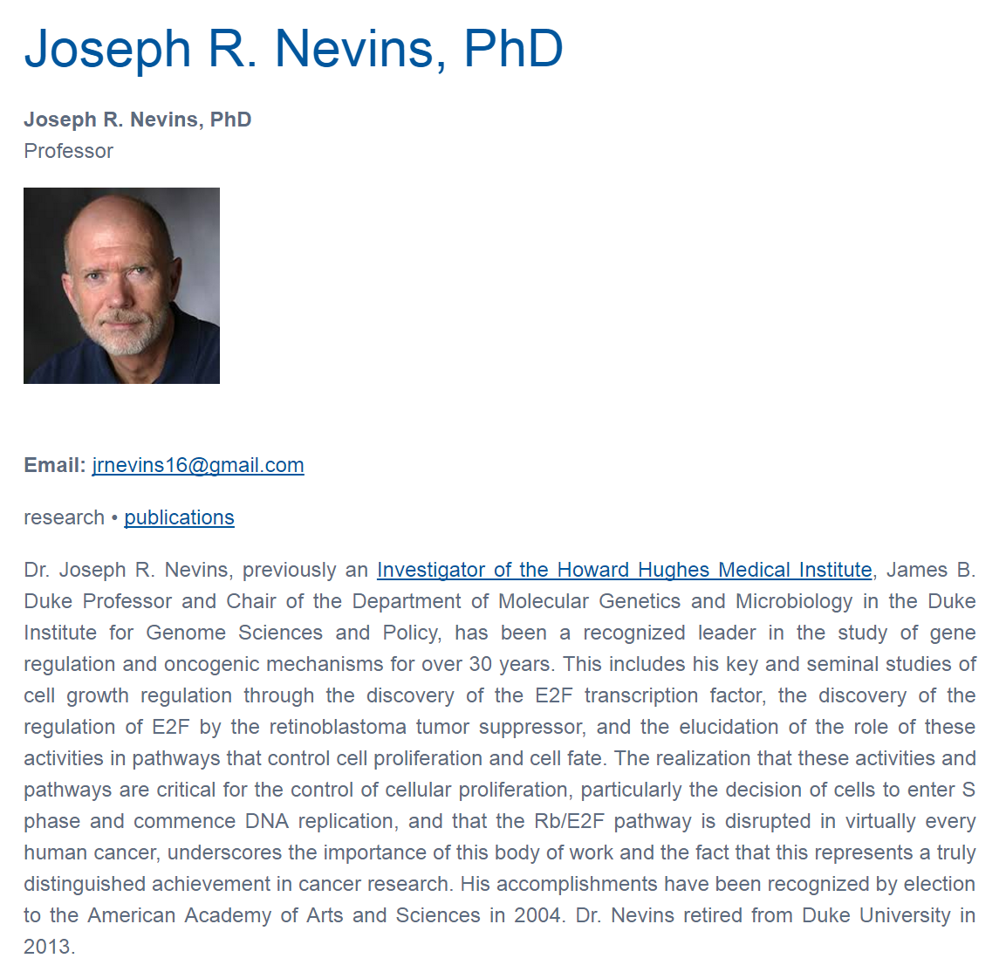

Slide 53
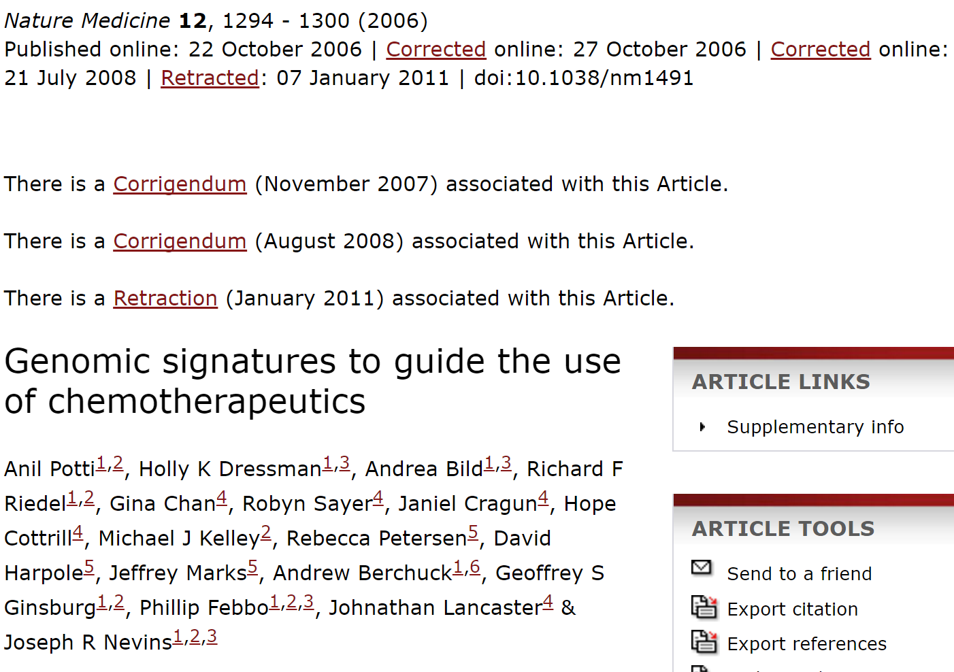
http://www.nature.com/nm/journal/v12/n11/full/nm1491.html

Slide 54
http://cancerletter.com/articles/20151113_2
This case is about as serious as one can imagine at the individual level. At the institutional level, it is beyond disappointing at every turn: in handing an internal whistleblower, in responding to credible, serious and repeated external scientific queries, in managing the multiple conflicts of interest in the situation, in limiting the information available to an interim scientific review, in how its leaders testified to an IOM review committee, in its legal responses.

Slide 55
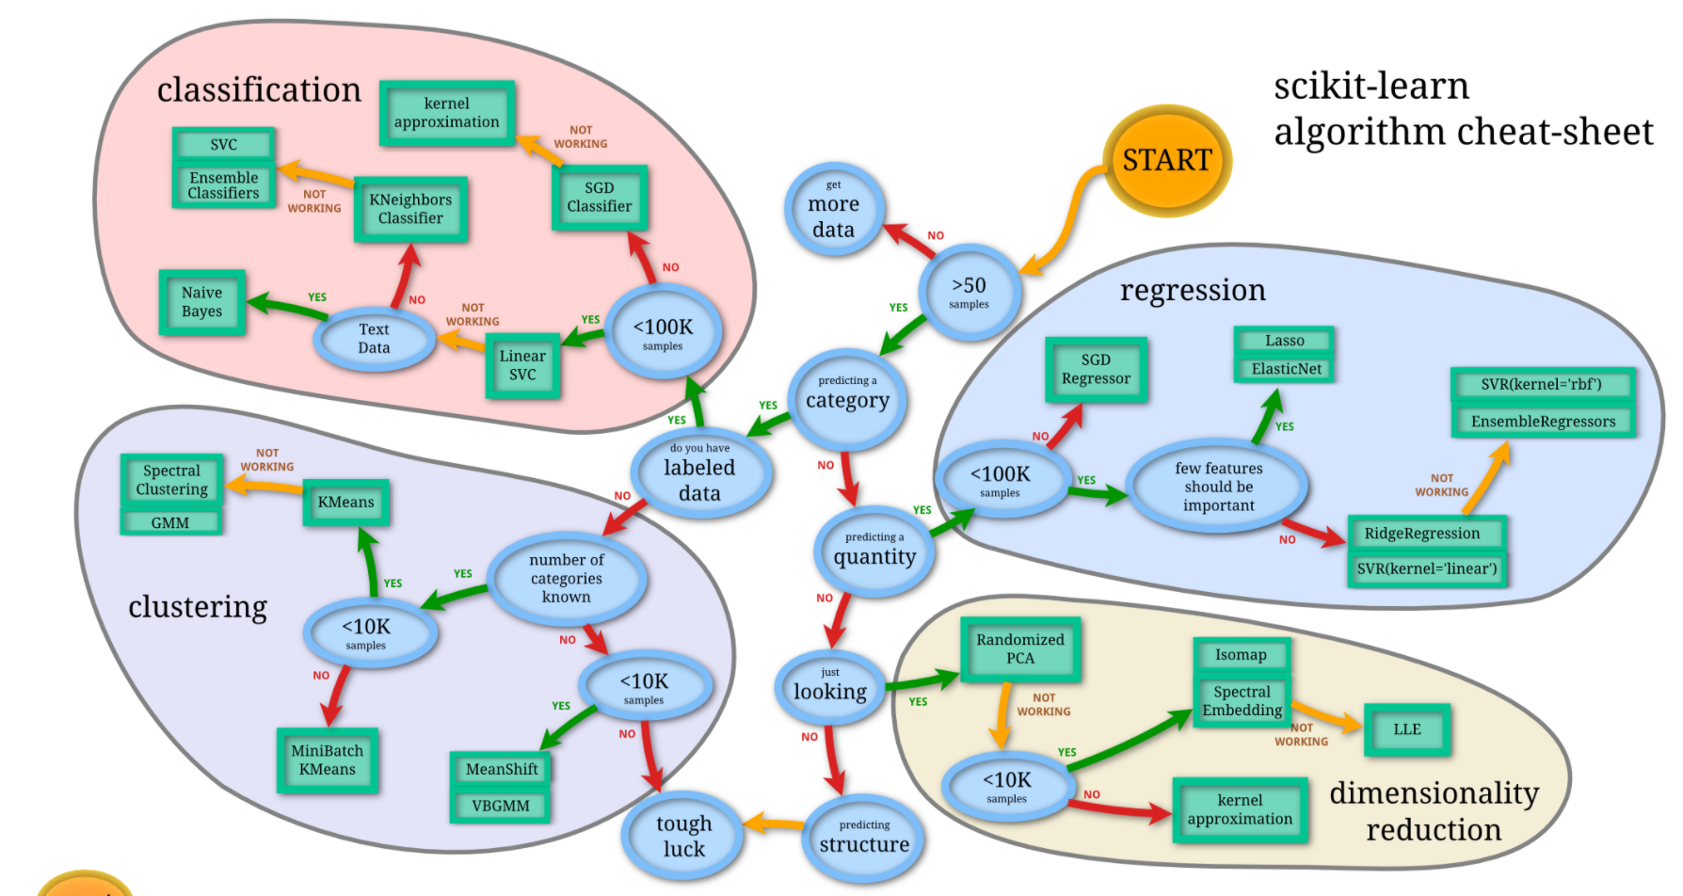
https://nbviewer.jupyter.org/github/donnemartin/data-science-ipython-notebooks/blob/master/scikit-learn/scikit-learn-intro.ipynb

