Slide 1
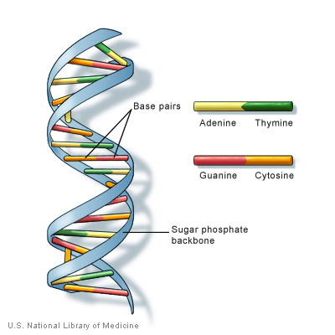
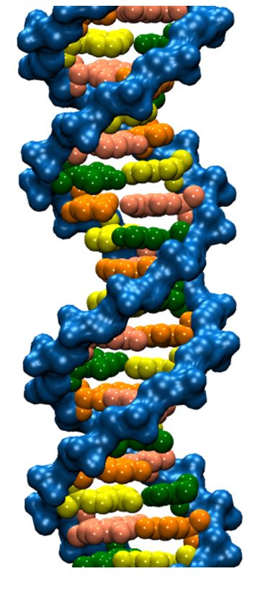
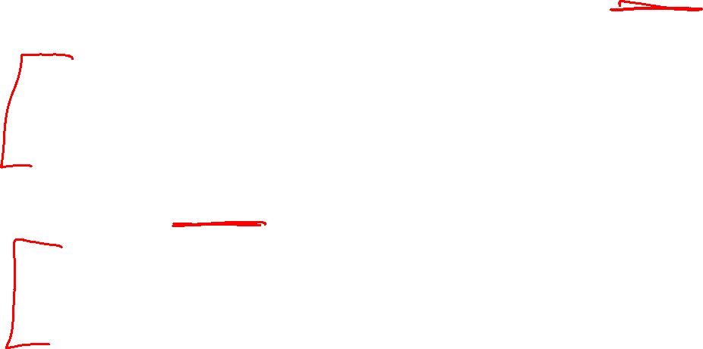
DNA trivia: Who are the authors of the 1953 paper on DNA with the following quotes:
“DNA is a helical structure”
with “two co-axial molecules.”
“period is 34 Å”
“one repeating unit contains ten
nucleotides on each of two . . . co-axial molecules.'’
“The phosphate groups lie on the outside of the structural unit, on a helix of diameter about 20 Å”
“the sugar and base groups must accordingly be turned inwards towards the helical axis.”

Slide 2

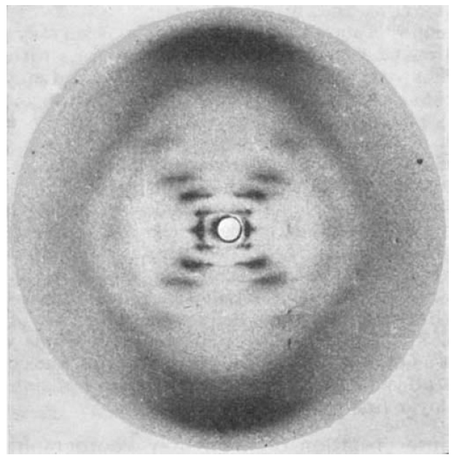
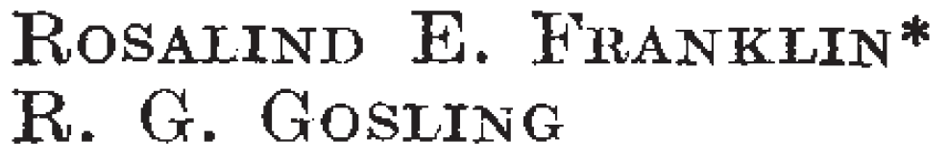
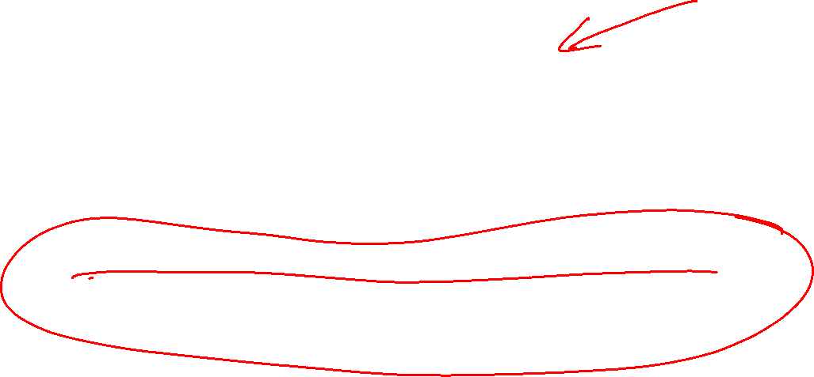

Slide 3
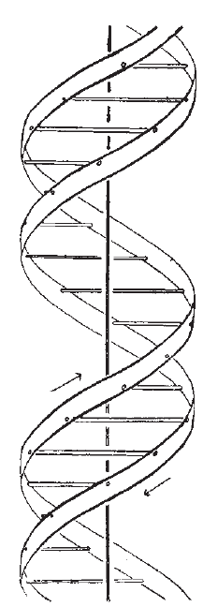

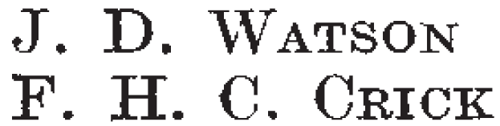
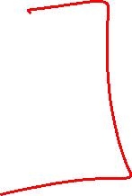
Also published in the same issue of Nature:

Slide 4
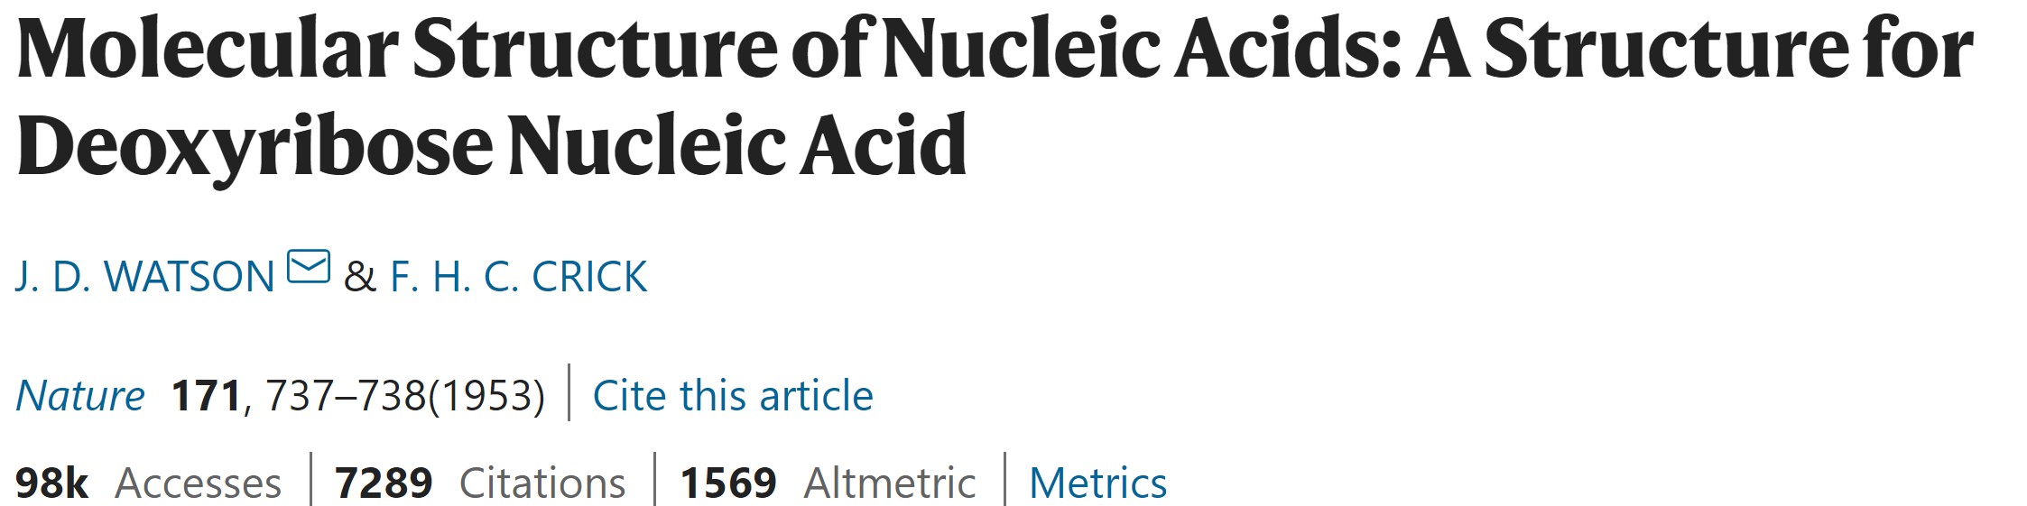
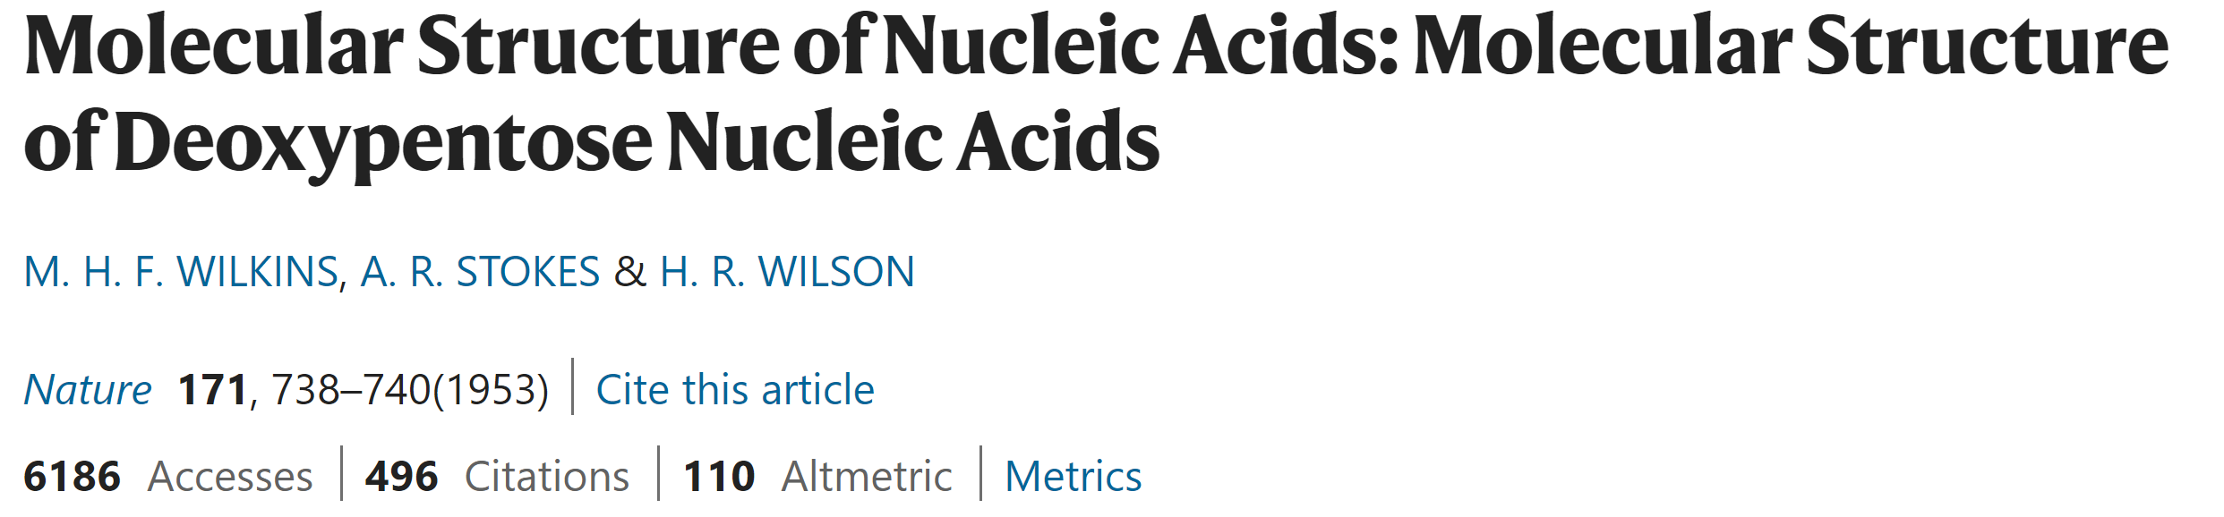
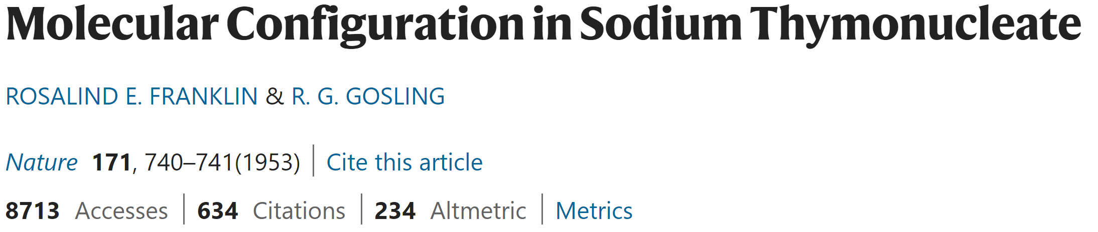
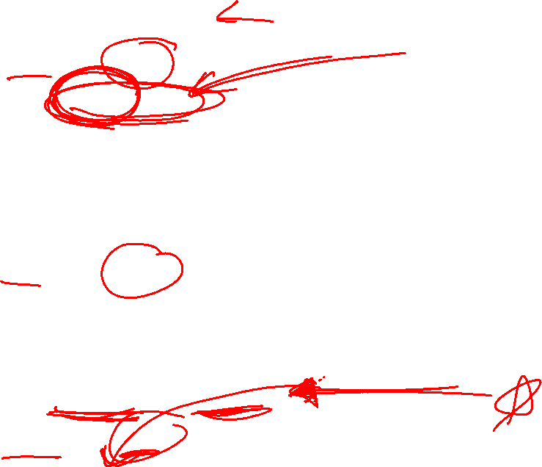

Slide 5
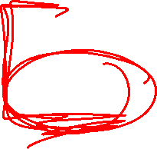
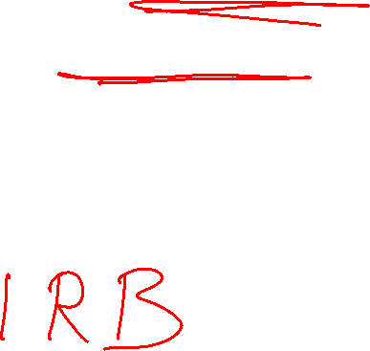
If someone gives you data, check with them BEFORE you share it with others.
If it involves human data, you may need approval from the ethics board.
If it involves human data, you may need to keep it secure – i.e, not on an unsecured laptop.

Slide 6
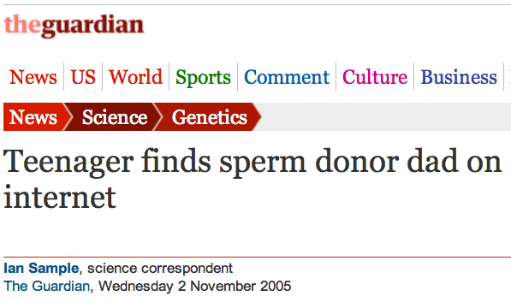
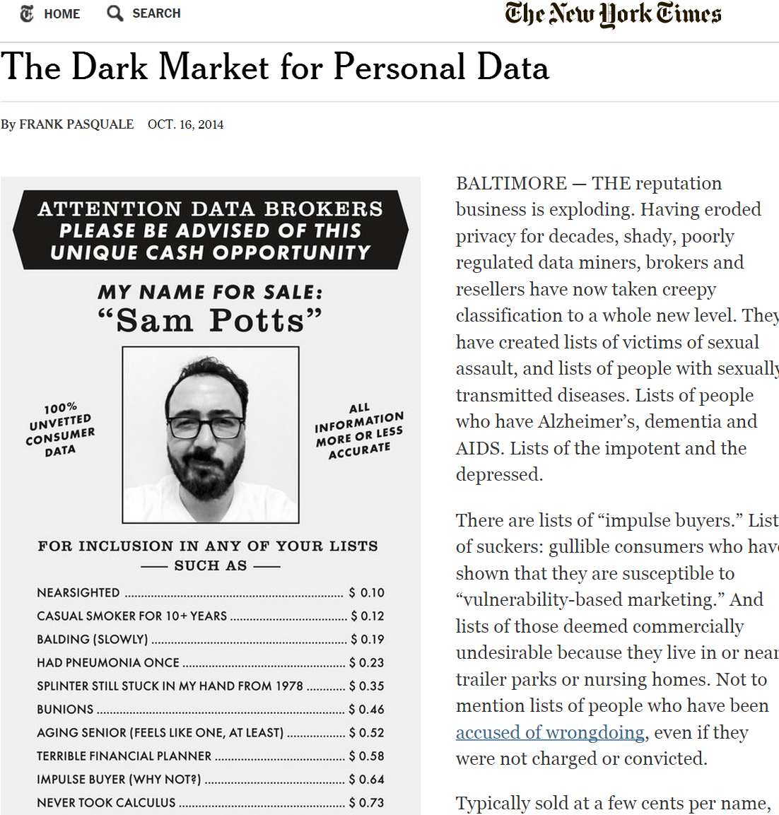
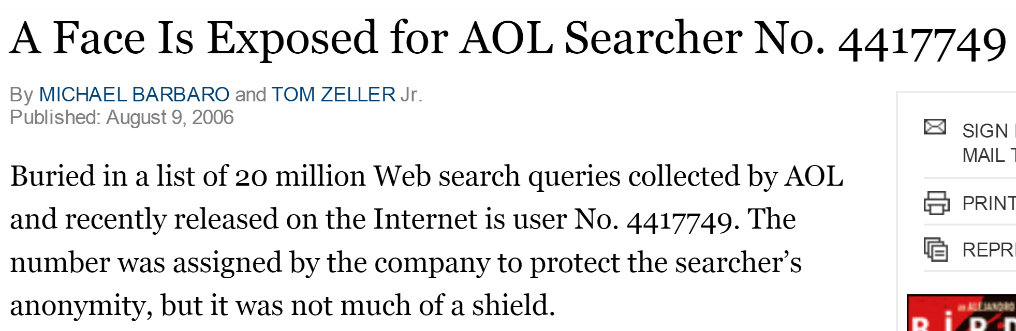
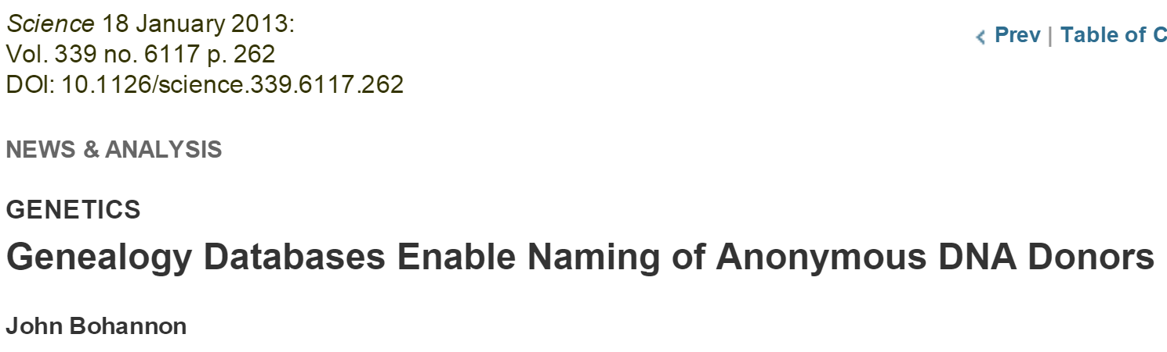

Data is NEVER fully anonymized
http://www.theguardian.com/science/2005/nov/03/genetics.news
http://www.nytimes.com/2014/10/17/opinion/the-dark-market-for-personal-data.html
http://www.nytimes.com/2006/08/09/technology/09aol.html, https://www.sciencemag.org/content/339/6117/262

Slide 7
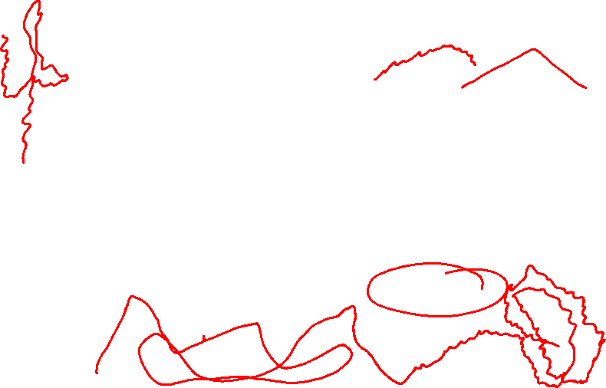
http://www.npr.org/blogs/health/2013/01/17/169634045/some-types-of-insurance-can-discriminate-based-on-genes
In the USA, Under GINA (2009), it's (mostly) illegal for
an employer to fire someone based on his genes, and it's illegal for health insurers to raise rates or to deny coverage because of someone's genetic code.
But the law has a loophole: It only applies to health insurance. It doesn't say anything about companies that sell life insurance, disability insurance or long-term-care insurance.”
People who discover they have the gene, ApoE4, associated with Alzheimer’s are 5 times more likely than the average person to go out and buy long-term-care insurance.

Slide 8
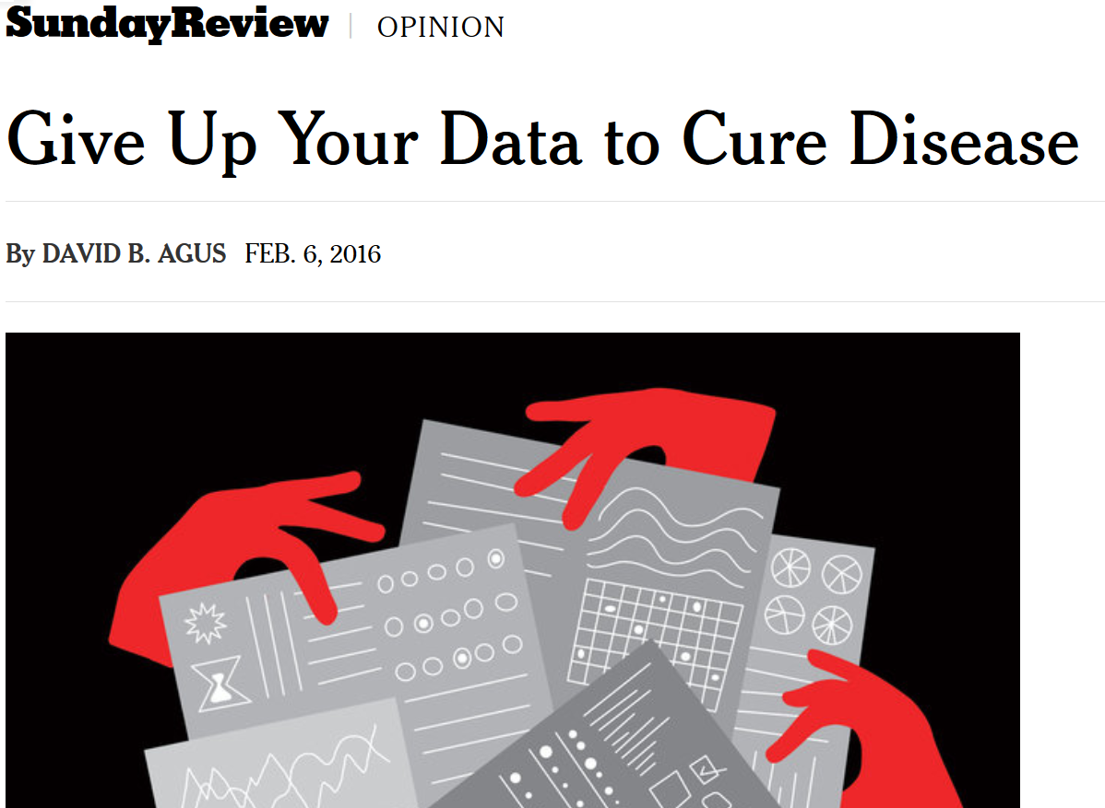
http://www.nytimes.com/2016/02/07/opinion/sunday/give-up-your-data-to-cure-disease.html

Slide 9
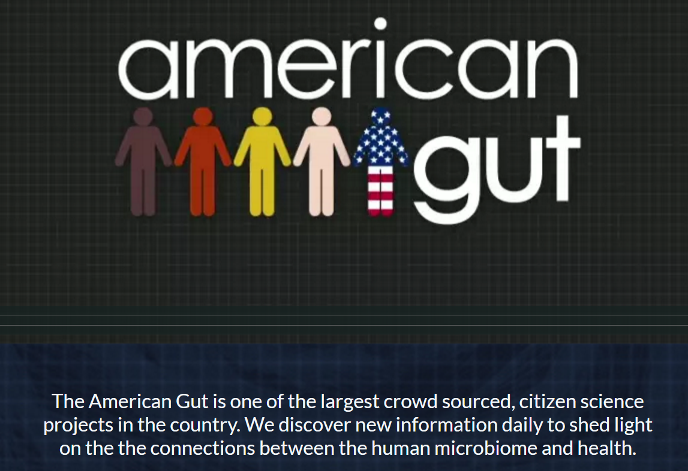
http://americangut.org

Slide 10
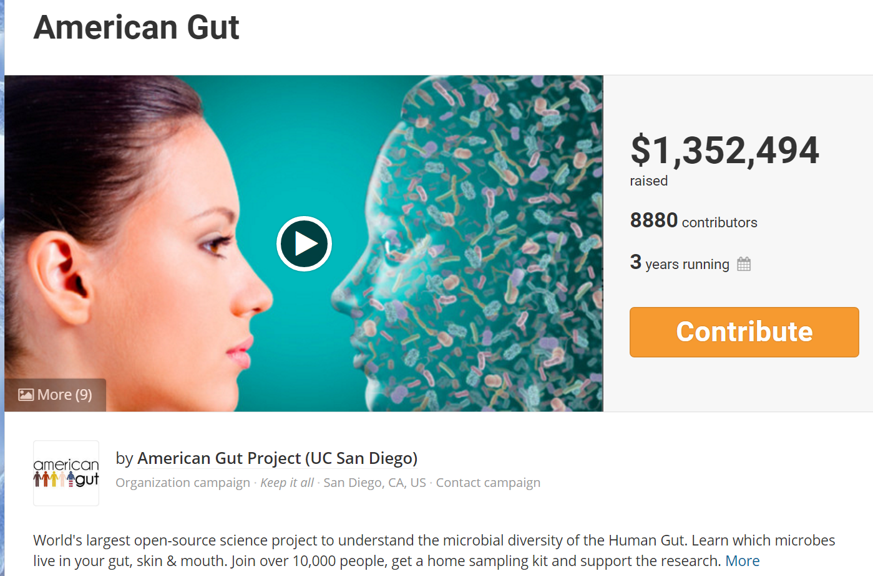
https://fundrazr.com/campaigns/4Tqx5

Slide 11


Slide 12

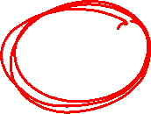
https://allofus.nih.gov
The future of health begins with you
The All of Us Research Program is a historic effort to gather data from one million or more people living in the United States to accelerate research and improve health. By taking into account individual differences in lifestyle, environment, and biology, researchers will uncover paths toward delivering precision medicine.
If you decide to join All of Us, we will ask you to share different kinds of information over time. We will ask you basic information like your name and where you live. We will ask you questions about your health, family, home, and work. If you have an electronic health record, we may ask for access. We may ask you to go to a local clinic or drug store for a free appointment with us. At this appointment we would measure your weight, height, hips, and waist, as well as your blood pressure and heart rate. We might ask you to give samples, like blood or urine at the appointment.

Slide 13
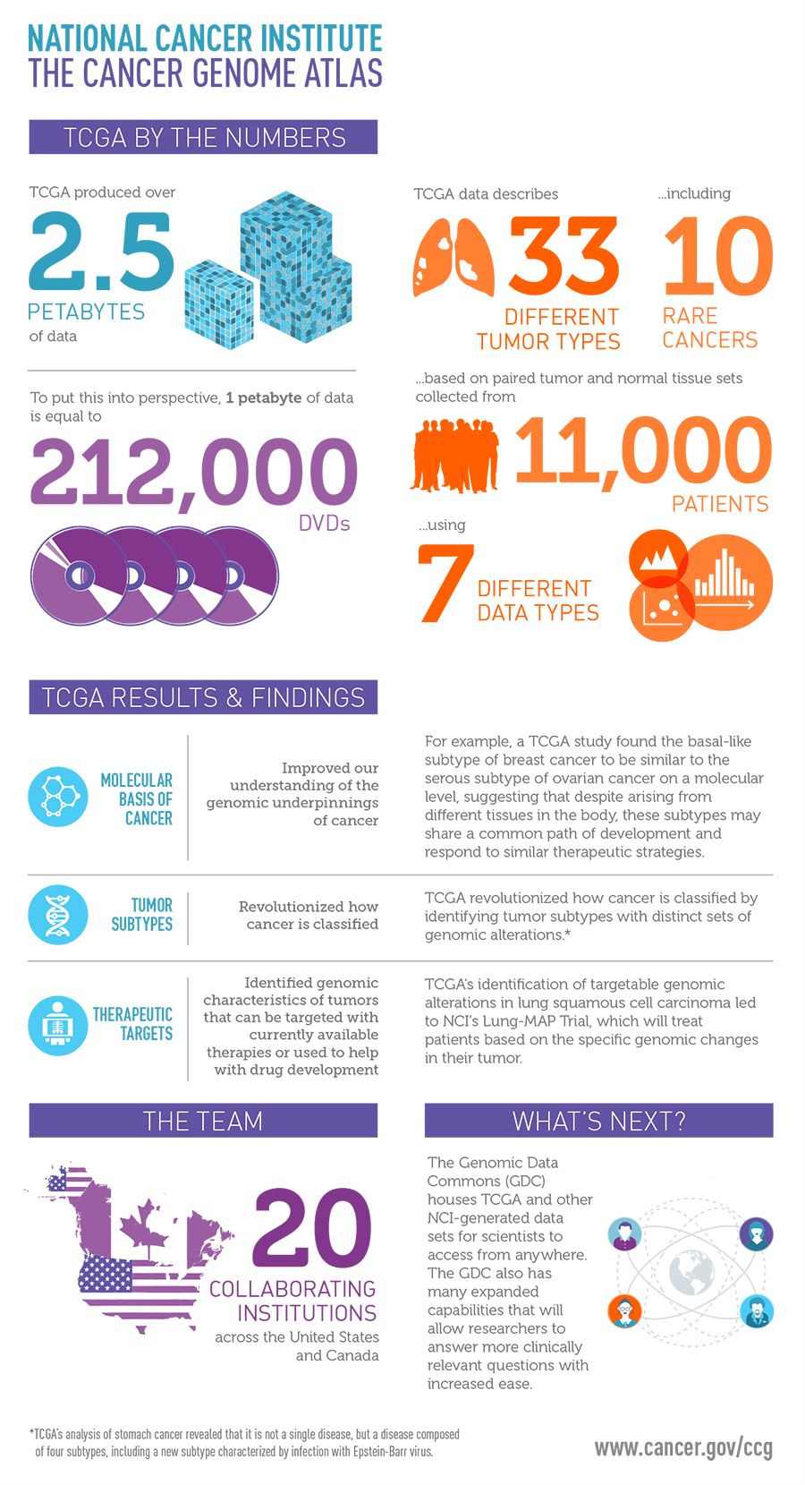
https://cancergenome.nih.gov/abouttcga

Slide 14
https://cancergenome.nih.gov/abouttcga

Slide 15

Written project (due: Saturday May 15)
Approximately 10 pages
  3-4 page paper
  6-7 page appendix
Appendix: Put ALL your labs into your appendix. Add a few comments.
References: You should reference the labs plus the ORIGINAL SOURCE; but you can omit these references if you prefer.
Figures:
  Axis should be labeled. Figures can be titled.
  Detailed figure captions are required for the main part of the paper.
You may submit an updated Module 6 HW 2: Project draft early this Saturday May 8 morning.

Slide 16

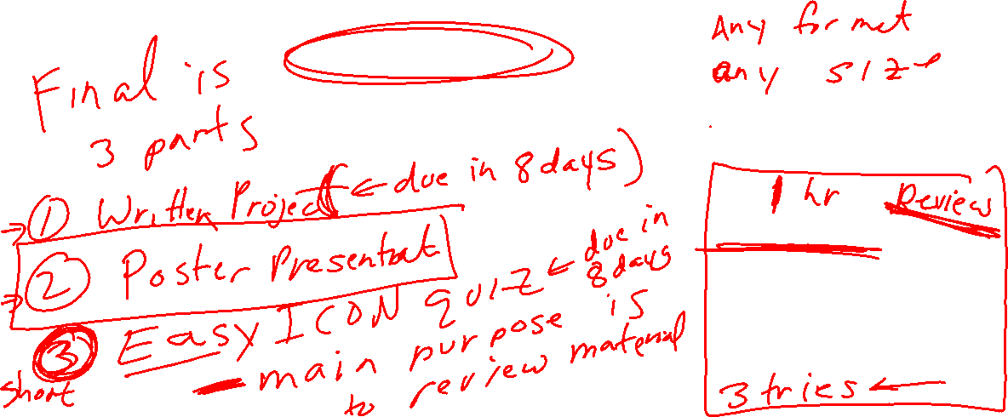
Poster Title
Authors
Affiliations
Introduction
Results
Conclusions
Include lots of figures and detailed figure captions.
Bullet points are much better than long paragraphs.
You do not need to use the headings in this sample.
Teach us one thing.
    You can do that using your data (ie from written project) or if you have a good artificial data example, you can use that.
You can easily resize the columns if (for example) a wider middle column better accommodates your figures.
ICON quiz due Saturday May 15. Will be available this weekend

Slide 17
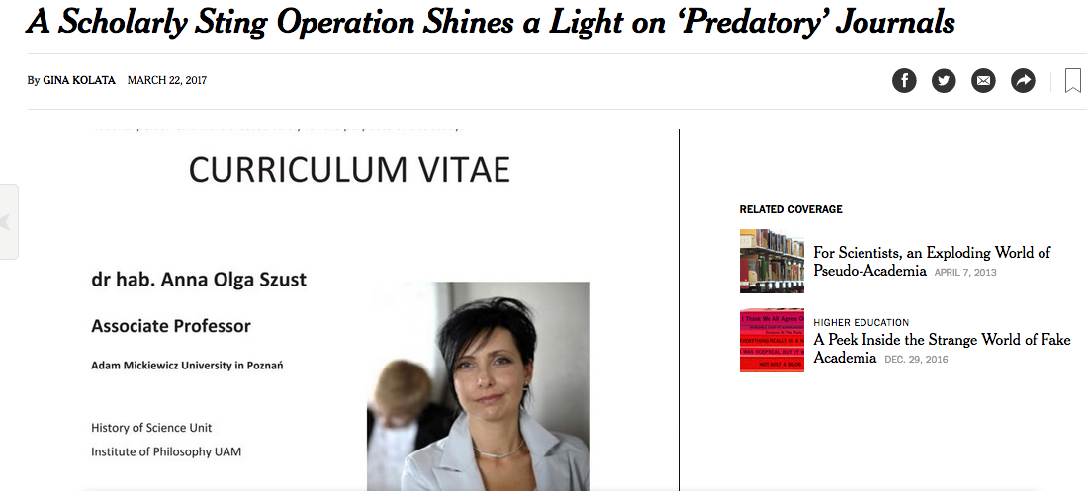

https://www.nytimes.com/2017/03/22/science/open-access-journals.html

Slide 18
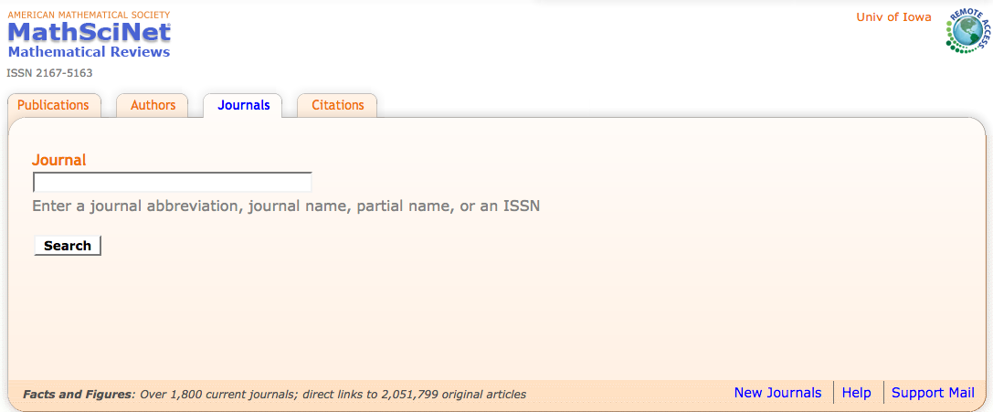
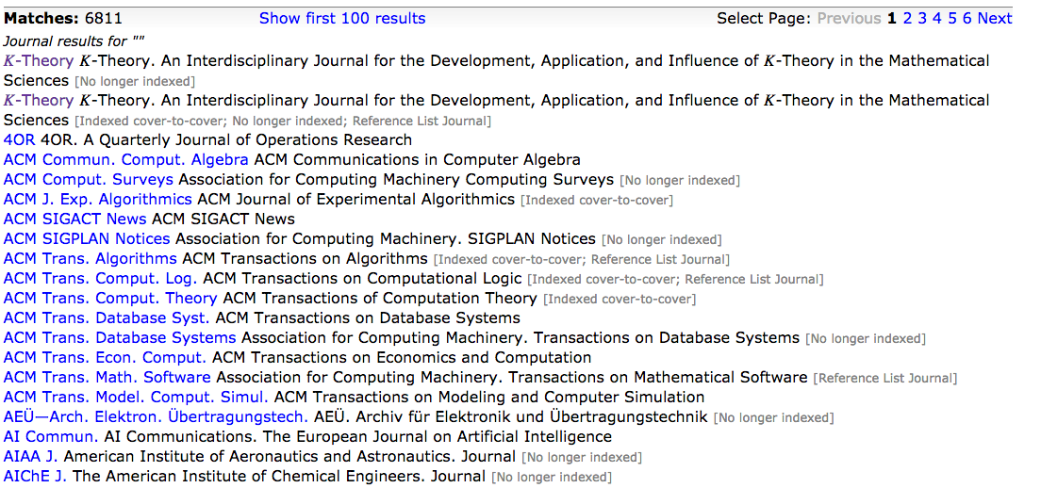
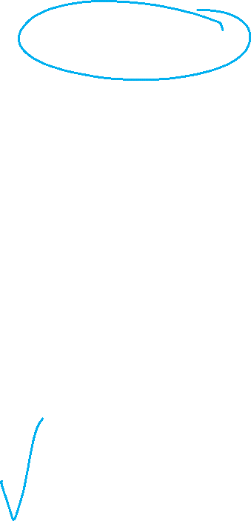

Slide 19
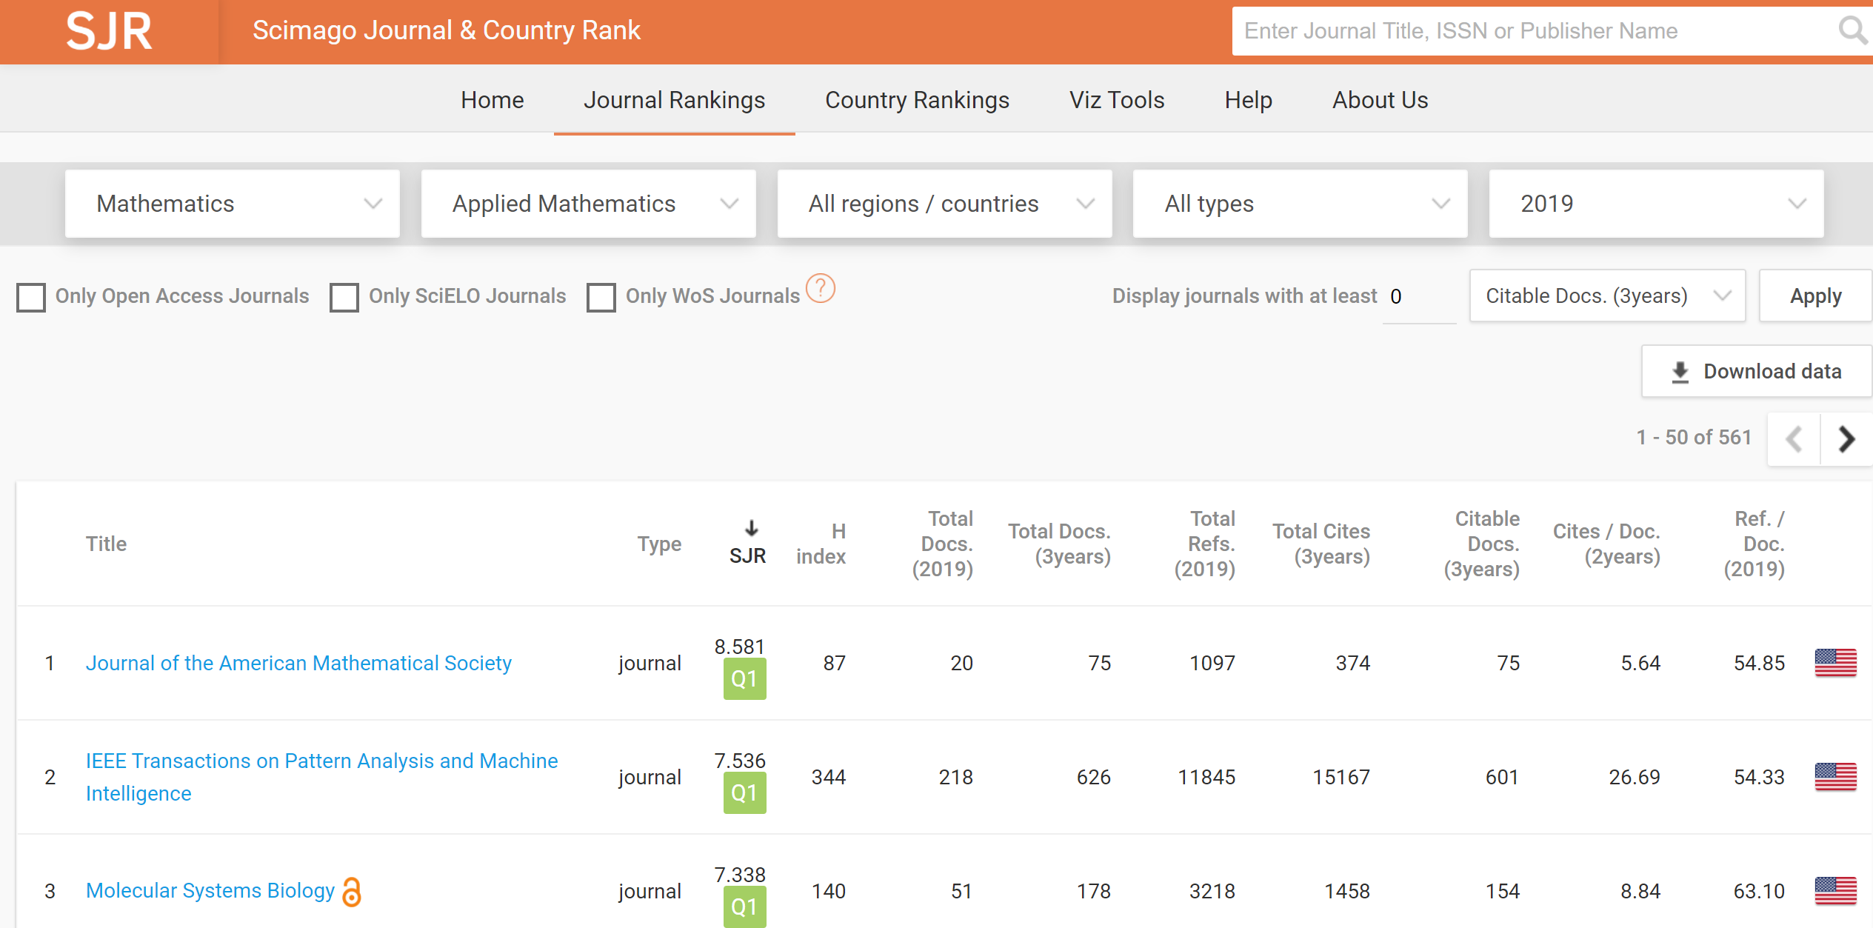
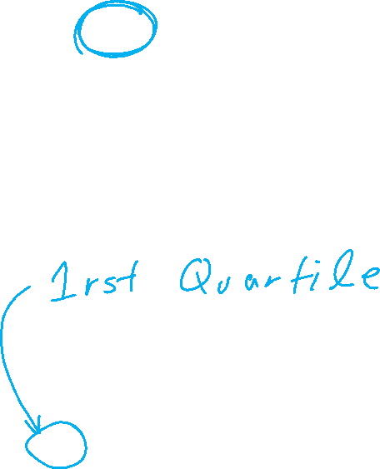
https://www.scimagojr.com/journalrank.php

Slide 20
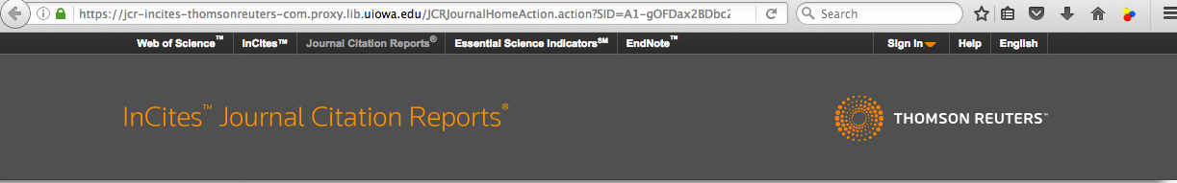
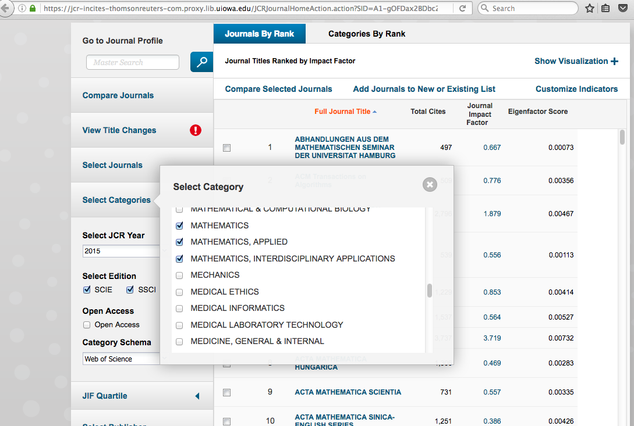
Web of Science Journal Citation Reports

Slide 22
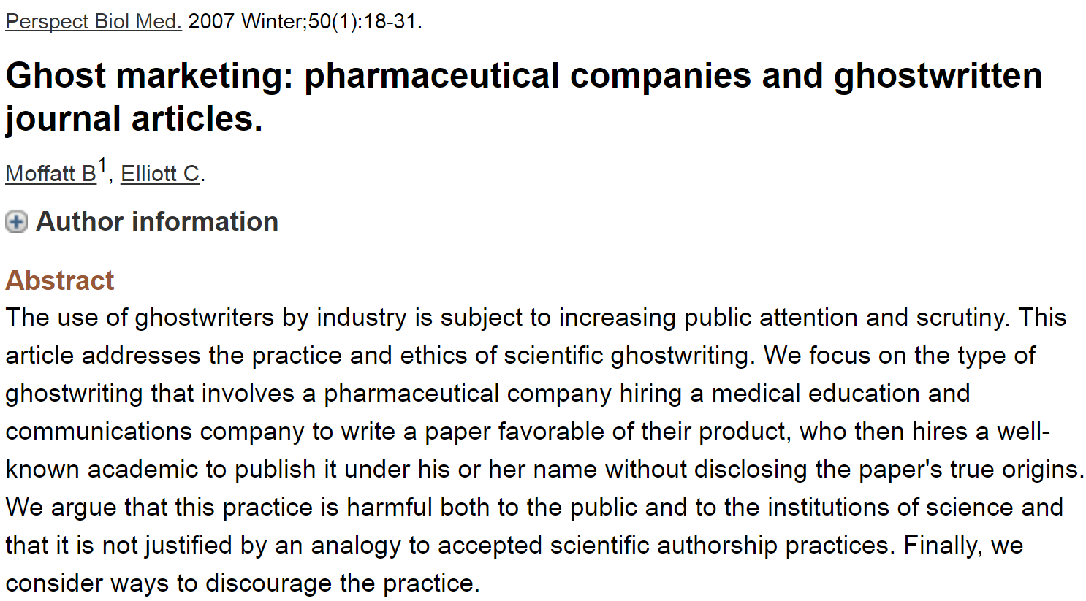
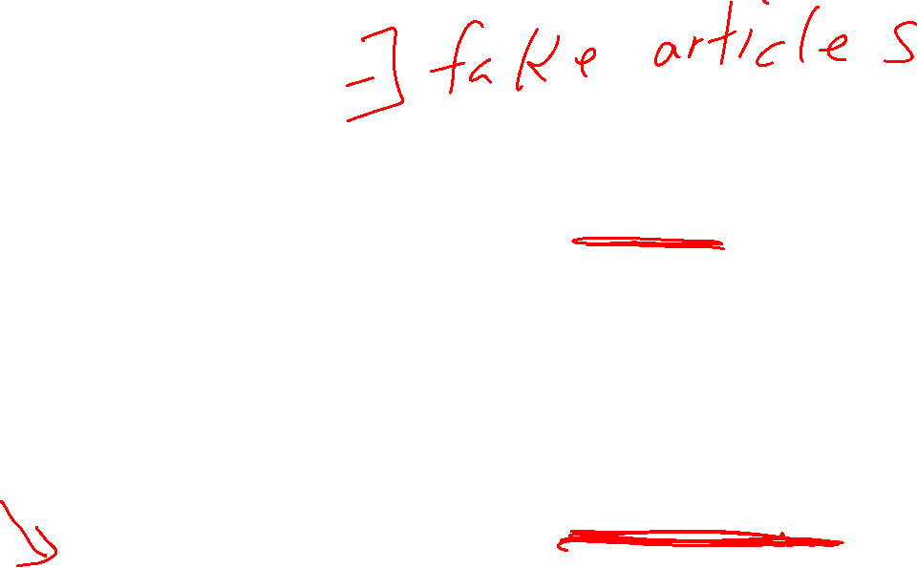
Most journals now require at least a conflicts of interest statement.
Many also require author contribution list.

Slide 23
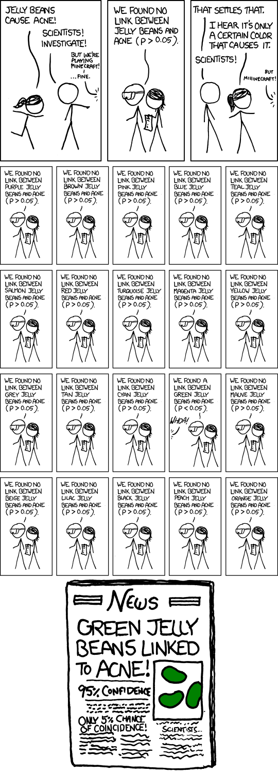

False Positives will occur
https://xkcd.com/882/

Slide 24
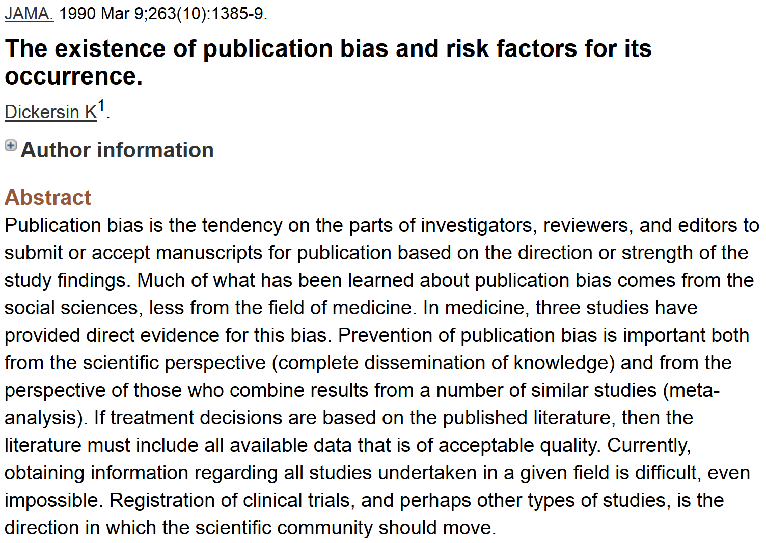
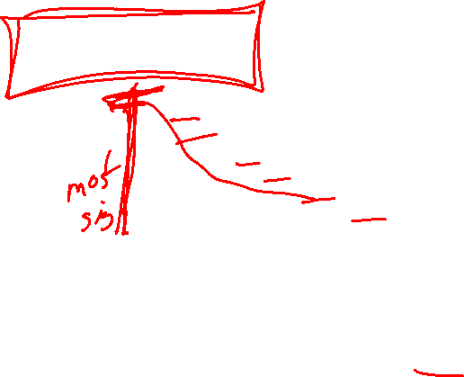
http://www.ncbi.nlm.nih.gov/pubmed/2406472?dopt=Abstract&holding=npg

Slide 25
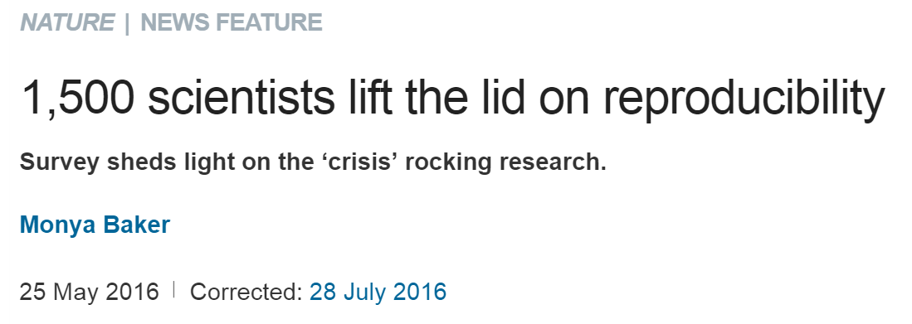
http://www.nature.com/news/1-500-scientists-lift-the-lid-on-reproducibility-1.19970
Note the following are based on researchers opinions,
not actual facts

Slide 26
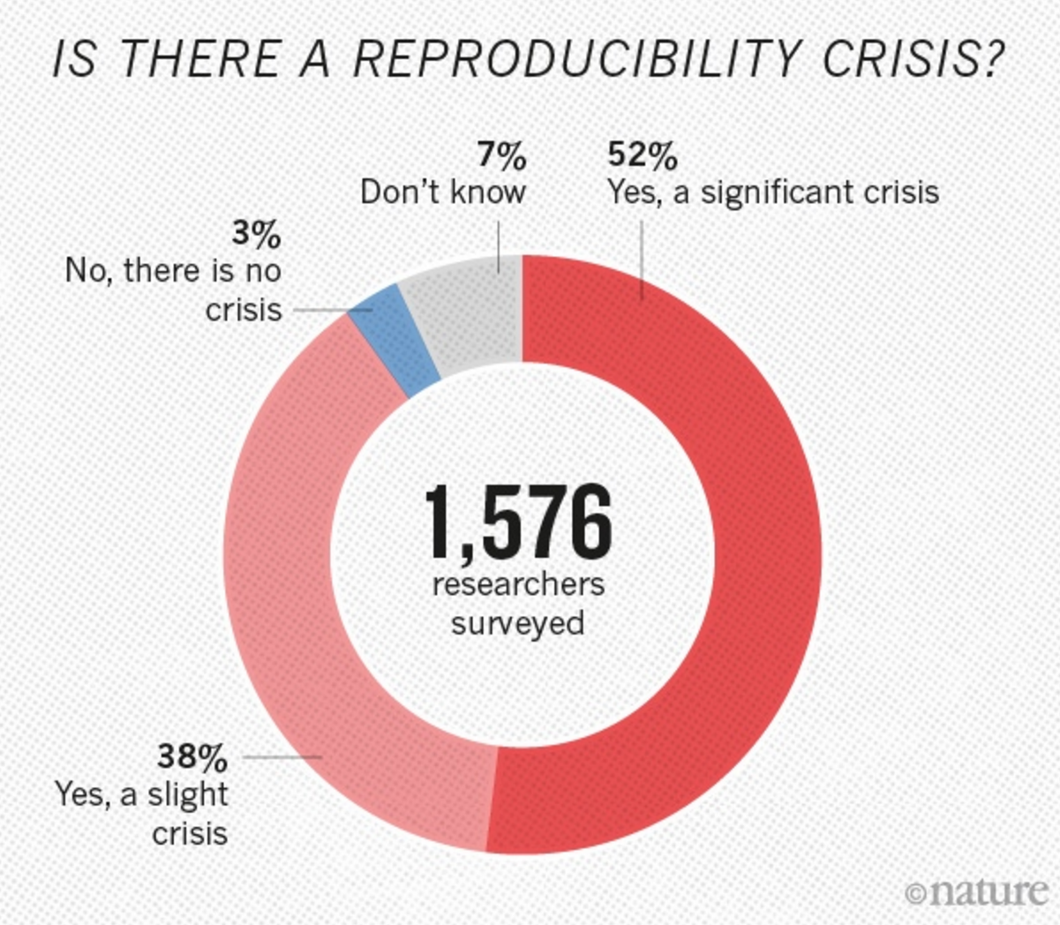
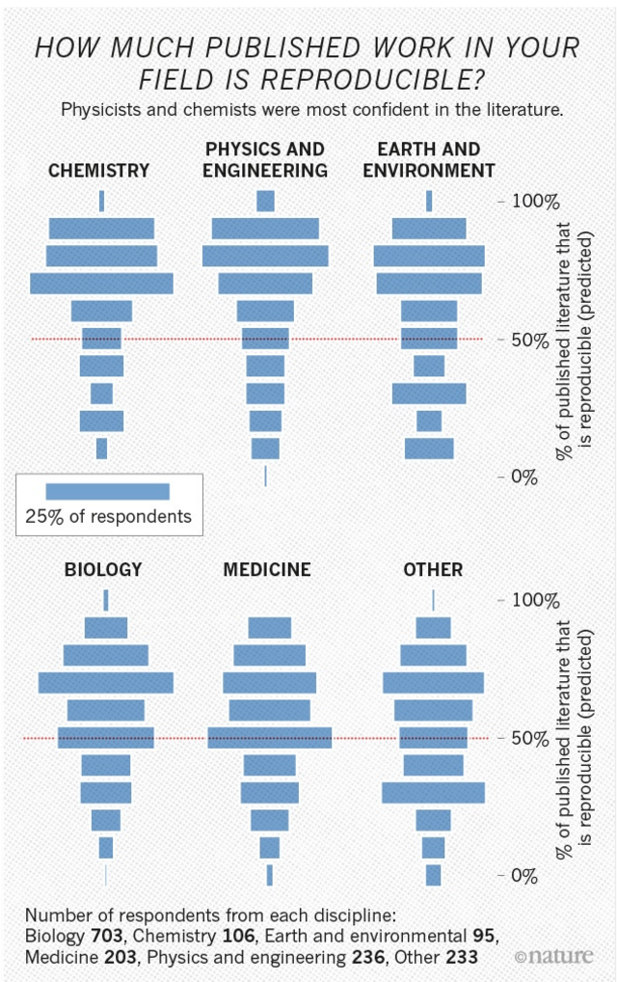


Slide 27
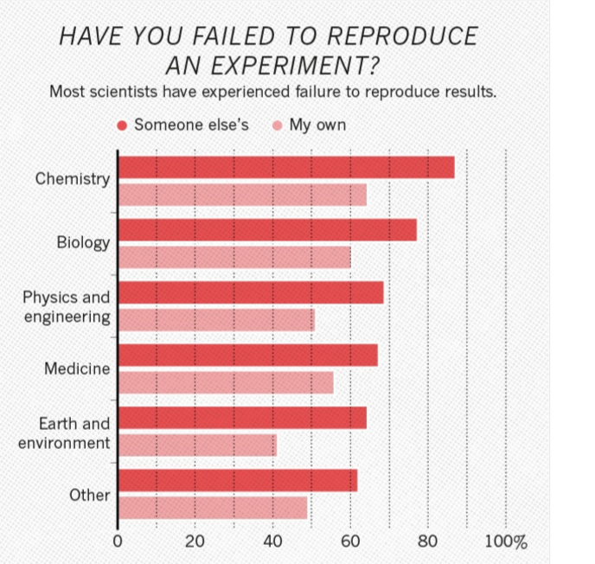


Slide 28
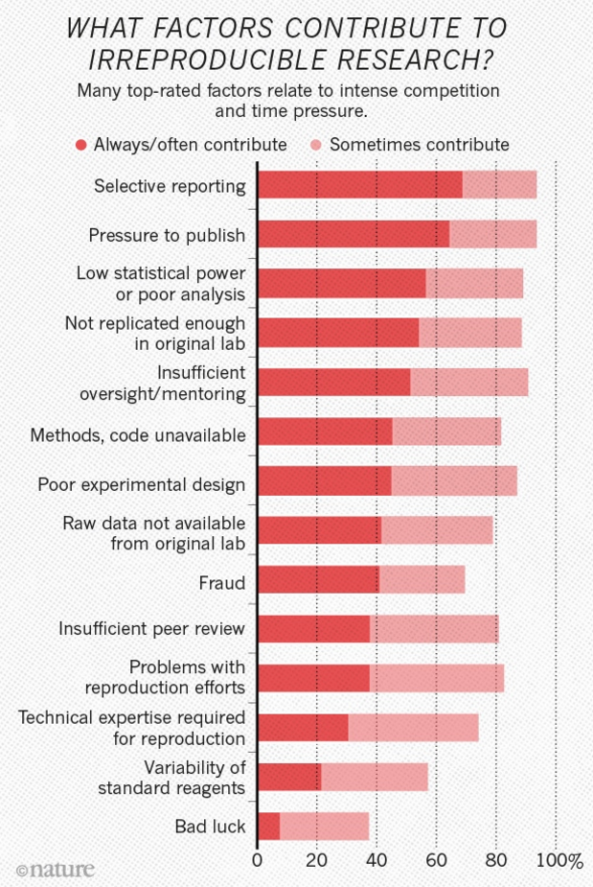
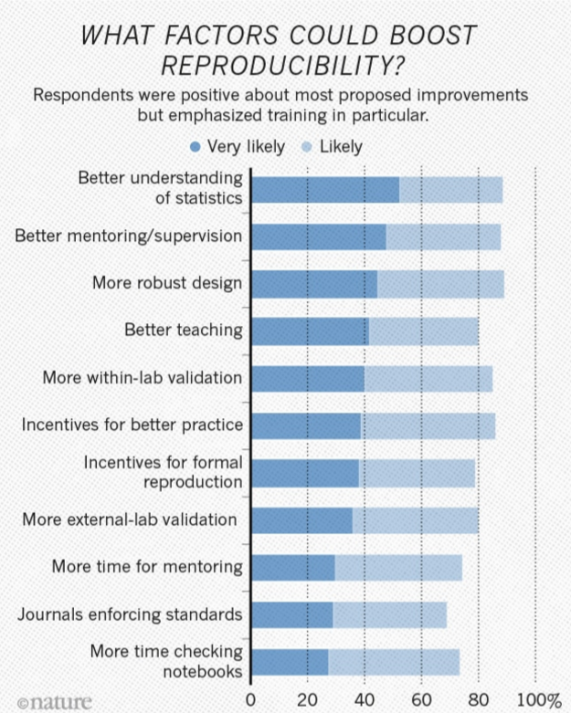


Slide 29
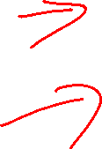
Cite original source.
Cite everything including figures (copywrite might not allow modifying figures – but even if modified, must still be referenced)
For more info:
http://www.biomedicalcomputationreview.org/7/2/9.pdf
ERROR! What biomedical computing can learn from its mistakes
BY KRISTIN SAINANI, PhD

Slide 30
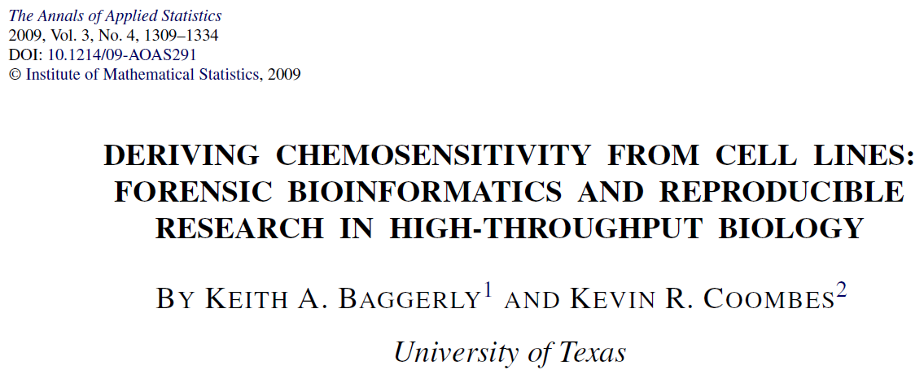
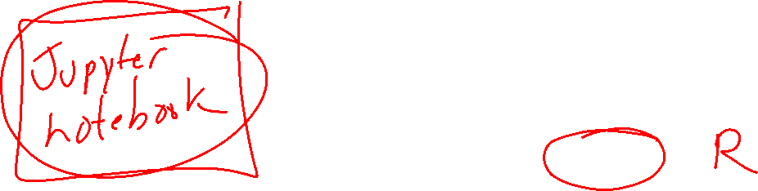
http://projecteuclid.org/download/pdfview_1/euclid.aoas/1267453942
We now require most of our reports to be written using Sweave [Leisch(2002)], a literate programming combination of LATEX source and R [R Development Core Team (2008)] code (SASweave and odfWeave are also available) so
that we can rerun the reports as needed and get the same results.
http://www.statistik.lmu.de/~leisch/Sweave/
help("Sweave", package="utils")
http://yihui.name/knitr/

Slide 31
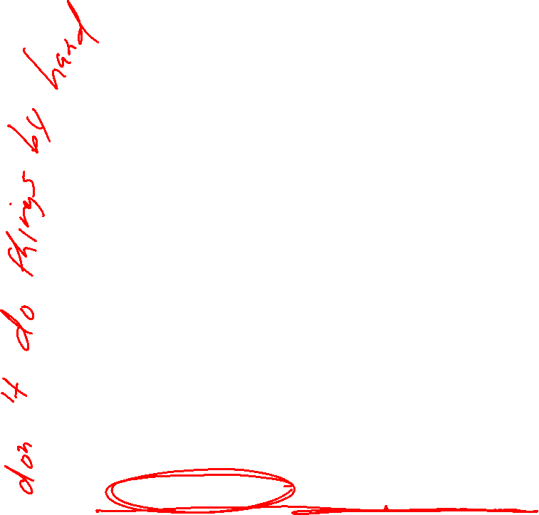
http://projecteuclid.org/download/pdfview_1/euclid.aoas/1267453942
High-throughput biological assays such as microarrays let us ask very detailed questions about how diseases operate, and promise to let us personalize therapy. Data processing, however, is often not described well enough to allow for exact reproduction of the results, leading to exercises in “forensic bioinformatics” where aspects of raw data and reported results are used to infer what methods must have been employed. Unfortunately, poor documentation can shift from an inconvenience to an active danger when it obscures not just methods but errors. In this report we examine several related papers purporting to use microarray-based signatures of drug sensitivity derived from cell lines to predict patient response. Patients in clinical trials are currently being allocated to treatment arms on the basis of these results. However, we show in five case studies that the results incorporate several simple errors that may be putting patients at risk. One theme that emerges is that the most common errors are simple (e.g., row or column offsets); conversely, it is our experience that the most simple errors are common. We then discuss steps we are taking to avoid such errors in our own investigations.

Slide 32
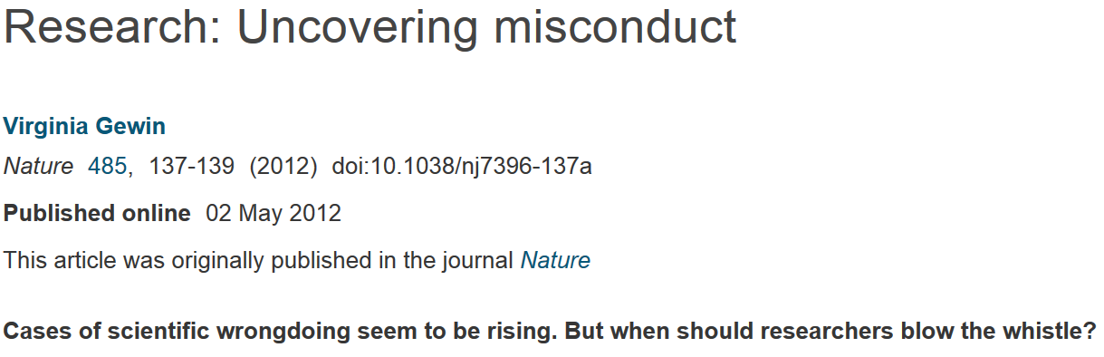


http://www.nature.com/naturejobs/science/articles/10.1038/nj7396-137a
http://journals.plos.org/plosone/article?id=10.1371/journal.pone.0005738
A pooled weighted average of 1.97% (N = 7, 95%CI: 0.86–4.45) of scientists admitted to have fabricated, falsified or modified data or results at least once –a serious form of misconduct by any standard– and up to 33.7% admitted other questionable research practices.

Slide 33

http://dana.org/Cerebrum/Default.aspx?id=39490

Slide 34


http://retractionwatch.com/?s=clare+francis

Slide 35

“The fact is almost all big data sets, generated by systems powered by ML/AI based models, are known to be biased.”
https://towardsdatascience.com/survey-d4f168791e57

Slide 36


https://towardsdatascience.com/survey-d4f168791e57

Slide 37




https://science.sciencemag.org/content/366/6464/447.full
https://ils.fd.org/sites/ils.fd.org/files/uploaded_files/cja_resources/training/13.Racial%20Bias%20in%20Criminal%20Risk%20Scores.pdf

Slide 38


https://www.ajl.org/about
THE INSPIRATION FOR THE ALGORITHMIC JUSTICE LEAGUE
Joy Buolamwini, Founder of the Algorithmic Justice League, came face to face with discrimination. From a machine. It may sound like a scene from a sci-fi movie, but it carries meaningful real-world consequences.
While working on an engineering project, a facial analysis software struggled to detect Joy’s face. She knew this was more than a technical blunder, but rather than surrender, she responded with curiosity. Her MIT peers with lighter skin color didn’t have the same issues, so Joy tried drawing a face on the palm of her hand. The machine recognized it immediately. Still, no luck with her real face, so she had to finish her project coding with a white mask over her face in order to be detected. Many questions surfaced giving Joy the motivation and insights to start the Algorithmic Justice League

Slide 39


https://www.ajl.org/library/home

Slide 40

https://research.fb.com/fellowship/

Slide 41



Overfitting

Slide 42


https://towardsdatascience.com/complete-guide-to-pythons-cross-validation-with-examples-a9676b5cac12

Slide 43


https://towardsdatascience.com/complete-guide-to-pythons-cross-validation-with-examples-a9676b5cac12

Slide 44


https://towardsdatascience.com/complete-guide-to-pythons-cross-validation-with-examples-a9676b5cac12

Slide 45


https://towardsdatascience.com/complete-guide-to-pythons-cross-validation-with-examples-a9676b5cac12

Slide 46

https://towardsdatascience.com/complete-guide-to-pythons-cross-validation-with-examples-a9676b5cac12

Slide 47



https://towardsdatascience.com/complete-guide-to-pythons-cross-validation-with-examples-a9676b5cac12

Slide 48

https://towardsdatascience.com/complete-guide-to-pythons-cross-validation-with-examples-a9676b5cac12

Slide 49

https://towardsdatascience.com/complete-guide-to-pythons-cross-validation-with-examples-a9676b5cac12

Slide 50


https://towardsdatascience.com/complete-guide-to-pythons-cross-validation-with-examples-a9676b5cac12

Slide 51


https://towardsdatascience.com/validating-your-machine-learning-model-25b4c8643fb7

Slide 52

https://nlp.stanford.edu/~manning/courses/ling236/handouts/whitehead-logistic-regression.ppt

Slide 53
The Logistic Regression Model
The "logit" model solves these problems:
ln[p/(1-p)] = α + βX + e
p is the probability that the event Y occurs, p(Y=1)
p/(1-p) is the "odds ratio"
ln[p/(1-p)] is the log odds ratio, or "logit"
https://nlp.stanford.edu/~manning/courses/ling236/handouts/whitehead-logistic-regression.ppt

Slide 54
Probability and Odds
On coin flip, p(H) = ½
On 2 dice roll, p(7) = 6/36 =1/6
https://jmg1.psychology.msstate.edu/8803/logisticReg09.ppt

Slide 55
Odds
On coin flip, Odds(H) = 1/1
Odds are 1 to 1 that your coin flip will be “heads”
On 2 dice roll, Odds(7) = 6/(30) = 1/5
Odds(7) = p(7)/[1 - p(7)] = 1/6 / 5/6 = 1/5
Odds are “1 to 5” that you will roll “seven”
https://jmg1.psychology.msstate.edu/8803/logisticReg09.ppt

Slide 56
Problems with Odds
Asymmetry
  Possible range from 0 to “very large”
    With 1 indicating no difference
Due to asymmetry
  The same odds in opposite direction may appear different
  Odds of 5.0 (5 to 1) of losing are the same as odds of .2 of winning (1 to 5)
https://jmg1.psychology.msstate.edu/8803/logisticReg09.ppt

Slide 57
More:
The logistic distribution constrains the estimated probabilities to lie between 0 and 1.
The estimated probability is:
p = 1/[1 + exp(-α - β X)]
if you let α + β X =0, then p = .50
as α + β X gets really big, p approaches 1
as α + β X gets really small, p approaches 0
https://nlp.stanford.edu/~manning/courses/ling236/handouts/whitehead-logistic-regression.ppt

Slide 58

More Visualizations and Formulas
https://jmg1.psychology.msstate.edu/8803/logisticReg09.ppt

Slide 59

https://jmg1.psychology.msstate.edu/8803/logisticReg09.ppt

Slide 60

https://jmg1.psychology.msstate.edu/8803/logisticReg09.ppt

Slide 61

https://jmg1.psychology.msstate.edu/8803/logisticReg09.ppt

Slide 62

Supervised Learning: Use labeled data to predict unlabeled data.
2 types of supervised learning:
Regression: Predict continuous values.
    Ex: Linear regression.
F(x_{new}) = b₀ + b₁x_{new}
2. Classification: Predict discrete values.
    Ex: Logistic regression
https://en.wikipedia.org/wiki/Linear_regression

Slide 63
https://nlp.stanford.edu/~manning/courses/ling236/handouts/whitehead-logistic-regression.ppt

Slide 64

https://nbviewer.jupyter.org/github/donnemartin/data-science-ipython-notebooks/blob/master/scikit-learn/scikit-learn-intro.ipynb

