Slide 1









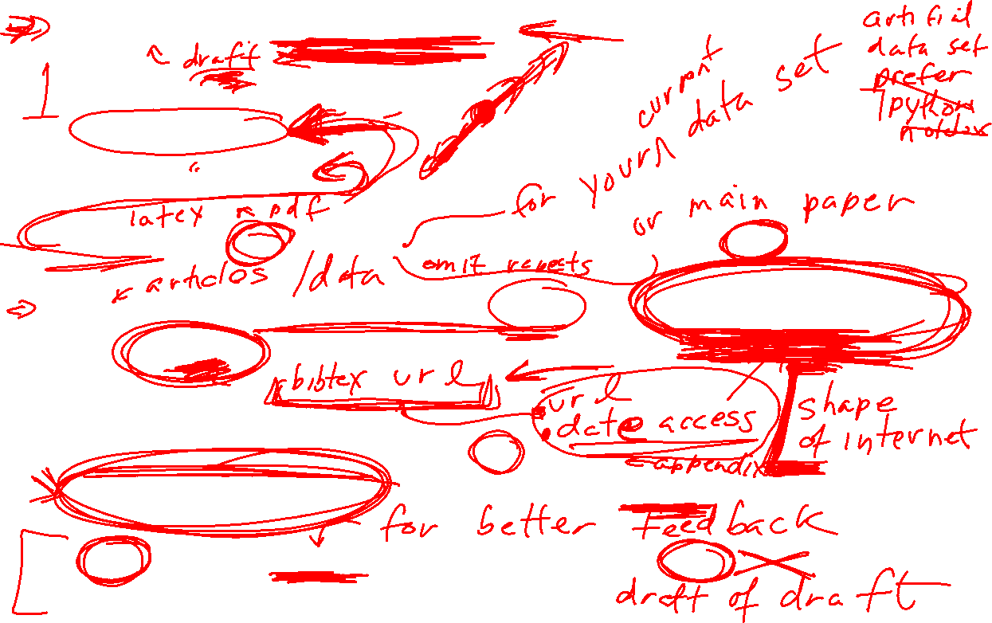

Written project (due: Saturday May 15)
Approximately 10 pages
  3-4 page paper
  6-7 page appendix
Appendix: Put ALL your labs into your appendix. Add a few comments.
References: You should reference the labs plus the ORIGINAL SOURCE; but you can omit these references if you prefer.
Figures:
  Axis should be labeled. Figures can be titled.
  Detailed figure captions are required for the main part of the paper.
You may submit an updated Module 6 HW 2: Project draft early this Saturday May 8 morning.

Slide 2
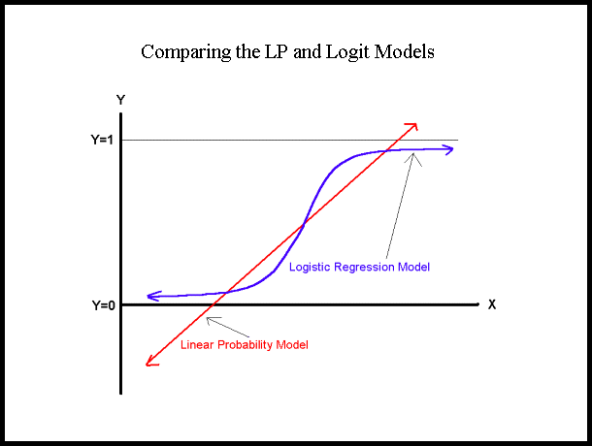
https://nlp.stanford.edu/~manning/courses/ling236/handouts/whitehead-logistic-regression.ppt

Slide 3
The Logistic Regression Model
The "logit" model solves these problems:
ln[p/(1-p)] = α + βX + e
p is the probability that the event Y occurs, p(Y=1)
p/(1-p) is the "odds ratio"
ln[p/(1-p)] is the log odds ratio, or "logit"
https://nlp.stanford.edu/~manning/courses/ling236/handouts/whitehead-logistic-regression.ppt

Slide 4
Probability and Odds
On coin flip, p(H) = ½
On 2 dice roll, p(7) = 6/36 =1/6
https://jmg1.psychology.msstate.edu/8803/logisticReg09.ppt

Slide 5
Odds
On coin flip, Odds(H) = 1/1
Odds are 1 to 1 that your coin flip will be “heads”
On 2 dice roll, Odds(7) = 6/(30) = 1/5
Odds(7) = p(7)/[1 - p(7)] = 1/6 / 5/6 = 1/5
Odds are “1 to 5” that you will roll “seven”
https://jmg1.psychology.msstate.edu/8803/logisticReg09.ppt

Slide 6
Problems with Odds
Asymmetry
  Possible range from 0 to “very large”
    With 1 indicating no difference
Due to asymmetry
  The same odds in opposite direction may appear different
  Odds of 5.0 (5 to 1) of losing are the same as odds of .2 of winning (1 to 5)
https://jmg1.psychology.msstate.edu/8803/logisticReg09.ppt

Slide 7
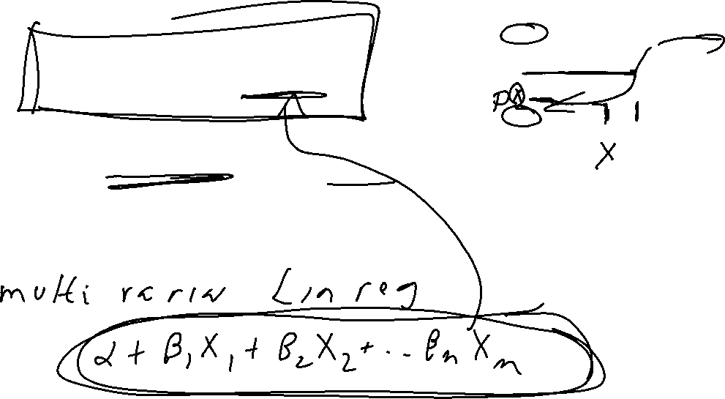
More:
The logistic distribution constrains the estimated probabilities to lie between 0 and 1.
The estimated probability is:
p = 1/[1 + exp(-α - β X)]
if you let α + β X =0, then p = .50
as α + β X gets really big, p approaches 1
as α + β X gets really small, p approaches 0
https://nlp.stanford.edu/~manning/courses/ling236/handouts/whitehead-logistic-regression.ppt

Slide 8
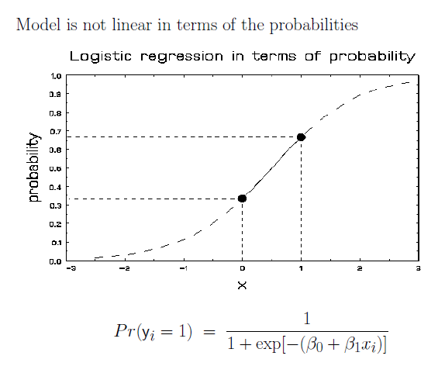
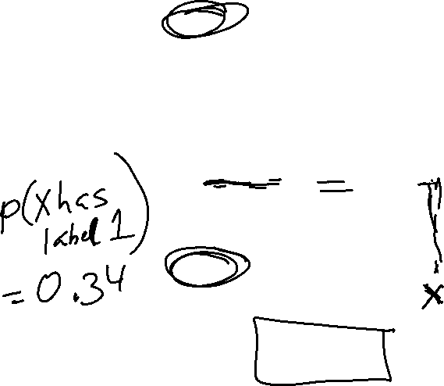
More Visualizations and Formulas
https://jmg1.psychology.msstate.edu/8803/logisticReg09.ppt

Slide 9
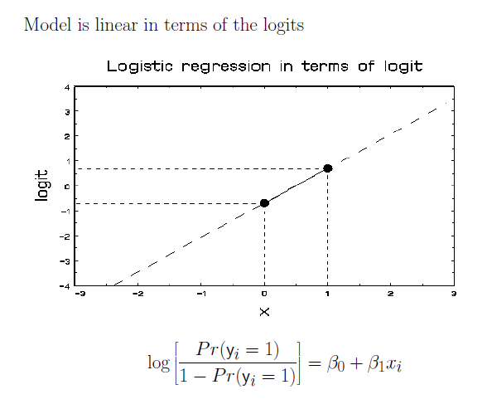
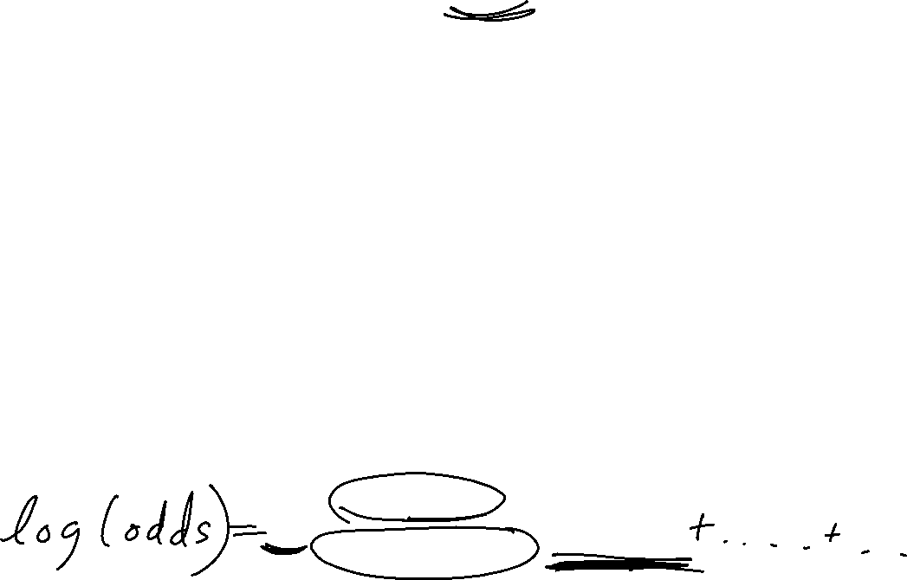
https://jmg1.psychology.msstate.edu/8803/logisticReg09.ppt

Slide 10
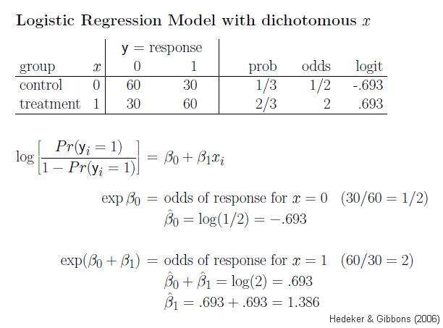
https://jmg1.psychology.msstate.edu/8803/logisticReg09.ppt

Slide 11
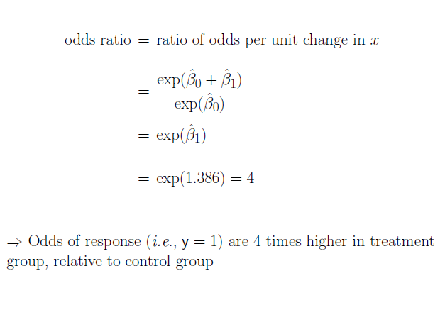
https://jmg1.psychology.msstate.edu/8803/logisticReg09.ppt

Slide 12
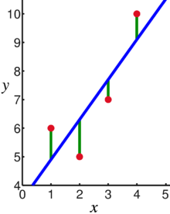
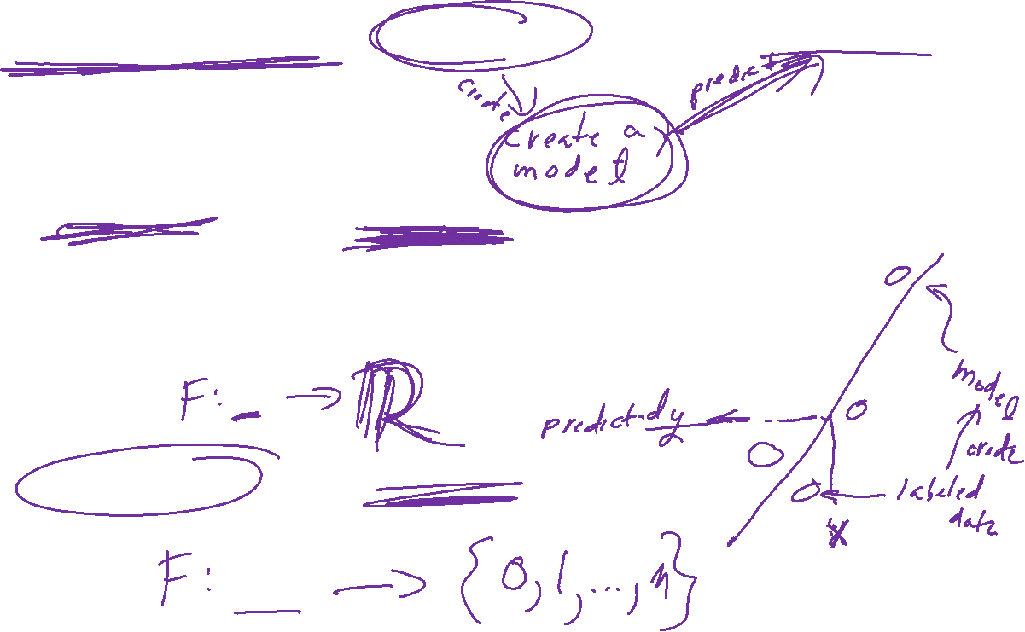
Supervised Learning: Use labeled data to predict unlabeled data.
2 types of supervised learning:
Regression: Predict continuous values.
    Ex: Linear regression.
F(x_{new}) = b₀ + b₁x_{new}
2. Classification: Predict discrete values.
    Ex: Logistic regression
https://en.wikipedia.org/wiki/Linear_regression

Slide 13
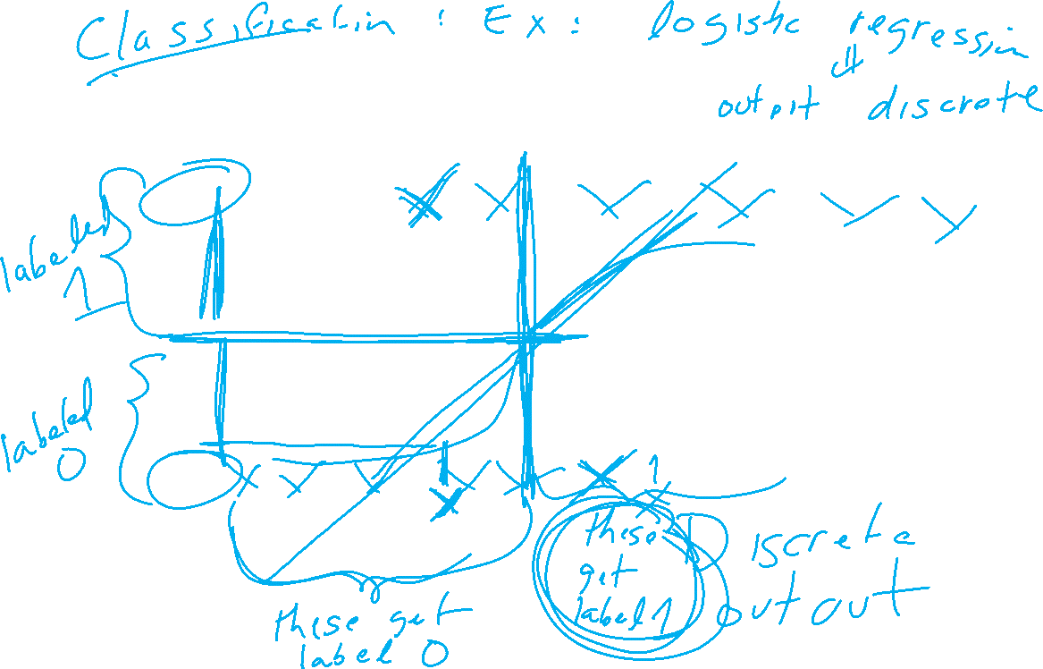
https://nlp.stanford.edu/~manning/courses/ling236/handouts/whitehead-logistic-regression.ppt

Slide 14
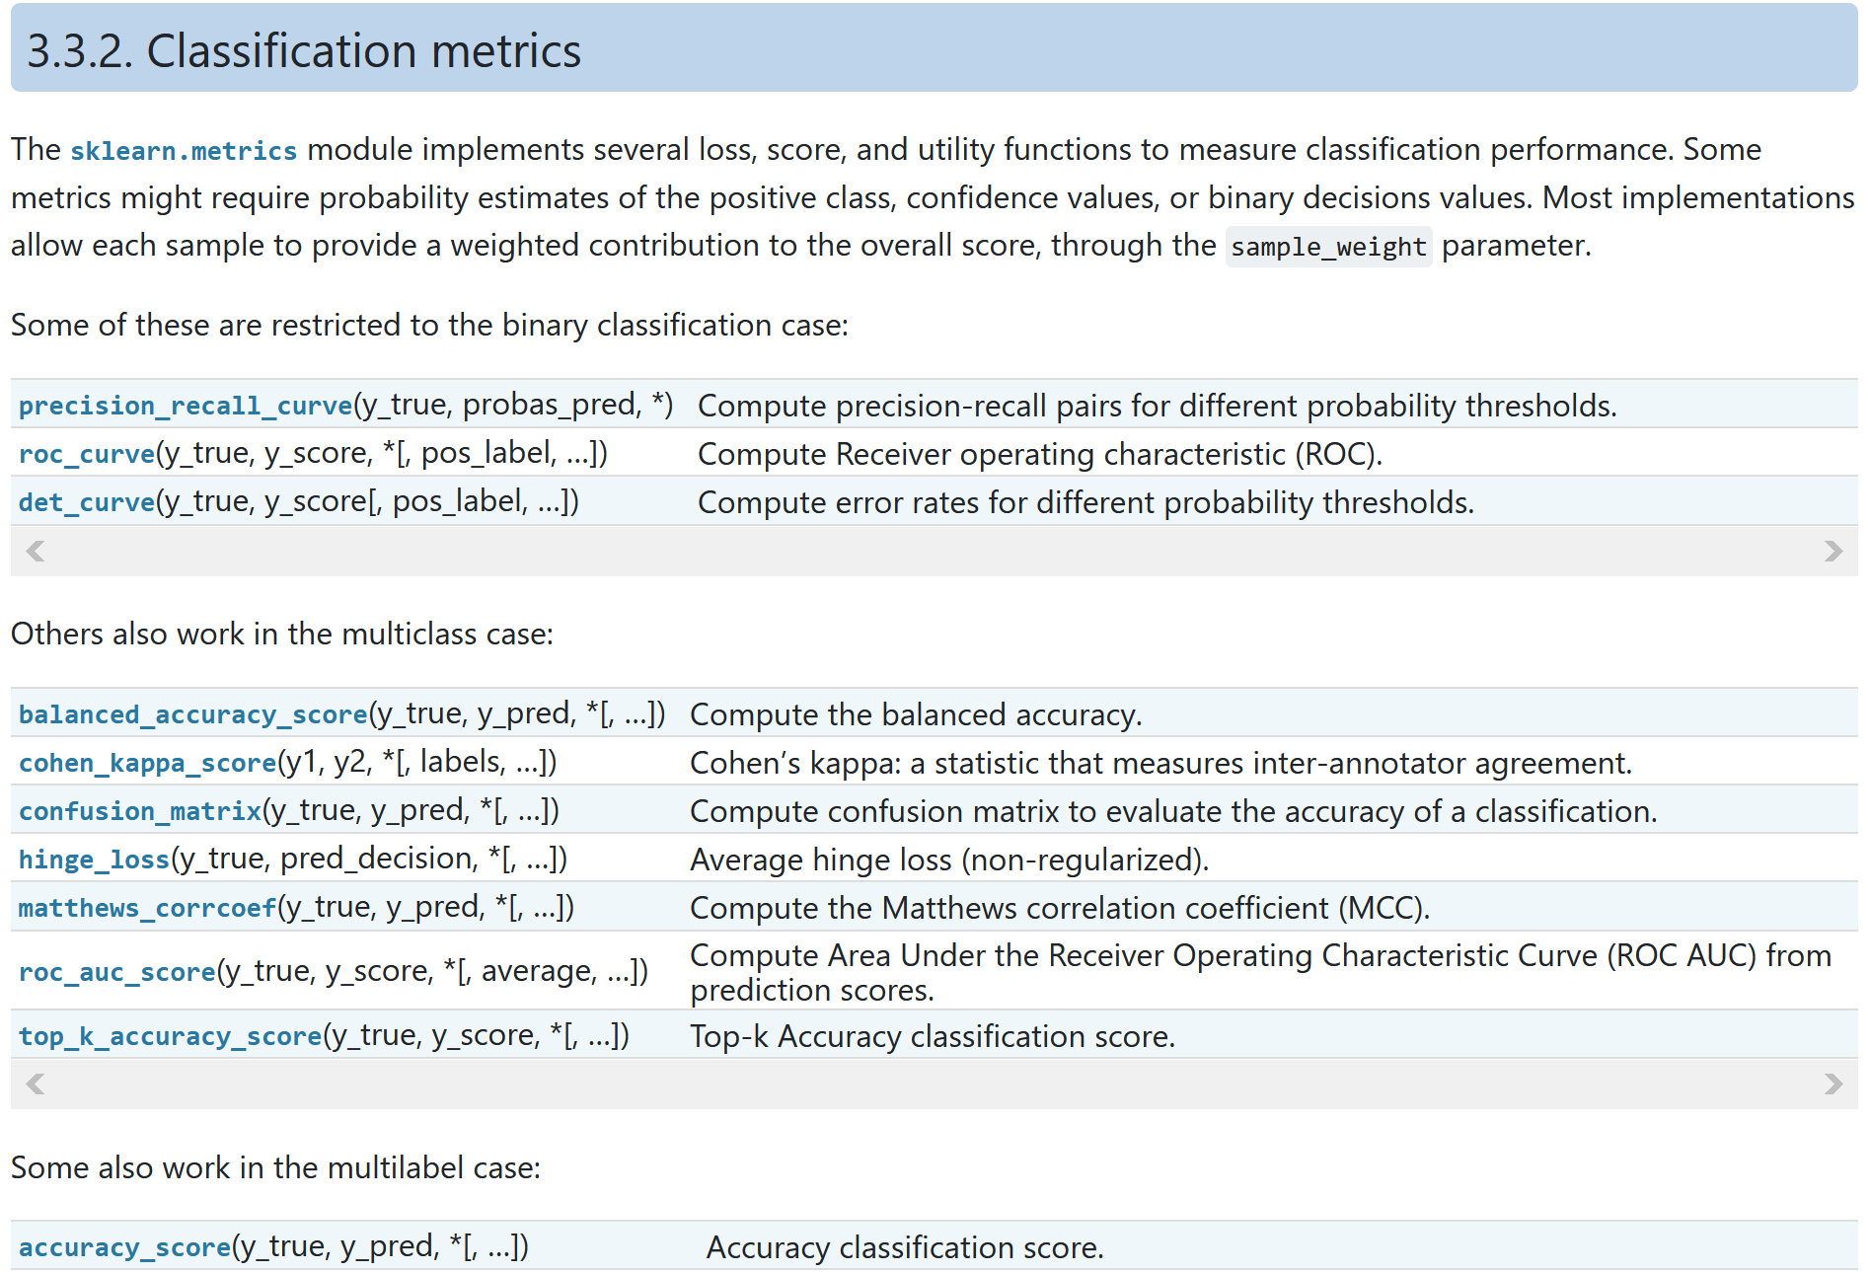

https://scikit-learn.org/stable/modules/model_evaluation.html#classification-metrics

Slide 15
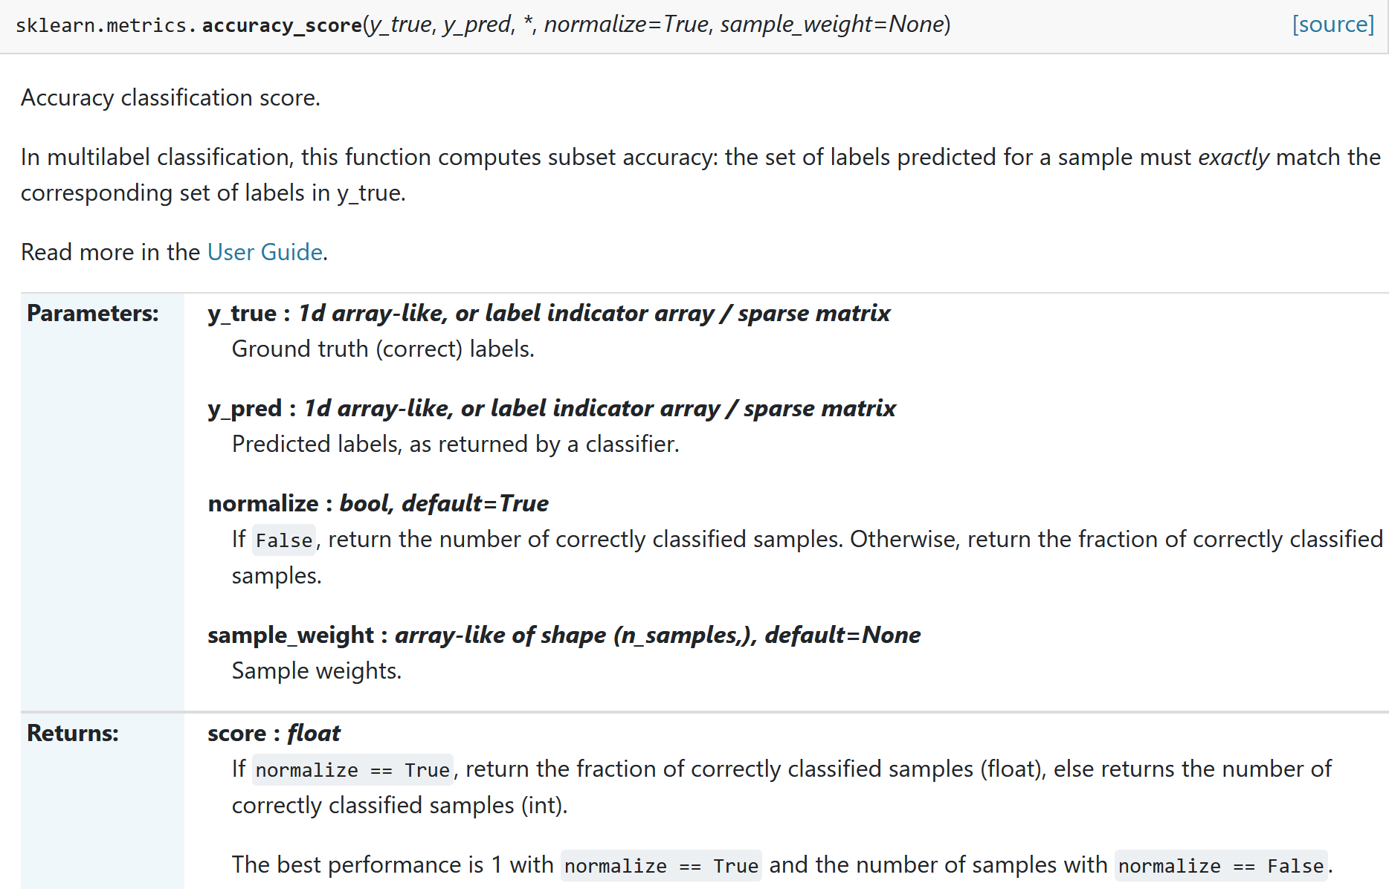
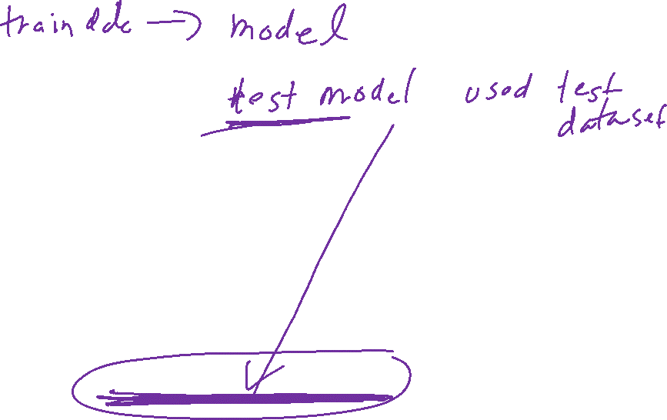

Slide 16
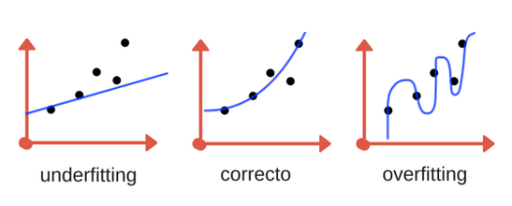
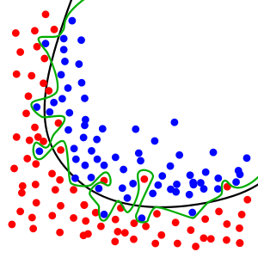
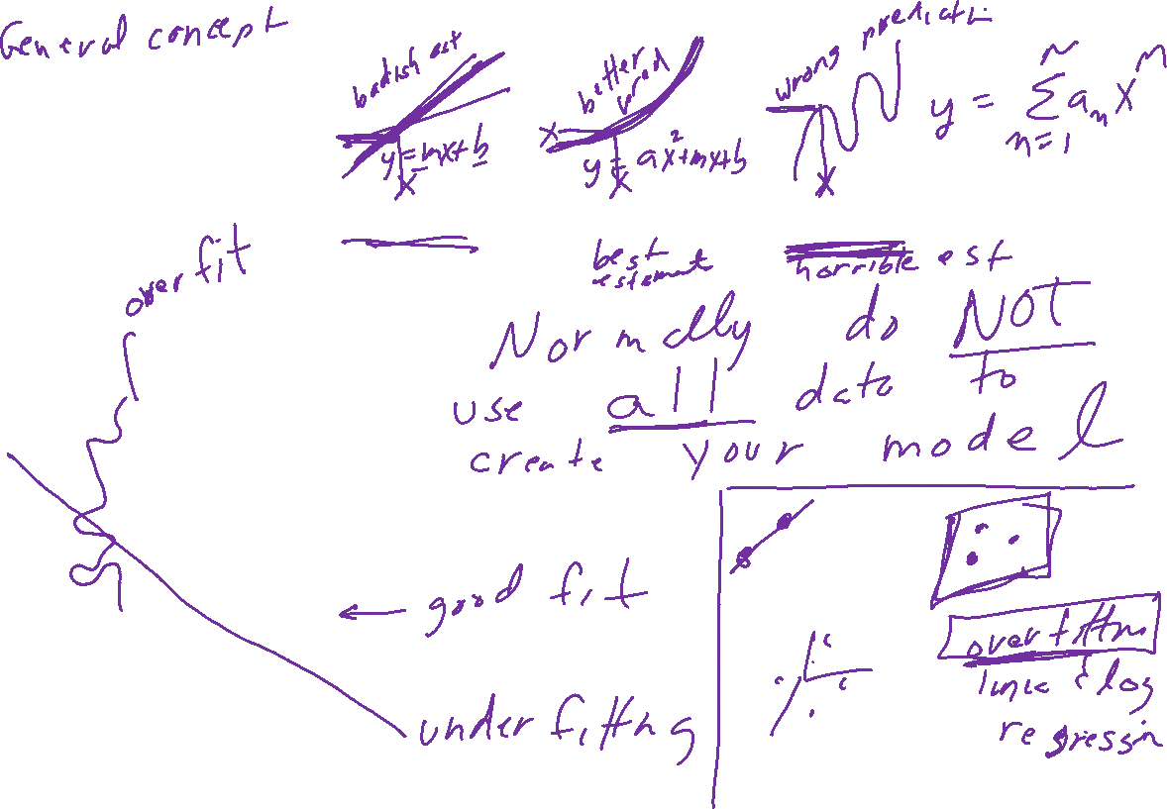
Overfitting

Slide 17
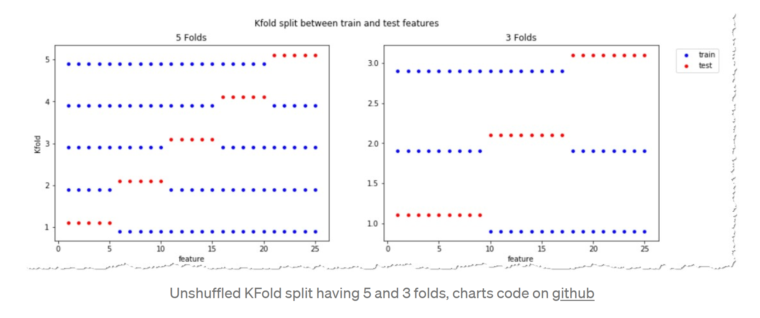
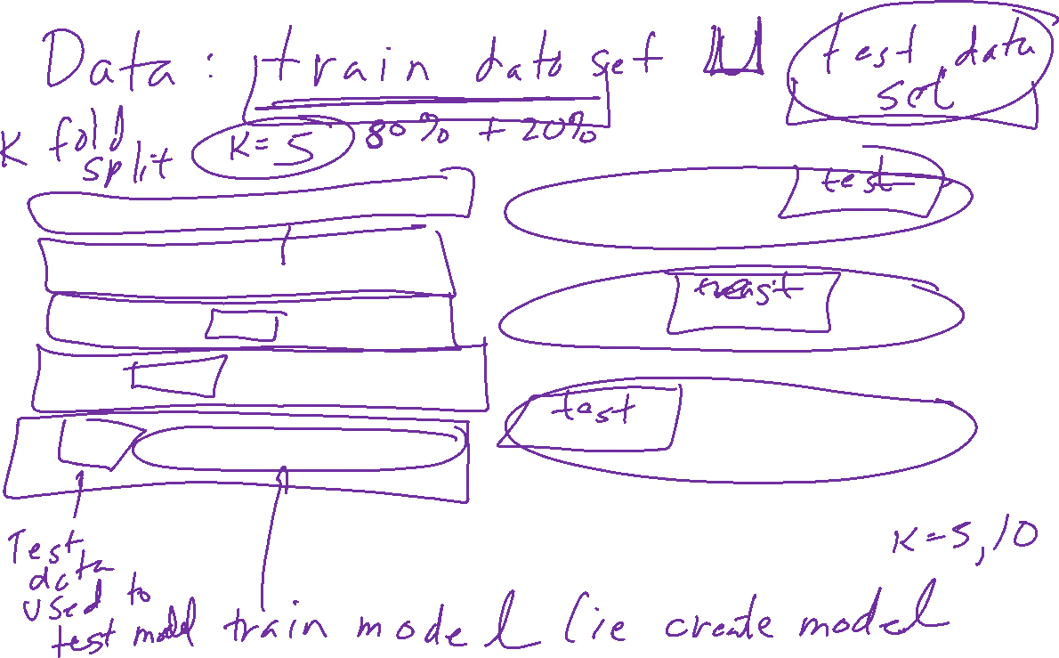
https://towardsdatascience.com/complete-guide-to-pythons-cross-validation-with-examples-a9676b5cac12

Slide 18
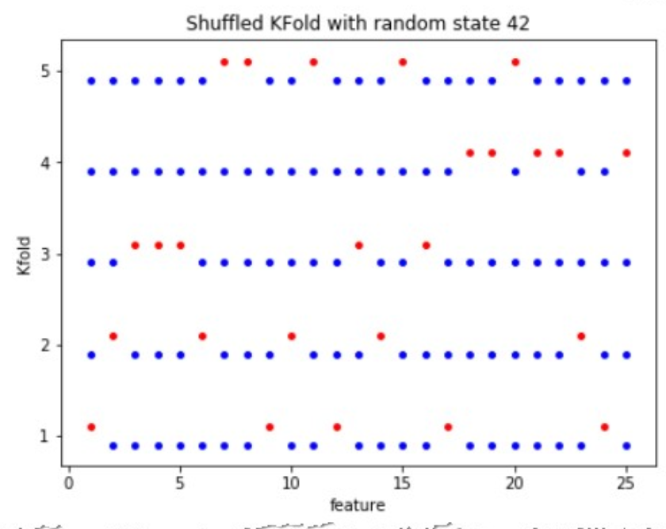
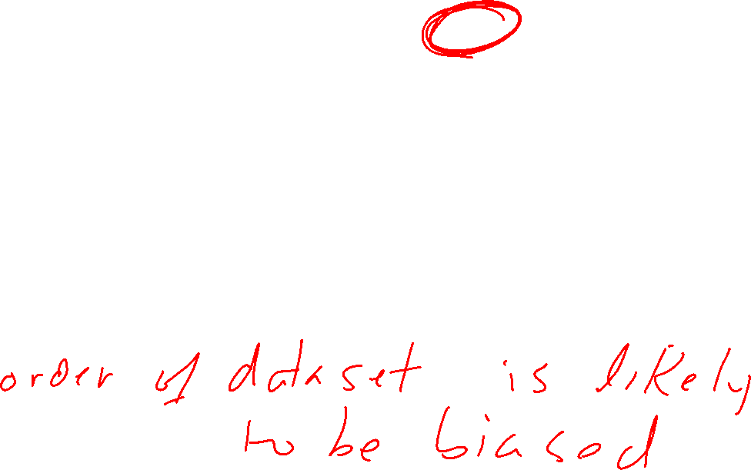
https://towardsdatascience.com/complete-guide-to-pythons-cross-validation-with-examples-a9676b5cac12

Slide 19
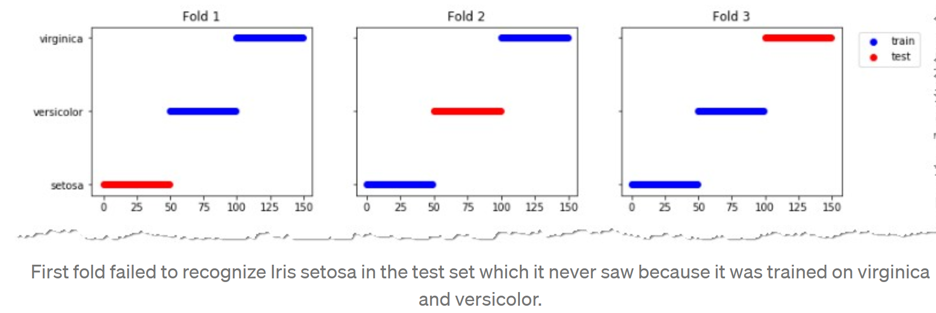
https://towardsdatascience.com/complete-guide-to-pythons-cross-validation-with-examples-a9676b5cac12

Slide 20
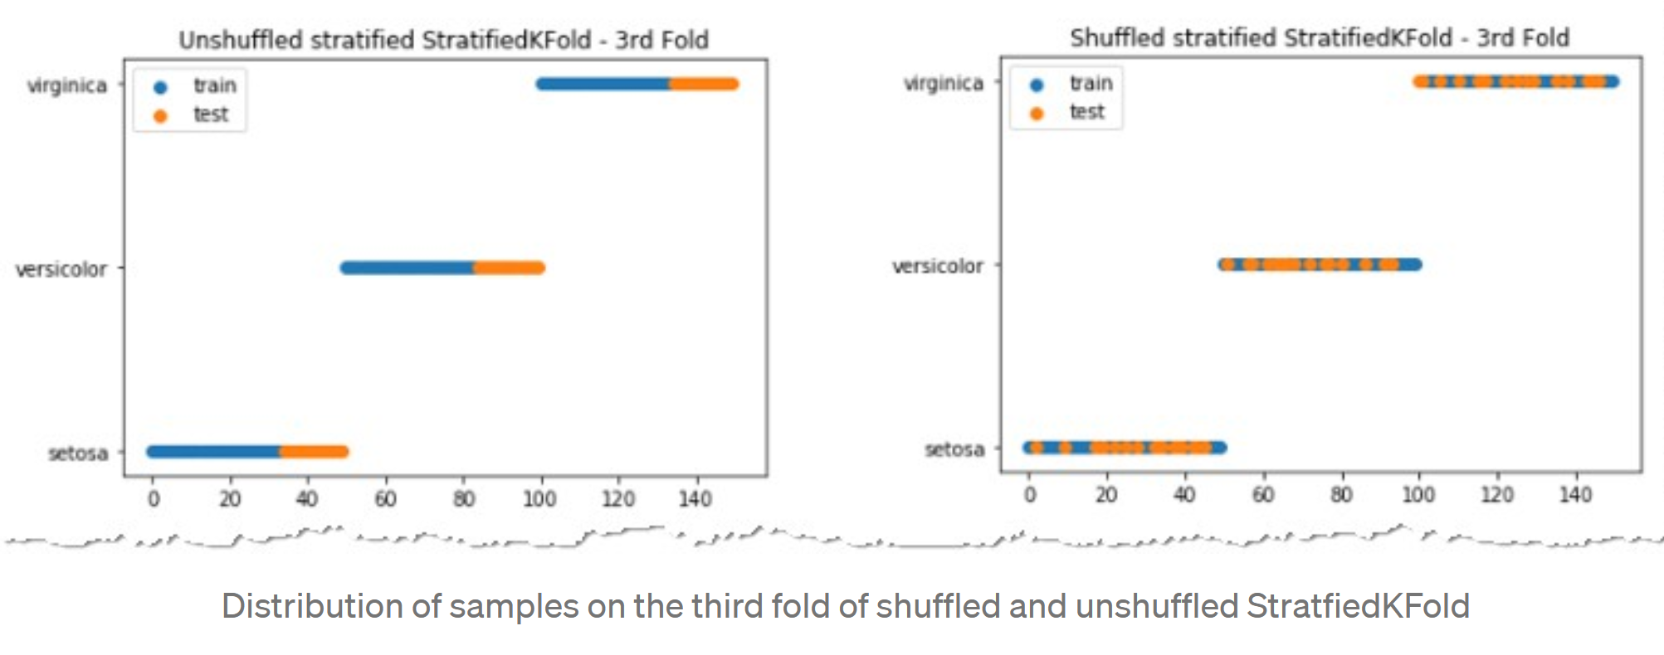
https://towardsdatascience.com/complete-guide-to-pythons-cross-validation-with-examples-a9676b5cac12

Slide 21
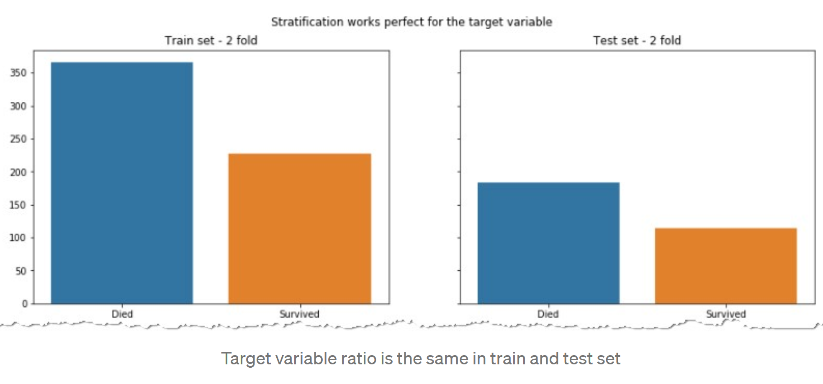
https://towardsdatascience.com/complete-guide-to-pythons-cross-validation-with-examples-a9676b5cac12

Slide 22
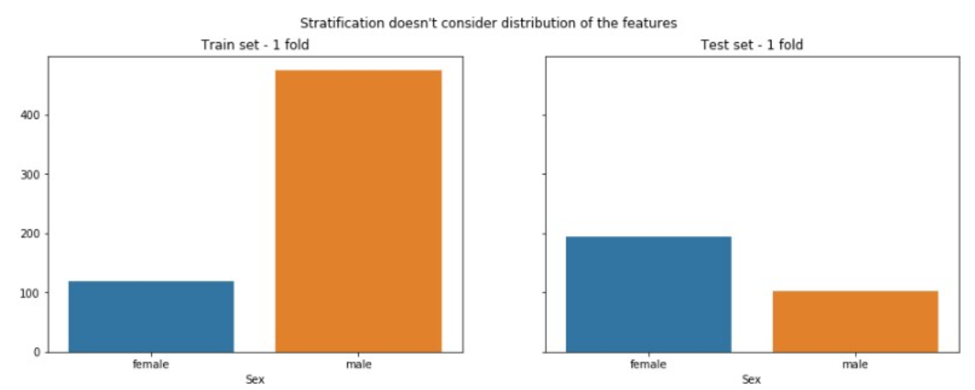
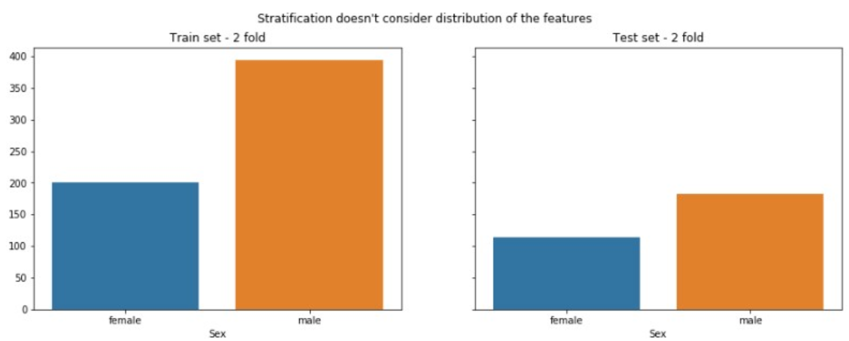
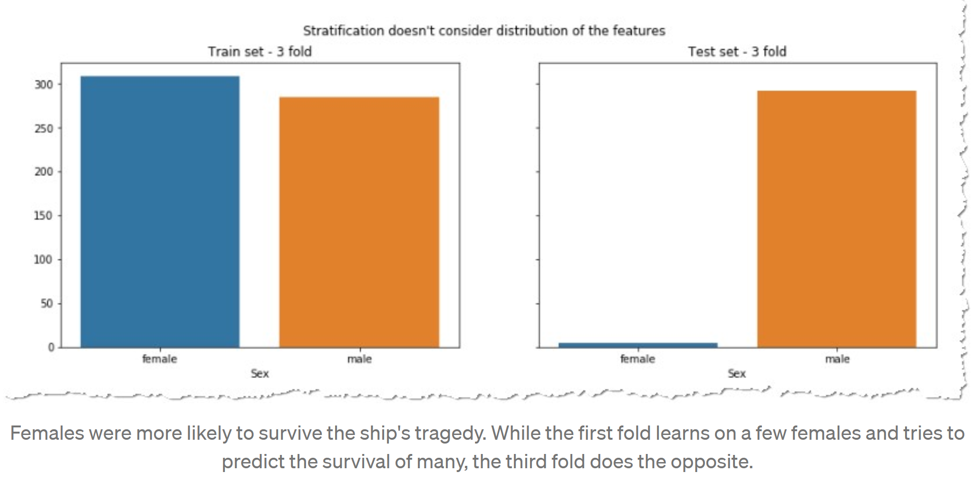
https://towardsdatascience.com/complete-guide-to-pythons-cross-validation-with-examples-a9676b5cac12

Slide 23
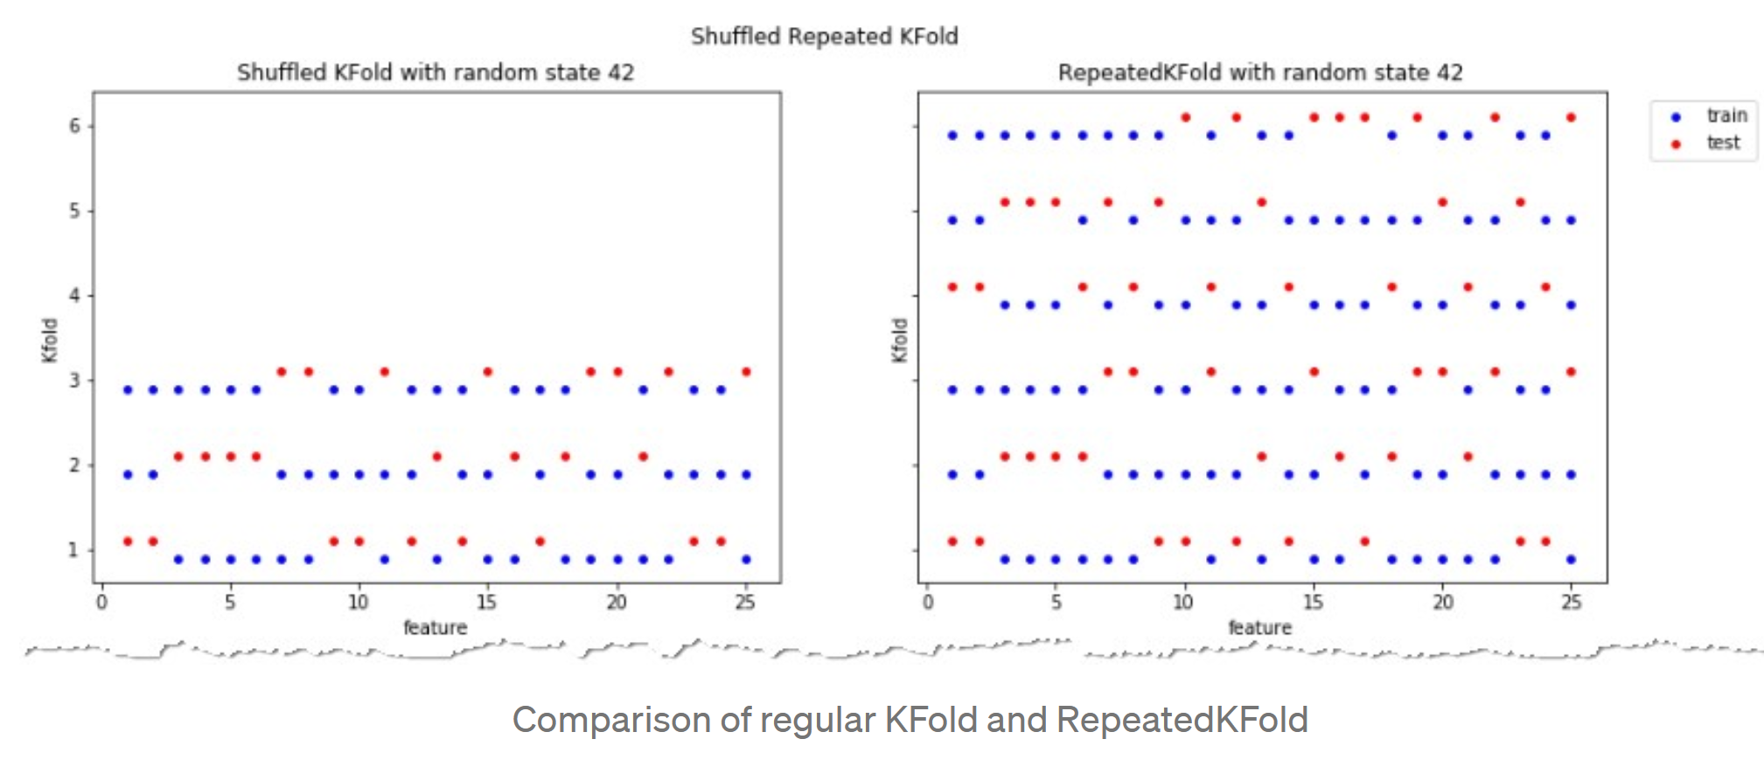
https://towardsdatascience.com/complete-guide-to-pythons-cross-validation-with-examples-a9676b5cac12

Slide 24
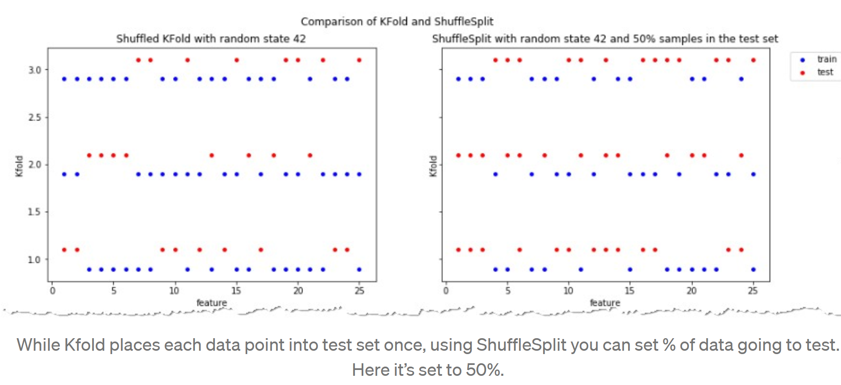
https://towardsdatascience.com/complete-guide-to-pythons-cross-validation-with-examples-a9676b5cac12

Slide 25
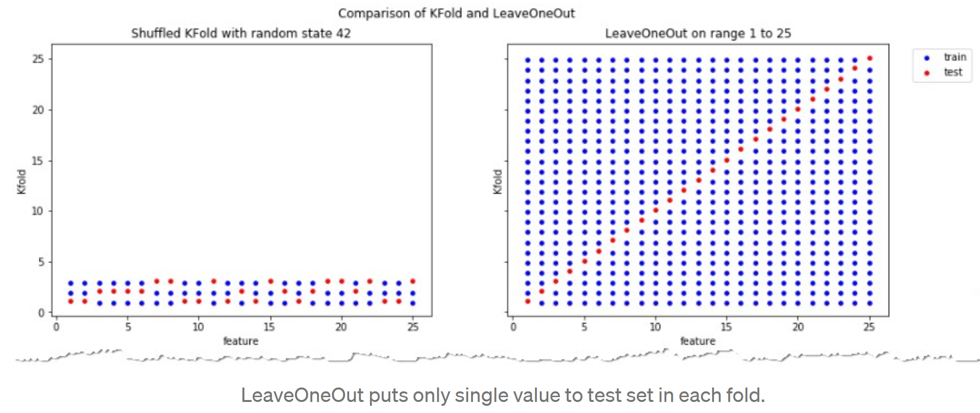
https://towardsdatascience.com/complete-guide-to-pythons-cross-validation-with-examples-a9676b5cac12

Slide 26
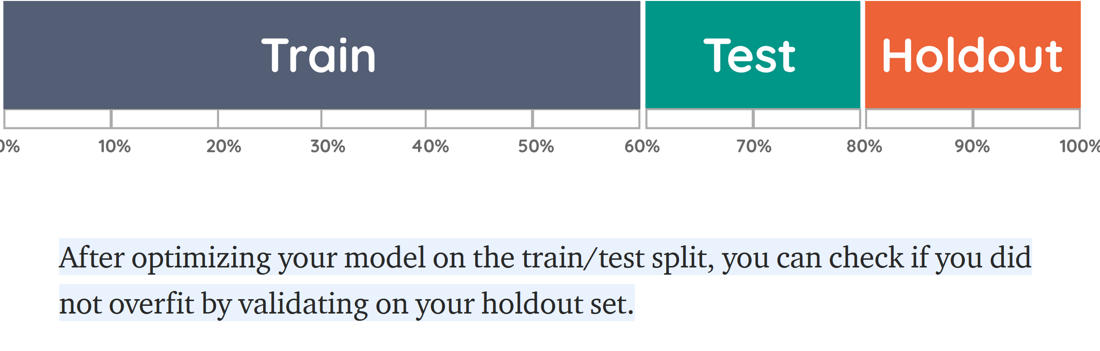
https://towardsdatascience.com/validating-your-machine-learning-model-25b4c8643fb7

