Slide 1
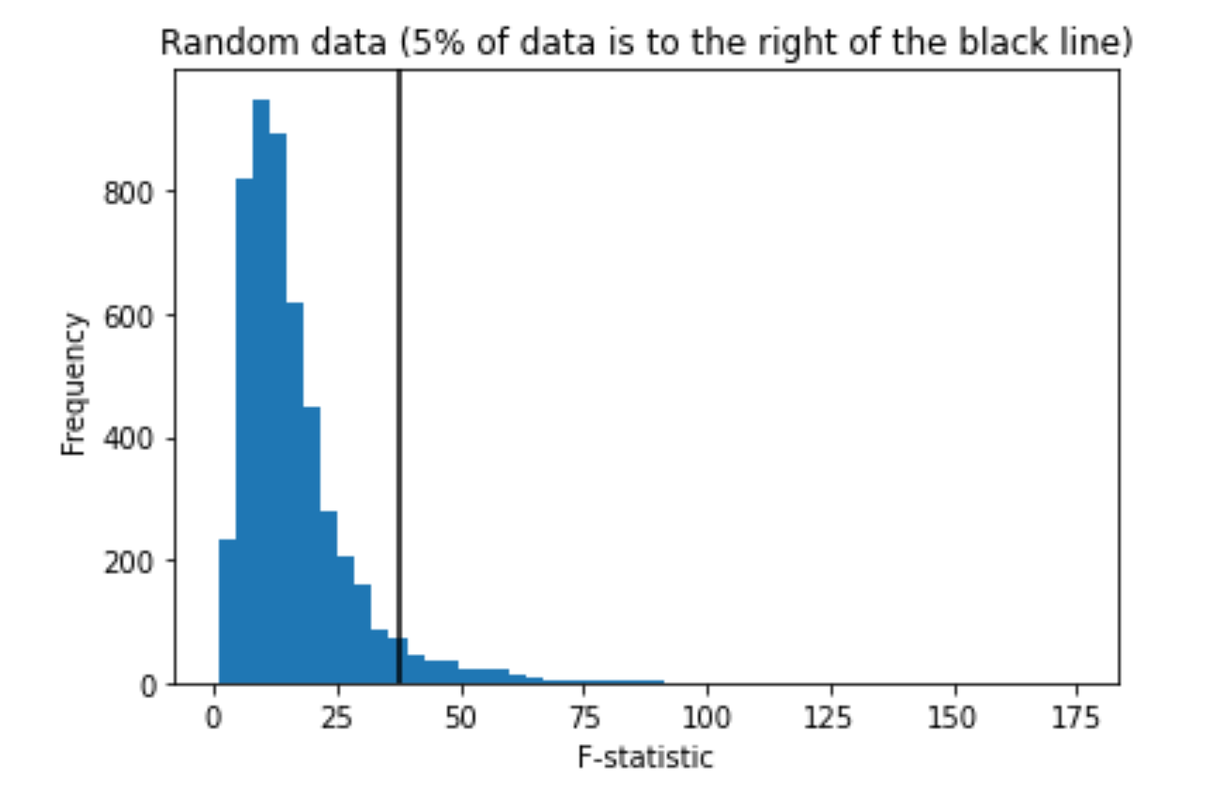
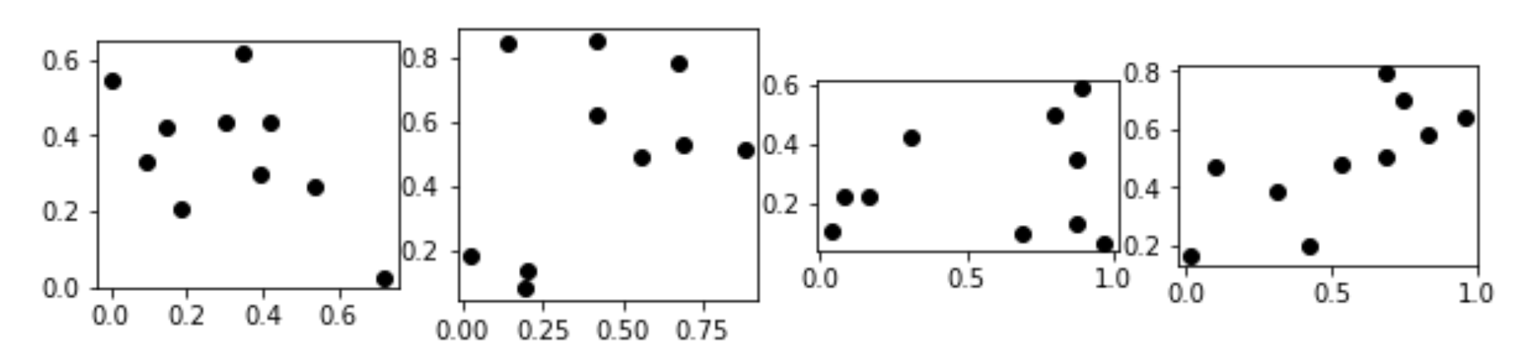
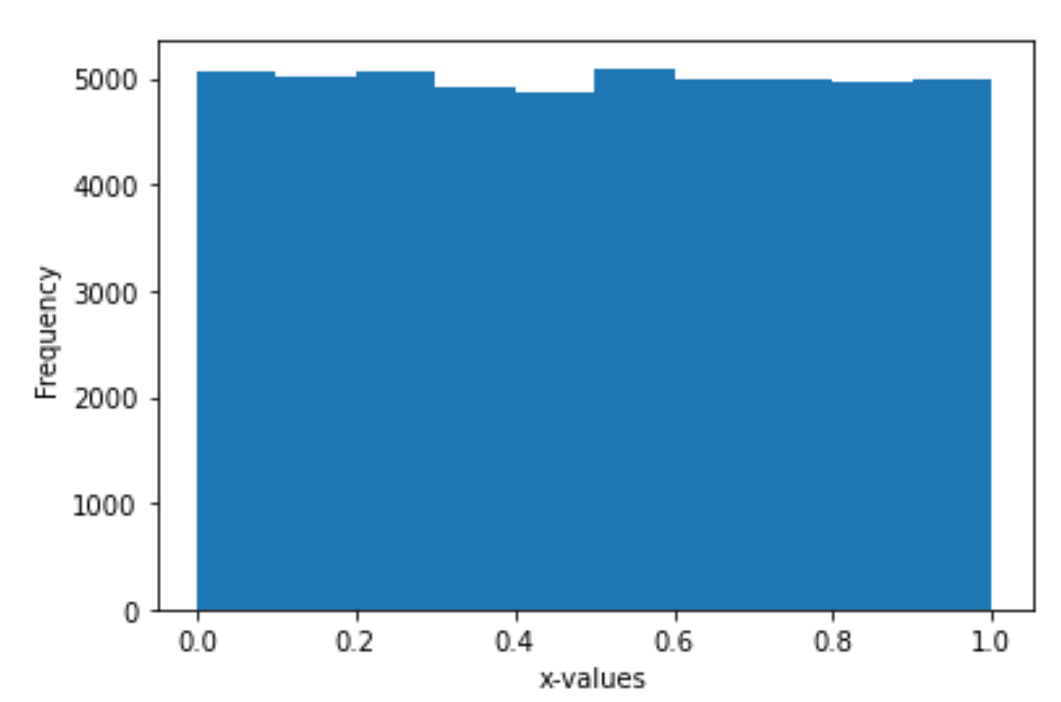
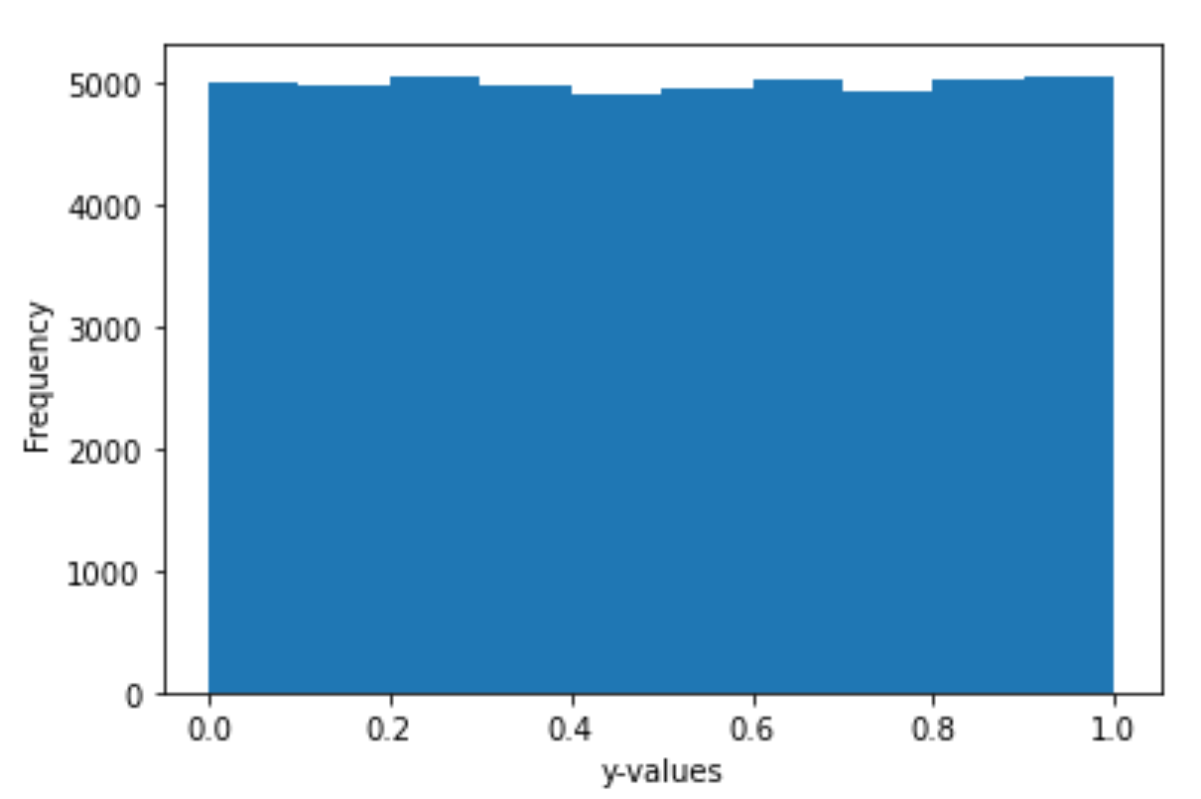
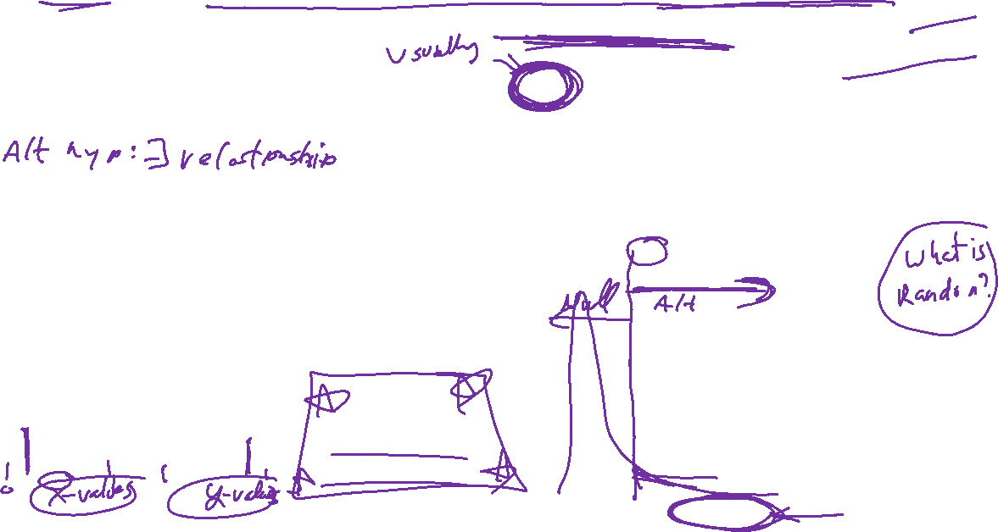
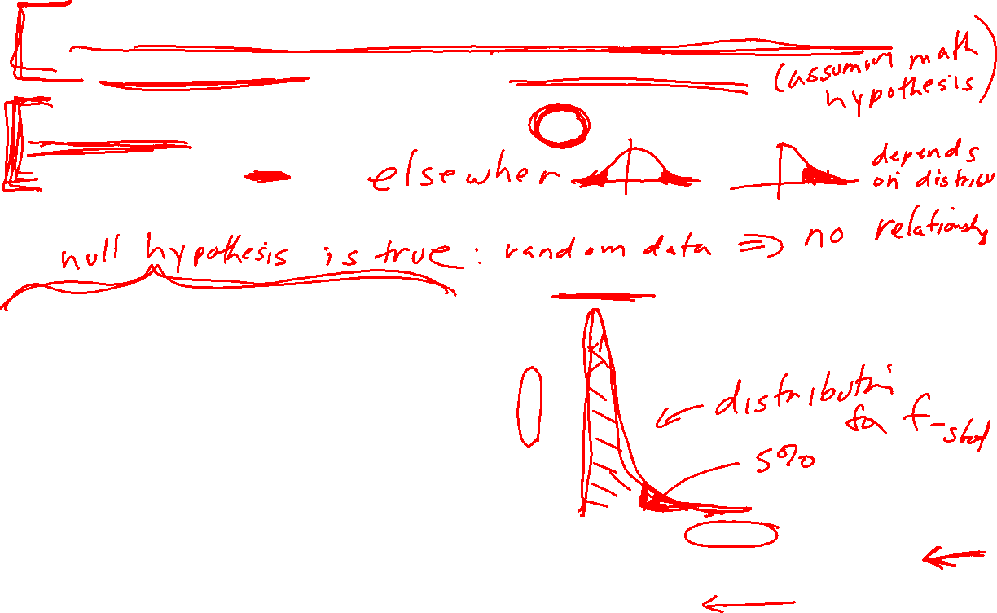
The P value is the probability of obtaining a test statistic at least as extreme as the one that was actually observed, assuming that the null hypothesis is true.
Null hypothesis: the probability that there is no relationship between x and y (i.e. the relationship is null)
The “magic p-value” is sometimes thought to be 0.05 = 5%
x and y generated independently.
Statistical Literacy of Obstetrics-Gynecology Residents
https://meridian.allenpress.com/jgme/article/5/2/272/200601/Statistical-Literacy-of-Obstetrics-Gynecology (2013)
Helping Doctors and Patients Make Sense of Health Statistics
https://journals.sagepub.com/doi/10.1111/j.1539-6053.2008.00033.x?url_ver=Z39.88-2003&rfr_id=ori%3Arid%3Acrossref.org&rfr_dat=cr_pub++0pubmed& (2007)

Slide 2
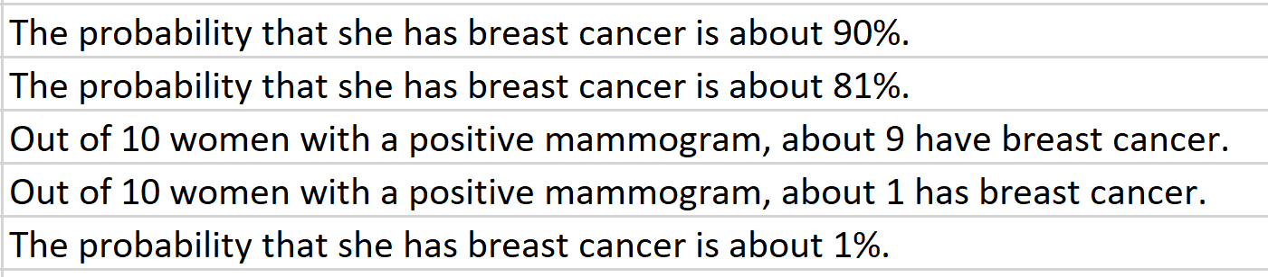
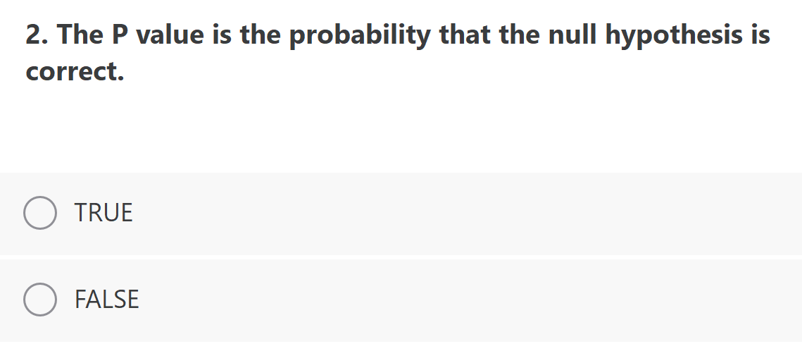
Using old inaccurate statistics: Ten out of every 1,000 women have breast cancer. Of these 10 women with breast cancer, 9 test positive. Of the 990 women without cancer, about 89 nevertheless test positive. A woman tests positive and wants to know whether she has breast cancer for sure, or at least what the chances are. What is the best answer?

Slide 3
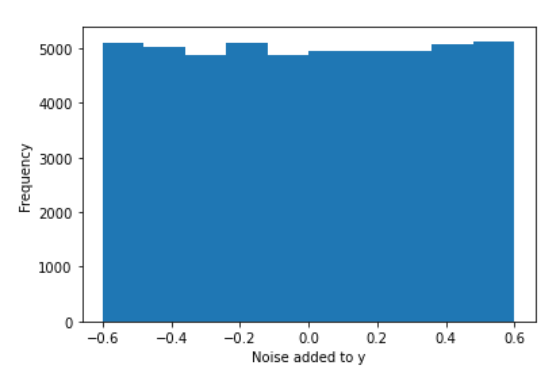
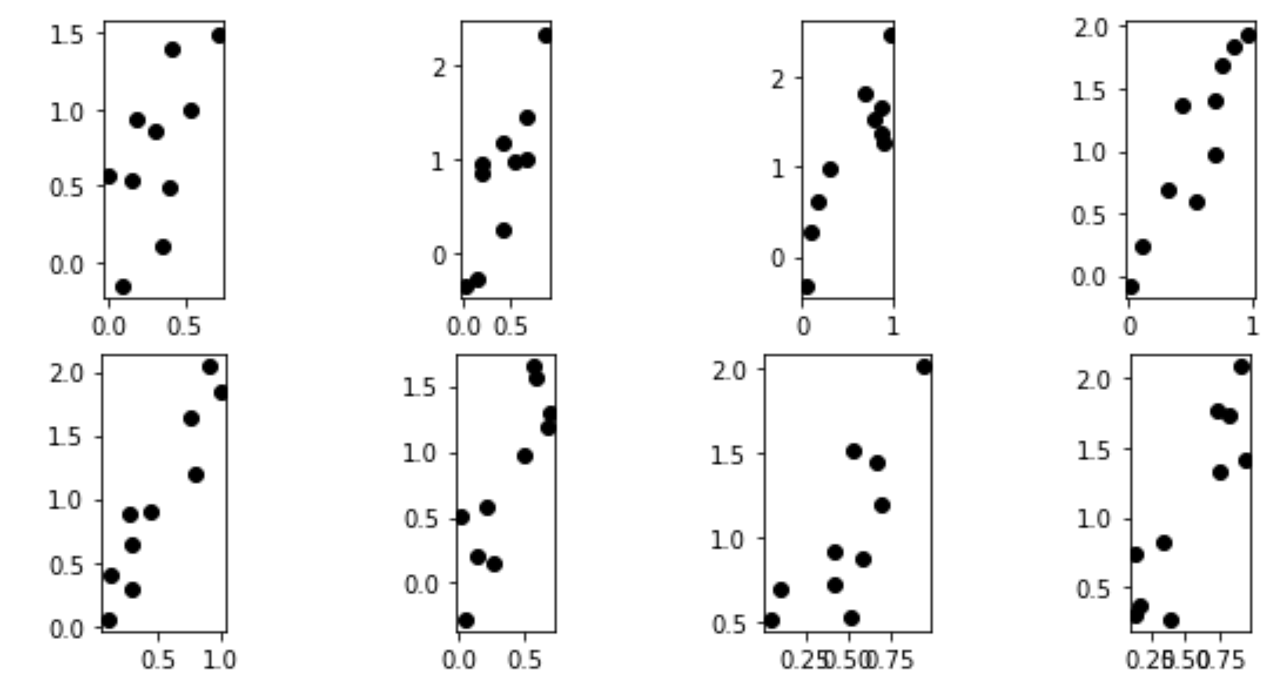
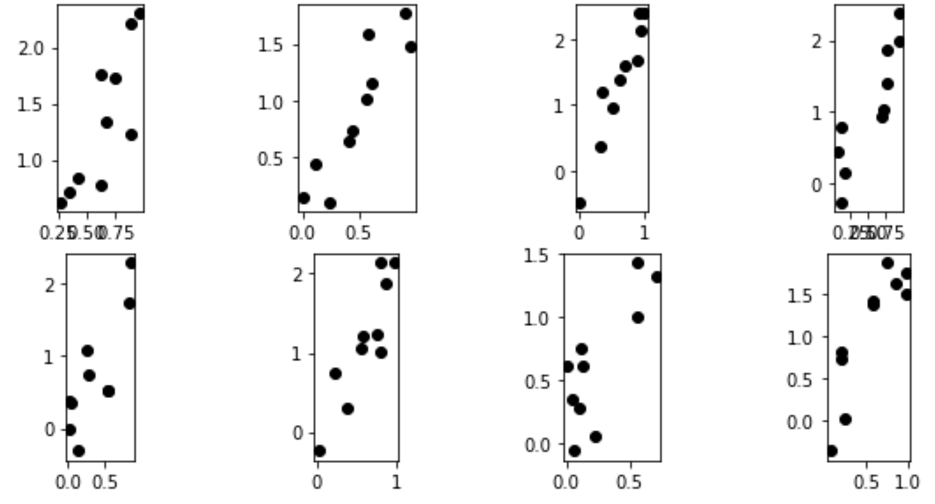
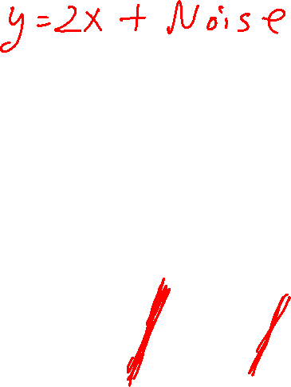
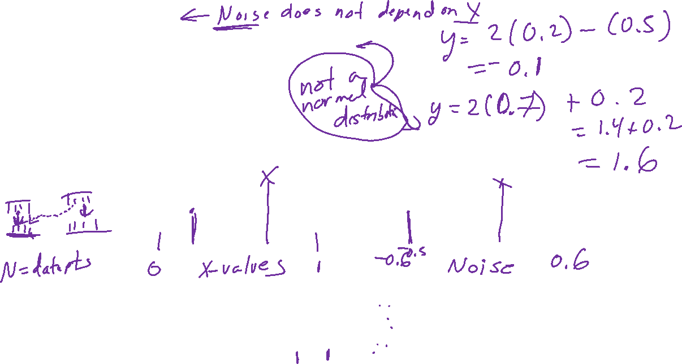
np.random.seed(4)
Noise = np.random.random((K, N)) - 0.5
y_NOISY = 2*x + 1.2*Noise

Slide 4
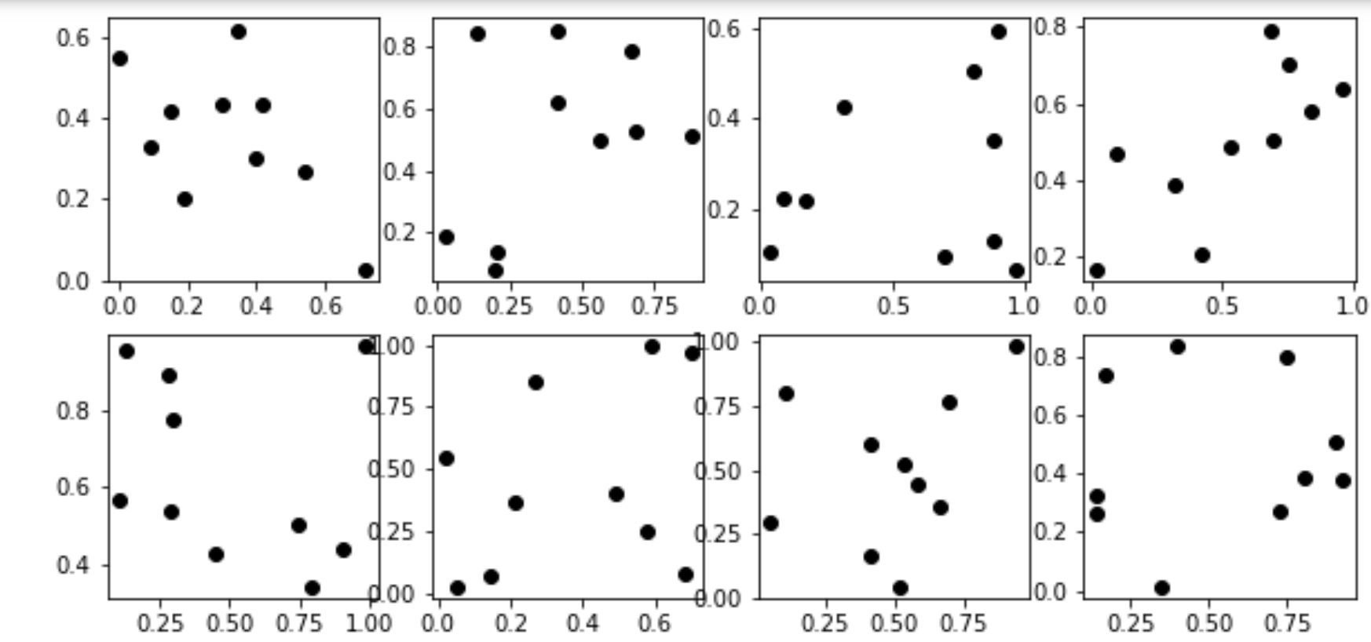
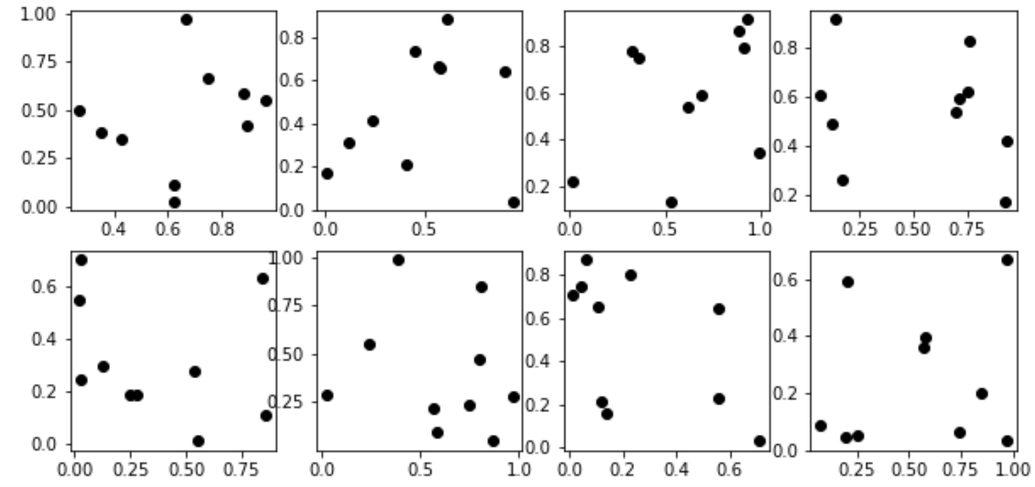
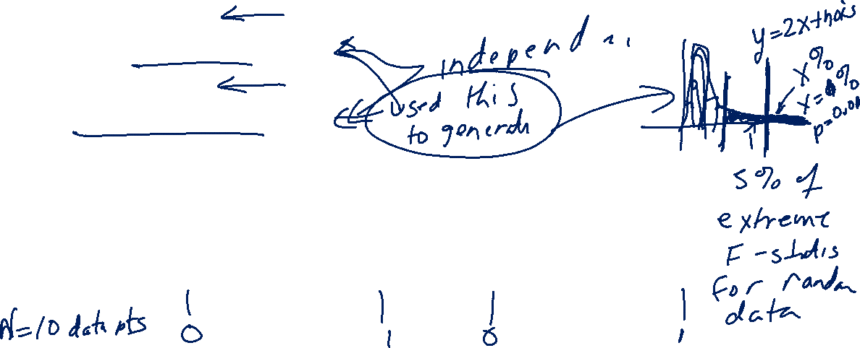
np.random.seed(1)
x = np.random.random((K,N))
np.random.seed(2)
y = np.random.random((K, N))

Slide 5
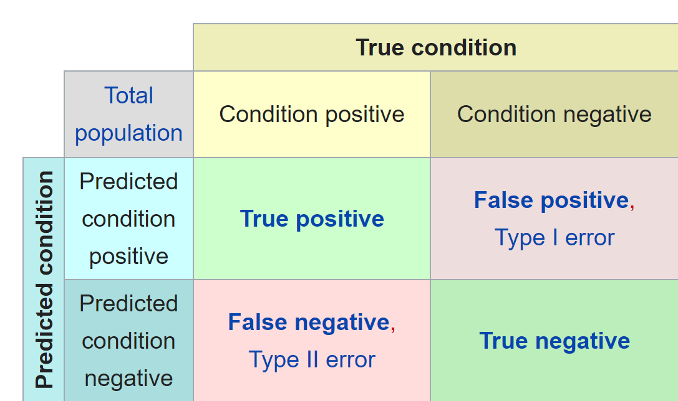
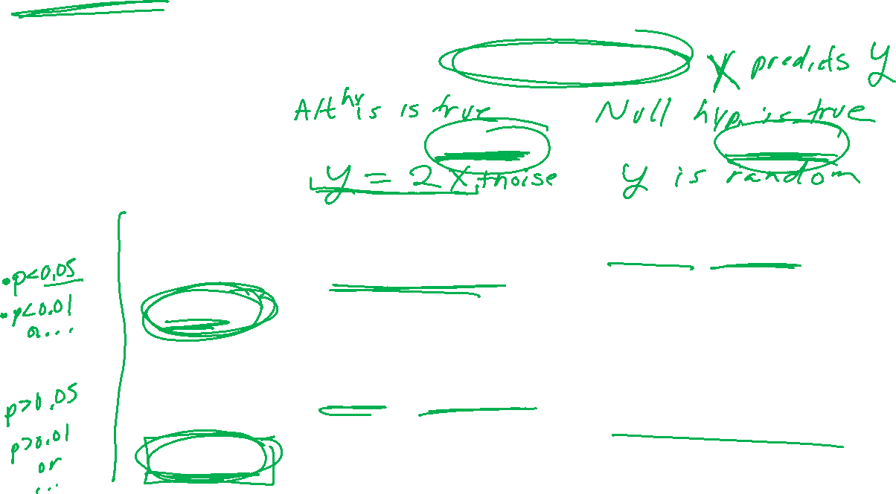
Confusion matrix
https://en.wikipedia.org/wiki/Confusion_matrix

Slide 6
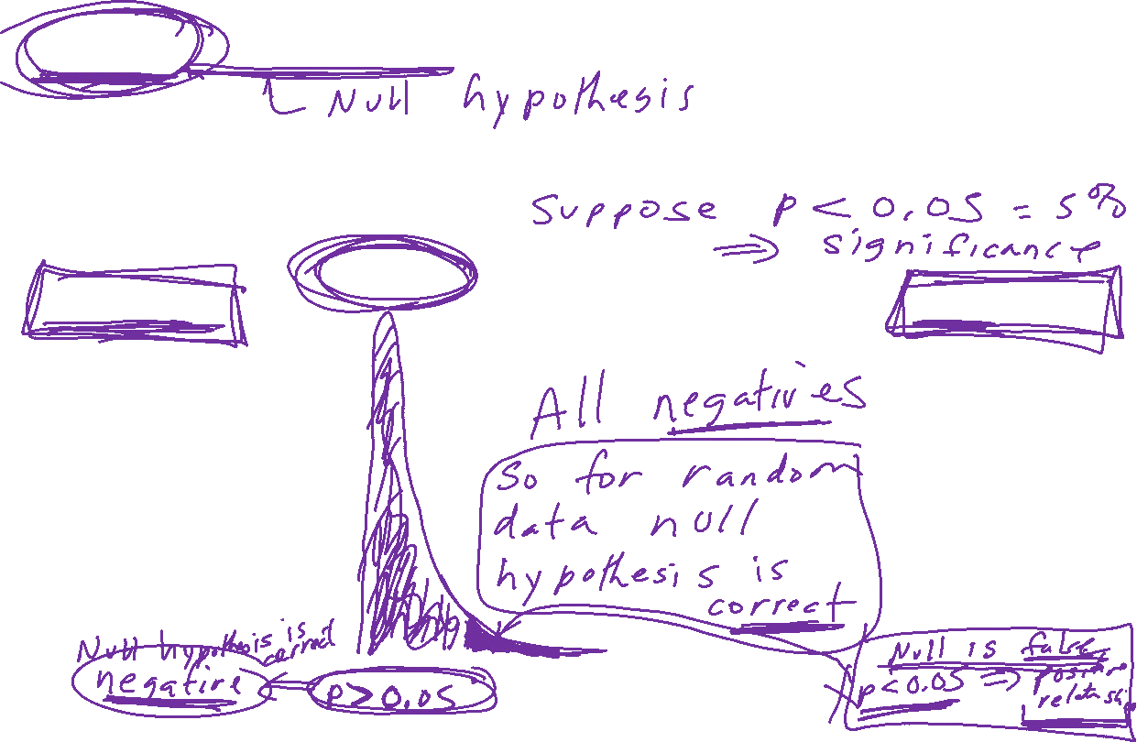
Negative: x does not predict y. There is no relationship between x and y.
The data used to generate the histogram below was randomly generated.
Thus there is no relationship between x and y. Thus the null hypothesis is true for these data sets
True negatives:
There is no relationship between x and y
and
the F-statistic indicates that there is no relationship between x and y
False positive:
There is no relationship between x and y
and
the F-statistic indicates that there is a relationship between x and y

Slide 7
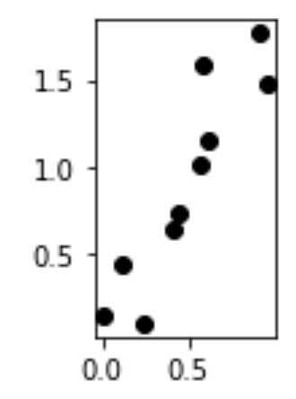
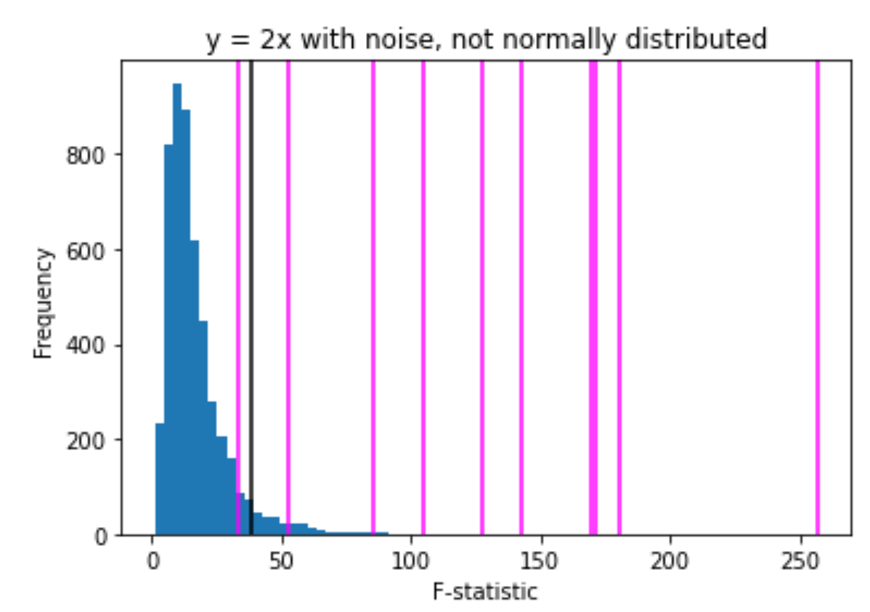
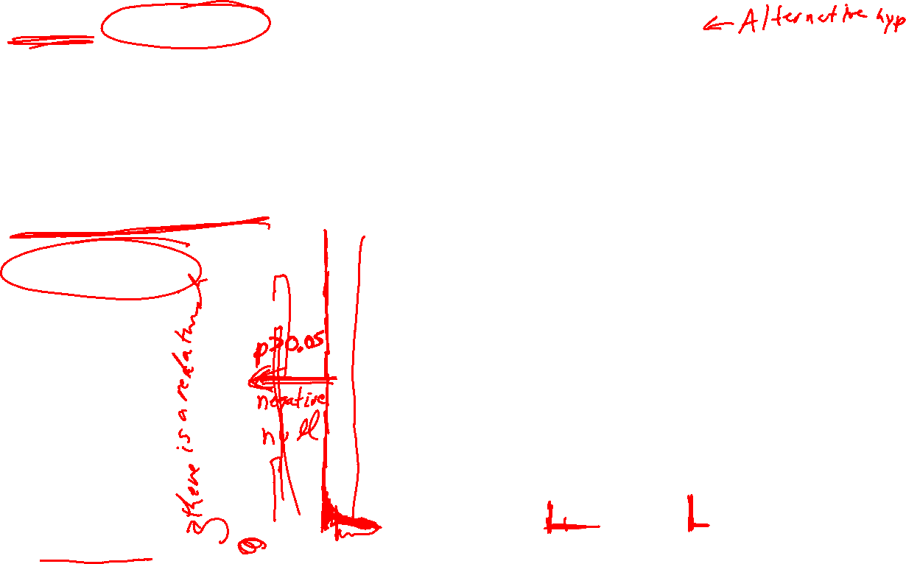
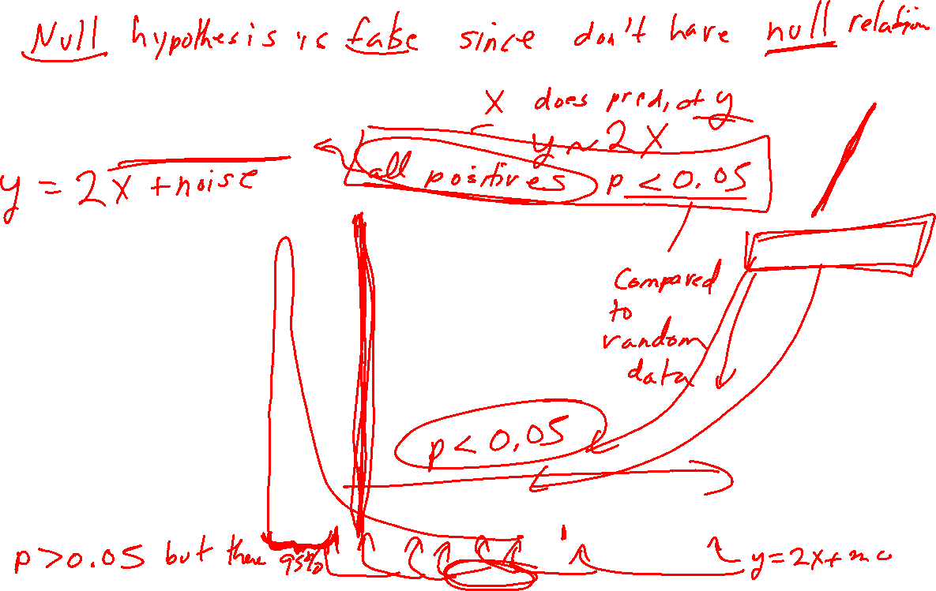
Positive: x predicts y. There is a relationship between x and y.
The data used to generate the histogram below was NOT randomly generated.
Noise = np.random.random((K, N)) - 0.5
y_NOISY = 2*x + 1.2*Noise
False negatives:
There is a relationship between x and y
and
the F-statistic indicates that there is no relationship between x and y
True positive:
There is a relationship between x and y
and
the F-statistic indicates that there is a relationship between x and y

Slide 8
Noise = np.random.random((K, N)) - 0.5
y_NOISY = 2*x + 1.2*Noise

Slide 9
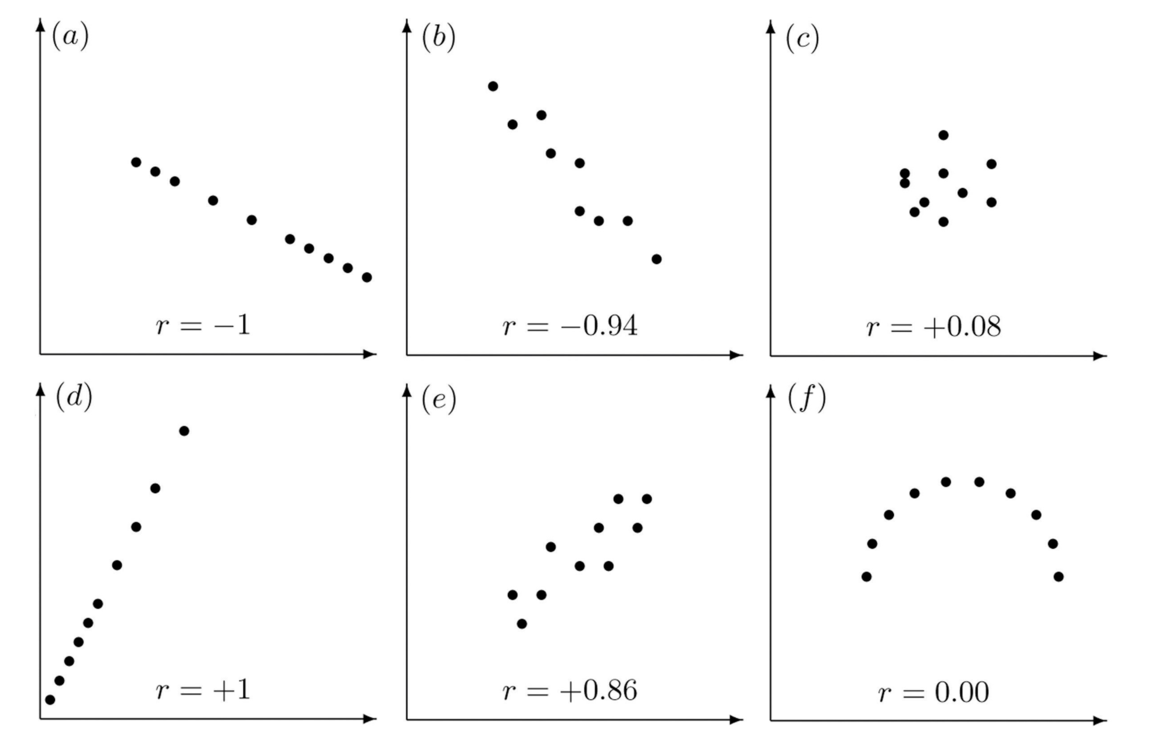
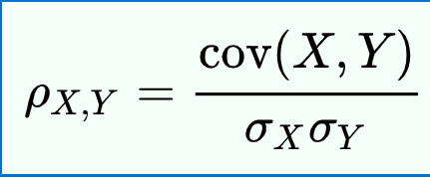
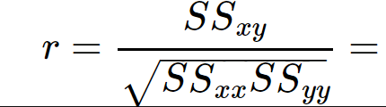

Properties of Linear Correlation Coefficients
https://emunix.emich.edu/~schu/MATH_170/Fall09_170/Evening%20session/Unit%203.ppt
Some properties of the linear correlation coefficient
  r is a unitless measure (so that r would be the same for a data set whether x and y are measured in feet, inches, meters etc.)
  r is always between –1 and +1.
        r = -1 : perfect negative correlation
        r = +1: perfect positive correlation
  Positive values of r correspond to positive relations
  Negative values of r correspond to negative relations
https://en.wikipedia.org/wiki/Pearson_correlation_coefficient
https://stats.libretexts.org/Bookshelves/Introductory_Statistics/Book%3A_Introductory_Statistics_(Shafer_and_Zhang)/10%3A_Correlation_and_Regression/10.02%3A_The_Linear_Correlation_Coefficient

Slide 10
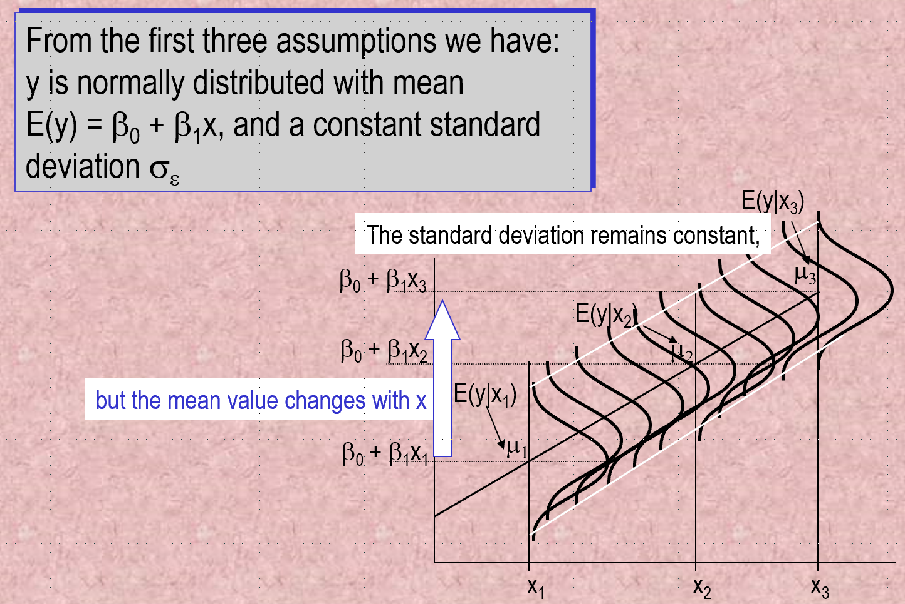

https://web.stanford.edu/class/msande247s/kchap17.ppt

Slide 11
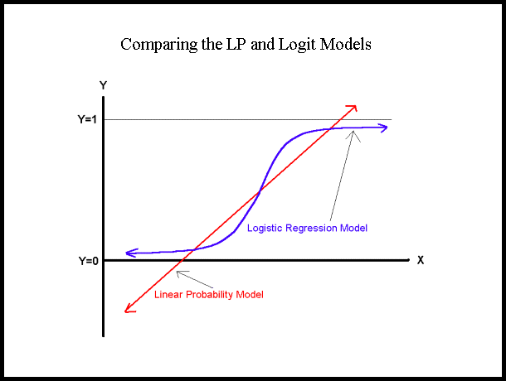
https://nlp.stanford.edu/~manning/courses/ling236/handouts/whitehead-logistic-regression.ppt

Slide 12
The Logistic Regression Model
The "logit" model solves these problems:
ln[p/(1-p)] = α + βX + e
p is the probability that the event Y occurs, p(Y=1)
p/(1-p) is the "odds ratio"
ln[p/(1-p)] is the log odds ratio, or "logit"
https://nlp.stanford.edu/~manning/courses/ling236/handouts/whitehead-logistic-regression.ppt

Slide 13
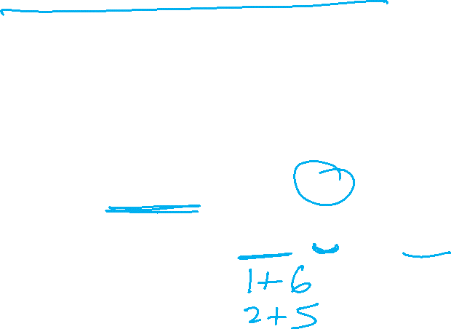
Probability and Odds
On coin flip, p(H) = ½
On 2 dice roll, p(7) = 6/36 =1/6
https://jmg1.psychology.msstate.edu/8803/logisticReg09.ppt

Slide 14

Odds
On coin flip, Odds(H) = 1/1
Odds are 1 to 1 that your coin flip will be “heads”
On 2 dice roll, Odds(7) = 6/(30) = 1/5
Odds(7) = p(7)/[1 - p(7)] = 1/6 / 5/6 = 1/5
Odds are “1 to 5” that you will roll “seven”
https://jmg1.psychology.msstate.edu/8803/logisticReg09.ppt

Slide 15

Problems with Odds
Asymmetry
  Possible range from 0 to “very large”
    With 1 indicating no difference
Due to asymmetry
  The same odds in opposite direction may appear different
  Odds of 5.0 (5 to 1) of losing are the same as odds of .2 of winning (1 to 5)
https://jmg1.psychology.msstate.edu/8803/logisticReg09.ppt

Slide 16
More:
The logistic distribution constrains the estimated probabilities to lie between 0 and 1.
The estimated probability is:
p = 1/[1 + exp(-α - β X)]
if you let α + β X =0, then p = .50
as α + β X gets really big, p approaches 1
as α + β X gets really small, p approaches 0
https://nlp.stanford.edu/~manning/courses/ling236/handouts/whitehead-logistic-regression.ppt

Slide 17
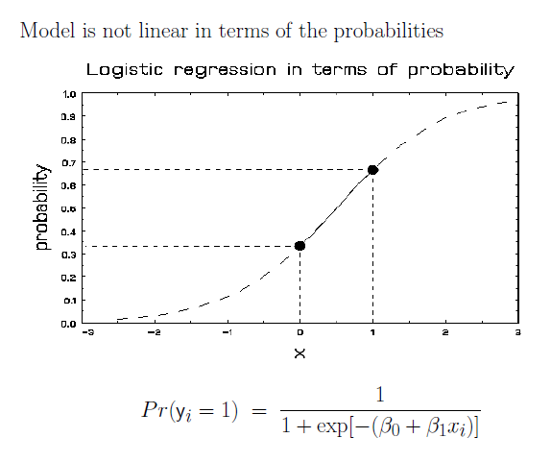
More Visualizations and Formulas
https://jmg1.psychology.msstate.edu/8803/logisticReg09.ppt

Slide 18
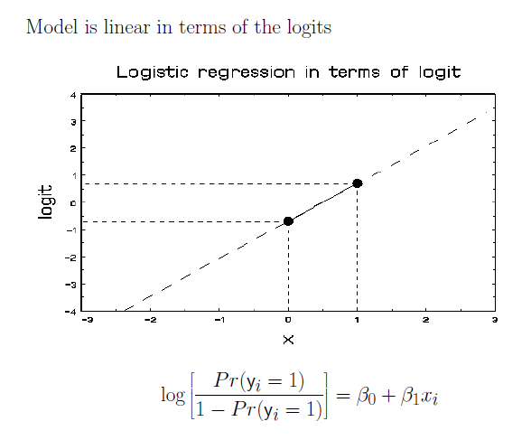

https://jmg1.psychology.msstate.edu/8803/logisticReg09.ppt

Slide 19
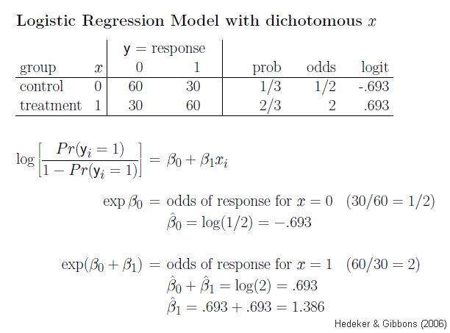
https://jmg1.psychology.msstate.edu/8803/logisticReg09.ppt

Slide 20
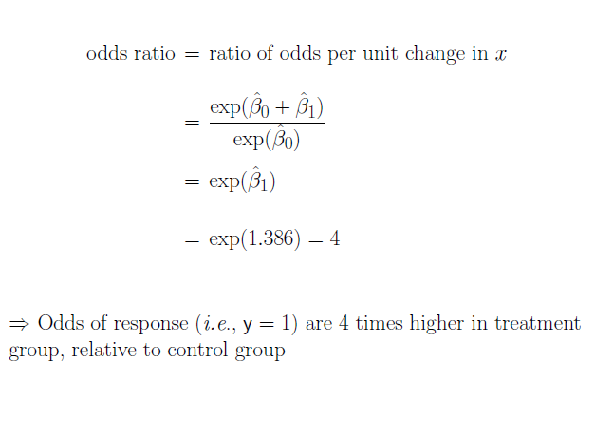
https://jmg1.psychology.msstate.edu/8803/logisticReg09.ppt

Slide 21
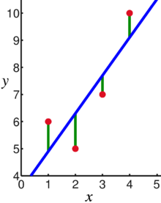
Supervised Learning: Use labeled data to predict unlabeled data.
2 types of supervised learning:
Regression: Predict continuous values.
    Ex: Linear regression.
F(x_{new}) = b₀ + b₁x_{new}
2. Classification: Predict discrete values.
    Ex: Logistic regression
https://en.wikipedia.org/wiki/Linear_regression

Slide 22
https://nlp.stanford.edu/~manning/courses/ling236/handouts/whitehead-logistic-regression.ppt

