Slide 1
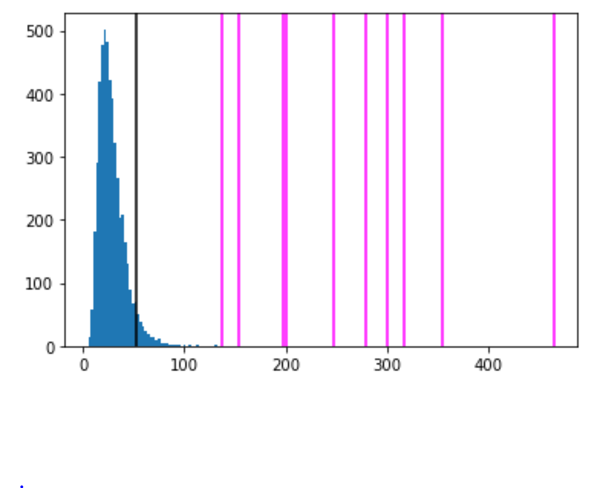
Histogram from Wednesday’s python notebook for distribution of F statistic for random data (blue histogram) as well as F statistic for several exponential curves.
run line "pip install statsmodels"

Slide 2
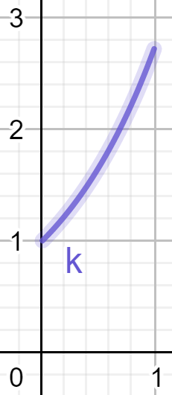
Histogram from Wednesday’s python notebook for distribution of F statistic for random data (blue histogram) as well as F statistic for several exponential curves.
www.geogebra.org/calculator

Slide 3
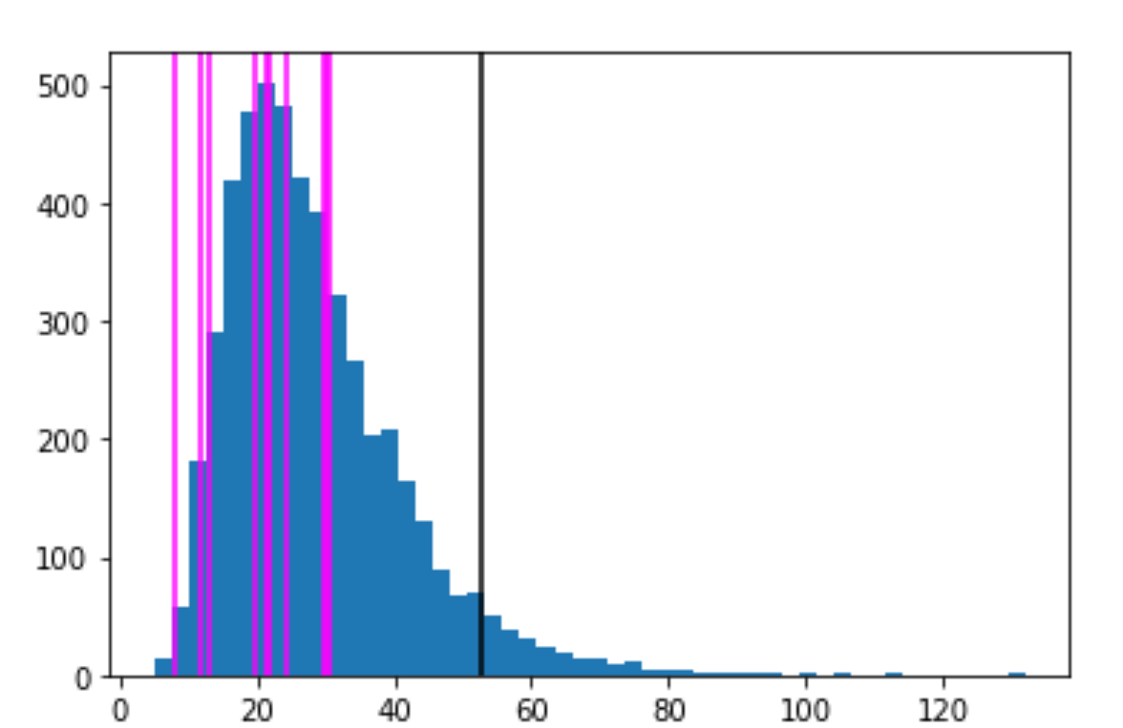
www.geogebra.org/calculator

Slide 4
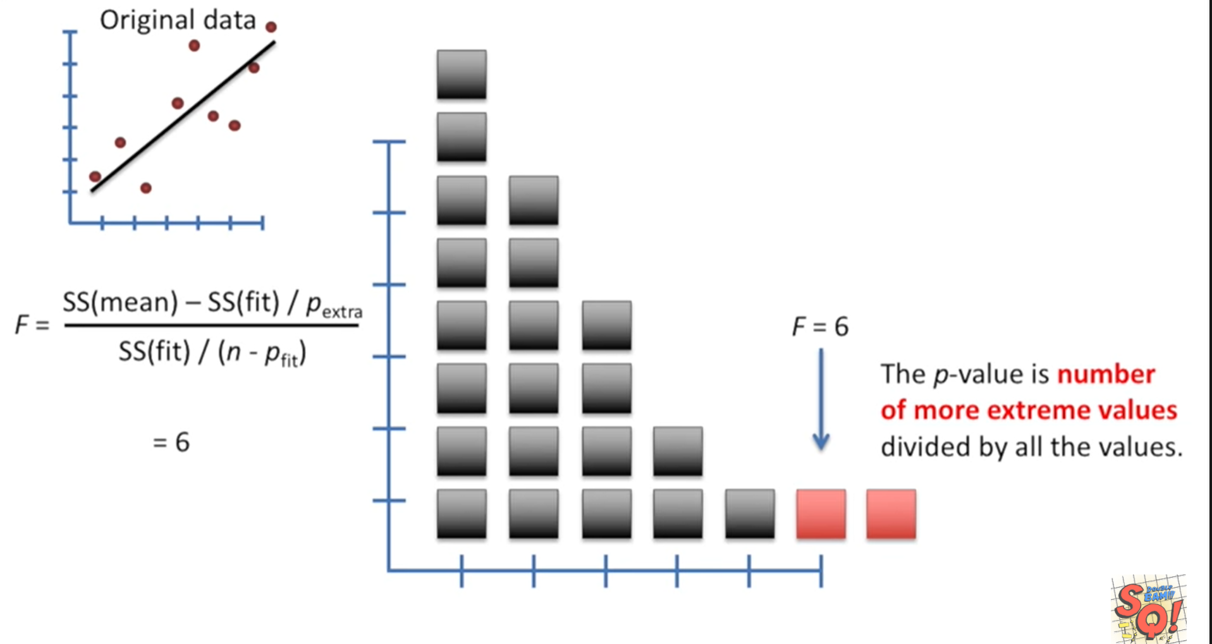
StatQuest: Linear Models Pt.1 - Linear Regression https://www.youtube.com/watch?v=nk2CQITm_eo

Slide 5
https://web.stanford.edu/class/msande247s/kchap17.ppt

Slide 6
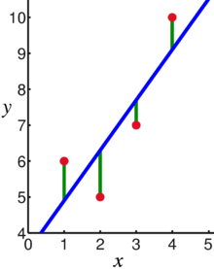
17.4 Error Variable: Required Conditions
The error ε is a critical part of the regression model.
Four requirements involving the distribution of ε must be satisfied.
The probability distribution of ε is normal.
The mean of ε is zero: E(ε) = 0.
The standard deviation of ε is σ_{ε} for all values of x.
The set of errors associated with different values of y are all independent.
https://en.wikipedia.org/wiki/Linear_regression
https://web.stanford.edu/class/msande247s/kchap17.ppt

Slide 7
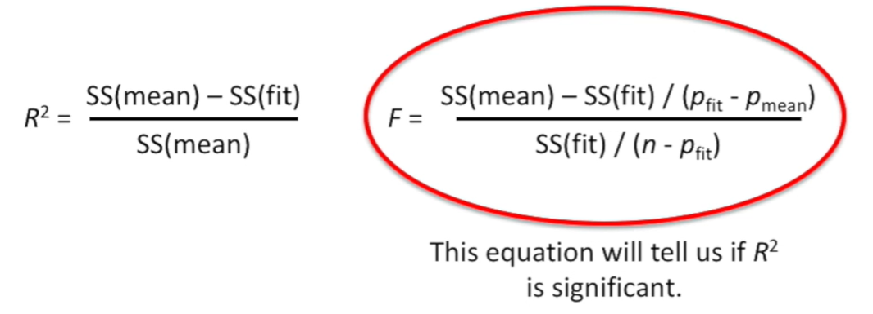

Slide 8
StatQuest: Linear Models Pt.1 - Linear Regression https://www.youtube.com/watch?v=nk2CQITm_eo

Slide 9
Coefficient of determination
When we want to measure the strength of the linear relationship, we use the coefficient of determination.

Slide 10
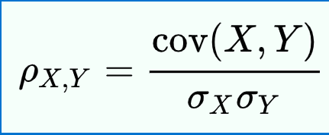
Measure of Linear Correlation
https://emunix.emich.edu/~schu/MATH_170/Fall09_170/Evening%20session/Unit%203.ppt
The linear correlation coefficient is a measure of the strength of linear relation between two quantitative variables
The sample correlation coefficient “r” is
https://en.wikipedia.org/wiki/Pearson_correlation_coefficient
Note: are the sample means and sample variances
of the two variables X and Y.
$$R^{2}=\frac{[\operatorname{cov}{(}X,Y)]^{2}}{s_{x}^{2}s_{y}^{2}}$$

Slide 11
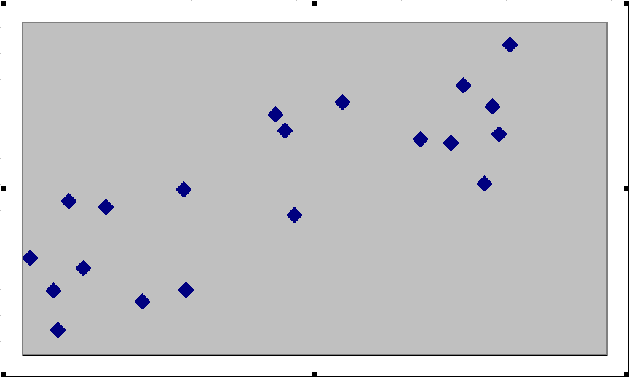
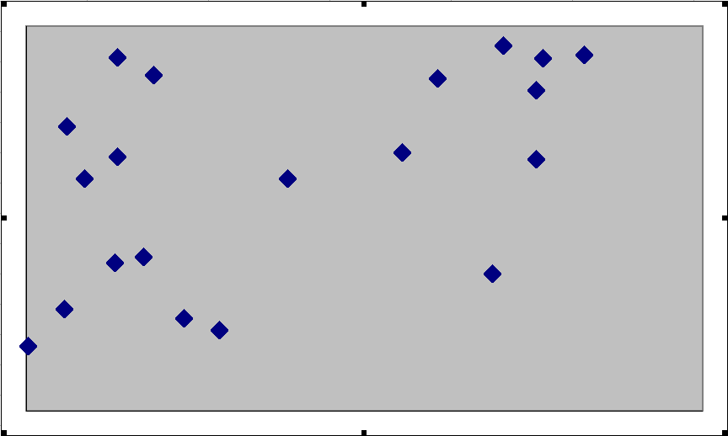
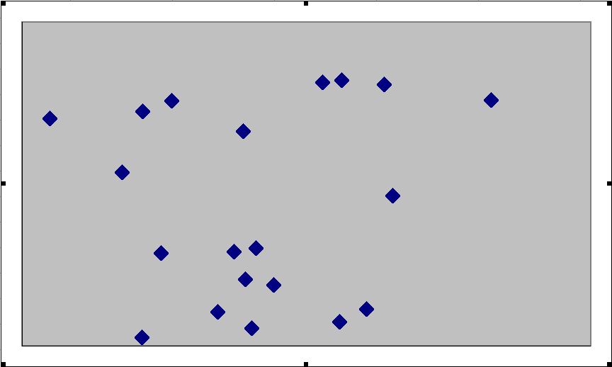
Positive Correlation Coefficients
Examples of positive correlation
In general, if the correlation is visible to the eye, then it is likely to be strong
Strong Positive
r = .8
Moderate Positive
r = .5
Very Weak
r = .1
https://emunix.emich.edu/~schu/MATH_170/Fall09_170/Evening%20session/Unit%203.ppt

Slide 12
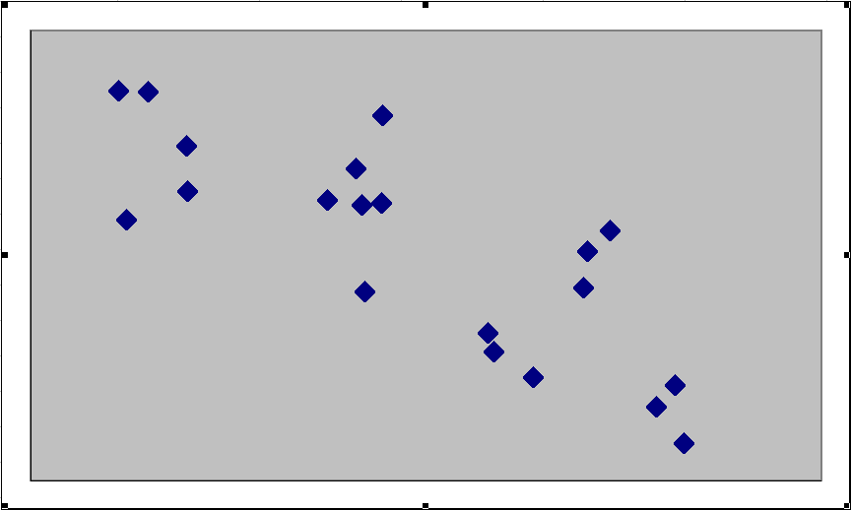
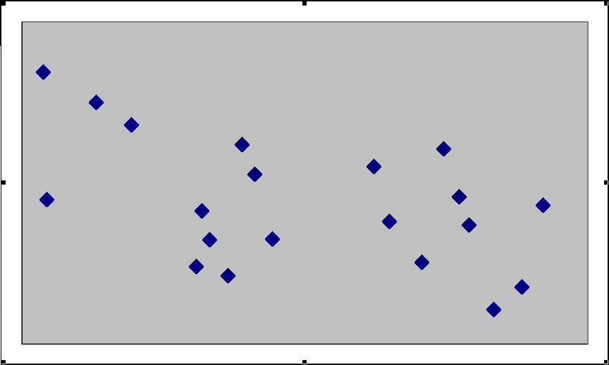
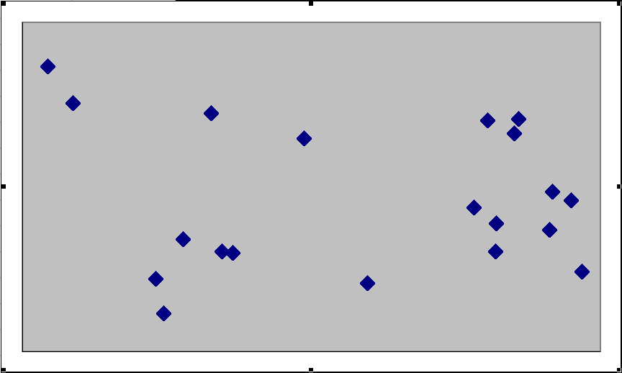
Negative Correlation Coefficients
Examples of negative correlation
In general, if the correlation is visible to the eye, then it is likely to be strong
Strong Negative
r = –.8
Moderate Negative
r = –.5
Very Weak
r = –.1
https://emunix.emich.edu/~schu/MATH_170/Fall09_170/Evening%20session/Unit%203.ppt

Slide 13
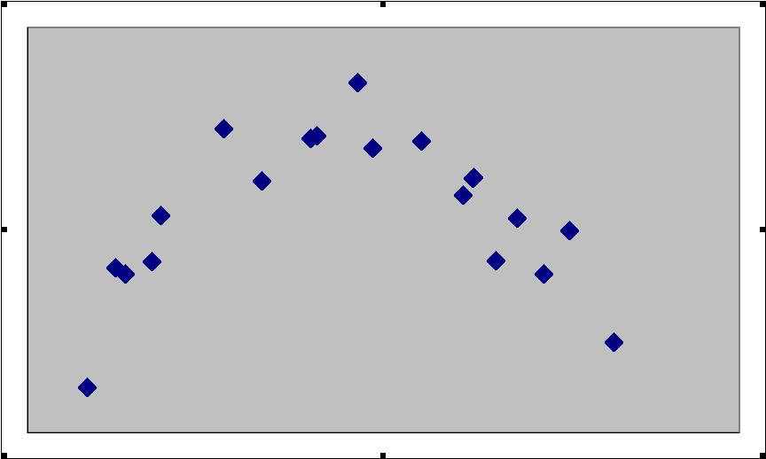
Nonlinear versus No Correlation
Nonlinear correlation and no correlation
Both sets of variables have r = 0.1, but the difference is that the nonlinear relation shows a clear pattern
Nonlinear Relation
No Relation
https://emunix.emich.edu/~schu/MATH_170/Fall09_170/Evening%20session/Unit%203.ppt

Slide 14
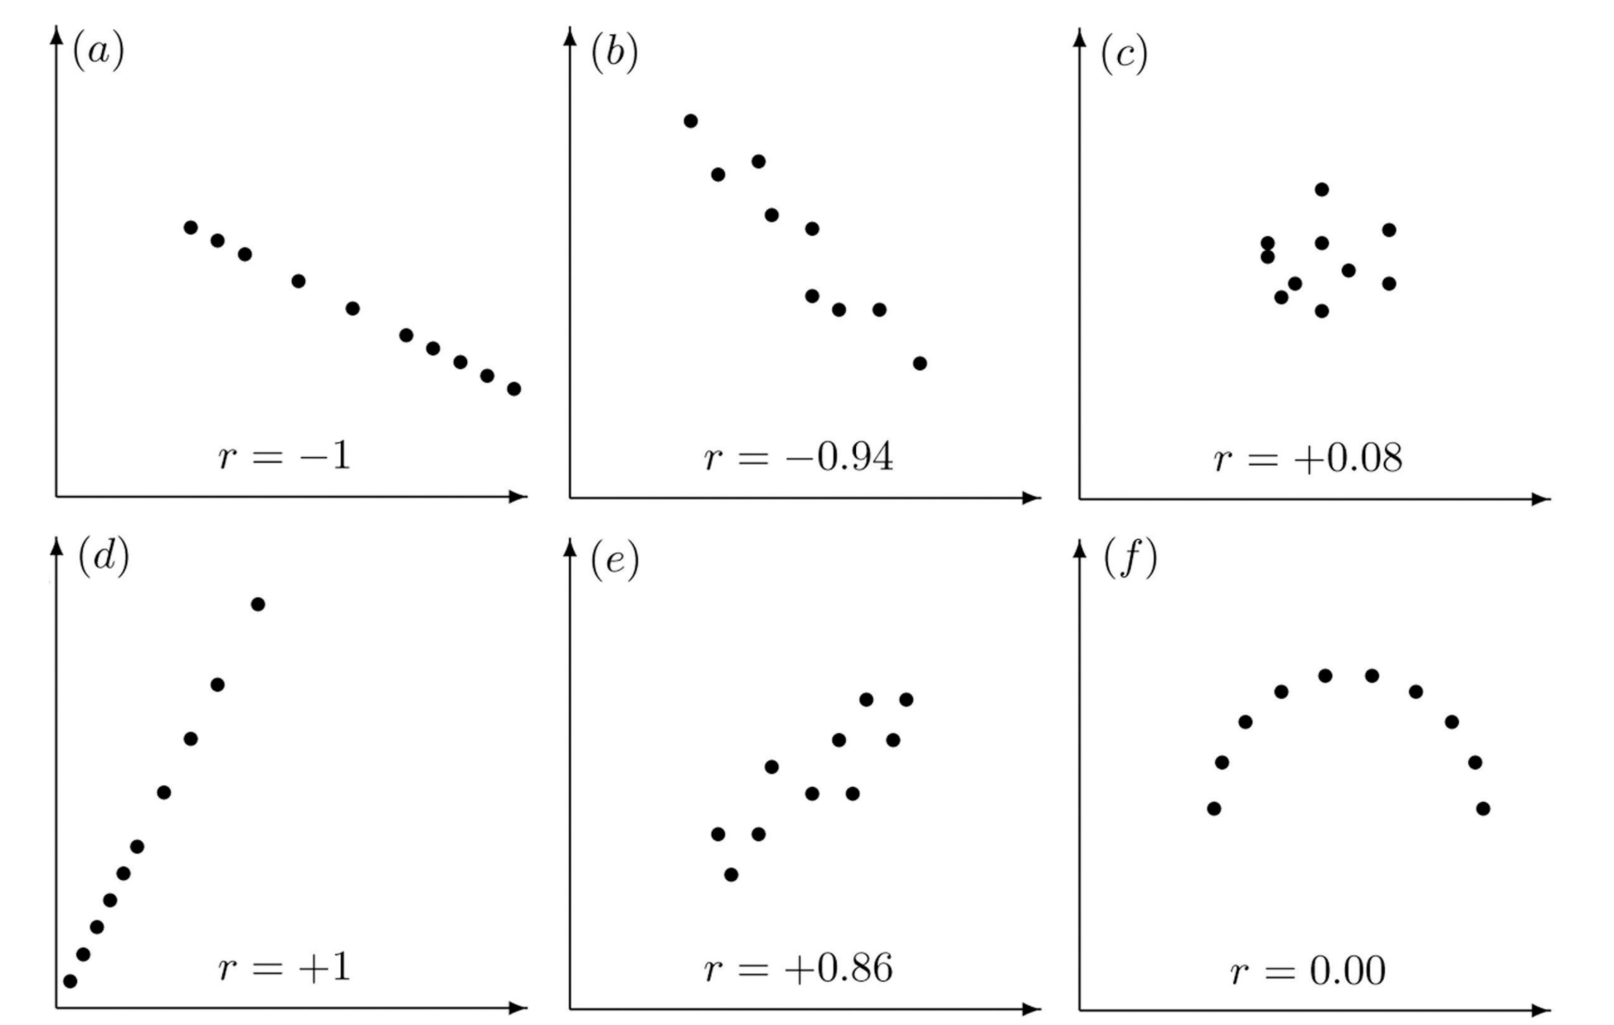
Properties of Linear Correlation Coefficients
https://emunix.emich.edu/~schu/MATH_170/Fall09_170/Evening%20session/Unit%203.ppt
Some properties of the linear correlation coefficient
r is a unitless measure (so that r would be the same for a data set whether x and y are measured in feet, inches, meters etc.)
r is always between –1 and +1.
r = -1 : perfect negative correlation
r = +1: perfect positive correlation
Positive values of r correspond to positive relations
Negative values of r correspond to negative relations
https://en.wikipedia.org/wiki/Pearson_correlation_coefficient
https://stats.libretexts.org/Bookshelves/Introductory_Statistics/Book%3A_Introductory_Statistics_(Shafer_and_Zhang)/10%3A_Correlation_and_Regression/10.02%3A_The_Linear_Correlation_Coefficient

Slide 15
https://web.stanford.edu/class/msande247s/kchap17.ppt

Slide 16
https://nlp.stanford.edu/~manning/courses/ling236/handouts/whitehead-logistic-regression.ppt

