Slide 1
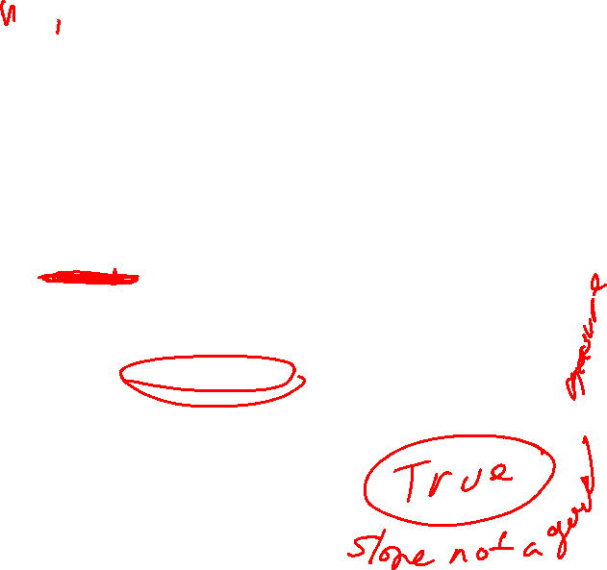
6533
0
No data
The intercept is b₀ = 6533.
This is the slope of the line.
For each additional mile on the odometer,
the price decreases by an average of $0.0312
Do not interpret the intercept as the
“Price of cars that have not been driven”
https://web.stanford.edu/class/msande247s/kchap17.ppt

Slide 2
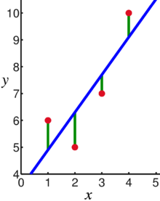
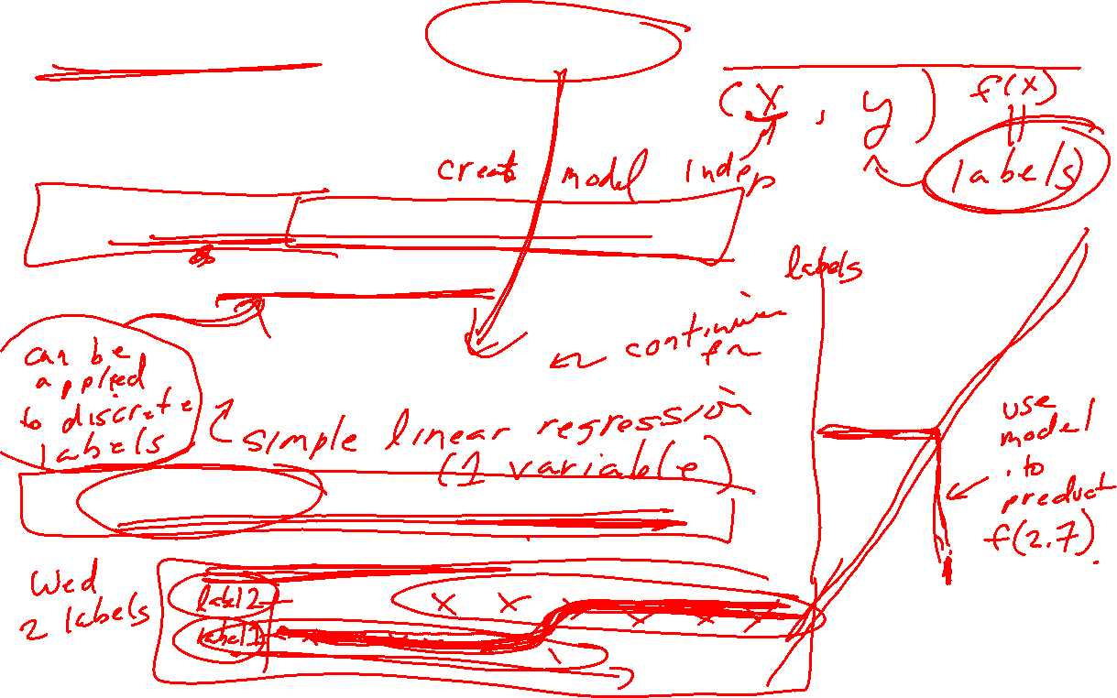
Supervised Learning: Use labeled data to predict unlabeled data.
2 types of supervised learning:
Regression: Predict continuous values.
    Ex: Linear regression.
F(x_{new}) = b₀ + b₁x_{new}
2. Classification: Predict discrete values.
    Ex: Logistic regression
https://en.wikipedia.org/wiki/Linear_regression

Slide 3
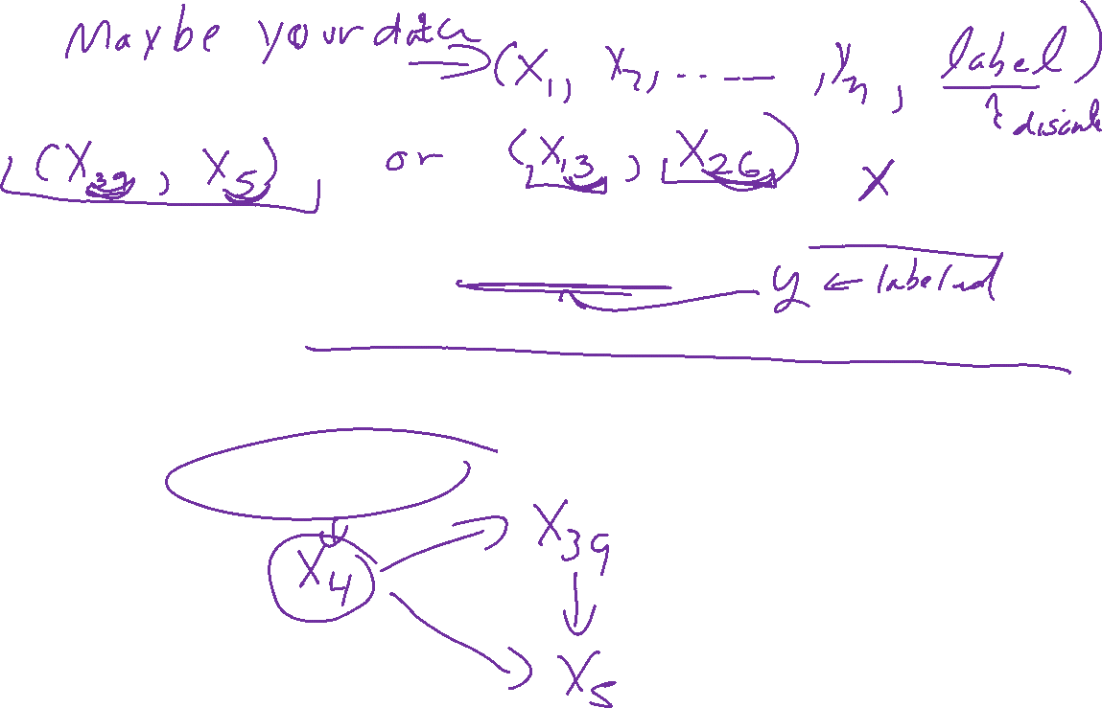
Lurking Variable
Sometimes it is not clear which variable is the explanatory variable and which is the response variable
Sometimes the two variables are related without either one being an explanatory variable
Sometimes the two variables are both affected by a third variable, a lurking variable, that had not been included in the study
https://emunix.emich.edu/~schu/MATH_170/Fall09_170/Evening%20session/Unit%203.ppt

Slide 4
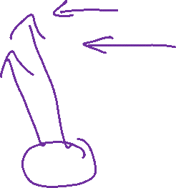
Example 1
An example of a lurking variable
A researcher studies a group of elementary school children
  Y = the student’s height
  X = the student’s shoe size
It is not reasonable to claim that shoe size causes height to change
The lurking variable of age affects both of these two variables
https://emunix.emich.edu/~schu/MATH_170/Fall09_170/Evening%20session/Unit%203.ppt

Slide 5
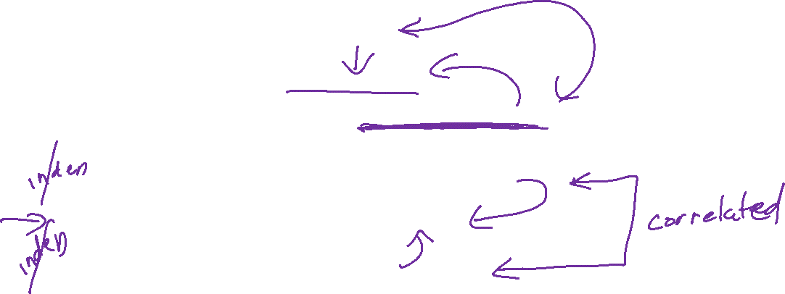
More Examples
Some other examples
Rainfall amounts and plant growth
  Explanatory variable – rainfall
  Response variable – plant growth
  Possible lurking variable – amount of sunlight
Exercise and cholesterol levels
  Explanatory variable – amount of exercise
  Response variable – cholesterol level
  Possible lurking variable – diet
https://emunix.emich.edu/~schu/MATH_170/Fall09_170/Evening%20session/Unit%203.ppt

Slide 6
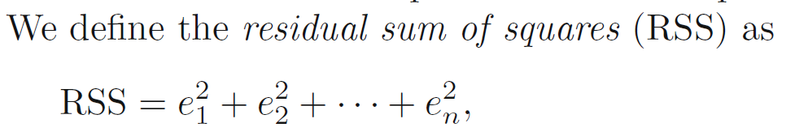
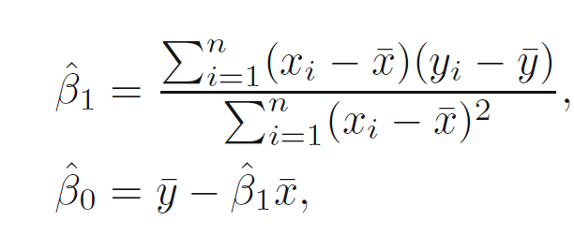
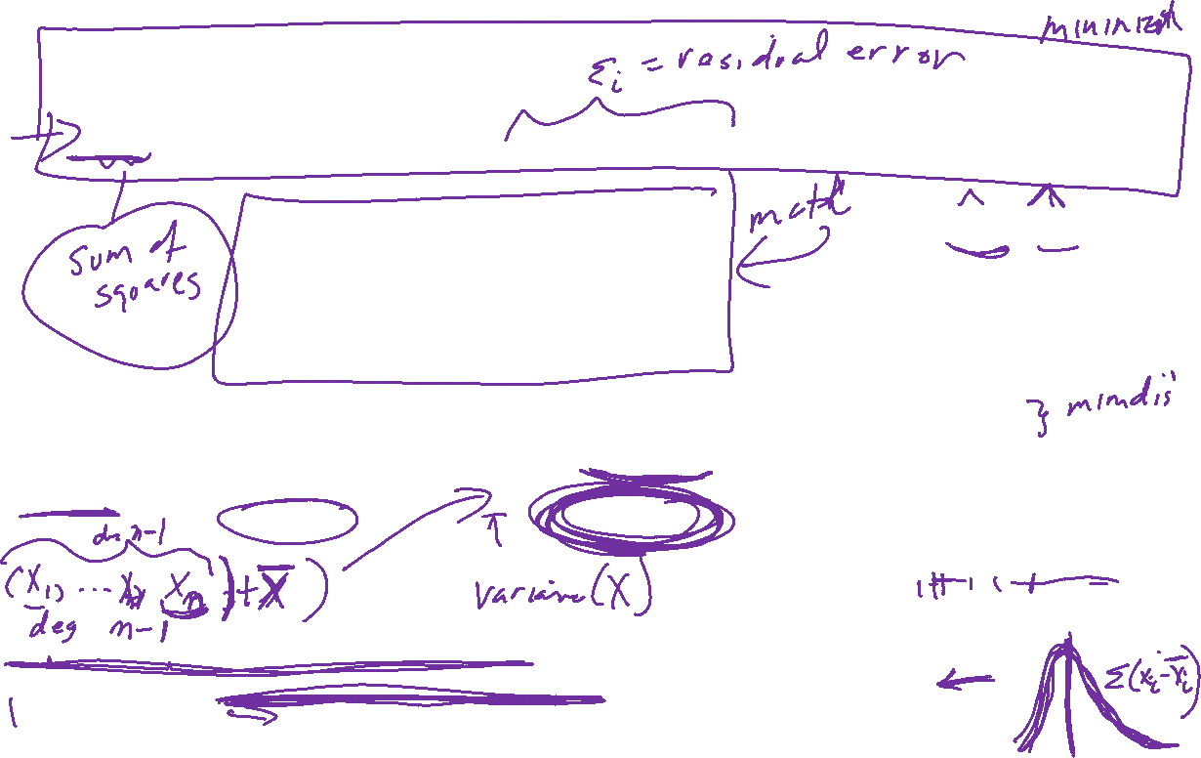
https://www.statlearning.com/
https://en.wikipedia.org/wiki/Linear_regression
Use n if you have info on the entire population
Use n-1 if you have sampled a subset of the population: https://youtu.be/xslIhnquFoE
https://web.ma.utexas.edu/users/mks/M358KInstr/SampleSDPf.pdf
https://en.wikipedia.org/wiki/Bessel%27s_correction#Proof_of_correctness_-_Alternate_3

Slide 7
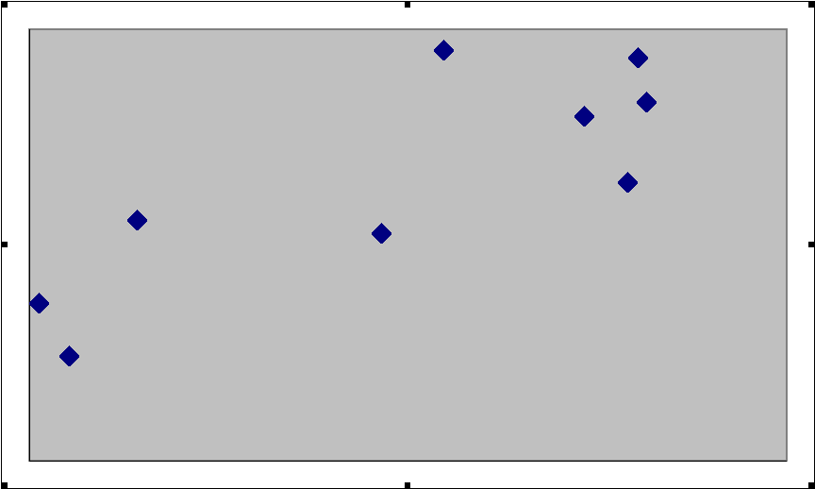

https://emunix.emich.edu/~schu/MATH_170/Fall09_170/Evening%20session/Unit%203.ppt
Here shows a residual on the scatter diagram
The residual
The regression line
The observed value y
The predicted value y
The x value of interest

Slide 8
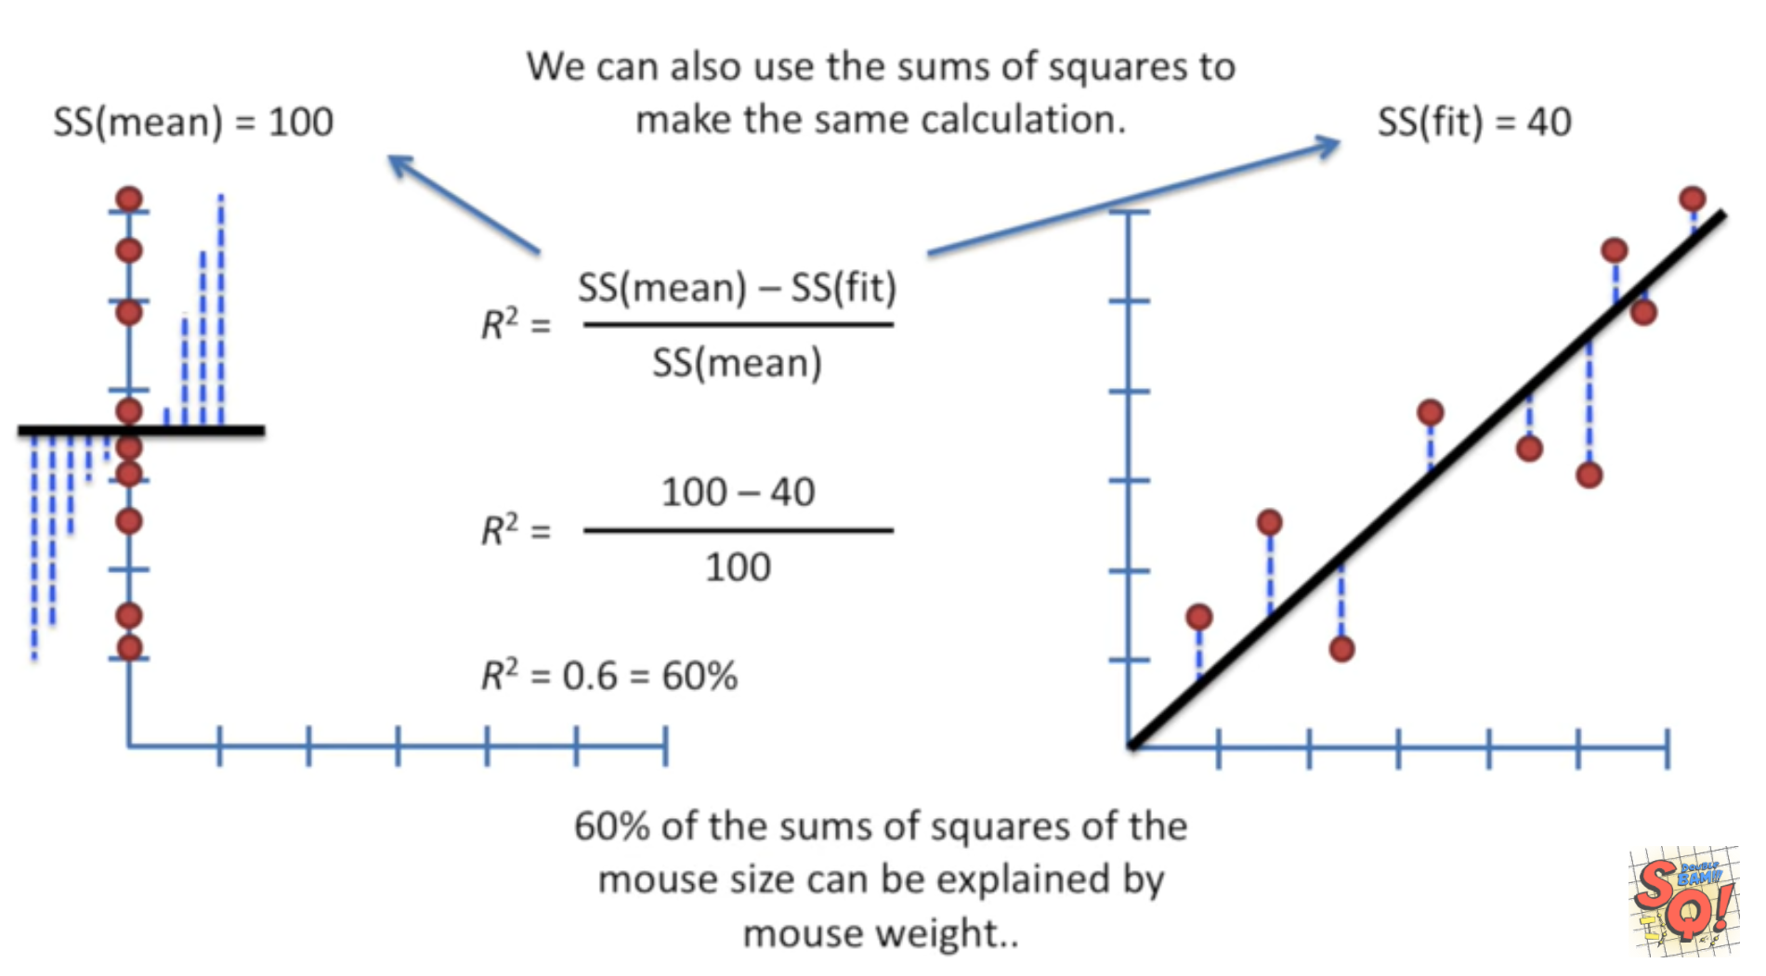
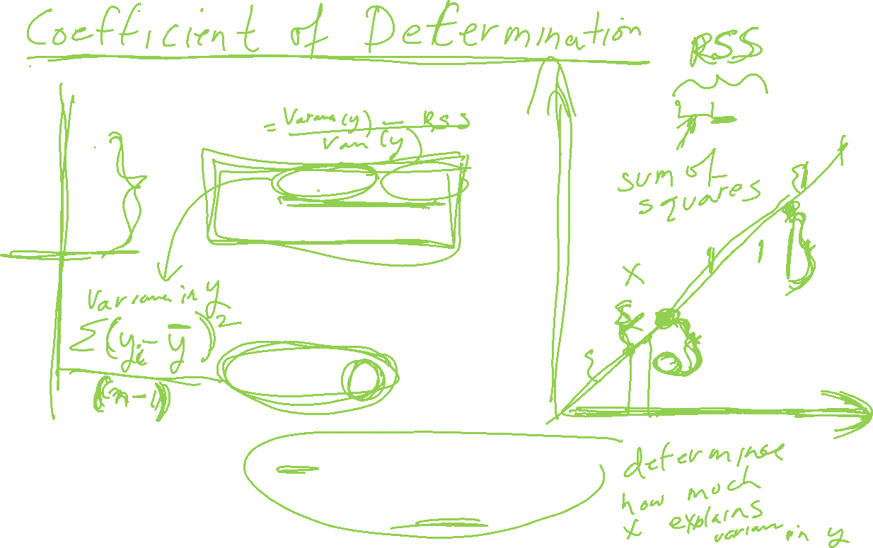
StatQuest: Linear Models Pt.1 - Linear Regression https://www.youtube.com/watch?v=nk2CQITm_eo

Slide 9
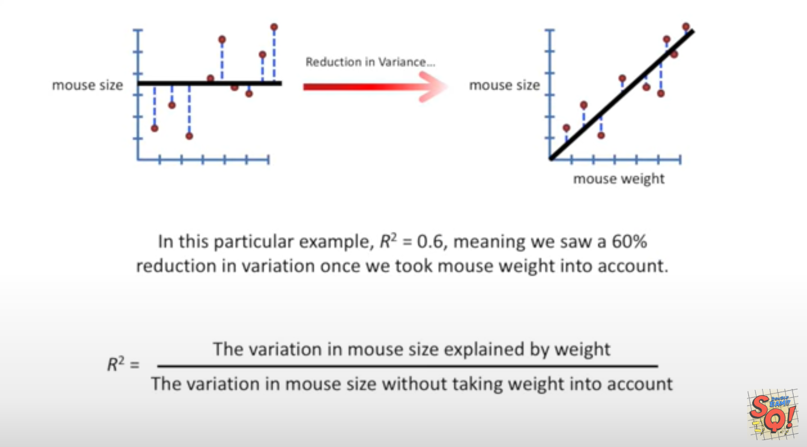
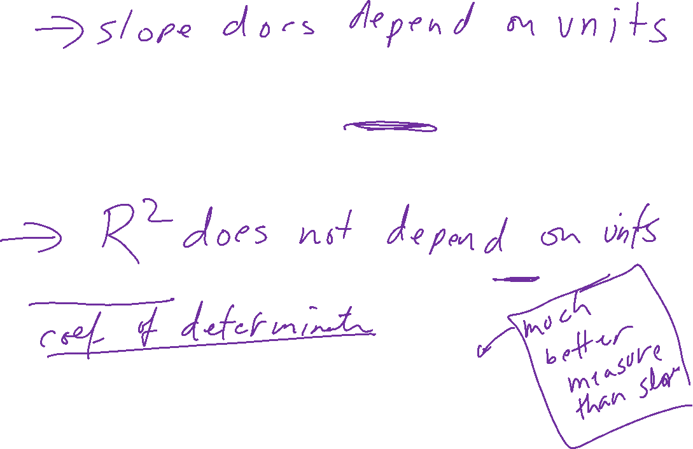
StatQuest: Linear Models Pt.1 - Linear Regression https://www.youtube.com/watch?v=nk2CQITm_eo

Slide 10
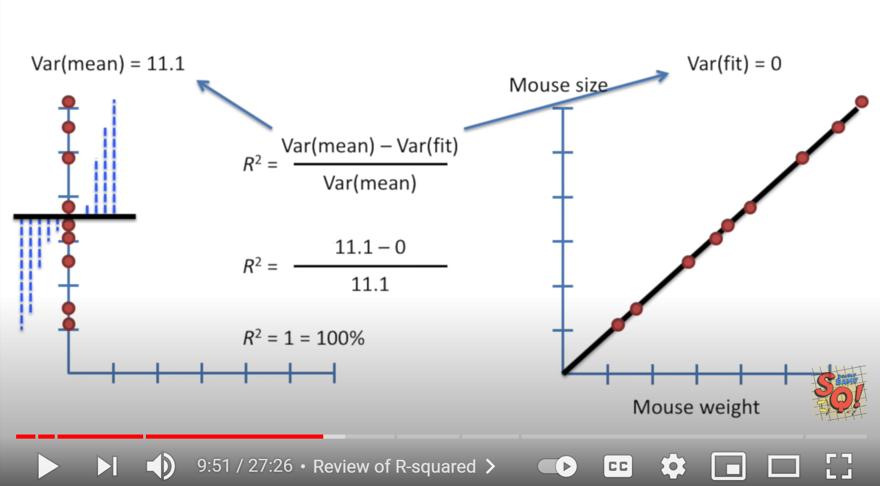
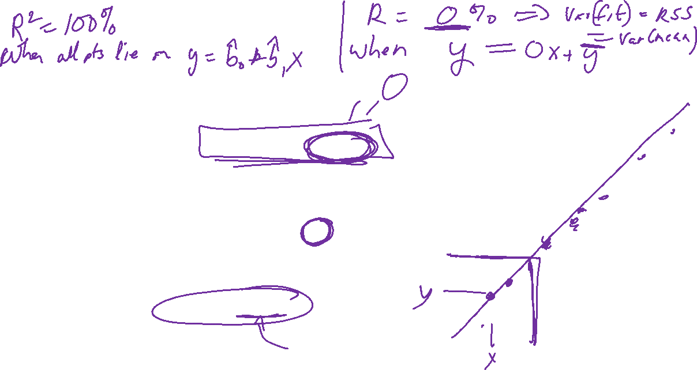
StatQuest: Linear Models Pt.1 - Linear Regression https://www.youtube.com/watch?v=nk2CQITm_eo

Slide 11
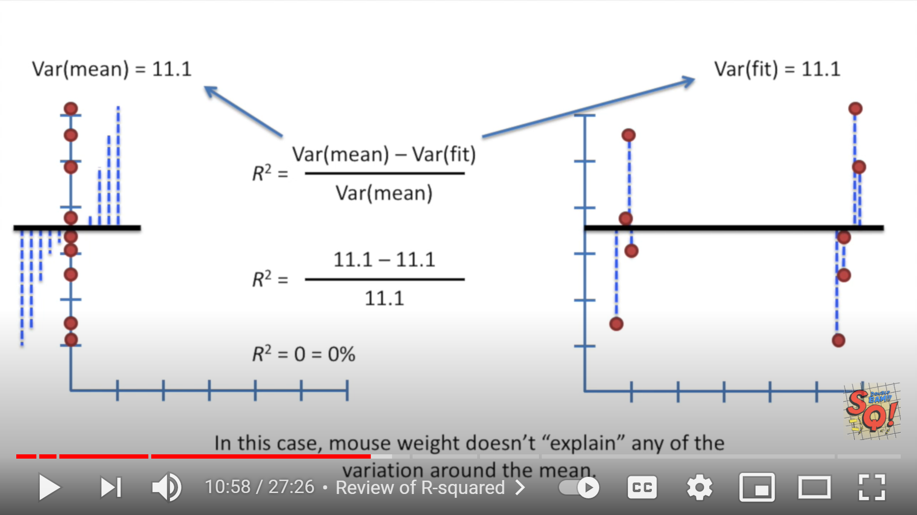
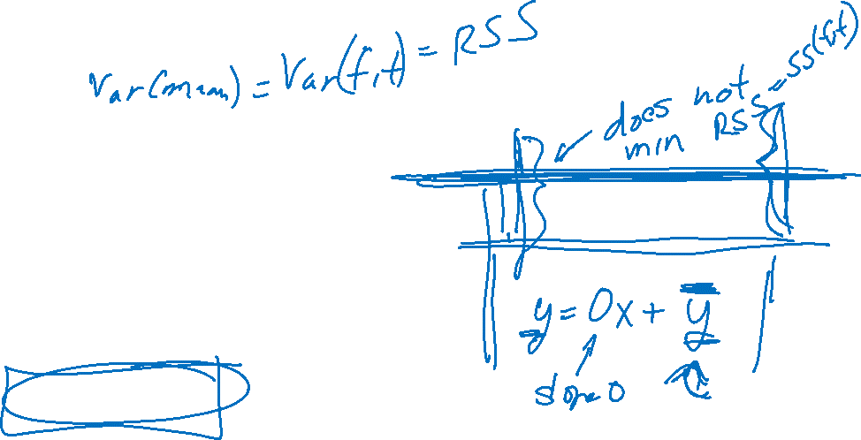
StatQuest: Linear Models Pt.1 - Linear Regression https://www.youtube.com/watch?v=nk2CQITm_eo

Slide 12
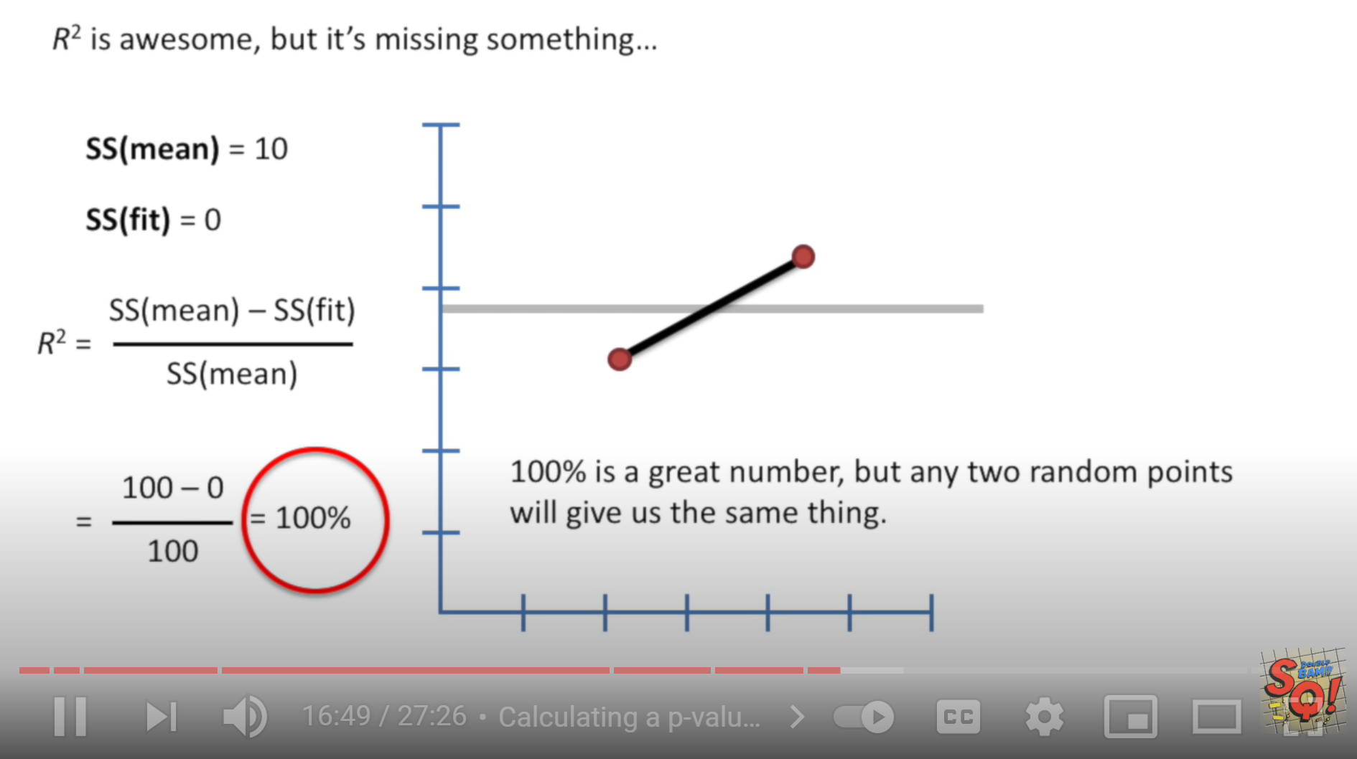
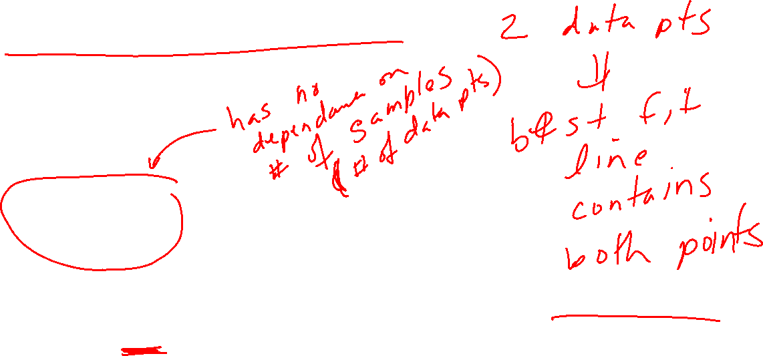
StatQuest: Linear Models Pt.1 - Linear Regression https://www.youtube.com/watch?v=nk2CQITm_eo

Slide 13
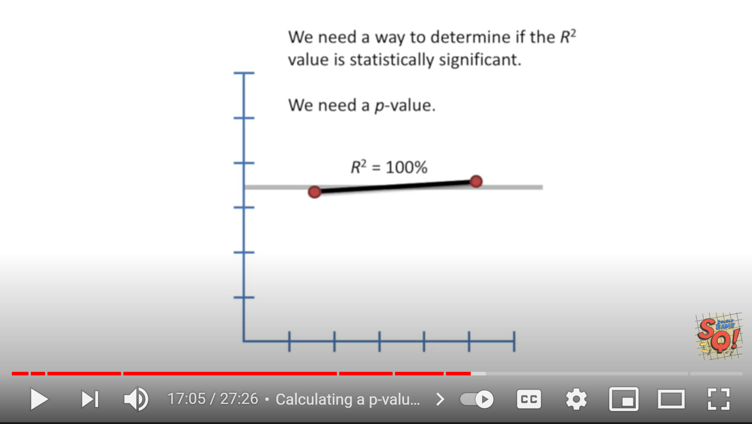

StatQuest: Linear Models Pt.1 - Linear Regression https://www.youtube.com/watch?v=nk2CQITm_eo

Slide 14
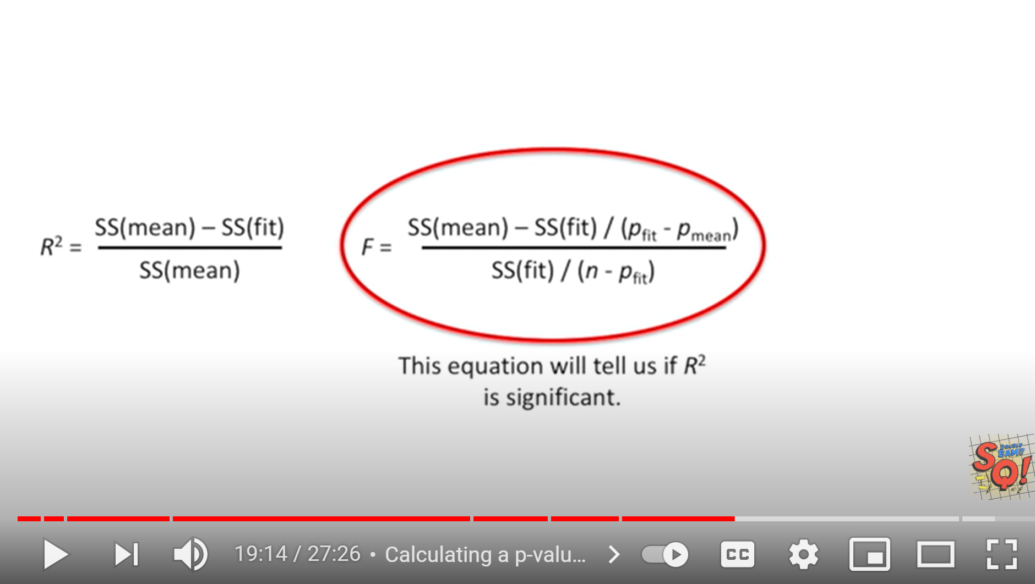
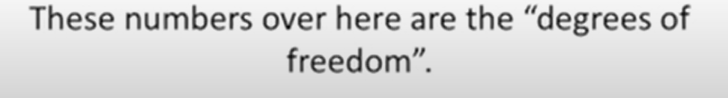
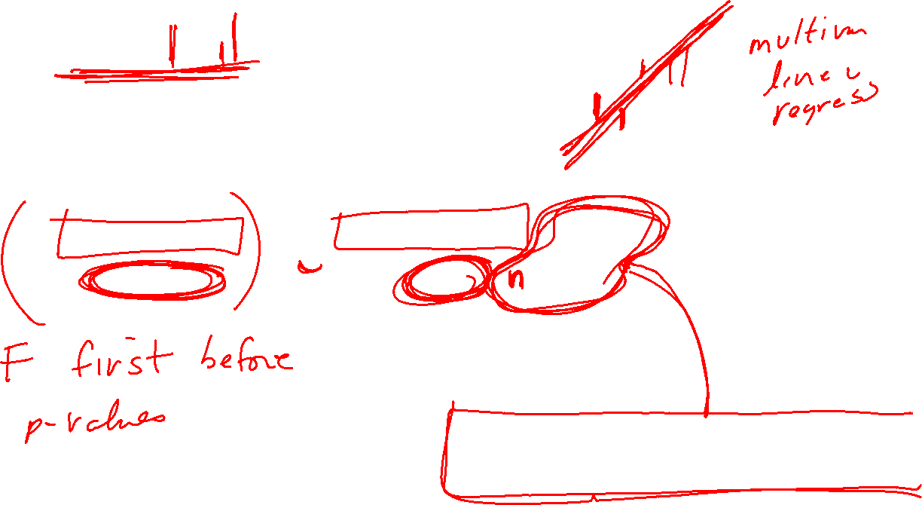
StatQuest: Linear Models Pt.1 - Linear Regression https://www.youtube.com/watch?v=nk2CQITm_eo

Slide 15
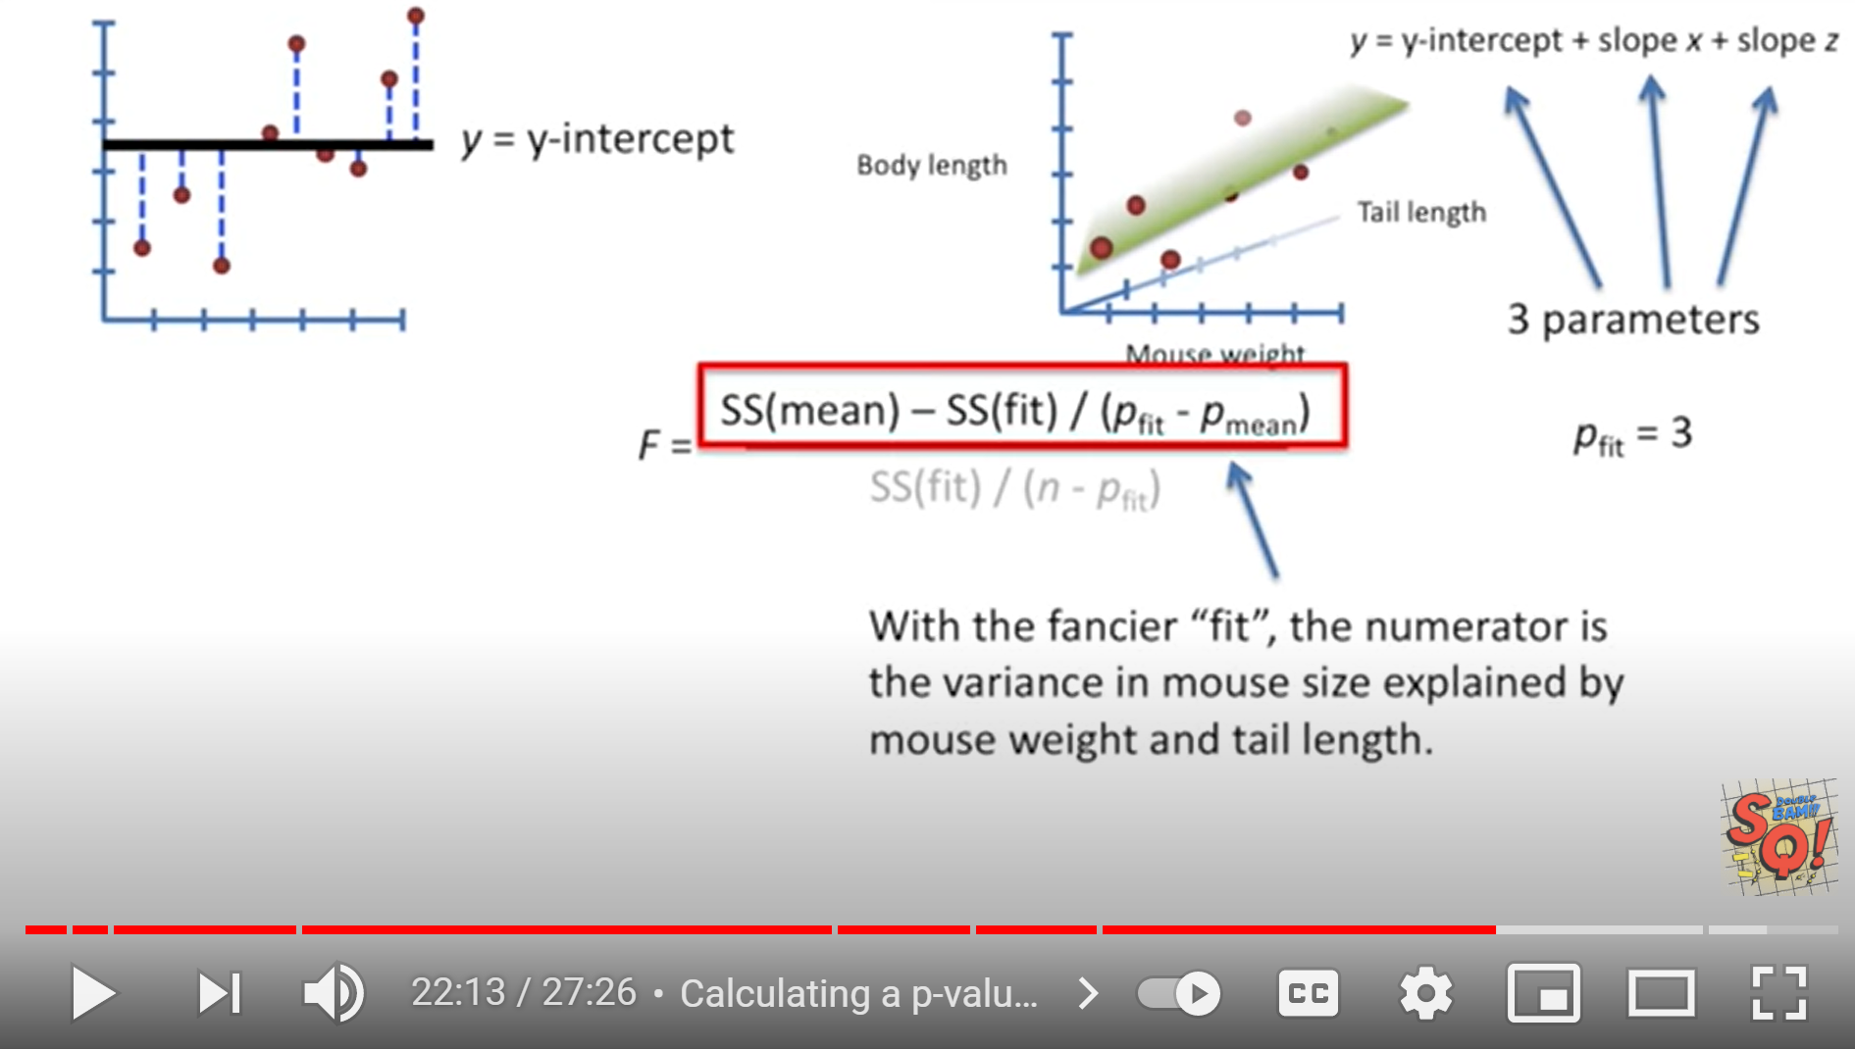
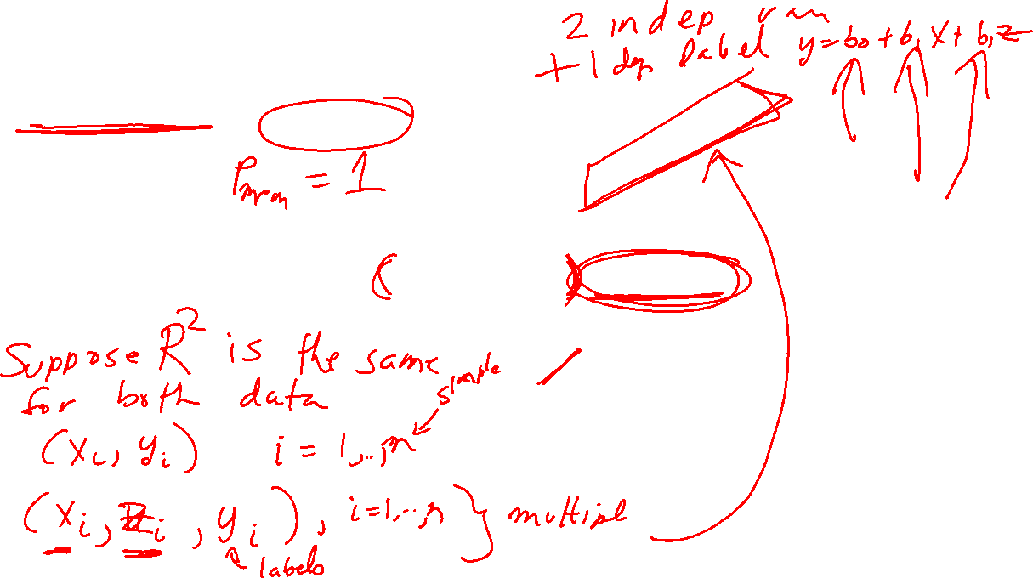
StatQuest: Linear Models Pt.1 - Linear Regression https://www.youtube.com/watch?v=nk2CQITm_eo

