Slide 1
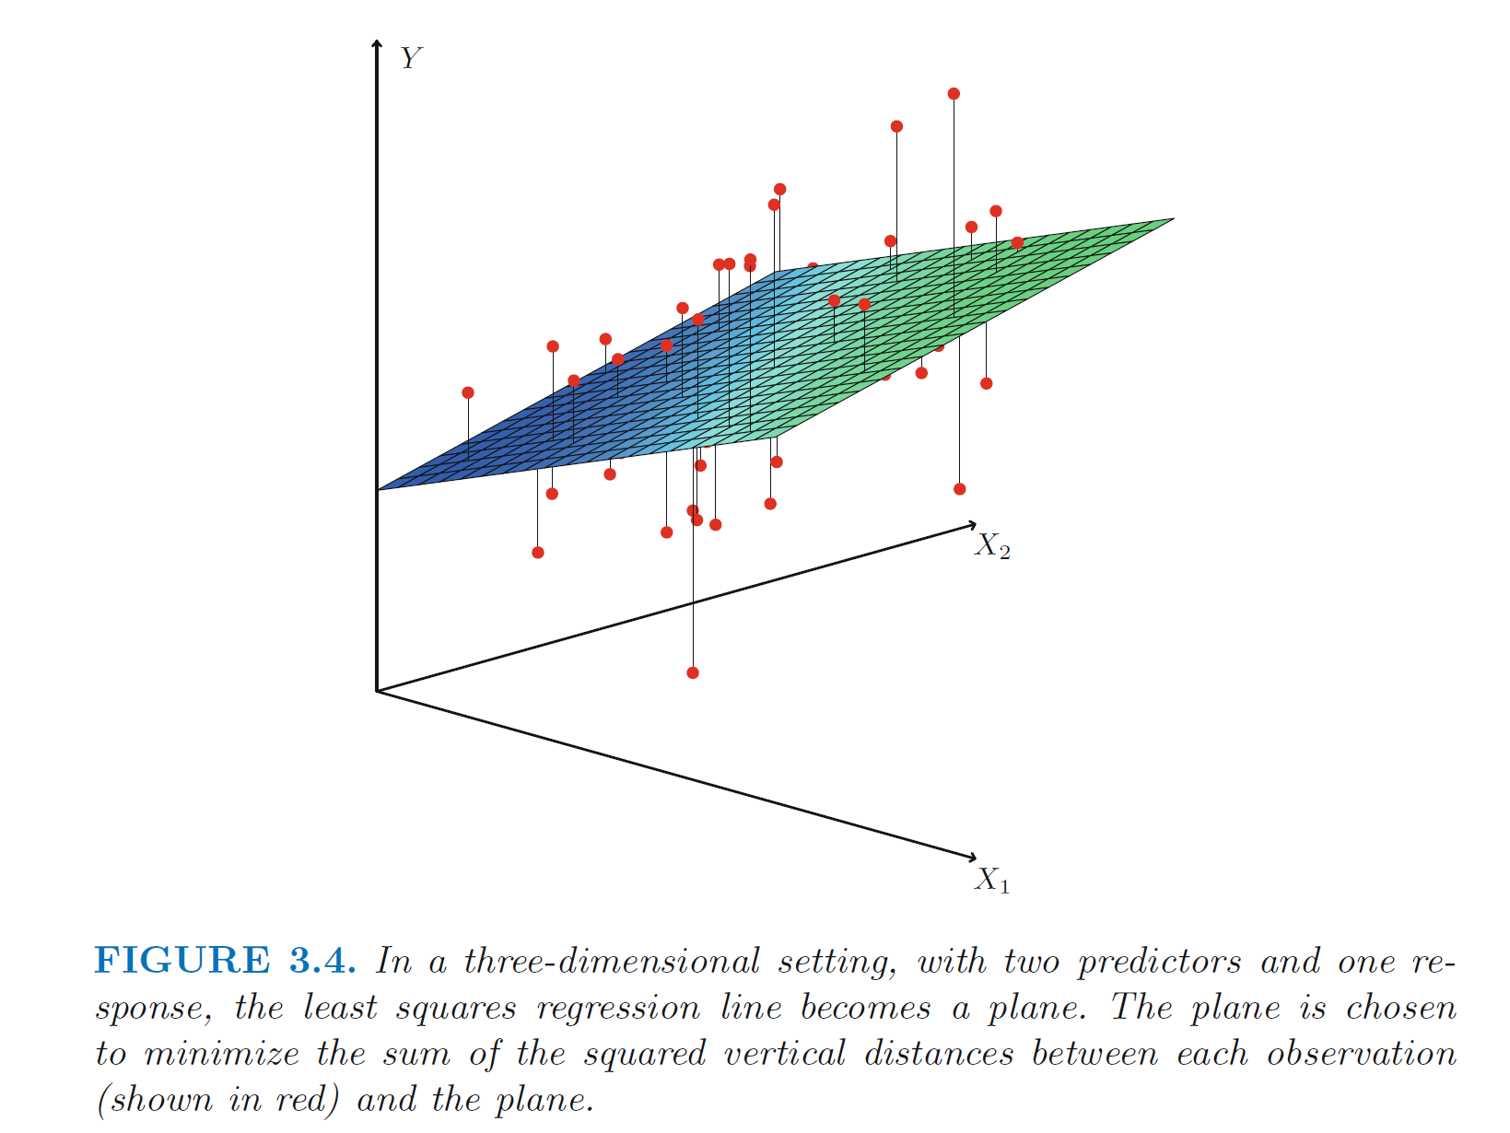
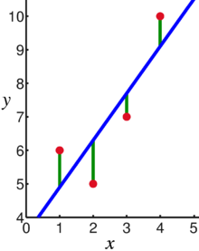
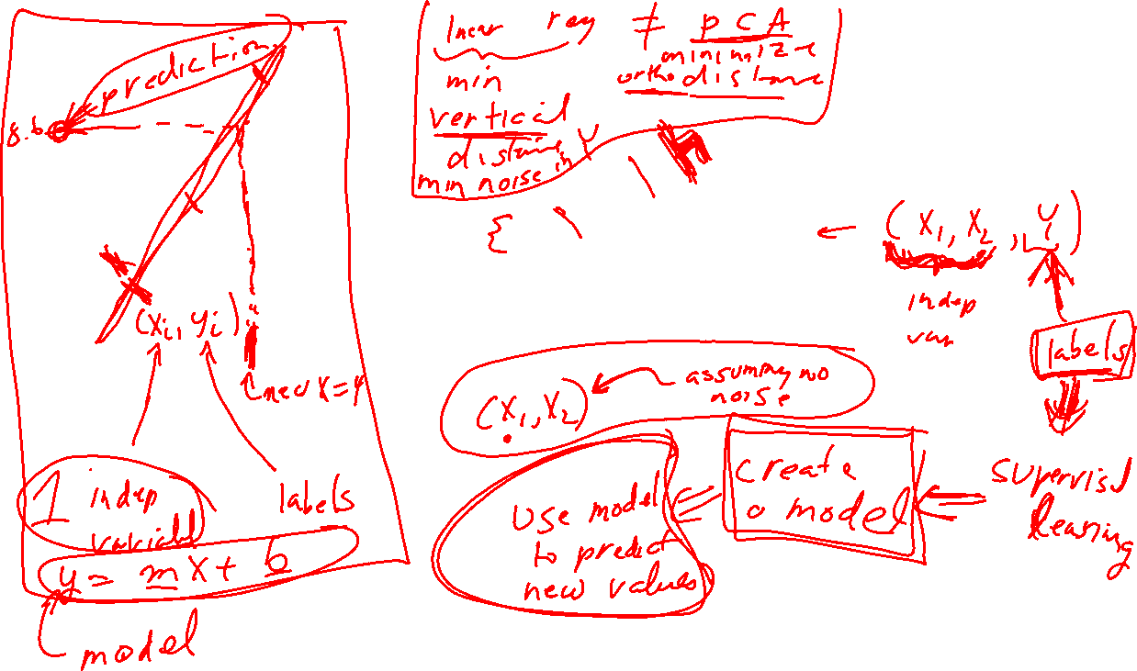
https://en.wikipedia.org/wiki/Linear_regression
https://www.statlearning.com/

Slide 2
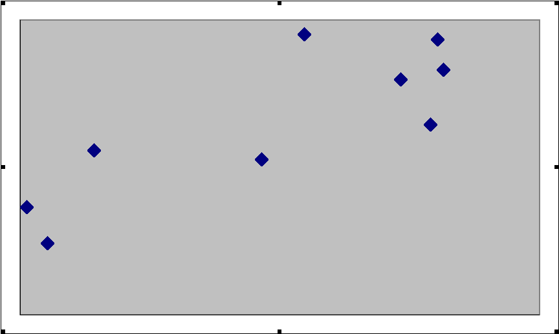
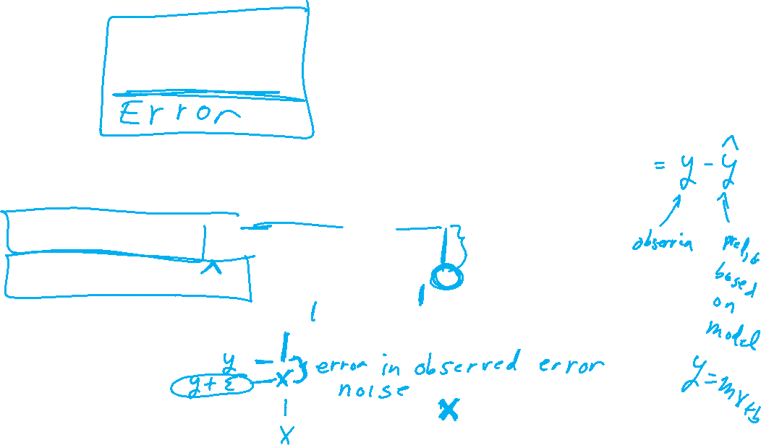
What is a Residual?
Here shows a residual on the scatter diagram
The residual
The regression line
The observed value y
The predicted value y
The x value of interest
https://emunix.emich.edu/~schu/MATH_170/Fall09_170/Evening%20session/Unit%203.ppt

Slide 3
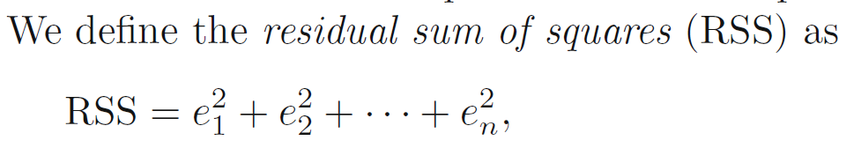
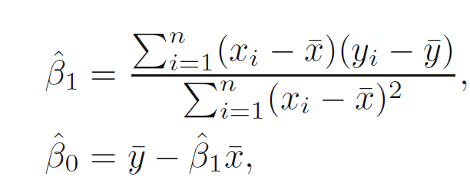
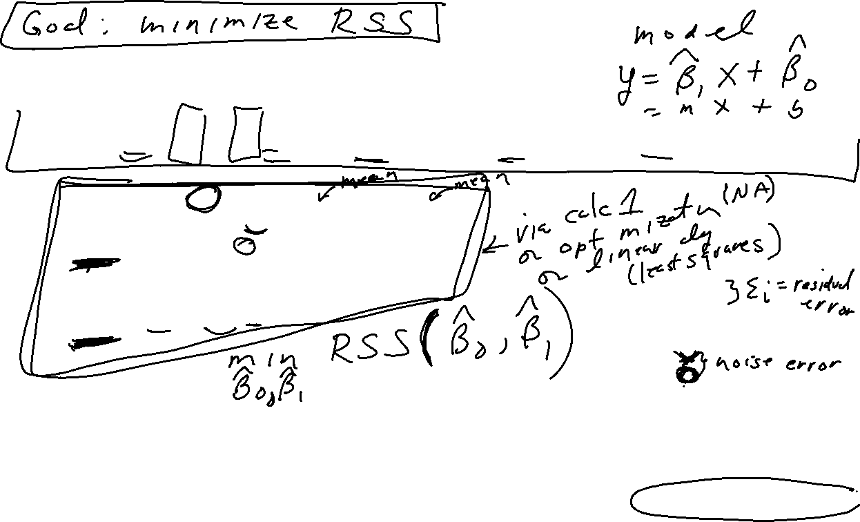
https://en.wikipedia.org/wiki/Linear_regression
https://www.statlearning.com/

Slide 4
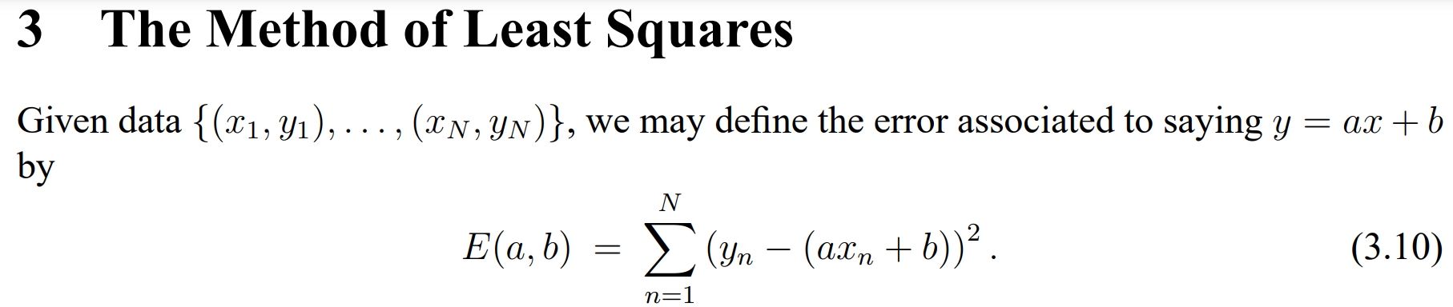
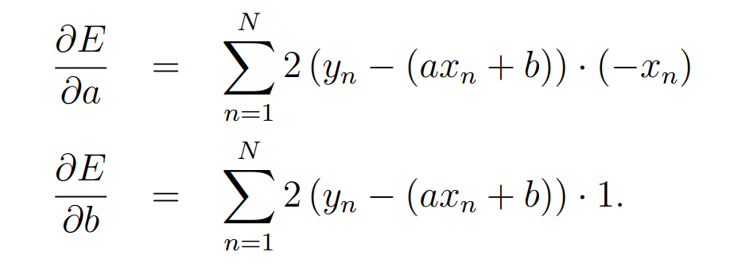
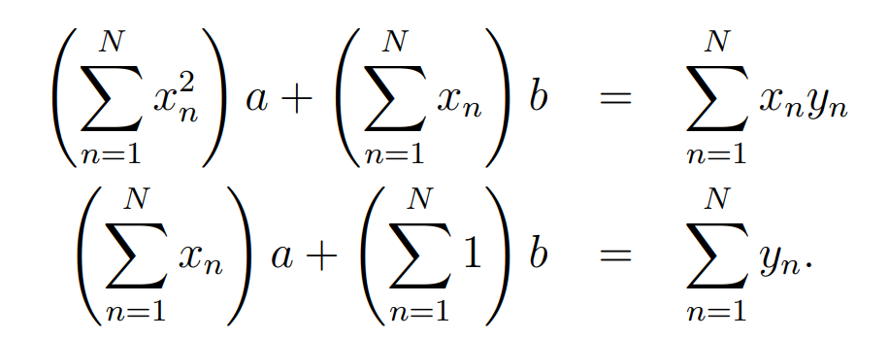
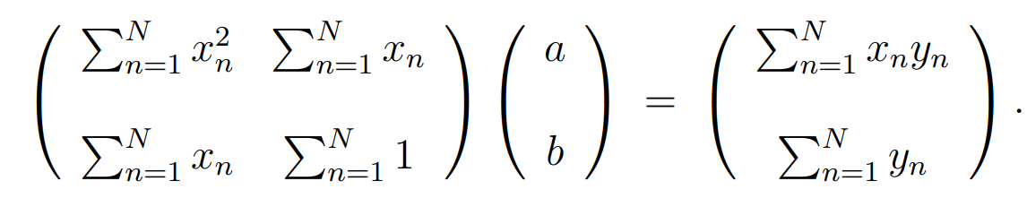
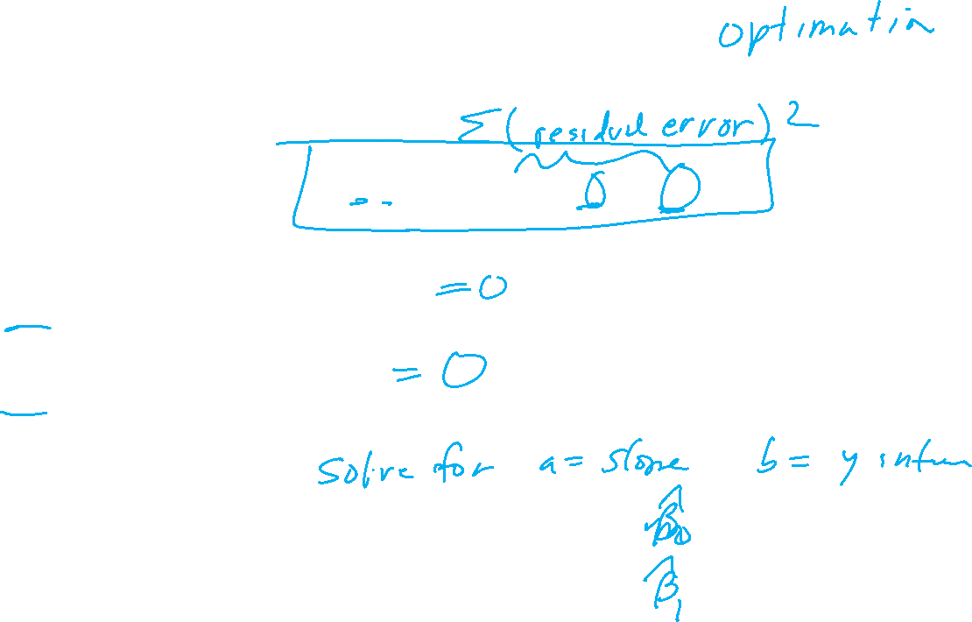
https://web.williams.edu/Mathematics/sjmiller/public_html/BrownClasses/54/handouts/MethodLeastSquares.pdf

Slide 5
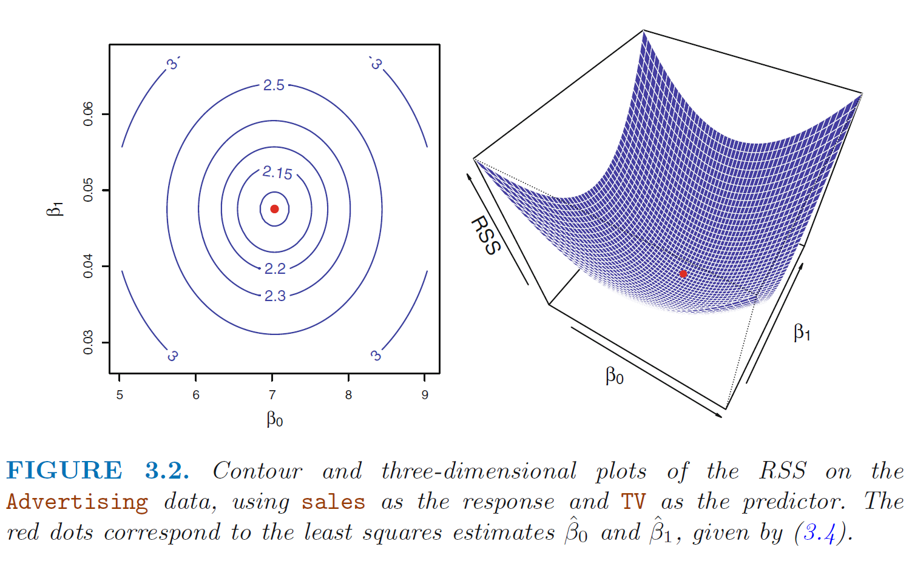
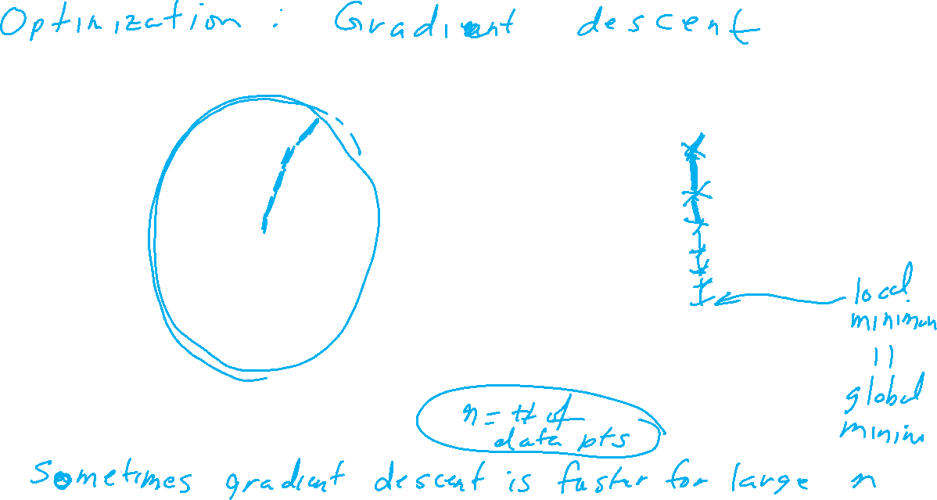
https://www.statlearning.com/

Slide 6





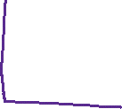
















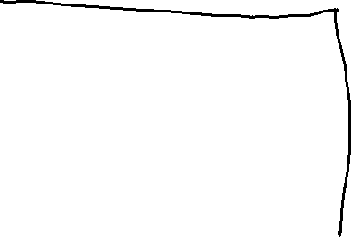

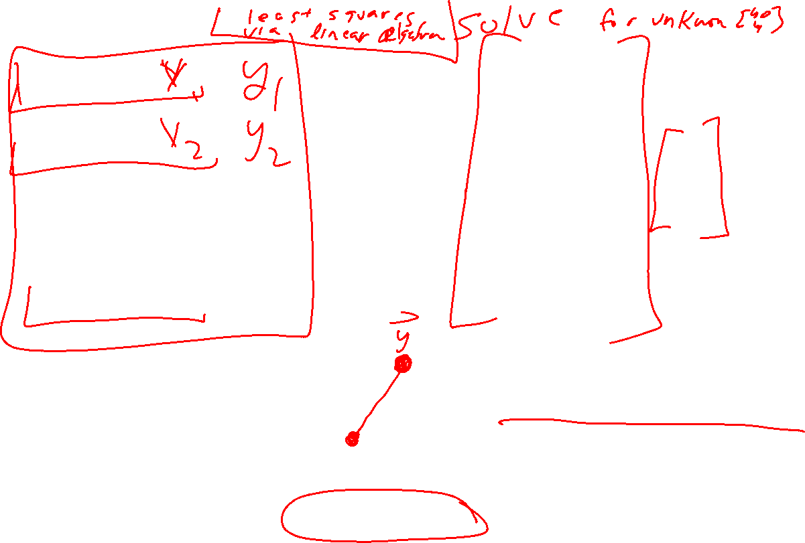

Slide 7
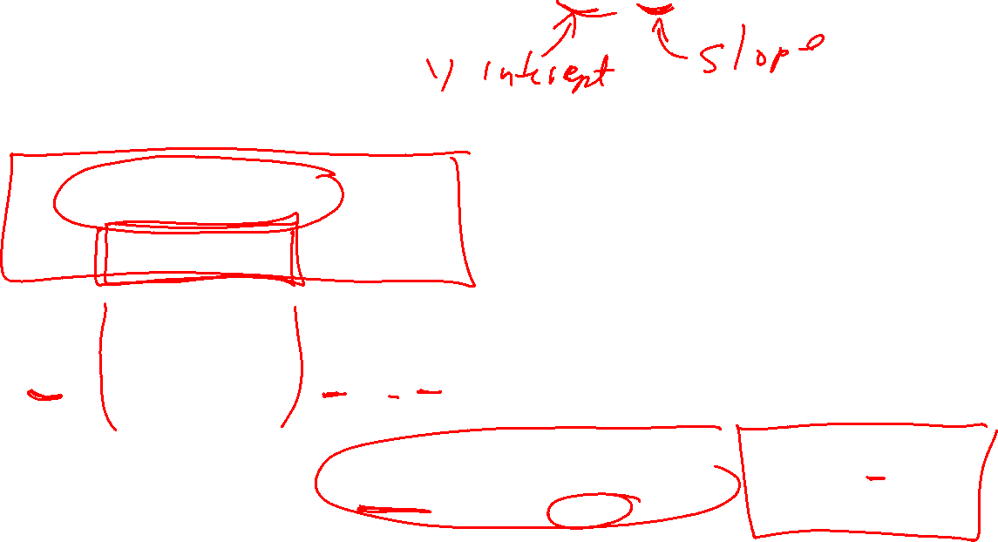
Find the Equation of a Linear Regression Line
The equation is determined by:
  b₀: y-intercept
  b₁: slope
Values that satisfy the least squares criterion:

Slide 8
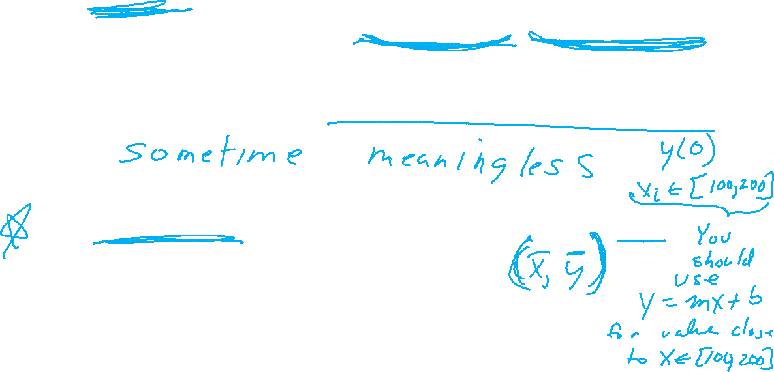
Please Note
The slope b₁ represents
the predicted change in y per unit increase in x
The y-intercept is the value of y where the line of best fit intersects the y-axis. That is, it is the predicted value of y when x is zero.
The line of best fit will always pass through the point

Slide 9
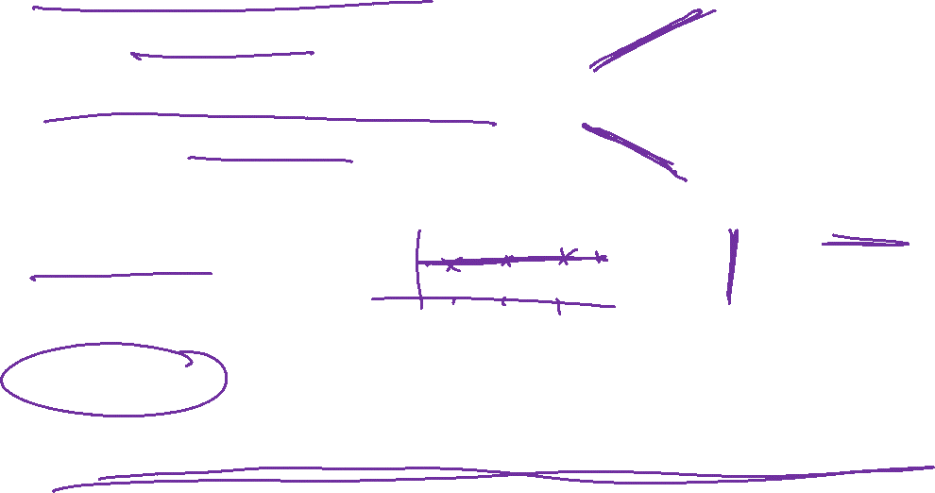
Please Note
Perfect positive correlation: all the points lie along a line with positive slope
Perfect negative correlation: all the points lie along a line with negative slope
If the points lie along a horizontal or vertical line: no correlation
If the points exhibit some other nonlinear pattern: nonlinear relationship
Need some way to measure the strength of correlation

Slide 10
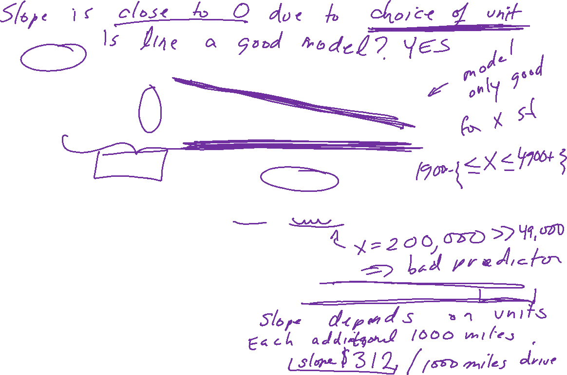
6533
0
No data
The intercept is b₀ = 6533.
This is the slope of the line.
For each additional mile on the odometer,
the price decreases by an average of $0.0312
Do not interpret the intercept as the
“Price of cars that have not been driven”
https://web.stanford.edu/class/msande247s/kchap17.ppt

Slide 11
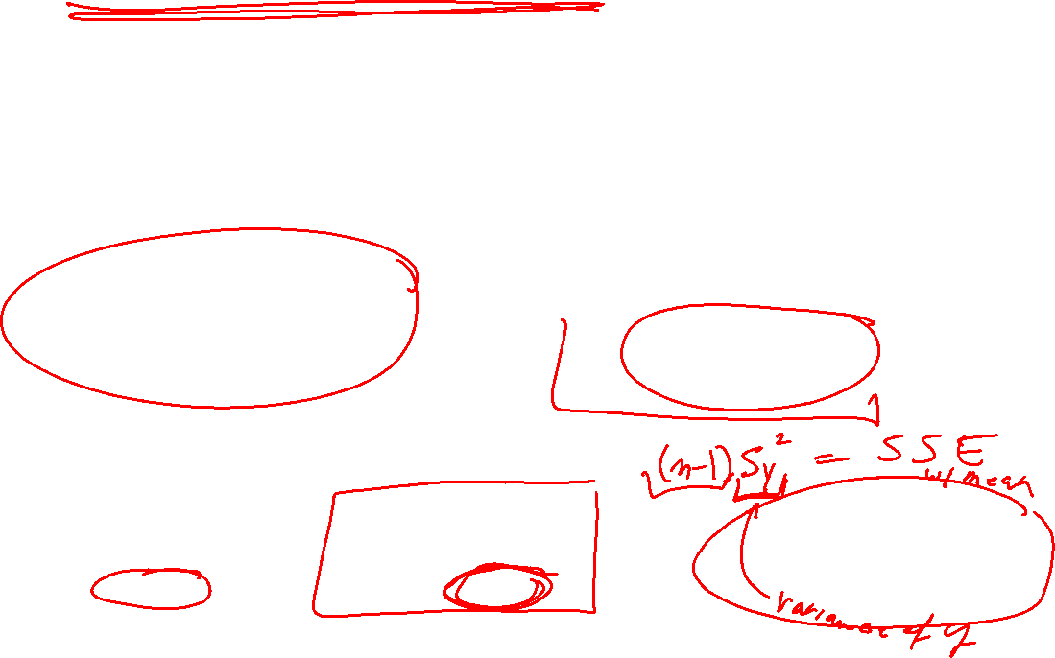
Coefficient of determination
https://web.stanford.edu/class/msande247s/kchap17.ppt
  When we want to measure the strength of the linear relationship, we use the coefficient of determination.

Slide 12
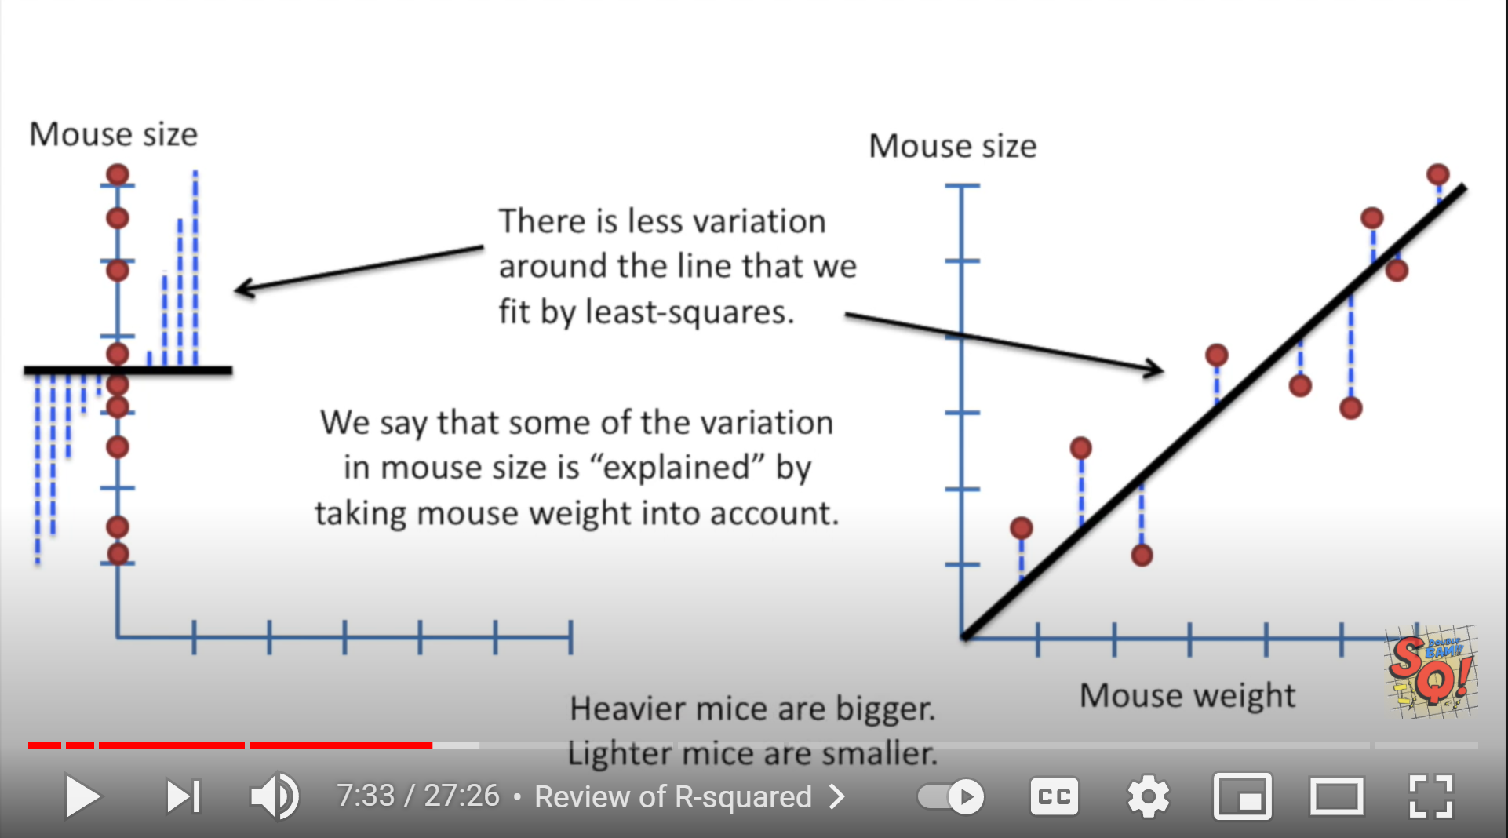
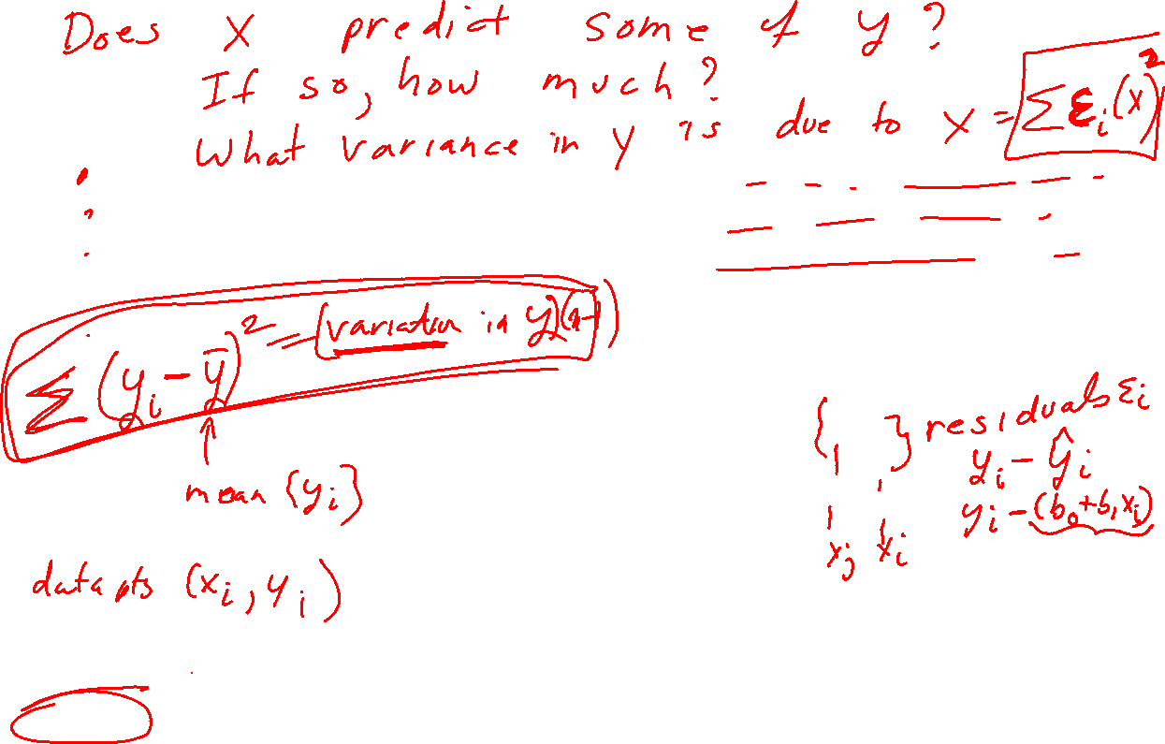
StatQuest: Linear Models Pt.1 - Linear Regression https://www.youtube.com/watch?v=nk2CQITm_eo

Slide 13
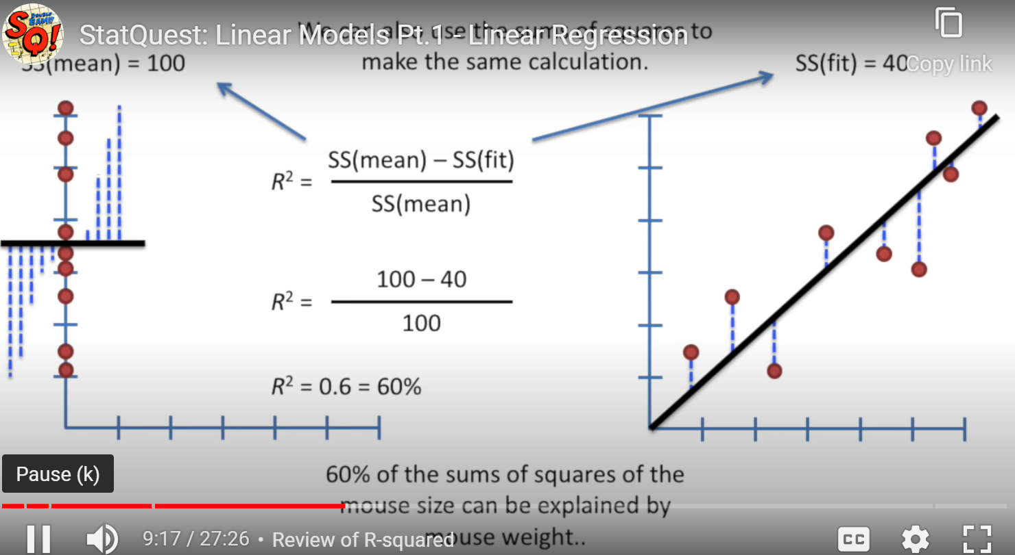

Slide 14
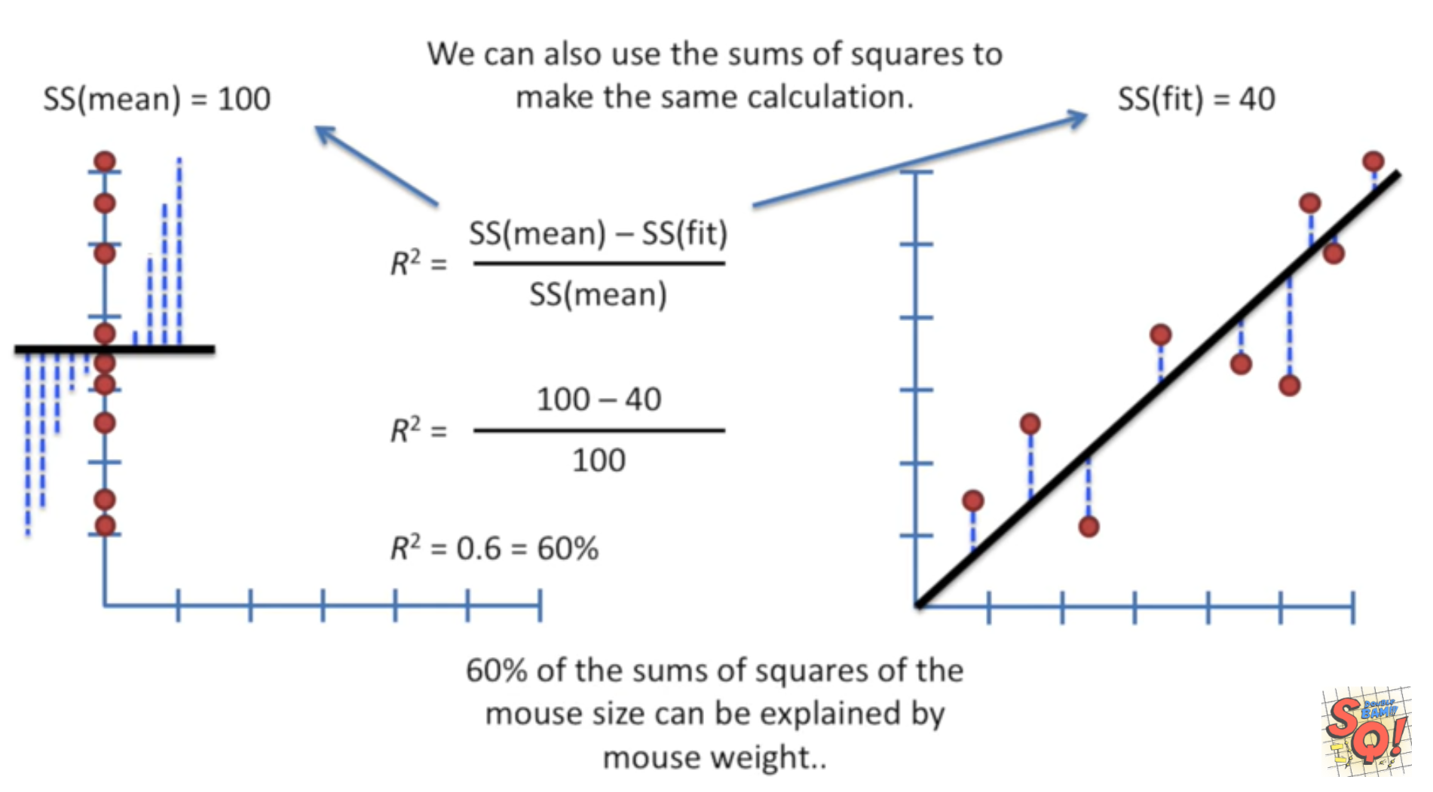
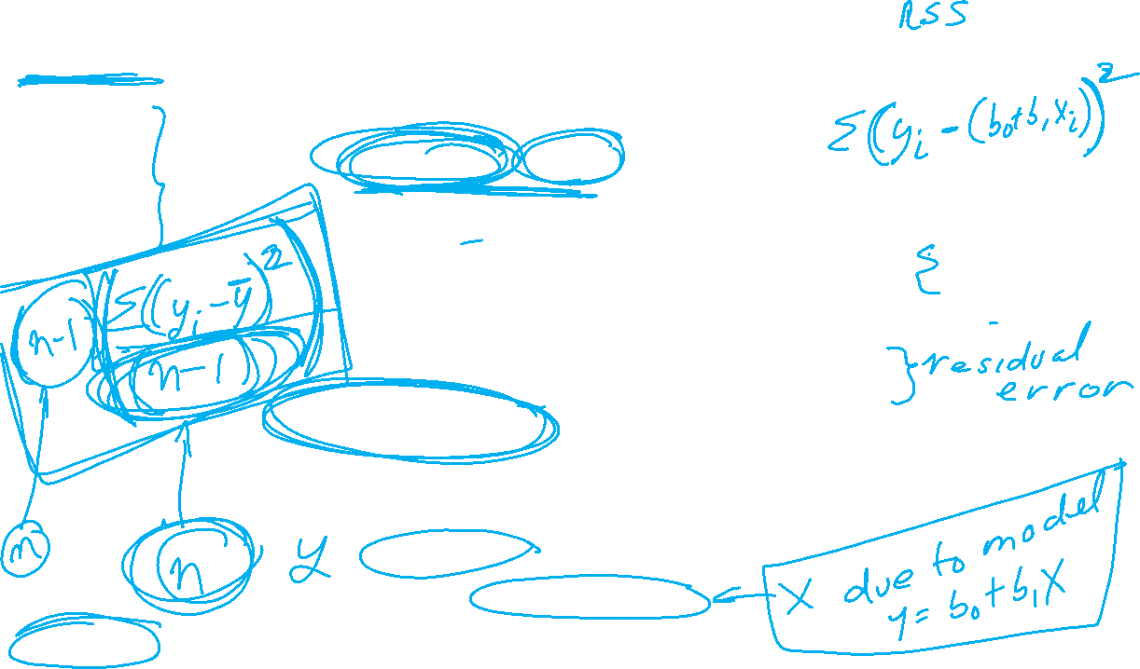
StatQuest: Linear Models Pt.1 - Linear Regression https://www.youtube.com/watch?v=nk2CQITm_eo

Slide 15
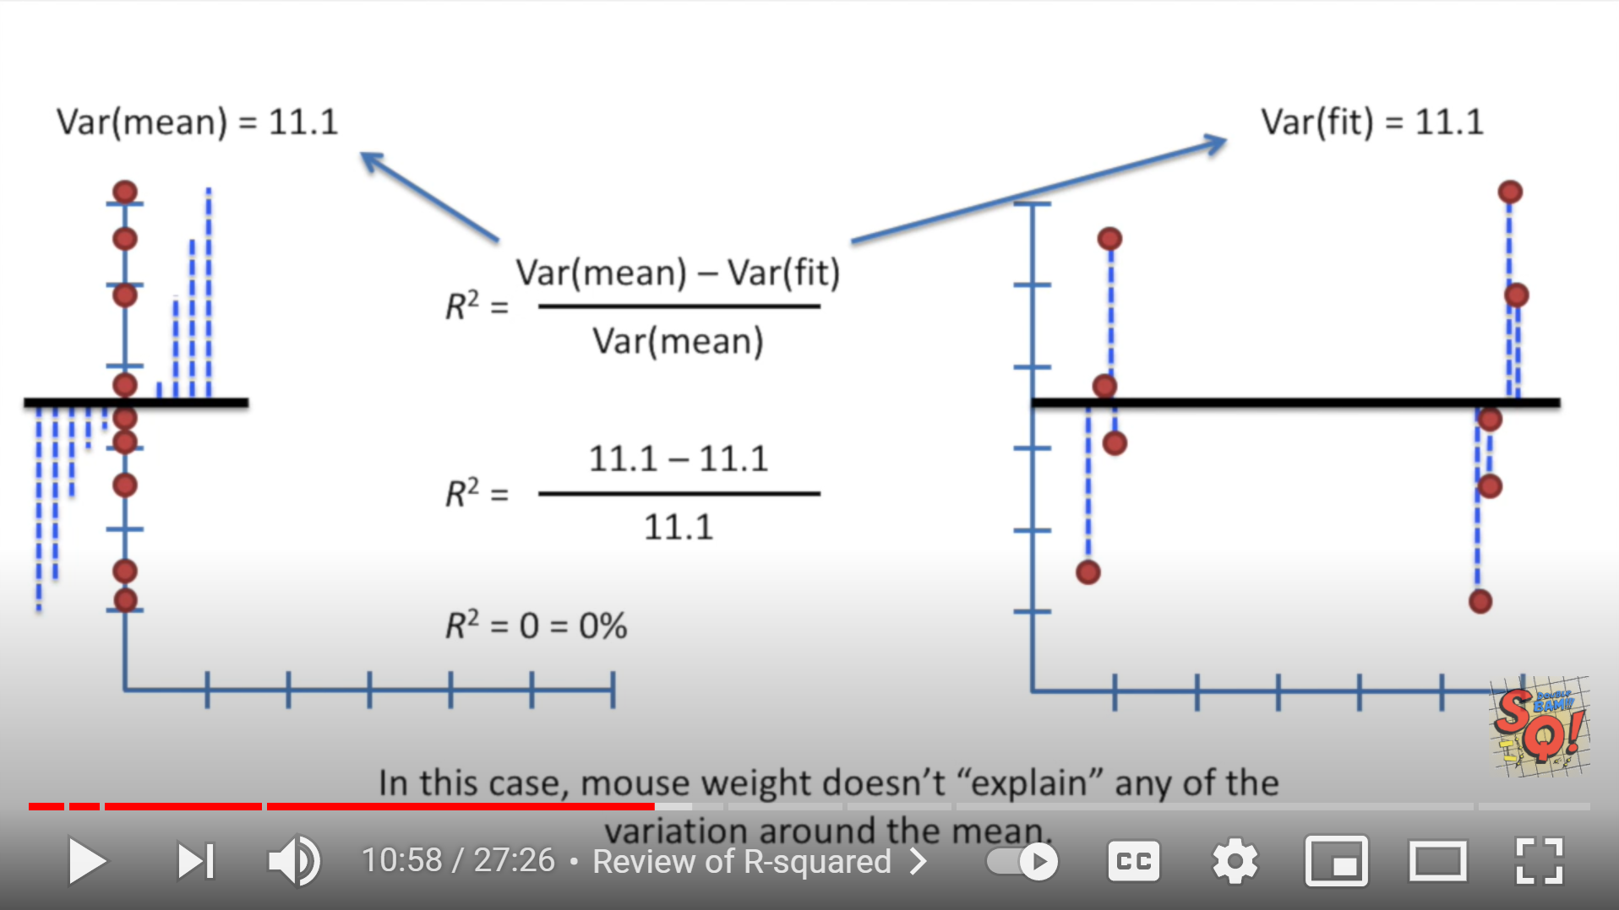
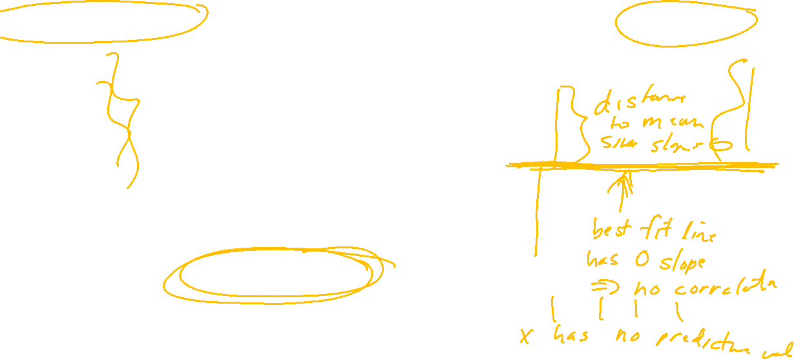
StatQuest: Linear Models Pt.1 - Linear Regression https://www.youtube.com/watch?v=nk2CQITm_eo

Slide 16
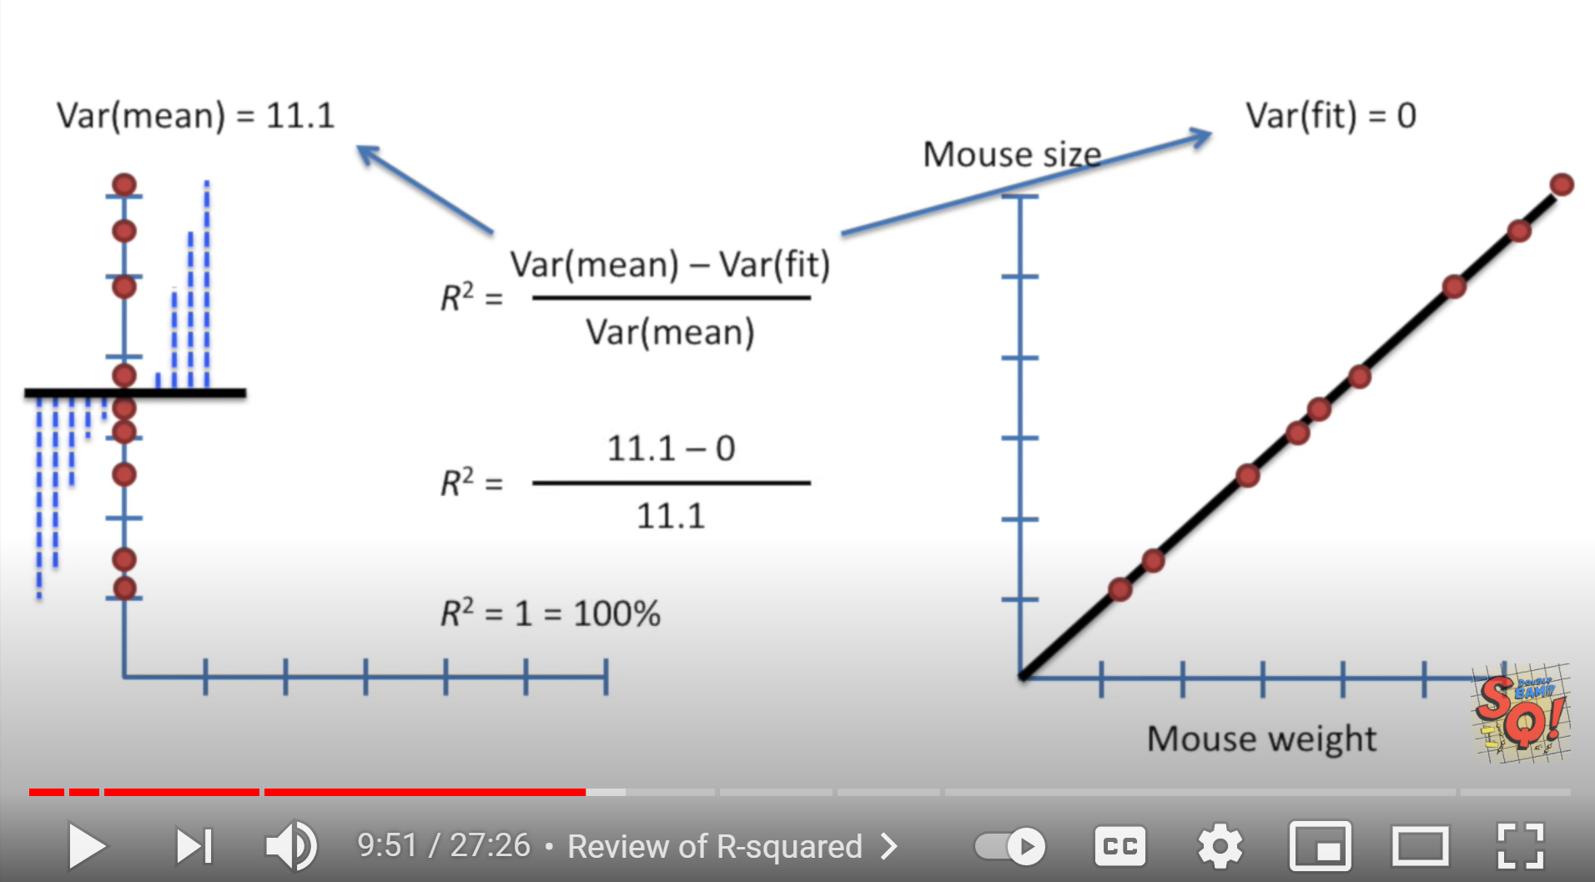
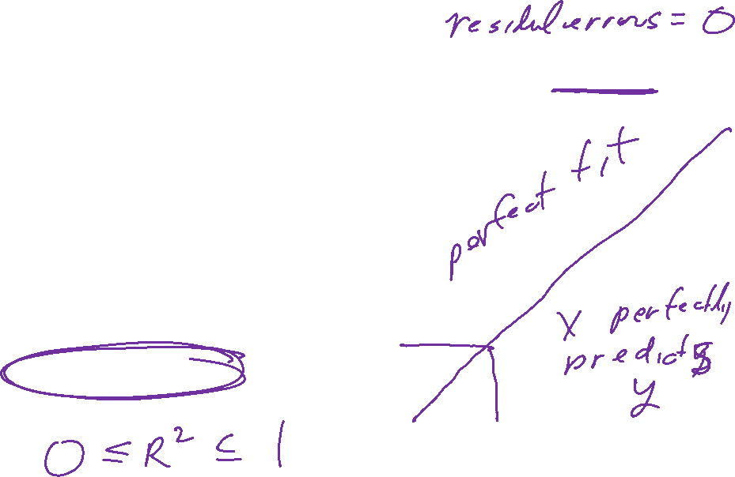
StatQuest: Linear Models Pt.1 - Linear Regression https://www.youtube.com/watch?v=nk2CQITm_eo

Slide 17
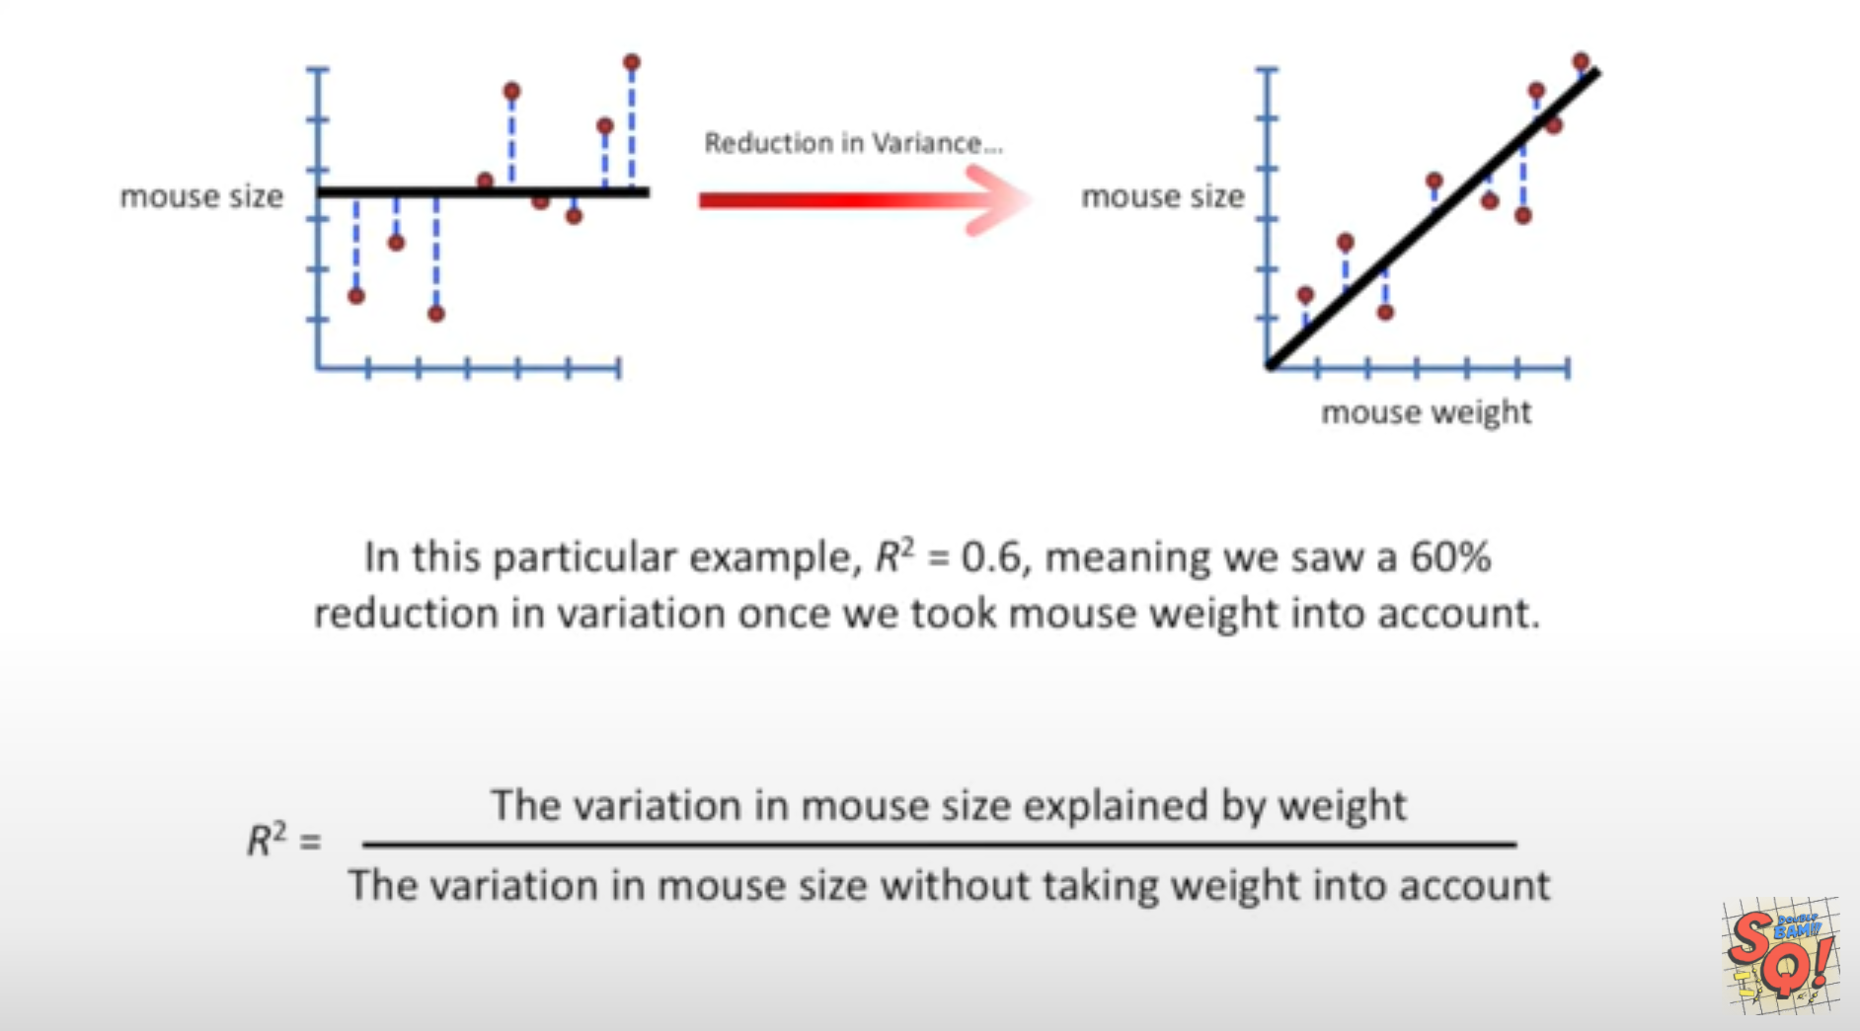
StatQuest: Linear Models Pt.1 - Linear Regression https://www.youtube.com/watch?v=nk2CQITm_eo

Slide 18
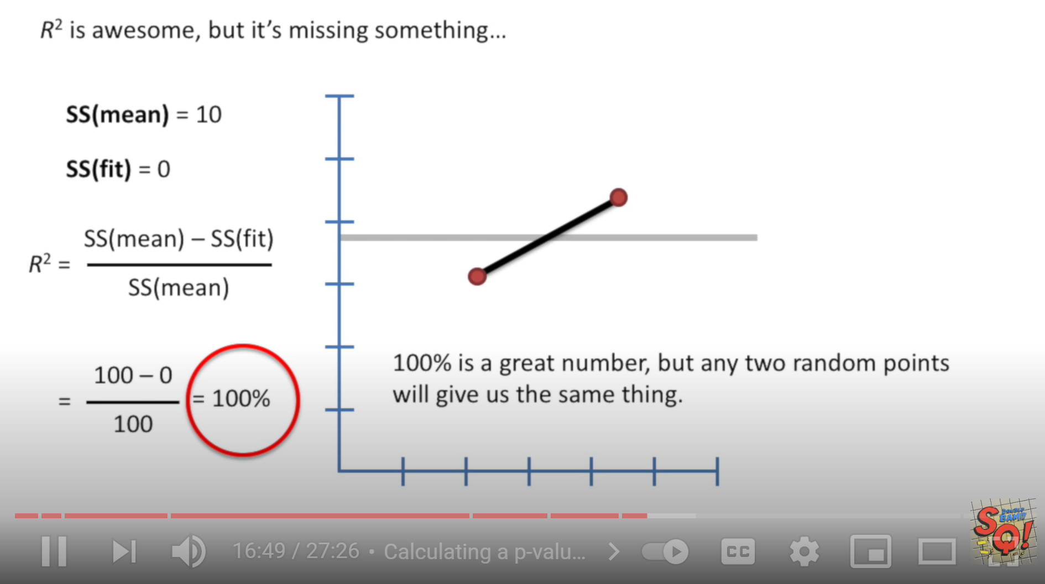
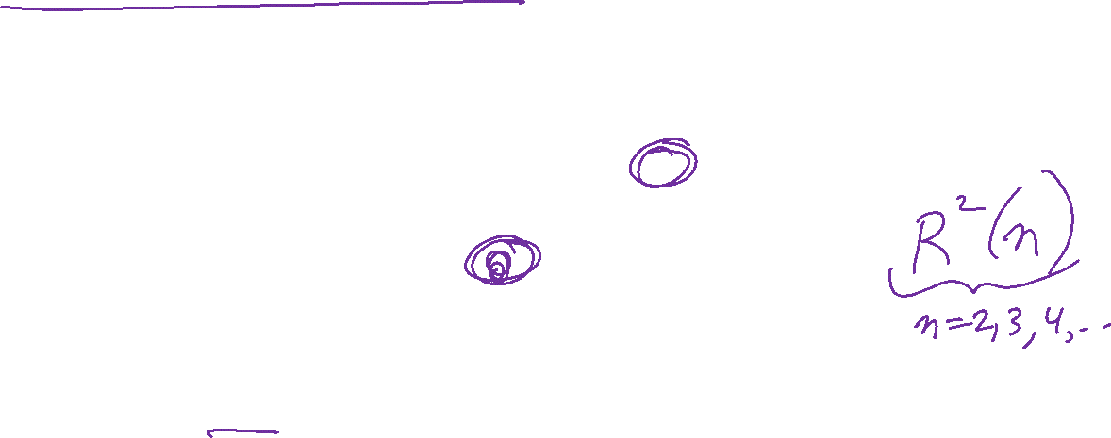
StatQuest: Linear Models Pt.1 - Linear Regression https://www.youtube.com/watch?v=nk2CQITm_eo

