Slide 1
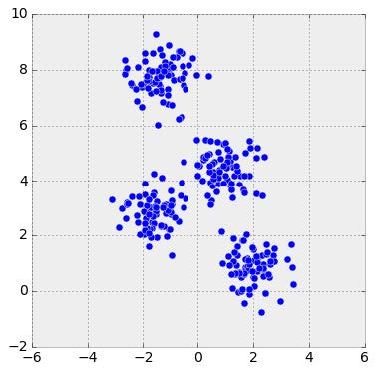
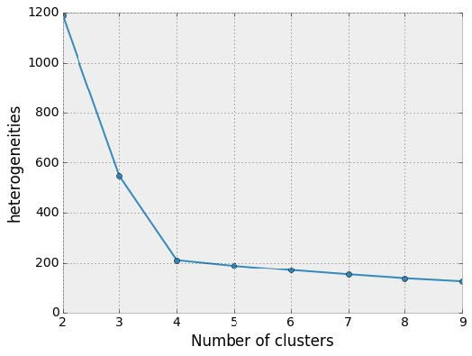
Elbow method
http://sites.northwestern.edu/msia/2016/12/
08/k-means-shouldnt-be-our-only-choice/

Slide 2
How many clusters?
x
x
x
x
x
x
x
x
x
x
x
x
x
x
x
x
x
x
x
x
x
x
x
x
x
x
x
x
x
x
x
x
x
x
x
x
x
x
x
x
x
x
x
x
x
x
x
x
x
x
x
x
x
x
x
x
x
x
x
x
x
x
x
x

Slide 3
x
x
x
x
How many clusters?
x
x
x
x
x
x
x
x
x
x
x
x
x
x
x
x
x
x
x
x
x
x
x
x
x
x
x
x
x
x
x
x
x
x
x
x
x
x
x
x
x
x
x
x
x
x
x
x
x
x
x
x
x
x
x
x
x
x
x
x

Slide 4
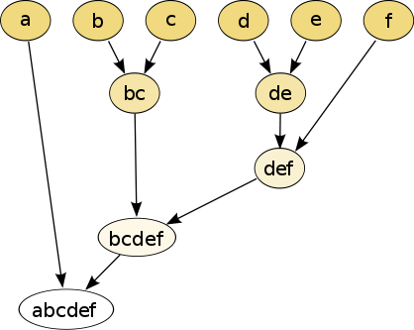
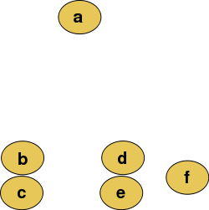
Hierarchical clustering
Data
Dendrogram
http://en.wikipedia.org/wiki/File:Clusters.svg
http://en.wikipedia.org/wiki/File:Hierarchical_clustering_simple_diagram.svg

Slide 5
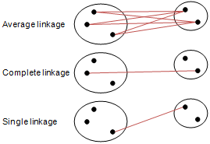
Different type of hierarchical clustering
What is the distance between 2 clusters?
http://en.wikipedia.org/wiki/File:Hierarchical_clustering_simple_diagram.svg
http://www.multid.se/genex/hs515.htm

Slide 6
Increasing threshold
Connect vertices (or clusters) whose distance is less than a given threshold

Slide 7
Increasing threshold
Connect vertices (or clusters) whose distance is less than a given threshold

Slide 8
Different type of hierarchical clustering
What is the distance between 2 clusters?
http://en.wikipedia.org/wiki/File:Hierarchical_clustering_simple_diagram.svg
http://www.multid.se/genex/hs515.htm

Slide 9
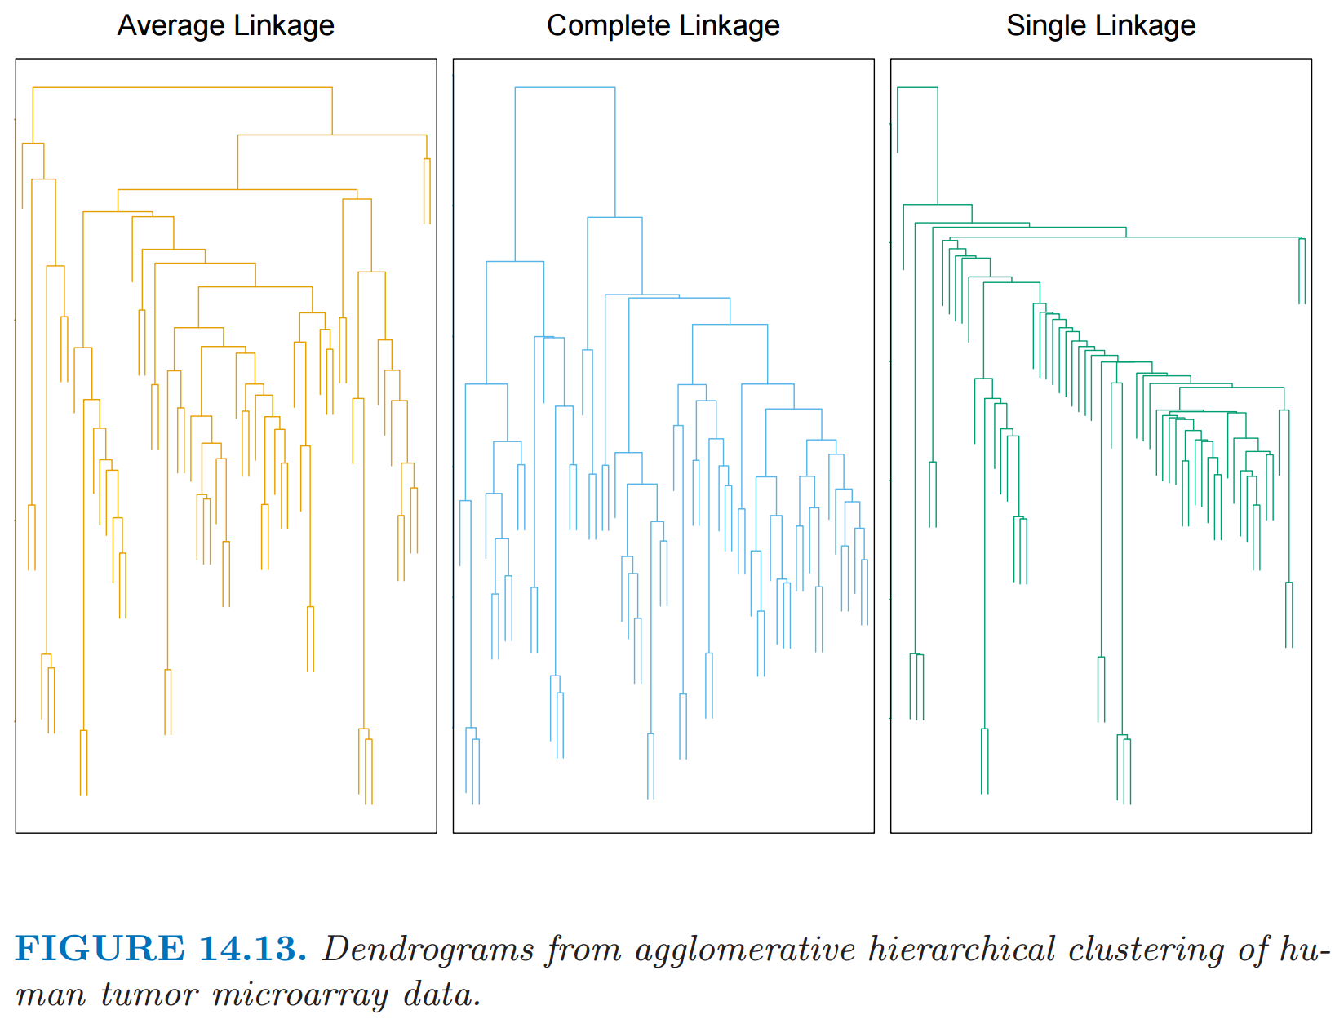
http://statweb.stanford.edu/~tibs/ElemStatLearn/
The Elements of Statistical Learning (2nd edition) Hastie, Tibshirani and Friedman

Slide 10
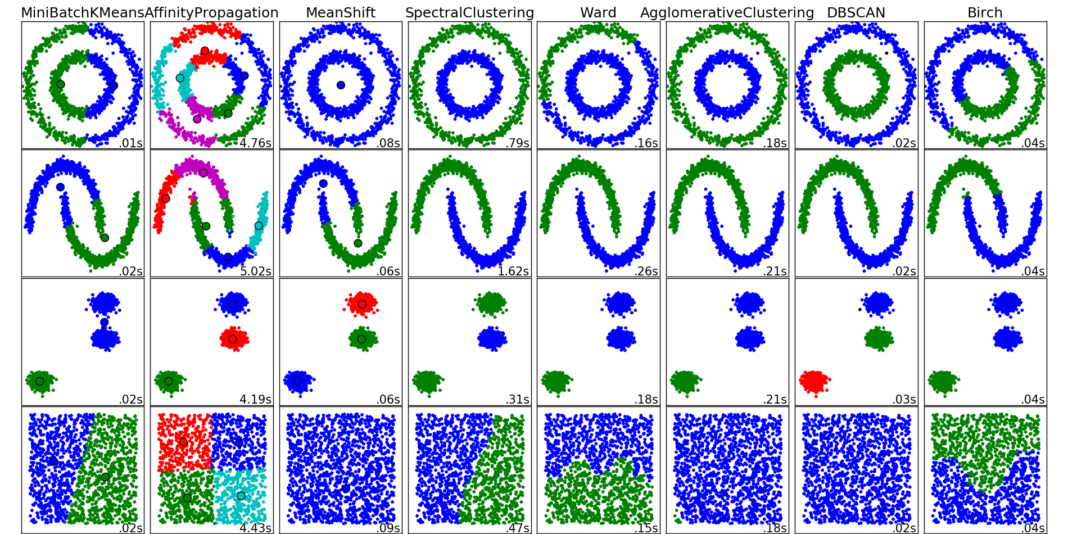
http://scikit-learn.org/stable/auto_examples/cluster/plot_cluster_comparison.html

Slide 11
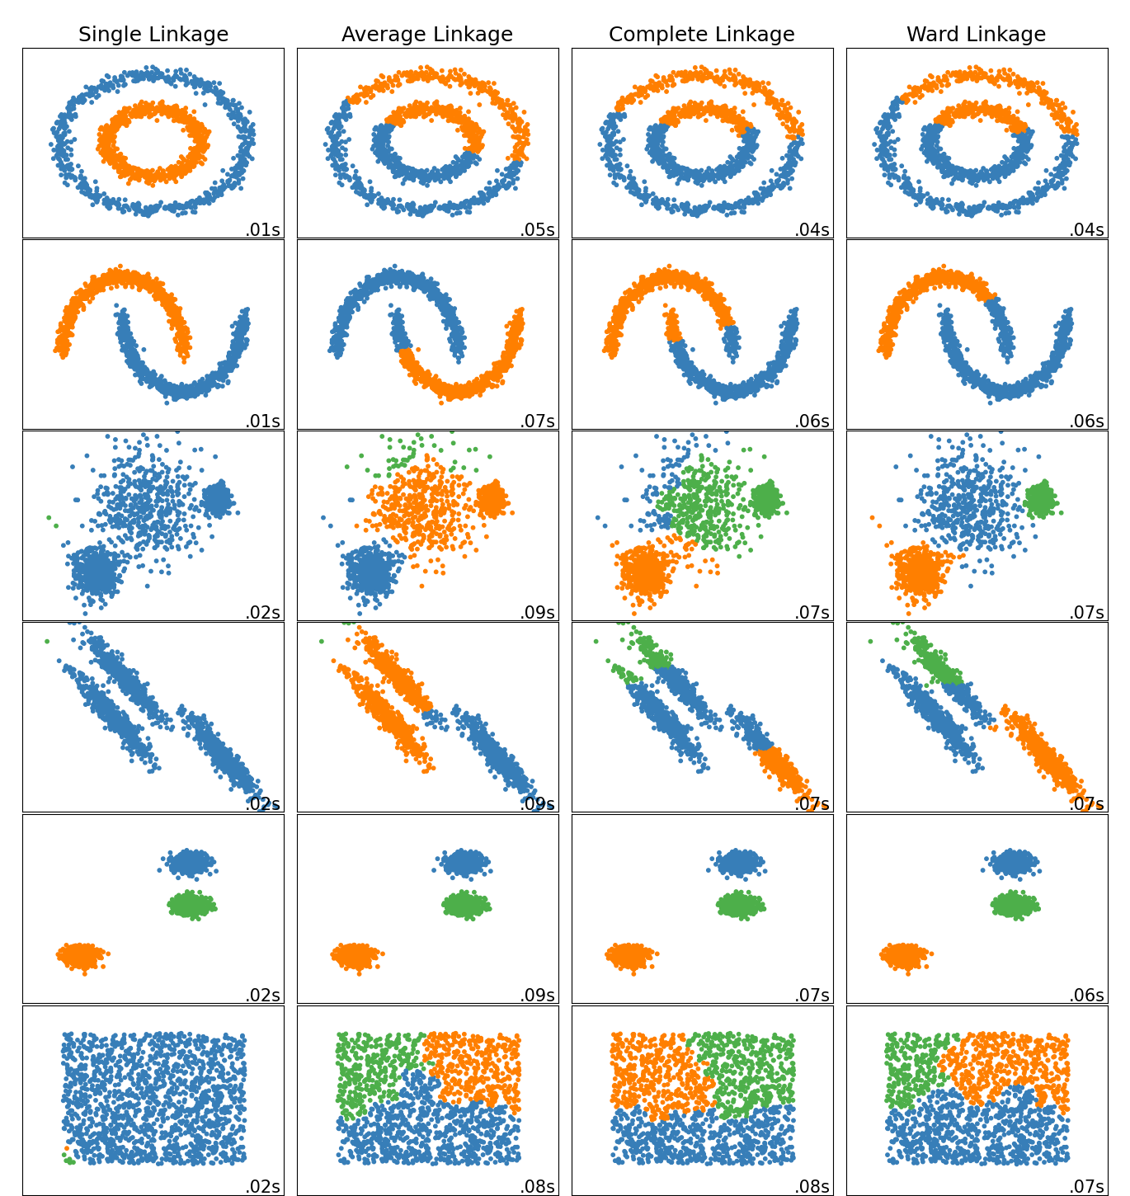
https://scikit-learn.org/stable/modules/clustering.html#hierarchical-clustering

Slide 12
Which pair is closer: a and b OR c and d?
Type your answer in the chat window.
a b
c
a b
c
d
http://statweb.stanford.edu/~tibs/ElemStatLearn/
d
The Elements of Statistical Learning (2nd edition) Hastie, Tibshirani and Friedman

Slide 13
Which pair is closer: a and b OR c and d?
a b
c
a b
d
c
d
http://statweb.stanford.edu/~tibs/ElemStatLearn/
The Elements of Statistical Learning (2nd edition) Hastie, Tibshirani and Friedman

Slide 14
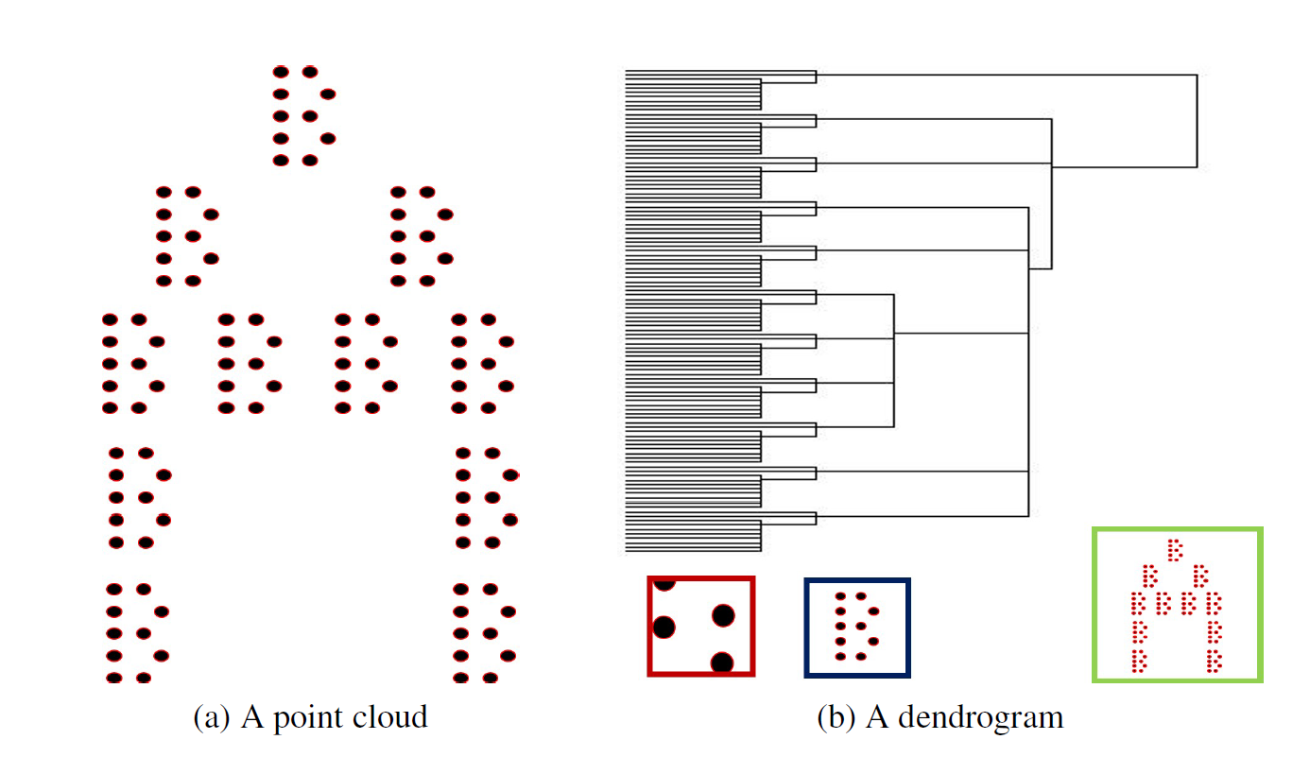
Figure courtesy of Paul Samuel Ignacio

Slide 15
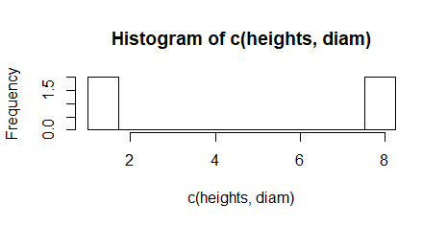
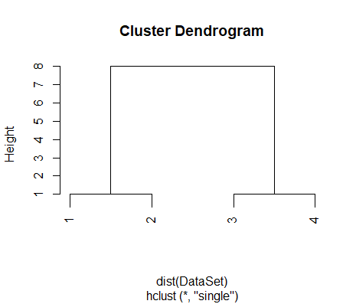

Slide 16
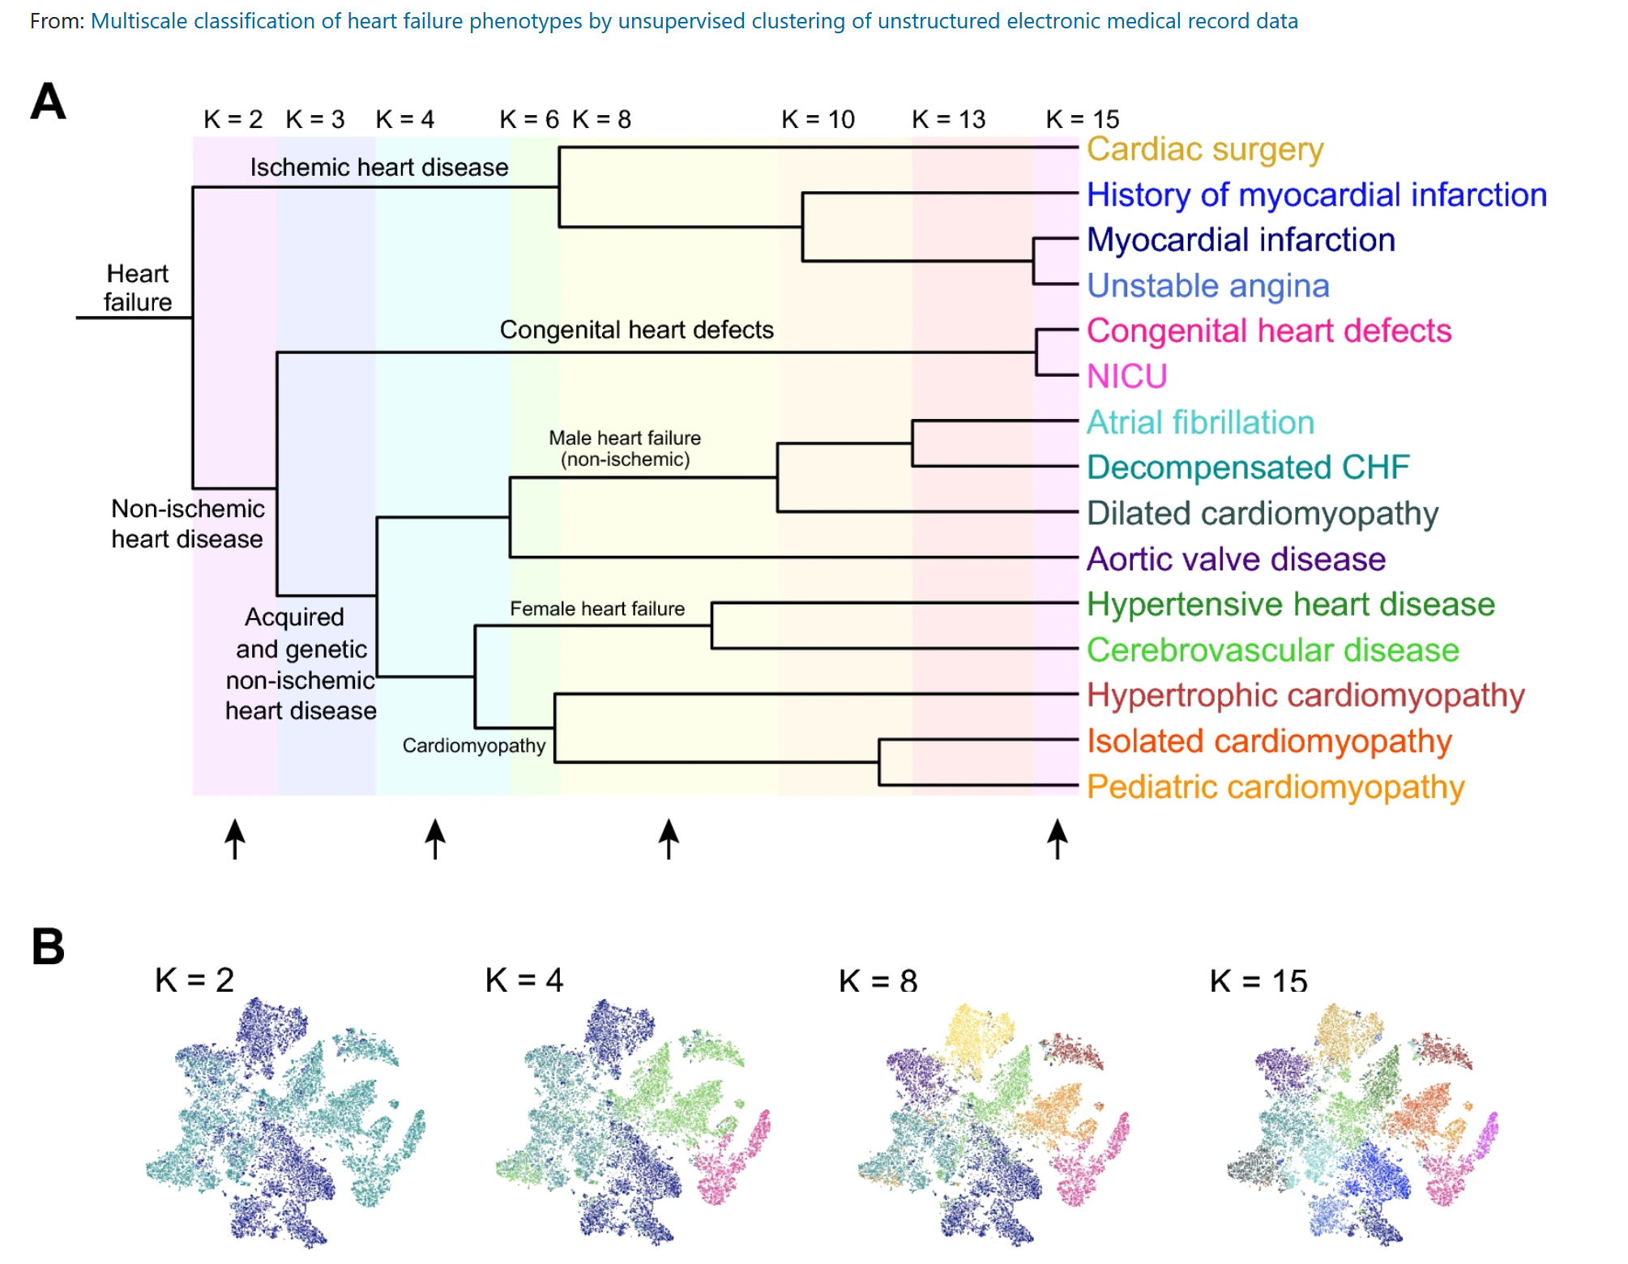
https://www.nature.com/articles/s41598-020-77286-6

Slide 17
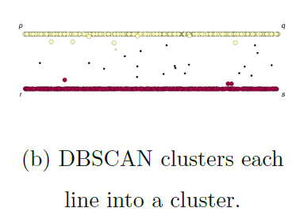
If you care about closeness:
Complete linkage
Average linkage
Ward’s linkage
K-means
If you care about connected components:
Single linkage
DBscan
Figures courtesy of Wako Bungula

