Slide 1
A few notes from yesterday’s colloquium regarding moving into industry:
https://www.datacamp.com/ Build data skills online (elementary broad overview)
Insight vs DataIncubator
Some recommended courses
Statistical Inference 1 and 2
Applied statistics 1 and 2*
*Computing and Statistics
CS:5110 Introduction to Informatics (python)
Github is your portfolio comment your code!!!!!!
Kaggle competition/Kaggle notebooks
Program using google
Social media is often not accurate including linkedin
You are all very smart people
*Rhonda 2: Applied statistics 2

Slide 2
Voronoi diagram:
Suppose your data points live in R^{n}.
Choose data point v.
The Voronoi cell associated with v is
H(v,w)
U
w ≠ v
The Voronoi cell associated with v is
C_{v}= { x in R^{n} : d(x, v) ≤ d(x, w) for all w ≠ v }
Notes:
data points.
In this very simplified case my data points lie in a two-dimensional plane. Normally data points are high dimensional.
For example, I may be comparing the expression or thousands of genes in tumor cells to healthy cells using microarray data. OR I might be comparing politicians voting records. Or I might be comparing the stats of basketball players. These three applications were all, by the way, published by Lum et al this past February in Nature’s Scientific Reports. I have included a link to their paper on my youtube site.
http://www.nature.com/srep/2013/130207/srep01236/full/srep01236.html

Slide 3
Applications of Voronoi Diagrams https://www.ics.uci.edu/~eppstein/gina/scot.drysdale.html
Anthropology and Archeology -- Identify the parts of a region under the influence of different neolithic clans, chiefdoms, ceremonial centers, or hill forts.
Astronomy -- Identify clusters of stars and clusters of galaxies (Here we saw what may be the earliest picture of a Voronoi diagram, drawn by Descartes in 1644, where the regions described the regions of gravitational influence of the sun and other stars.)
Biology, Ecology, Forestry -- Model and analyze plant competition ("Area potentially available to a tree", "Plant polygons")
Cartography -- Piece together satellite photographs into large "mosaic" maps
Crystallography and Chemistry -- Study chemical properties of metallic sodium ("Wigner-Seitz regions"); Modelling alloy structures as sphere packings ("Domain of an atom")
Finite Element Analysis -- Generating finite element meshes which avoid small angles
Geography -- Analyzing patterns of urban settlements
Geology -- Estimation of ore reserves in a deposit using information obtained from bore holes; modelling crack patterns in basalt due to contraction on cooling
Geometric Modeling -- Finding "good" triangulations of 3D surfaces
Marketing -- Model market of US metropolitan areas; market area extending down to individual retail stores
Mathematics -- Study of positive definite quadratic forms ("Dirichlet tesselation", "Voronoi diagram")
Metallurgy -- Modelling "grain growth" in metal films
Meteorology -- Estimate regional rainfall averages, given data at discrete rain gauges ("Thiessen polygons")
Pattern Recognition -- Find simple descriptors for shapes that extract 1D characterizations from 2D shapes ("Medial axis" or "skeleton" of a contour)
Physiology -- Analysis of capillary distribution in cross-sections of muscle tissue to compute oxygen transport ("Capillary domains")
Robotics -- Path planning in the presence of obstacles
Statistics and Data Analysis -- Analyze statistical clustering ("Natural neighbors" interpolation)
Zoology -- Model and analyze the territories of animals
In addition to all these "real world" applications, Voronoi diagrams have several applications within the field of computer science, in particular, computational geometry.
Knuth's Post Office Problem -- Given a set of locations for post offices, how do you determine the closest post office to a given house? (Apparently, Knuth was ignoring the existence of ZIP codes.)
Closest Pair -- Given a set of points, which two are closest together?
All Nearest Neighbors -- Given a set of points, find each point's nearest neighbor
Euclidean Minimum Spanning Tree
Largest Empty Circle, also known as the Toxic Waste Dump Problem
Fixed Radius Near Neighbors -- Find all pairs of points closer than a given distance apart.
All k Nearest Neighbors -- Find each point's k closest neighbors
Enumerating interpoint distances in increasing order -- Find the closest pair, then the next closest pair, then the next closest pair, and so on.

Slide 4
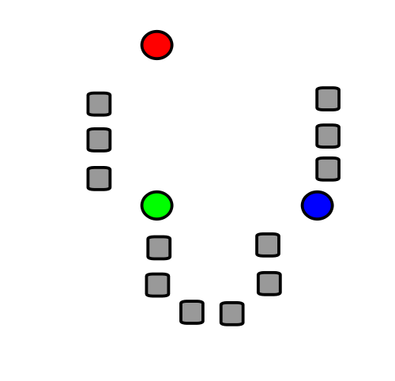
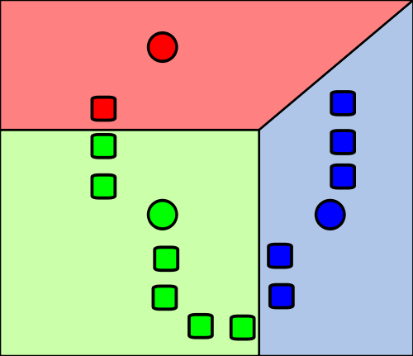
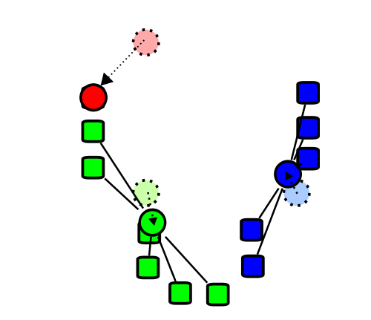
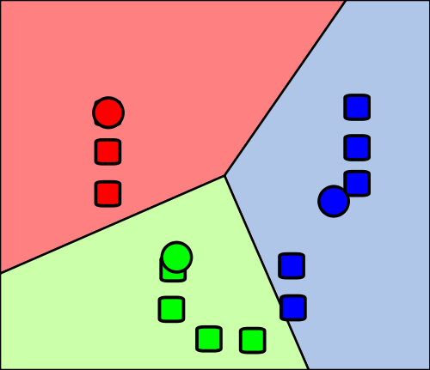
Re-partition data set into 3 voronoi cells corresponding to the 3 centroids
Figure modified from https://en.wikipedia.org/wiki/File:K_Means_Example_Step_1.svg

Slide 5
Applications of k-means clustering:
1.) Group like items together
2.) Reduce the size of your data set.
3.) Color quantization.
(a) Reduce memory use.
(b) Certain devices might have limited number of colors for display.

Slide 6
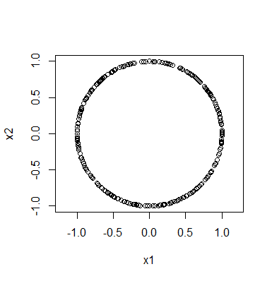
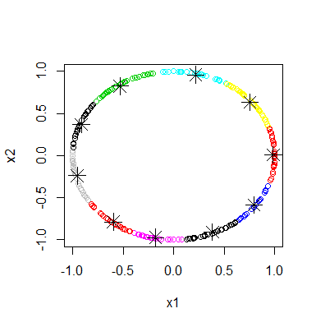
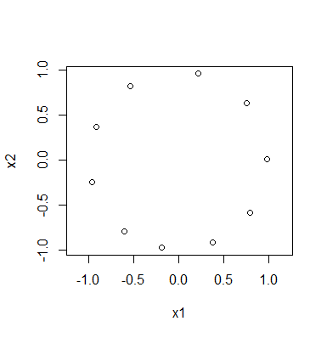
Rstudio:
library("TDA")
circle = circleUnif(300, r = 1)
plot(circle, asp = 1)
cl <- kmeans(circle, 10)
plot(circle,col=cl$cluster)
points(cl$centers, pch=8, cex = 2)
plot(cl$centers, asp = 1)

Slide 7
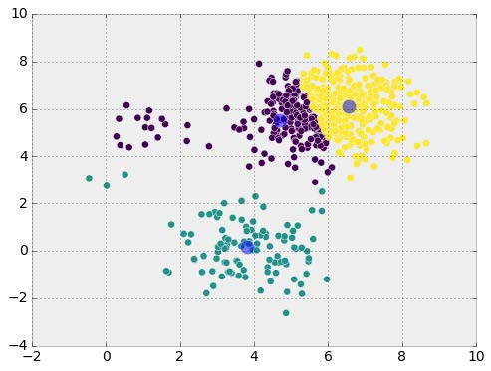
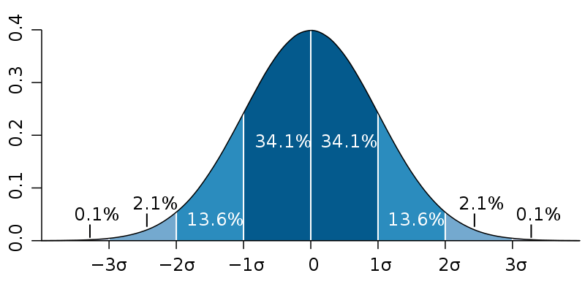
Many algorithms work best with normal distributions. But often data does NOT follow a normal distribution
https://commons.wikimedia.org/wiki/File:Standard_deviation_diagram.svg

Slide 8
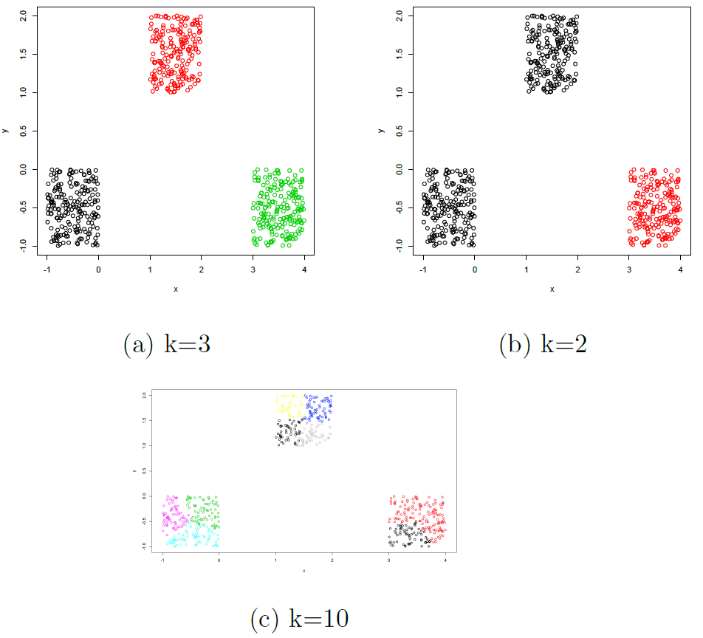
For k-means,
There are many methods for determining k.
k = number of desired clusters
Figures courtesy of Wako Bungula

Slide 9
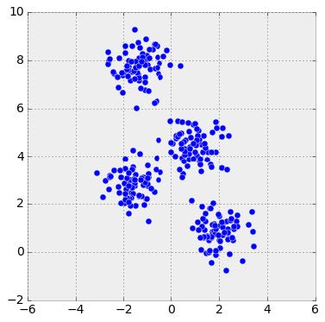
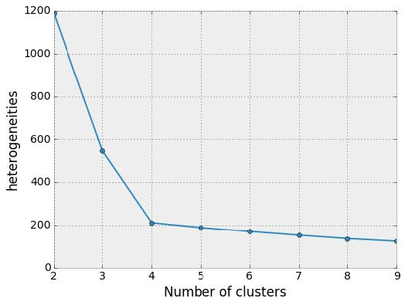
Elbow method
http://sites.northwestern.edu/msia/2016/12/
08/k-means-shouldnt-be-our-only-choice/

Slide 10
https://nbviewer.jupyter.org/github/ethen8181/machine-learning/blob/master/clustering/kmeans.ipynb

Slide 11
https://nbviewer.jupyter.org/github/ethen8181/machine-learning/blob/master/clustering/kmeans.ipynb

Slide 12
Figures courtesy of Wako Bungula

Slide 13
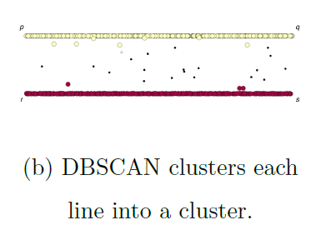
Figures courtesy of Wako Bungula

Slide 14
If you care about closeness:
Complete linkage
Average linkage
Ward’s linkage
K-means
If you care about connected components:
Single linkage
DBscan
Figures courtesy of Wako Bungula

Slide 15
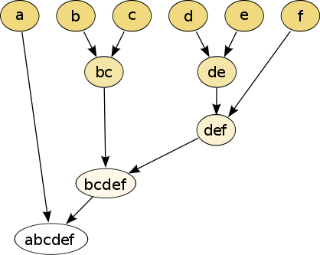
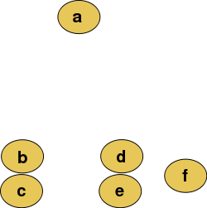
Hierarchical clustering
Data
Dendrogram
http://en.wikipedia.org/wiki/File:Clusters.svg
http://en.wikipedia.org/wiki/File:Hierarchical_clustering_simple_diagram.svg

Slide 16
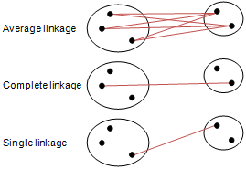
Different type of hierarchical clustering
What is the distance between 2 clusters?
http://en.wikipedia.org/wiki/File:Hierarchical_clustering_simple_diagram.svg
http://www.multid.se/genex/hs515.htm

Slide 17
Increasing threshold
Connect vertices (or clusters) whose distance is less than a given threshold

Slide 18
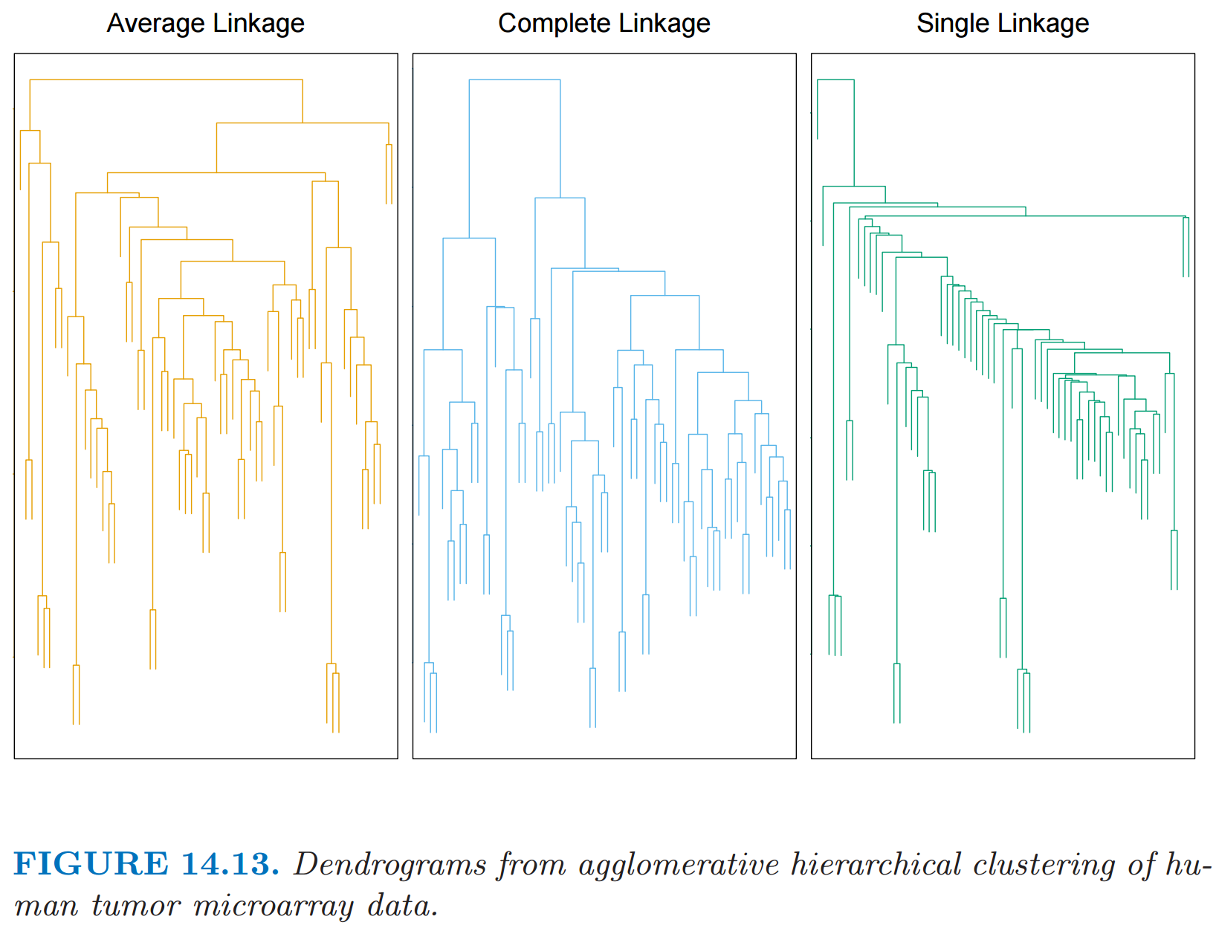
http://statweb.stanford.edu/~tibs/ElemStatLearn/
The Elements of Statistical Learning (2nd edition) Hastie, Tibshirani and Friedman

