Slide 1
Supervised vs Reinforcement vs Unsupervised Learning
Supervised Learning
Data: (x, y)
x is data, y is label
Goal: Learn a function to map x → y
Examples: Classification, regression, object detection, semantic segmentation, image captioning, etc.
Unsupervised Learning
Data: x
Just data, no labels!
Goal: Learn some underlying hidden structure of the data
Examples: Clustering, dimensionality reduction, feature learning, density estimation, etc.
https://www.cc.gatech.edu/classes/AY2020/cs7643_fall/slides/L23_generative2.pptx
Slide Credit: Fei-Fei Li, Justin Johnson, Serena Yeung, CS 231n
Notes:
To summarize differences, sup uses labeled data to learn a function mapping from x to y
Unsup uses no labels, tries to learn some underlying hidden structure of the data, whether grouping, axes of variation, underlying density

Slide 2
For your final exam written project, you will turn in your weekly labs into a draft of a paper.
Do not spend too much time on formatting.
You must use a bib file.

Slide 3
http://www.ncbi.nlm.nih.gov/pubmed/22784623

Slide 4
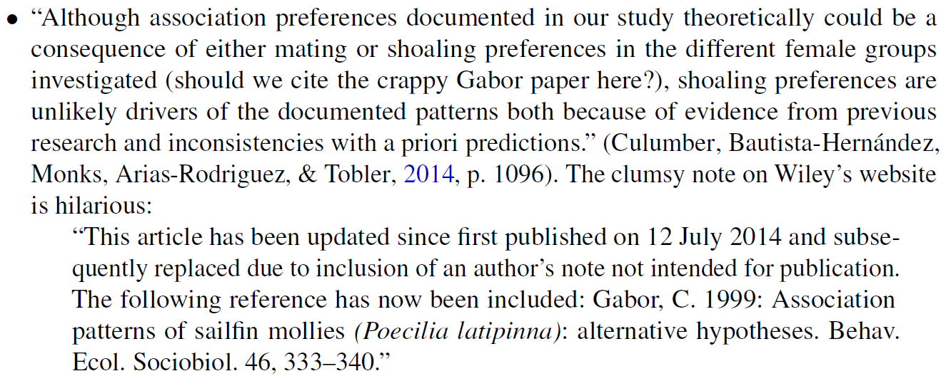

Slide 5
Resources for finding articles including articles about data sets:
https://mathscinet-ams-org.proxy.lib.uiowa.edu/mathscinet
https://www.ncbi.nlm.nih.gov/
https://arxiv.org/list/math/recent
https://scholar.google.com/
Can also search for excel filetype:
Duckduckgo: topic site:edu filetype:xls

Slide 6
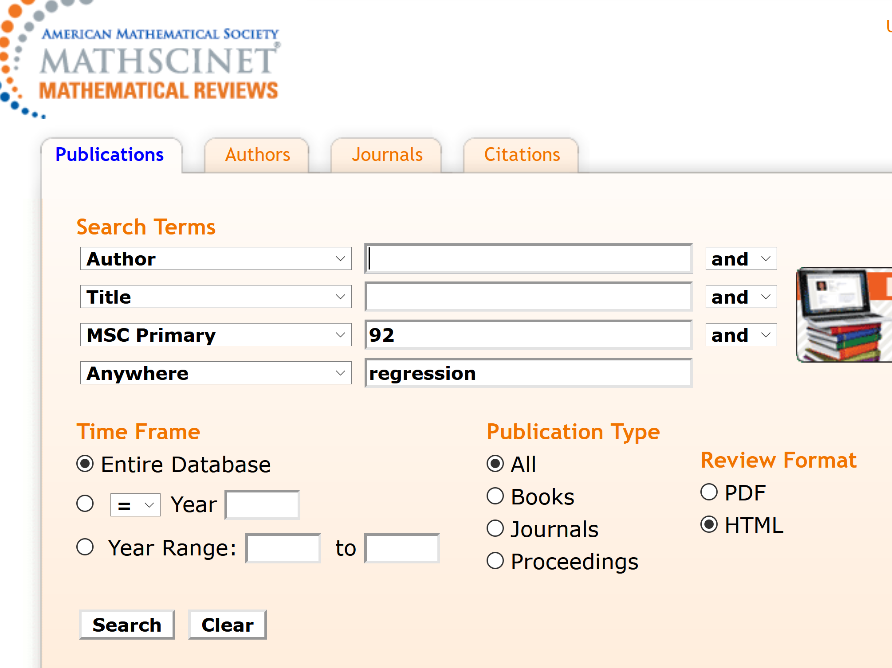
https://mathscinet-ams-org.proxy.lib.uiowa.edu/mathscinet

Slide 7
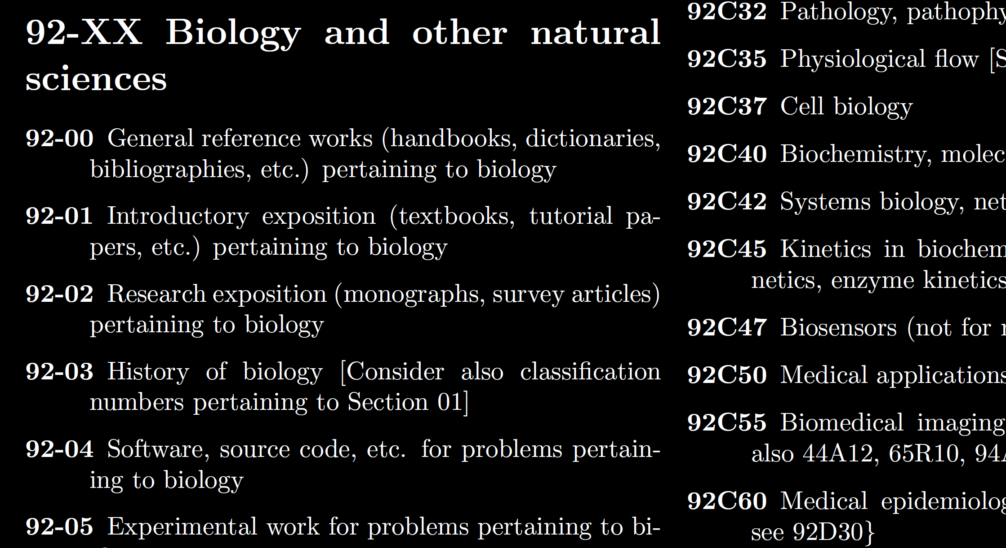
https://mathscinet-ams-org.proxy.lib.uiowa.edu/msnhtml/msc2020.pdf

Slide 8
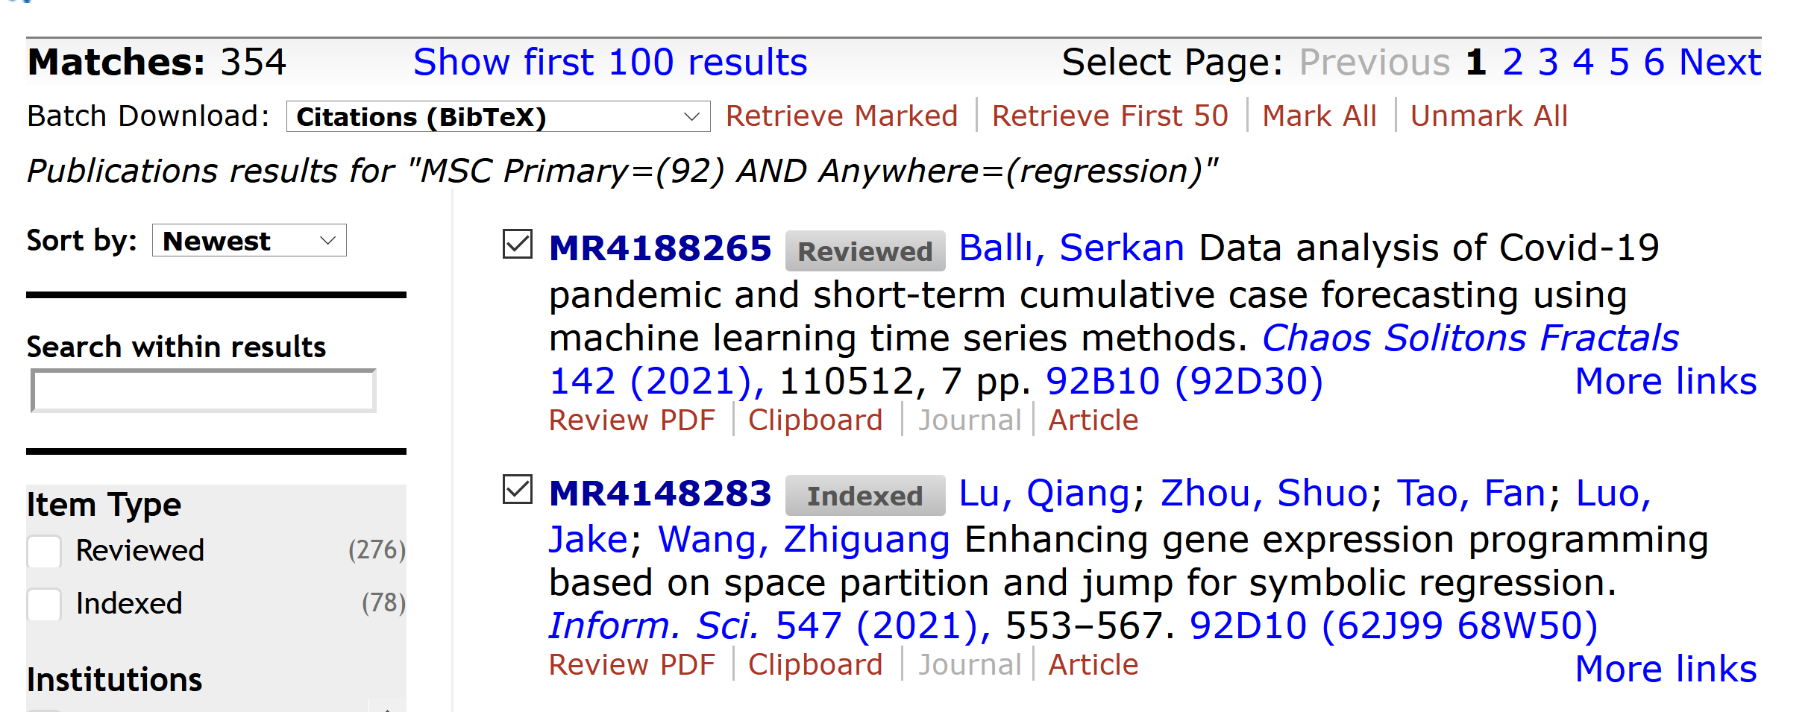
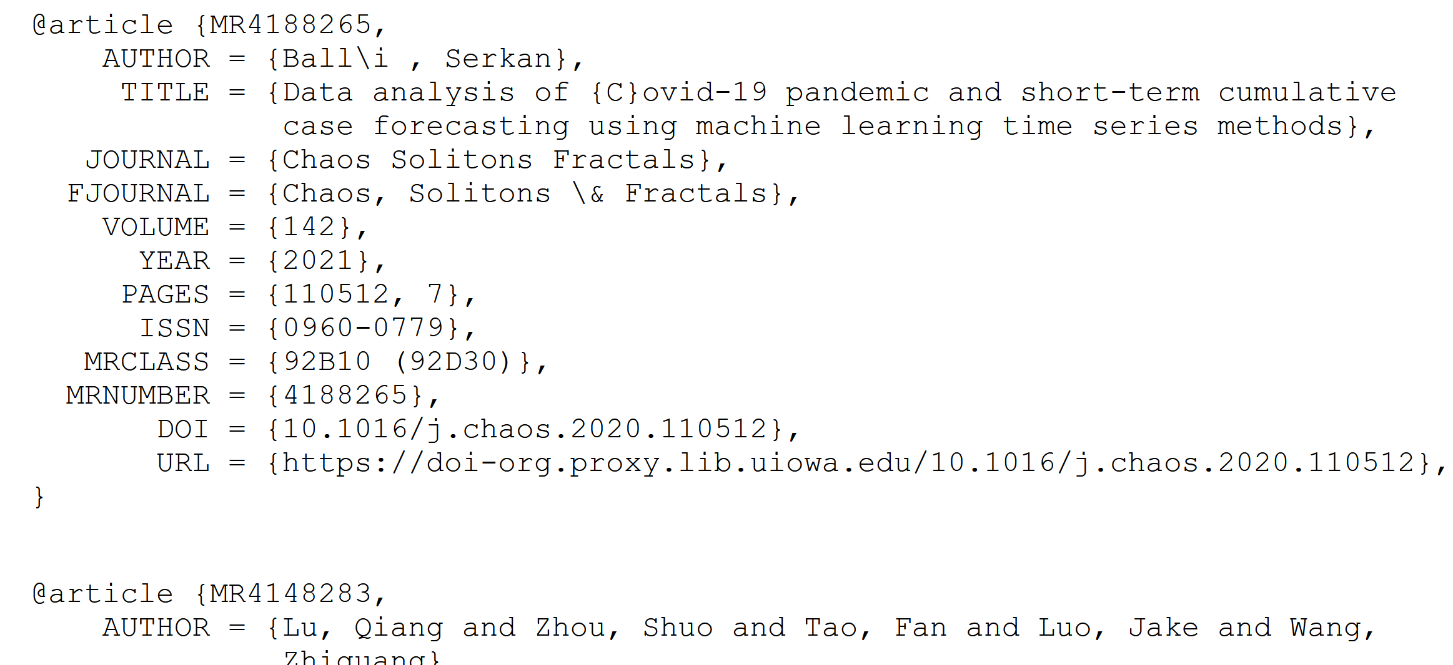

Slide 9
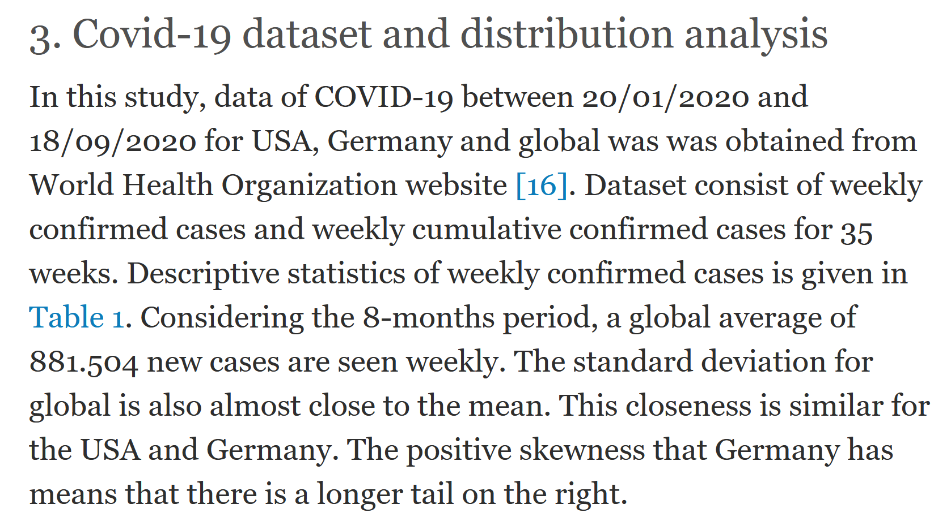

Slide 10
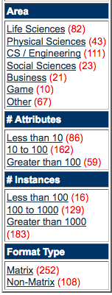
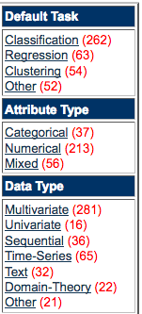
We currently maintain 412 data sets as a service to the machine learning community.
http://archive.ics.uci.edu/ml/index.php

Slide 11
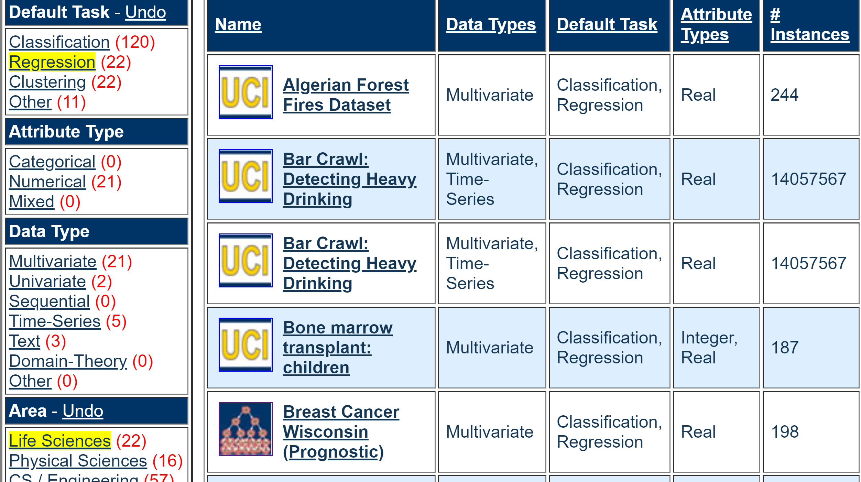

Slide 13
An image taken by black and white digital camera can be viewed as a vector, with one coordinate for each pixel
Each pixel has a “gray scale” value, can be thought of as a real number (in reality, takes one of 255 values)
Typical camera uses tens of thousands of pixels, so images lie in a very high dimensional space, call it pixel space, P

Slide 14
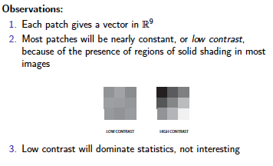
Lee-Mumford-Pedersen [LMP] study only high contrast patches.
Collection: 4.5 x 10⁶ high contrast patches from a
collection of images obtained by van Hateren and van der Schaaf
http://www.kyb.mpg.de/de/forschung/fg/bethgegroup/downloads/van-hateren-dataset.html

Slide 15
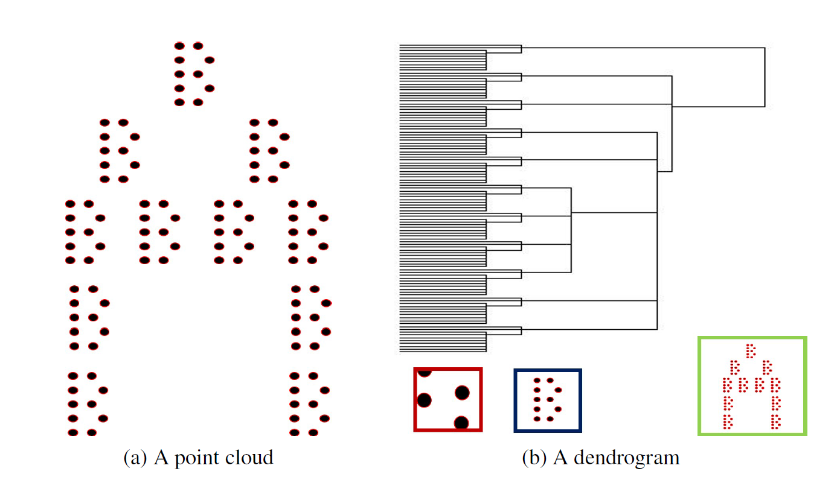
Hierarchical clustering
Figure courtesy of Paul Samuel Ignacio

Slide 16
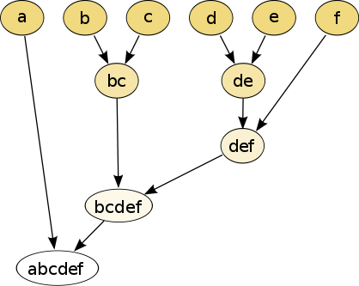
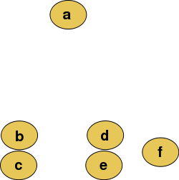
Hierarchical clustering
Data
Dendrogram
http://en.wikipedia.org/wiki/File:Clusters.svg
http://en.wikipedia.org/wiki/File:Hierarchical_clustering_simple_diagram.svg

Slide 17
Increasing threshold
Connect vertices whose distance is less than a given threshold
single linkage hierarchical clustering

Slide 18
Hierarchical clustering
Data
Dendrogram
http://en.wikipedia.org/wiki/File:Clusters.svg
http://en.wikipedia.org/wiki/File:Hierarchical_clustering_simple_diagram.svg

Slide 19
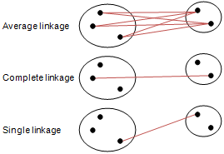
Different type of hierarchical clustering
What is the distance between 2 clusters?
http://en.wikipedia.org/wiki/File:Hierarchical_clustering_simple_diagram.svg
http://www.multid.se/genex/hs515.htm

Slide 20
Increasing threshold
Connect vertices (or clusters) whose distance is less than a given threshold

Slide 21
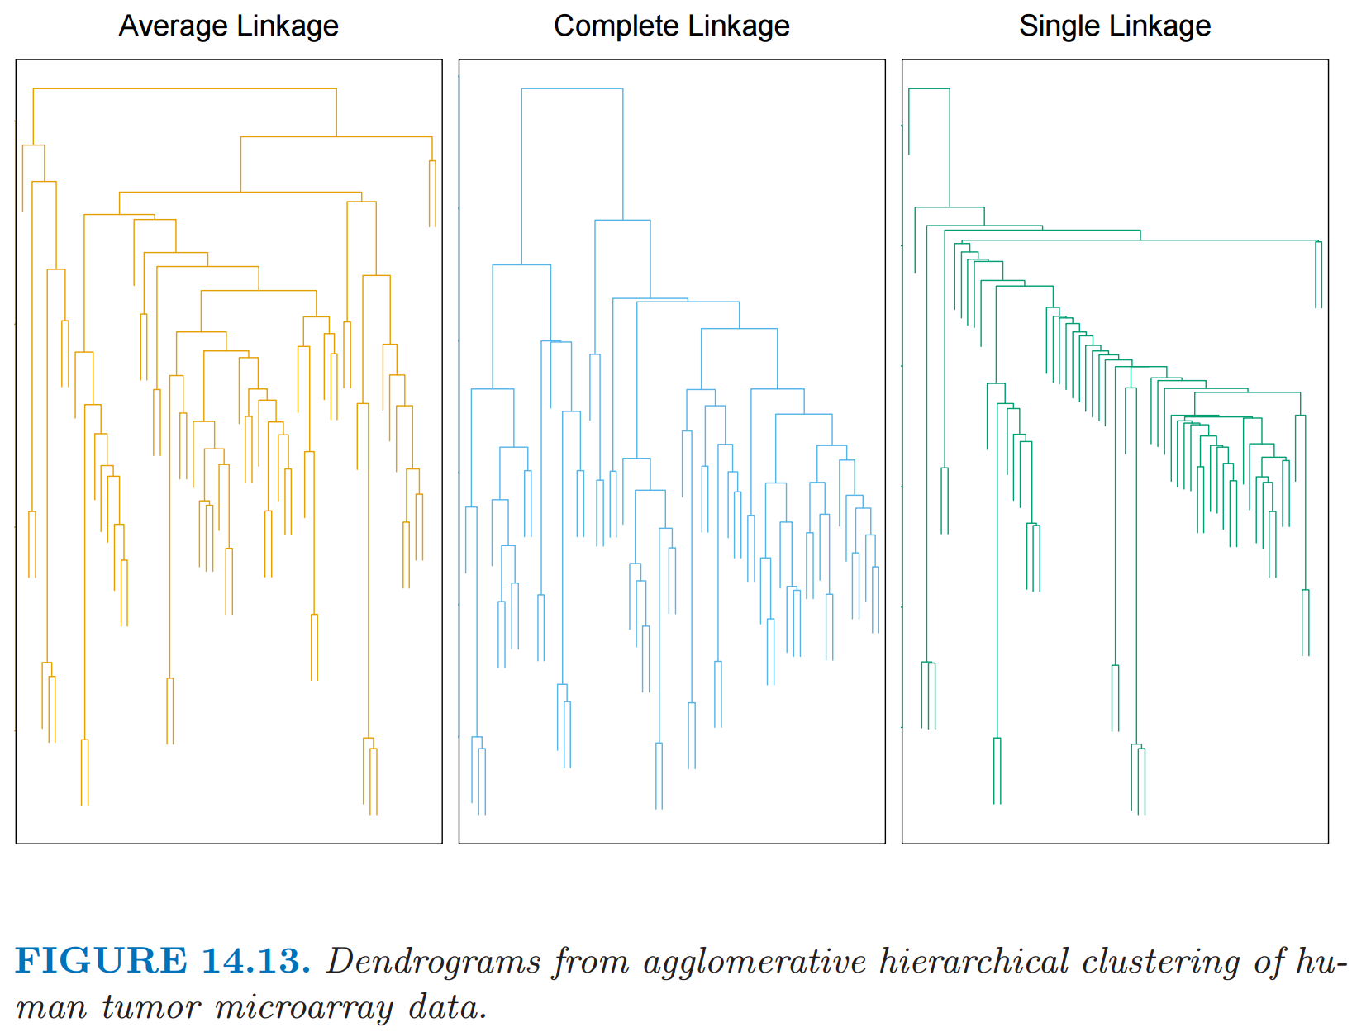
http://statweb.stanford.edu/~tibs/ElemStatLearn/
The Elements of Statistical Learning (2nd edition) Hastie, Tibshirani and Friedman

Slide 22
Figure courtesy of Paul Samuel Ignacio

Slide 23
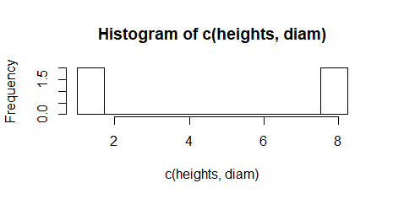
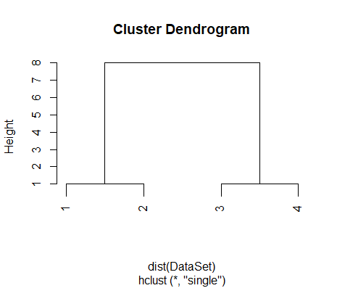

Slide 24
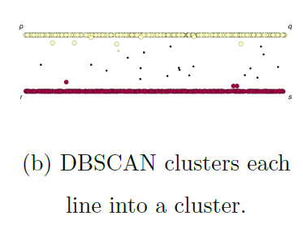
If you care about closeness:
Complete linkage
Average linkage
Ward’s linkage
K-means
If you care about connected components:
Single linkage
DBscan
Figures courtesy of Wako Bungula

Slide 25
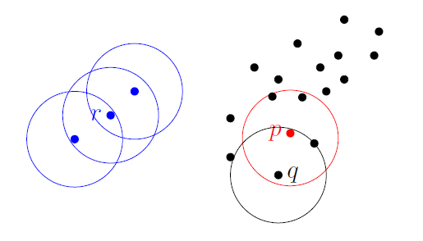
Dbscan (Density-based spatial clustering of applications with noise )
Figures courtesy of Wako Bungula

Slide 26
Figures courtesy of Wako Bungula

Slide 27
Figures courtesy of Wako Bungula

Slide 28
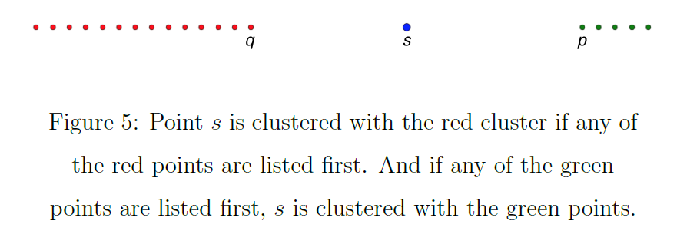
Figures courtesy of Wako Bungula

Slide 29
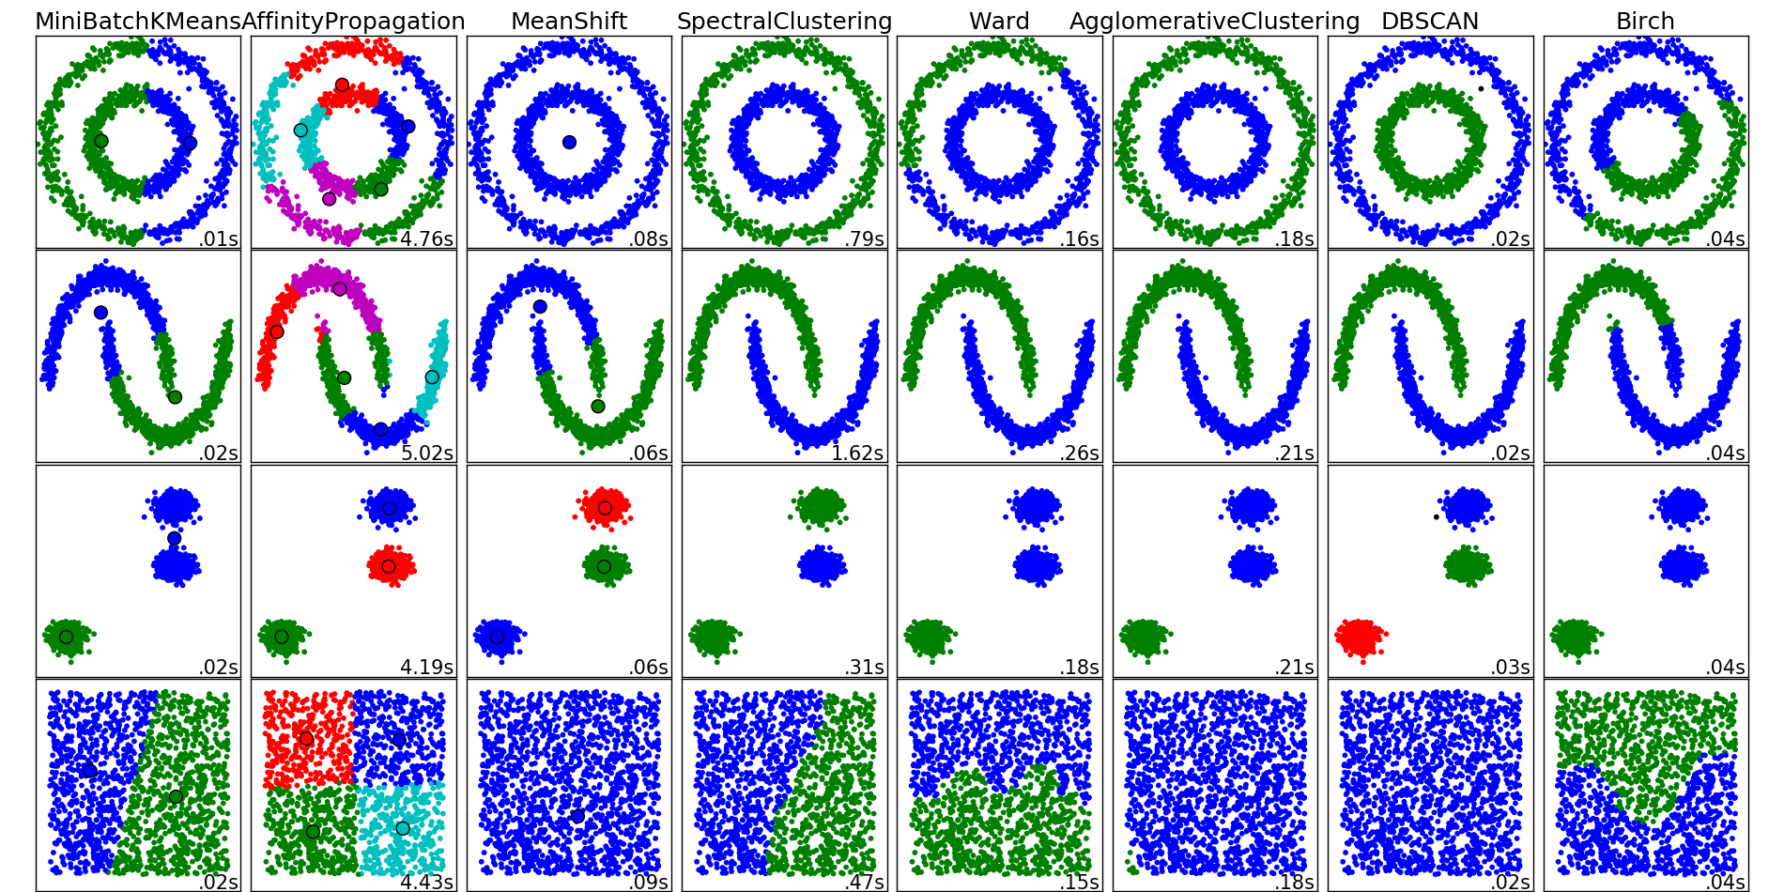
http://scikit-learn.org/stable/auto_examples/cluster/plot_cluster_comparison.html

Slide 30
Dimensionality Reduction: Given dataset D R^{N}
Want: embedding f: D → R^{n} where n << N
which “preserves” the structure of the data.
Many reduction methods:
f₁: D → R, f₂: D → R, … f_{n}: D → R
(f₁, f₂, … f_{n}): D → R^{n}
Many are linear, M: R^{N} → R^{n}, Mx = y
But there are also non-linear dimensionality reduction algorithms.
U

Slide 31
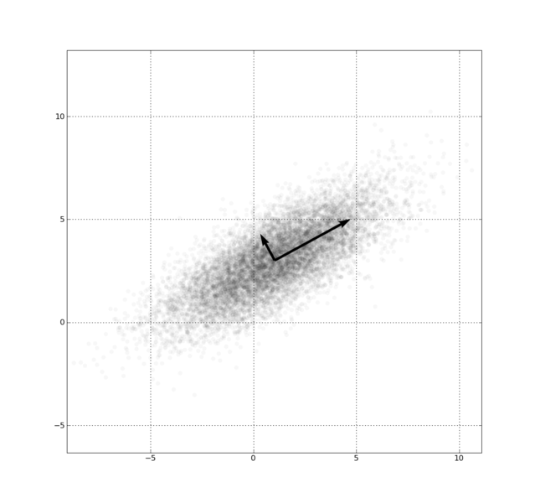
Example: Principle component analysis (PCA)
http://en.wikipedia.org/wiki/File:GaussianScatterPCA.png

Slide 32
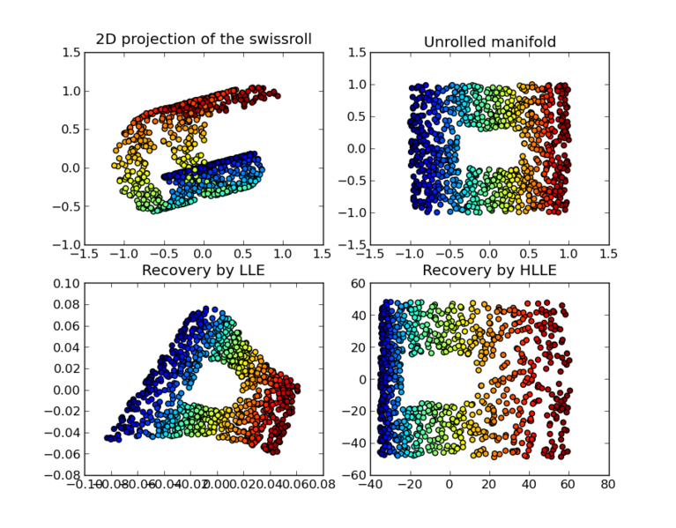
https://en.wikipedia.org/wiki/Nonlinear_dimensionality_reduction

Slide 33
Why use PCA in data analysis?
Consider the points (0, 0, …, 0), (1, 0, …, 0), (10, 0, …, 0)
Add noise to first point (0, 0, …, 0) → (0, 1, …, 1)
In R¹⁰⁰, d((0, 1, …, 1), (1, 0, …, 0)) = 10 > 9.
Add small noise to first point (0, 0, …, 0) → (0, 0.1, …, 0.1)
In R^{39,900}, d((0, 0.1, …, 0.1), (1, 0, …, 0)) = 20 > 9.
0 1 10

Slide 34
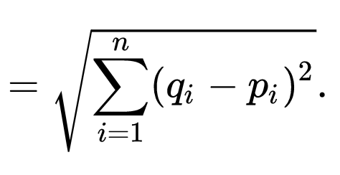
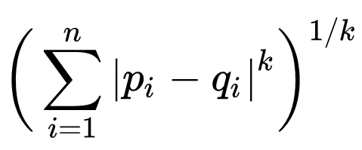
q
d(p, q) = ??
Euclidean
Minkowski distance
Chebyshev distance
5
4
p
3

Slide 35
In R^{n}
If n small, Euclidean distance often makes sense
If n is large, consider Chebyshev distance or
performing PCA first to project data into R^{d}, for small d
and then using Euclidean distance
Chebyshev distance:

Slide 36
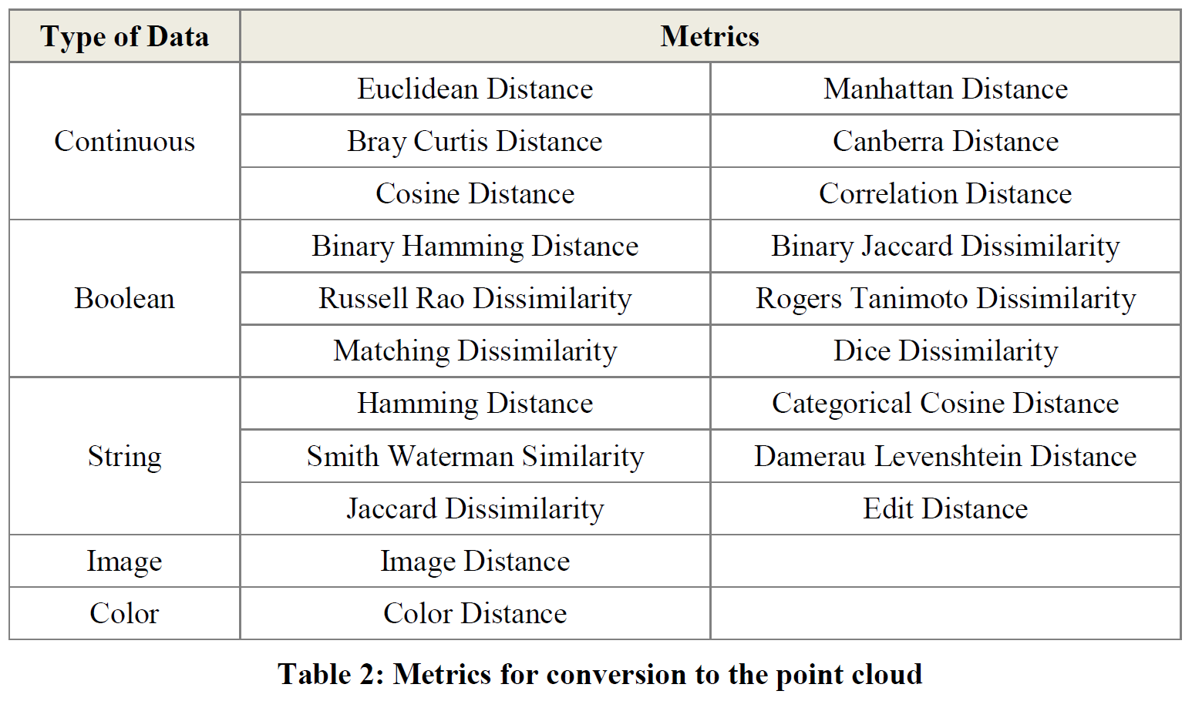
Section 2.2.2: Distances (optional)

