Slide 1
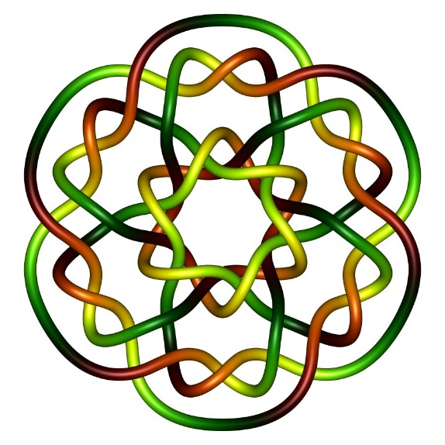
Solving homogeneous equations: Ax = 0
Putting answer in parametric vector form
Isabel K. Darcy
Mathematics Department
Applied Math and Computational Sciences
University of Iowa
Fig from
knotplot.com

Slide 2
Solving homogeneous equations: Ax = 0
Putting answer in parametric vector form
or
Determining the solution set for Ax = 0
Isabel K. Darcy
Mathematics Department
Applied Math and Computational Sciences
University of Iowa
Fig from
knotplot.com

Slide 3
Solving homogeneous equations: Ax = 0
Putting answer in parametric vector form
or
Determining the solution set for Ax = 0
Nullspace of A = solution set for Ax = 0
Isabel K. Darcy
Mathematics Department
Applied Math and Computational Sciences
University of Iowa
Fig from
knotplot.com

Slide 4
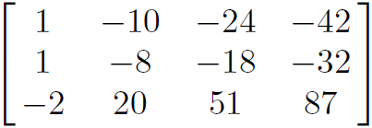
=
Solve: A x = 0 where A

Slide 5
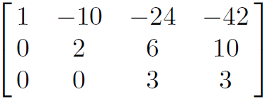
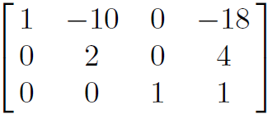
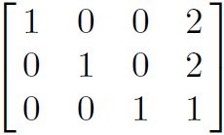
=
Solve: A x = 0 where A
Put A into echelon form and then into reduced echelon form:
R₂ – R₁ → R₂
R₃ + 2R₁ → R₃
R₁ + 8R₃ → R₁
R₁ - 2R₃ → R₁
R₃/3 → R₃
R₁ + 5R₂ → R₁
R₂/2 → R₂

Slide 6
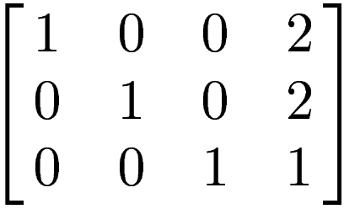
~
Solve: A x = 0 where A
Put A into echelon form and then into reduced echelon form:
R₂ – R₁ → R₂
R₃ + 2R₁ → R₃
R₁ + 8R₃ → R₁
R₁ - 2R₃ → R₁
R₃/3 → R₃
R₁ + 5R₂ → R₁
R₂/2 → R₂

Slide 7
0
0
0
~
Solve: A x = 0 where A

Slide 8
0
0
0
~
Solve: A x = 0 where A
x₁ x₂ x₃ x₄

Slide 9
0
0
0
~
Solve: A x = 0 where A
x₁ x₂ x₃ x₄
x₁ -2 x₄
x₂ -2 x₄
x₃ - x₄ x₄ x₄
=

Slide 10
0
0
0
~
Solve: A x = 0 where A
x₁ x₂ x₃ x₄
x₁ -2 x₄ -2
x₂ -2 x₄ -2
x₃ - x₄ -1
x₄ x₄ 1
=
=
x₄

Slide 11
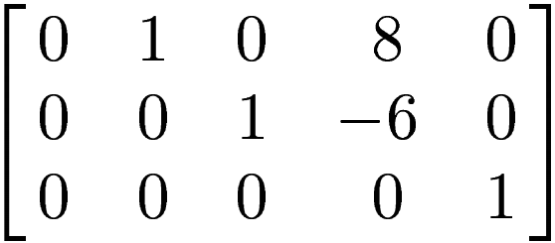
~
Solve: B x = 0 where B

Slide 12
0
0
0
~
Solve: B x = 0 where B
x₁ x₂ x₃ x₄ x₅
x₁
x₂
x₃
x₄
x₅
=

Slide 13
0
0
0
~
Solve: B x = 0 where B
x₁ x₂ x₃ x₄ x₅
x₁ x₁
x₂
x₃
x₄ x₄
x₅
=

Slide 14
0
0
0
~
Solve: B x = 0 where B
x₁ x₂ x₃ x₄ x₅
x₁ x₁ x₁ 0 1 0
x₂ -8 x₄ 0 -8 x₄ 0 -8
x₃ -6 x₄ 0 -6 x₄ 0 -6
x₄ x₄ 0 x₄ 0 1
x₅ 0 0 0 0 0
=
= + = +
x₁
x₄

Slide 15
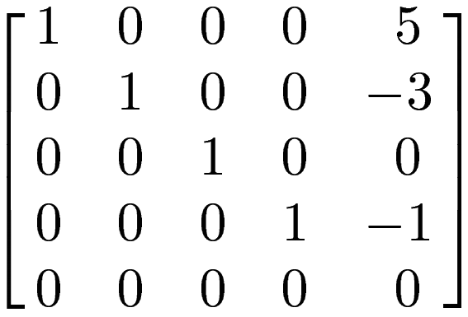
~
Solve: C x = 0 where C

Slide 16
0
0
0
0
0
~
Solve: C x = 0 where C
x₁ x₂ x₃ x₄ x₅
x₁
x₂
x₃
x₄
x₅
=

Slide 17
0
0
0
0
0
~
Solve: C x = 0 where C
x₁ x₂ x₃ x₄ x₅
x₁ -5x₅ -5
x₂ 3 x₅ 3
x₃ 0 0
x₄ x₅ 1
x₅ x₅ 1
=
=
x₅

Slide 18
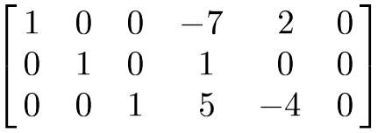
~
Solve: D x = 0 where D

Slide 19
0
0
0
~
Solve: D x = 0 where D
x₁ x₂ x₃ x₄ x₅ x₆
x₁
x₂
x₃
x₄
x₅
x₆
=

Slide 20
0
0
0
~
Solve: D x = 0 where D
x₁ x₂ x₃ x₄ x₅ x₆
x₁
x₂
x₃
x₄ x₄
x₅ x₅
x₆ x₆
=

Slide 21
0
0
0
~
Solve: D x = 0 where D
x₁ x₂ x₃ x₄ x₅ x₆
x₁ 7x₄ - 2x₅
x₂ -x₄
x₃ -5x₄ + 4x₅
x₄ x₄
x₅ x₅
x₆ x₆
=

Slide 22
0
0
0
~
Solve: D x = 0 where D
x₁ x₂ x₃ x₄ x₅ x₆
x₁ 7x₄ - 2x₅ 7 -2 0
x₂ -x₄ -1 0 0
x₃ -5x₄ + 4x₅ -5 4 0
x₄ x₄ 1 0 0
x₅ x₅ 0 1 0
x₆ x₆ 0 0 1
=
= + +
x₄
x₅
x₆

Slide 23
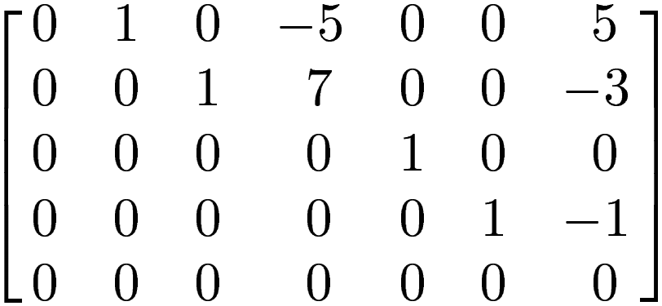
~
Solve: E x = 0 where E

Slide 24
~
Solve: E x = 0 where E
x₁ x₂ x₃ x₄ x₅ x₆ x₇
x₁
x₂
x₃
x₄
x₅
x₆
x₇
=

Slide 25
~
Solve: E x = 0 where E
x₁ x₂ x₃ x₄ x₅ x₆ x₇
x₁ x₁
x₂ 5x₄ - 5x₇
x₃ -7x₄ + 3x₇
x₄ x₄
x₅ 0
x₆ x₇
x₇ x₇
=
= + +
x₁
x₄
x₇

Slide 26
~
Solve: E x = 0 where E
x₁ x₂ x₃ x₄ x₅ x₆ x₇
x₁ x₁ 1 0 0
x₂ 5x₄ - 5x₇ 0 5 -5
x₃ -7x₄ + 3x₇ 0 -7 3 x₄ x₄ 0 1 0
x₅ 0 0 0 0
x₆ x₇ 0 0 1
x₇ x₇ 0 0 1
=
= + +
x₁
x₄
x₇

