Slide 1
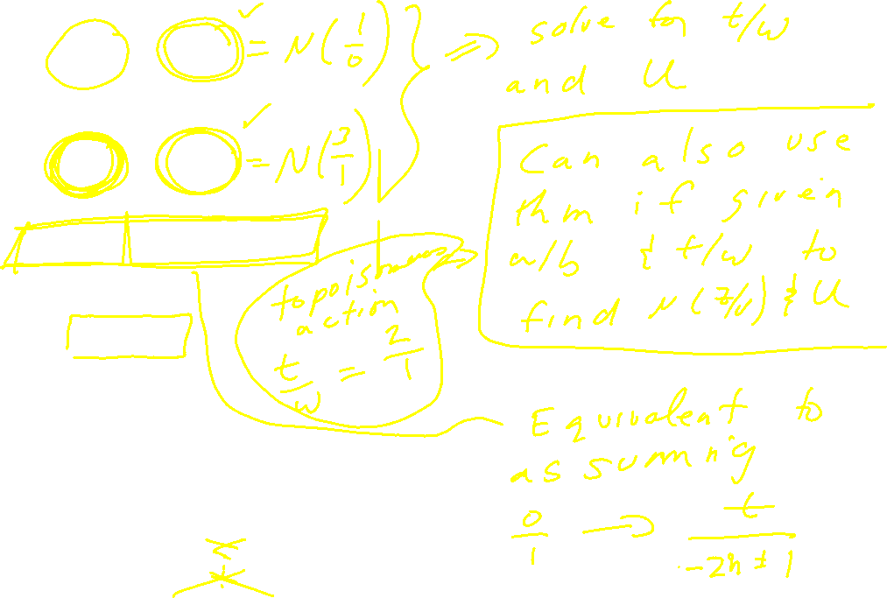
|t| > 1

Slide 2
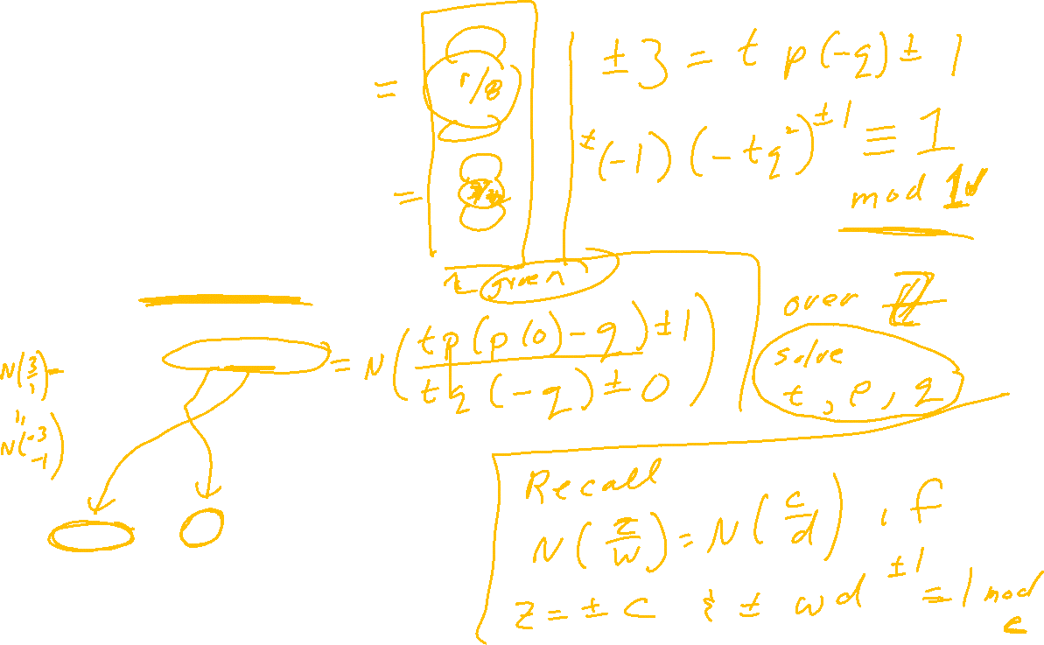
|t| > 1

Slide 3
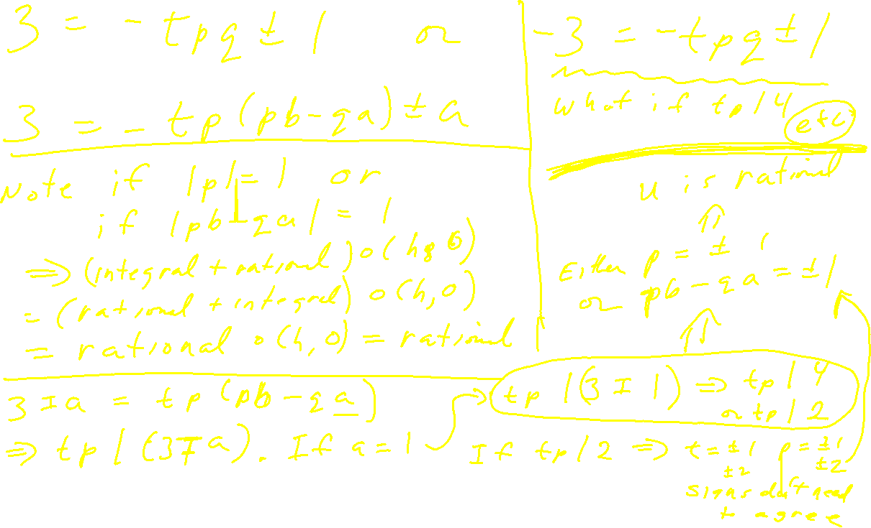

Slide 4
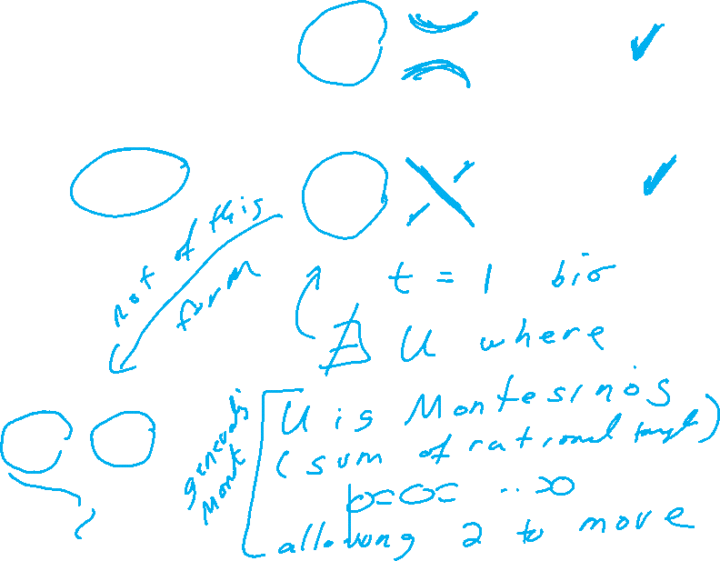
|t| > 1

Slide 5
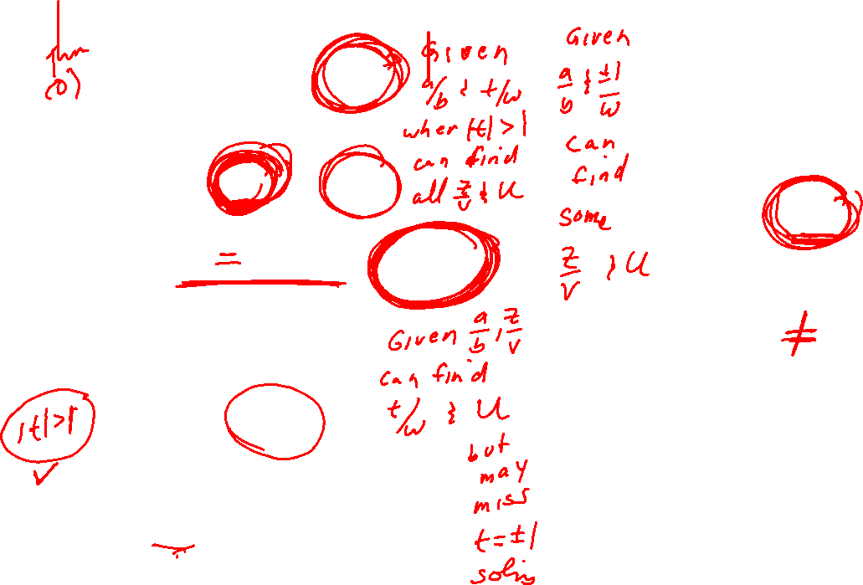
|t| > 1

Slide 6
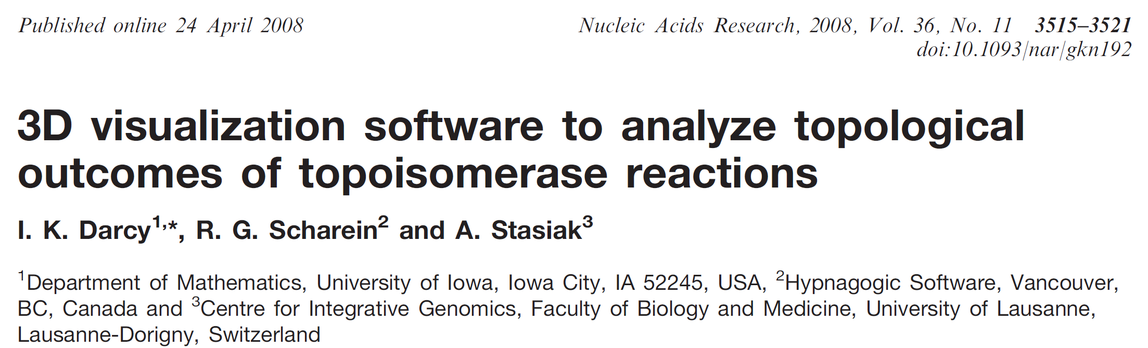

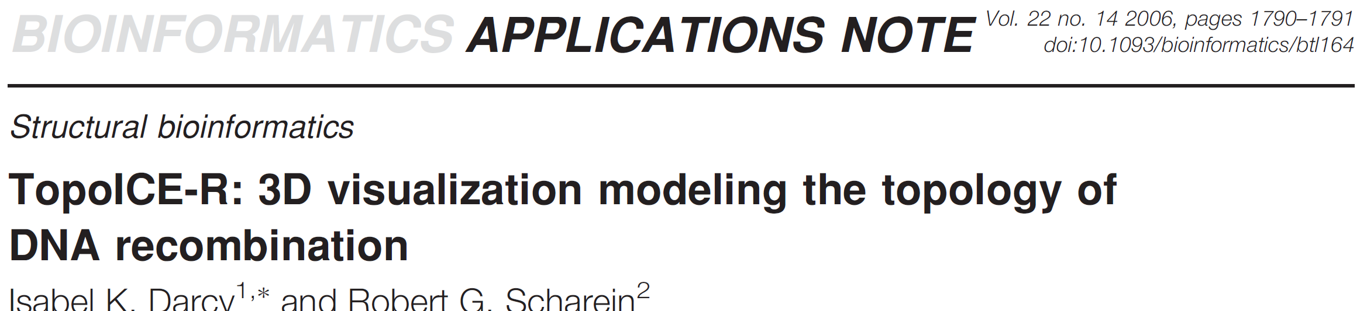
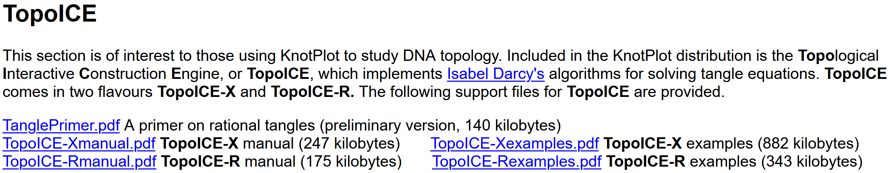
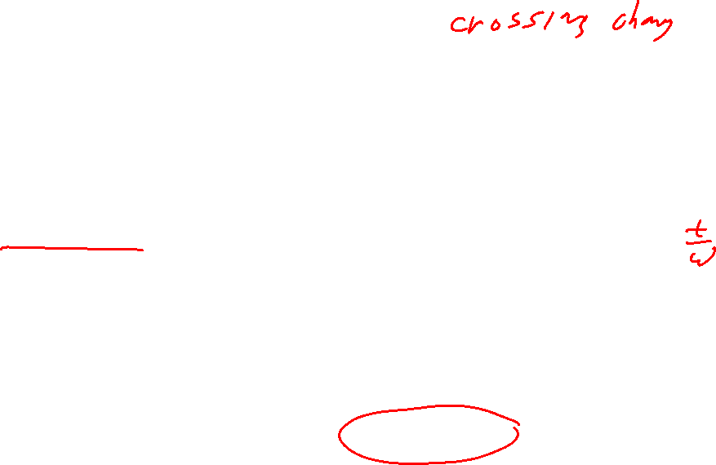
https://academic.oup.com/nar/article/36/11/3515/2410103
https://academic.oup.com/bioinformatics/article/22/14/1790/227088
https://knotplot.com/download/

Slide 8
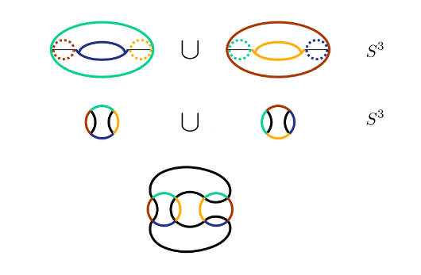
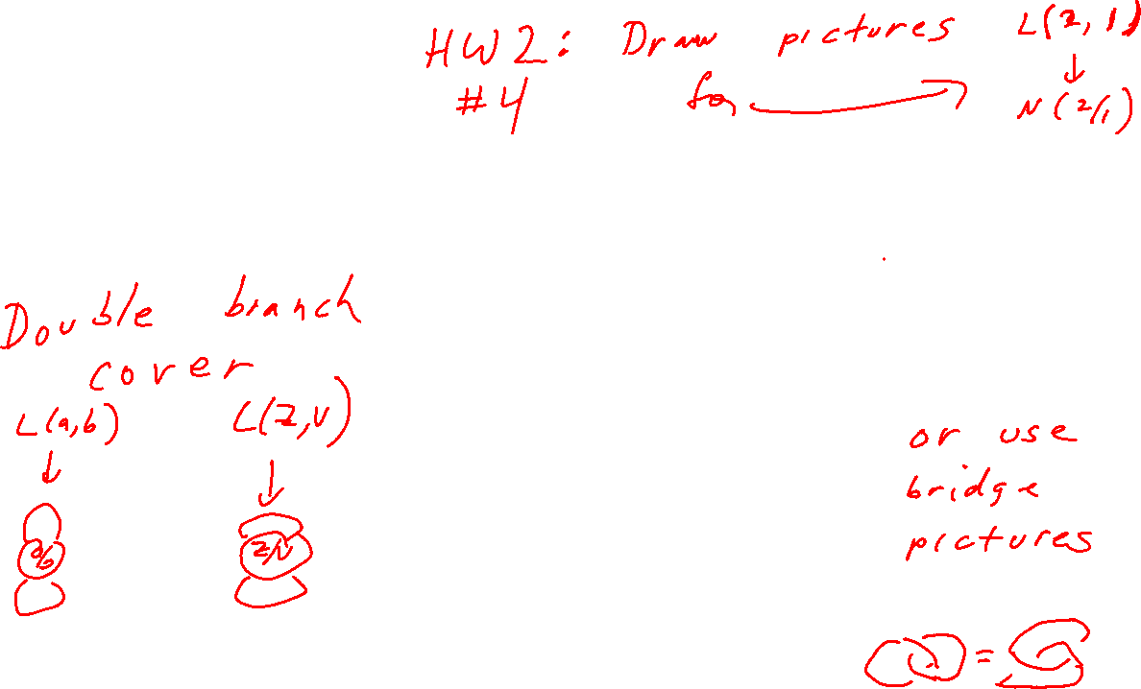

Slide 9

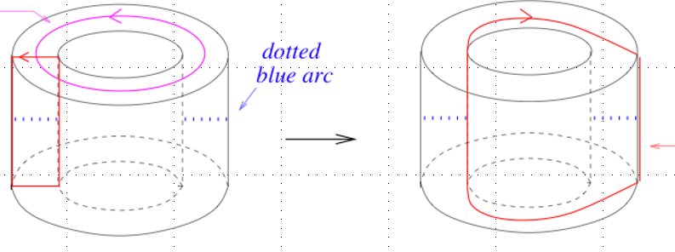
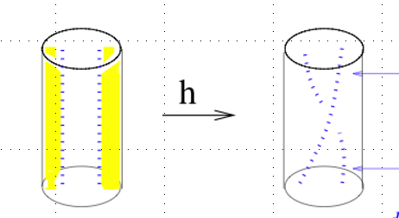
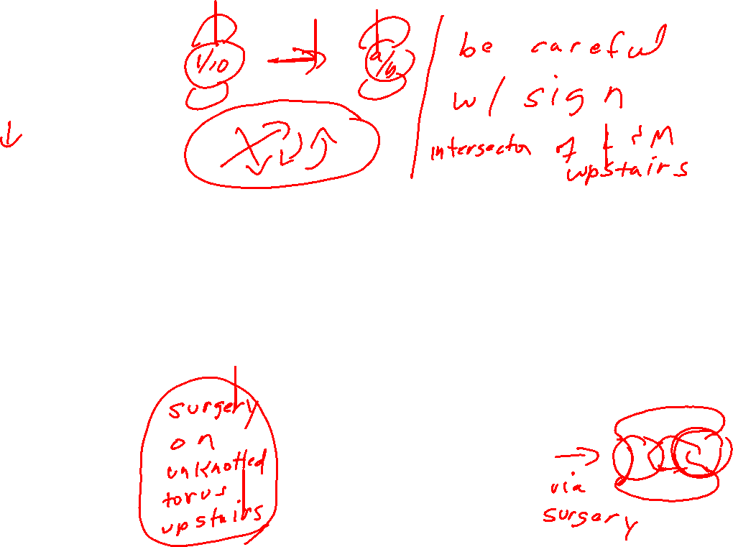

Slide 10
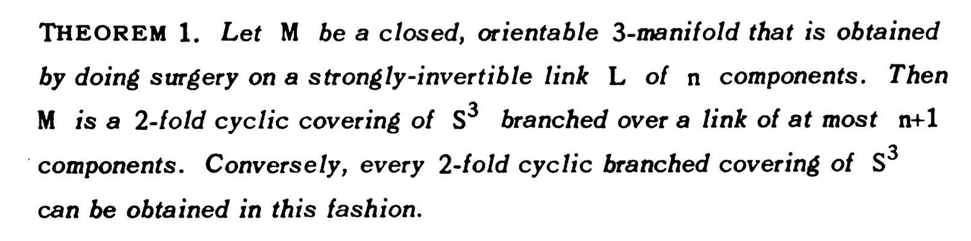
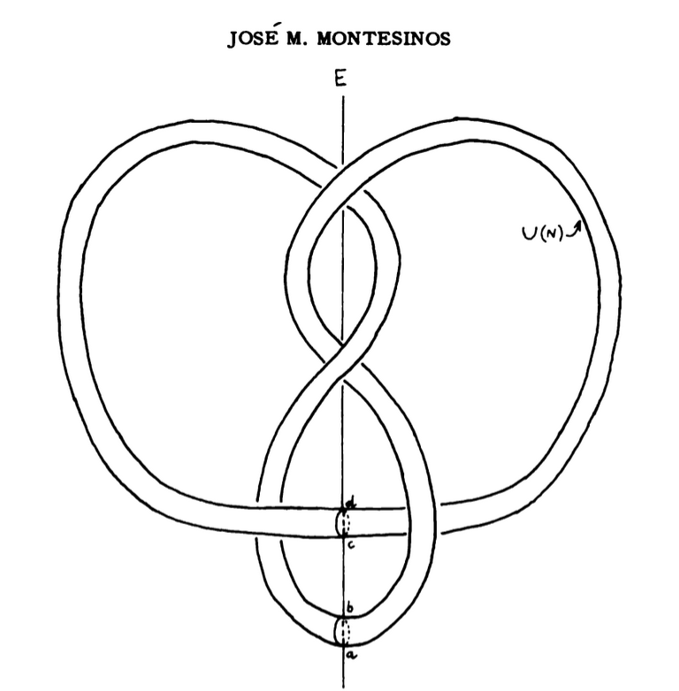
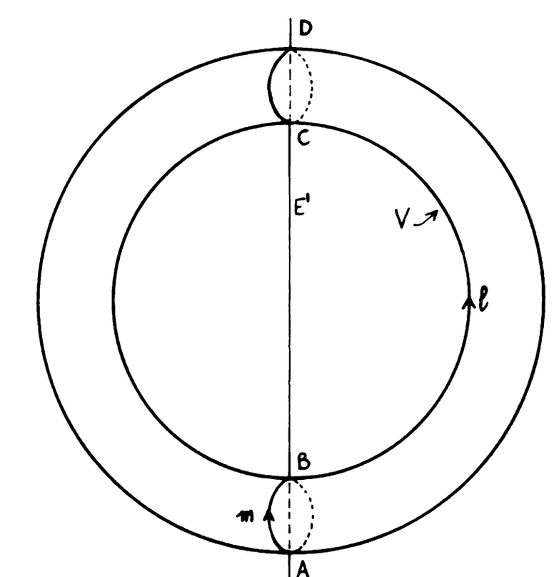







Slide 11
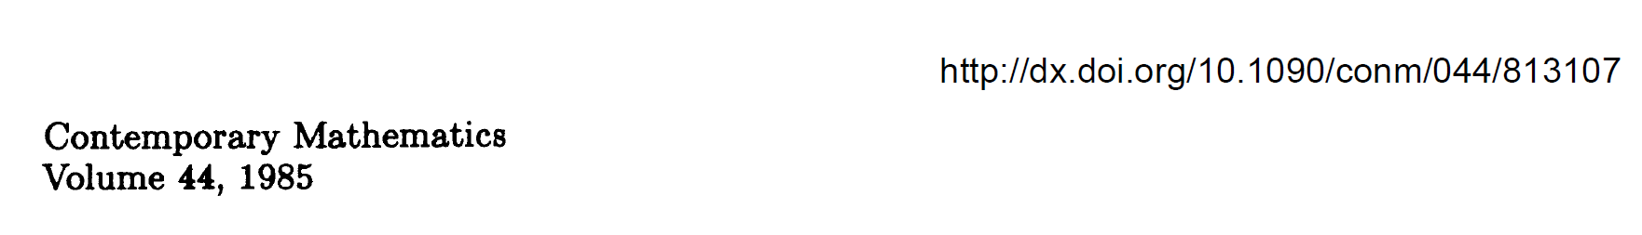

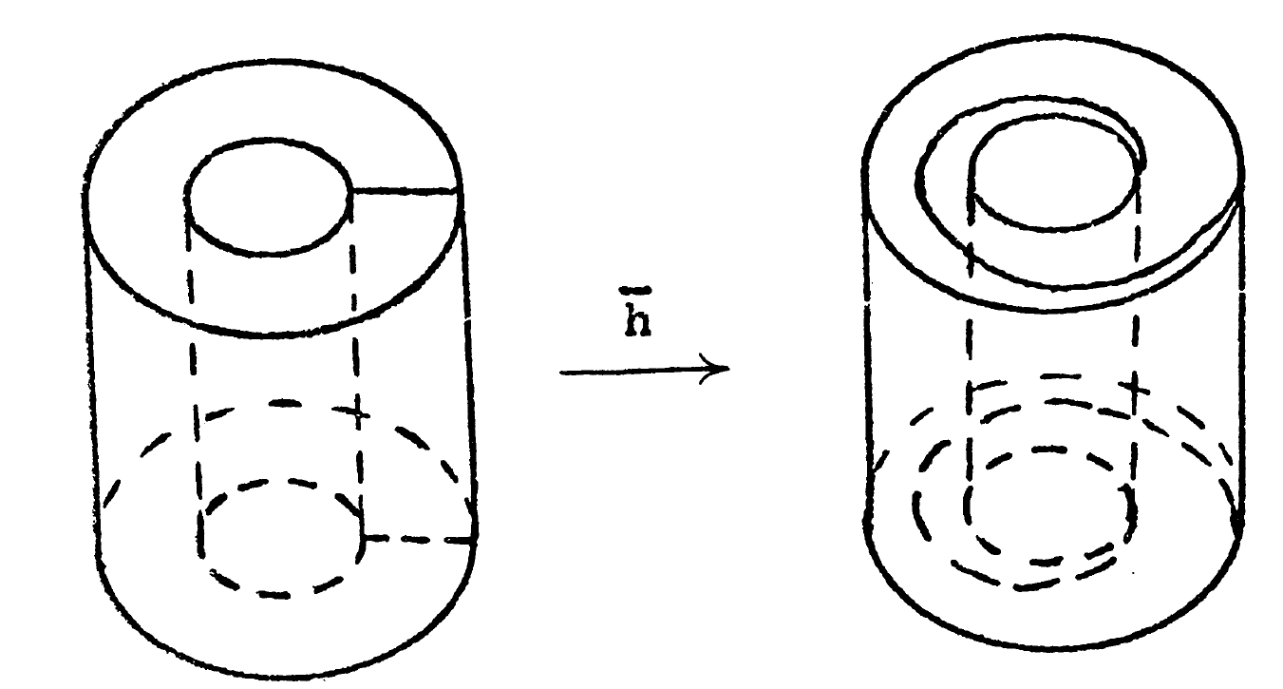
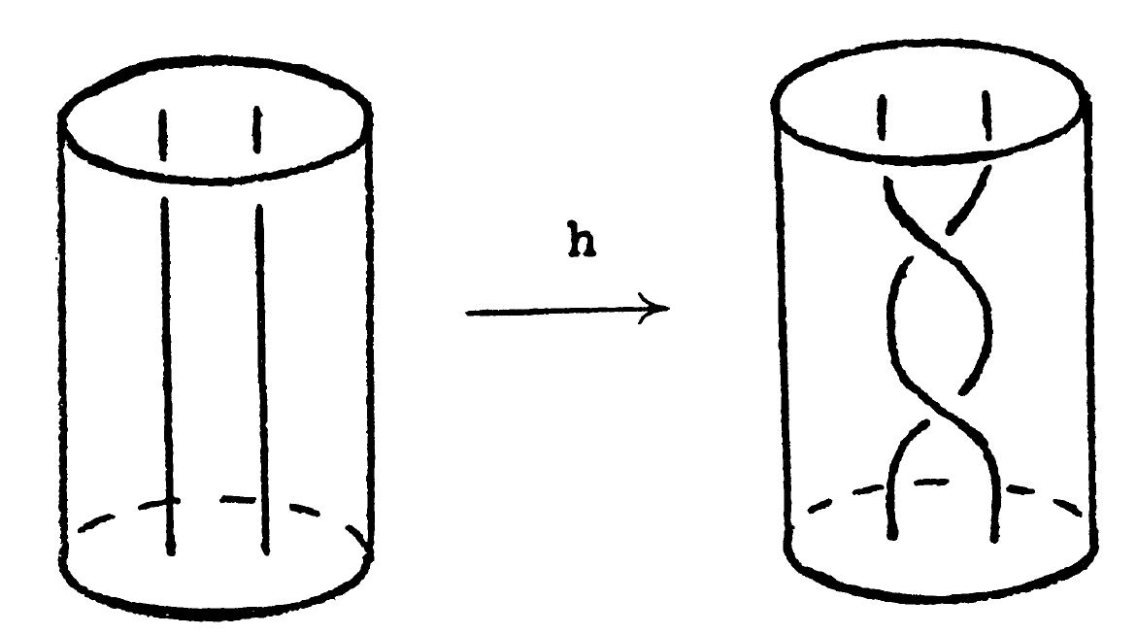





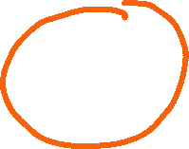







Slide 12
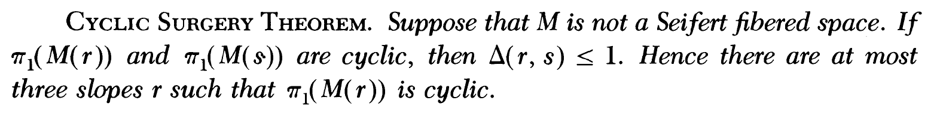
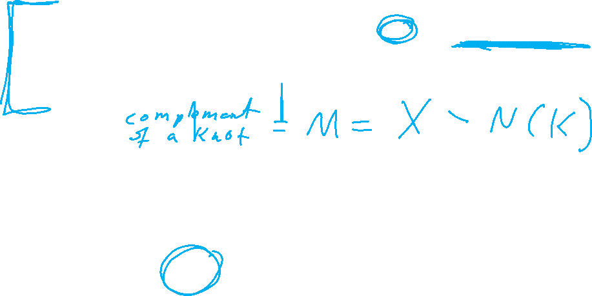
M. Culler, C. Gordon, J. Luecke, P. Shalen (1987). Dehn surgery on knots. The Annals of Mathematics (Annals of Mathematics) 125 (2): 237-300.
https://marc-culler.info/static/home/papers/CyclicSurgery.pdf

Slide 13
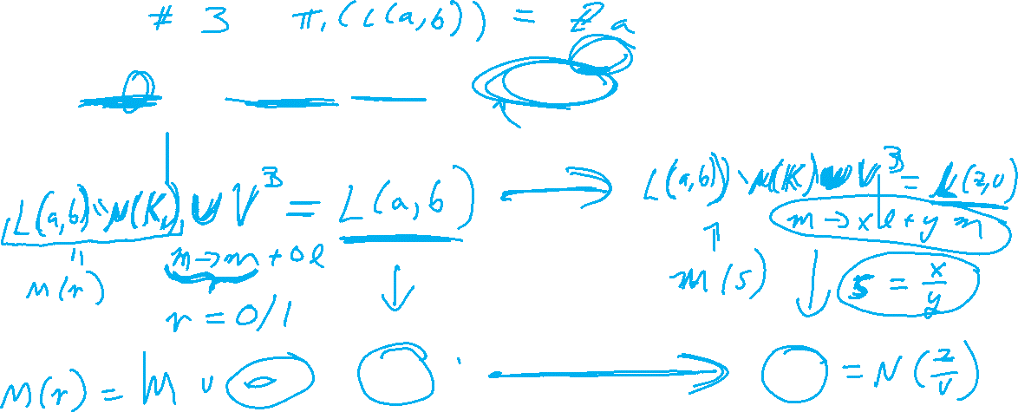
M. Culler, C. Gordon, J. Luecke, P. Shalen (1987). Dehn surgery on knots. The Annals of Mathematics (Annals of Mathematics) 125 (2): 237-300.
https://marc-culler.info/static/home/papers/CyclicSurgery.pdf

Slide 14
M. Culler, C. Gordon, J. Luecke, P. Shalen (1987). Dehn surgery on knots. The Annals of Mathematics (Annals of Mathematics) 125 (2): 237-300.
https://marc-culler.info/static/home/papers/CyclicSurgery.pdf

Slide 15
