Slide 1








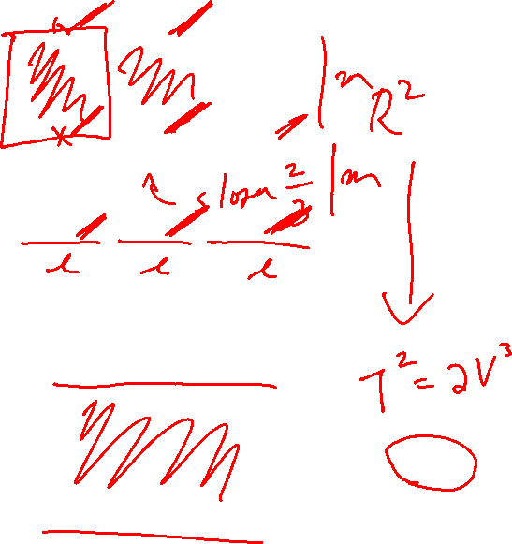











Slide 2










Slide 3






















Slide 4








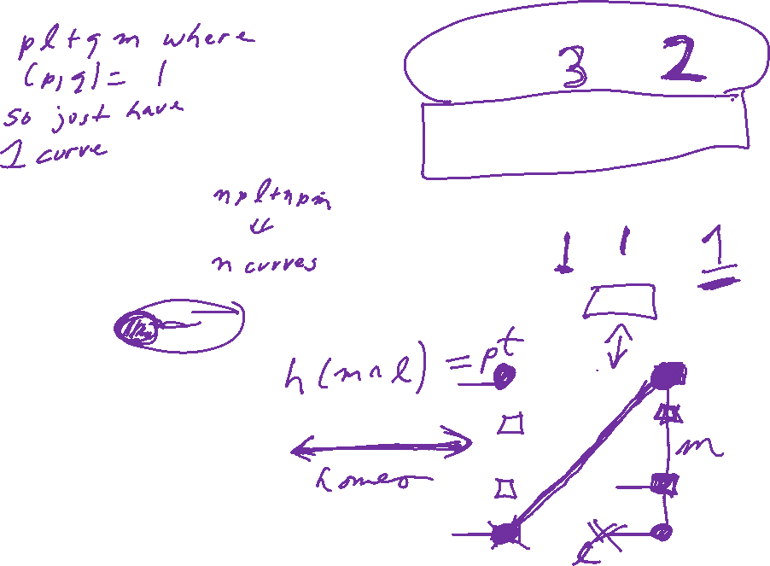





Slide 5


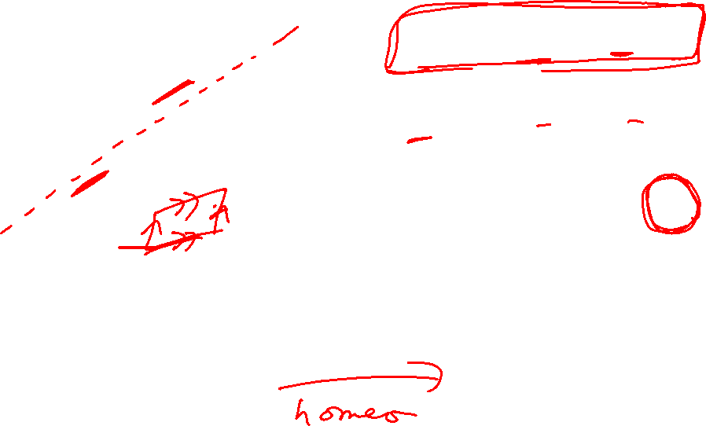






Slide 6








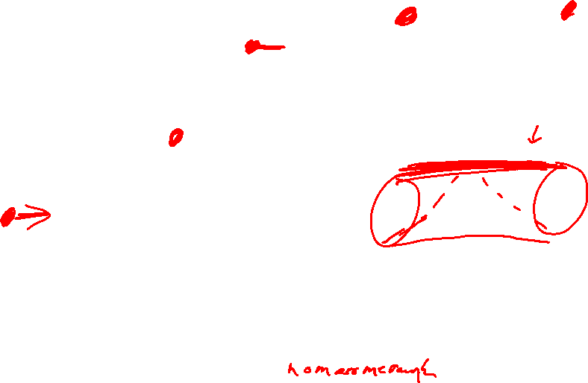






Slide 7


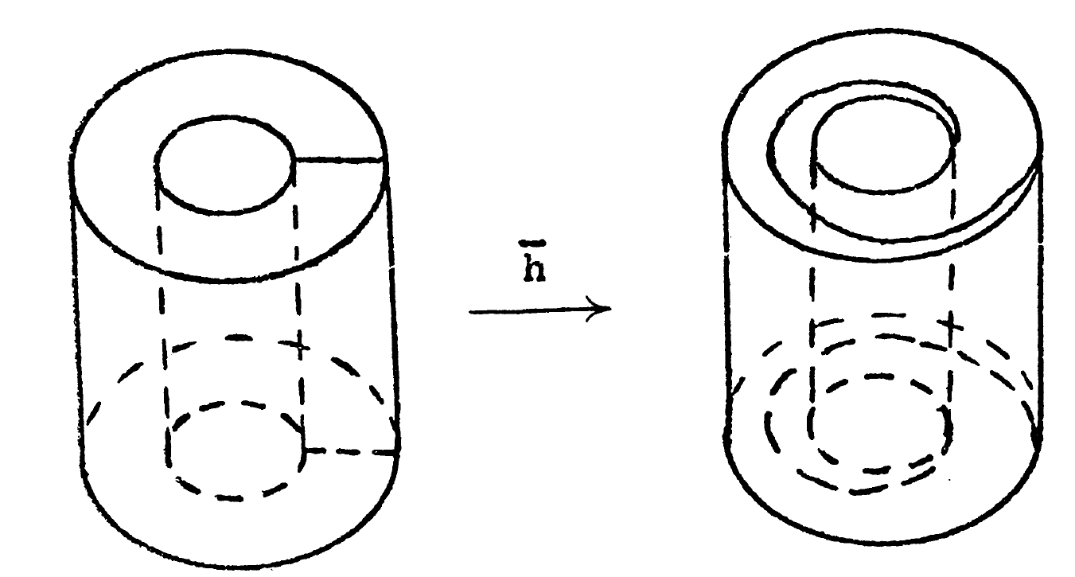
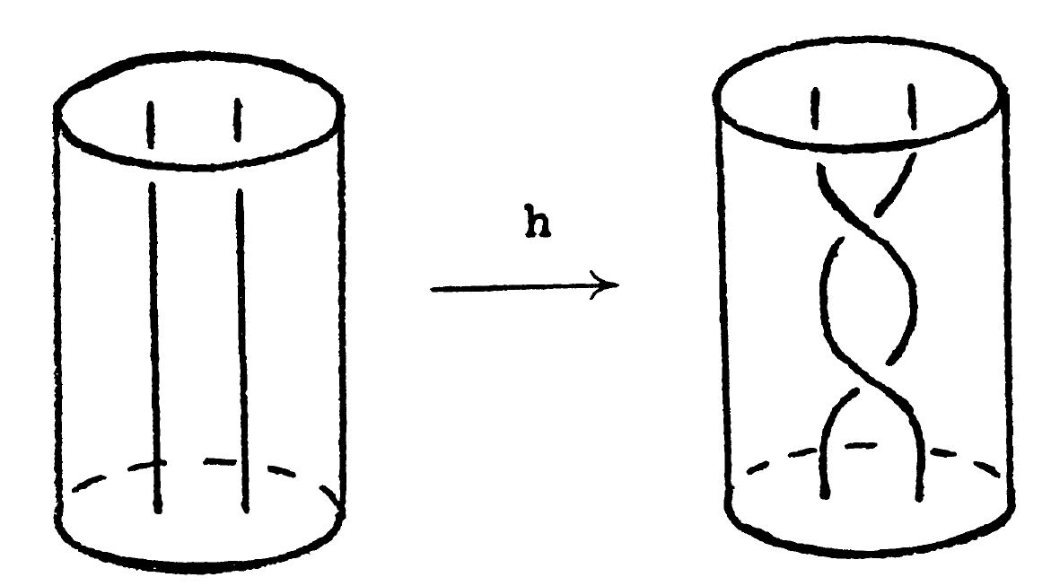
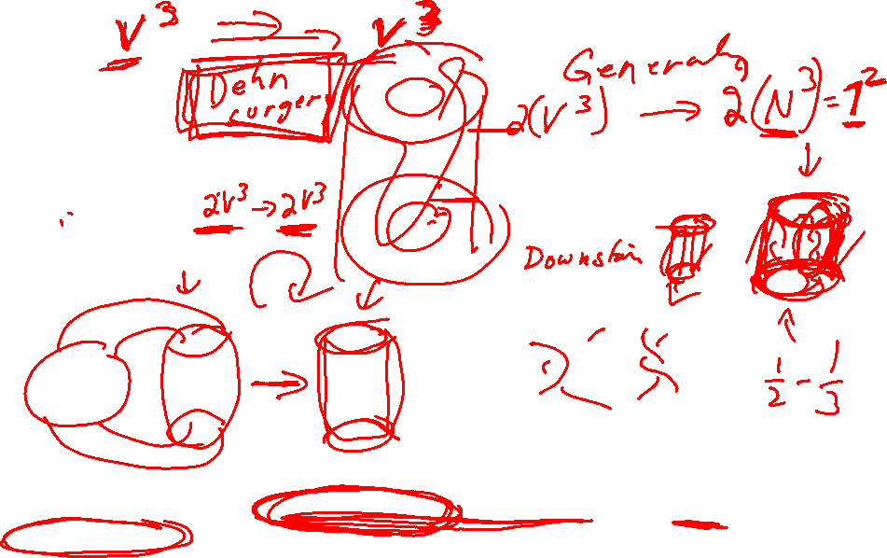

Slide 8
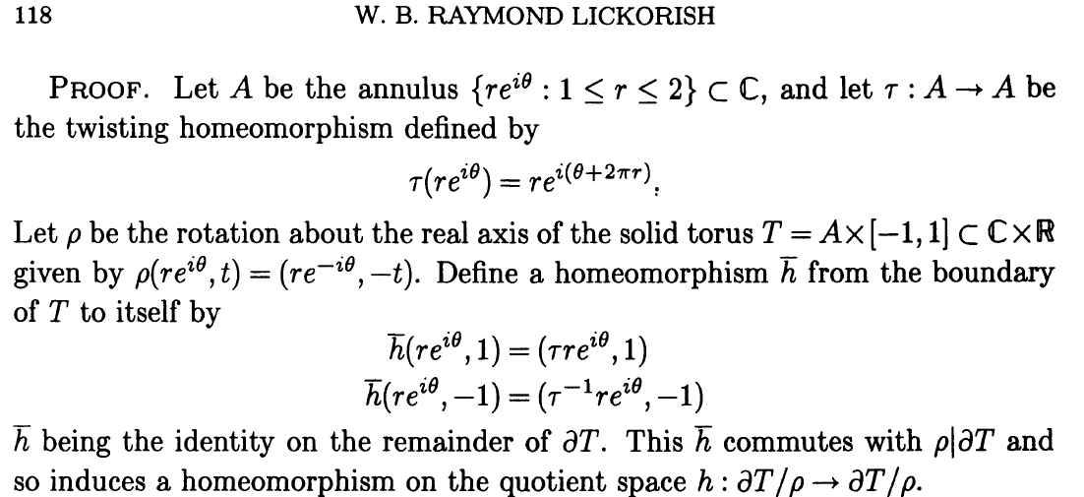

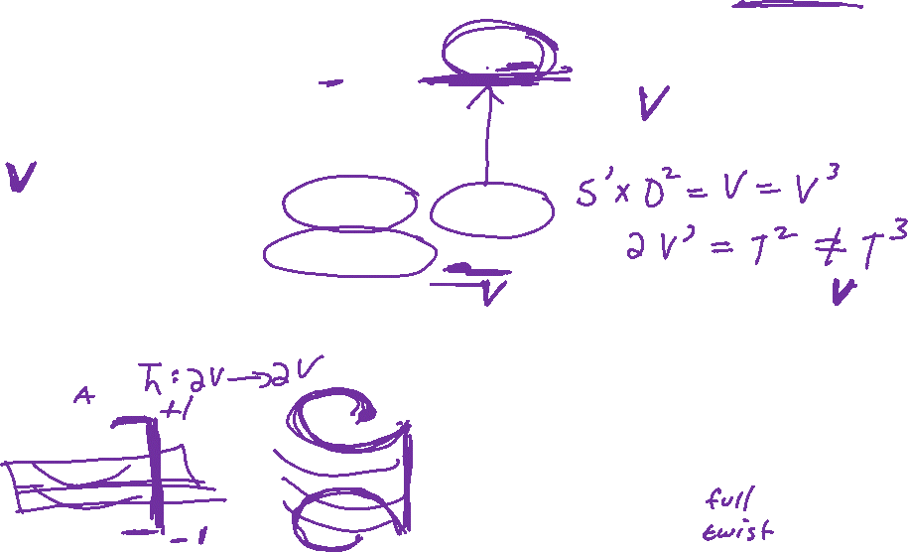

Slide 9
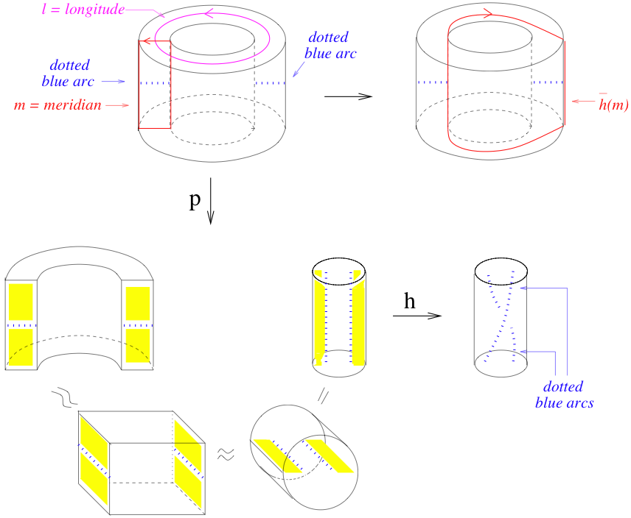
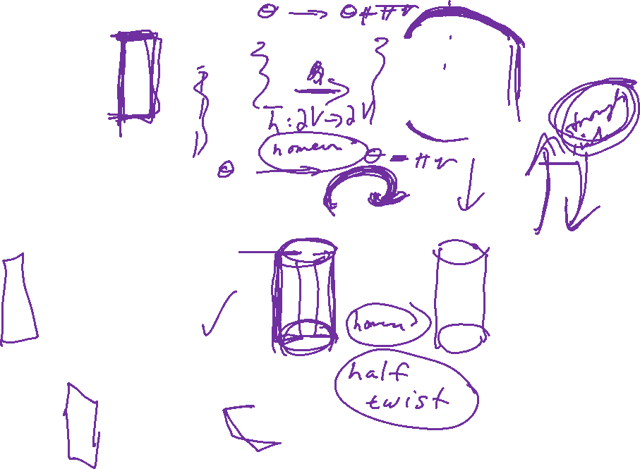

Slide 10

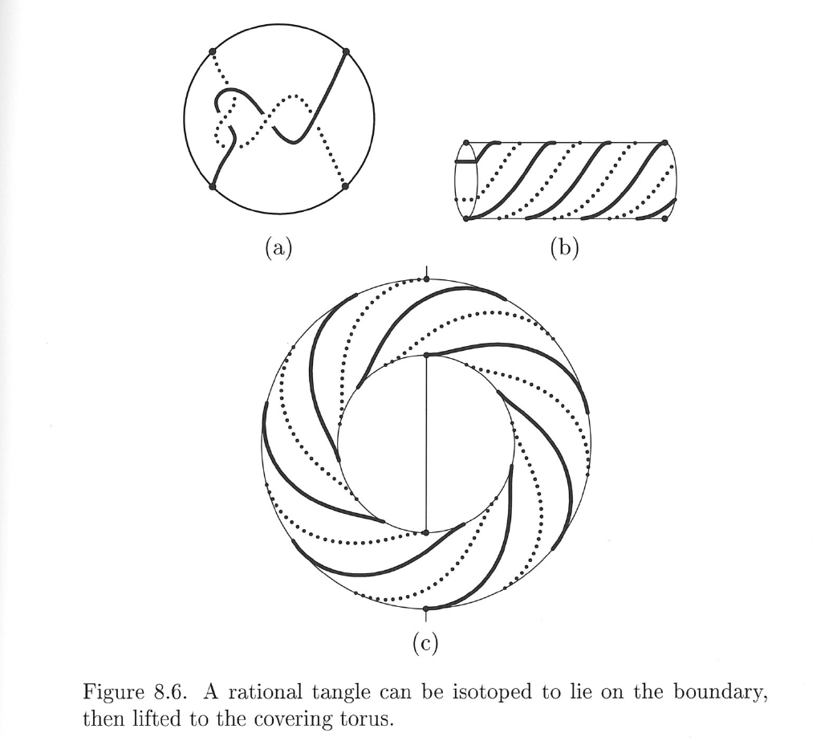
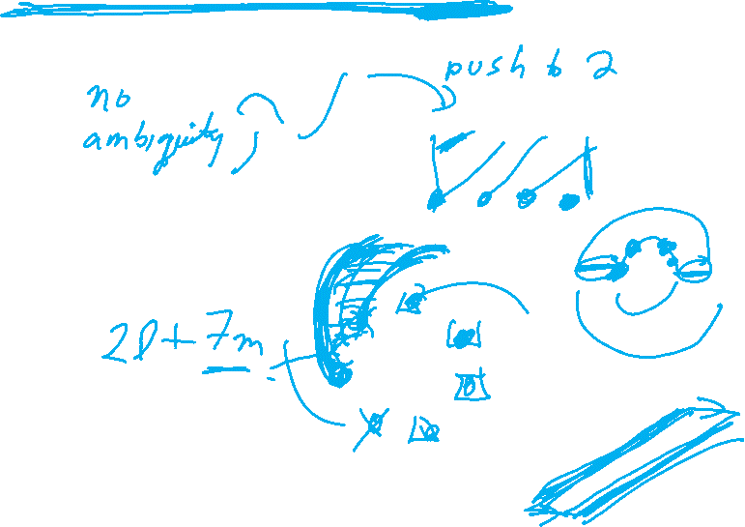
Classification of rational tangles is simpler:

Slide 11

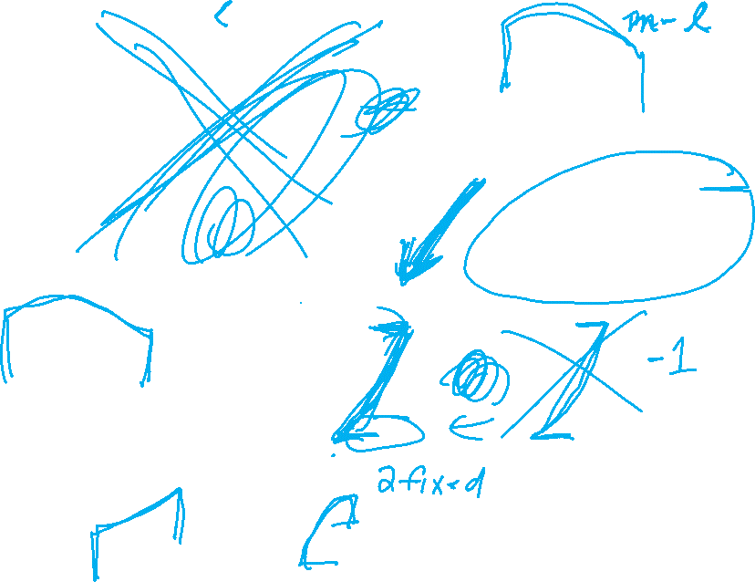










Slide 12
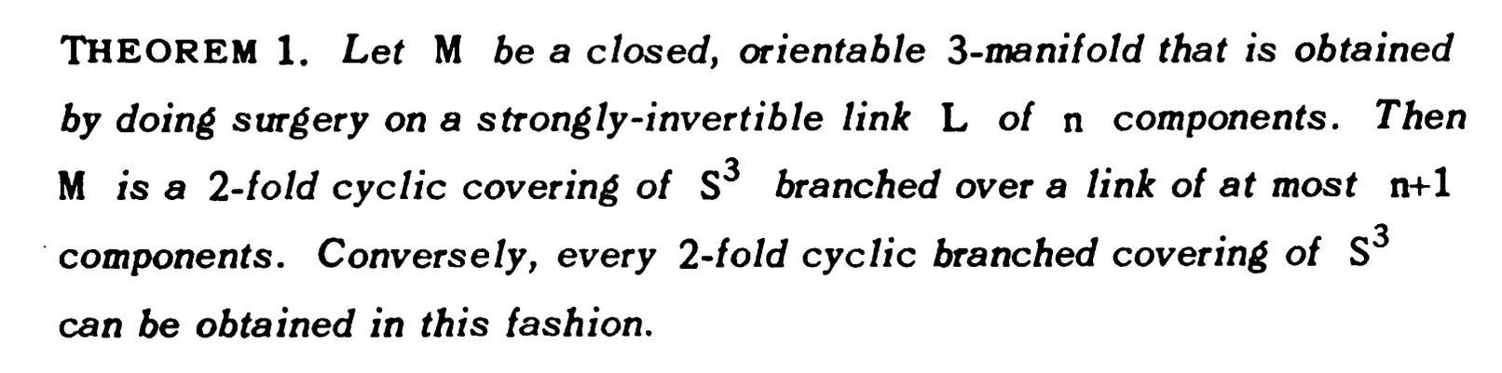
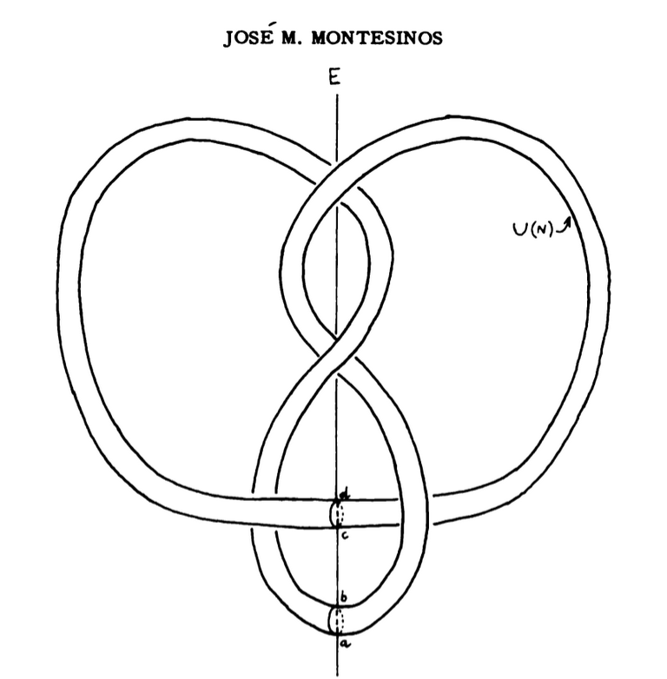
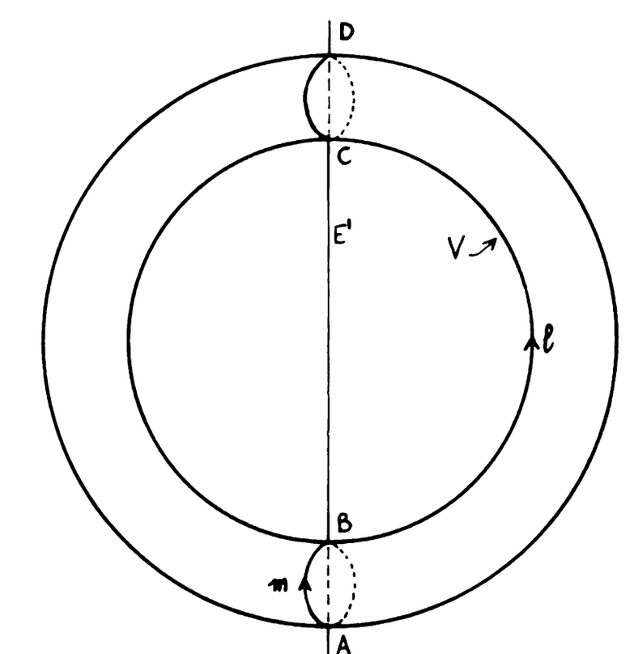
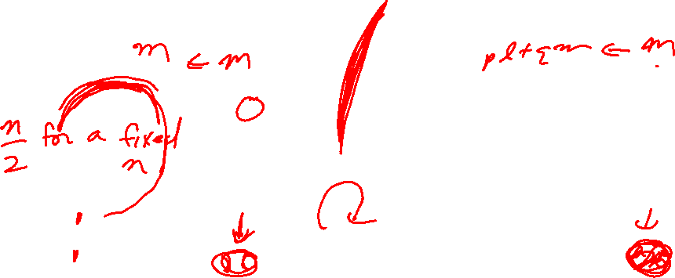







Slide 13


Slide 14
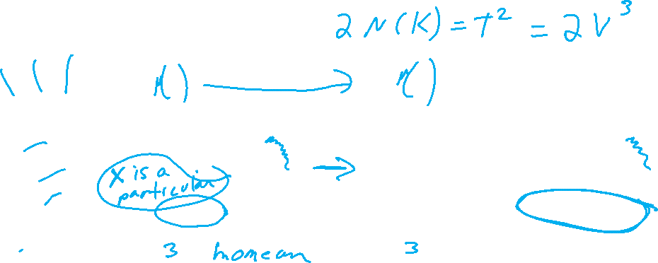

Slide 15









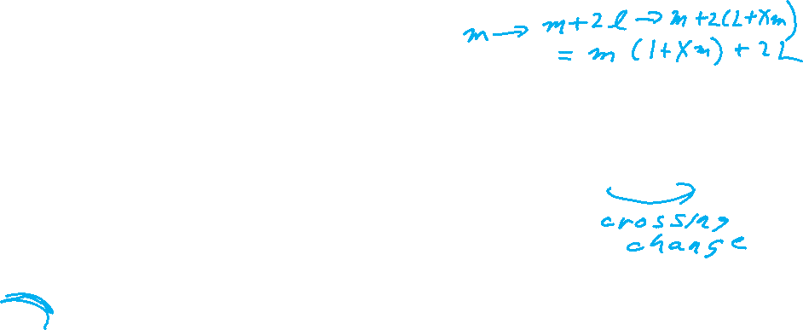




Slide 16


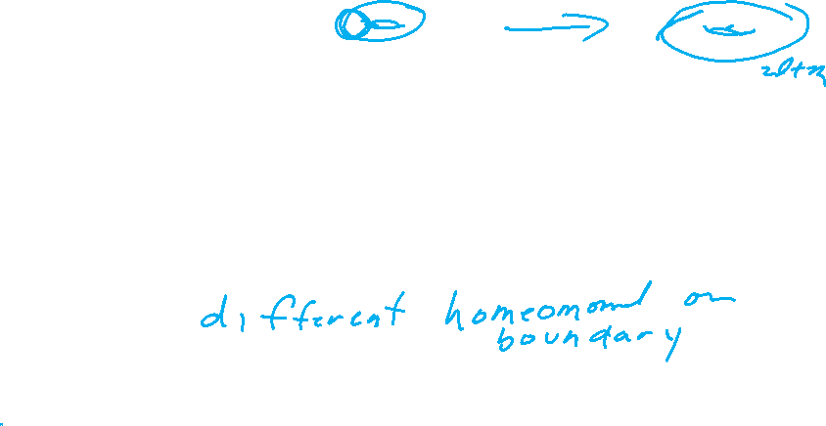



















Slide 17










HW 2: Choose 1 problem
Option 2: Relate tangle equations on previous slide to double branch cover.
Hint:

Slide 18
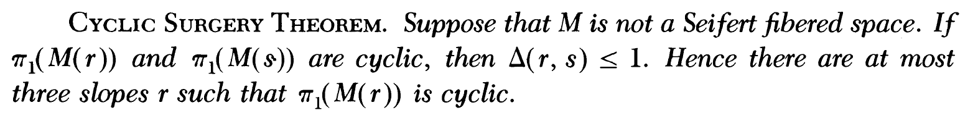
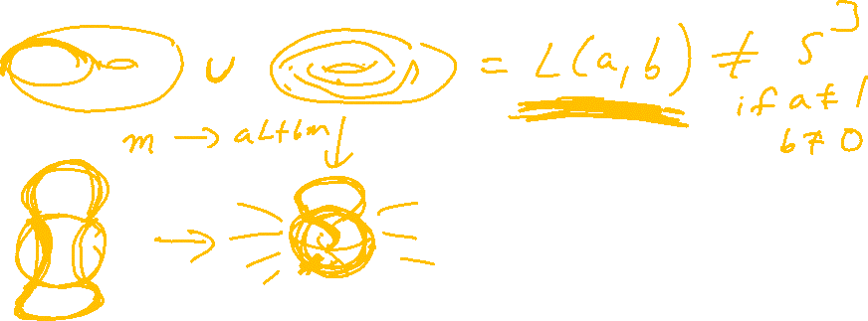
M. Culler, C. Gordon, J. Luecke, P. Shalen (1987). Dehn surgery on knots. The Annals of Mathematics (Annals of Mathematics) 125 (2): 237-300.
https://marc-culler.info/static/home/papers/CyclicSurgery.pdf

Slide 19
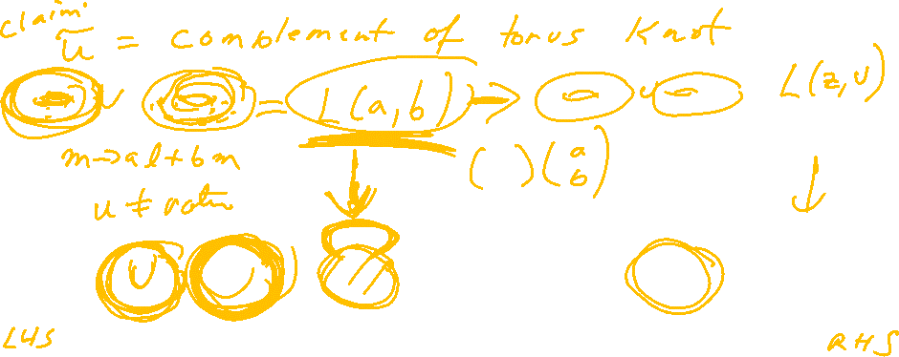
M. Culler, C. Gordon, J. Luecke, P. Shalen (1987). Dehn surgery on knots. The Annals of Mathematics (Annals of Mathematics) 125 (2): 237-300.
https://marc-culler.info/static/home/papers/CyclicSurgery.pdf

