Slide 1
Exam 2: Monday (Oct 26th)
Presentation: Choose a day(s) before Thanksgiving break (Nov 21) so you have time to incorporate feedback.

Slide 4
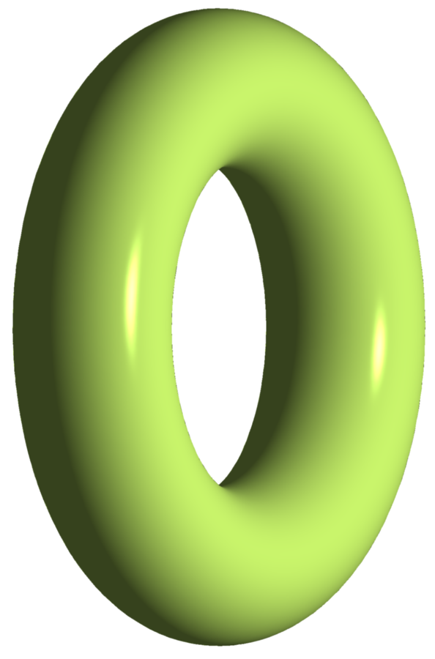

Slide 6
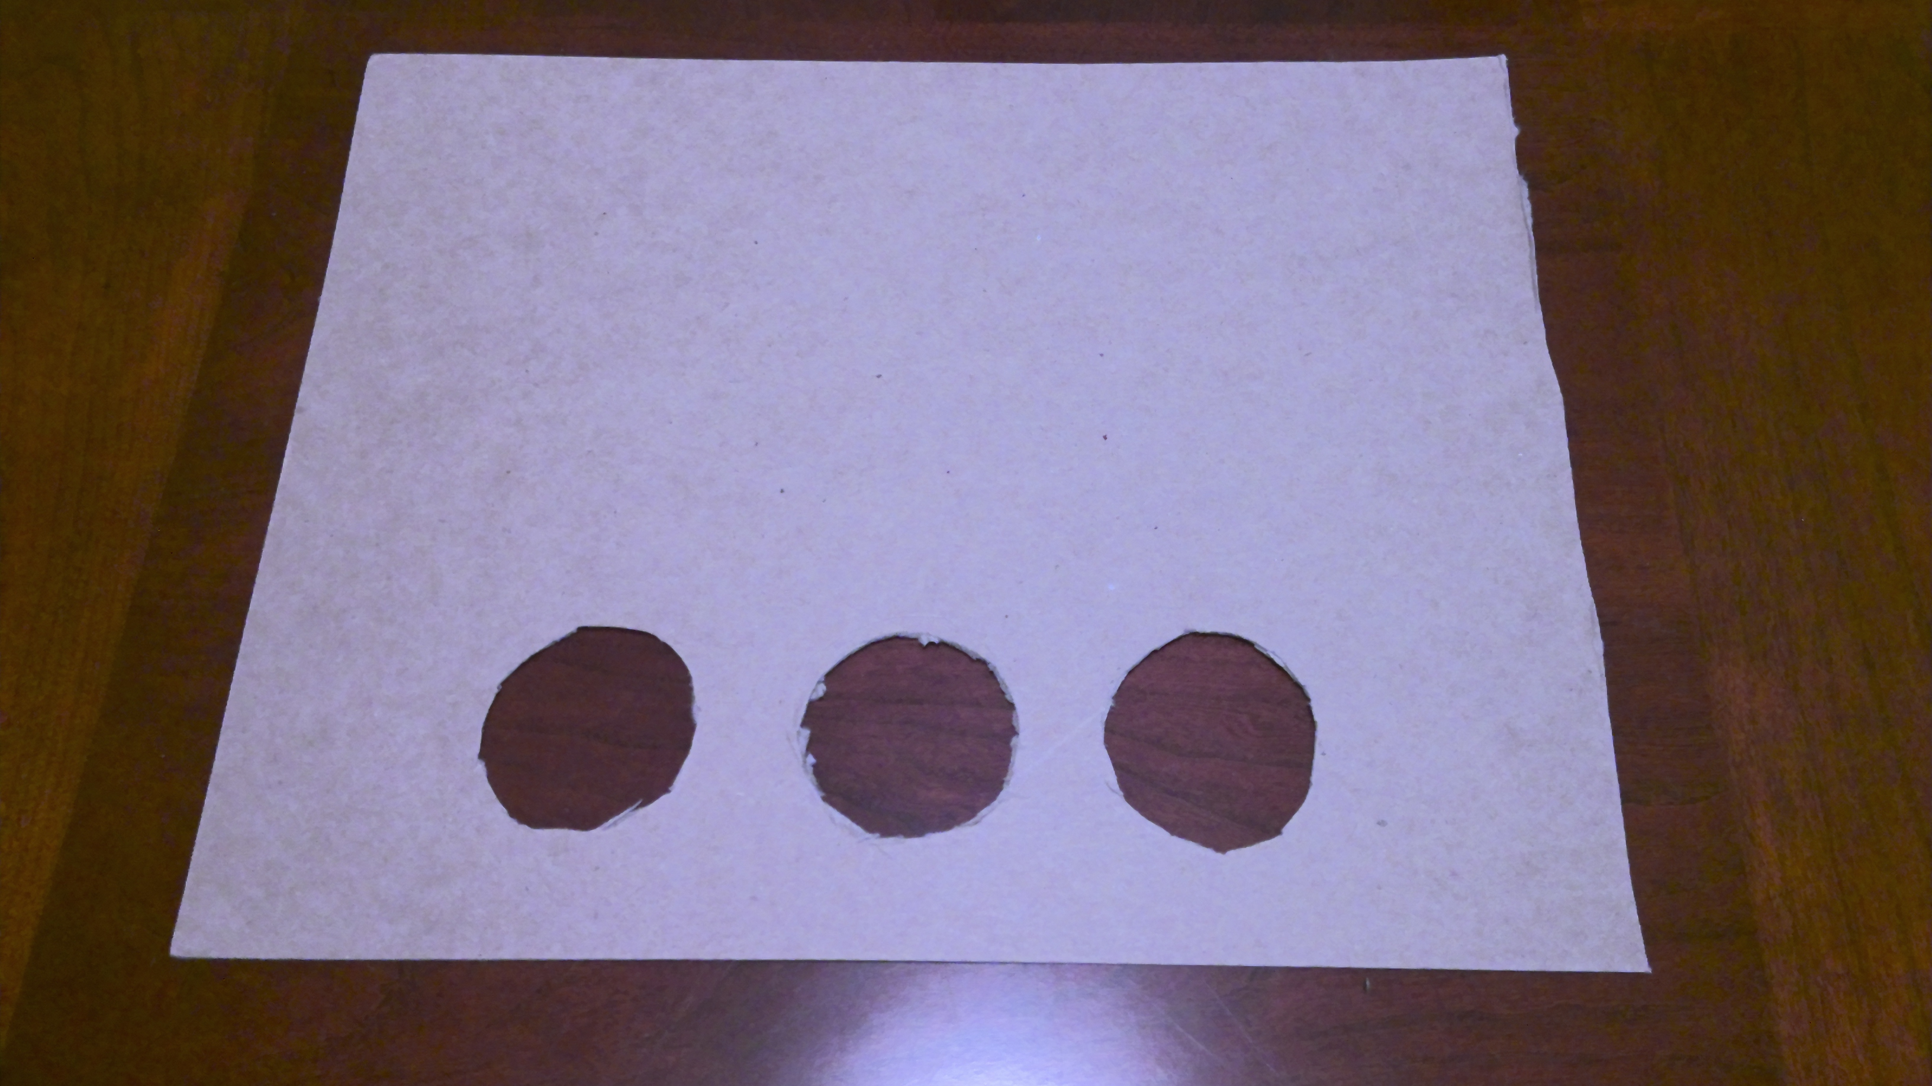
Remove exceptional fibers and create new cross section:

Slide 7
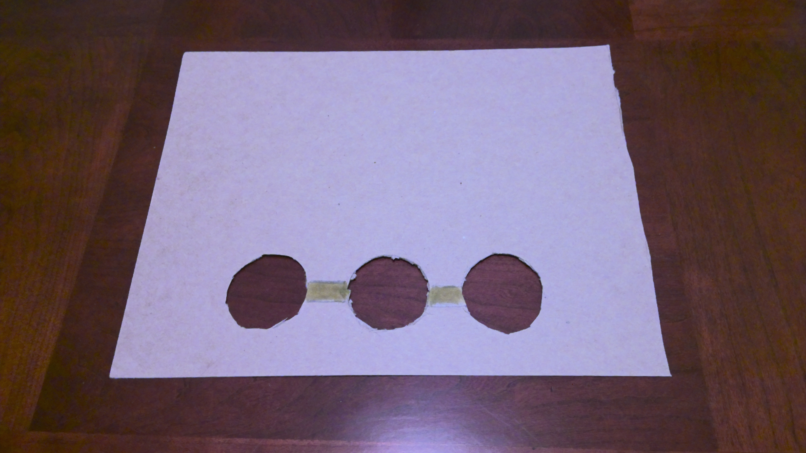

Slide 8
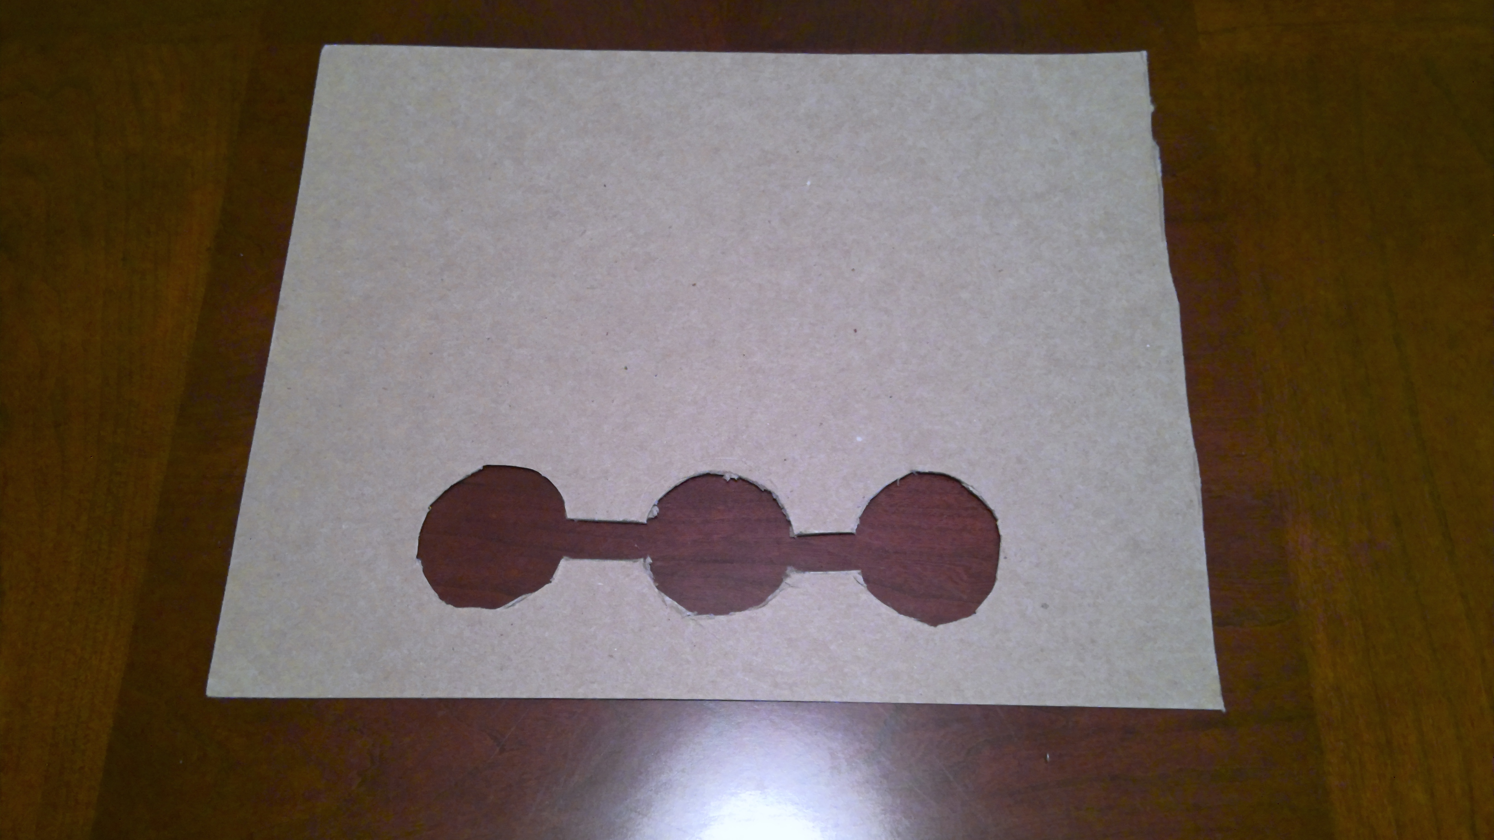

Slide 9
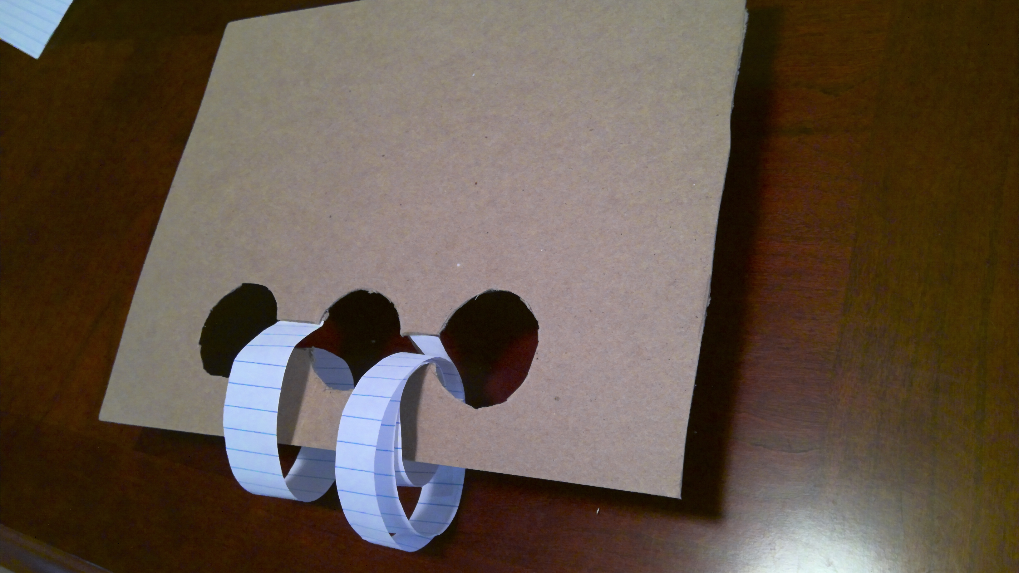

Slide 10
Remove exceptional fibers and create new cross section:

Slide 18
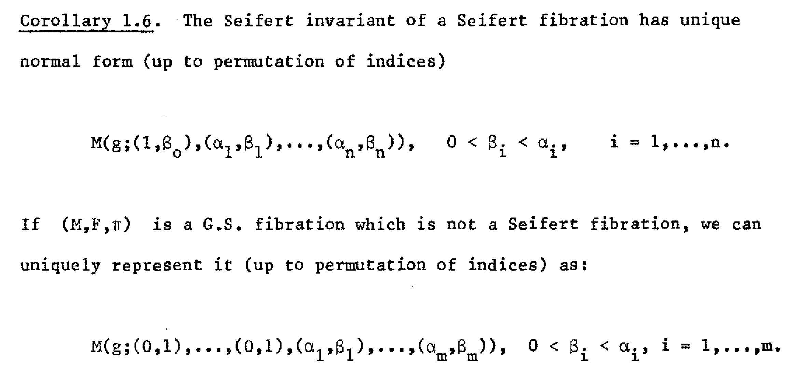

Slide 19
Identify M(0; (5, 12))

Slide 21
Identify M(0; (5, 12))

Slide 22
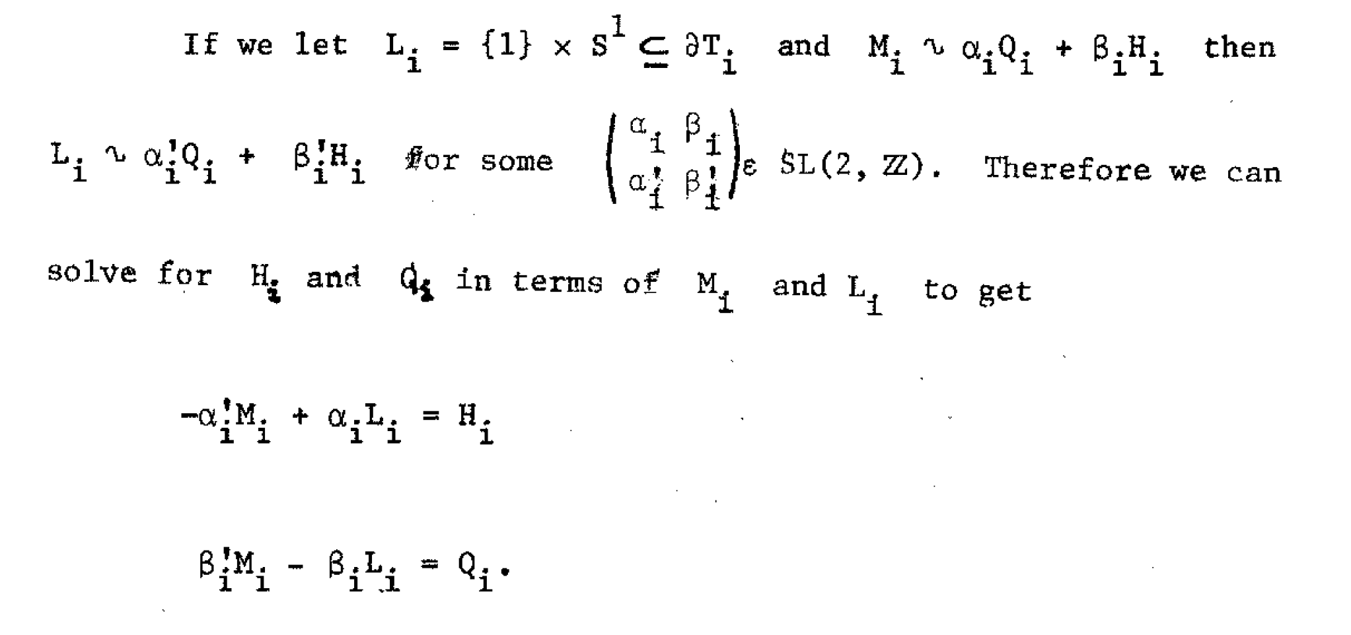
F
F
F
F

Slide 23
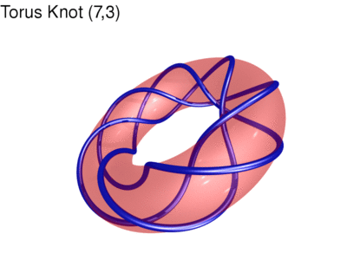
Identify this manifold:

Slide 24
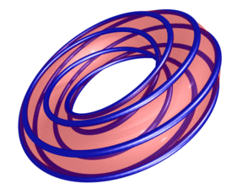
Identify this manifold:
http://www.mitchr.me/SS/torusKnots/index.html

Slide 26
Identify this manifold:
http://www.mitchr.me/SS/torusKnots/index.html

Slide 28
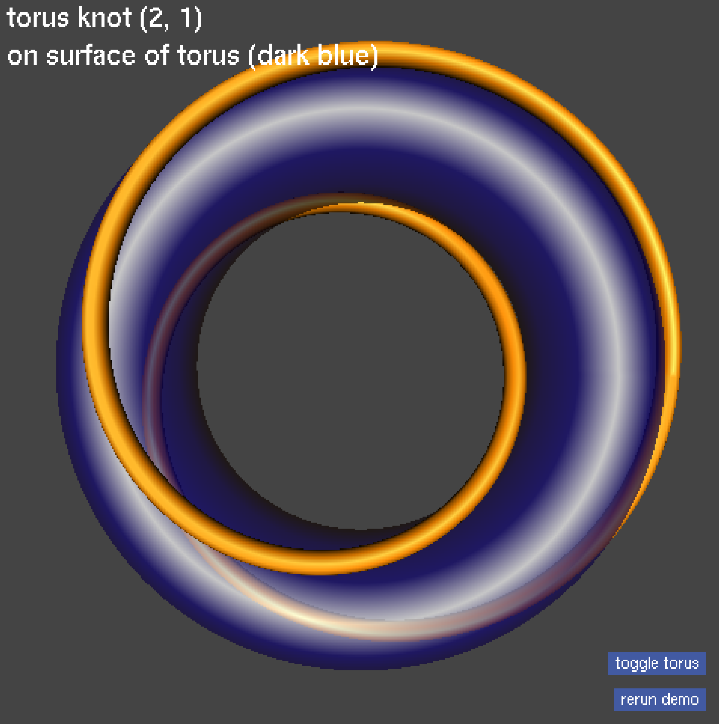
Identify this manifold

Slide 30
$$S^{2}×S^{1}−N\left(M+2L\right)$$

Slide 31
$$S^{2}×S^{1}−N\left(M+2L\right)$$

Slide 32
$$S^{2}×S^{1}−N\left(M+2L\right)$$

Slide 33
$$S^{2}×S^{1}−N\left(M+2L\right)$$

Slide 37
$S^{2}×S^{1}−N\left(M+2L\right)$ =

