Slide 1
Exam 2: Monday (Oct 26th)
Presentation: Choose a day(s) before Thanksgiving break (Nov 21) so you have time to incorporate feedback.

Slide 4
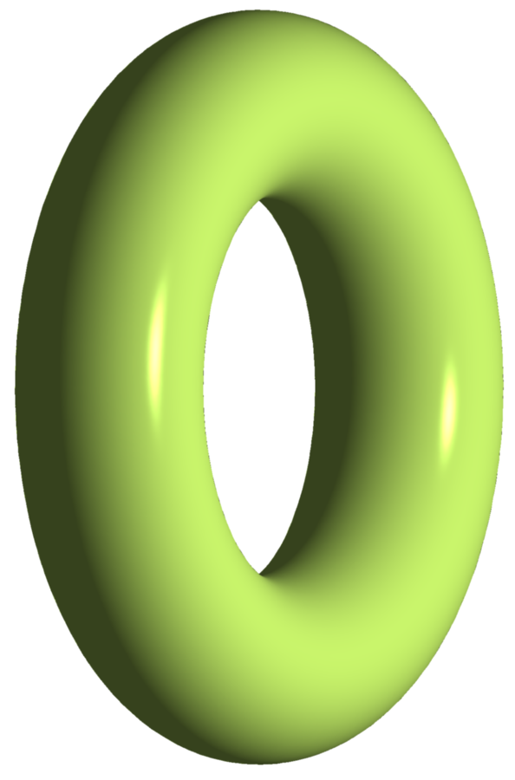

Slide 7
Remove exceptional fibers and create new cross section:

Slide 8
Remove exceptional fibers and create new cross section:

Slide 9
Remove exceptional fibers and create new cross section:

Slide 10
Remove exceptional fibers and create new cross section:

Slide 11
Remove exceptional fibers and create new cross section:

Slide 12
Remove exceptional fibers and create new cross section:

Slide 13
Remove exceptional fibers and create new cross section:

Slide 14
Remove exceptional fibers and create new cross section:

Slide 15
Remove exceptional fibers and create new cross section:

Slide 16
Remove exceptional fibers and create new cross section:

Slide 17
Remove exceptional fibers and create new cross section:

Slide 18
Remove exceptional fibers and create new cross section:

Slide 19
Remove exceptional fibers and create new cross section:

Slide 20
Remove exceptional fibers and create new cross section:

Slide 21
Remove exceptional fibers and create new cross section:

Slide 22
Remove exceptional fibers and create new cross section:

Slide 23
Remove exceptional fibers and create new cross section:

Slide 27
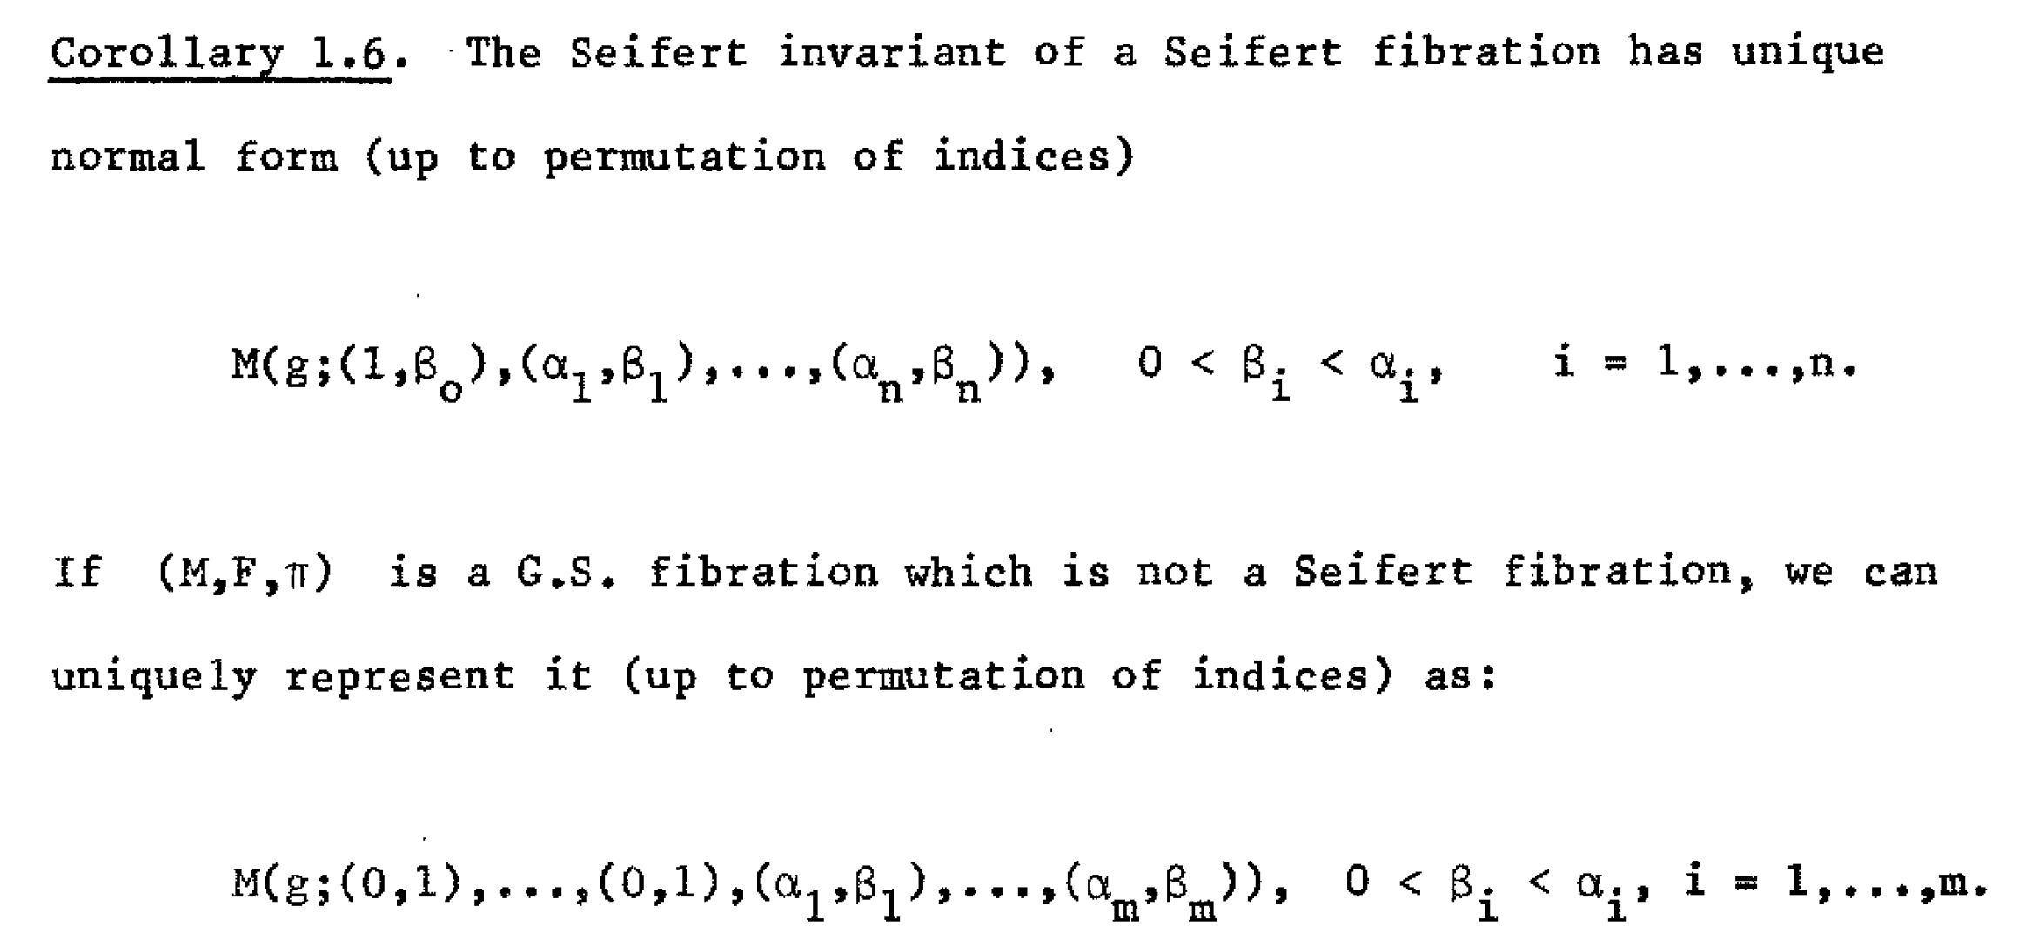

Slide 29
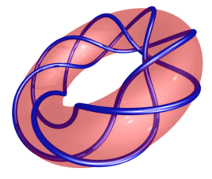
Identify this manifold:

