Slide 1
HW 2: post answers on ICON discussion page (if you prefer you can also e-mail me).
HW 3: Comment on the HW 2 answers and
HW: post/answer questions.

Slide 2
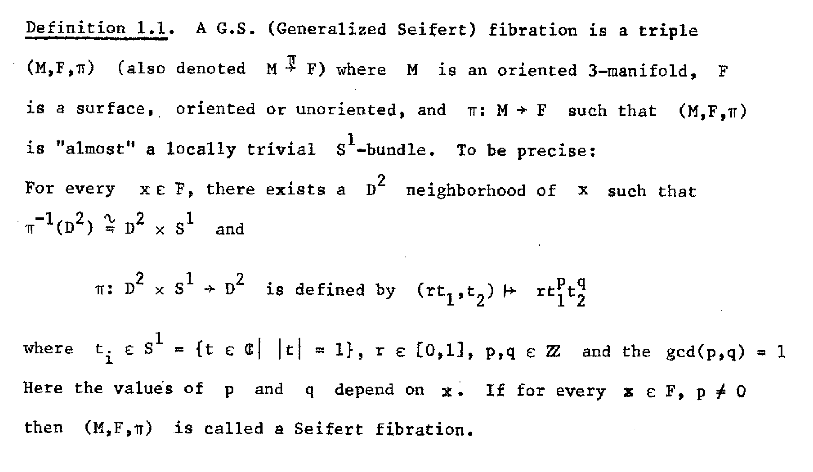
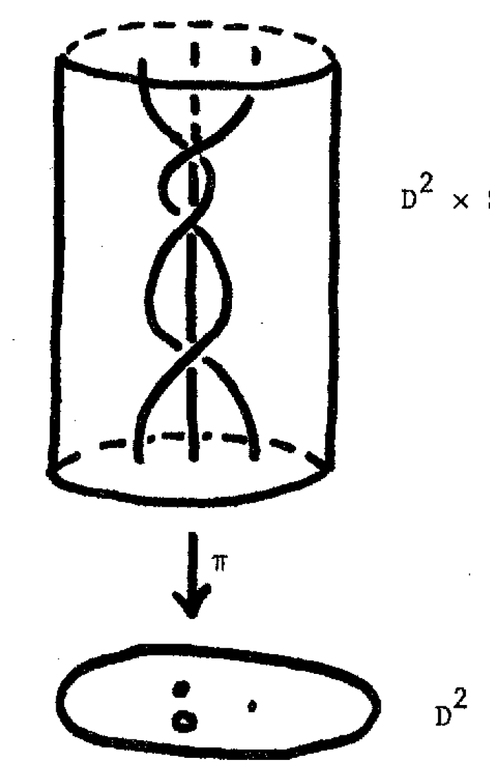

Slide 3
Neighborhood of ordinary fiber (1)

Slide 4
Neighborhood of ordinary fiber (2)

Slide 5
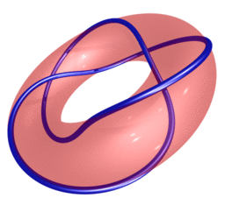
Neighborhood of exceptional fiber (SFS)
http://www.mitchr.me/SS/torusKnots/index.html

Slide 6
Neighborhood of exceptional fiber (SFS)
http://www.mitchr.me/SS/torusKnots/index.html

Slide 8
Neighborhood of exceptional fiber (SFS)
http://www.mitchr.me/SS/torusKnots/index.html

Slide 9
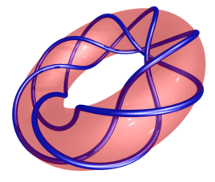
Neighborhood of exceptional fiber (SFS)
http://www.mitchr.me/SS/torusKnots/index.html

Slide 10
Neighborhood of exceptional fiber (Generalized SFS)

