Slide 1
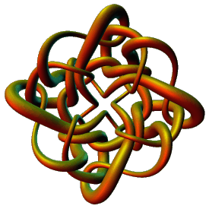
Modeling Protein-DNA Complexes Using Tangles
Isabel K. Darcy
Mathematics Department
Applied Mathematical and Computational Sciences (AMCS)
University of Iowa
http://www.math.uiowa.edu/~idarcy
This work was partially supported by the Joint DMS/NIGMS Initiative to Support Research in the Area of Mathematical Biology (NSF 0800285).
©2008 I.K. Darcy. All rights reserved

Slide 2
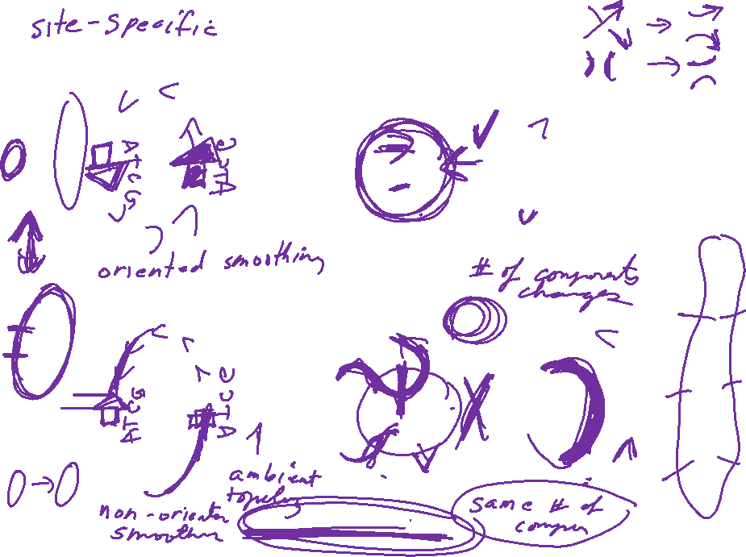
Recombination:

Slide 3
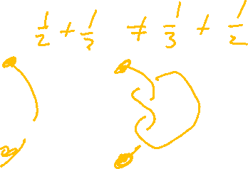
Why are we interested in rational tangles?
1.) Rational tangles are simple
simplest
non-rational
tangles:
2.) Rational tangles are
formed by adding twists.
Think supercoils:
EM courtesy of Andrzej Stasiak

Slide 4
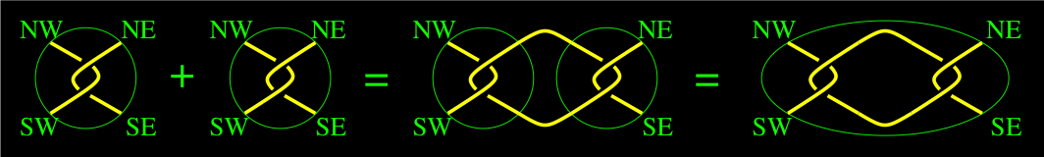
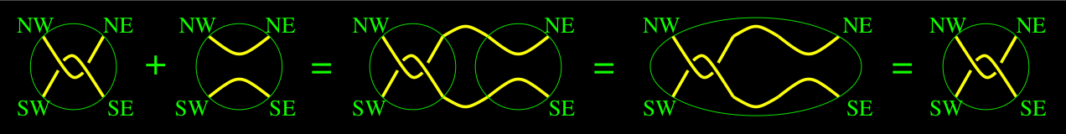
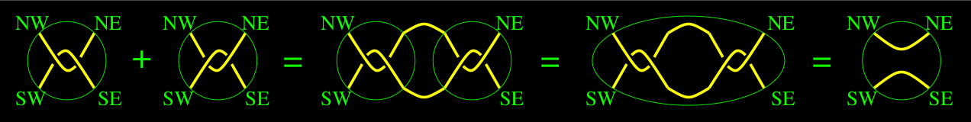
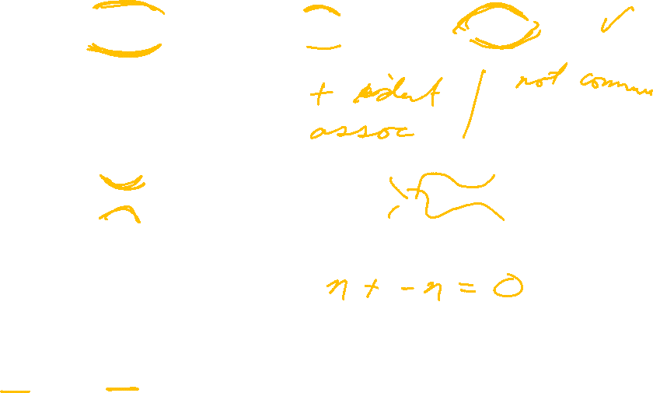
A + B = C
2 + 0 = 2
2 + -2 = 0
Most tangles don’t have inverses

Slide 7
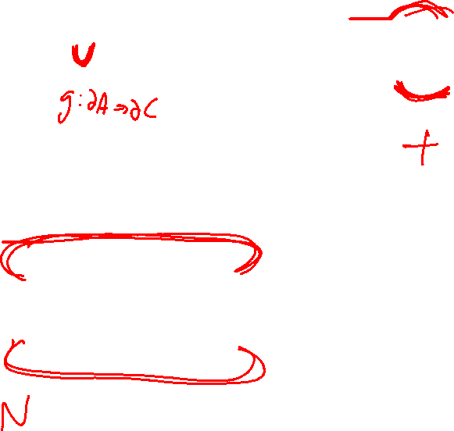

Slide 8
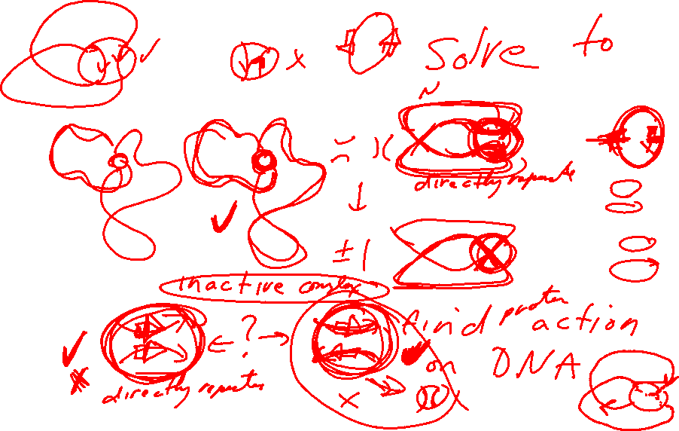
The tangle equations corresponding to an electron micrograph:

Slide 9
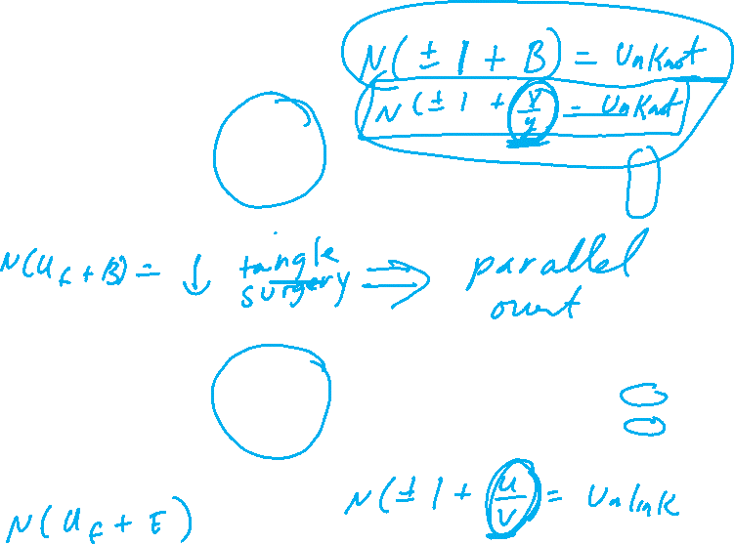
Different recombinases have different topological mechanisms:

Slide 10
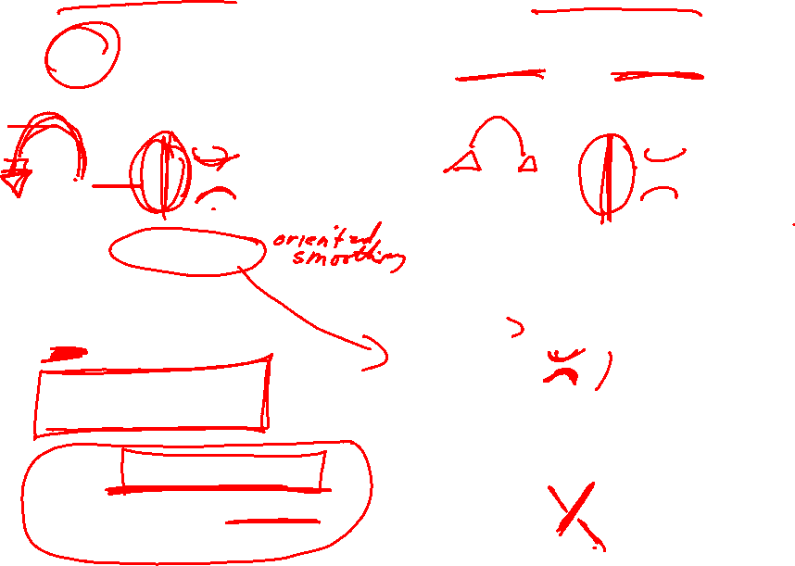
Different recombinases have different topological mechanisms:
Ex: Cre recombinase can act on both directly and inversely repeated sites.
Xer recombinase on psi.
Unique product
Uses topological filter to only perform deletions, not inversions

Slide 11
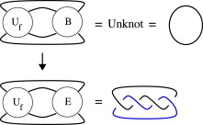
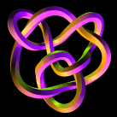
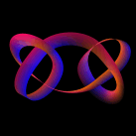
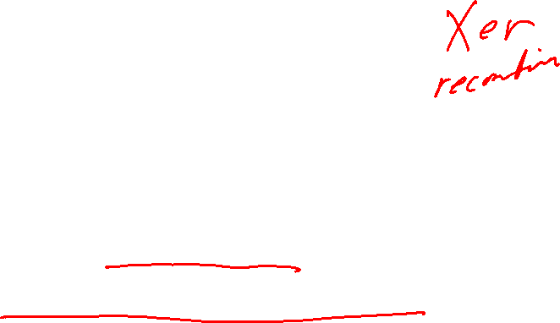
There are an infinite number of solutions to
Can solve by using
TopoICE in Rob Scharein’s KnotPlot.com

Slide 12
