Slide 1
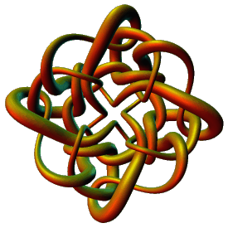
Modeling Protein-DNA Complexes Using Tangles
Isabel K. Darcy
Mathematics Department
Applied Mathematical and Computational Sciences (AMCS)
University of Iowa
http://www.math.uiowa.edu/~idarcy
This work was partially supported by the Joint DMS/NIGMS Initiative to Support Research in the Area of Mathematical Biology (NSF 0800285).
©2008 I.K. Darcy. All rights reserved

Slide 2
An introduction to the tangle model for protein-bound DNA

Slide 3
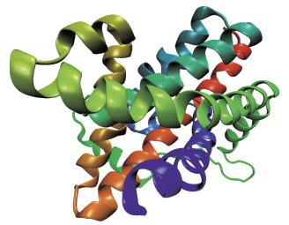
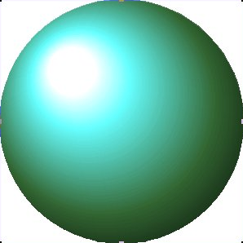
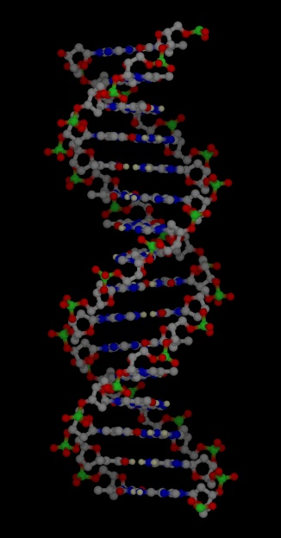
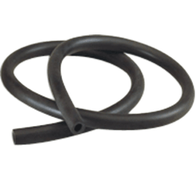
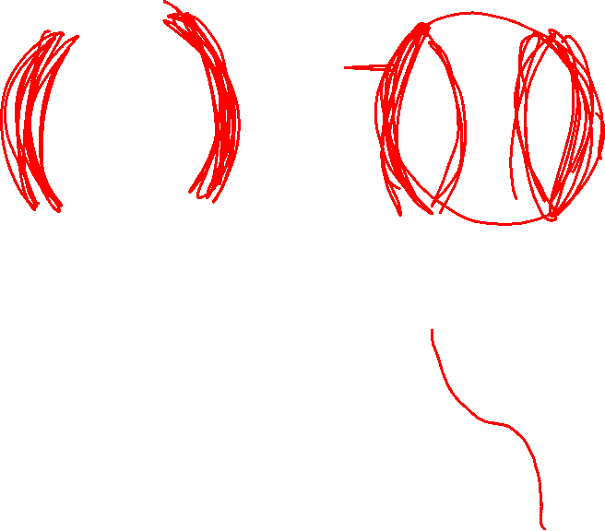
Mathematical Model
Protein =
=
=
=
DNA =

Slide 4
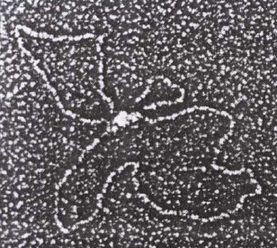
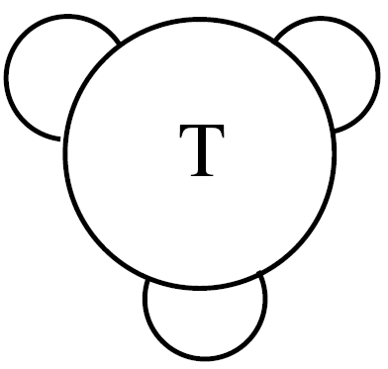
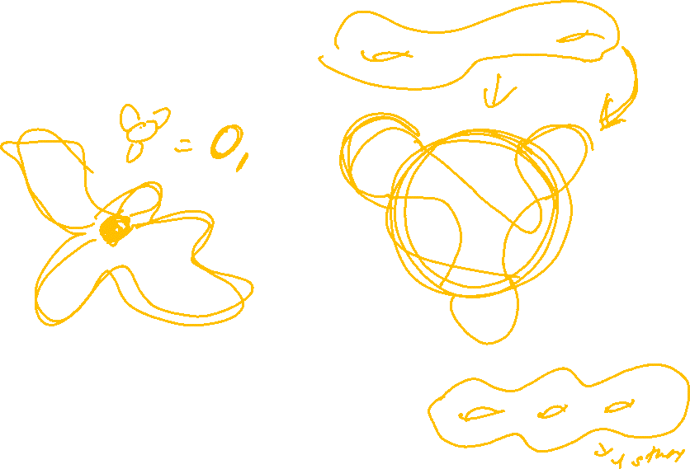
C. Ernst, D. W. Sumners, A calculus for rational tangles: applications to DNA recombination, Math. Proc. Camb. Phil. Soc. 108 (1990), 489-515.
protein = three dimensional ball
protein-bound DNA = strings.
Protein-DNA complex
Heichman and Johnson
Slide (modified) from Soojeong Kim

Slide 5

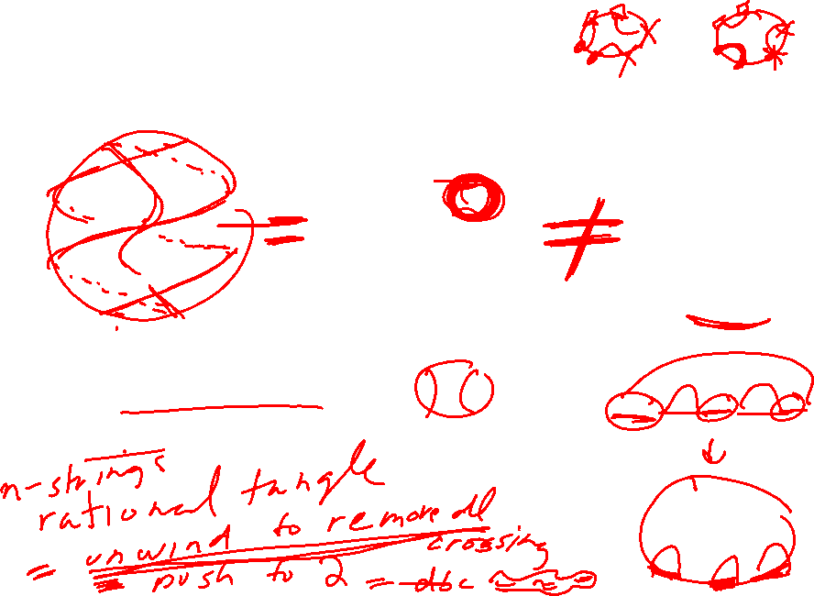
Tangle = 3-dimensional ball containing strings where the endpoints of the strings are fixed on the boundary of the ball.
=
≠
Protein = 3-dimensional ball
DNA = strings

Slide 6
Tangle = 3-dimensional ball containing strings where the endpoints of the strings are fixed on the boundary of the ball.
=
≠
Protein = 3-dimensional ball
DNA = strings

Slide 7
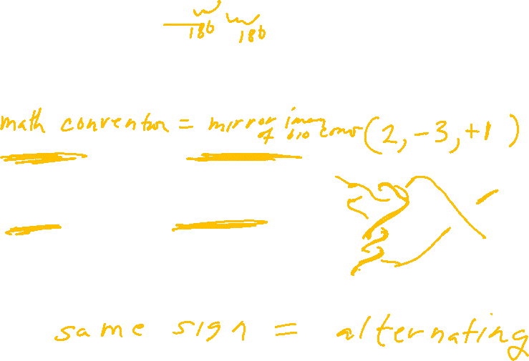
Rational Tangles
Rational tangles alternate between vertical crossings & horizontal crossings.
k horizontal crossings are right-handed if k > 0
k horizontal crossings are left-handed if k < 0
k vertical crossings are left-handed if k > 0
k vertical crossings are right-handed if k < 0
Note that if k > 0, then the slope of the overcrossing strand is negative,
while if k < 0, then the slope of the overcrossing strand is positive.
By convention, the rational tangle notation always ends with the number of horizontal crossings.

Slide 8
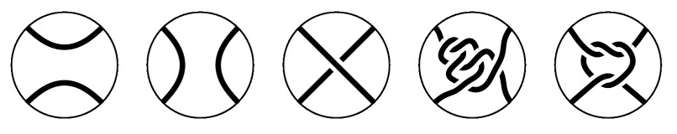
Tangles

Slide 9
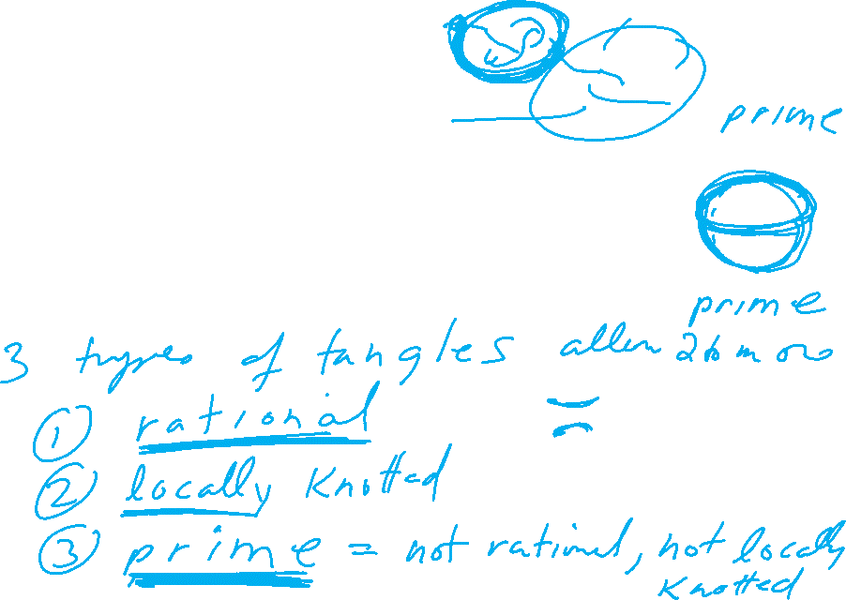
Which tangles are rational?
This one is not rational.
The others are all rational

Slide 10
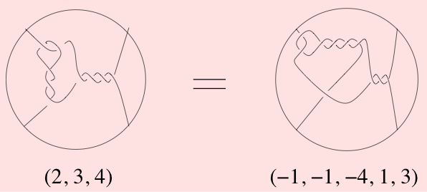
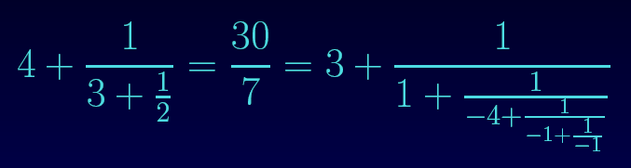
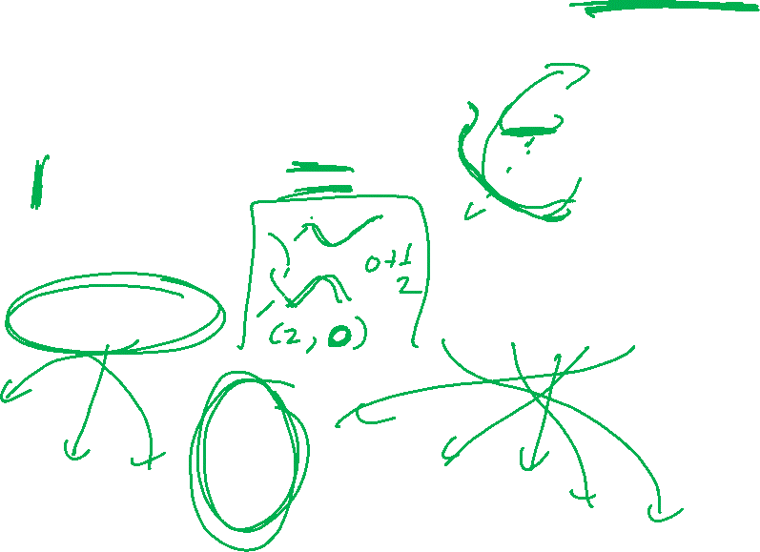
Rational tangles can be classified with fractions.

Slide 11
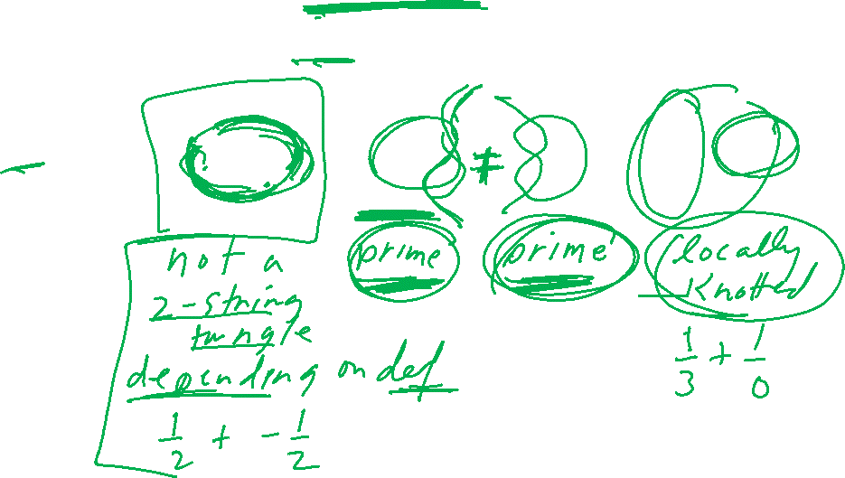
Why are we interested in rational tangles?
1.) Rational tangles are simple
simplest
non-rational
tangles:

Slide 12
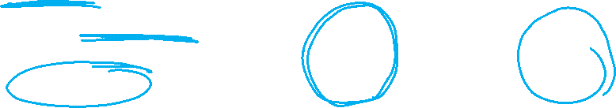
Why are we interested in rational tangles?
1.) Rational tangles are simple
simplest
non-rational
tangles:
2.) Rational tangles are
formed by adding twists.
Think supercoils:
EM courtesy of Andrzej Stasiak

Slide 13
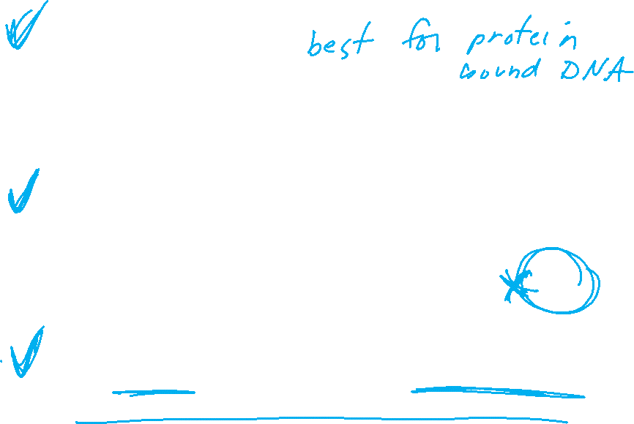
Why are we interested in rational tangles?
1.) Rational tangles are simple
simplest
non-rational
tangles:
2.) Rational tangles are
formed by adding twists.
Think supercoils:
EM courtesy of Andrzej Stasiak
3.) A tangle is rational if and only if one can push the strings to lie on the boundary of the 3-ball so that the strings do not cross themselves on 3-ball

Slide 14
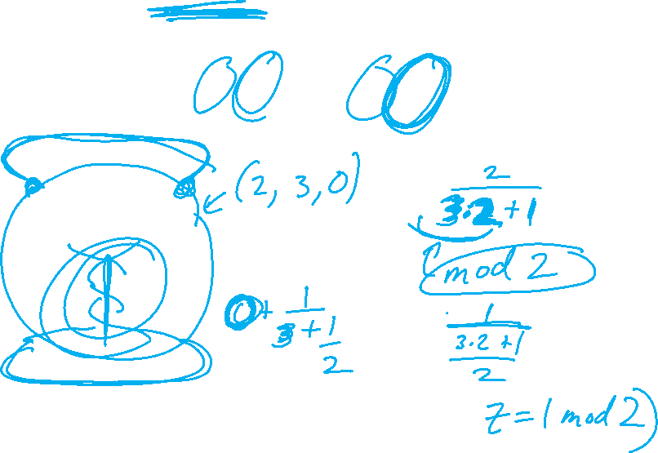
A knot/link is rational if it can be formed from a rational tangle via numerator closure.
N(2/7) = N(2/1)
Note 7 – 1 = 6 = 2(3)

Slide 15
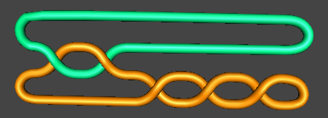
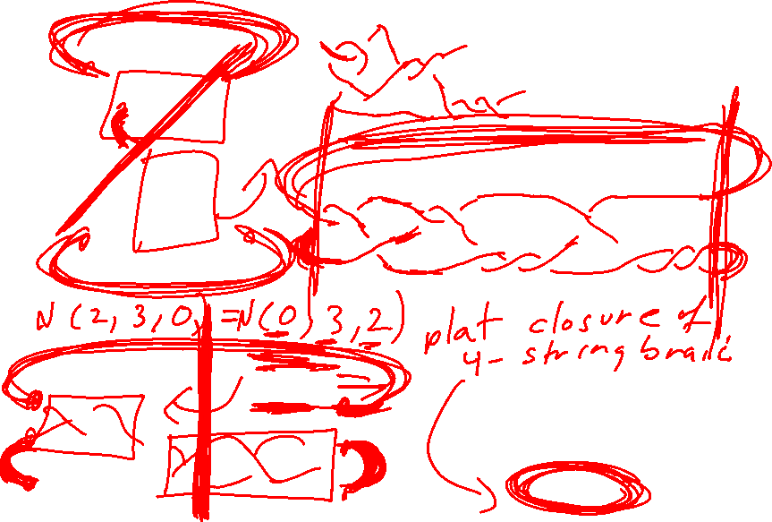
A knot/link is rational if it can be formed from a rational tangle via numerator closure.
A rational knot/link is also called a
2-bridge knot/link
or 4-plat

Slide 16
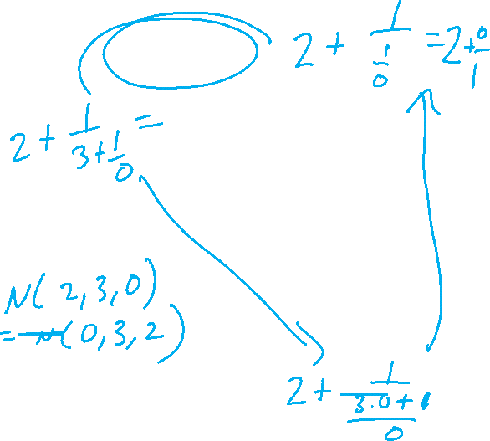
A knot/link is rational if it can be formed from a rational tangle via numerator closure.
N(2/7) = N(2/1)
Note 7 – 1 = 6 = 2(3)

Slide 17
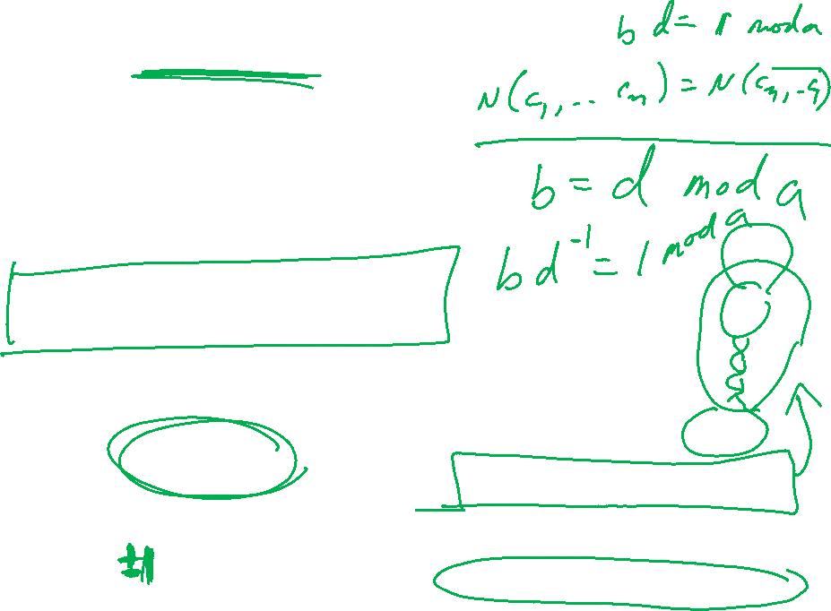
a = c
and
b – d is a multiple of a or
bd – 1 is a multiple of a.

