Slide 8
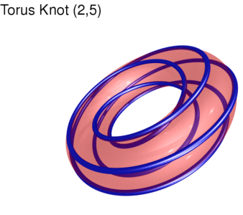
https://www.mitchr.me/SS/torusKnots/

Slide 17
https://www.mitchr.me/SS/torusKnots/

Slide 18
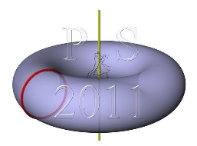
http://www.surynkova.info/Picasa-galerie/Galerie-3Dmodely/Surfaces/images/02_surfaces_of_revolution03.jpg
https://www.mitchr.me/SS/torusKnots/

