Slide 1
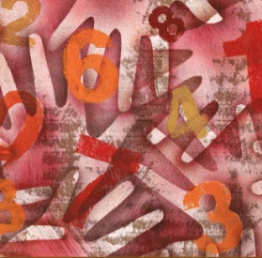
Chapter 1: Urban Services
Lesson Plan
For All Practical Purposes
Euler Circuits
  Parking-Control Officer Problem
Finding Euler Circuits
  Qualifications: Even Valence and Connectedness
Beyond Euler Circuits
  Chinese Postman Problem
  Eulerizing a Graph
Urban Graph Traversal Problems
  More practical applications and modifications
Mathematical Literacy in Today’s World, 9th ed.
1
© 2013 W. H. Freeman and Company

Slide 2
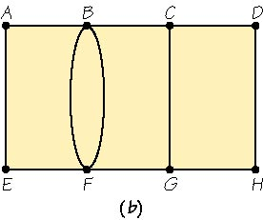
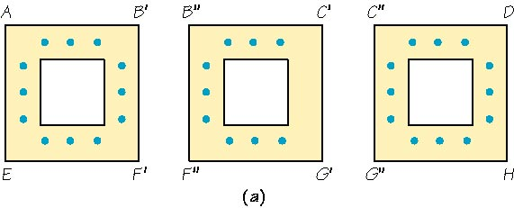
Chapter 1: Urban Services
Beyond Euler Circuits
Chinese Postman Problem
  In real life, not all problems will be perfect Euler circuits.
  If no Euler circuit exists (odd valences), you want to minimize the length of the circuit by carefully choosing the edges to be retraced.
  For our purposes, we assume all edges have the same length—simplified Chinese postman problem.
  Chinese mathematician Meigu Guan first studied this problem in 1962, hence the name.
The blue dots indicate parking meters along the street.
The graph represents edges with parking meters. Notice only vertices C and G have odd valence.
2

Slide 3
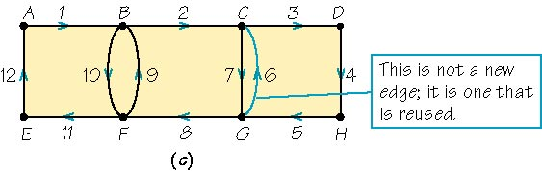
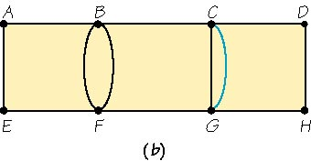
Chapter 1: Urban Services
Beyond Euler Circuits
Eulerize the Graph to Solve Chinese Postman Problem
  For graphs that are connected but have vertices with odd valence, we will want to reuse (duplicate) the minimum number of edges until all vertices appear to have even valence.
  Only existing edges can be duplicated (or added).
  Each edge that is duplicated (added) will later be the edge that will be reused during eulerization.
The edge CG is reused, which would make all vertices appear to have even valence.
A circuit is made by reusing the edge CG. Below, the graph is eulerized (starts and stops at same point and covers all “edges” once — including reused ones).
3

Slide 4
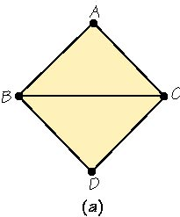
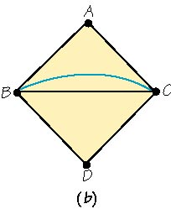
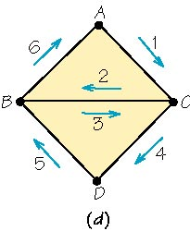
Chapter 1: Urban Services
Beyond Euler Circuits
Eulerizing a Graph
  On the graph, add edges by duplicating existing ones, until you arrive at a graph that is connected and even-valent.
    The graph to the right is an efficient eulerization because the fewest number of edges were added.
  Find an Euler circuit on the eulerized graph.
    Traverse every original and “added” edge once, as you find a circuit that starts and ends at the same vertex.
  “Squeeze” this Euler circuit from the eulerized graph onto the original graph by replacing the “added” edge with an arrow showing it was retraced.
Only reuse (add) edge BC.
Squeeze the eulerized circuit onto the graph.
4

Slide 5
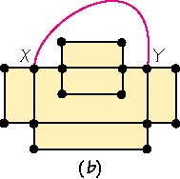
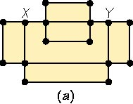
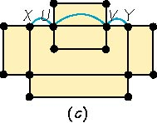
Chapter 1: Urban Services
Beyond Euler Circuits
For weighted graphs, you look for lowest weight paths, not fewest edges
Hints for Eulerizing a Graph
  For the most efficient eulerization, look for the fewest edges to add to make all vertices even.
  Typically, locate odd valence vertices and try to reuse (add) the connecting edge between the vertices.
  Sometimes vertices are more than one edge apart; in this case, reuse edges between vertices (see graph below).
Remember: Only duplicate (add to) the existing edges.
Odd vertices, X and Y, are more than one edge apart.
This is not allowed — must only reuse existing edges.
Reuse existing edges between the odd vertices.
5

Slide 6
Chapter 1: Urban Services
Urban Graph Traversal Problem
Euler Circuits and Eulerizing Graphs: Practical Applications
  Checking parking meters (discussed)
  Collecting garbage
  Salting icy roads
  Inspecting railroad tracks
Special Requirements May Need to Be Addressed
  Traffic directions
  Number of streets/lanes (divided routes)
  Parking time restriction
Theory Modifications Can Address Special Requirements
  A digraph (directed graph) is used to show a one-way street.
    Arrows show restriction in traversal possibilities (not part of circuits).
  Territories may need to be divided into multiple routes.
6

