Slide 1
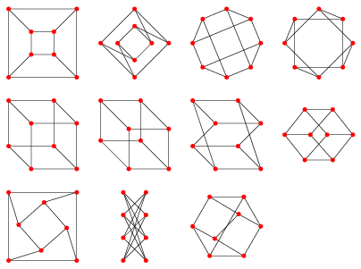
Drawing a graph
http://mathworld.wolfram.com/GraphEmbedding.html

Slide 2
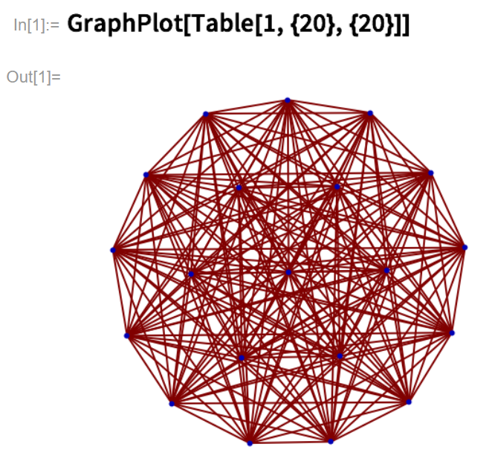
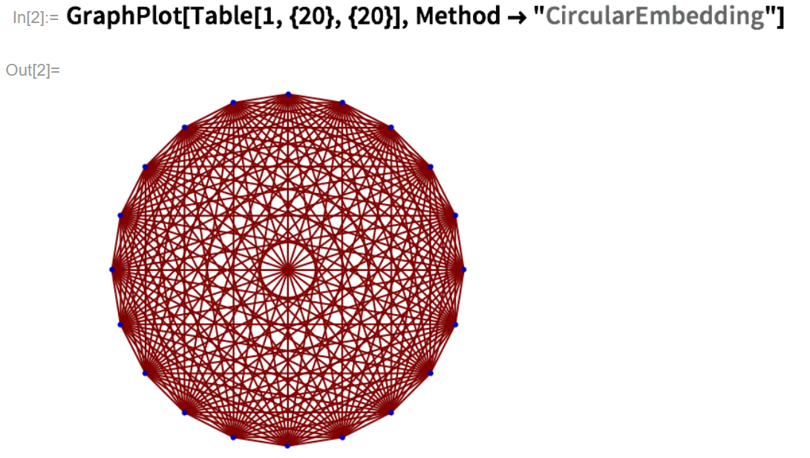
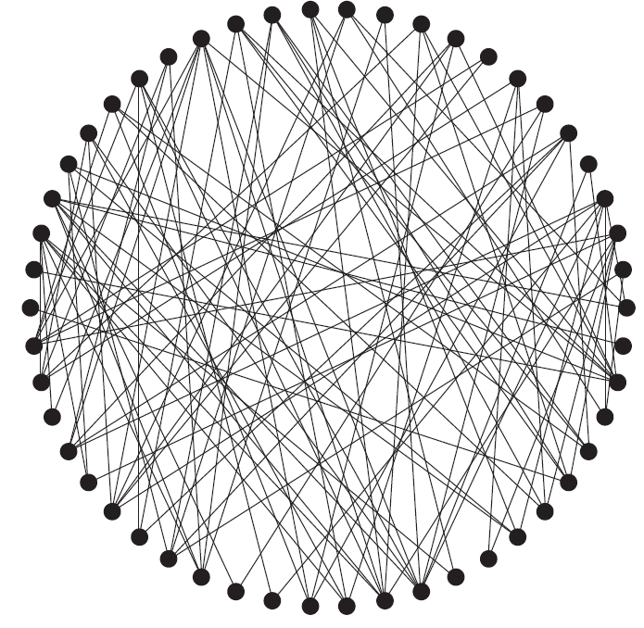
https://reference.wolfram.com/language/ref/GraphPlot.html
Graph Theory and Complex Networks by Maarten van Steen

Slide 3
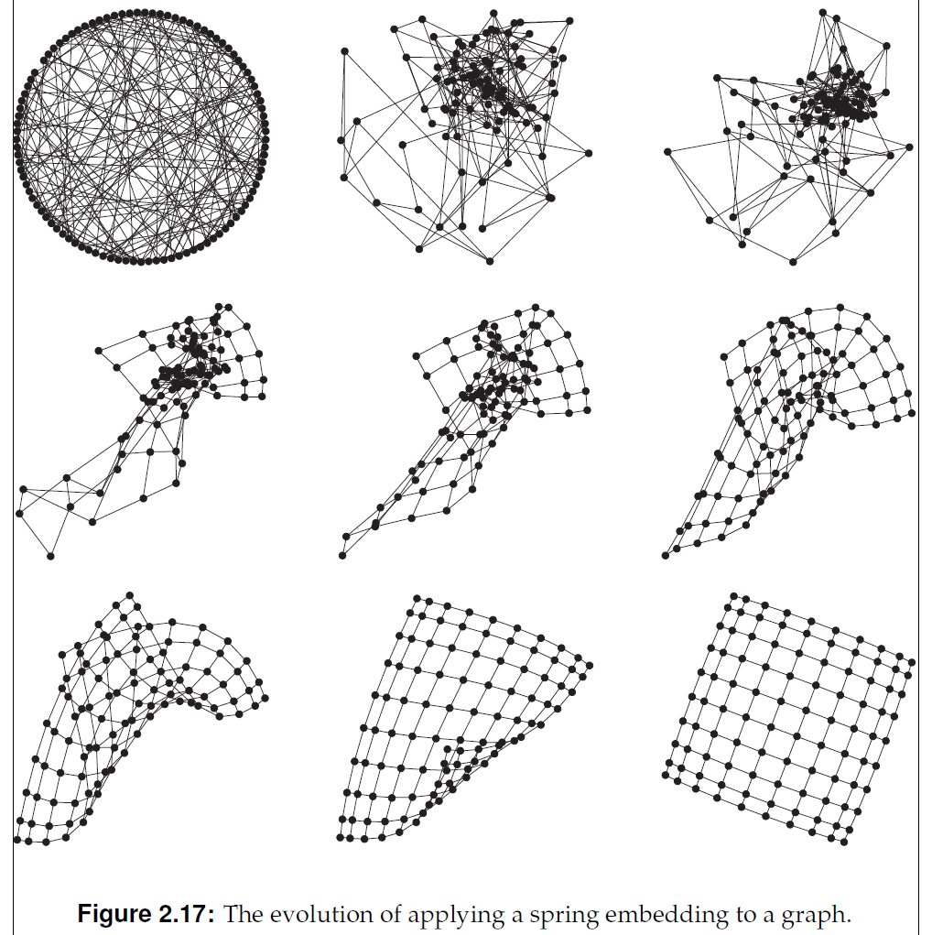
Graph Theory and Complex Networks by Maarten van Steen

Slide 4
What is a planar embedding?
drp.math.umd.edu/Project-Slides/Characteristics of Planar Graphs.pptx
K₄
http://www.boost.org/doc/libs/1_49_0/libs/graph/doc/figs/planar_plane_straight_line.png

Slide 5
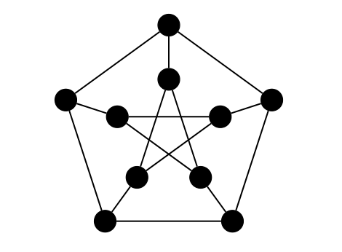
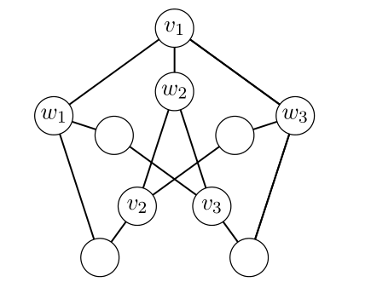
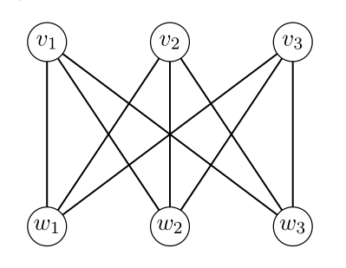
Kuratowski’s Theorem (1930)
A graph is planar if and only if it does not contain a subdivision of K₅ or K_{3,3}.
http://www.math.ucla.edu/~mwilliams/pdf/petersen.pdf

Slide 6
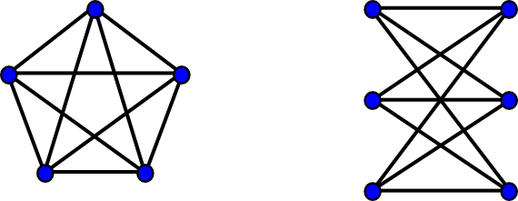
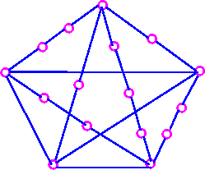
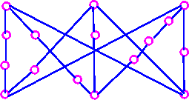
Kuratowski Subgraphs
K₅
K_{3,3}
http://www.boost.org/doc/libs/1_49_0/libs/graph/doc/figs/k_5_and_k_3_3.png
What is a subdivision?
Kuratowski Subgraphs
http://www.personal.kent.edu/~rmuhamma/GraphTheory/MyGraphTheory/Diagrams/g83.gif
http://www.personal.kent.edu/~rmuhamma/GraphTheory/MyGraphTheory/Diagrams/g82.gif

Slide 7
Euler characteristic (simple form):
= number of vertices – number of edges + number of faces
Or in short-hand,
= |V| - |E| + |F|
where V = set of vertices
E = set of edges
F = set of faces = set of regions
& the notation |X| = the number of elements in the set X.
For a planar connected graph |V| - |E| + |F| = 2

Slide 8
Defn: A tree is a connected graph that does not contain a cycle.
A forest is a graph whose components are trees.
Lemma 2.1: Any tree with n vertices has n-1 edges.
χ = 8 – 7 + 1 = 2 χ = 8 – 8 + 2 = 2 χ = 8 – 9 + 3= 2

Slide 9
= |V| – |E| + |F|
= 1 – 0 + 1 = 2
= 2 – 1 + 1 = 2
= 3 – 2 + 1 = 2

Slide 10
= |V| – |E| + |F|
= 4 – 3 + 1 = 2
= 5 – 4 + 1 = 2
= 8 – 7 + 1 = 2

Slide 11
= |V| – |E| + |F|
= 8 – 8 + 2 = 2
= 8 – 9 + 3 = 2
For the brave of heart, consider graphs drawn on other surfaces such as a torus or Klein bottle. For fun, see http://youtu.be/Q6DLWJX5tbs or www.geometrygames.org.
Not a tree.

Slide 12
Euler’s fomula: For a planar connected graph |V| - |E| + |F| = 2
where V = set of vertices, E = set of edges, F = set of faces = set of
regions
Defn: A tree (or acyclic graph) is a connected graph that does not contain a cycle.
A forest is a graph whose components are trees.
Lemma 2.1: Any tree with n vertices has n-1 edges.
Thm 2.9: For any connected planar graph with |V| ≥ 2,
|E| ≤ 3|V| - 6
Cor 2.4: K₅ is nonplanar.
Thm 2.10: K_{3,3} is nonplanar.
Cor: A graph is planar if and only if it does not contain a subdivision of K₅ or K_{3,3}.

