Slide 1
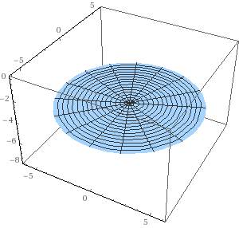
Example
https://mathinsight.org/surface_integral_vector_examples

Slide 2
Example
https://mathinsight.org/surface_integral_vector_examples

Slide 3
Example
https://mathinsight.org/surface_integral_vector_examples

Slide 4
Example
https://mathinsight.org/surface_integral_vector_examples

Slide 5
Example
https://mathinsight.org/surface_integral_vector_examples

Slide 8
Let S be a disk of radius 6 centered around the z-axis in plane z=-4, oriented with an upward pointing normal.

Slide 9
Surface S

Slide 10
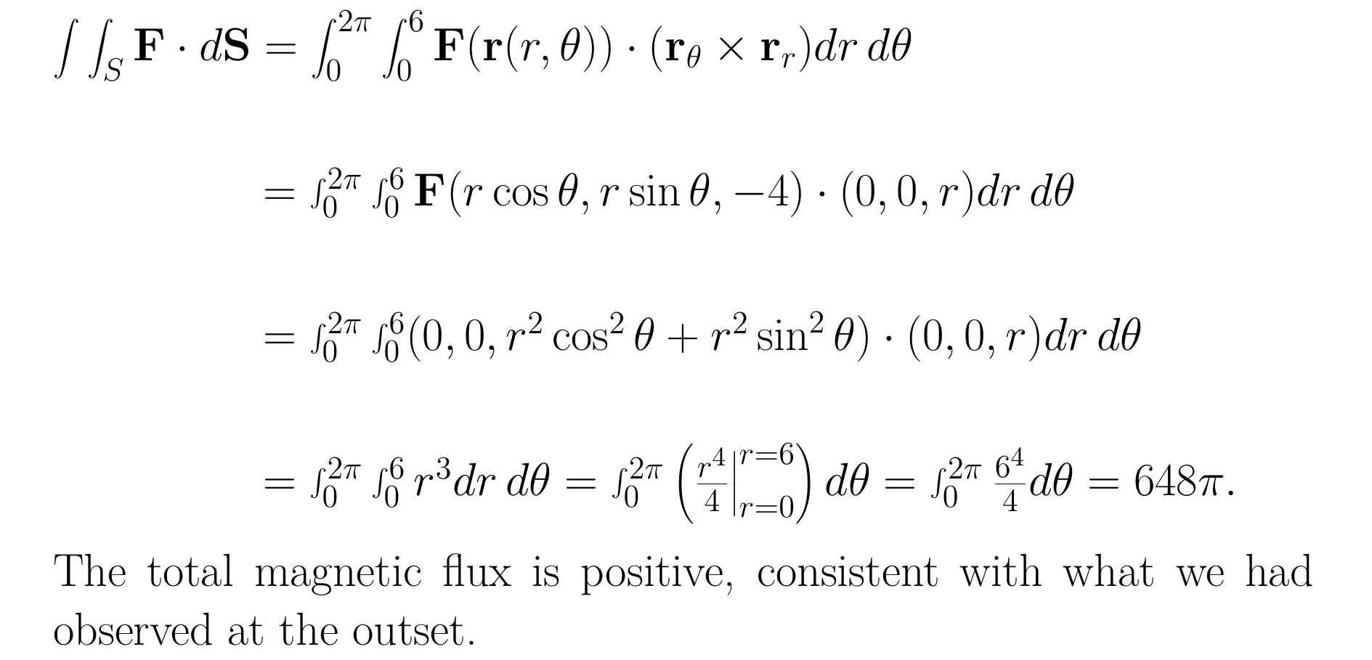

Slide 11
Example
https://mathinsight.org/surface_integral_vector_examples

Slide 12
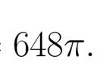
Example
c
https://mathinsight.org/surface_integral_vector_examples

Slide 13
Example
c
https://mathinsight.org/surface_integral_vector_examples

