Slide 1
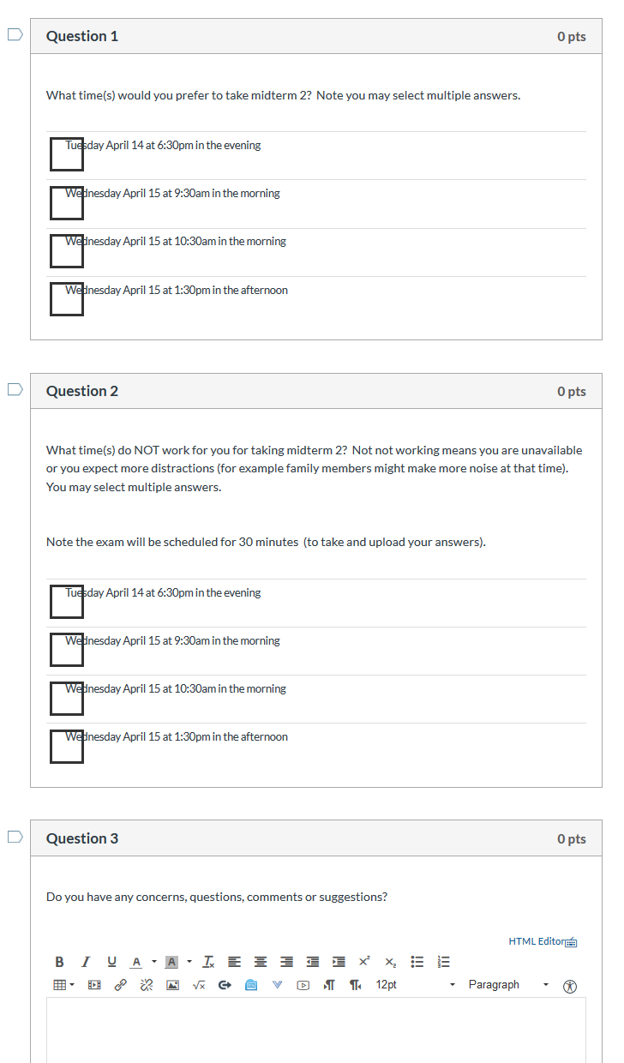
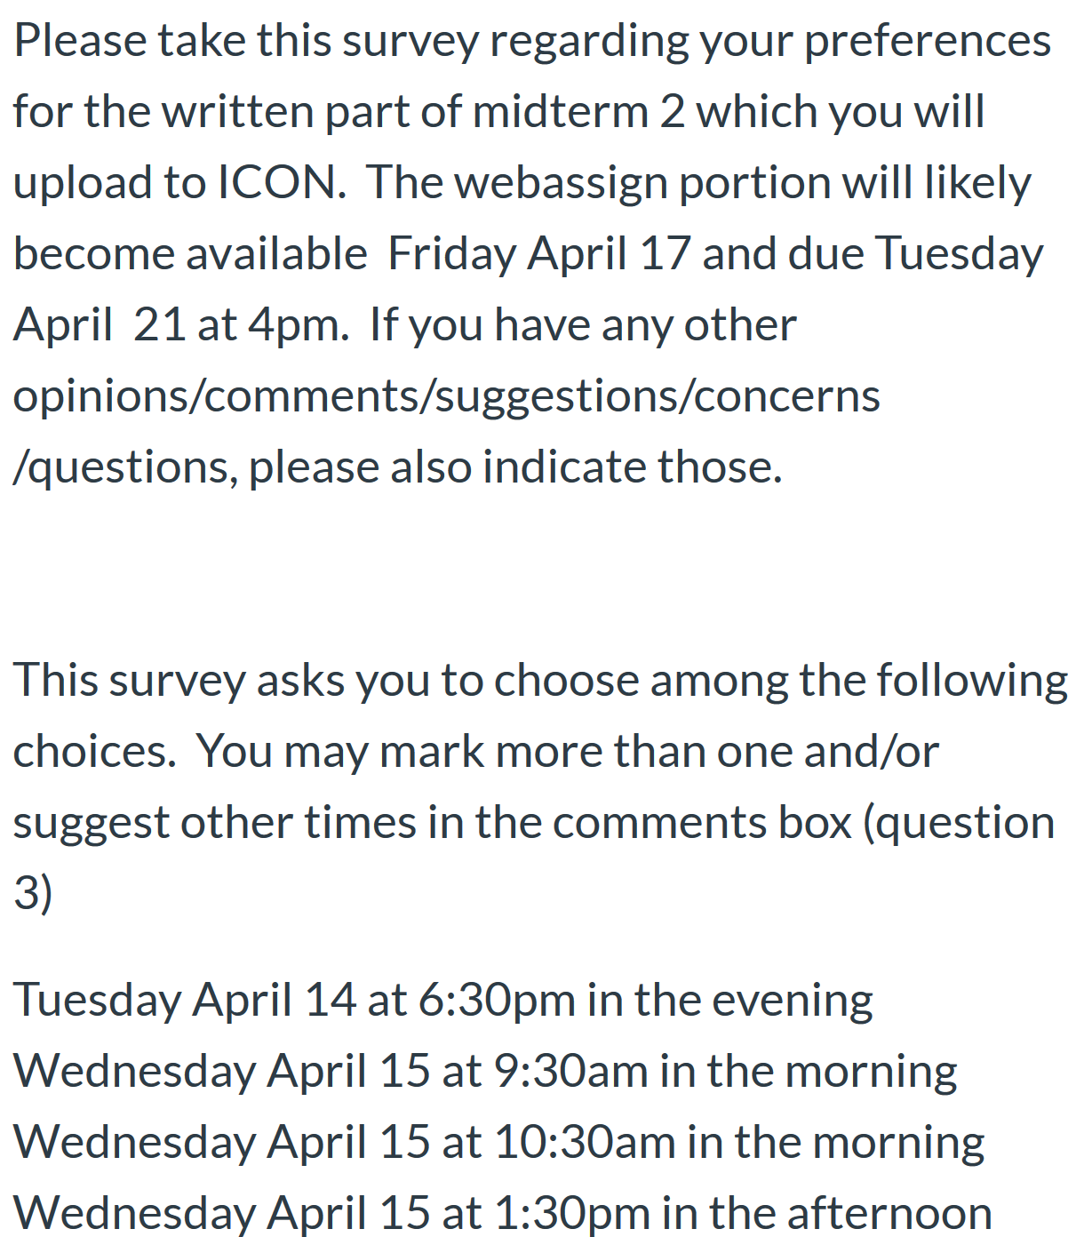
Survey due today at 5pm

Slide 2
What sections will the test cover? 13.6 – 14.5, 7
Most likely will only cover curl from 14.7 for exam 2.
On the last test you hinted at what sections would be covered most heavily, could you do the same for this one? Yes
Will we need to know and use trig identities on the exam? No, but exam is open book/notes
How much time will we have for thewritten portion of the test? 30 min
Is it a hard 30 minute time limit or will some time be allotted to upload our work? I hope so.
How many questions will be on the written portion? 1 or 2
For webassign part: three separate 45 minute attempts.
will include multiple part webassign problems

Slide 3
http://homepage.divms.uiowa.edu/~idarcy/COURSES/3550/Spring20/online.html

Slide 4
http://tutorial.math.lamar.edu/Classes/CalcIII/GreensTheorem.aspx
http://ltcconline.net/greenl/courses/202/vectorIntegration/greensTheorem.htm

Slide 5
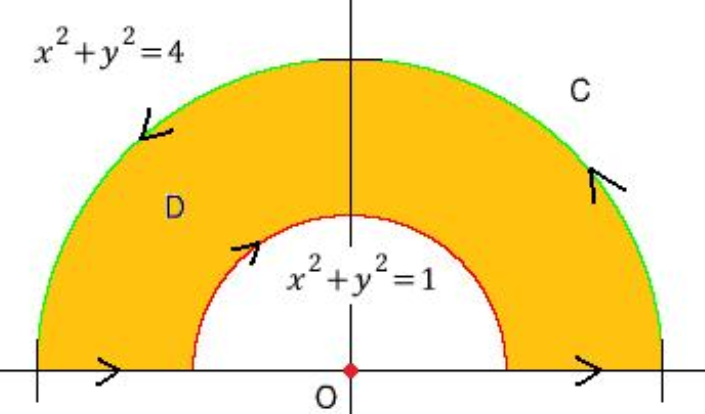
http://tutorial.math.lamar.edu/Classes/CalcIII/GreensTheorem.aspx
http://blog.naver.com/PostView.nhn?blogId=mindo1103&logNo=90179767504&parentCategoryNo=35&categoryNo=&viewDate=&isShowPopularPosts=true&from=search

Slide 6
http://tutorial.math.lamar.edu/Classes/CalcIII/GreensTheorem.aspx
http://ltcconline.net/greenl/courses/202/vectorIntegration/greensTheorem.htm

Slide 7
http://tutorial.math.lamar.edu/Classes/CalcIII/GreensTheorem.aspx
NOT closed
https://mathinsight.org/

Slide 8
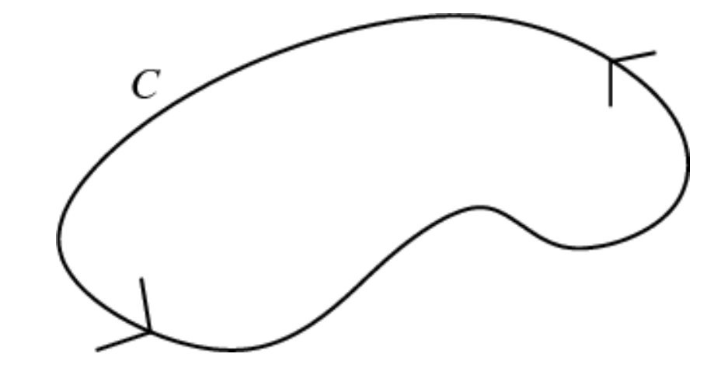
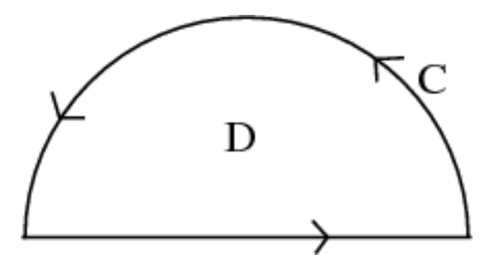
http://tutorial.math.lamar.edu/Classes/CalcIII/GreensTheorem.aspx
closed
https://mathinsight.org/

Slide 9
http://tutorial.math.lamar.edu/Classes/CalcIII/GreensTheorem.aspx
closed
https://mathinsight.org/

Slide 10
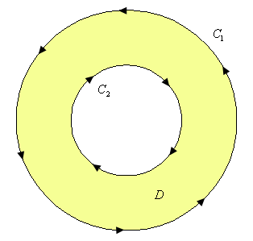
http://tutorial.math.lamar.edu/Classes/CalcIII/GreensTheorem.aspx
http://tutorial.math.lamar.edu/Classes/CalcIII/GreensTheorem.aspx

Slide 11
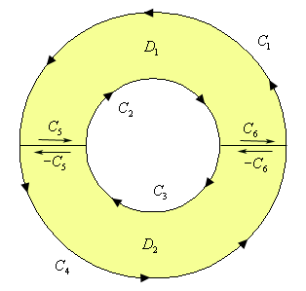
http://tutorial.math.lamar.edu/Classes/CalcIII/GreensTheorem.aspx
http://tutorial.math.lamar.edu/Classes/CalcIII/GreensTheorem.aspx

Slide 12
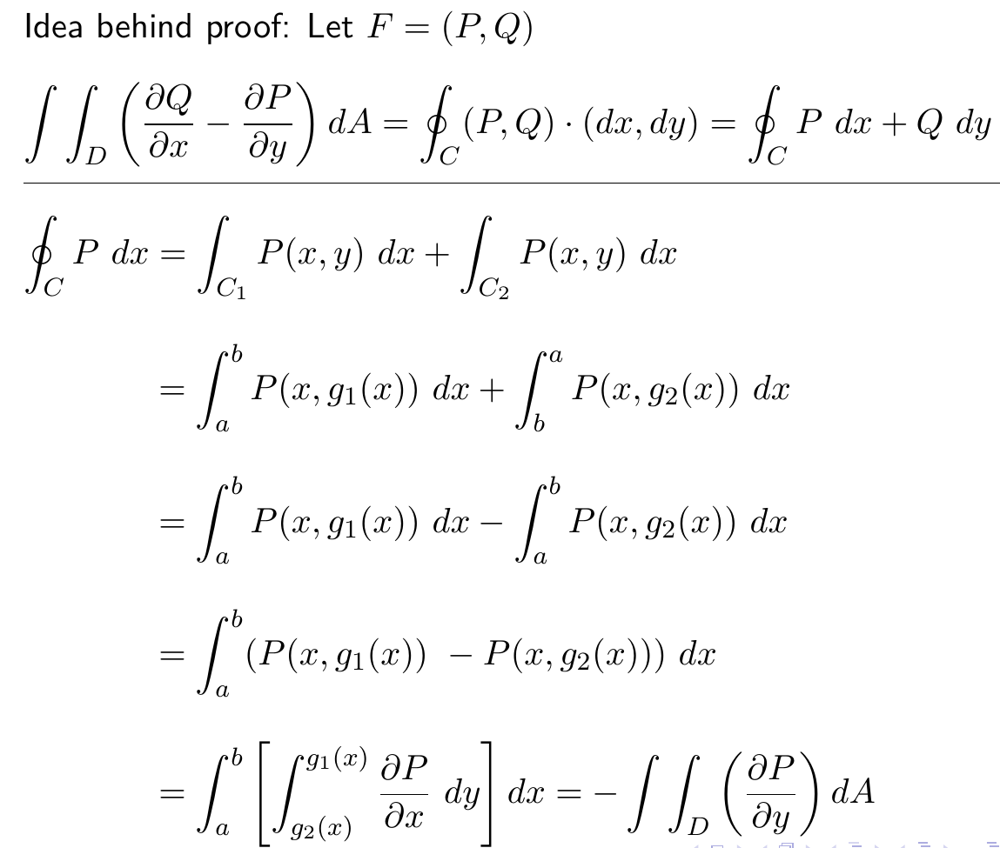
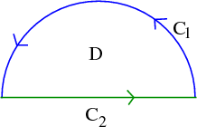
http://tutorial.math.lamar.edu/Classes/CalcIII/GreensTheorem.aspx

Slide 13
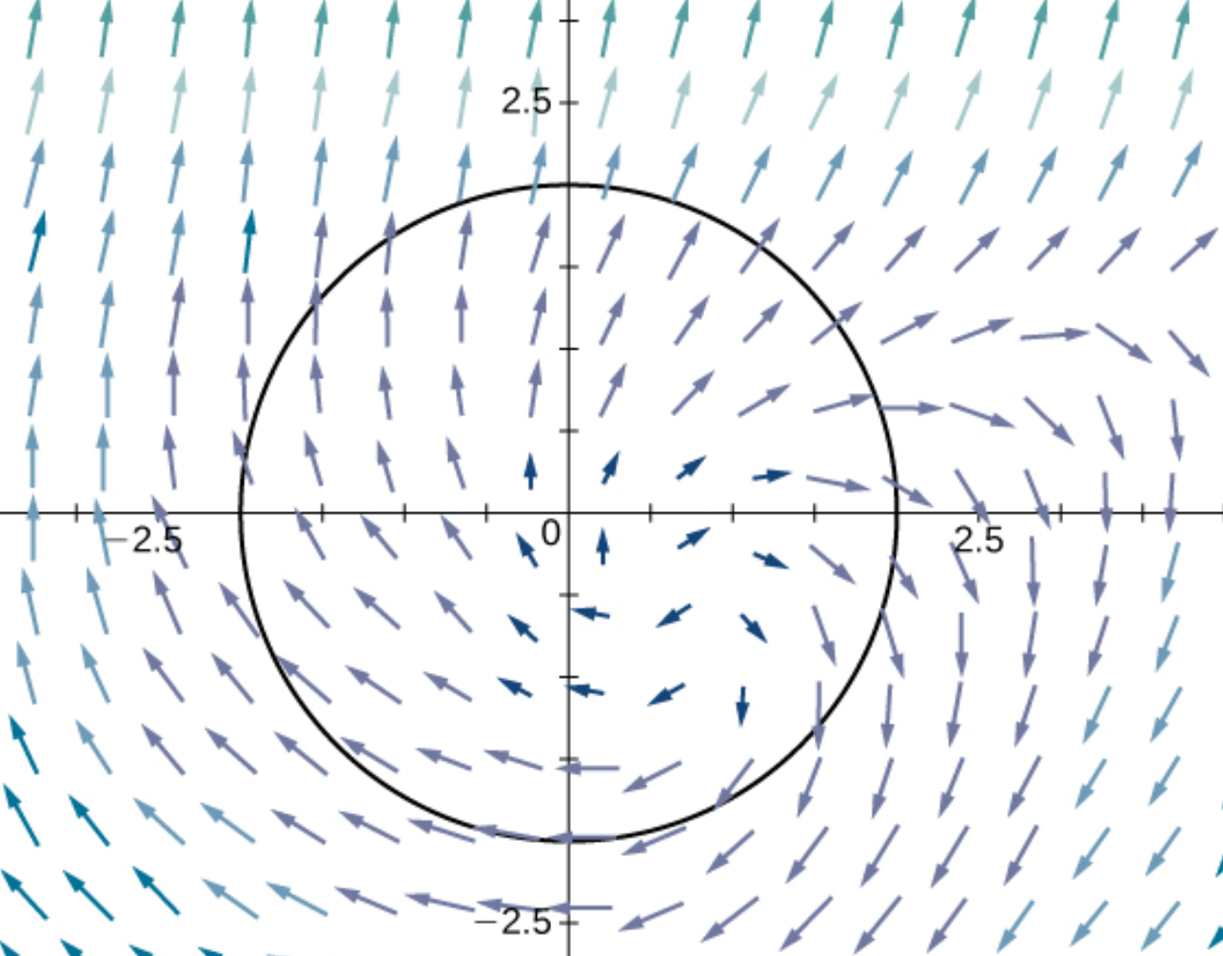
(
)
https://opentextbc.ca/calculusv3openstax/chapter/greens-theorem/

Slide 14
(
)
https://opentextbc.ca/calculusv3openstax/chapter/greens-theorem/

Slide 15
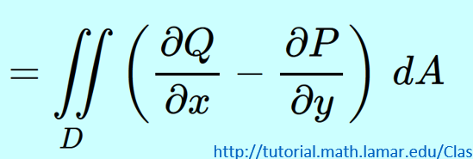
(
)
https://opentextbc.ca/calculusv3openstax/chapter/greens-theorem/

Slide 16
(
)
(
)
https://opentextbc.ca/calculusv3openstax/chapter/greens-theorem/

Slide 17
(
)
(
)
https://opentextbc.ca/calculusv3openstax/chapter/greens-theorem/

Slide 18
(
)
https://opentextbc.ca/calculusv3openstax/chapter/greens-theorem/

Slide 19
(
)
https://opentextbc.ca/calculusv3openstax/chapter/greens-theorem/

Slide 20
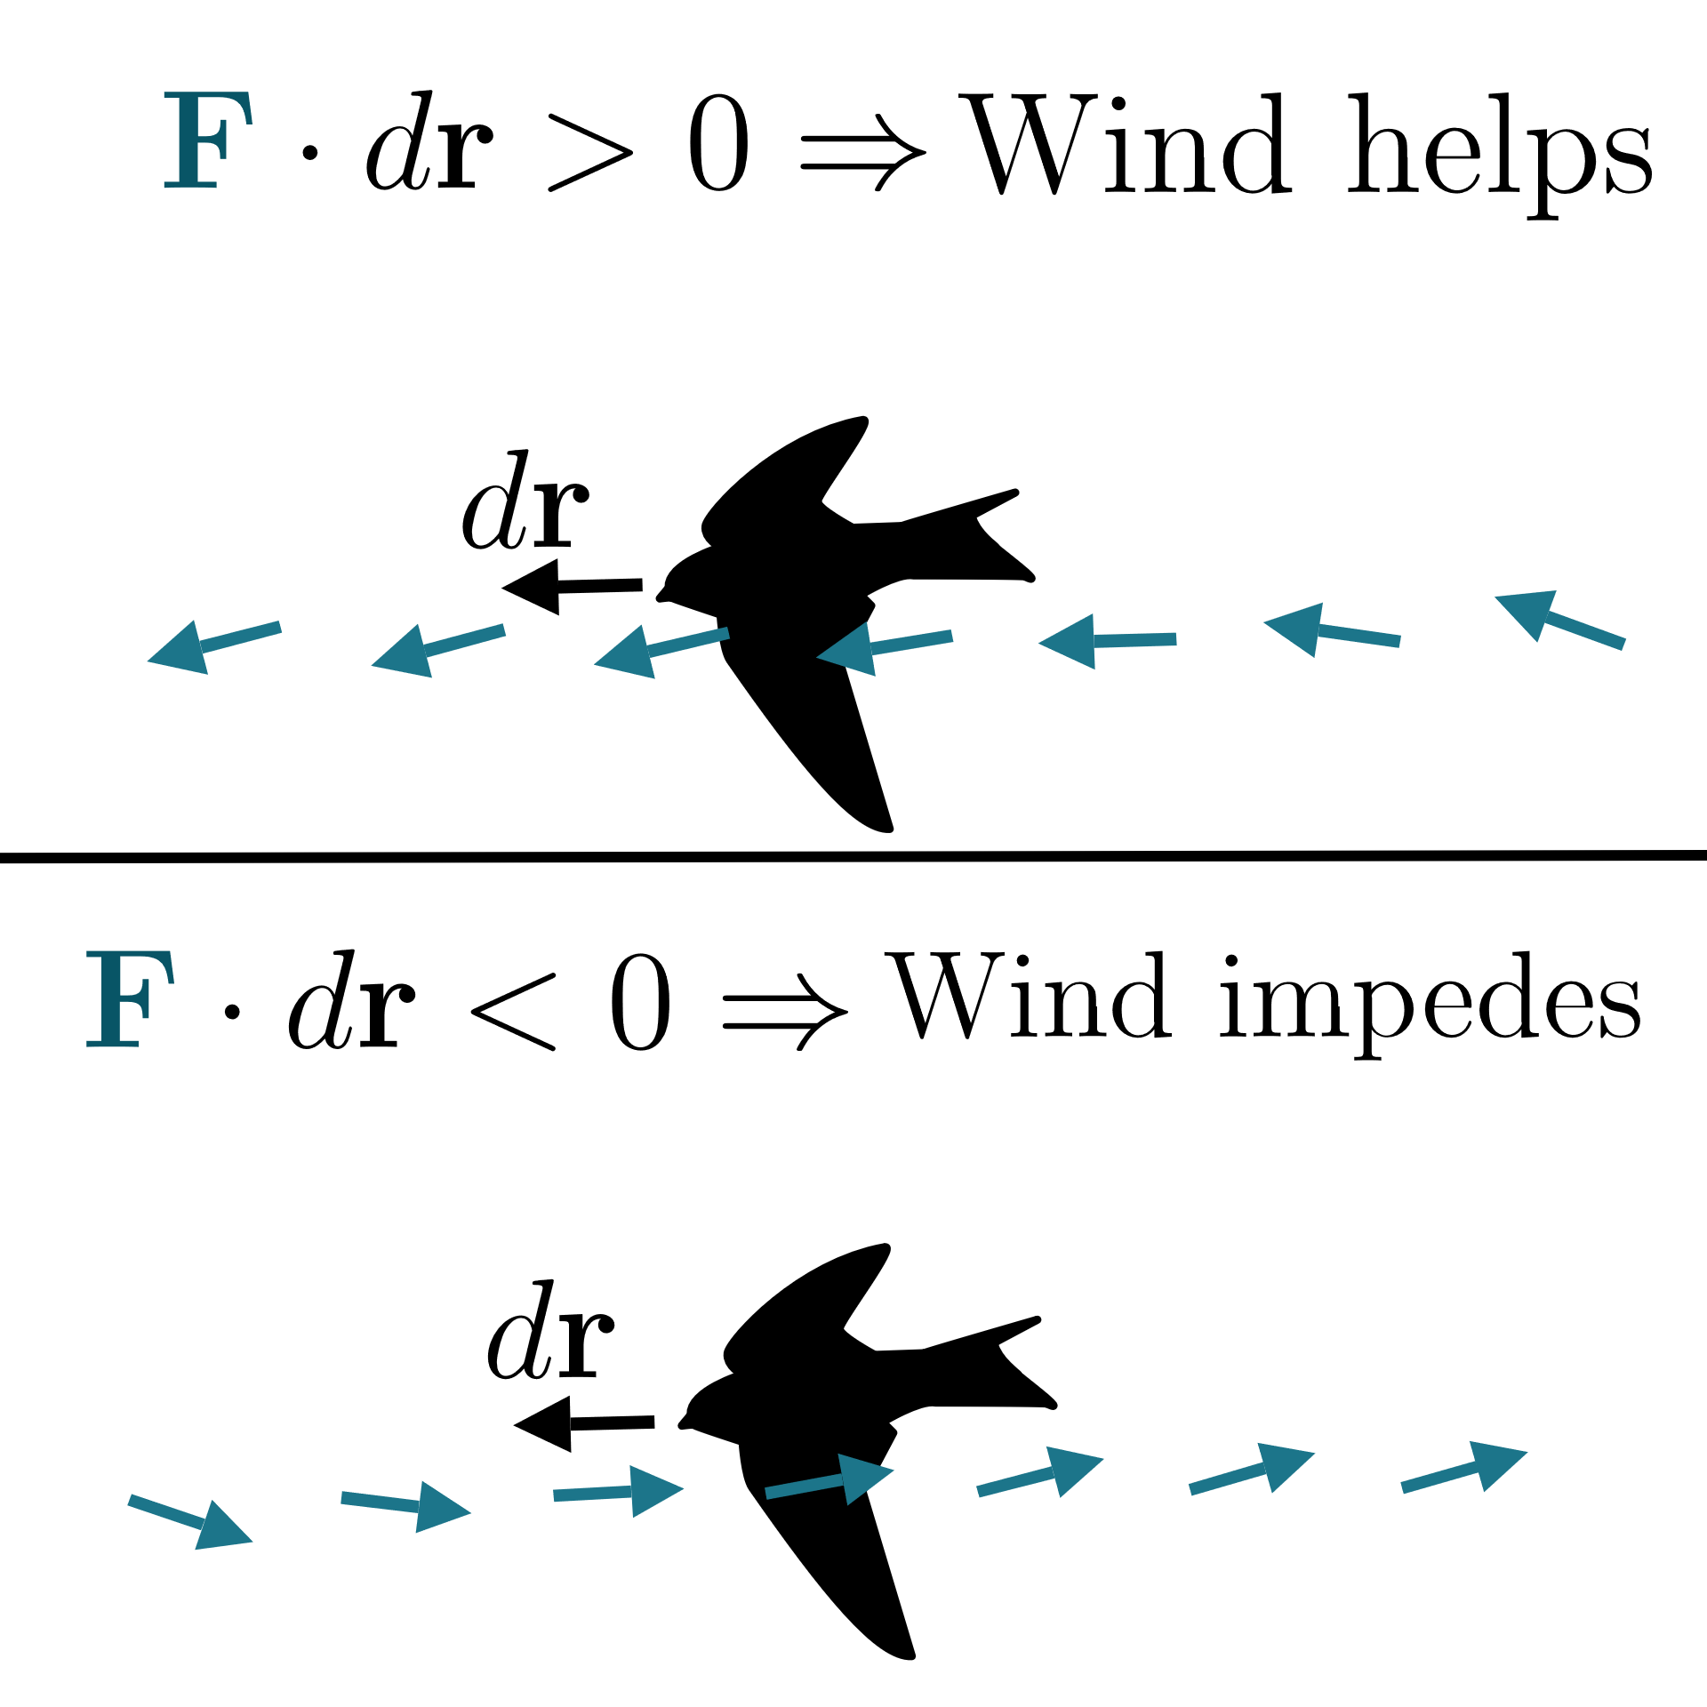
https://www.khanacademy.org/math/multivariable-calculus/greens-theorem-and-stokes-theorem/stokes-theorem-articles/a/stokes-theorem

Slide 21
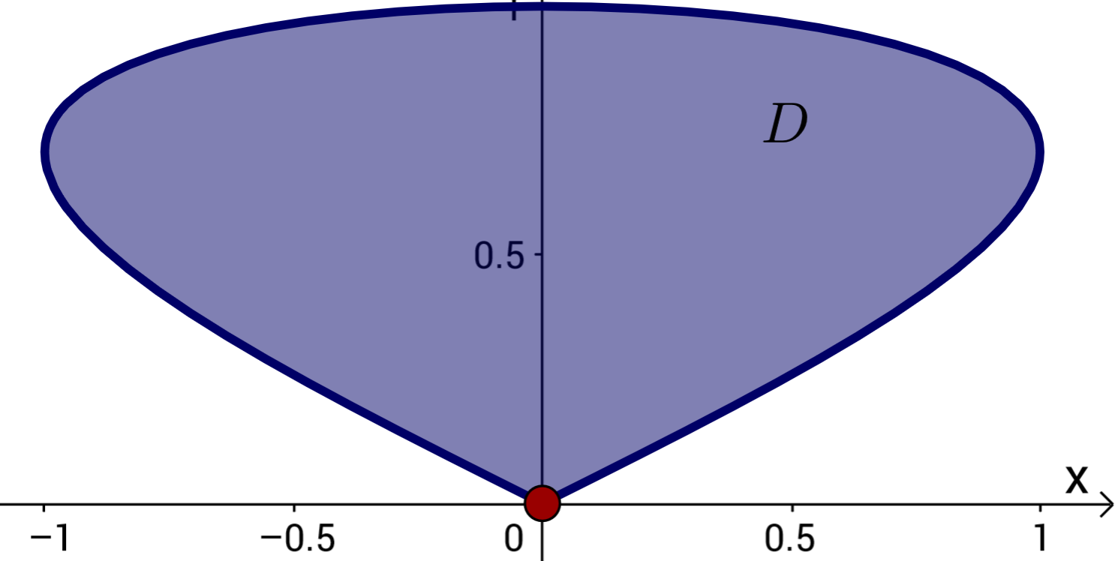
Can also use Green’s theorem to calculate double integrals.
Example: Find area of a region.
https://mathinsight.org/greens_theorem_find_area

Slide 22
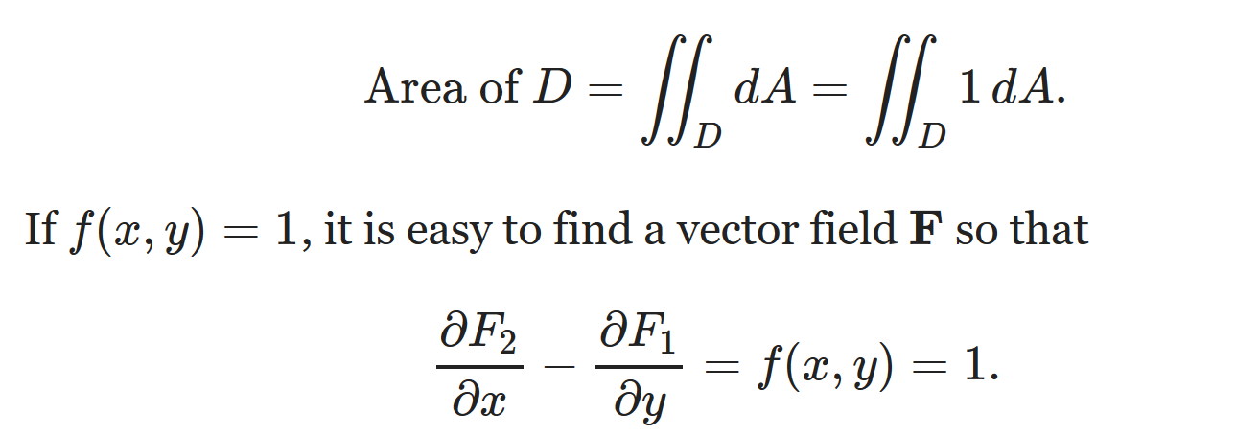
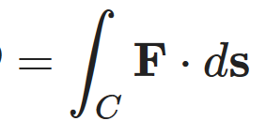
Can also use Green’s theorem to calculate double integrals.
Example: Find area of a region.

Slide 23
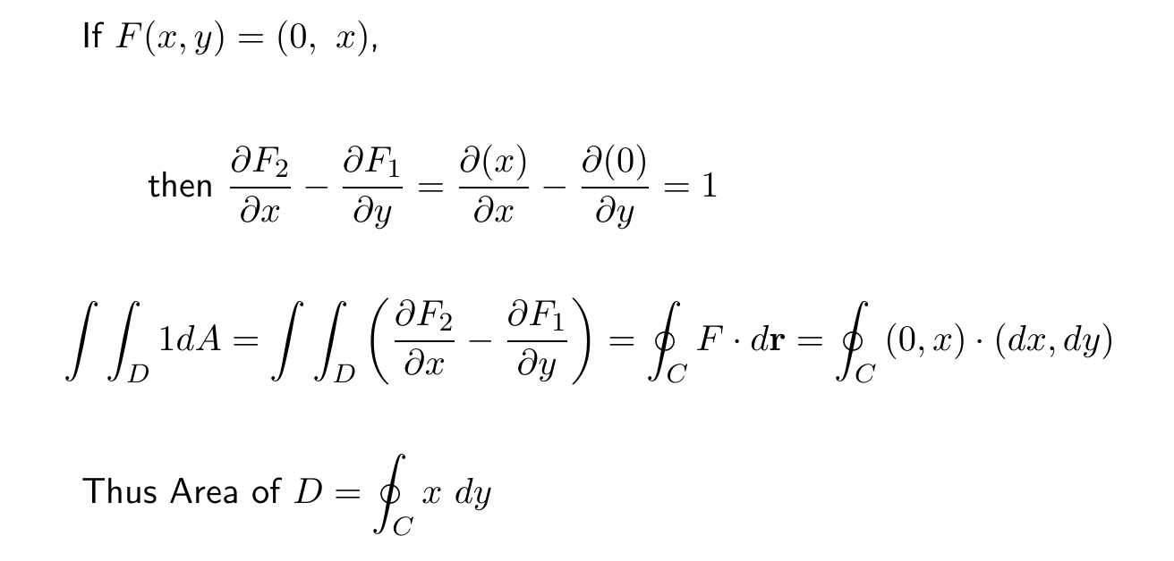
Can also use Green’s theorem to calculate double integrals.
Example: Find area of a region.

Slide 24
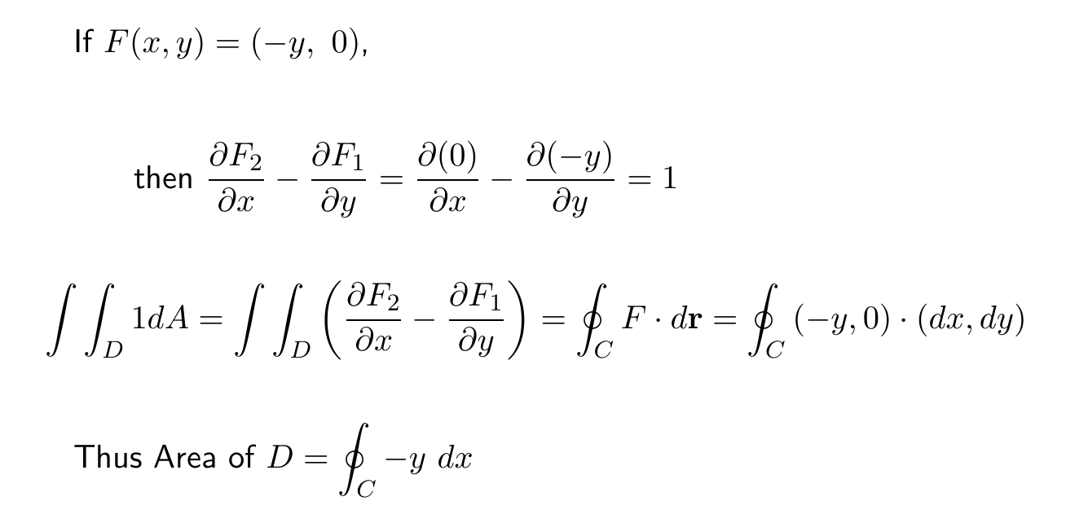
Can also use Green’s theorem to calculate double integrals.
Example: Find area of a region.

Slide 25
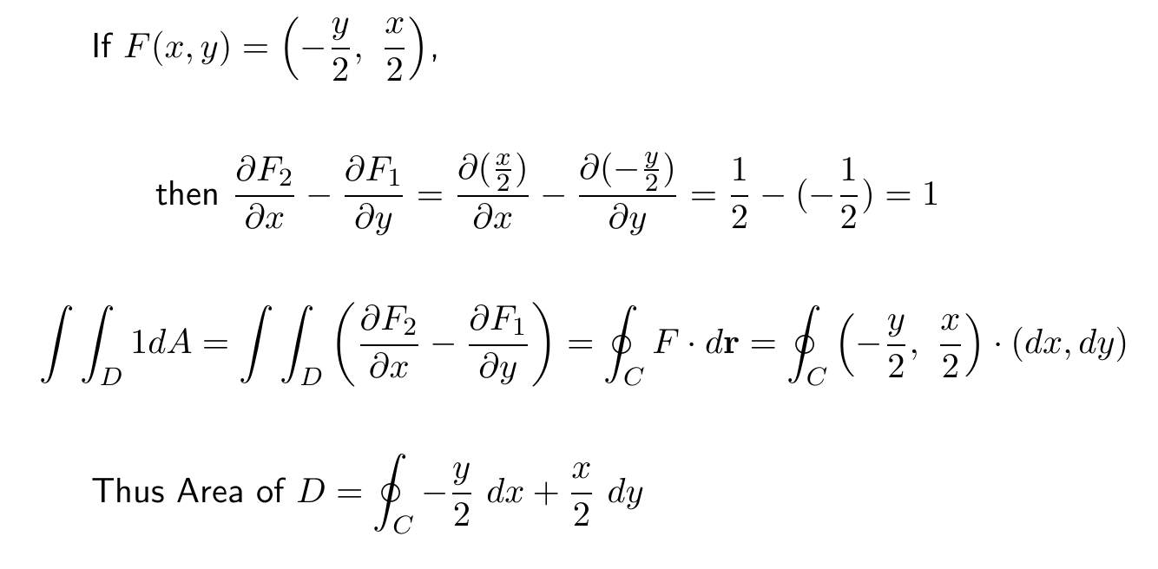
Can also use Green’s theorem to calculate double integrals.
Example: Find area of a region.

Slide 26
https://mathinsight.org/greens_theorem_find_area

Slide 27
https://mathinsight.org/greens_theorem_find_area

Slide 28
https://mathinsight.org/greens_theorem_find_area

Slide 29
(Section 14.4)
http://tutorial.math.lamar.edu/Classes/CalcIII/GreensTheorem.aspx
(Section 14.7)

Slide 30
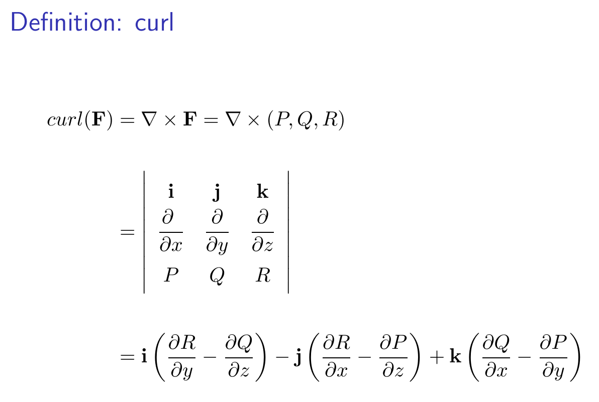

Slide 31
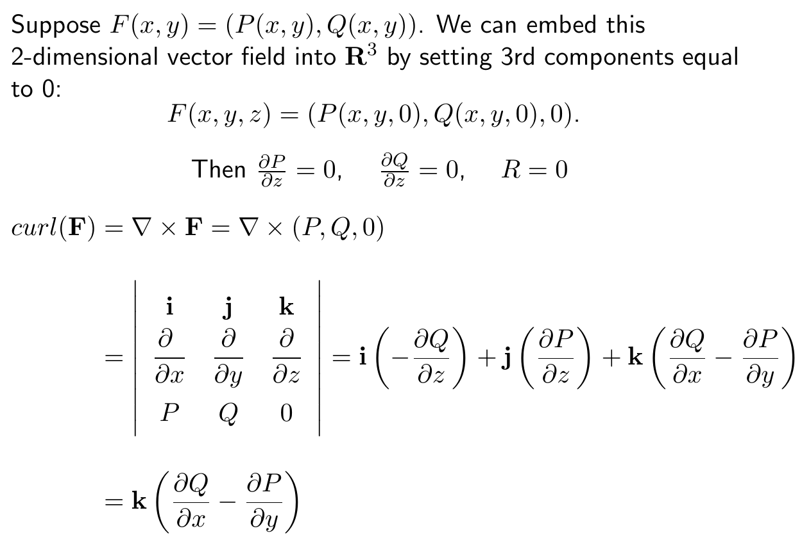

Slide 32
http://tutorial.math.lamar.edu/Classes/CalcIII/GreensTheorem.aspx

Slide 33
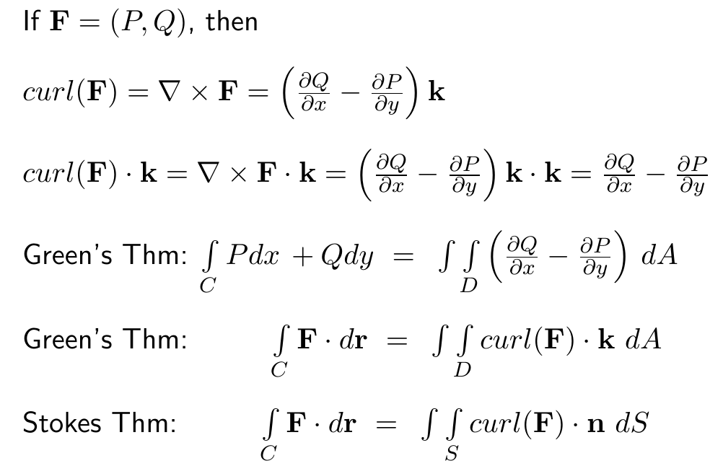

Slide 34
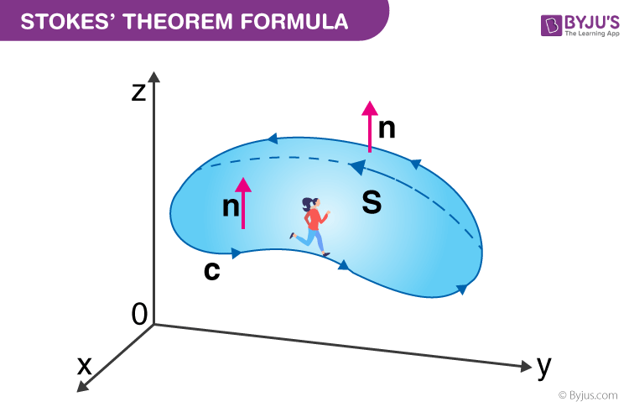
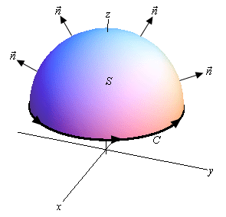
https://byjus.com/maths/stokes-theorem/
http://tutorial.math.lamar.edu/Classes/CalcIII/StokesTheorem.aspx

