Slide 1
Practice Problem for Final exam:
Suppose one wishes to determine the point on the plane $4x−2y+z=1$that is closest to the point (−2,−1,5). State a function $f\left(\vec{x}\right)$for which finding the minimum of $f$ can be used to find this point.
Note answer $f$is available at http://tutorial.math.lamar.edu/Classes/CalcIII/RelativeExtrema.aspx
See example 3.

Slide 2
10.5 Heat Equation
Solve to find general solution:
Note we are looking for nontrivial solutions for u(t, x) so that initial values can also be satisfied
And then plug in initial values to find constants:

Slide 3
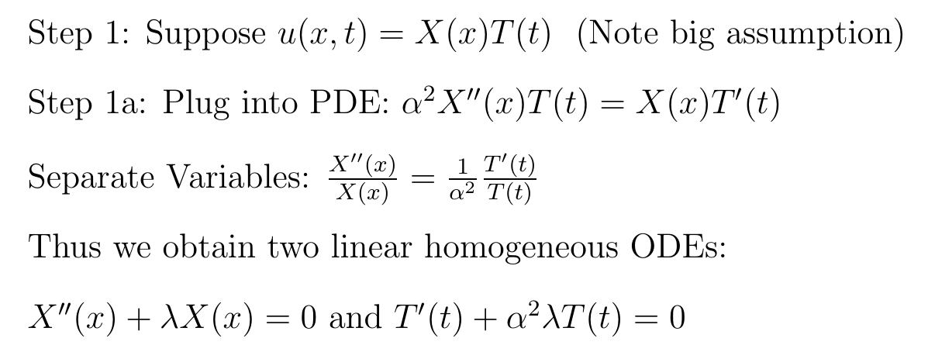
Method: Separation of Variables

Slide 4
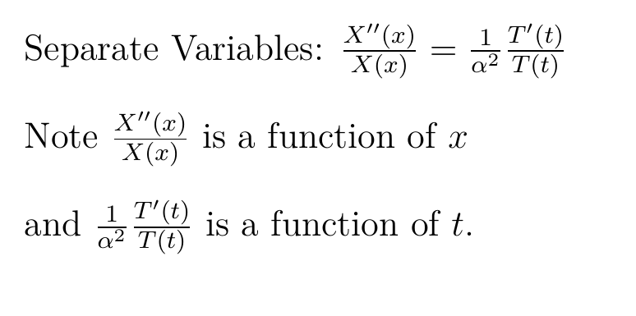
Method: Separation of Variables
-λ is the separation constant.

Slide 5
Method: Separation of Variables
then

Slide 6
Method: Separation of Variables
then

Slide 7
10.1: Eigenvalue Problems
Solve the following for nontrivial solutions:
Note $X(x) = 0$ for all $x$ satisfies the above BVP
But we want nontrivial sol’ns
Recall λ is an arbitrary constant.
Goal: Find λ such that the above BVP has non-trivial solutions
Solve BVP and determine for which values of λ does the BVP have non-trivial solutions.

Slide 8
λ is an eigenvalue of A if Ax = λx has nontrivial solutions. If v is a nonzero solution to
Ax = λx, then v is called an eigenvector of A with eigenvalue λ. Note nonzero linear combinations of eigenvectors with eigenvalue λ are also eigenvectors.
____________________________________________________________________________________
λ is an eigenvalue of the BVP
if this BVP has nontrivial solutions. If X is a nontrivial solution f to this BVP, then f is called an eigenfunction of the BVP with eigenvalue λ.
Note nonzero linear combinations of eigenfunctions with eigenvalue λ are also eigenfunctions.
Terminology

Slide 9
10.1: Eigenvalue Problems
Solve the following for nontrivial solutions:
Note $X(x) = 0$ for all $x$ satisfies the above BVP
But we want nontrivial sol’ns
Recall λ is an arbitrary constant.
Goal: Find λ such that the above BVP has non-trivial solutions
Solve BVP and determine for which values of λ does the BVP have non-trivial solutions. We will determine solutions for $X$ at the same time.

Slide 10
Thus λ = 0 is not an eigenvalue for this BVP since the only solution is trivial.

Slide 11
Since λ is negative, we have two real roots.
Lots of work will show that the only solution to this BVP is trivial when the roots are real
Thus λ < 0 is not an eigenvalue for this BVP since the only solution is trivial.

Slide 12
$c_{1}=0$implies $c_{2}≠0$ as we need nontrivial solutions.

Slide 13
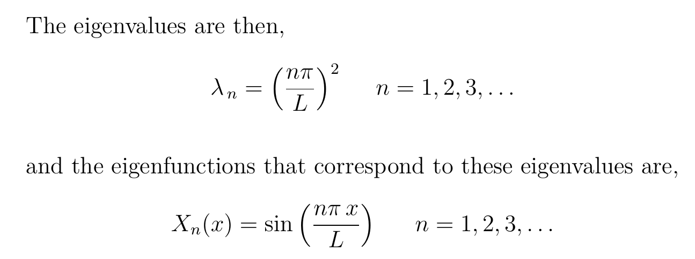

Slide 14
The nontrivial solutions to this BVP include
Where
Principle of superposition for linear homogeneous ODEs: Linear combinations of solutions are also solutions to ODE.

Slide 15
Method: Separation of Variables
then

Slide 17
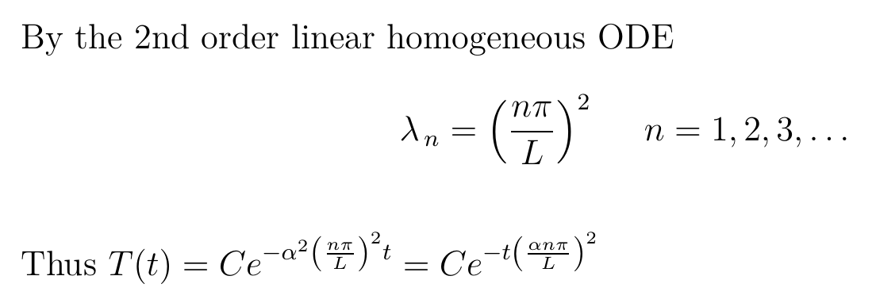

Slide 18
Method: Separation of Variables
then

Slide 19
Method: Separation of Variables
then

Slide 20
Method: Separation of Variables
then

Slide 21
Solve to find general solution:
And then plug in initial values to find constants:

Slide 22
Solve to find general solution:
And then plug in initial values to find constants:

Slide 23
General solution:
And then plug in initial values to find constants:

Slide 24
General solution:
And then plug in initial values to find constants:

Slide 25
General solution:
And then plug in initial values to find constants:

Slide 26
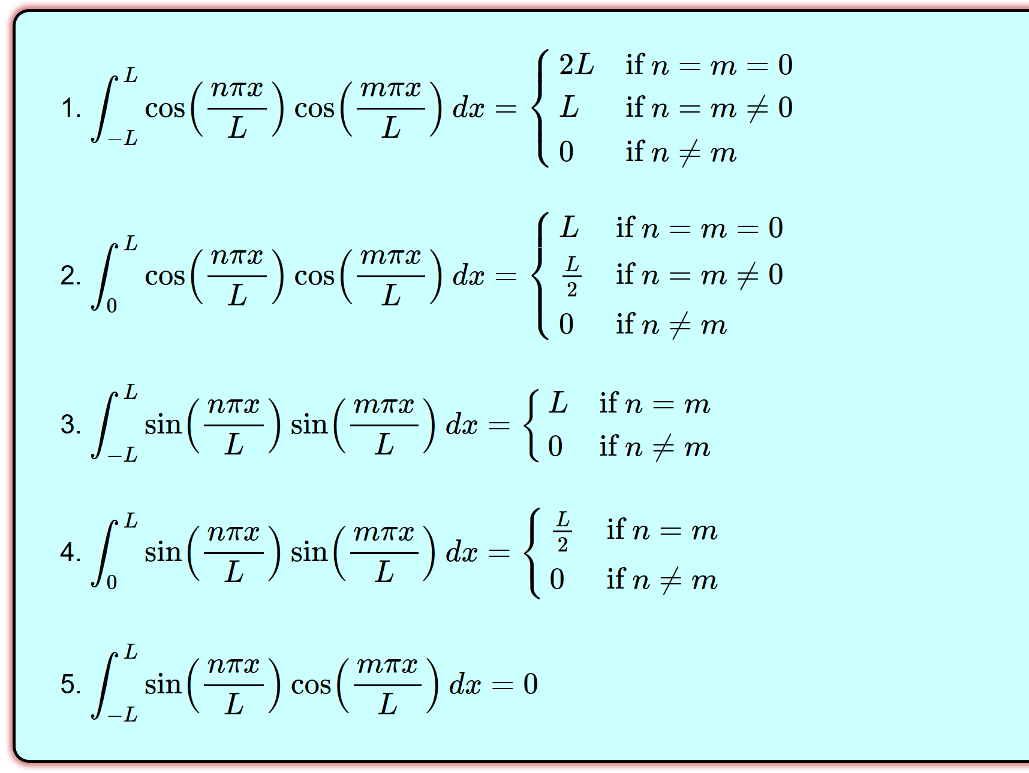
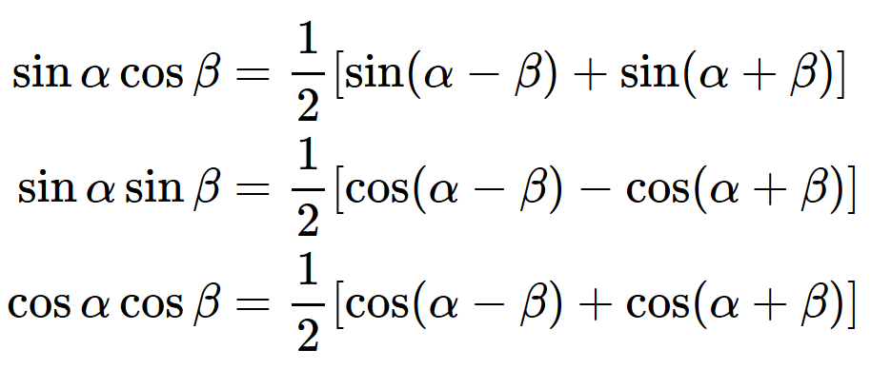
http://tutorial.math.lamar.edu/Classes/DE/PeriodicOrthogonal.aspx

Slide 28
General solution:
And then plug in initial values to find constants:

Slide 29
10.5 Heat Equation

