Slide 1
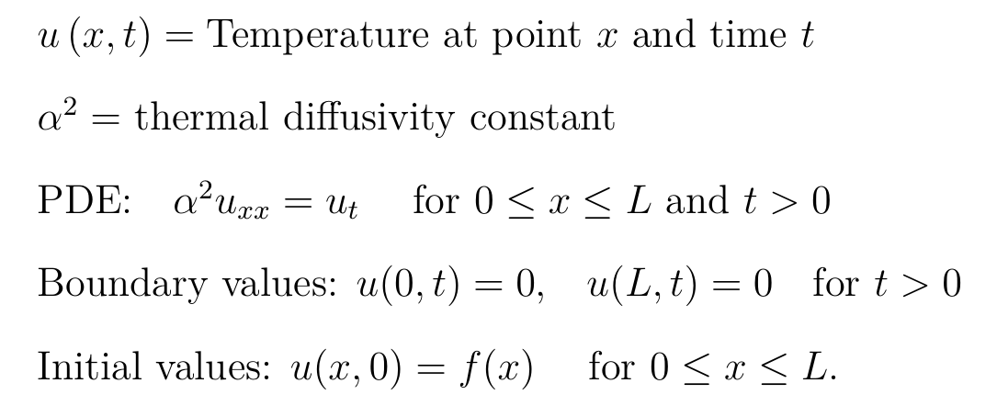
10.5 Heat Equation

Slide 2
10.5 Heat Equation

Slide 3
Solve to find general solution:
And then plug in initial values to find constants:

Slide 4
Solve to find general solution:
Method: Separation of Variables
Note: This is a big assumption
Are there other solutions?

Slide 5
Method: Separation of Variables

Slide 6
Method: Separation of Variables

Slide 7
Method: Separation of Variables

Slide 8
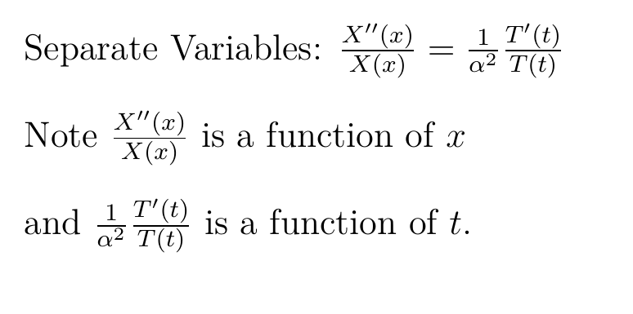
Method: Separation of Variables

Slide 9
When does a function of x = a function of t?
I.e., when does f(x) = g(t) for all x, t?
If f(x) = sin(x), is there a g(t) = f(x)?

Slide 10
When does a function of x = a function of t?
I.e., when does f(x) = g(t) for all x, t?
If f(x) = sin(x), is there a g(t) = f(x)?
If f(x) = 2, is there a g(t) = f(x)?

Slide 11
Method: Separation of Variables

Slide 12
Method: Separation of Variables
-λ is the separation constant.

Slide 13
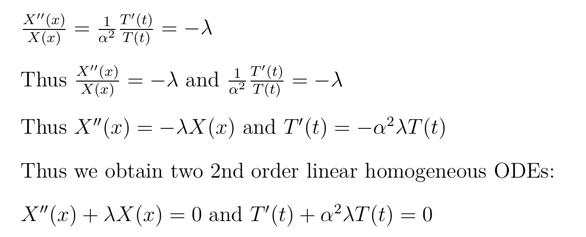
Thus we obtain two linear homogeneous ODEs:

Slide 14
Thus we obtain two linear homogeneous ODEs:

Slide 15
Method: Separation of Variables
then

Slide 16
Method: Separation of Variables
then

Slide 17
Method: Separation of Variables
then

Slide 18
Method: Separation of Variables
then

Slide 19
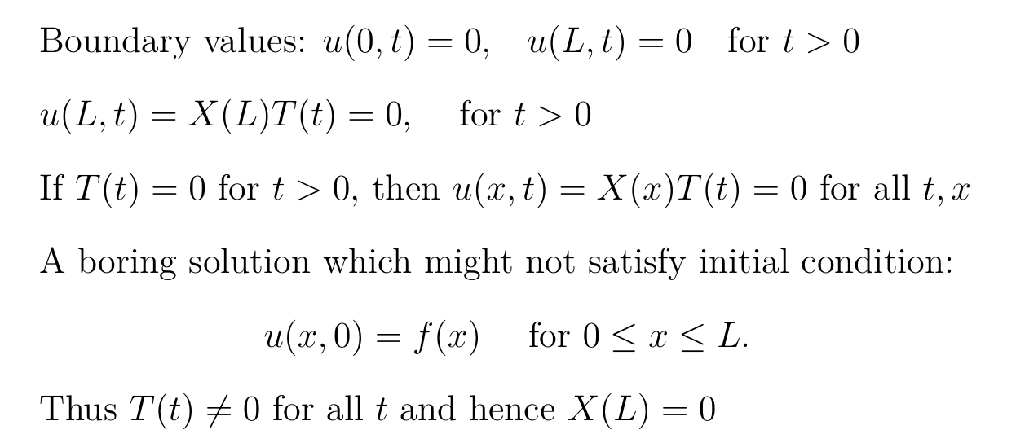
Method: Separation of Variables
then

Slide 20
Method: Separation of Variables
then

Slide 21
10.1: Eigenvalue Problems
Solve the following for nontrivial solutions:

Slide 22
10.1: Eigenvalue Problems
Solve the following for nontrivial solutions:
Recall λ is an arbitrary constant.
Note we are only interested in values for λ for which the above boundary value problem has non-trivial solutions.
For what values of λ, does the above have a nontrivial solution for X(x)?

Slide 23
λ is an eigenvalue of A if Ax = λx has nontrivial solutions. If v is a nonzero solution to
Ax = λx, then v is called an eigenvector of A with eigenvalue λ.
____________________________________
λ is an eigenvalue of the BVP
If this BVP has nontrivial solutions. If X is a nontrivial solution to this BVP, then X is called an eigenfunction of the BVP with eigenvalue λ.

Slide 24
http://tutorial.math.lamar.edu/Classes/DE/BoundaryValueProblem.aspx

Slide 25
http://tutorial.math.lamar.edu/Classes/DE/BoundaryValueProblem.aspx
3 is NOT an eigenvalue of the BVP

Slide 26
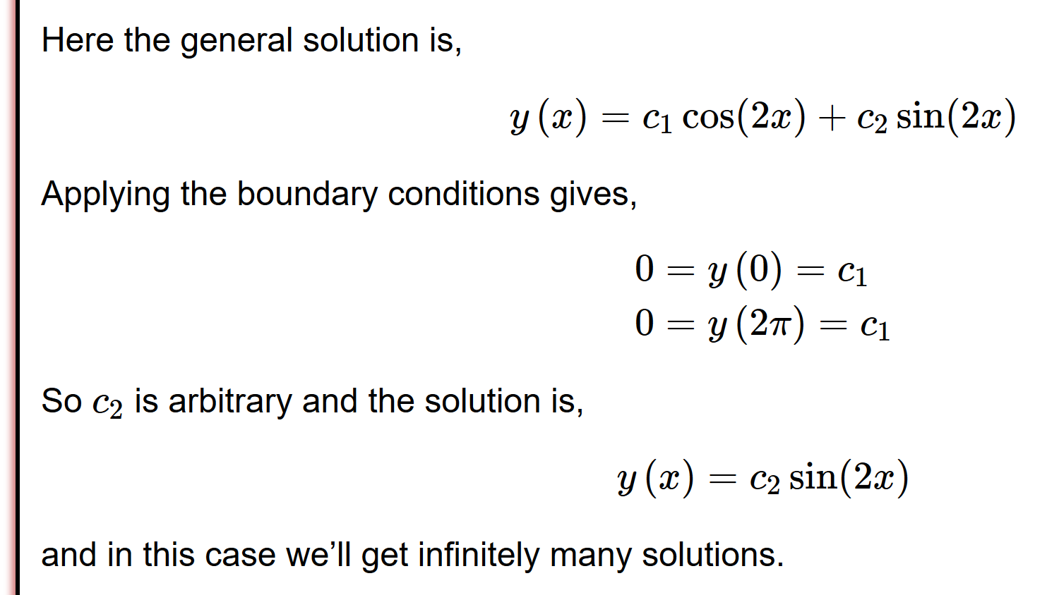
http://tutorial.math.lamar.edu/Classes/DE/BoundaryValueProblem.aspx

Slide 27
http://tutorial.math.lamar.edu/Classes/DE/BoundaryValueProblem.aspx
4 is an eigenvalue of the BVP
Eigenfunctions →

Slide 31
Thus λ = 0 is not an eigenvalue for this BVP since the only solution is trivial.

Slide 32
Since λ is negative, we have two real roots.
Lots of work will show that the only solution to this BVP is trivial when the roots are real
Thus λ = 0 is not an eigenvalue for this BVP since the only solution is trivial.

Slide 36
Nontrivial solution implies:

Slide 39
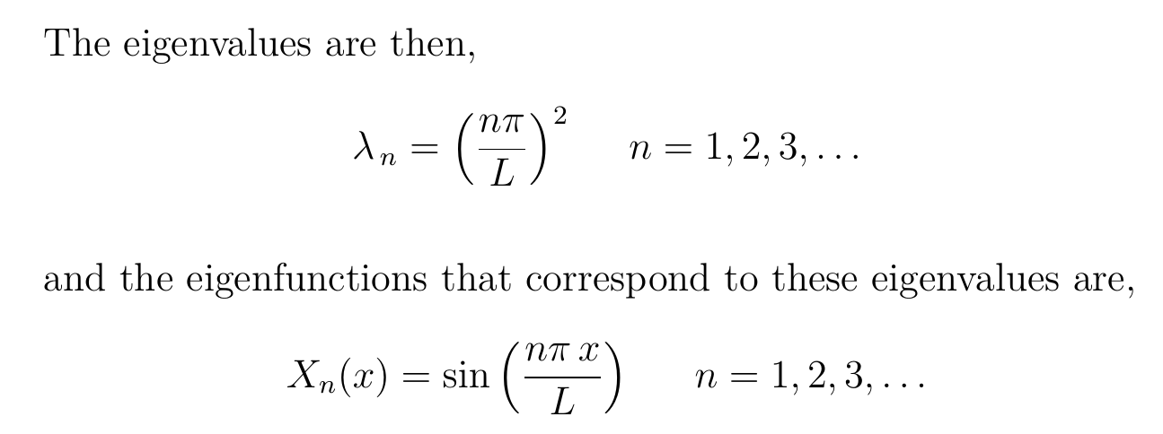

Slide 40
The nontrivial solutions to this BVP include
Where
Principle of superposition for linear homogeneous ODEs: Linear combinations of solutions are also solutions.

Slide 41
Method: Separation of Variables
then

Slide 42
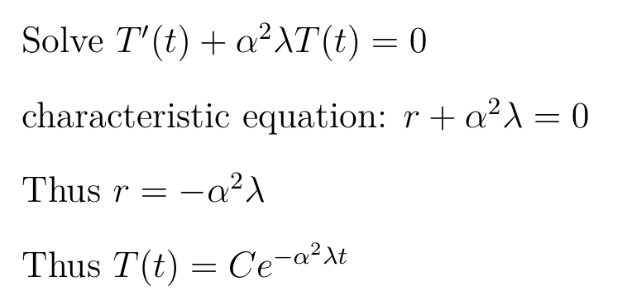
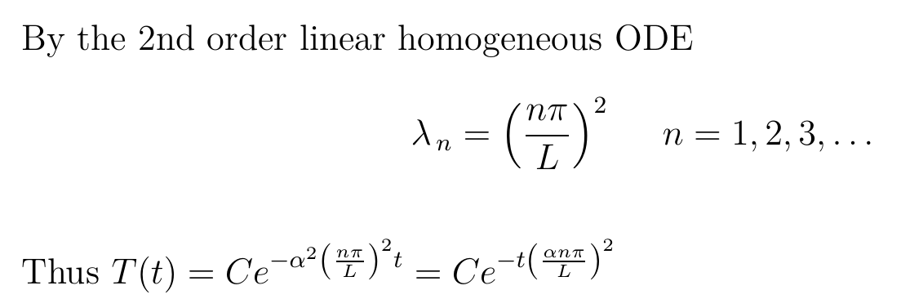

Slide 43
Method: Separation of Variables
then

Slide 44
Method: Separation of Variables
then

Slide 45
Method: Separation of Variables
then

Slide 46
Solve to find general solution:
And then plug in initial values to find constants:

Slide 47
Solve to find general solution:
And then plug in initial values to find constants:

Slide 48
General solution:
And then plug in initial values to find constants:

