Slide 1
http://www.sas.upenn.edu/~vnanda/perseus/index.html
If you use it, cite it

Slide 2
Click here to download for linux

Slide 3
Create your data file. Note first 2 rows contain the information described below
Number of coordinates (i.e., number of columns in your original data set).
3
1 0.01 50
1.2 3.4 -0.9 0.1
2.0 -6.6 4.1 0.1
Your data points plus extra column = starting radius r
Scaling factor k = 1,
step size s = 0.1,
number of steps N = 5,
At time step i,
radius of ball = kr + si,
for i = 0, …, N

Slide 4
Note: Instead of entering data points, you can use a distance matrix
Number of data points.
I.e., size of matrix is 3x3
3
0 0.1 5 2
0 0.26 0.4
0.26 0 2.1
0.4 2.1 0
distance matrix (symmetric)
initial radius r = 0,
step size s = 0.1,
number of steps N = 5,
dimension cap C = 2
Increase radius by 0.1 five times.
max dim of simplices

Slide 5
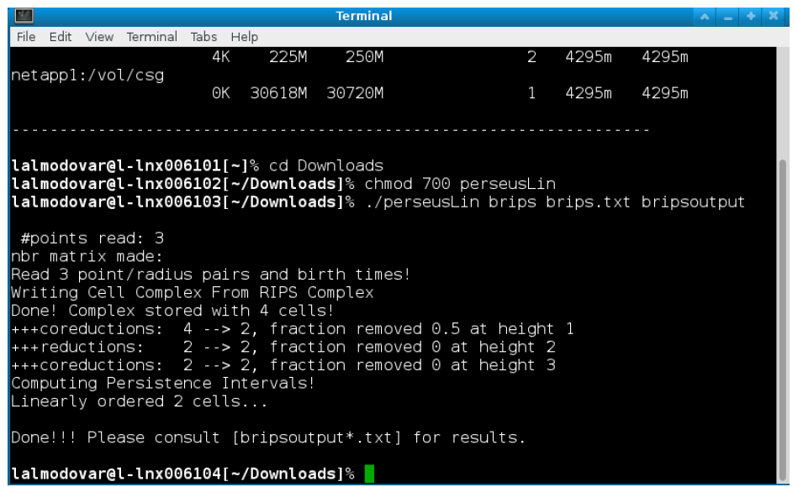
Run Perseus in a Terminal Window

Slide 6
To change directory into Downloads: cd Downloads
To make perseusLin executable: chmod 700 perseusLin.
To run your file: ./perseusLin brips input.txt output
This will create several files (overwriting existing files):
output_0.txt, output_1.txt,... and so on. How many such files are created depends on how many dimensions the discrete Morse-reduced complex actually has.
Some files will be empty.
output_i.txt contains birth death times for ith homology.
output_betti.txt contains the Betti numbers at each step in the filtration.
See Visualizing the Output: Persistent Homology via Intervals for more info

Slide 7
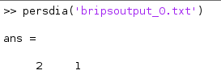
Plotting Persistence Diagrams
In order to aid with visualization, a simple Matlab script called persdia has been bundled along with the source code for Perseus. This script may be called from the Matlab command prompt to plot the Perseus output file as a persistence diagram in the following way:
Make sure you set the directory to the one containing your Perseus files.

Slide 8
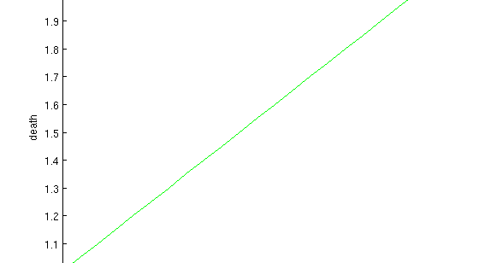
Persistence Diagram

