Slide 1
Newton’s Method
http://www.calculusinmotion.com/images/NewtonsMethod.gif

Slide 2
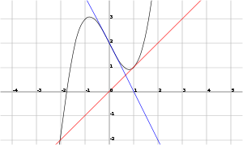
Note Newton’s method only works if you choose x₁ carefully
http://www.thefullwiki.org/Newton-Raphson

