Slide 1
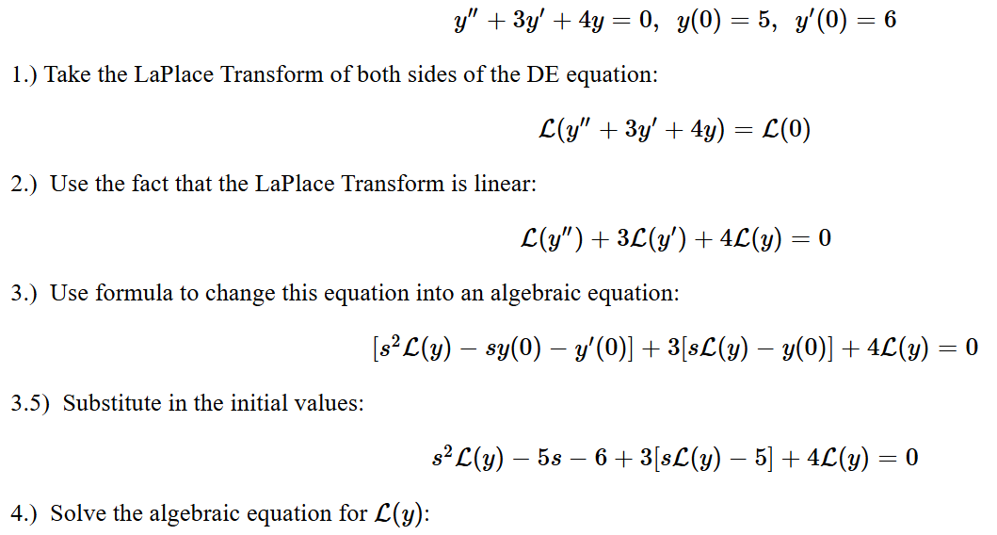
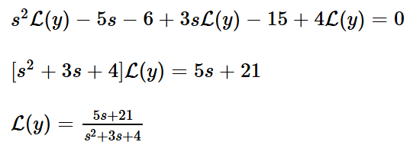
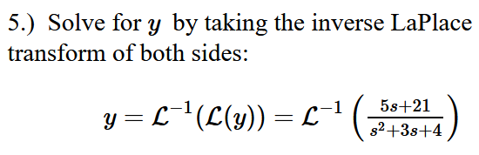

Slide 2
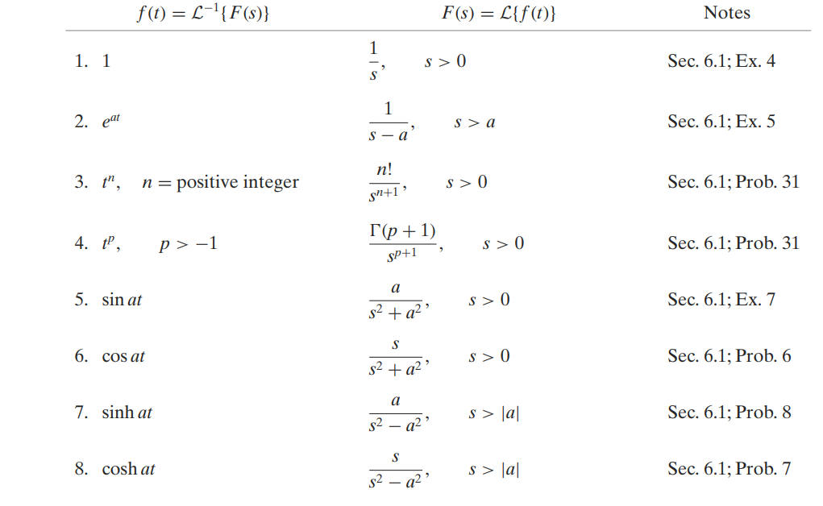

Slide 3
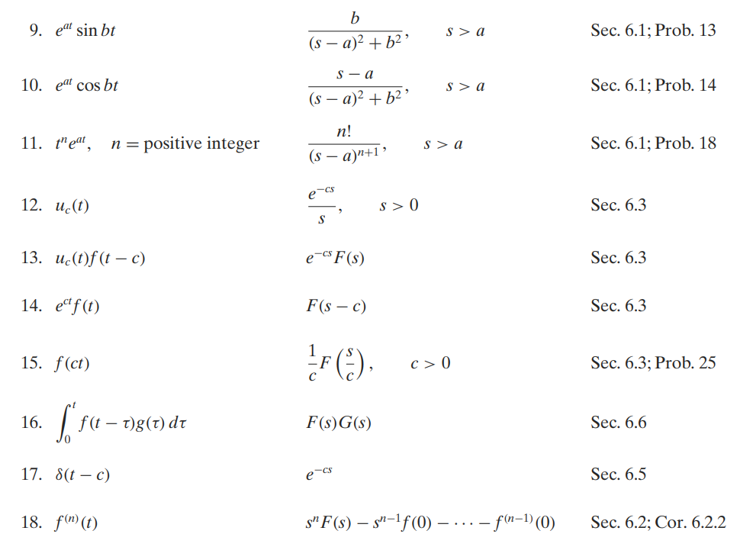

Slide 4
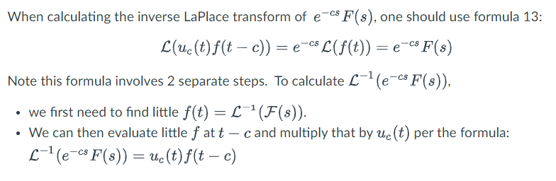
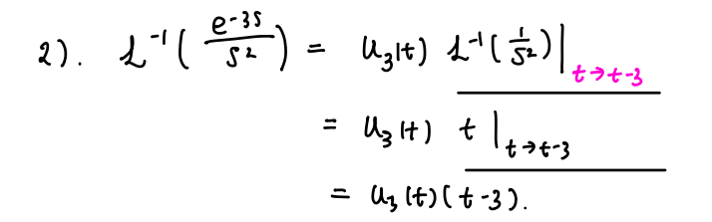

Slide 5
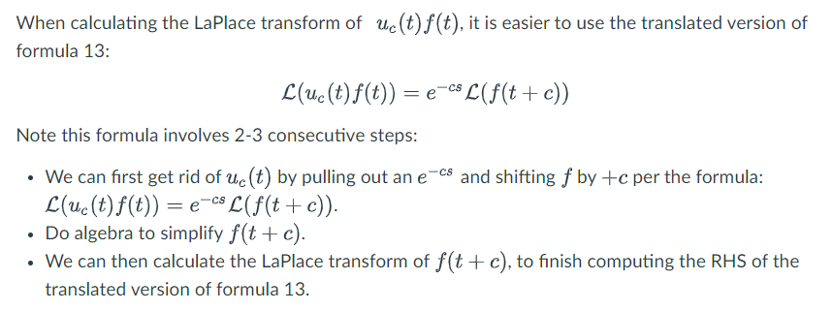

Slide 6
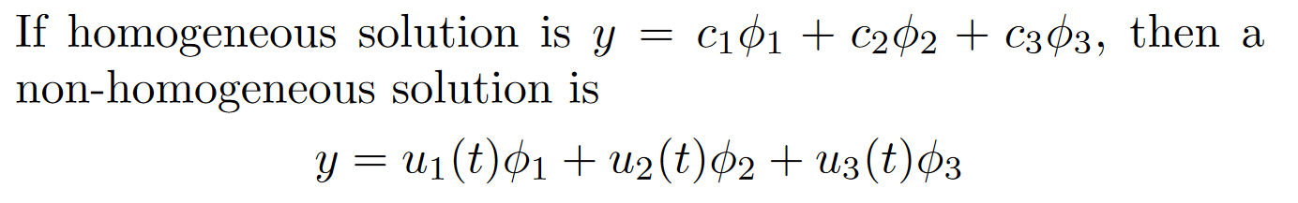
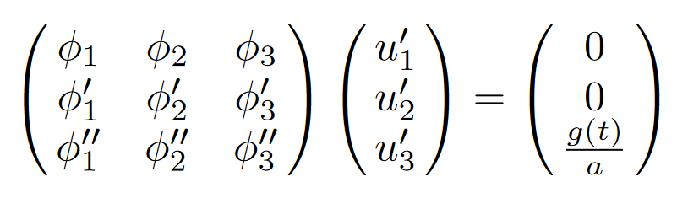
Ch 3/4:
Solve homogeneous first
Find a particular non-homogenous solution
3.5/4.3 Undetermined coefficients is easier
See 3.5 worksheet.
3.6/4.4 Variation of parameters
where
W u’ = [0, …, 0, g(t)/a]^{T}
3. If initial value problem, plug in initial values.
Solve using Cramer’s rule or use formula
If 3rd order

Slide 7
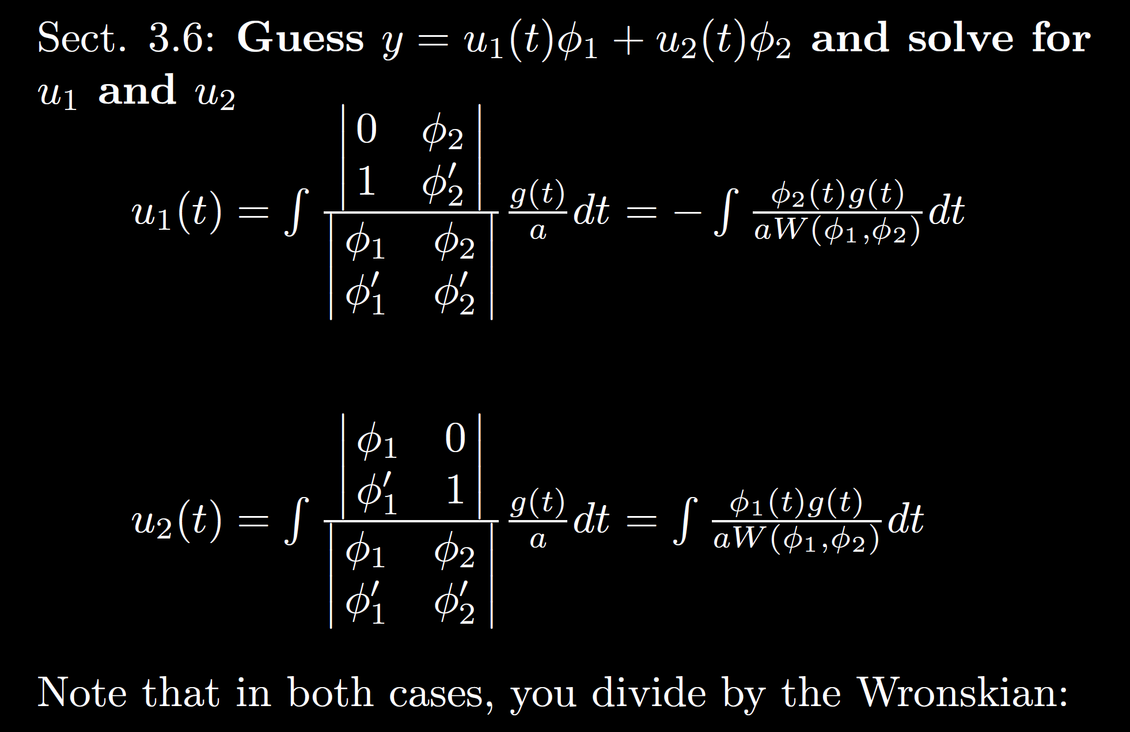




For second order case
Solve $Wu^{′}=\left[\begin{matrix}0 \\ {g(t)}/a\end{matrix}\right]$ using Cramer’s rule

Slide 8
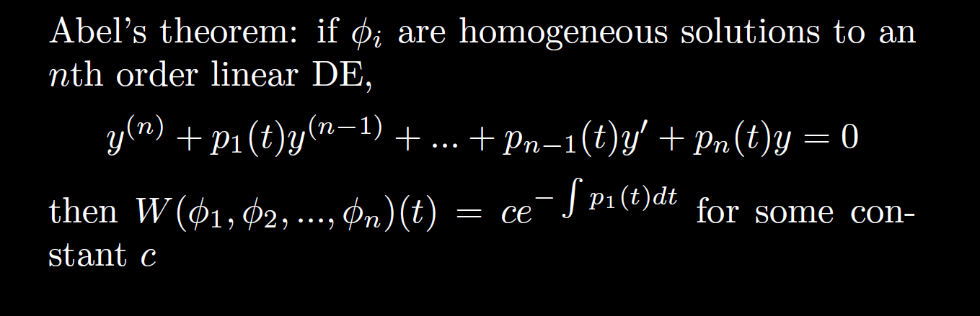

Example 1: Find the Wronskian of the fundamental set of solutions for the differential equation:
$$ty^{′′′}+2y^{′′}−y=0$$

Slide 9

Example 1: Find the Wronskian of the fundamental set of solutions for the differential equation up to a constant multiple:
$$y^{′′′}+\frac{2}{t}y^{′′}−\frac{1}{t}y=0$$

Slide 10

Example 2: Find the Wronskian $W(t)$ of the fundamental set of solutions for the differential equation if $W(1) = 3$:
$$y^{′′′}+\frac{2}{t}y^{′′}−\frac{1}{t}y=0$$

Slide 11
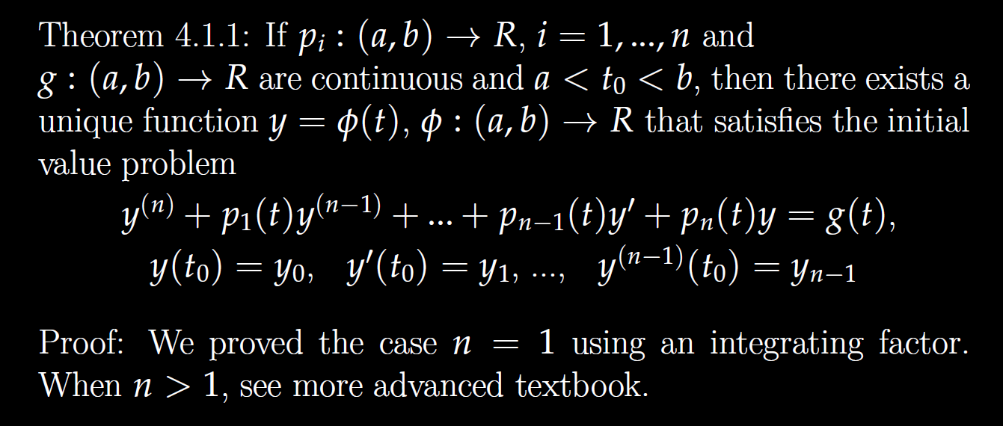

Slide 12
Determine (without solving the problem) an interval in which the solution of the given initial value problem is certain to exist and be unique.
$$1y^{′′′}+\ln\left|t − 5\right|{ y}^{′} + 2 y = \sqrt{t+4} y\left(t0\right)= ?$$
$\left(1 − t\right)\left(1 + t^{2}\right)$ $\left(1 − t\right)\left(1 + t^{2}\right)$ $\left(1 − t\right)\left(1 + t^{2}\right)$
( )( )(
-4 1 5
t = 0, thus domain is (-4, 1) for the solution to this initial value problem.

Slide 13
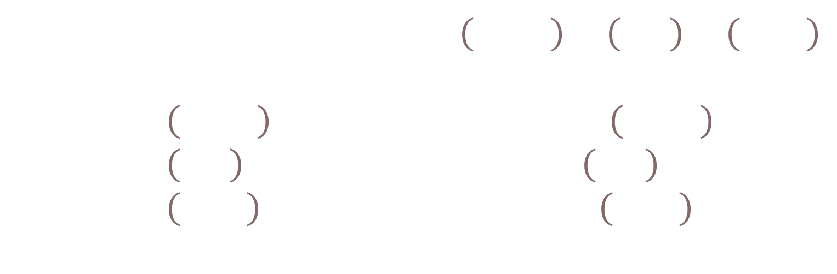
Determine (without solving the problem) an interval in which the solution of the given initial value problem is certain to exist and be unique.
$$1y^{′′′}+\ln\left|t − 5\right|{ y}^{′} + 2 y = \sqrt{t+4} y\left(t0\right)= ?$$
$\left(1 − t\right)\left(1 + t^{2}\right)$ $\left(1 − t\right)\left(1 + t^{2}\right)$ $\left(1 − t\right)\left(1 + t^{2}\right)$
( )( )(
-4 1 5
Unique solution exists if $t_{0}∈\left(−4,1\right)∪\left(1,5\right)∪\left(5,∞\right)$
If $t_{0}∈\left(−4,1\right)$, domain of solution is $\left(−4,1\right)$.
If $t_{0}∈\left(1,5\right)$, domain of solution is $\left(1,5\right)$.
If $t_{0}∈\left(5,∞\right)$, domain of solution is $\left(5,∞\right)$.

Slide 14

Be able to factor the following:
$$ar4 − b = 0$$
$$ar4+ br2+ c = 0$$
$$kar3+ kbr2+ nar + nb =kr2(ar + b)+ n\left(ar + b\right)$$
$= (kr2+ n)(ar + b)$

Slide 15

FYI: For those taking circuits
Example from circuits: $v_{c}^{′}\left(t\right)+\frac{1}{RC}v_{c}=\frac{V_{M}}{RC}\cos\left(ωt\right)$
First order linear with constant coefficients so Ch 3/4 apply

Slide 16
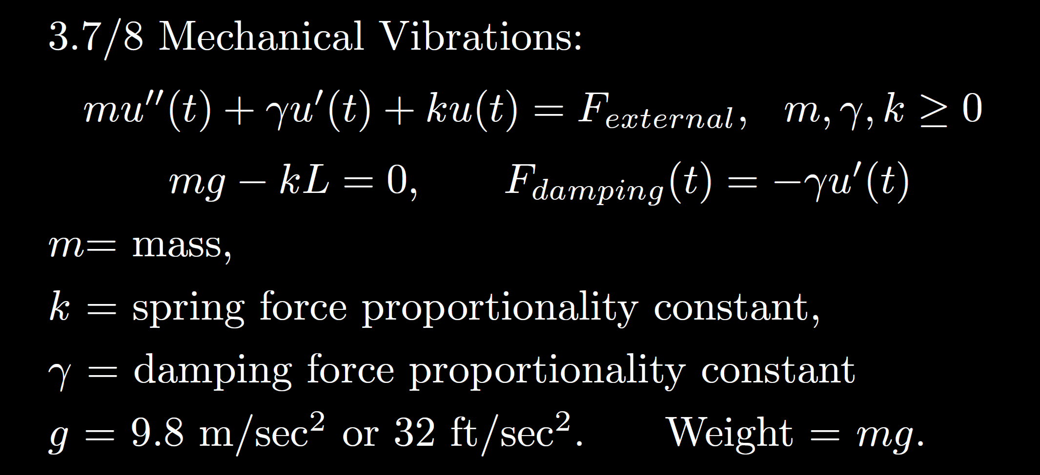
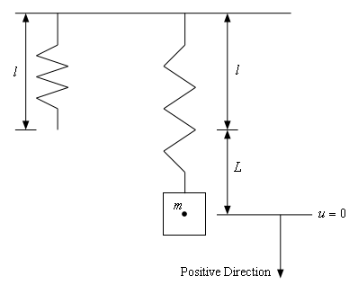
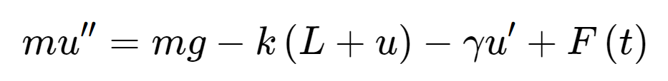
Total force
F= ma
Spring force
External force
Sec 3.8
Gravitational force
Viscous or damping force
https://tutorial.math.lamar.edu/Classes/DE/Vibrations.aspx

Slide 17
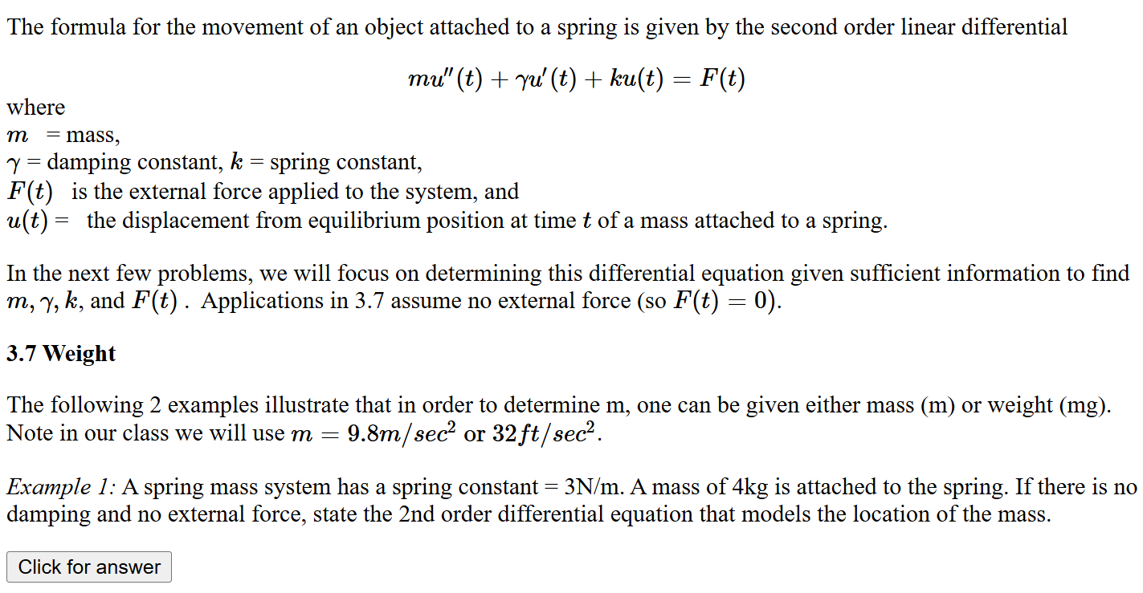
https://homepage.math.uiowa.edu/~idarcy/COURSES/100/mv.html

Slide 18






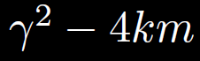




Homogeneous
No damping
oscillation
zero
3.3
Underdamping
oscillation w/decreasing amplitude
small
Critical damping
3.4
No oscillation
critical
Over- damping
3.1
No oscillation
large

Slide 19
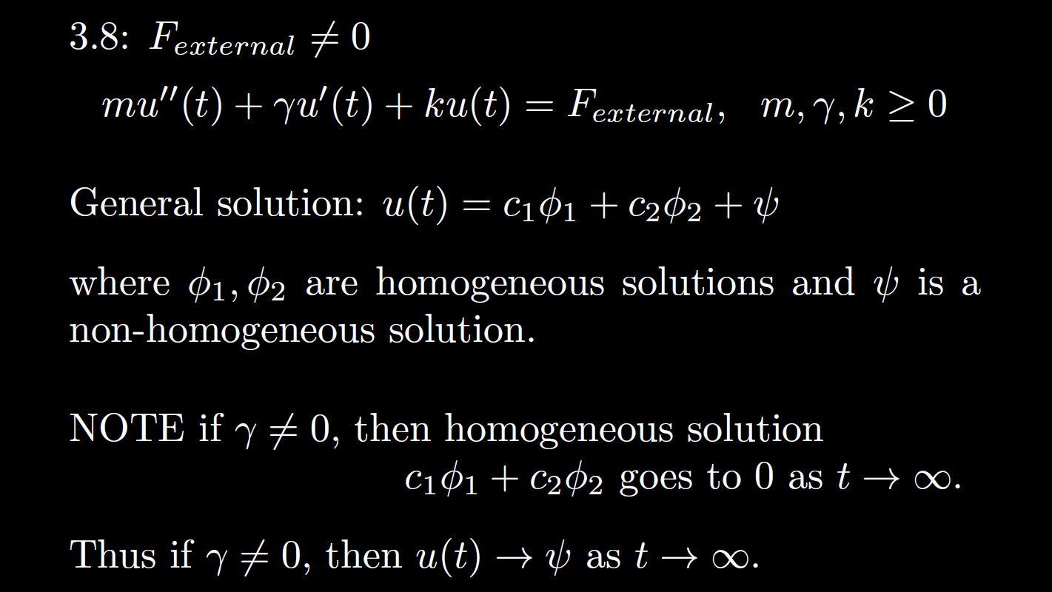


Non-Homogeneous
is the steady state response when

Slide 20


Non-Homogeneous
, then is the transient part.
is the steady state response when

Slide 21


Ch 3, 4: homogeneous soln Particular solution
3.7, 3.8 when transient soln Steady state soln
If the homogeneous solution goes to 0 as t goes to $∞$,
then the long-term behavior only depends on the steady state solution
Note in this case,
the initial values have almost no effect on the long-term behavior.
=
=

Slide 22
Homogeneous
No damping
oscillation
zero
3.3
Underdamping
oscillation w/decreasing amplitude
small
Critical damping
3.4
No oscillation
critical
Over- damping
3.1
No oscillation
large

Slide 23
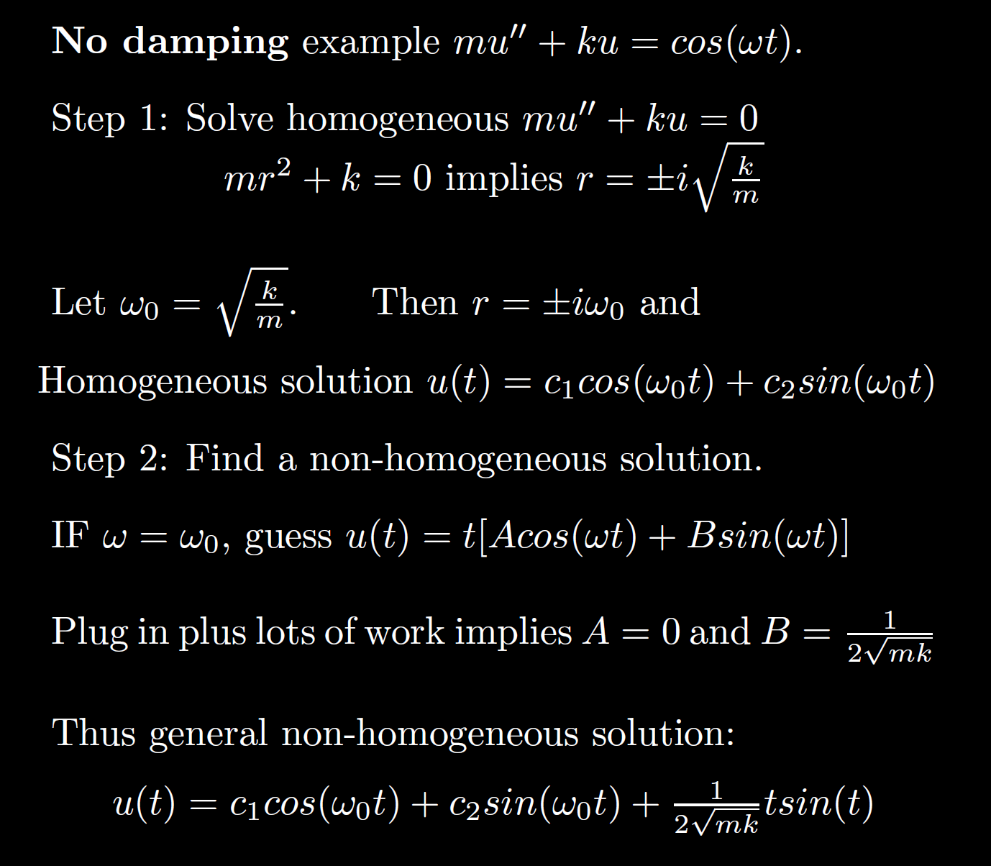
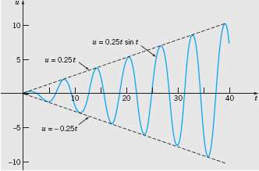

Non-Homogeneous
Boyce/DiPrima/Meade 11th ed, Ch 3.8: Forced Periodic Vibrations
Resonant frequency:
Resonance:
Note when the external force frequency matches the frequency of the homogeneous solution, we must multiply by t.
Thus the amplitude goes to infinity.

Slide 24

Non-Homogeneous
No damping case where external force = Fcos(w₀t) + Gsin(w₀t):
mu’’ + ku = Fcos(w₀t) + Gsin(w₀t):
Resonant frequency = frequency of the homogenous solution = external force frequency =
If homogeneous solution is u(t) = c₁cos(w₀t) + c₂sin(w₀t),
Then nonhomogeneous particular solution is
t[Acos(w₀t) + Bsin(w₀t)]
This same frequency is a good approximation for small damping case.
per previous slide.
Boyce/DiPrima/Meade 11th ed, Ch 3.8: Forced Periodic Vibrations

Slide 25
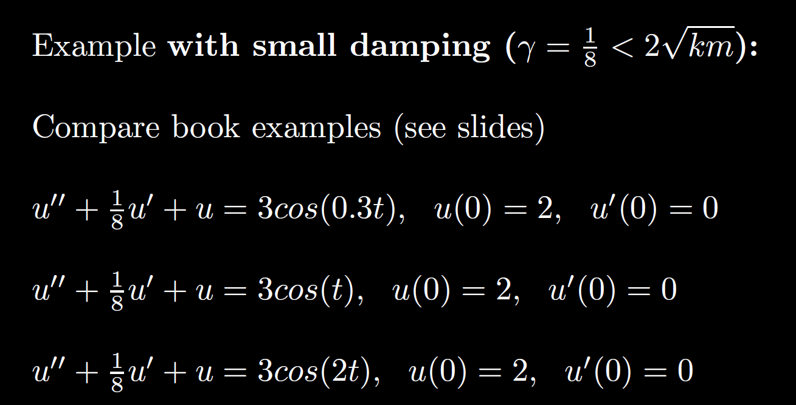
Non-Homogeneous

Slide 26
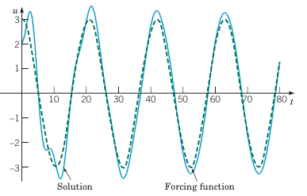
Example 2: Forced Vibrations with Damping (2 of 4)
Graphs of the solution and external force for .
Small external force frequency results in mass moving similar to external force
Boyce/DiPrima/Meade 11th ed, Ch 3.8: Forced Periodic Vibrations

Slide 27
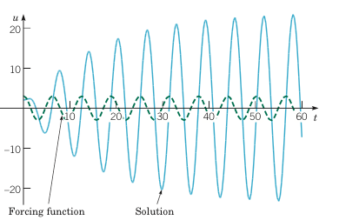
Example 2: Forced Vibrations with Damping (3 of 4)
Graphs of the solution and external force for
If external force frequency is close to the resonant frequency, the amplitude of the response is much larger (solid blue curve) – compare to previous and next slide.
Boyce/DiPrima/Meade 11th ed, Ch 3.8: Forced Periodic Vibrations
Resonance

Slide 28
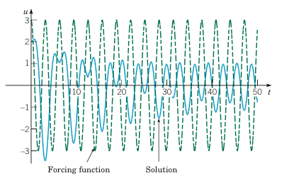
Example 2: Forced Vibrations with Damping (4 of 4)
Graphs of the solution and external force for
Large external force frequency results in
smaller amplitude.
Note the amplitude of the external force (dashed green curve) is larger than the response (solid blue curve).
Boyce/DiPrima/Meade 11th ed, Ch 3.8: Forced Periodic Vibrations

Slide 29
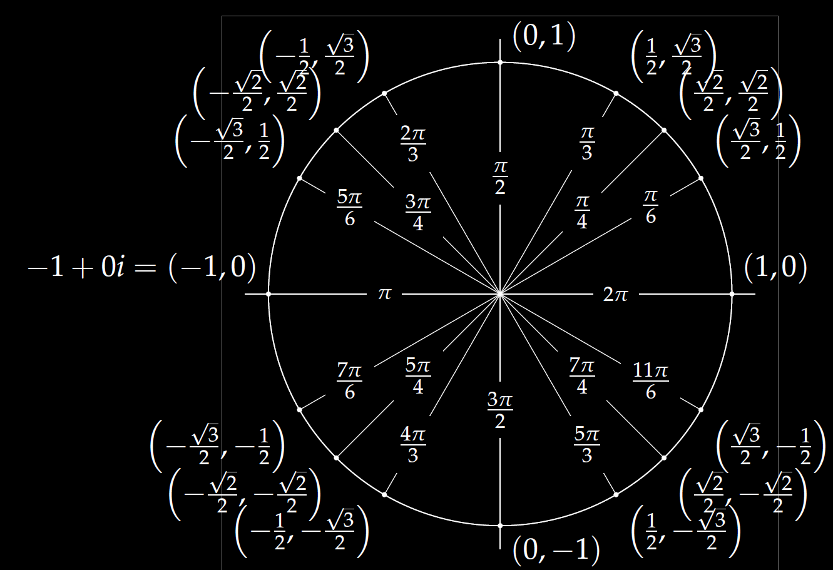

Examples:
$$1=ⅇ^{ⅈ0}$$
$$−1=ⅇ^{ⅈπ}$$
$$−2=2ⅇ^{ⅈπ}$$
$$3+3ⅈ=\sqrt{18}ⅇ^{iπ/4}$$
$$Reiδt=R\cos\left(δt\right)+ⅈR\sin\left(δt\right)$$
($R\cos\left(δt\right), R\sin\left(δt\right))$

Slide 30
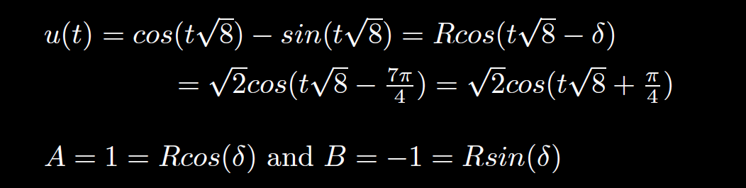
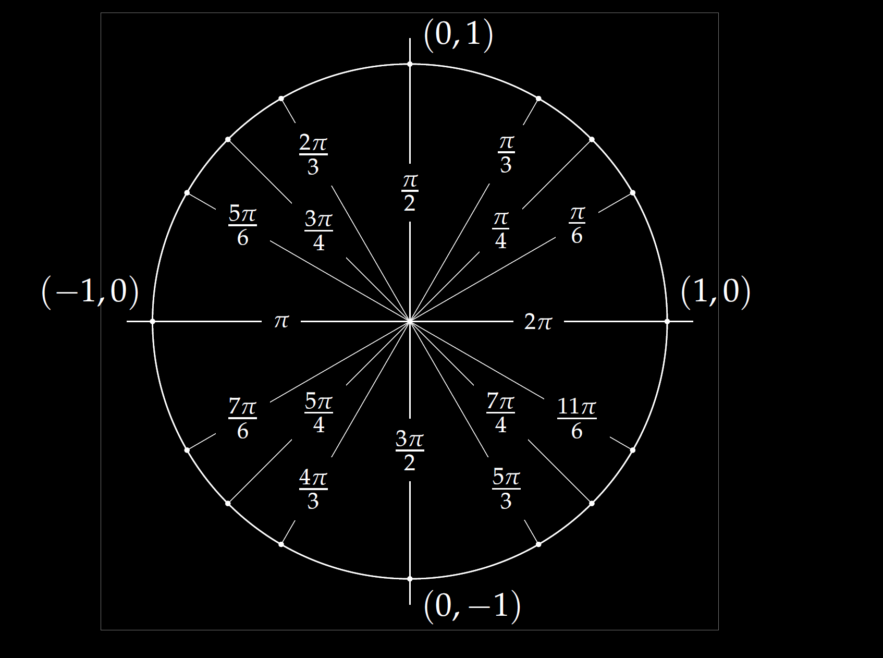
Frequency =
Period =
Amplitude =
Shift =

Slide 31
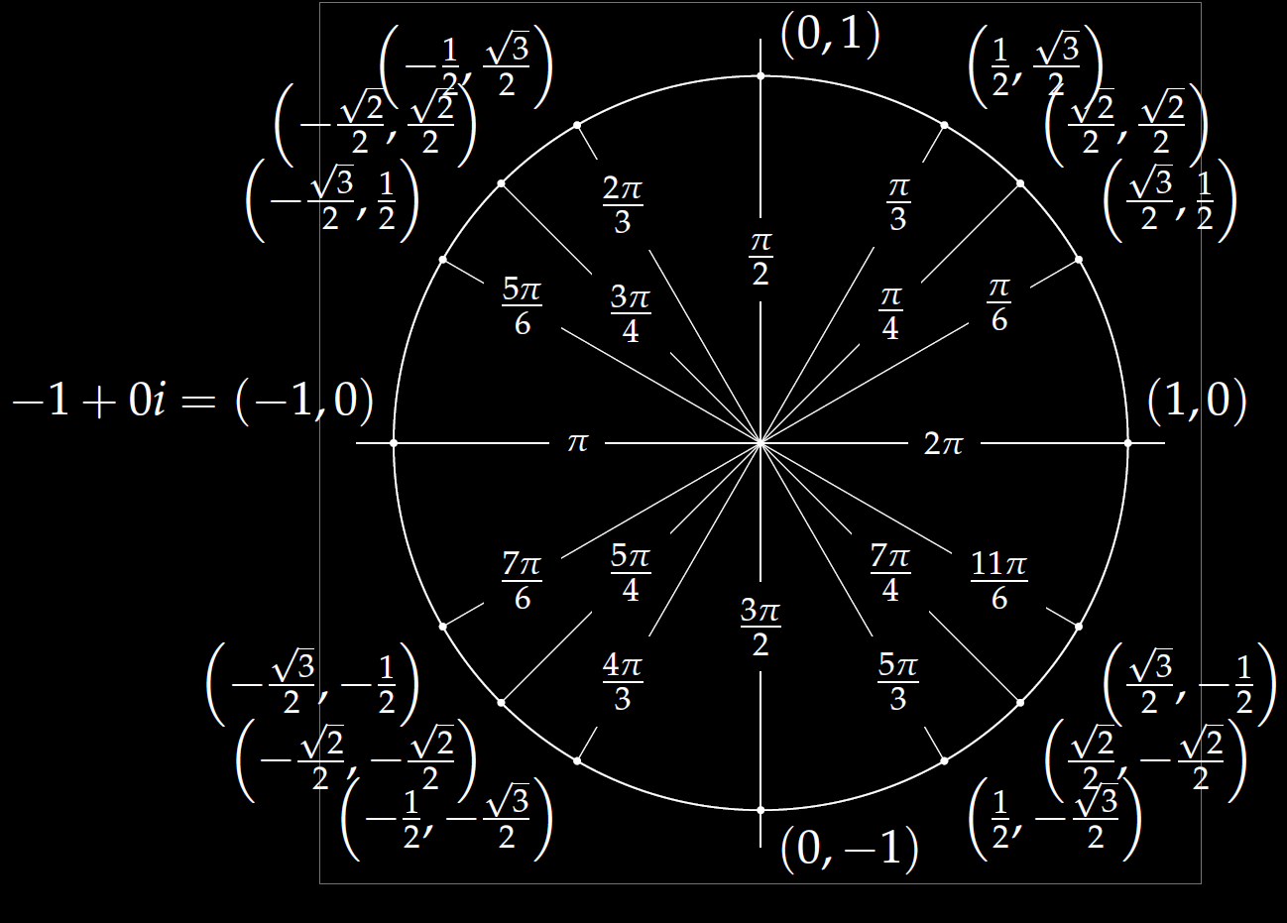
$$u\left(t\right)=−4\cos\left(7t\right)+4\sqrt{3}\sin\left(7t\right)$$
(cos δ, sin δ)

Slide 32
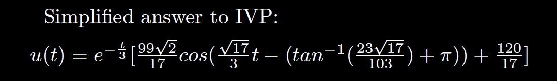

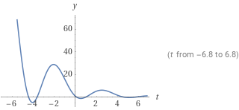
Quasi-frequency:
Quasi-period:
2 π /( )

