Slide 1
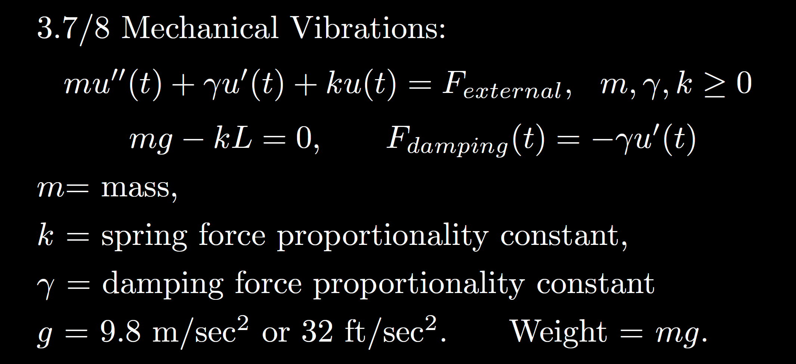
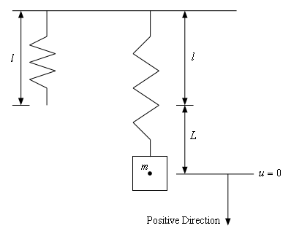
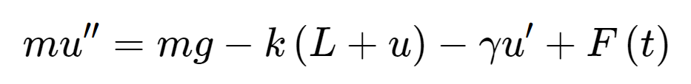
Total force
F= ma
Spring force
External force
Sec 3.8
Gravitational force
Viscous or damping force
https://tutorial.math.lamar.edu/Classes/DE/Vibrations.aspx

Slide 2






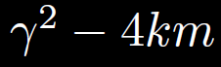




Homogeneous
No damping
oscillation
zero
3.3
Underdamping
oscillation w/decreasing amplitude
small
Critical damping
3.4
No oscillation
critical
Over- damping
3.1
No oscillation
large

Slide 3
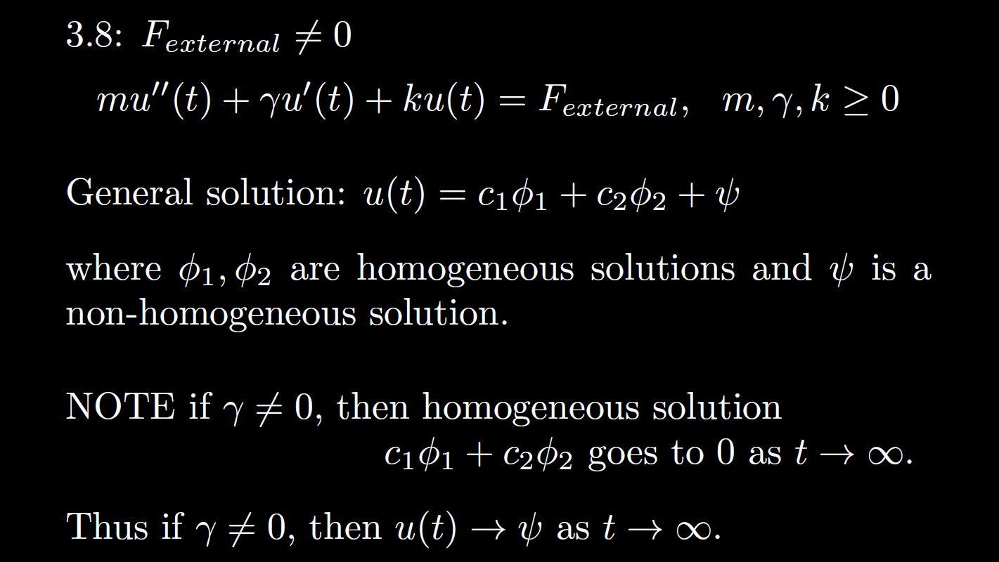


Non-Homogeneous
is the steady state response when

Slide 4


Non-Homogeneous
, then is the transient part.
is the steady state response when

Slide 5


Ch 3, 4: homogeneous soln Particular solution
3.7, 3.8 when transient soln Steady state soln
If the homogeneous solution goes to 0 as t goes to $∞$,
then the long-term behavior only depends on the steady state solution
Note in this case,
the initial values have almost no effect on the long-term behavior.
=
=

Slide 6
Homogeneous
No damping
oscillation
zero
3.3
Underdamping
oscillation w/decreasing amplitude
small
Critical damping
3.4
No oscillation
critical
Over- damping
3.1
No oscillation
large

Slide 7
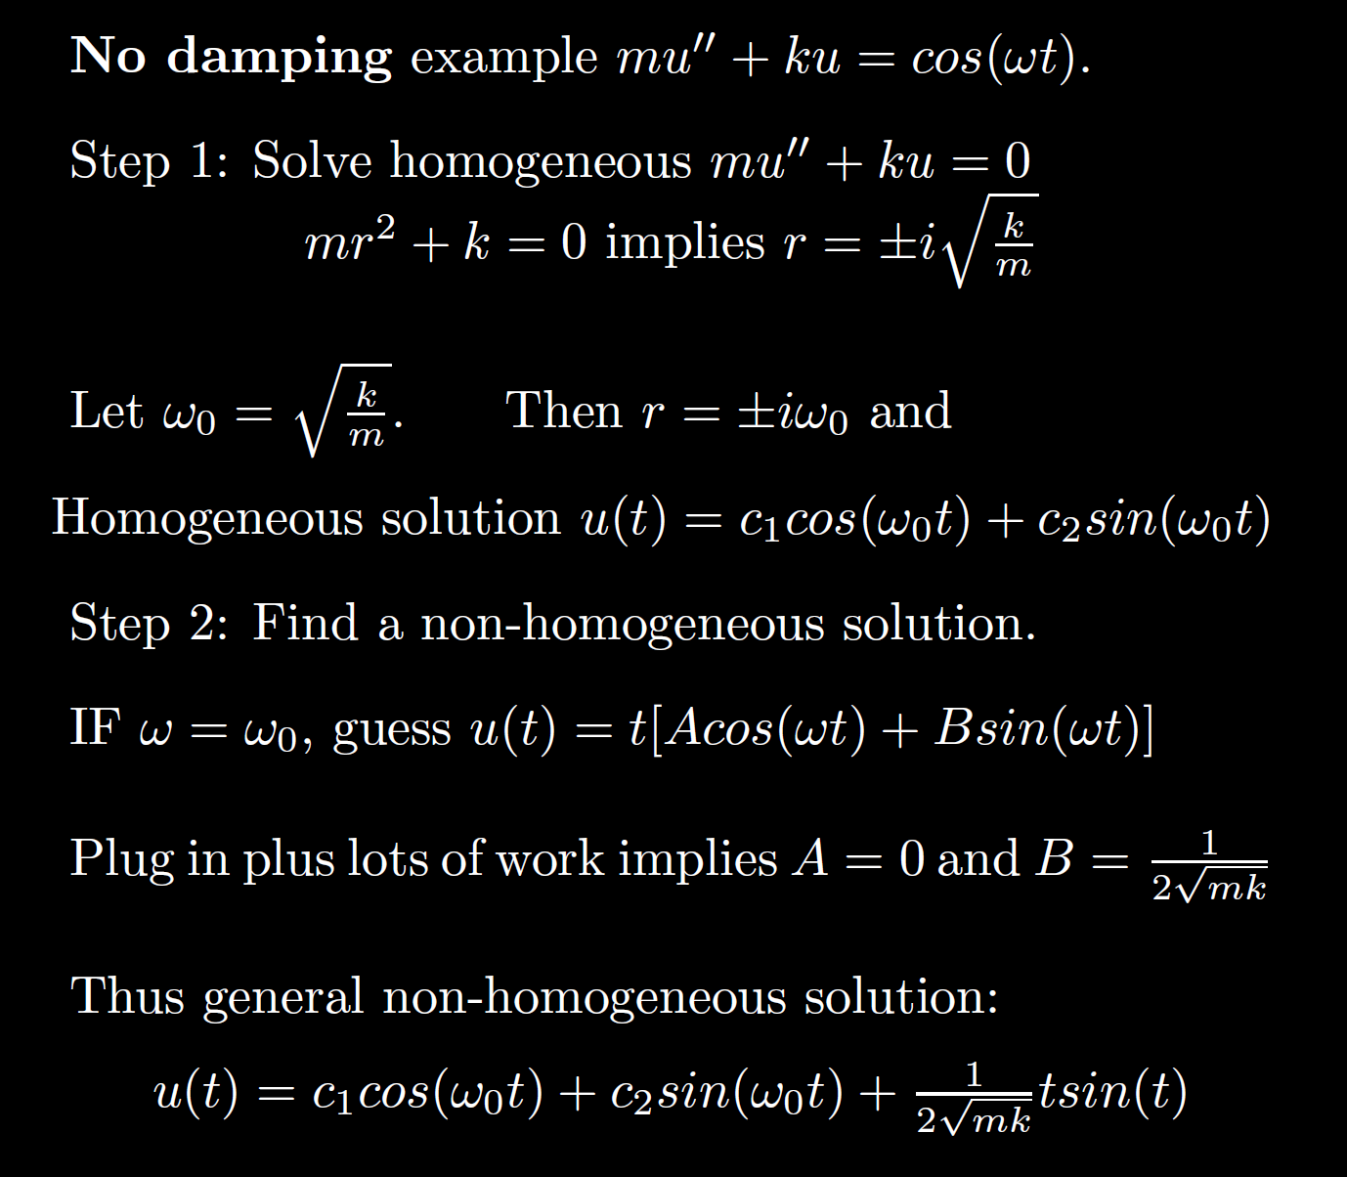
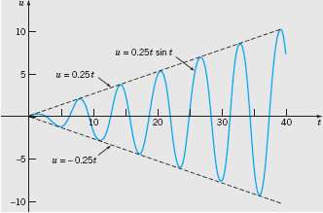

Non-Homogeneous
Boyce/DiPrima/Meade 11th ed, Ch 3.8: Forced Periodic Vibrations
Resonant frequency:
Resonance:
Note when the external force frequency matches the frequency of the homogeneous solution, we must multiply by t.
Thus the amplitude goes to infinity.

Slide 8

Non-Homogeneous
No damping case where external force = Fcos(w₀t) + Gsin(w₀t):
mu’’ + ku = Fcos(w₀t) + Gsin(w₀t):
Resonant frequency = frequency of the homogenous solution = external force frequency =
If homogeneous solution is u(t) = c₁cos(w₀t) + c₂sin(w₀t),
Then nonhomogeneous particular solution is
t[Acos(w₀t) + Bsin(w₀t)]
This same frequency is a good approximation for small damping case.
per previous slide.
Boyce/DiPrima/Meade 11th ed, Ch 3.8: Forced Periodic Vibrations

Slide 9
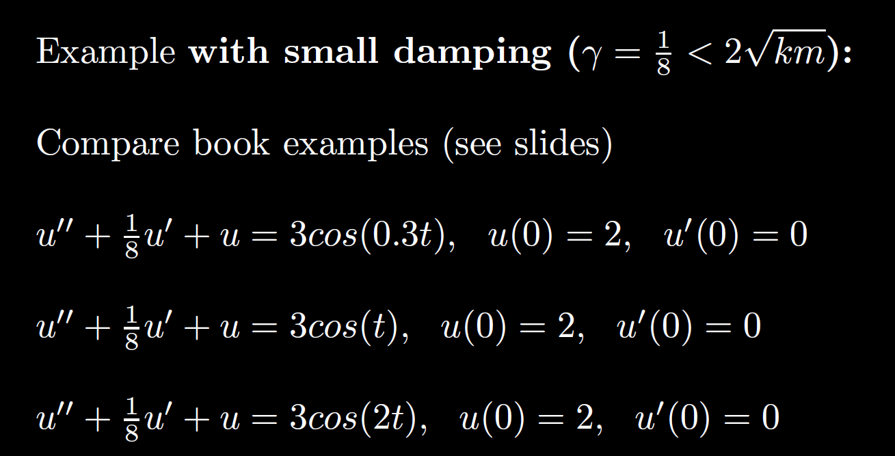
Non-Homogeneous

Slide 10
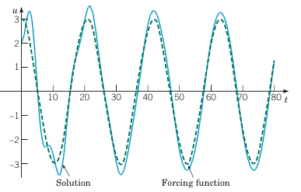
Example 2:
Forced Vibrations with Damping (2 of 4)
Graphs of the solution and external force for .
Small external force frequency results in mass moving similar to external force
Boyce/DiPrima/Meade 11th ed, Ch 3.8: Forced Periodic Vibrations

Slide 11
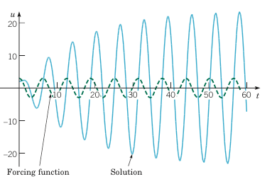
Example 2:
Forced Vibrations with Damping (3 of 4)
Graphs of the solution and external force for
If external force frequency is close to the resonant frequency, the amplitude of the response is much larger (solid blue curve) – compare to previous and next slide.
Boyce/DiPrima/Meade 11th ed, Ch 3.8: Forced Periodic Vibrations
Resonance

Slide 12
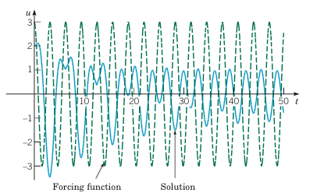
Example 2:
Forced Vibrations with Damping (4 of 4)
Graphs of the solution and external force for
Large external force frequency results in
smaller amplitude.
Note the amplitude of the external force (dashed green curve) is larger than the response (solid blue curve).
Boyce/DiPrima/Meade 11th ed, Ch 3.8: Forced Periodic Vibrations

Slide 13
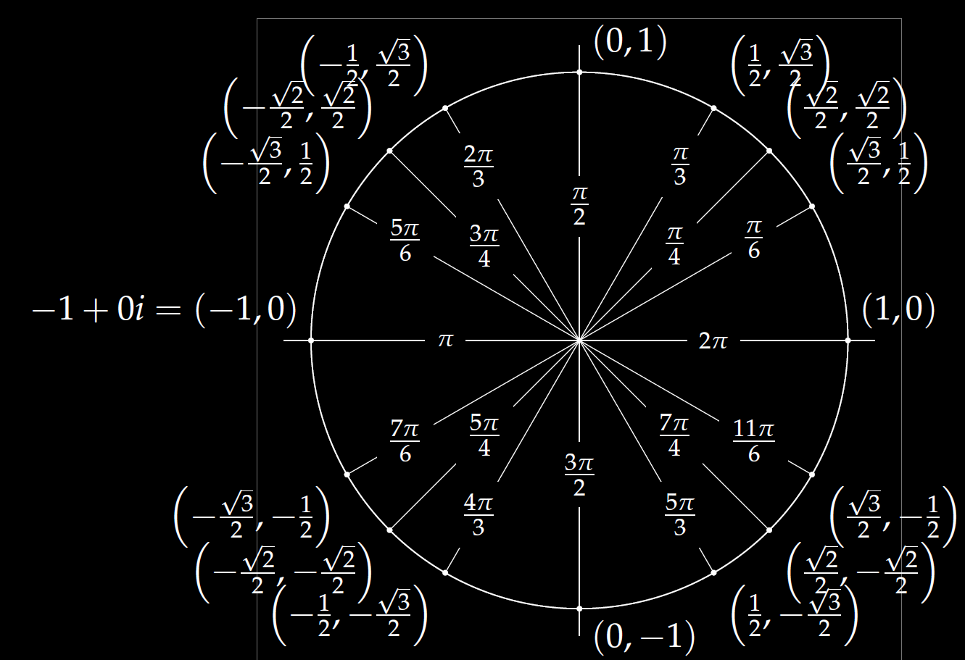

Examples:
$$1=ⅇ^{ⅈ0}$$
$$−1=ⅇ^{ⅈπ}$$
$$−2=2ⅇ^{ⅈπ}$$
$$3+3ⅈ=\sqrt{18}ⅇ^{iπ/4}$$
$$Reiδt=R\cos\left(δt\right)+ⅈR\sin\left(δt\right)$$
($R\cos\left(δt\right), R\sin\left(δt\right))$

Slide 14
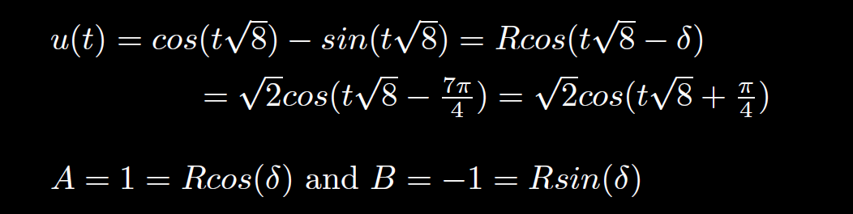
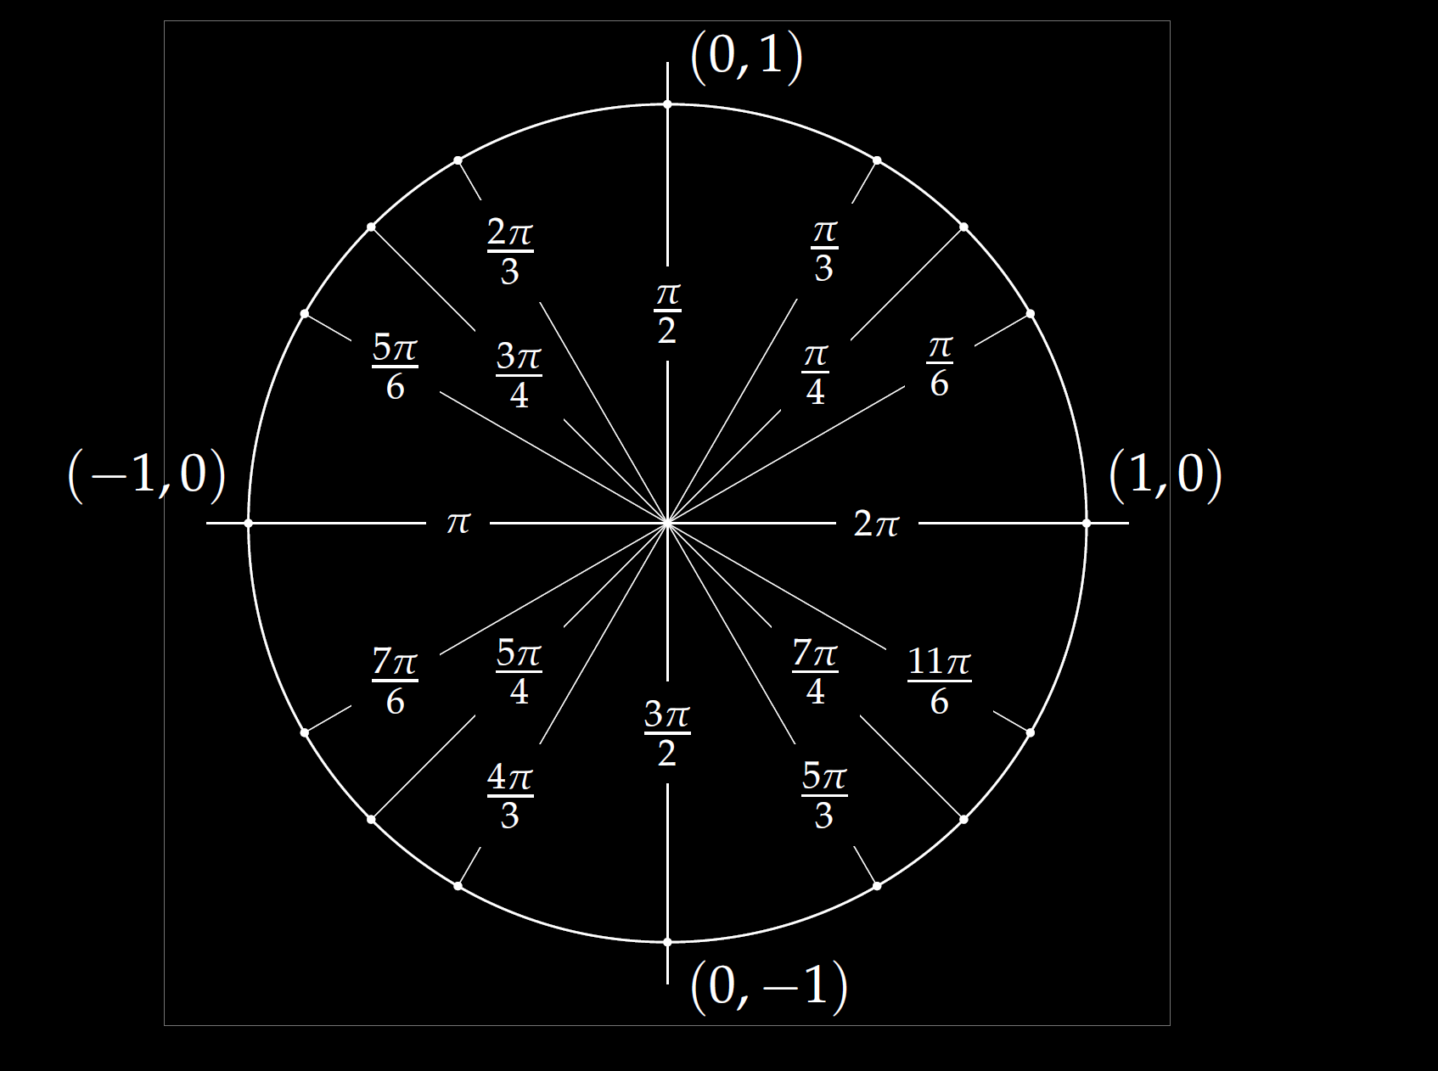
Frequency =
Period =
Amplitude =
Shift =

Slide 15
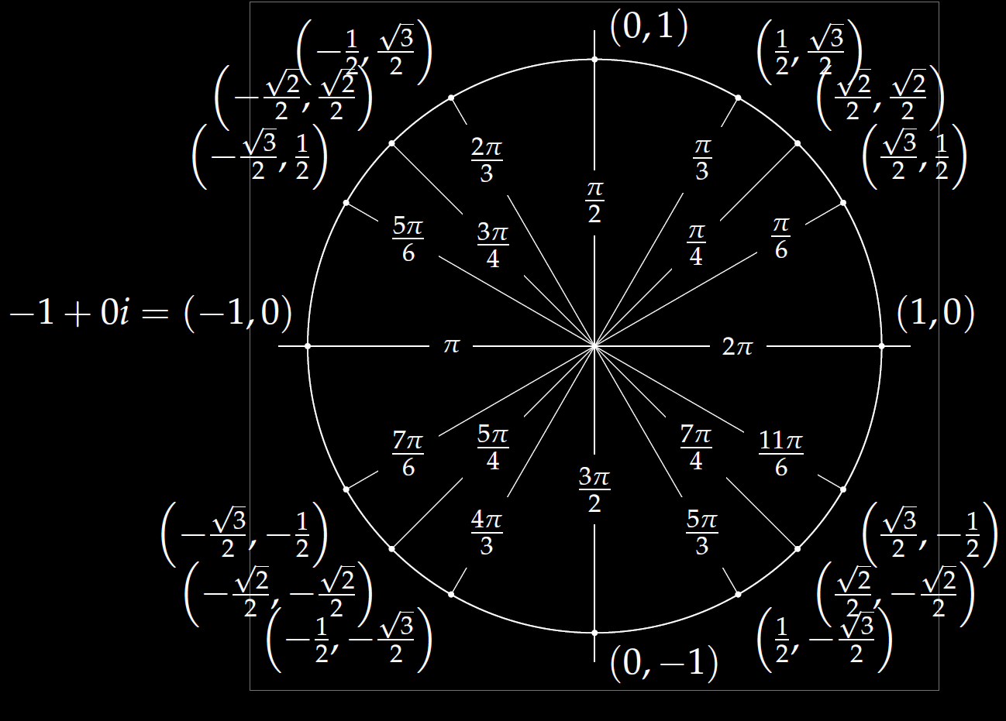
$$u\left(t\right)=−4\cos\left(7t\right)+4\sqrt{3}\sin\left(7t\right)$$
(cos δ, sin δ)

Slide 16
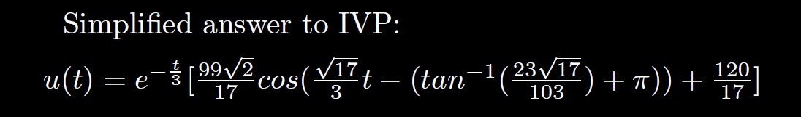

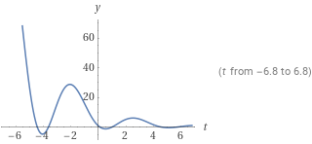
Quasi-frequency:
Quasi-period:
2 π /( )

Slide 17
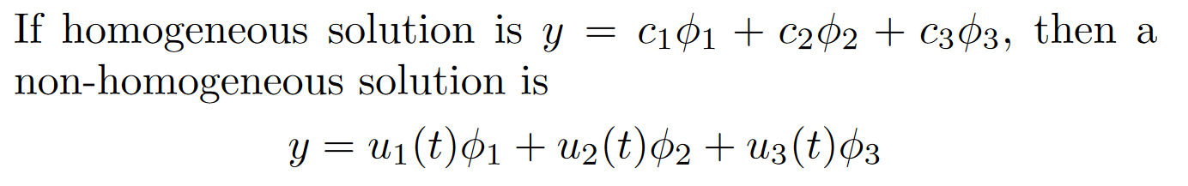
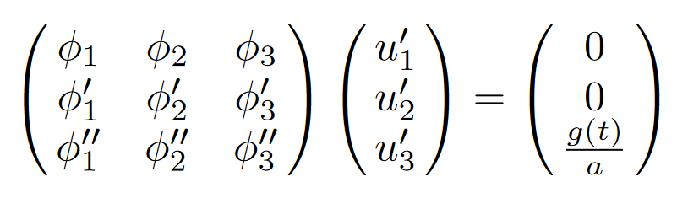
Ch 3/4:
Solve homogeneous first
Find a particular non-homogenous solution
  3.5/4.3 Undetermined coefficients is easier
    See 3.5 worksheet.
  3.6/4.4 Variation of parameters
    where
    W u’ = [0, …, 0, g(t)/a]^{T}
3. If initial value problem, plug in initial values.
Solve using Cramer’s rule or use formula

Slide 18
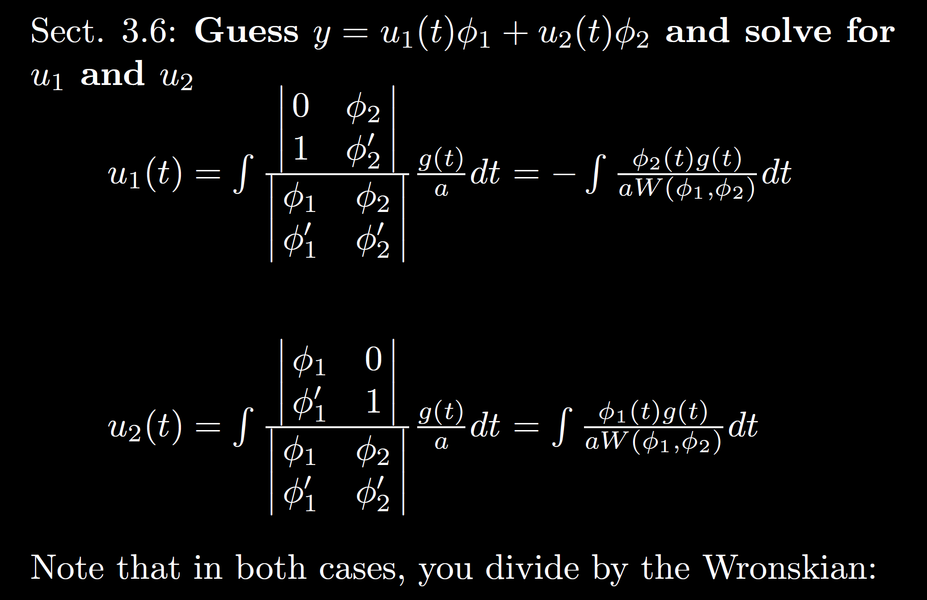

Slide 19

Be able to factor the following:
$$ar4 − b = 0$$
$$ar4+ br2+ c = 0$$
$$kar3+ kbr2+ nar + nb =kr2(ar + b)+ n\left(ar + b\right)$$
$= (kr2+ n)(ar + b)$

Slide 20
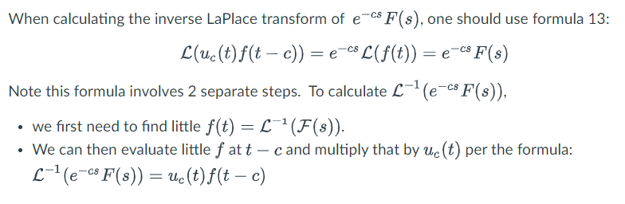
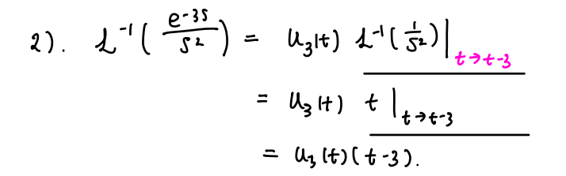

Slide 21
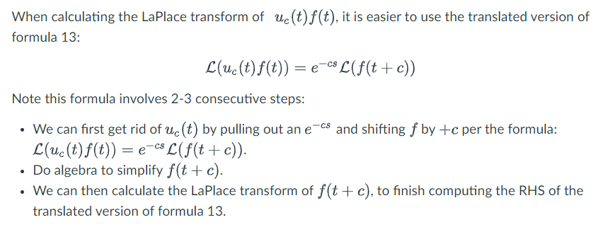

Slide 22
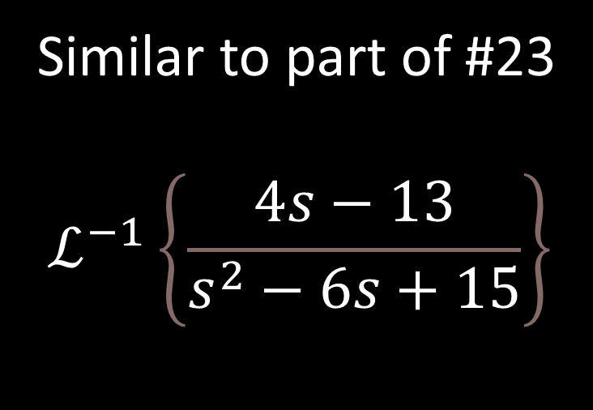
Similar to part of #23
$$ℒ^{−1}\left\{\frac{4s−13}{s^{2}−6s+15}\right\}$$

Slide 23

FYI: For those taking circuits
Example from circuits: $v_{c}^{′}\left(t\right)+\frac{1}{RC}v_{c}=\frac{V_{M}}{RC}\cos\left(ωt\right)$
First order linear with constant coefficients so Ch 3/4 apply

