Slide 1
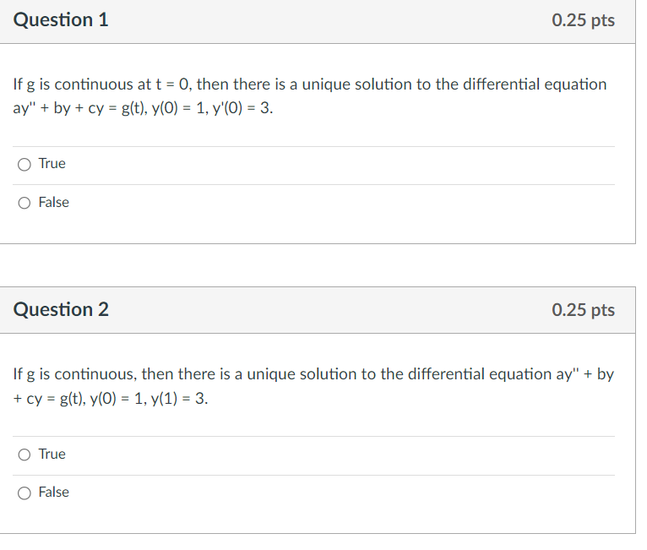
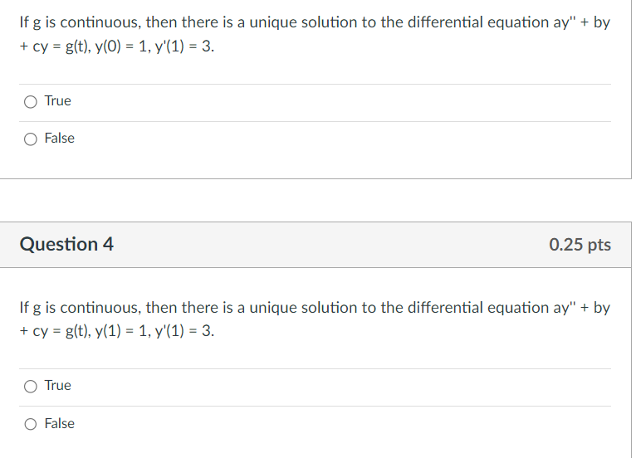
x
x
x
x
Midterm 1 will be held Thursday October 3, 2024 from 6:30PM - 8:00PM over Chapters 1 and 2 and 3.1-3.4 in 100 PH
Corner of Iowa/Clinton
Slope at (t₀, y₀) is y (t₀) = y₁
(t₀, y₀)

Slide 2


See ICON Module for Midterm 1

Slide 3

Solving differential equations
1st order 2nd order LINEAR
Linear vs separable or both homogeneous: plug in e^{rt}
a(t)y’ + b(t)y = g(t) with constant coefficients
Use integrating factor Separate variables to
to create product rule create 2 calculus problems
$$\int{f\left(y\right)ⅆy}=\int{g\left(t\right)ⅆt}$$

Slide 4
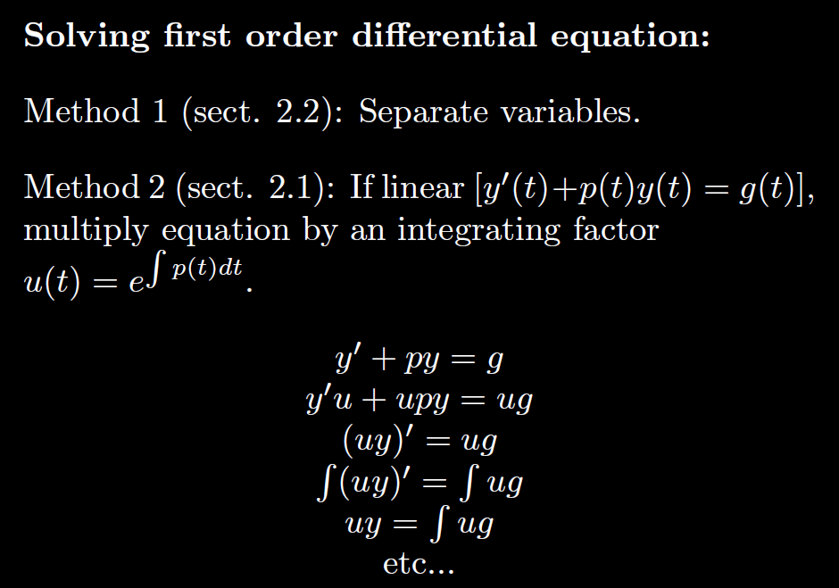

Slide 5
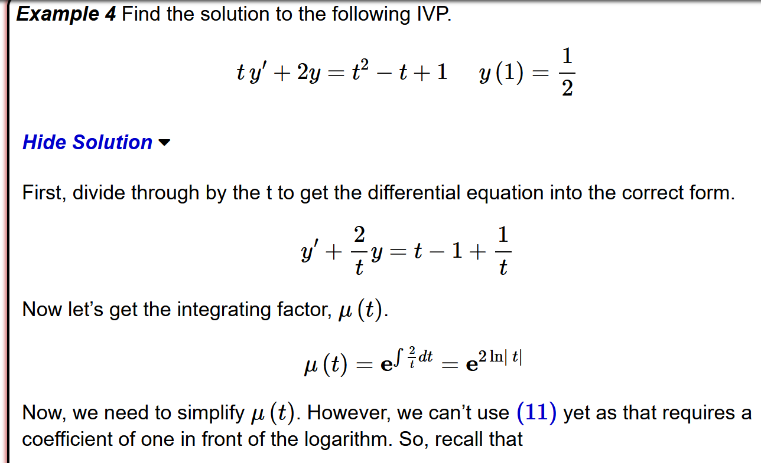
From: https://tutorial.math.lamar.edu/Classes/DE/Linear.aspx

Slide 6
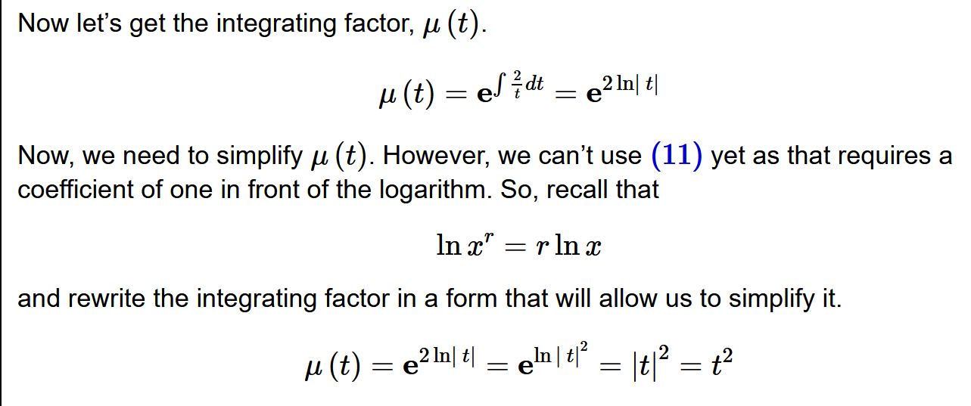

Slide 7
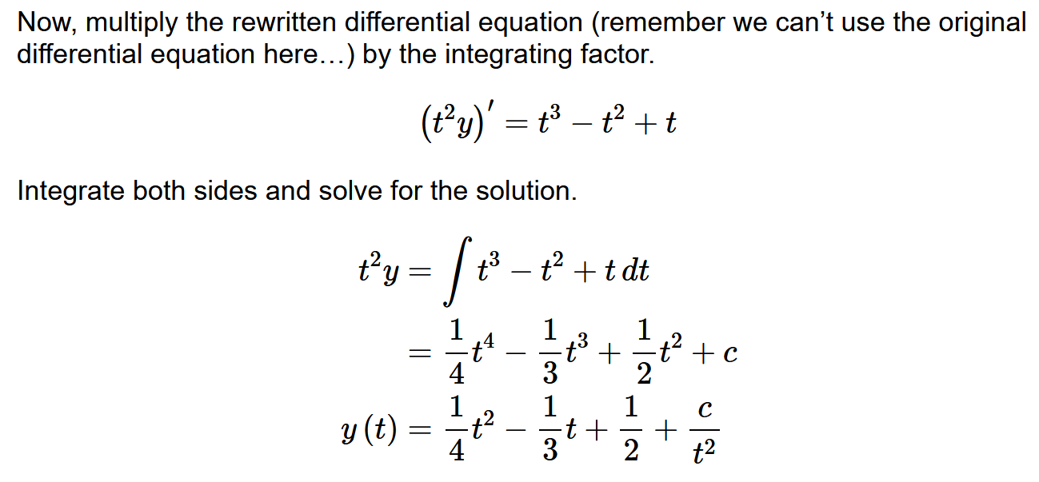

Slide 8
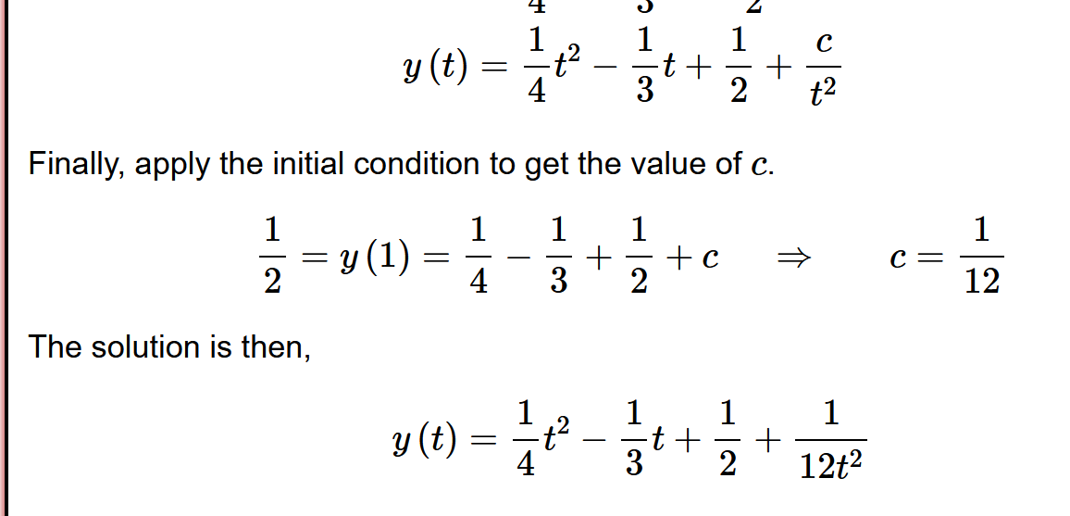

Slide 9
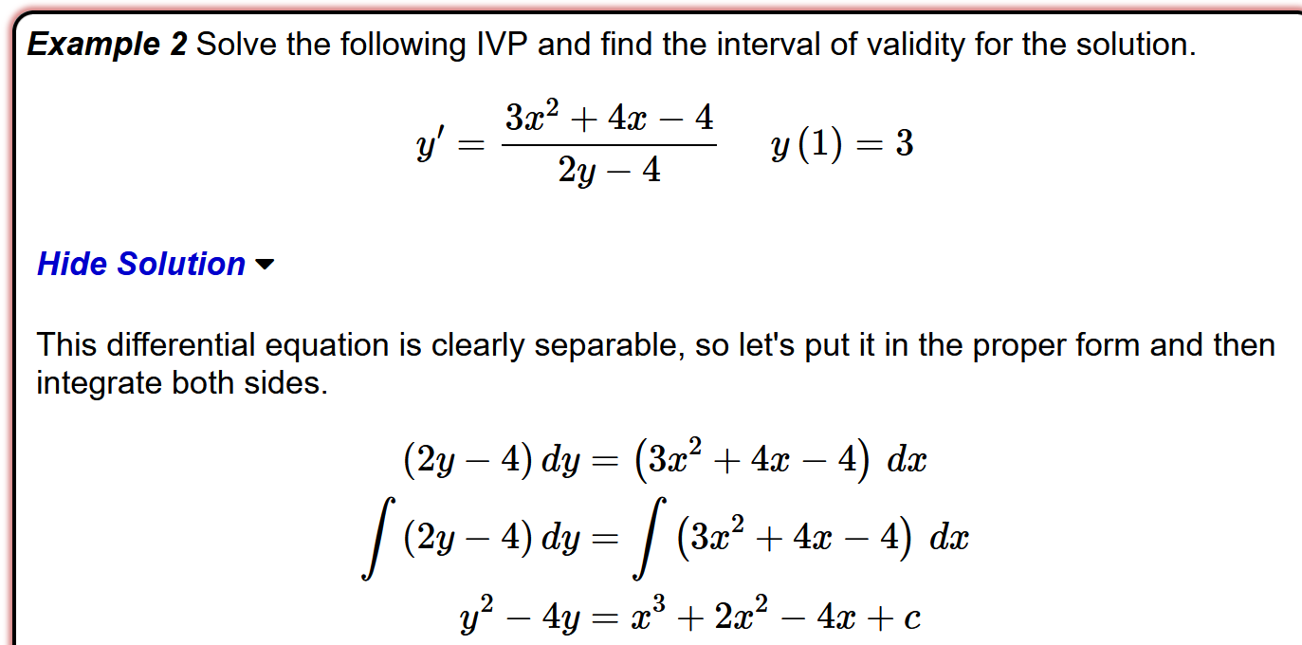
From: https://tutorial.math.lamar.edu/Classes/DE/Separable.aspx

Slide 10
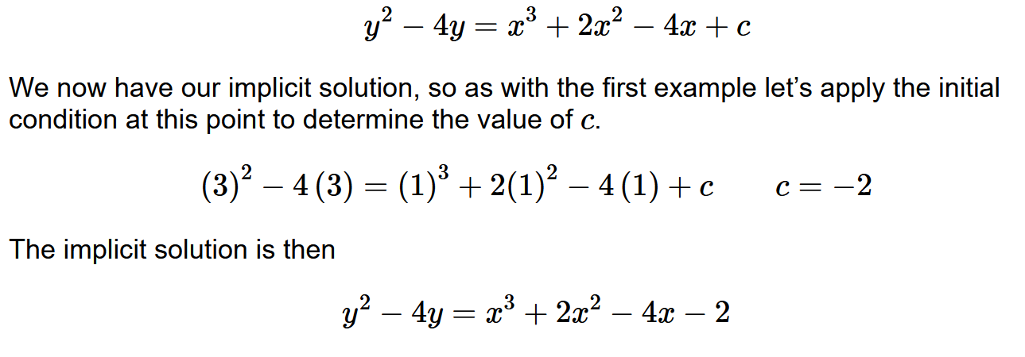

Slide 11
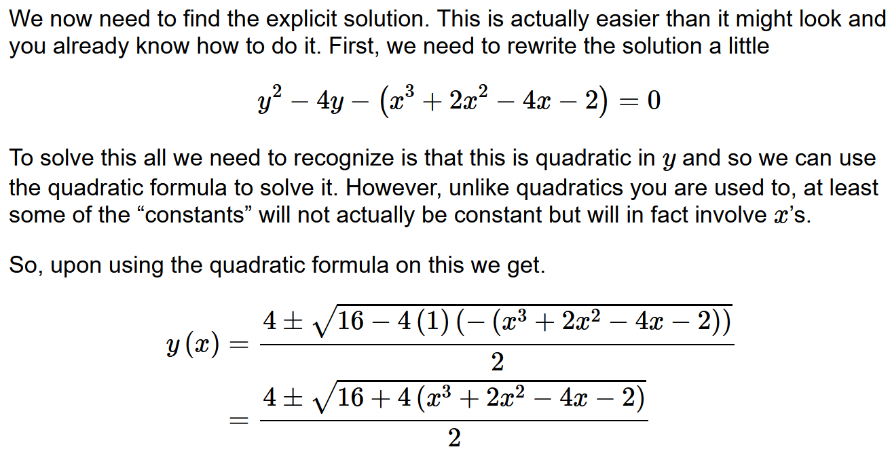

Slide 12
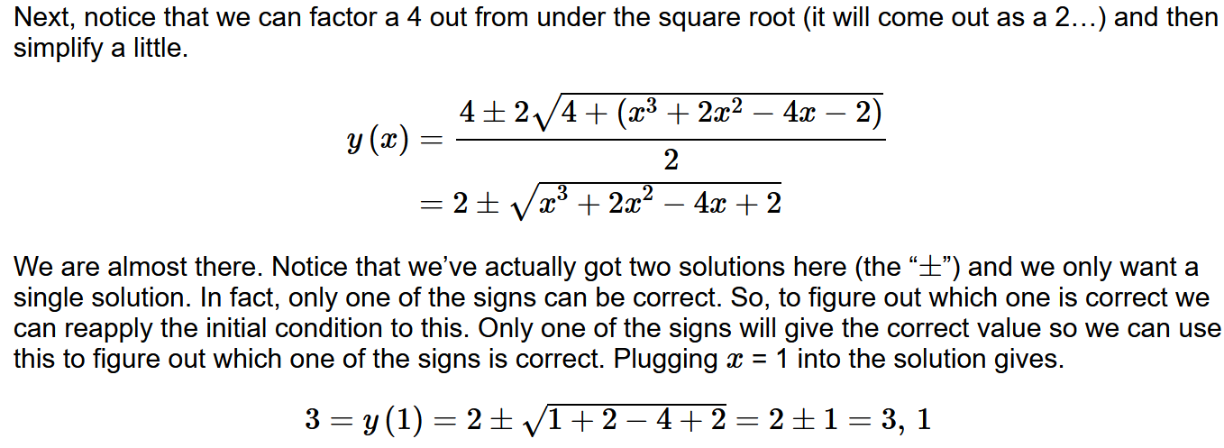
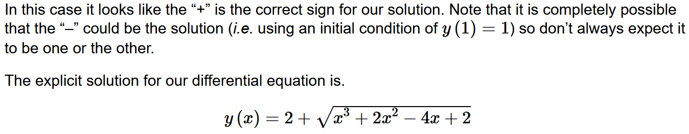

Slide 13
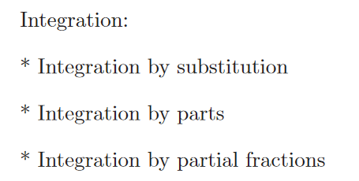
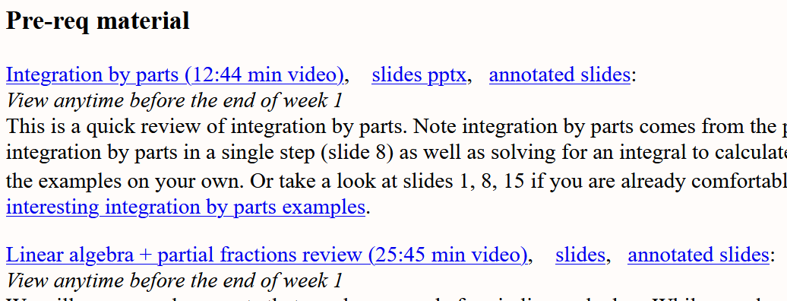

Slide 14
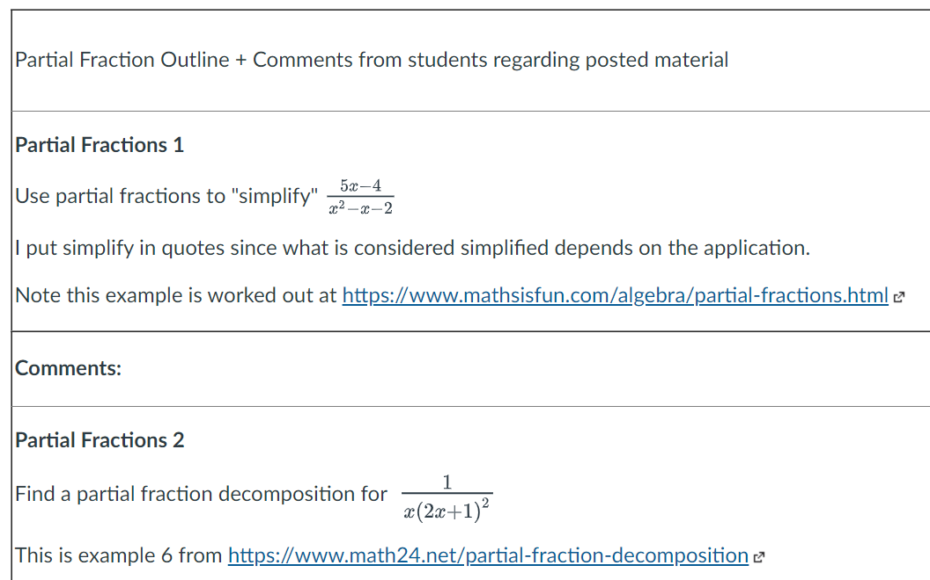

Slide 15
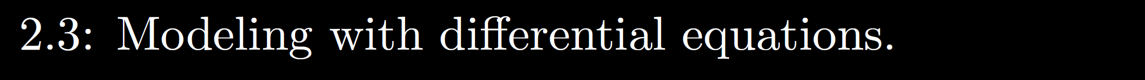

Slide 16
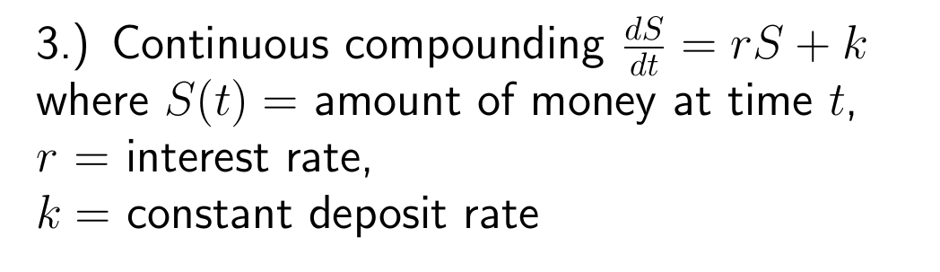
If rate of change is constant:

Slide 17
If rate of change proportional to S:

Slide 19
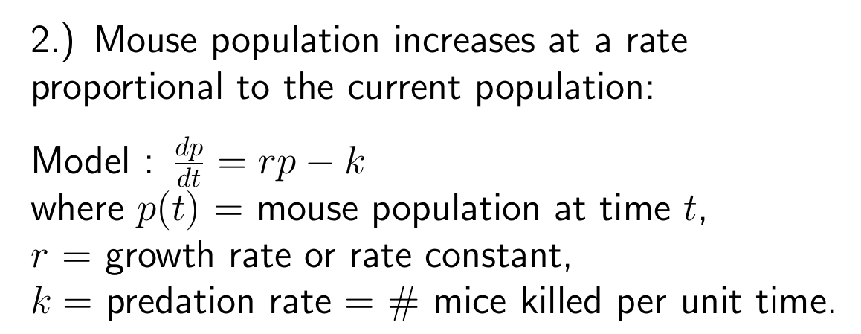
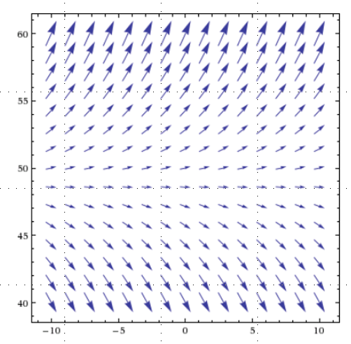

Slide 20
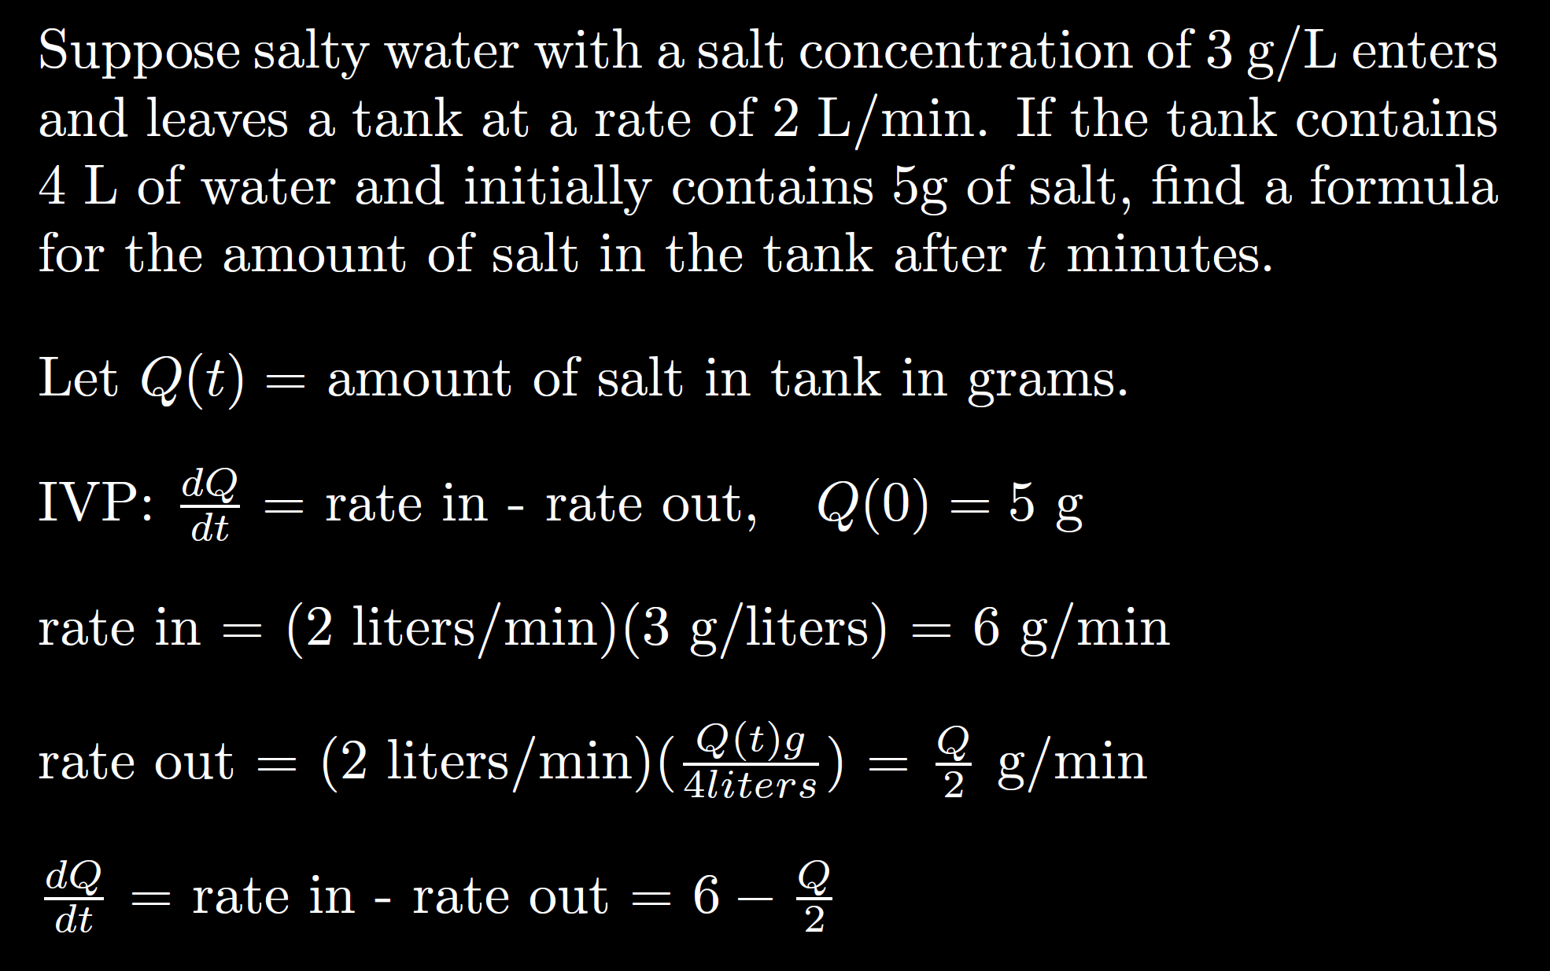

Slide 21
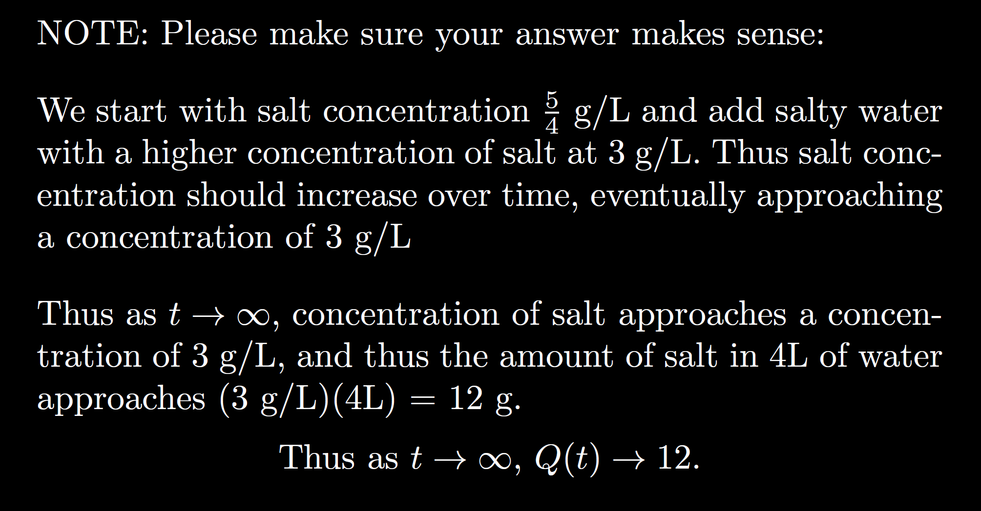
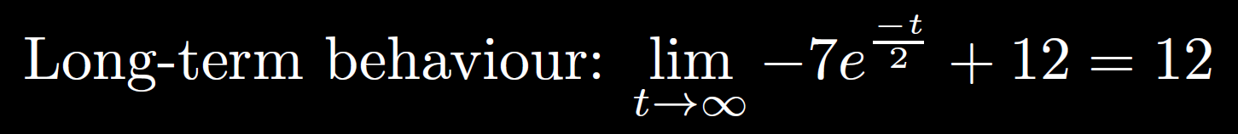

Slide 22
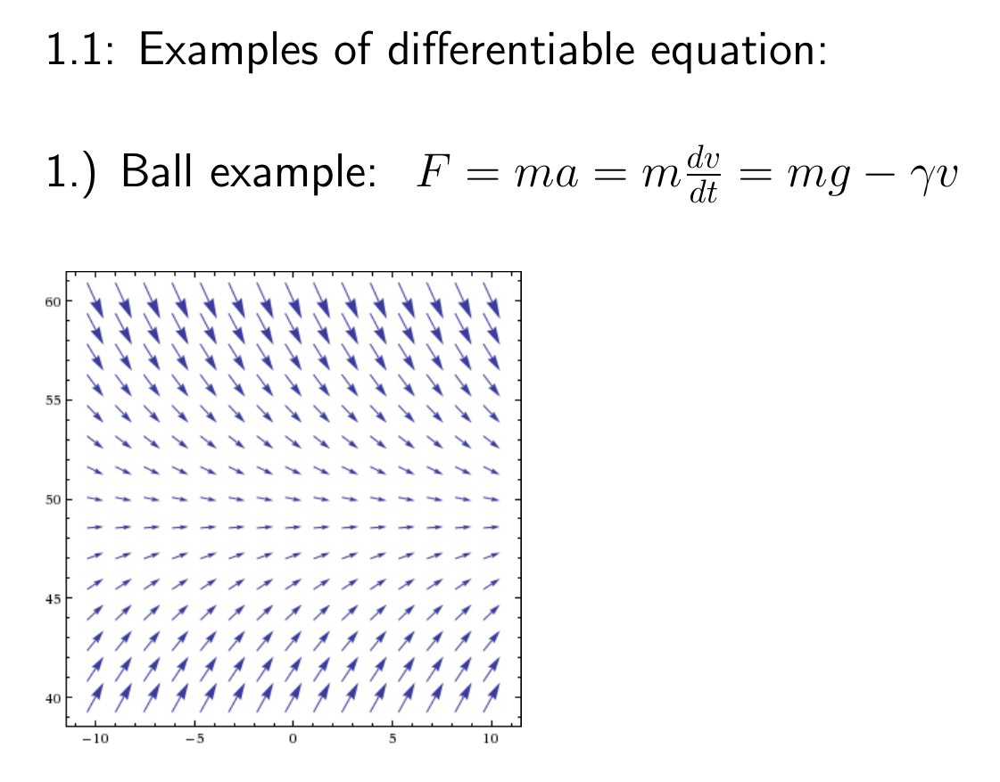

Slide 23
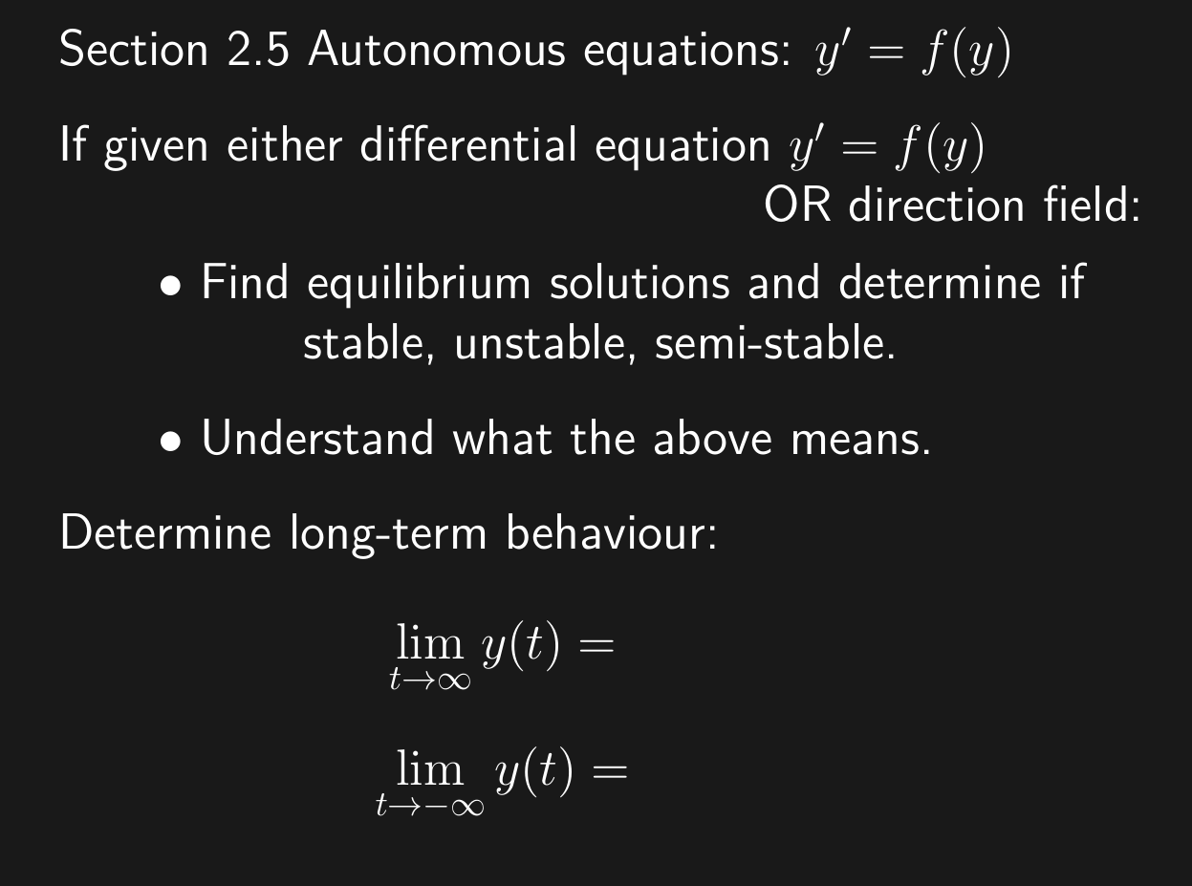

Slide 24
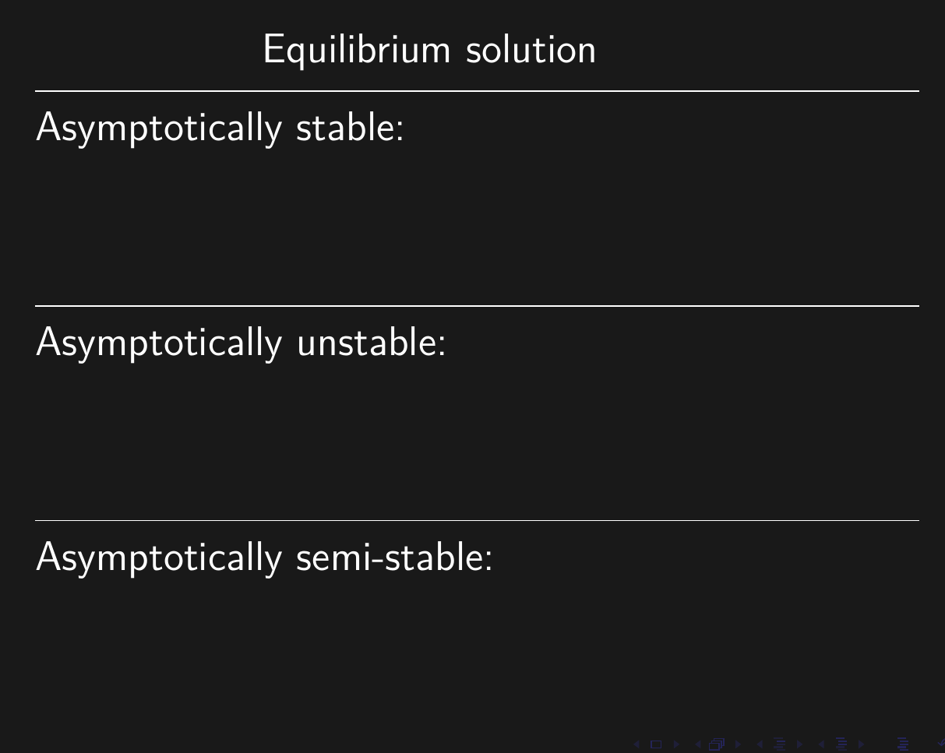
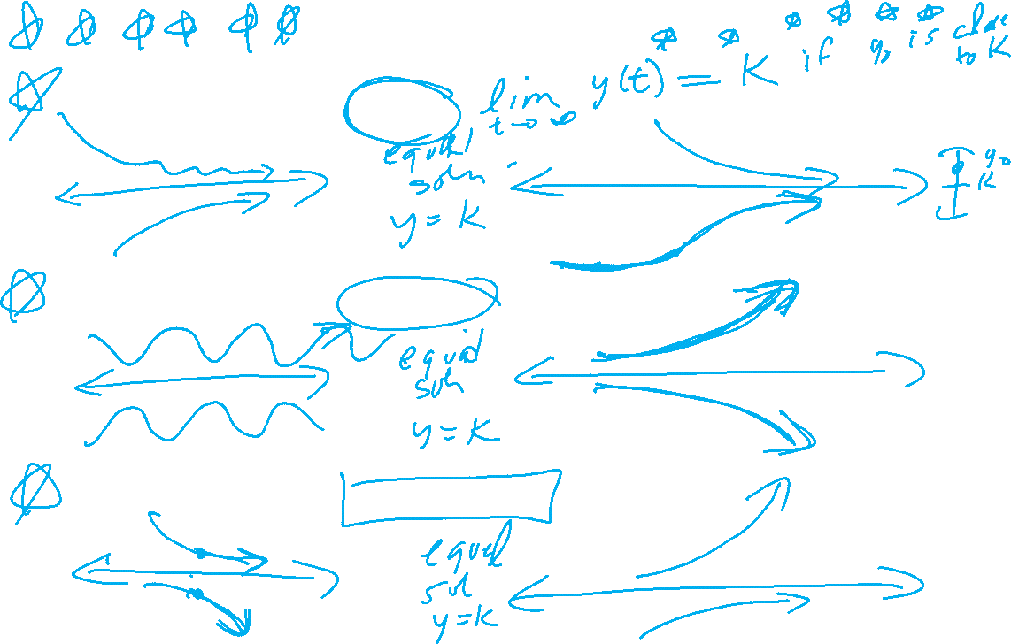

Slide 25
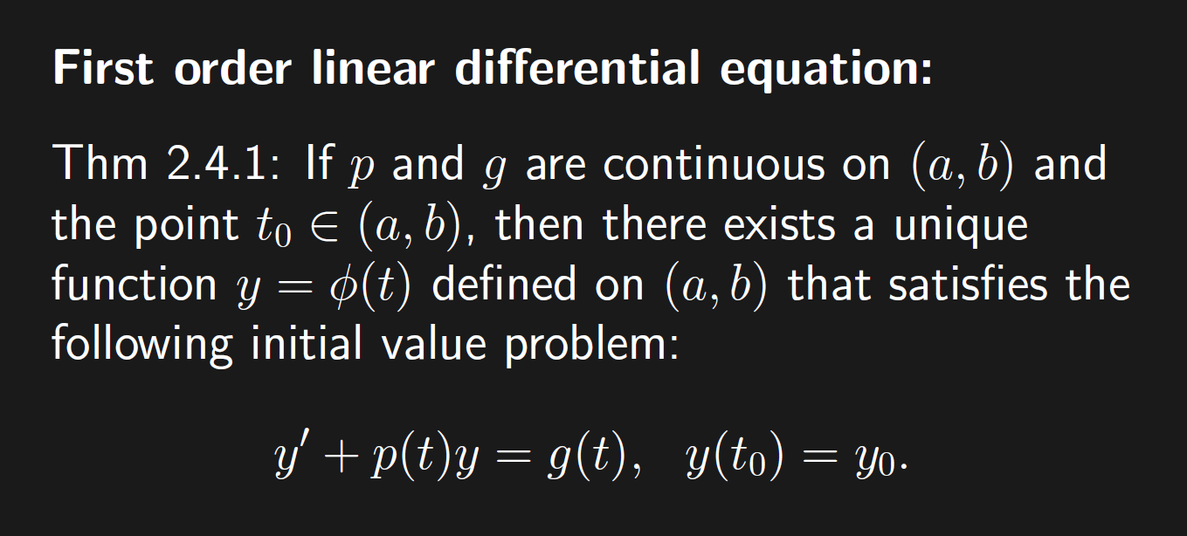

Slide 26
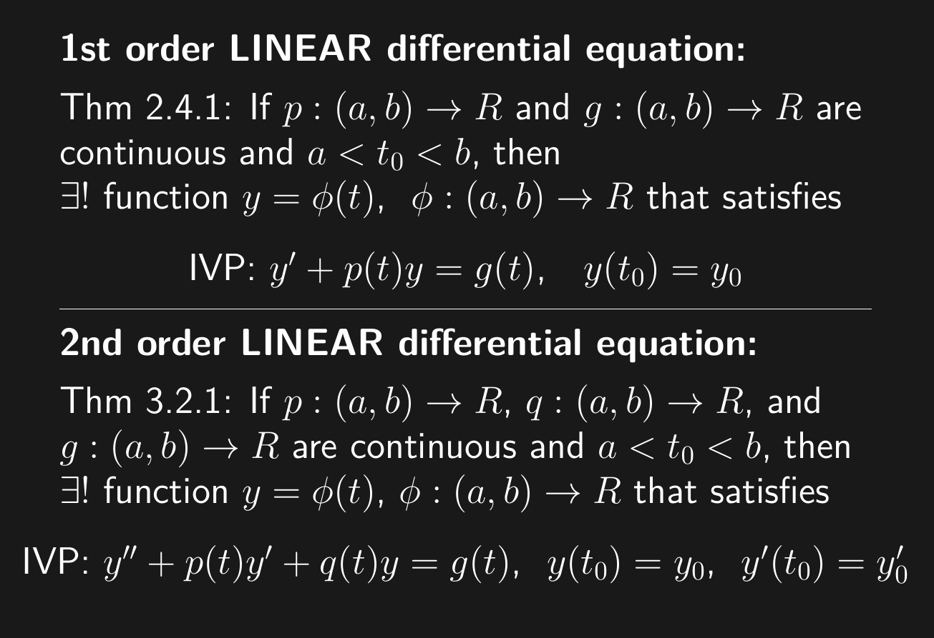

Slide 27
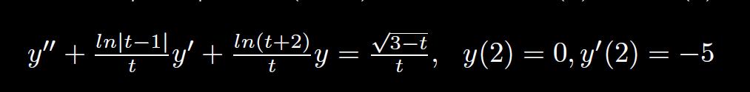
( )( )( )
-2 0 1 3
2
Thus unique solution exists to this IVP where the solution is defined on the interval (1, 3)

Slide 28
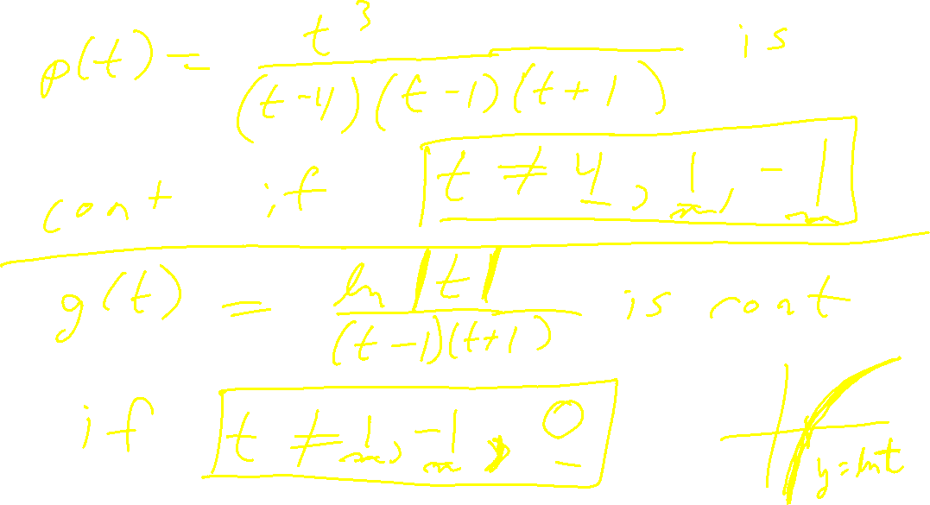

Slide 29
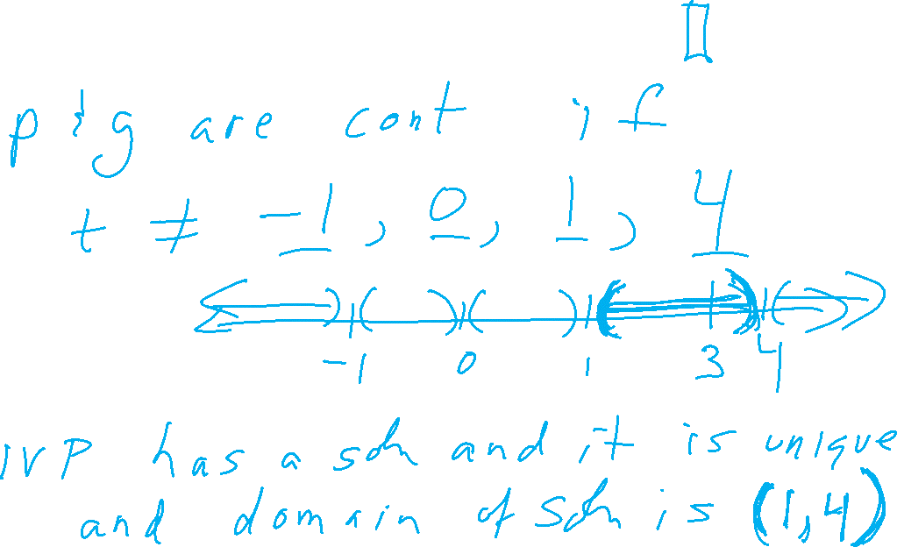

Slide 30
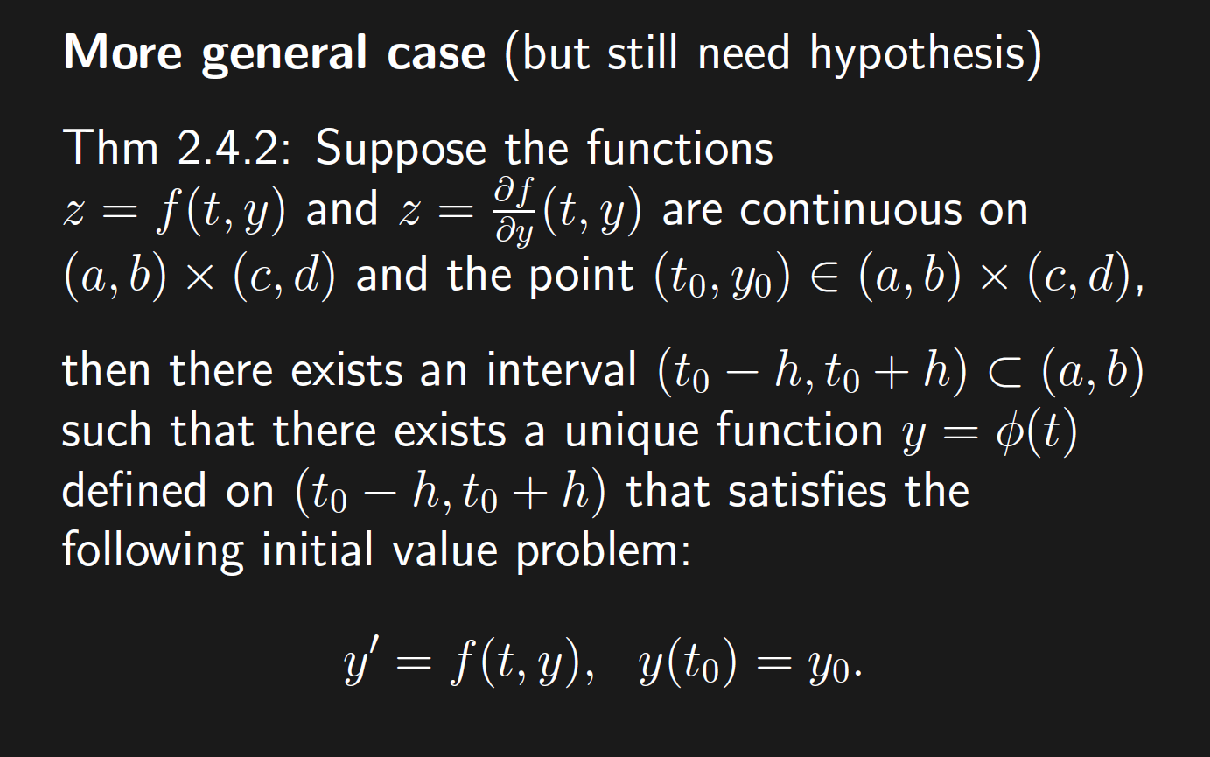
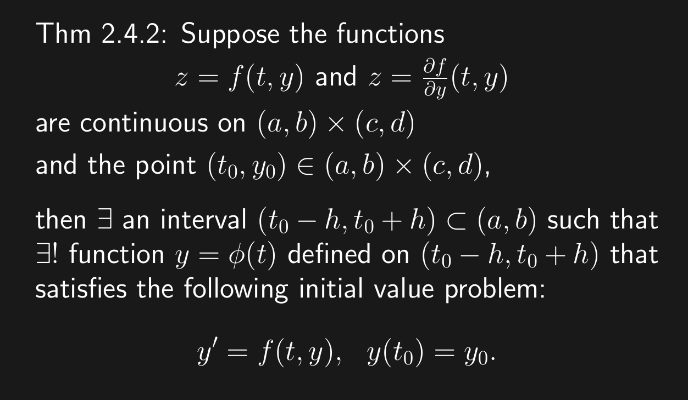
If DE is not linear, must solve IVP to find domain as this theorem does not give any information about the domain of the solution.

Slide 31
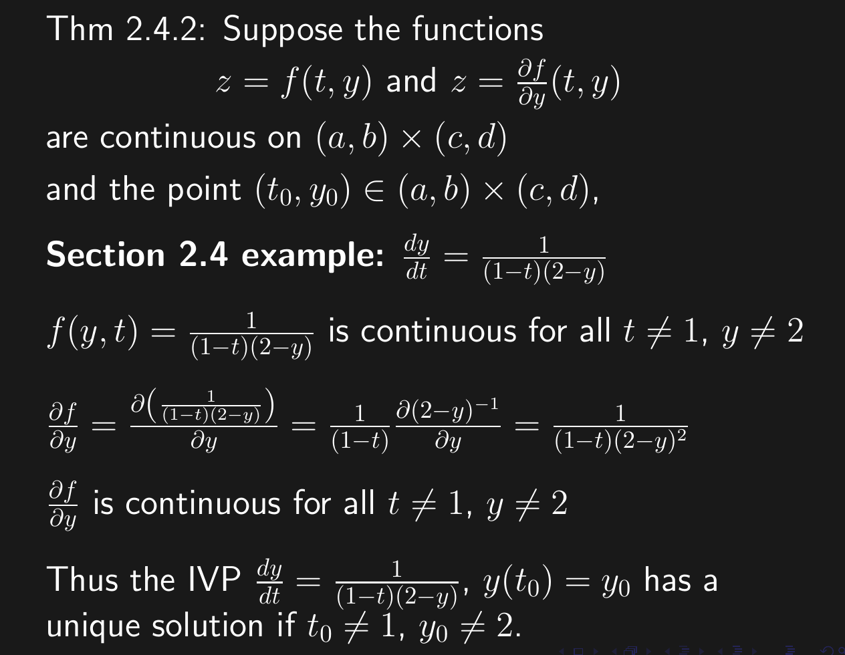
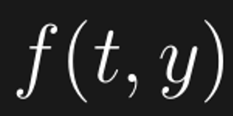
If DE is not linear, must solve IVP to find domain as this theorem does not give any information about the domain of the solution.

Slide 32
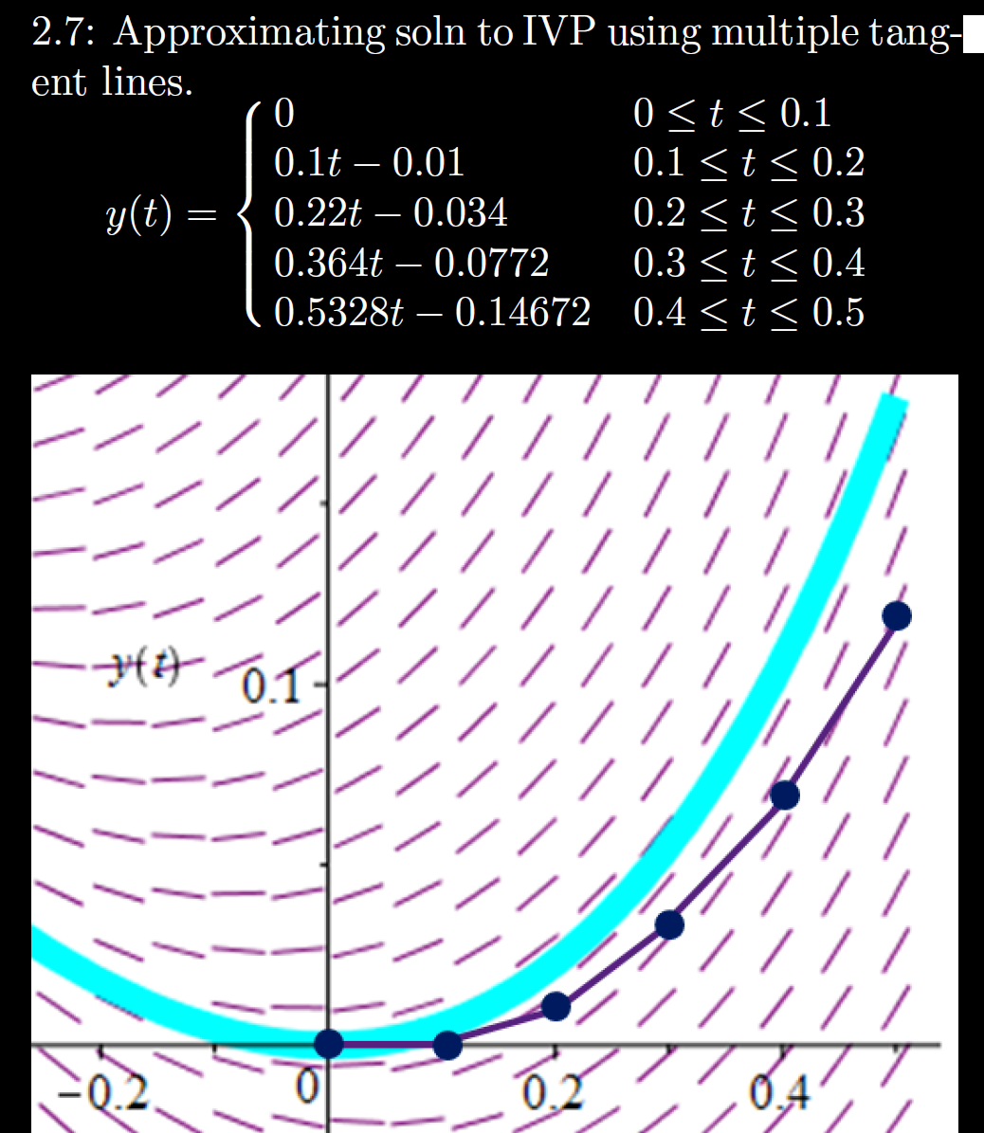
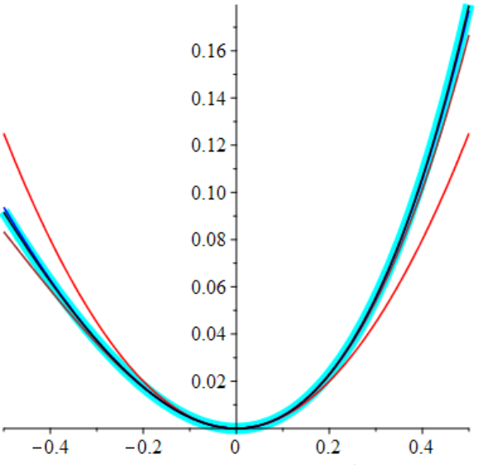



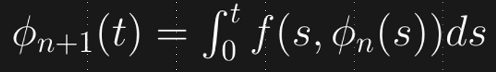


$y’ = f(t, y)$, $y(0)=0$
$$ϕ’ = f(t,ϕ)$$
h = Step size
= Δt = 0.1

Slide 33
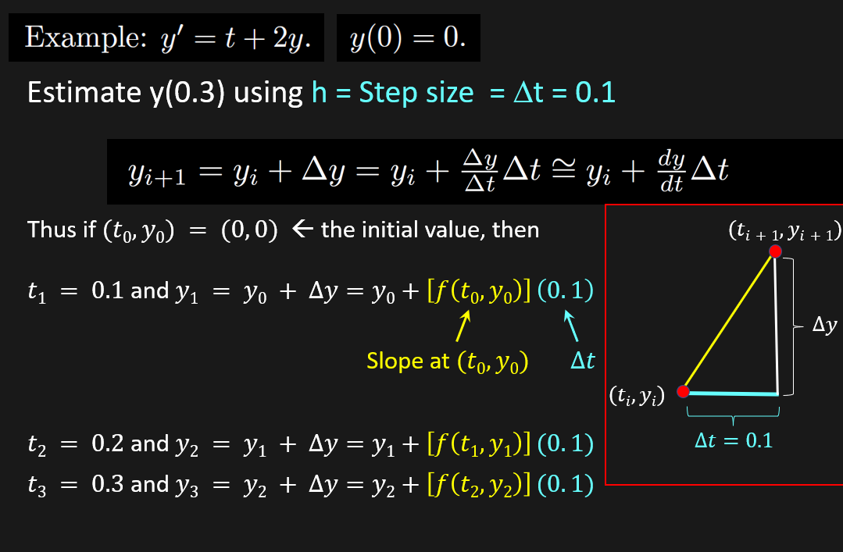

Slide 34
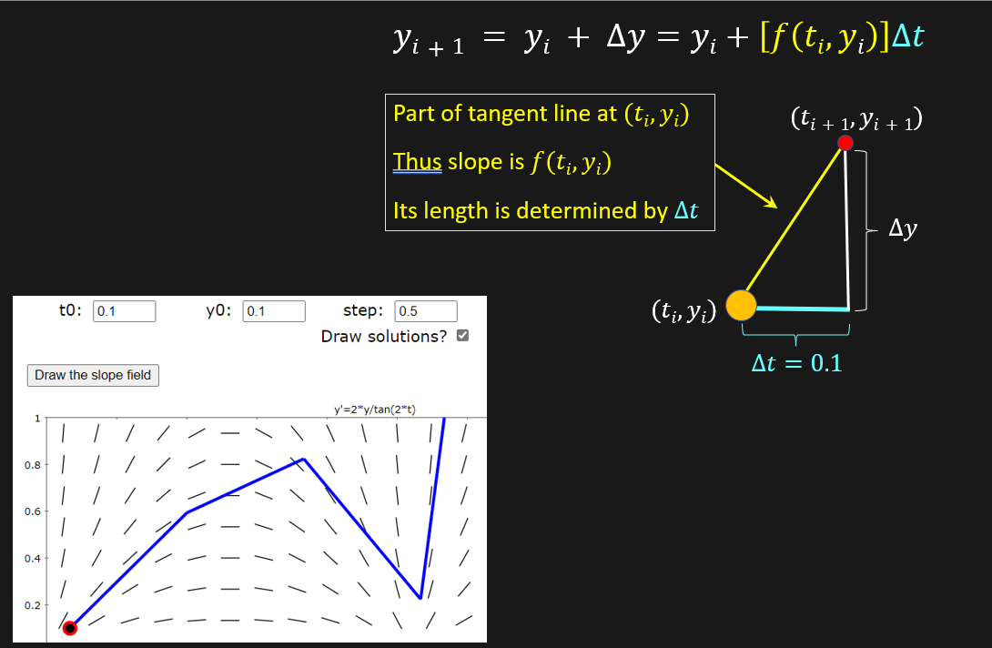

Slide 35
Note chapter 3 will appear on exam 1, exam 2, and the final exam. Learn it now!

Slide 36
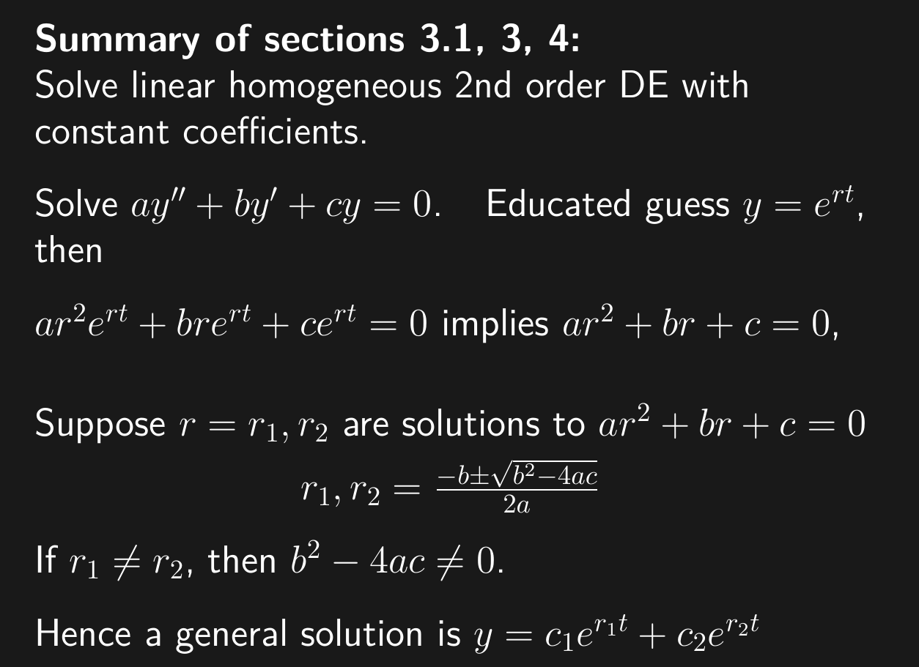

Slide 37
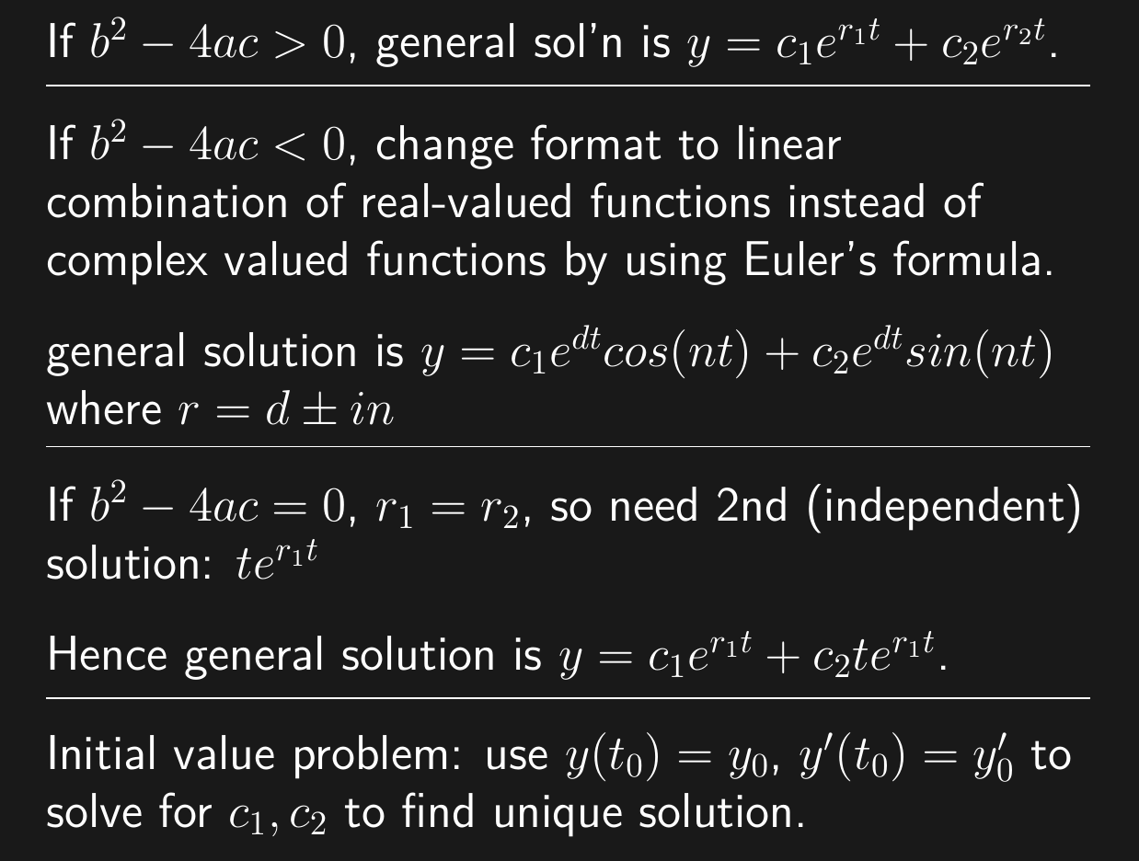
3.1
3.3
3.4

Slide 38
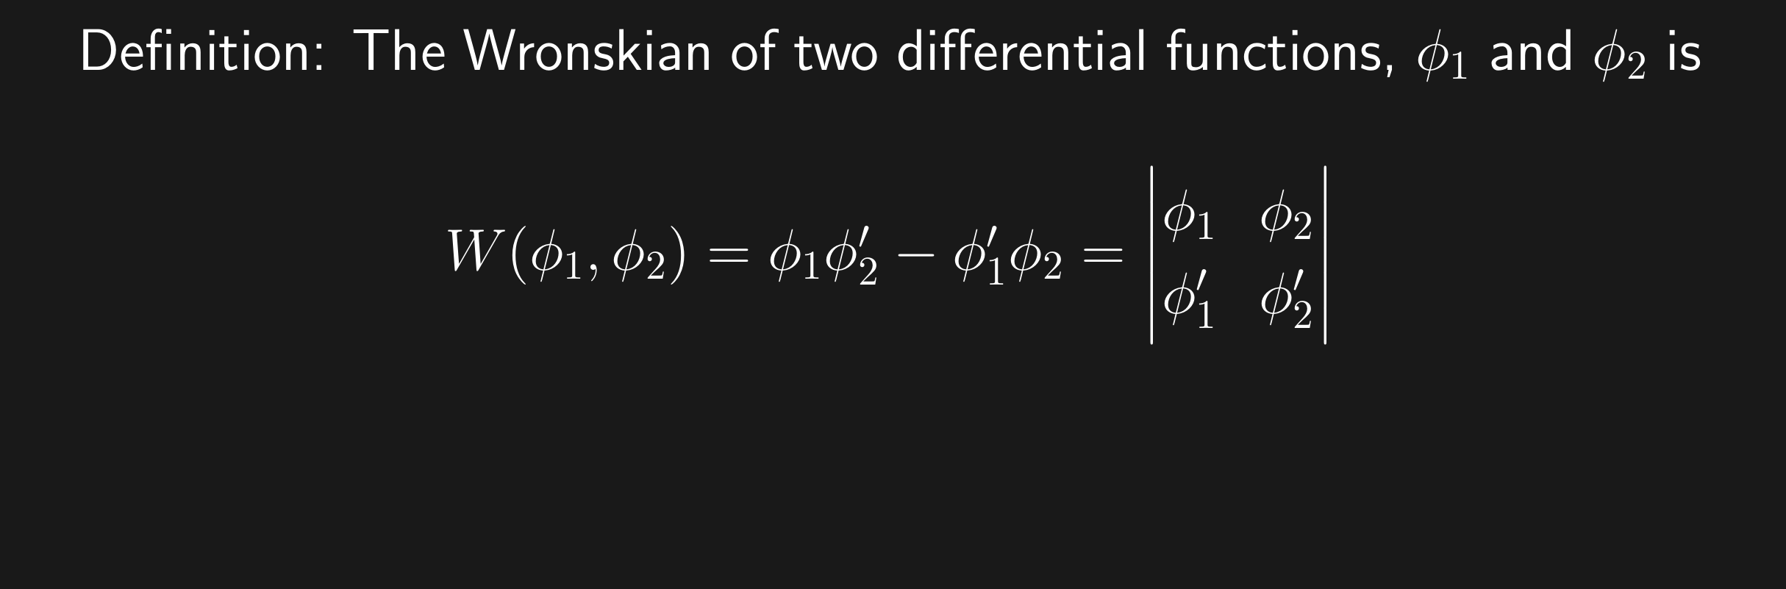
The Wronskian evaluated at t₀ is the determinant of the coefficient matrix used to solve for the constants c_{i} for the IVP y(t₀) = y₀, y'(t₀) = y_{1.}

Slide 39
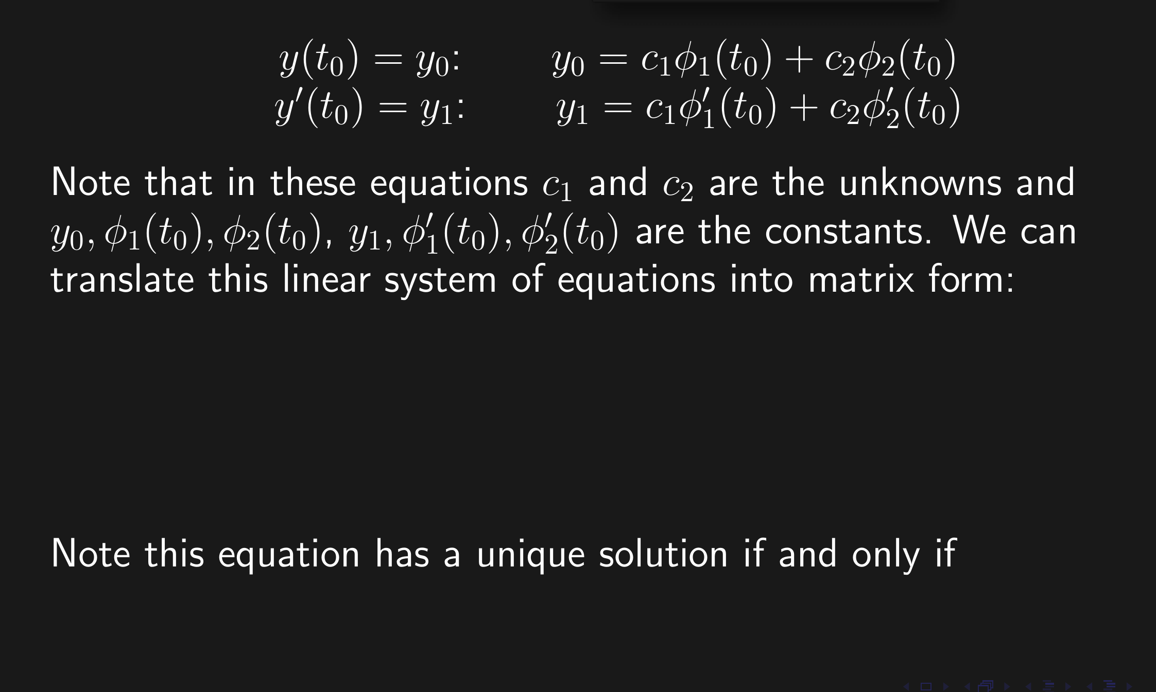
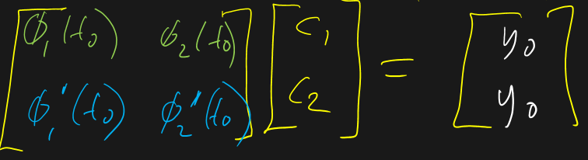

det $≠ 0$

Slide 40
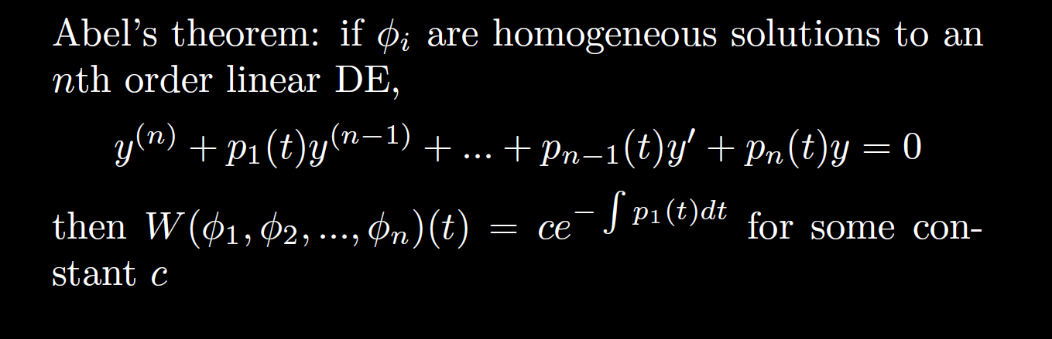

Slide 41
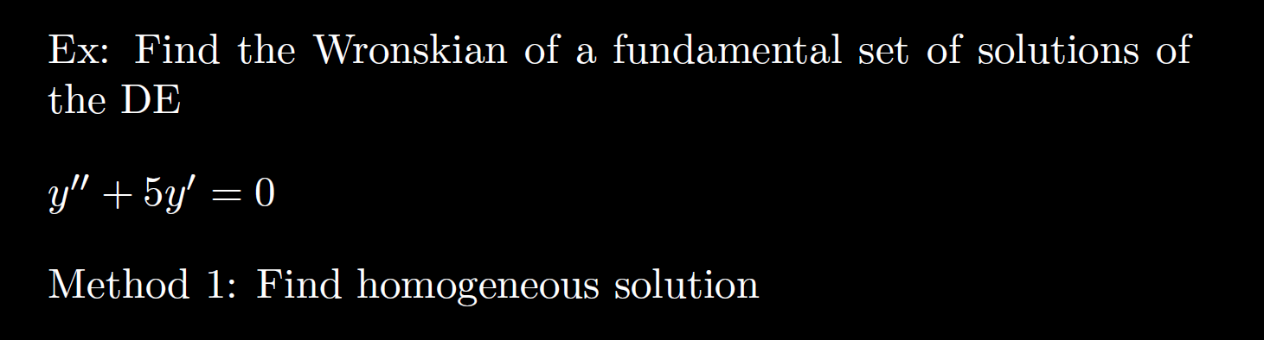


$$y’’ +5y’ +6y = 0$$
$$r^{2}+5r +6 = 0$$
$(r+2)(r+3) = 0$implies r = -2, -3
General solution: $y=c_{1}e^{−2t}+c_{2}ⅇ^{−3t}$
$$W\left(ⅇ^{−2t},ⅇ^{−3t}\right)=\left|\begin{matrix}ⅇ^{−2t} & ⅇ^{−3t} \\ {−2ⅇ}^{−2t} & {−3ⅇ}^{−3t}\end{matrix}\right| = −ⅇ^{−5t}$$

Slide 42
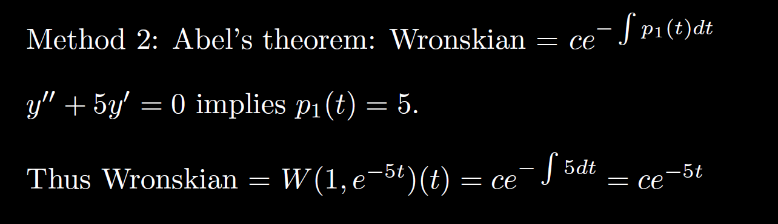


$$y’’ +5y’ +6y = 0$$
General solution: $y=c_{1}e^{−2t}+c_{2}ⅇ^{−3t}$
$$W\left(ⅇ^{−2t},ⅇ^{−3t}\right)=\left|\begin{matrix}ⅇ^{−2t} & ⅇ^{−3t} \\ {−2ⅇ}^{−2t} & {−3ⅇ}^{−3t}\end{matrix}\right| = −ⅇ^{−5t}$$

Slide 43

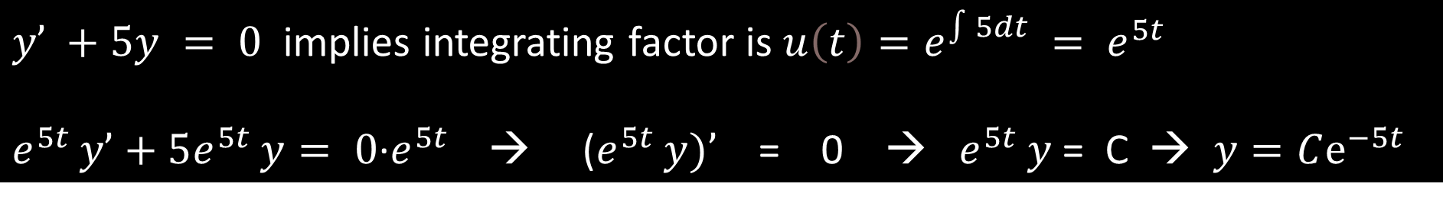
FYI: This works for any linear homogeneous differential equation including first order:
$$y’ +5y = 0$$
$y’ +5y = 0$ implies integrating factor is $u\left(t\right)=e^{\int{5dt} }= e^{5t }$
$e^{5t }y’+5e^{5t }y= 0$∙$e^{5t }$ → ($e^{5t }y)’$ = 0 → $e^{5t }y$ = C → $y=Cⅇ^{−5t}$
General solution: $y=Cⅇ^{−5t} W\left(ⅇ^{−5t} \right)=ⅇ^{−5t}$

Slide 45
( )( )( )
-2 0 1 3
2
Thus unique solution exists to this IVP where the solution is defined on the interval (1, 3)

Slide 46
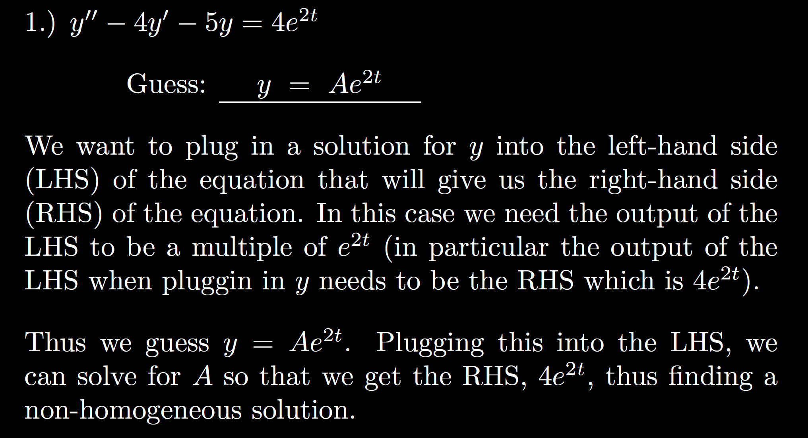
0

Slide 47
3.5

Slide 48

3.5

Slide 49

3.5

Slide 50

3.5

Slide 51

3.5

Slide 52
3.5

Slide 53

k
3.5
with undetermined coefficients

Slide 54
3.5

