Slide 1
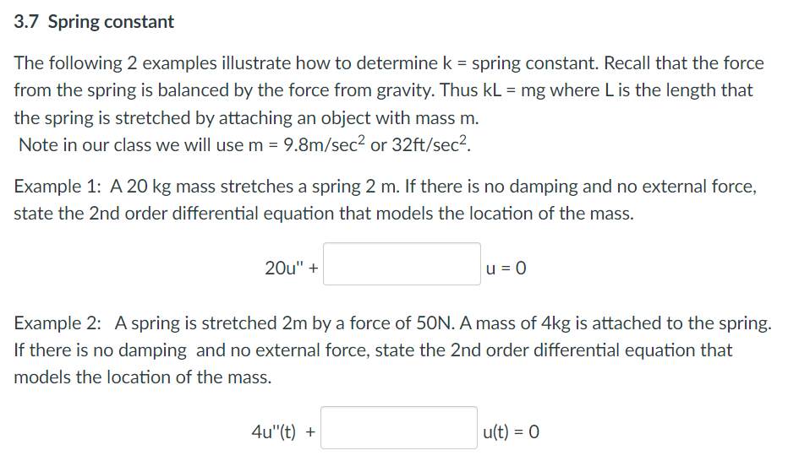

Slide 2
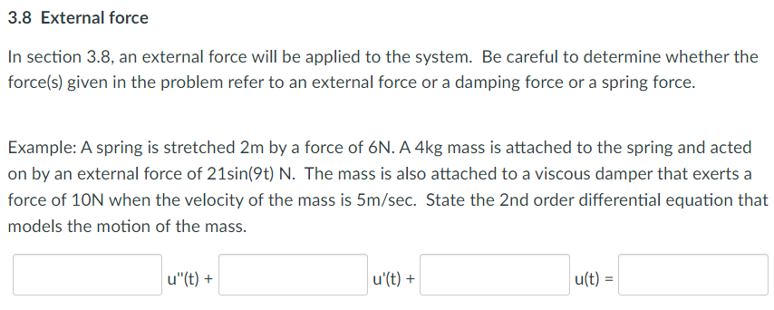

Slide 3
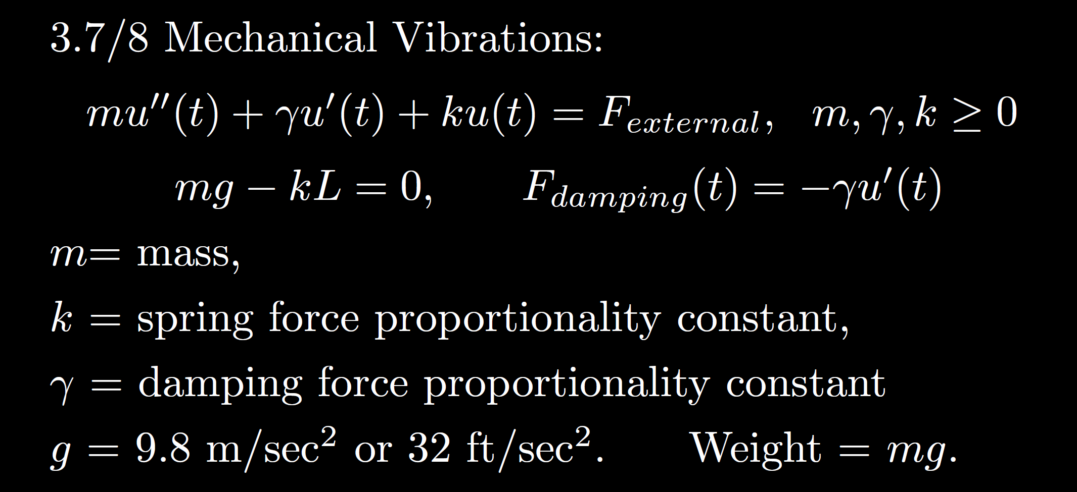
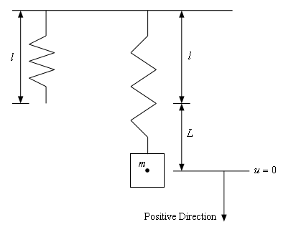
https://tutorial.math.lamar.edu/Classes/DE/Vibrations.aspx

Slide 4
3.3
3.4
3.1

Slide 5
3.3
3.4
3.1

Slide 6
zero
3.3
small
critical
3.4
large
3.1

Slide 7
No damping
3.3
Small damping
Critical damping
3.4
Large damping
3.1

Slide 8
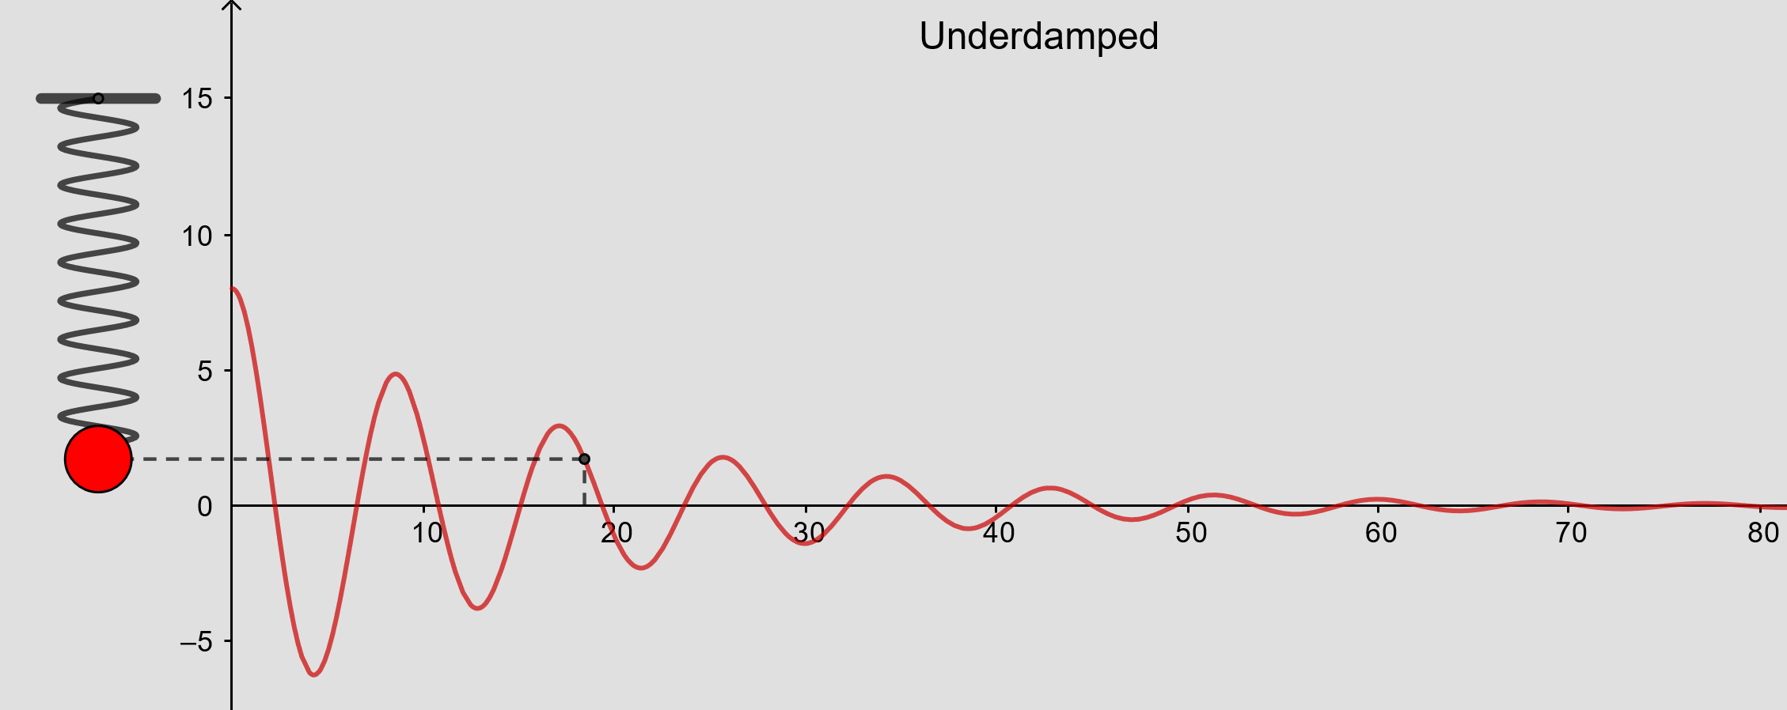
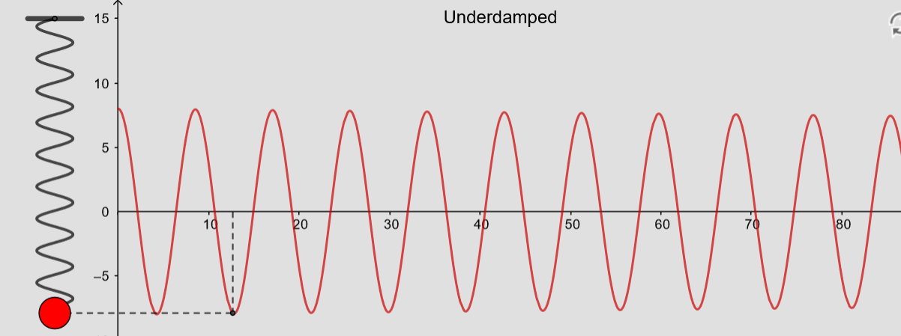
From https://www.geogebra.org/m/ZzKbkvnz
Note: Sign convention is opposite our convention

Slide 9
From https://www.geogebra.org/m/ZzKbkvnz
Note: Sign convention is opposite our convention
0.01

Slide 10
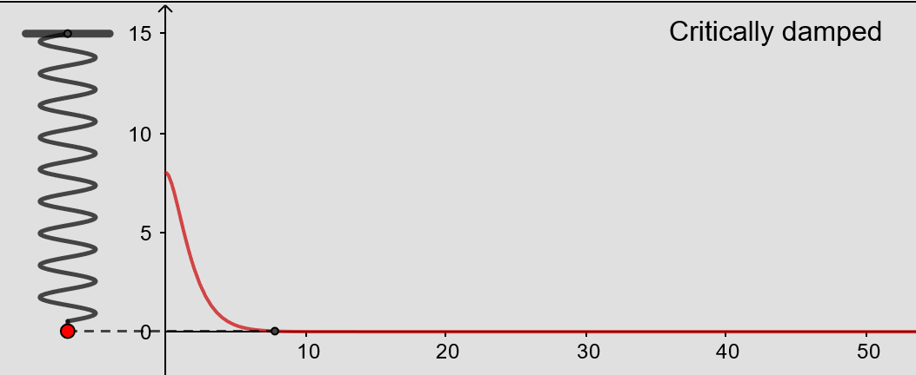
From https://www.geogebra.org/m/ZzKbkvnz
Note: Sign convention is opposite our convention

Slide 11
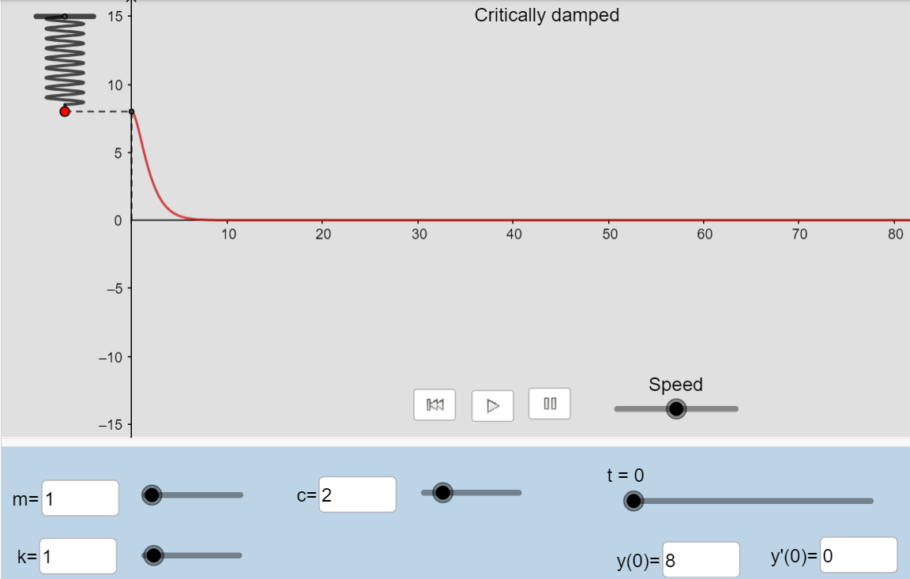
From https://www.geogebra.org/m/ZzKbkvnz
Note: Sign convention is opposite our convention

Slide 12
From https://www.geogebra.org/m/ZzKbkvnz
Note: Sign convention is opposite our convention
For 0 < t < 1,
$e^{r1t}$ > t $e^{r1t}$
For t > 1,
${ e}^{r1t}$ < t $e^{r1t}$

Slide 13
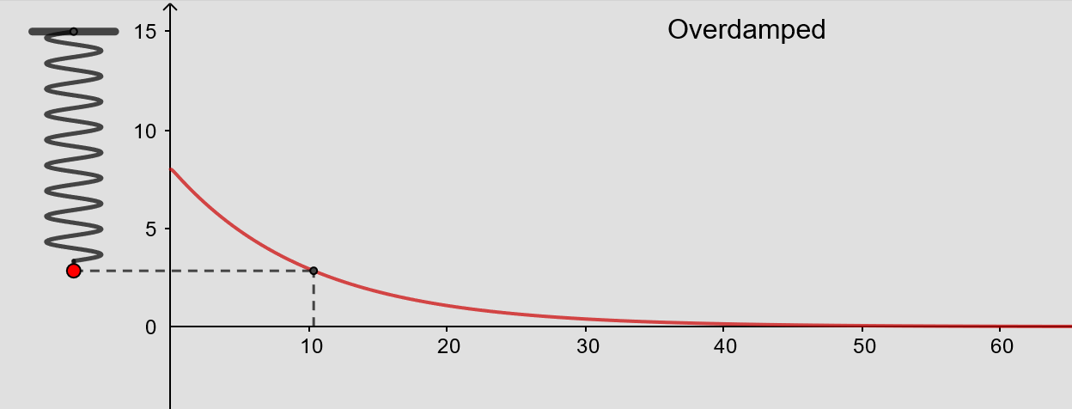
From https://www.geogebra.org/m/ZzKbkvnz
Note: Sign convention is opposite our convention

Slide 14
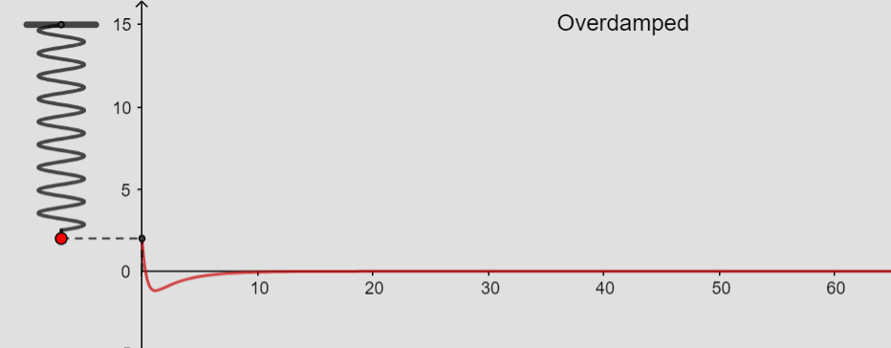
From https://www.geogebra.org/m/ZzKbkvnz
Note: Sign convention is opposite our convention
Initial behavior depends on initial conditions
Long-term behavior:
u(t) → 0
as t → ∞

Slide 15
No damping
oscillation
3.3
Small damping
oscillation w/decreasing amplitude
Critical damping
3.4
No oscillation
Large damping
3.1
No oscillation

Slide 16
Overdamped
3.1
3.3
Underdamped or no damping if d = 0
3.4
Critically damped

Slide 17
is the steady state response when

