Slide 1
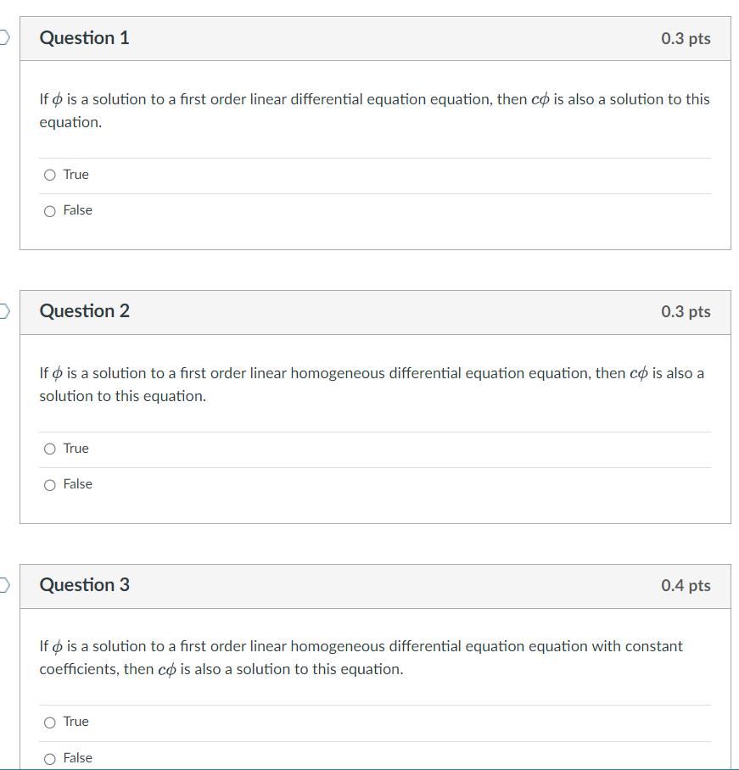

Slide 2
General solution of 2nd order Linear Homogenous DE is a linear combination of 2 linearly independent functions (which are solutions). If coefficients are constants:
3.1
3.3
3.4

Slide 3
Slope at (t₀, y₀) is y₀
(t₀, y₀)
Example: y’’ – 8y’ + 15y = 0, y(t₀) = a, y’(t₀) = b

Slide 5
det $≠ 0$

Slide 6
The Wronskian evaluated at t₀ is the determinant of the coefficient matrix used to solve for the constants c_{i} for the IVP y(t₀) = y₀, y'(t₀) = y_{1.}

Slide 16
Recall from matrix algebra that Ax = b is a homogeneous equation iff b = 0.
Suppose A has 2 free variables. Then the general solution to the homogenous matrix equation Ax = 0 will be of the form
x =c₁v₁ + c₂v₂.

