Slide 1
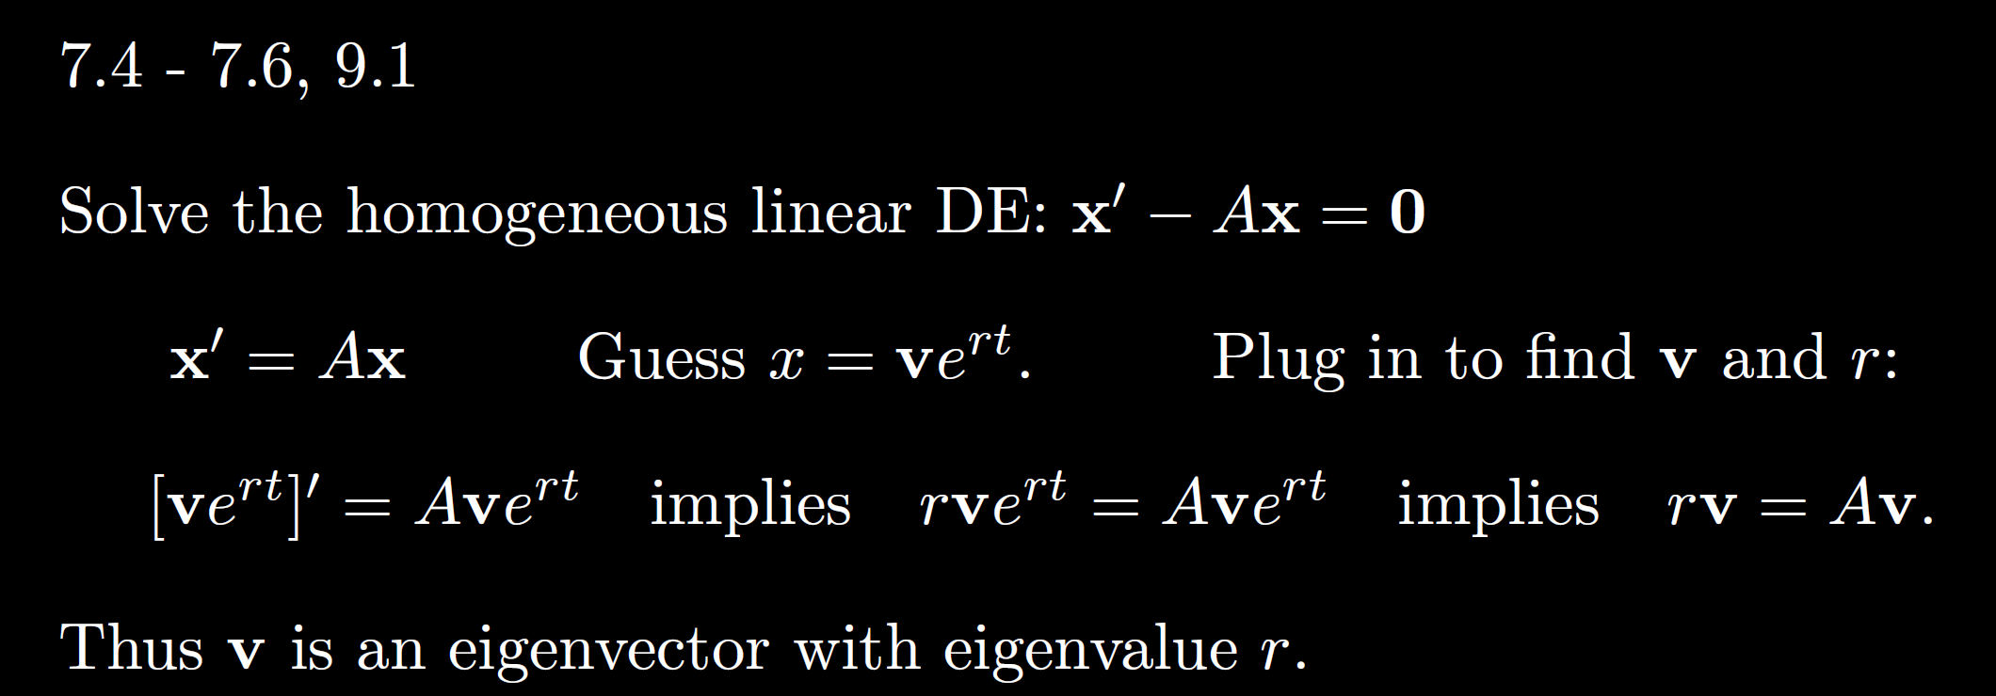
Solving a system of differential equations

Slide 2
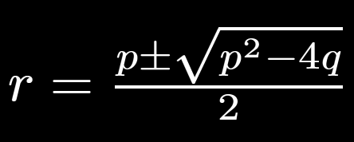
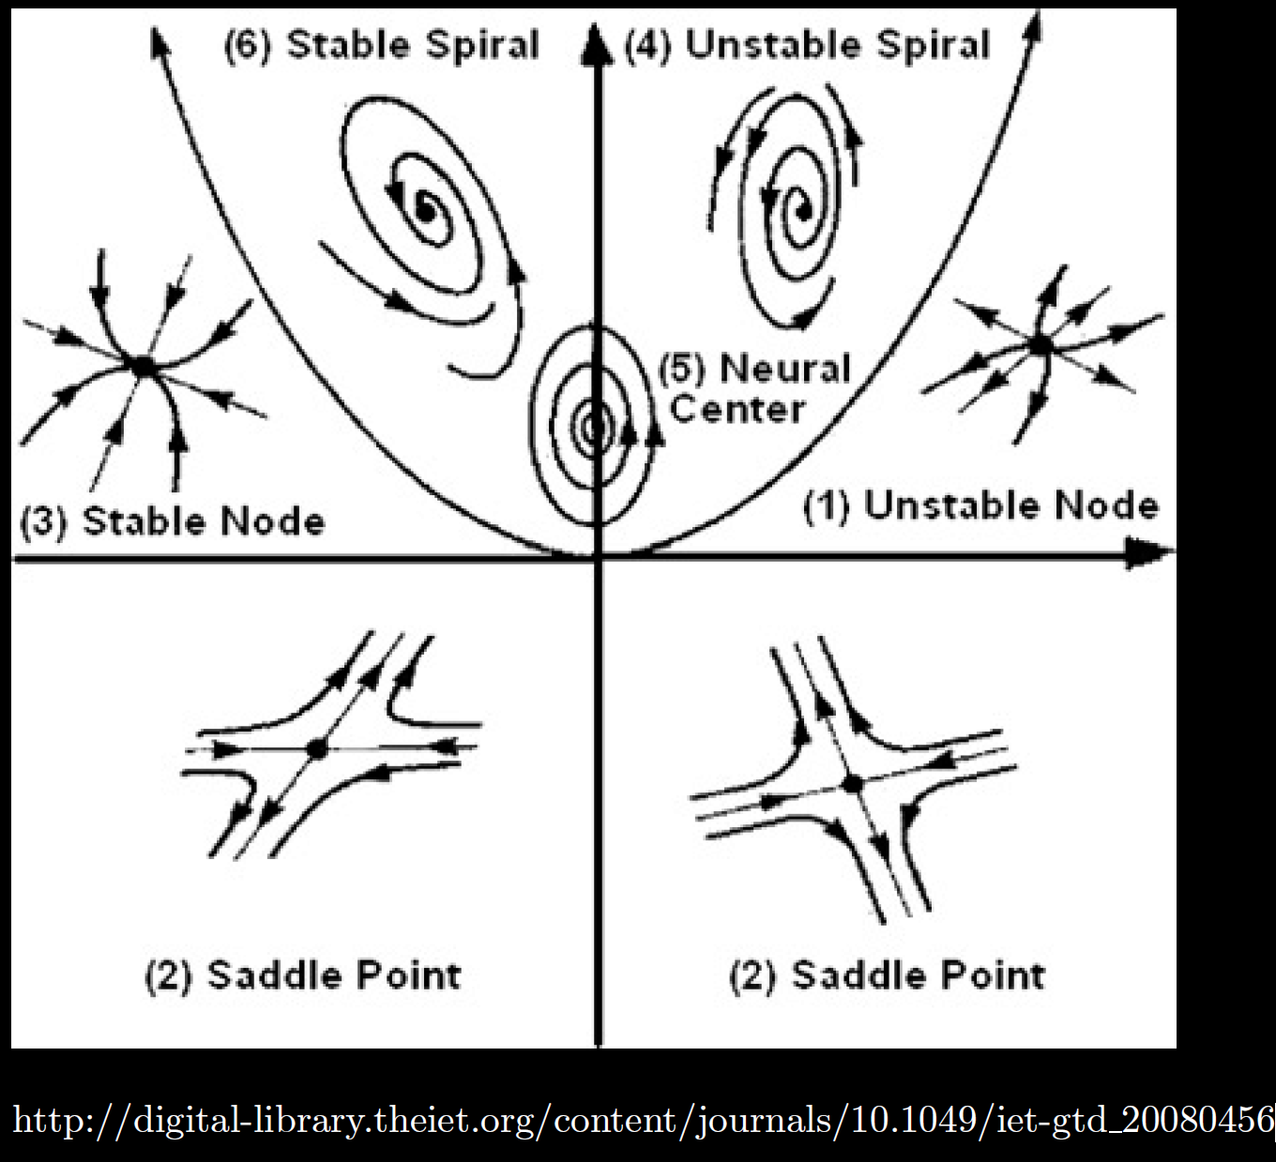

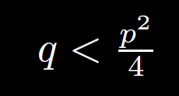

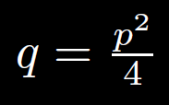

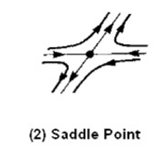
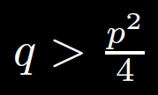

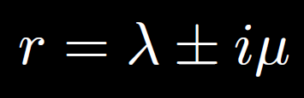
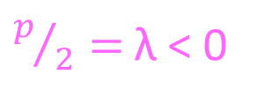
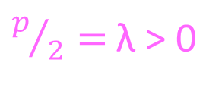
$p/2=$λ < 0
q
$p/2=$λ > 0
Complex roots
2 positive
eigenvalues
2 negative
eigenvalues
Two real roots
p
Repeated roots
q < 0 implies
1 positive and
1 negative
eigenvalue
Two complex roots
Unstable

Slide 3
Center is stable, but not asymptotically stable
Asymptotically stable
Just need one positive expo-nential for
Unstable

Slide 4
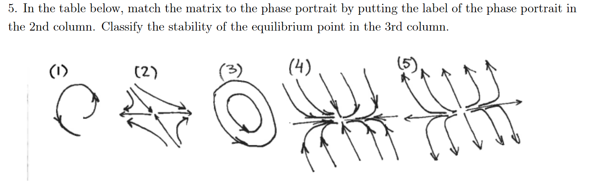
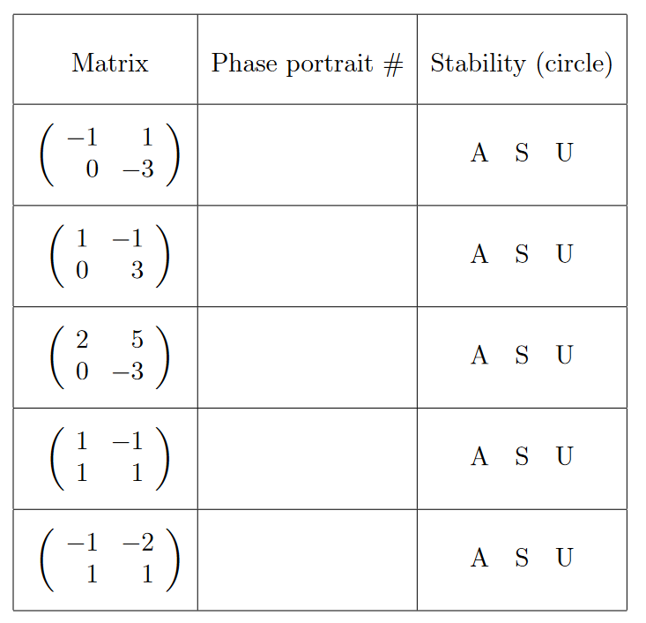
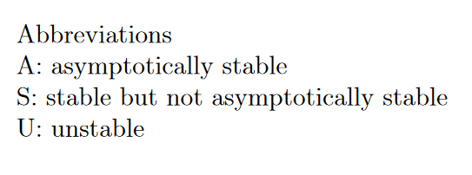
Ch 9
Answer depends only on the eigenvalues

Slide 5
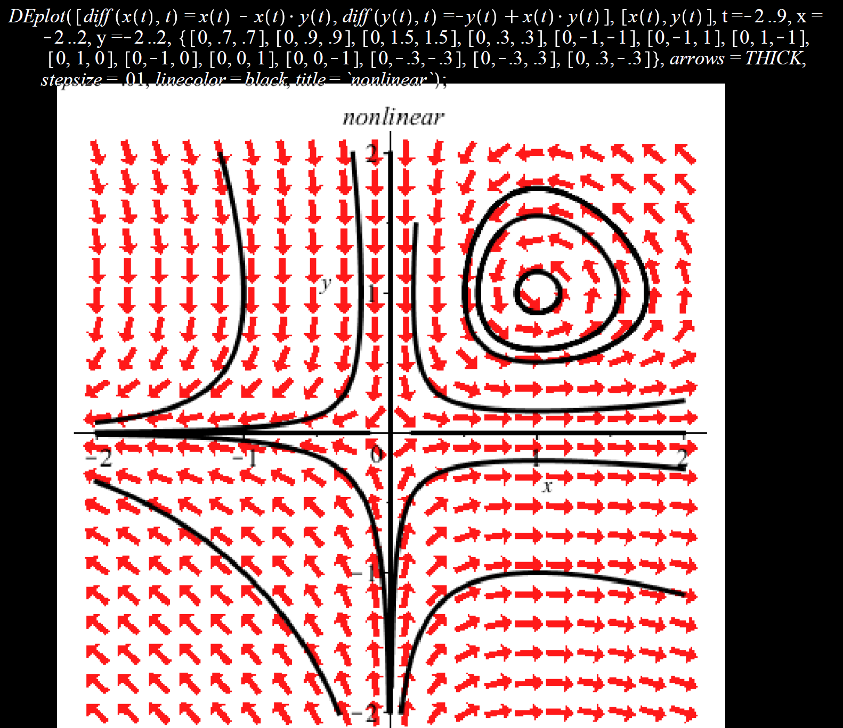
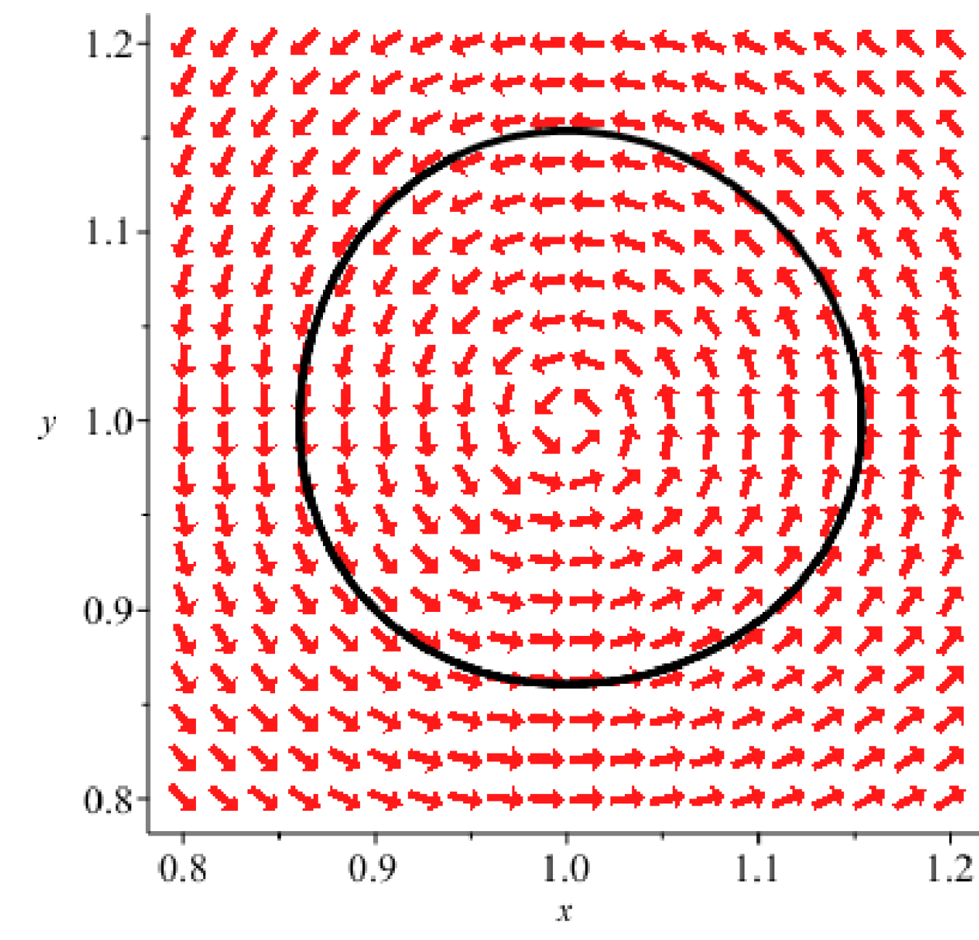
Locally can be approximated by a stable center
Locally can be approximated by an unstable saddle
Nonlinear system of differential equations can be locally approximated by linear homog DE x’ = Ax

Slide 6

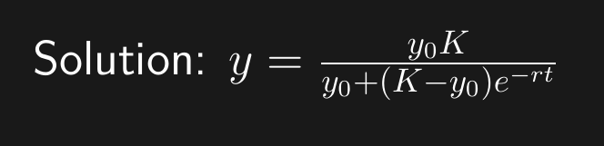
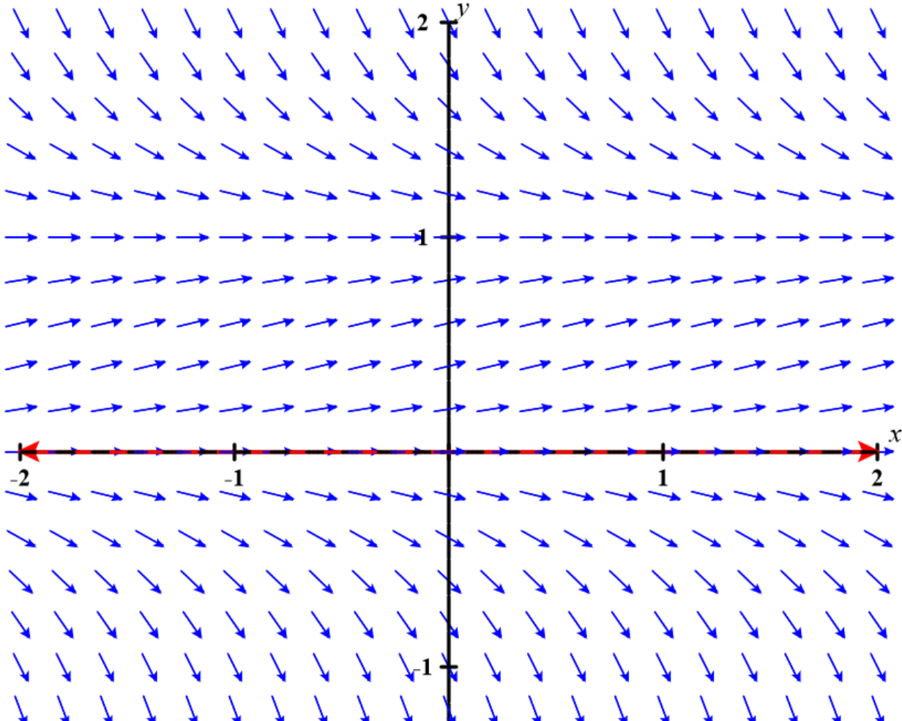
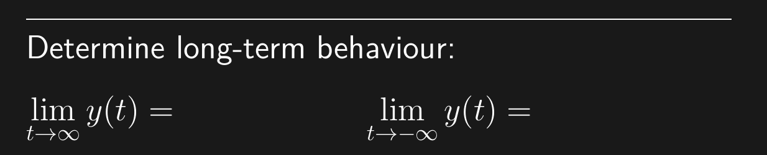
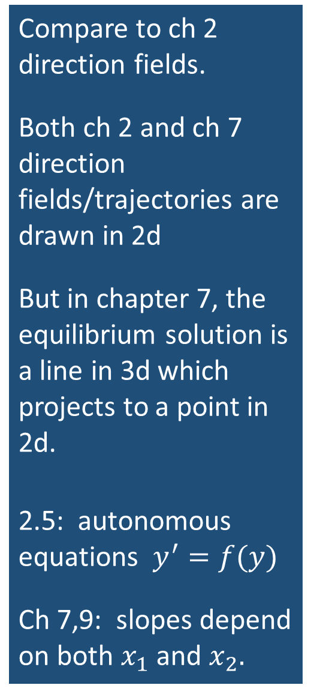
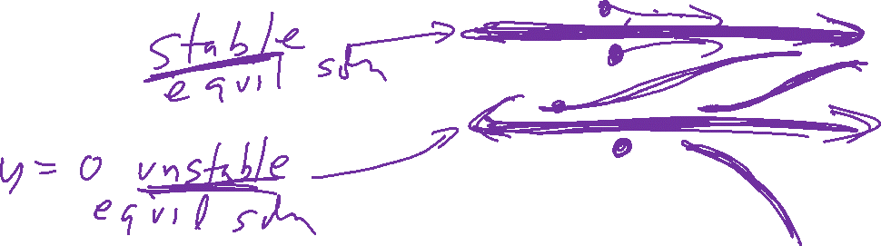
Compare to ch 2 direction fields.
Both ch 2 and ch 7 direction fields/trajectories are drawn in 2d
But in chapter 7, the equilibrium solution is a line in 3d which projects to a point in 2d.
2.5: autonomous equations $y^{′}=f(y)$
Ch 7,9: slopes depend on both $x_{1}$ and $x_{2}.$
https://c3d.libretexts.org/DirectionField/index.html

Slide 7
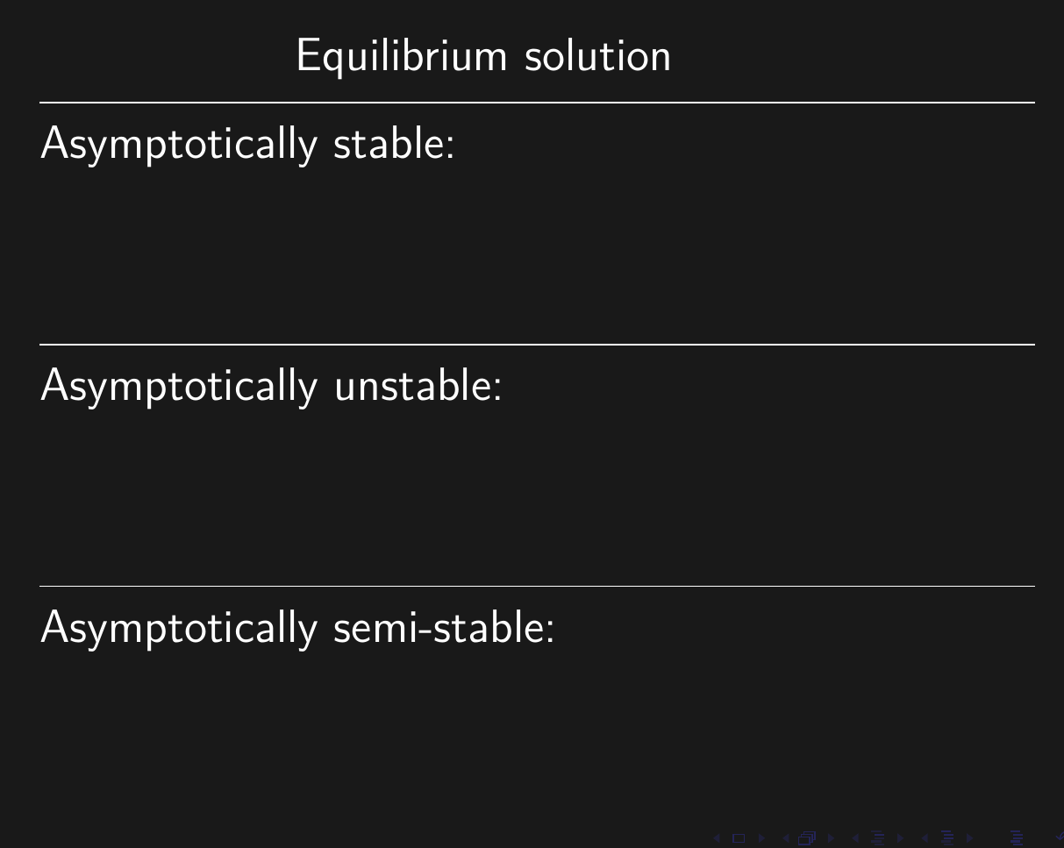
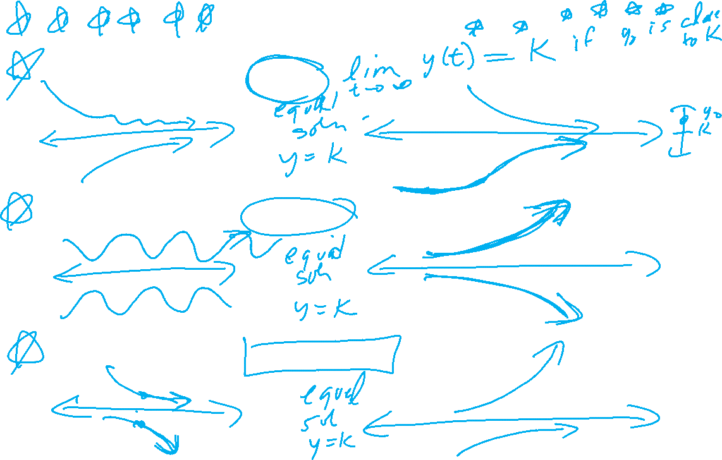
Ch 2

Slide 8
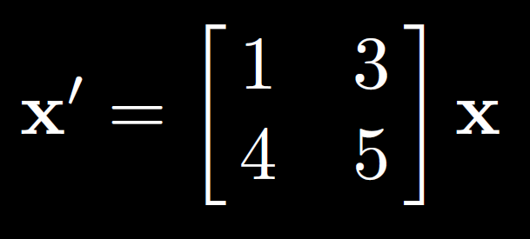
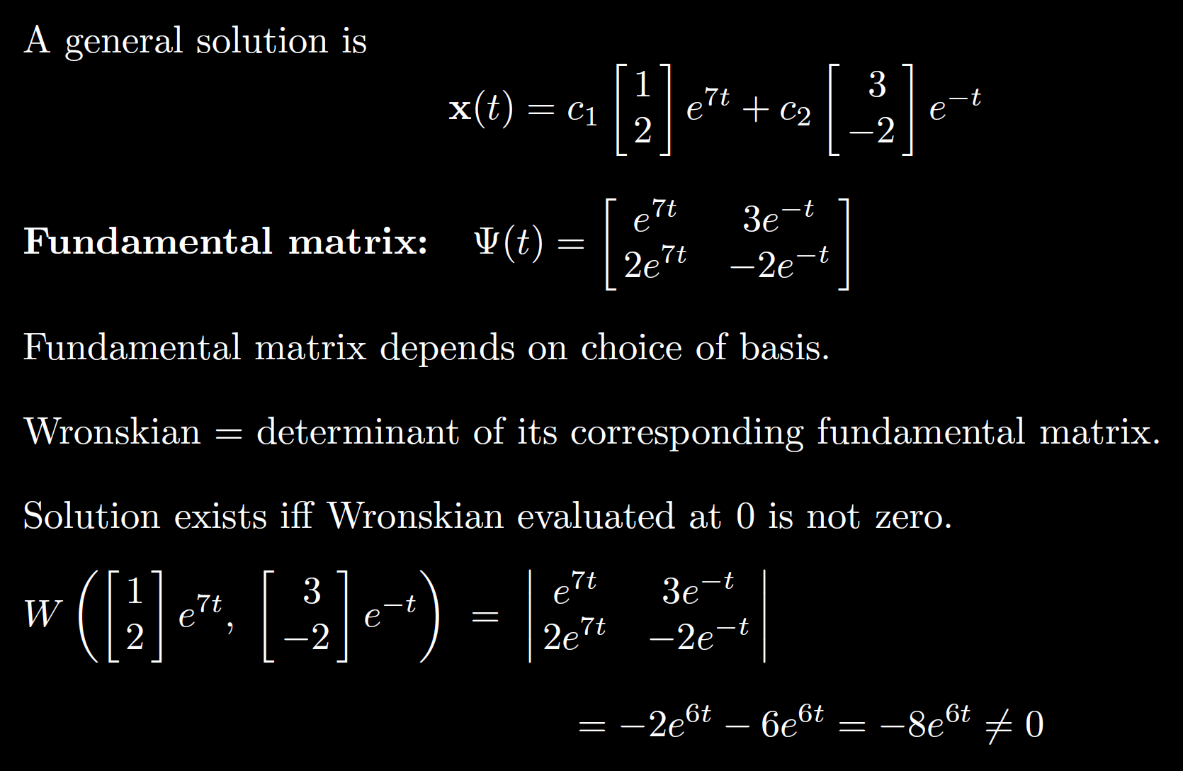
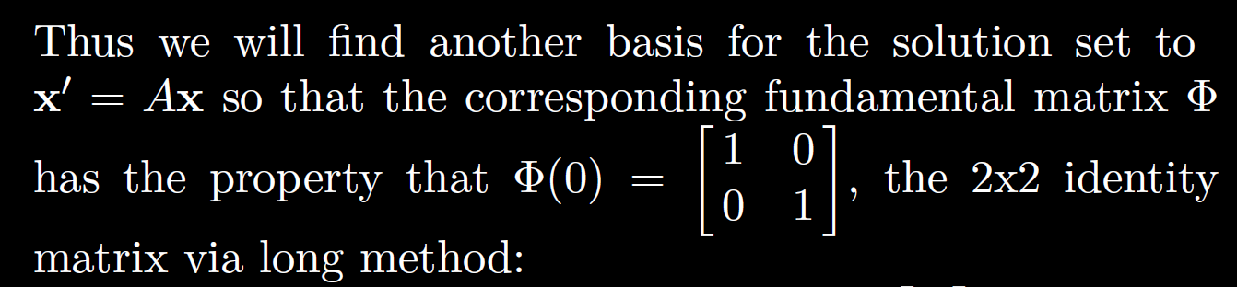
7.7:

Slide 9






















Slide 10
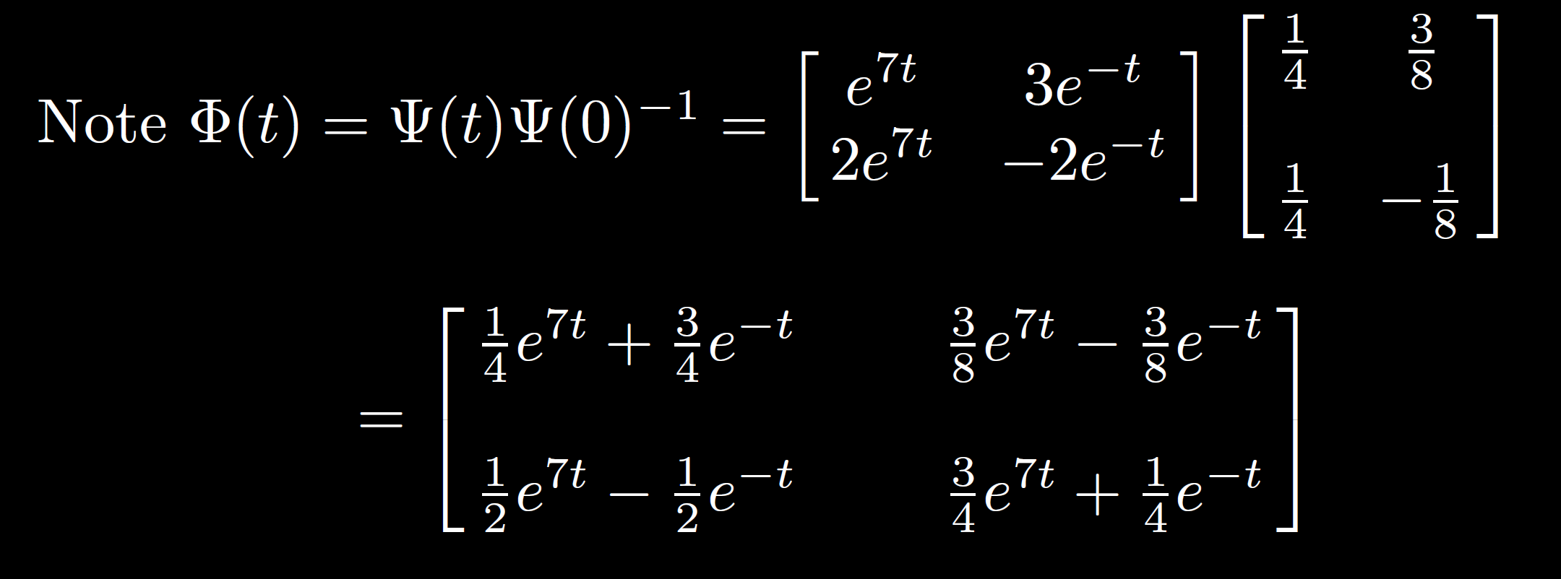

Slide 11
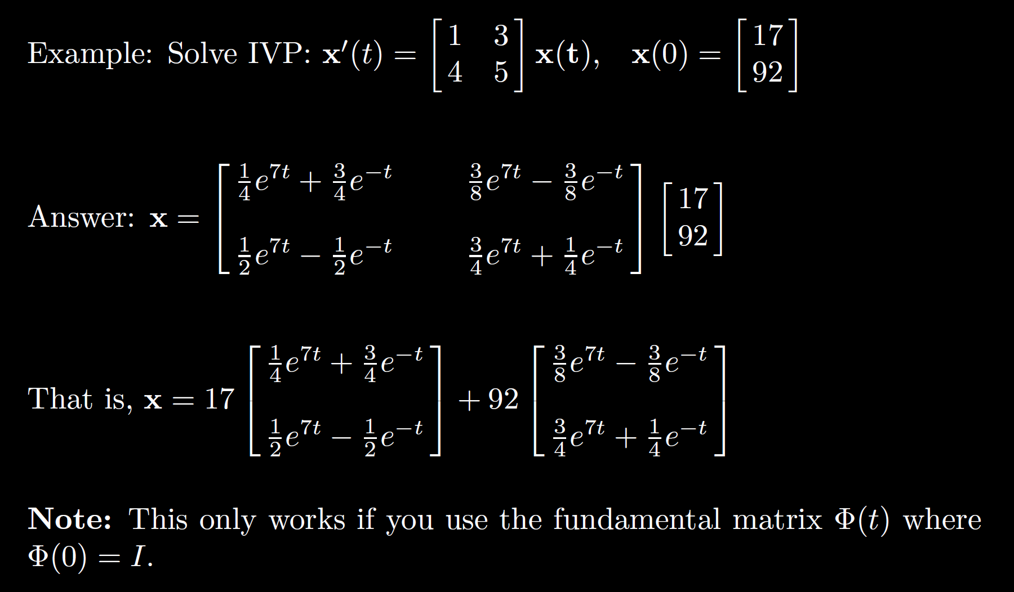

Slide 12

Plug in initial values to solve for constants $c_{1}$ and $c_{2}$
$$\left[\begin{matrix}17 \\ 92\end{matrix}\right]=c_{1}\left[\begin{matrix}1 \\ 2\end{matrix}\right]+c_{2}\left[\begin{matrix}3 \\ −2\end{matrix}\right]$$
etc.

Slide 13



Solving a differential equation
1st order linear with constant coefficients
Linear vs separable or both homogeneous: plug in e^{r}
a(t)y’ + b(t)y = g(t) non-homogeneous: Guess using
Ch 6: LaPlace Transform
Use linearity+formulas
Use integrating factor Separate variables to
to create product rule create 2 calculus 2 problems
Ch 3 and 4
homog: plug in e^{rt}
non-homog: Guess using undetermined coefficients
$$\int{f\left(y\right)ⅆy}=\int{g\left(t\right)ⅆt}$$

Slide 14

Be able to factor the following:
$$ar4 − b = 0$$
$$ar4+ br2+ c = 0$$
$$kar3+ kbr2+ nar + nb =kr2(ar + b)+ n\left(ar + b\right)$$
$= (kr2+ n)(ar + b)$

