Slide 1
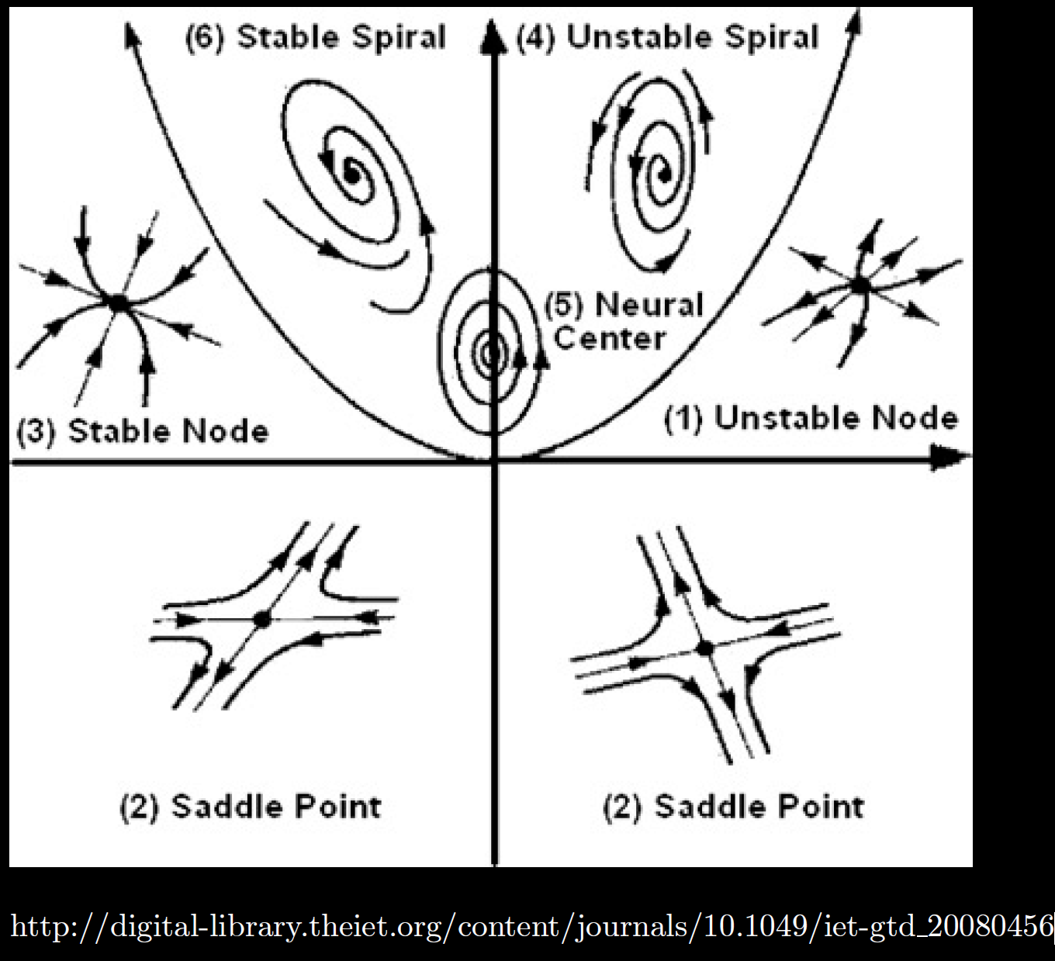
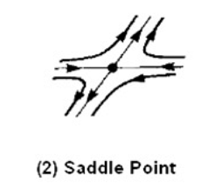
Center is stable, but not asymptotically stable
Asymptotically stable
Just need one positive expo-nential for
Unstable
Linear system of DEs:
x’ = Ax
Unstable

Slide 2
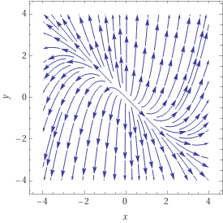
Solve x’ = $\begin{matrix}1 & 0 \\ 2 & 3\end{matrix}$ x
General solution: x = c₁ $\begin{matrix} 1 \\ −1\end{matrix}$ e^{t} + c₂ $\begin{matrix}0 \\ 1\end{matrix}$ e^{3t}

Slide 3
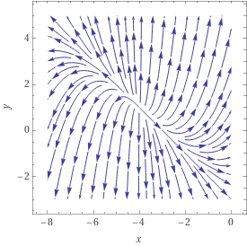
Linear homogeneous Linear non-homogeneous
Solve x’ = $\begin{matrix}1 & 0 \\ 2 & 3\end{matrix}$ x
Solve x’ = $\begin{matrix}1 & 0 \\ 2 & 3\end{matrix}$ x + $\begin{matrix}4 \\ 5\end{matrix}$
x = c₁ $\begin{matrix} 1 \\ −1\end{matrix}$ e^{t} + c₂ $\begin{matrix}0 \\ 1\end{matrix}$ e^{3t}
General solution: x = c₁ $\begin{matrix} 1 \\ −1\end{matrix}$ e^{t} + c₂ $\begin{matrix}0 \\ 1\end{matrix}$ e^{3t} + $\begin{matrix}−4 \\ 1\end{matrix}$

Slide 4
Homogeneous linear system of equations: x’ = Ax
Non-homogeneous linear system of equations: x’ = Ax + b
To find equilibrium solutions, set x’ = 0:
Suppose Aw + b = 0 for some constant vector w.
Then x = w is a solution to x’ = Ax + b : [w]’ = 0 = Aw + b
Thus x = w is an equilibrium solution.
To determine its type, translate to the origin (or graph):
Let u = x – w. Then x = u + w
(u + w)’ = A(u + w) + b
u ‘+ w’ = Au + Aw + b
u’ = Au

Slide 5
Solve x’ = $\begin{matrix}1 & 0 \\ 2 & 3\end{matrix}$ x + $\begin{matrix}4 \\ 5\end{matrix}$ = $\begin{matrix}1x1+0x2+4 \\ 2x1+3x2+5\end{matrix}$
General solution: x = c₁ $\begin{matrix} 1 \\ −1\end{matrix}$ e^{t} + c₂ $\begin{matrix}0 \\ 1\end{matrix}$ e^{3t} + $\begin{matrix}−4 \\ 1\end{matrix}$
After translating critical point to origin:
$$x′$$
$$x$$
x’ $≈$ $\begin{matrix}1 & 0 \\ 2 & 3\end{matrix}$ x

Slide 6
Center is stable, but not asymptotically stable
Asymptotically stable
Just need one positive expo-nential for
Unstable
Linear system of DEs:
x’ = Ax + b
Unstable

Slide 7
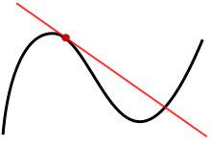
9.2
Calculus 1:
Linear approx. = tangent line

Slide 8
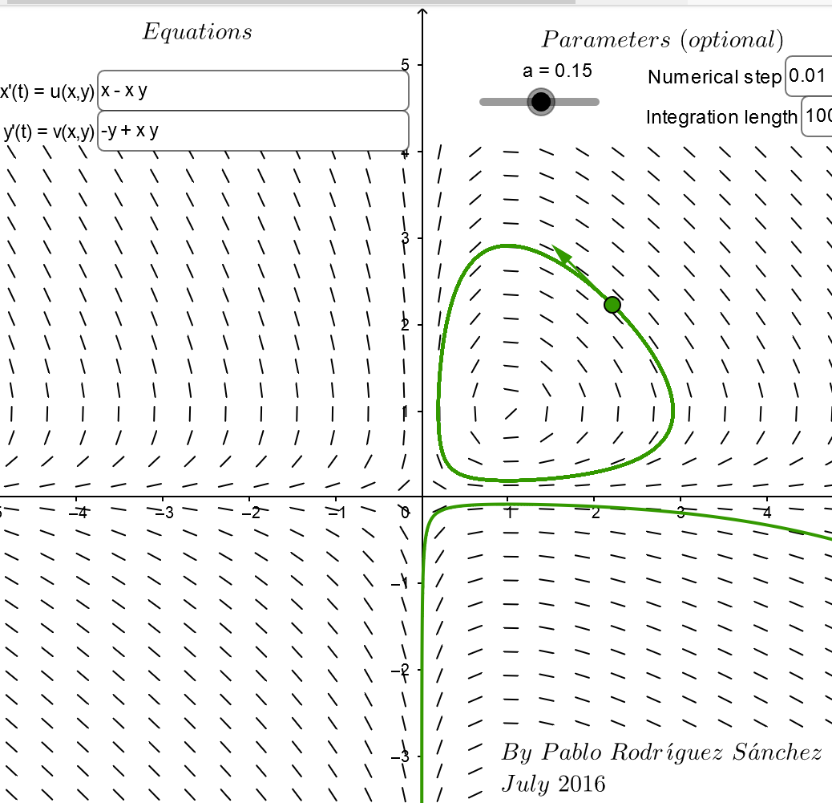
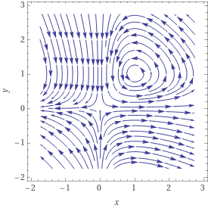
https://www.geogebra.org/m/abg8NJzF
https://www.wolframalpha.com/input/?i=streamplot+%7B+x+-+xy%2C++-y+%2B+xy%7D

Slide 9
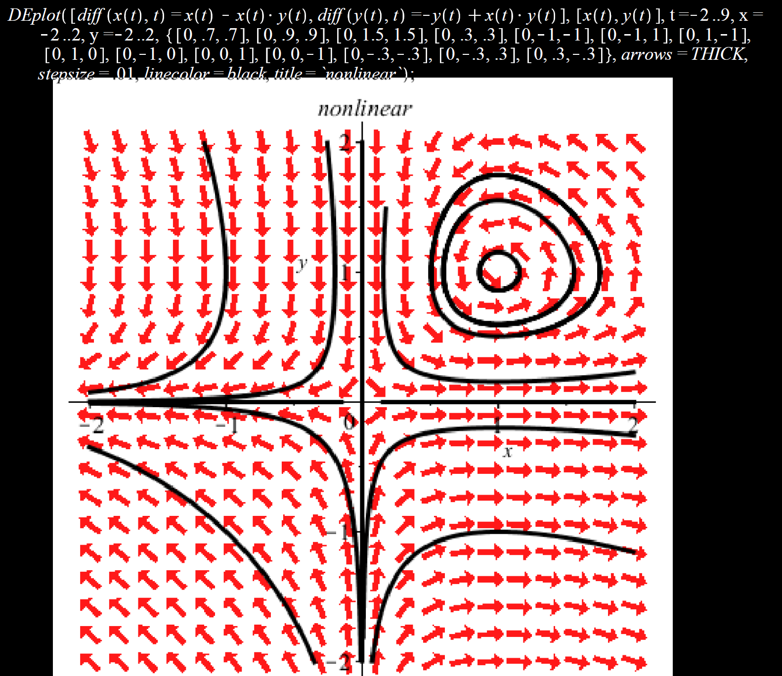
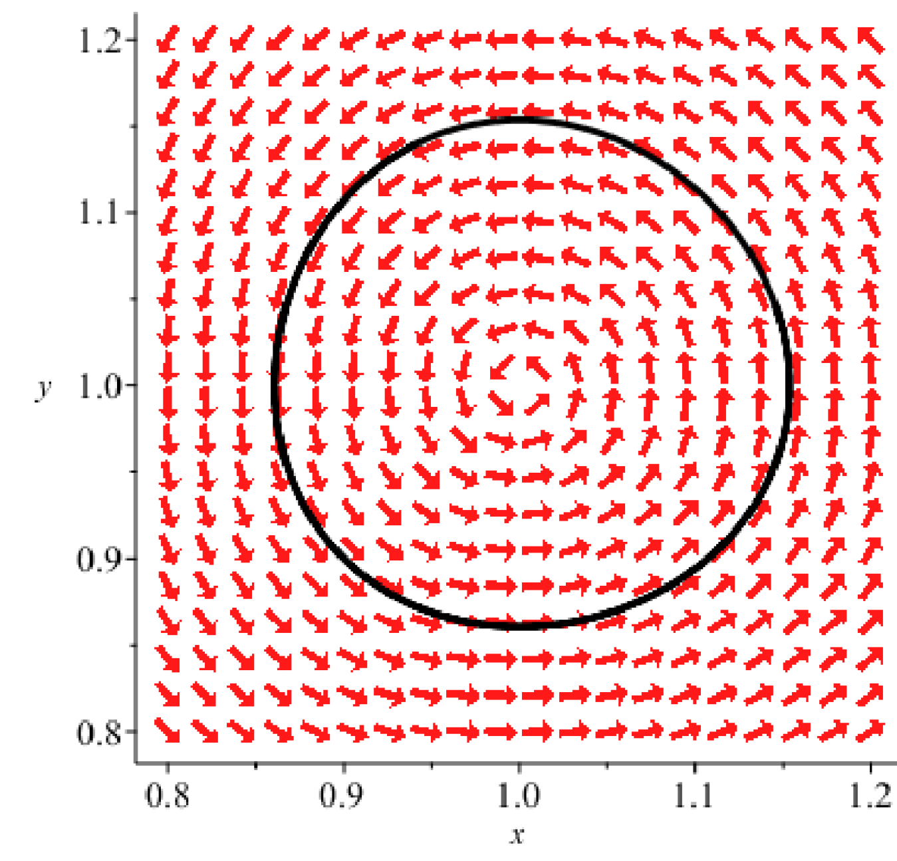
Locally can be approximated by a stable center
Locally can be approximated by an unstable saddle

Slide 11
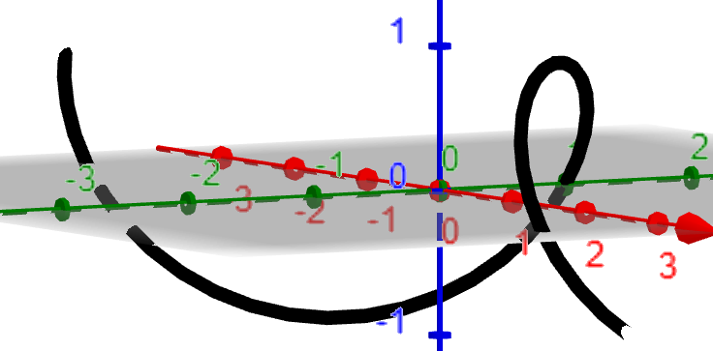
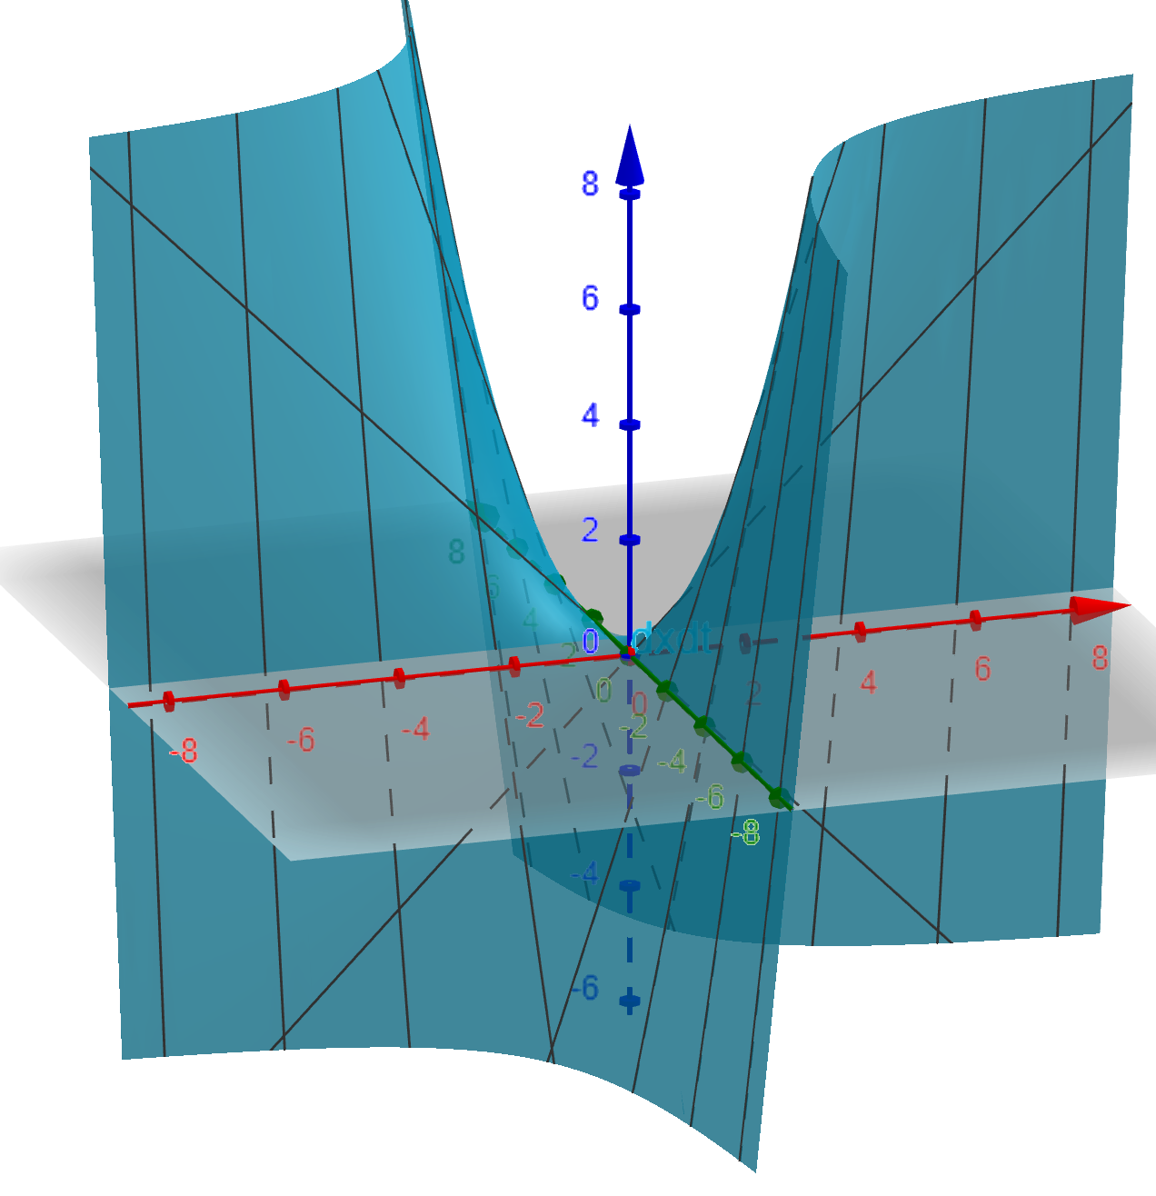
x
y
t
t

Slide 12
Locally can be approximated by a stable center
Locally can be approximated by an unstable saddle

Slide 16
We will determine stability of these critical points in 9.3
via linear approximations.
Can also determine graphically
(but be careful):

Slide 20
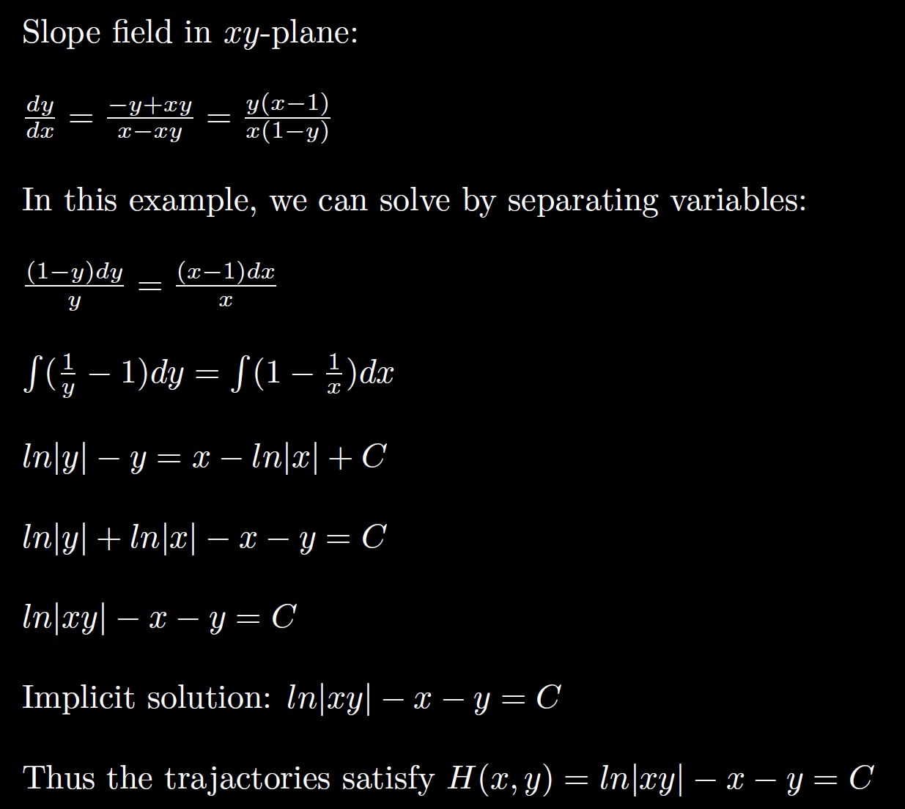
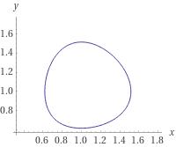
ln|xy| - x - y = -2.1

Slide 21
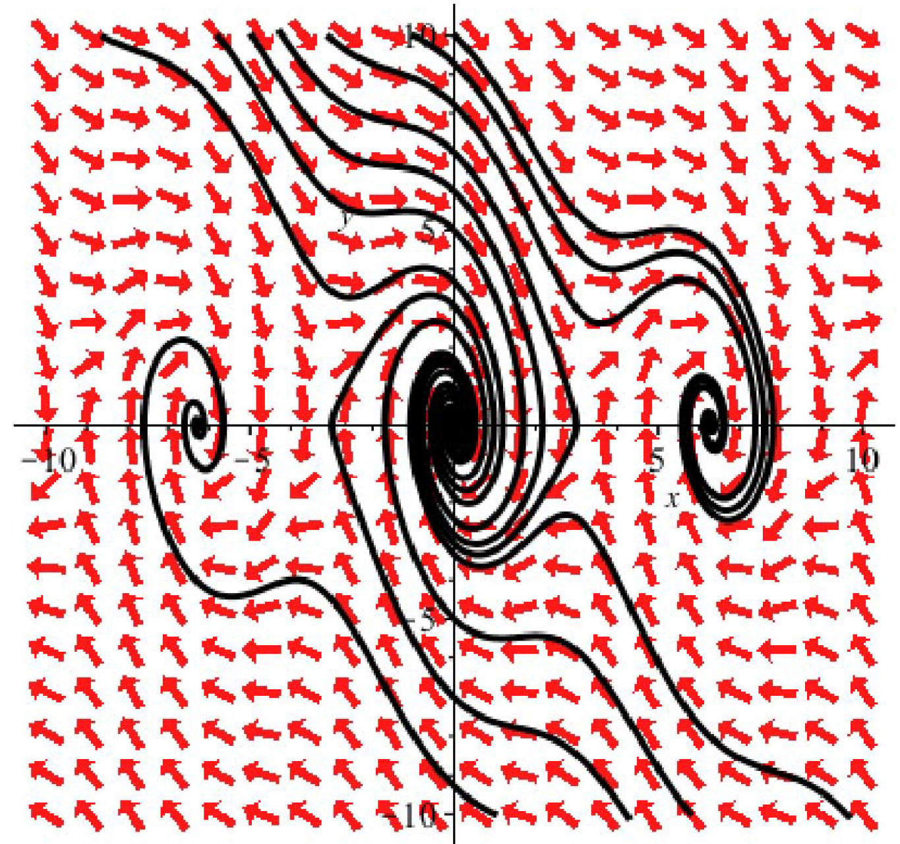

Slide 26
Error term

Slide 27
Error term

Slide 28
Error term

Slide 31
After translating critical point to origin:
$$u′$$
$$u$$
Thus at the critical point , the system of DEs
is approximated by the translated linear system:
$$x′$$
$$x$$

Slide 32
After translating critical point to origin:
$$x′$$
$$x$$

Slide 44
Basin of attraction – region of asymptotic stability of a critical point
Separatrix = trajectory that bounds basin of attaction

Slide 45
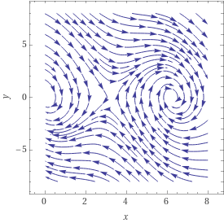

Slide 47
Center is stable, but not asymptotically stable
Asymptotically stable
Just need one positive expo-nential for
Unstable

