Slide 1
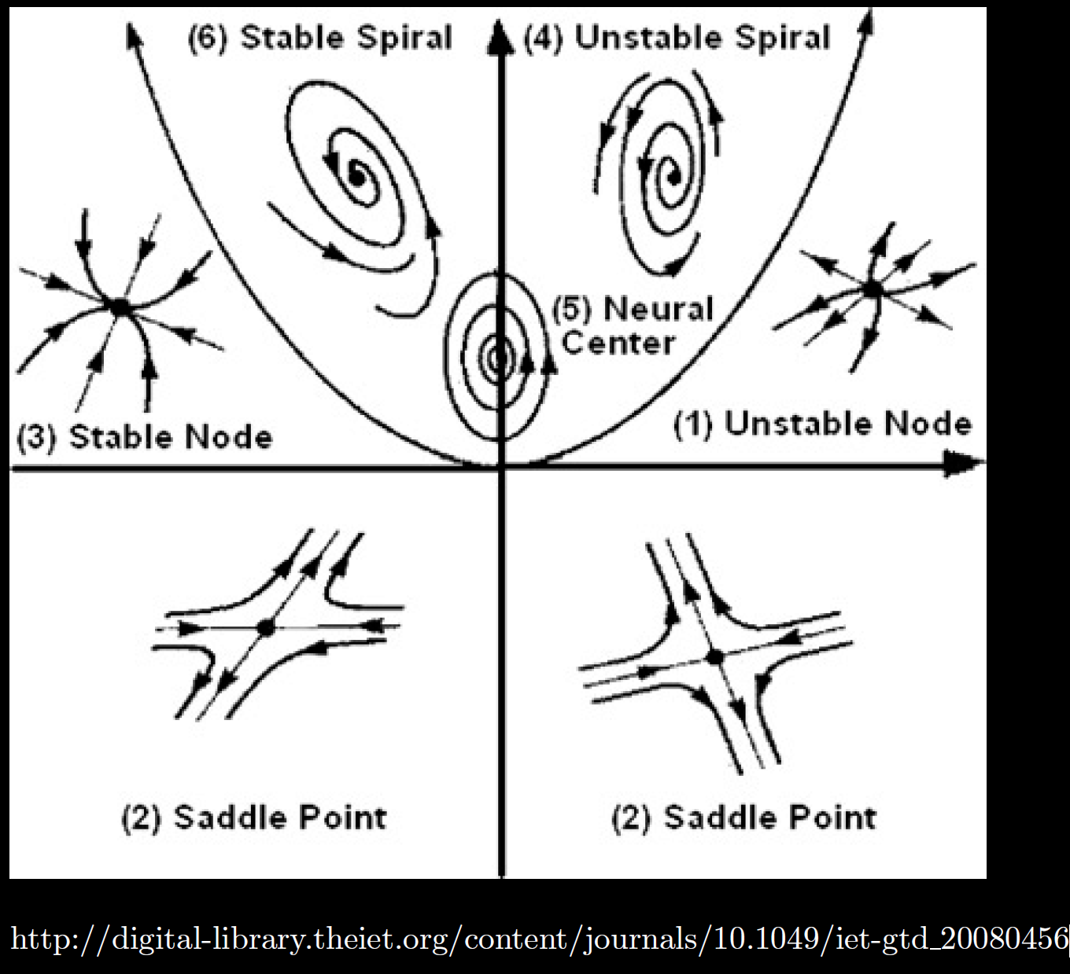
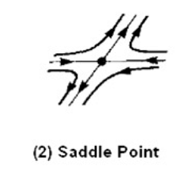
Center is stable, but not asymptotically stable
Asymptotically stable
Just need one positive expo-nential for
Unstable

