Slide 1
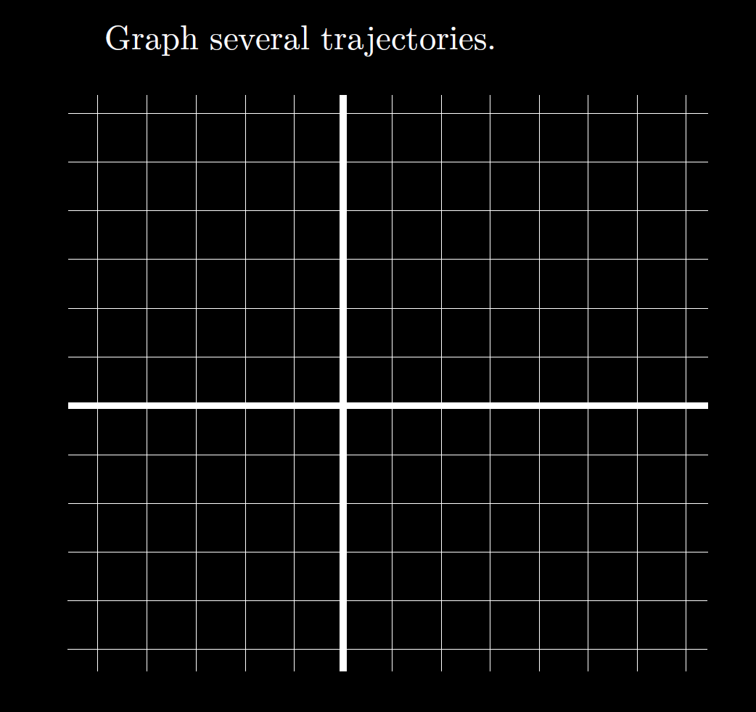
Graph

Slide 2
Graph
Slope field:

Slide 5
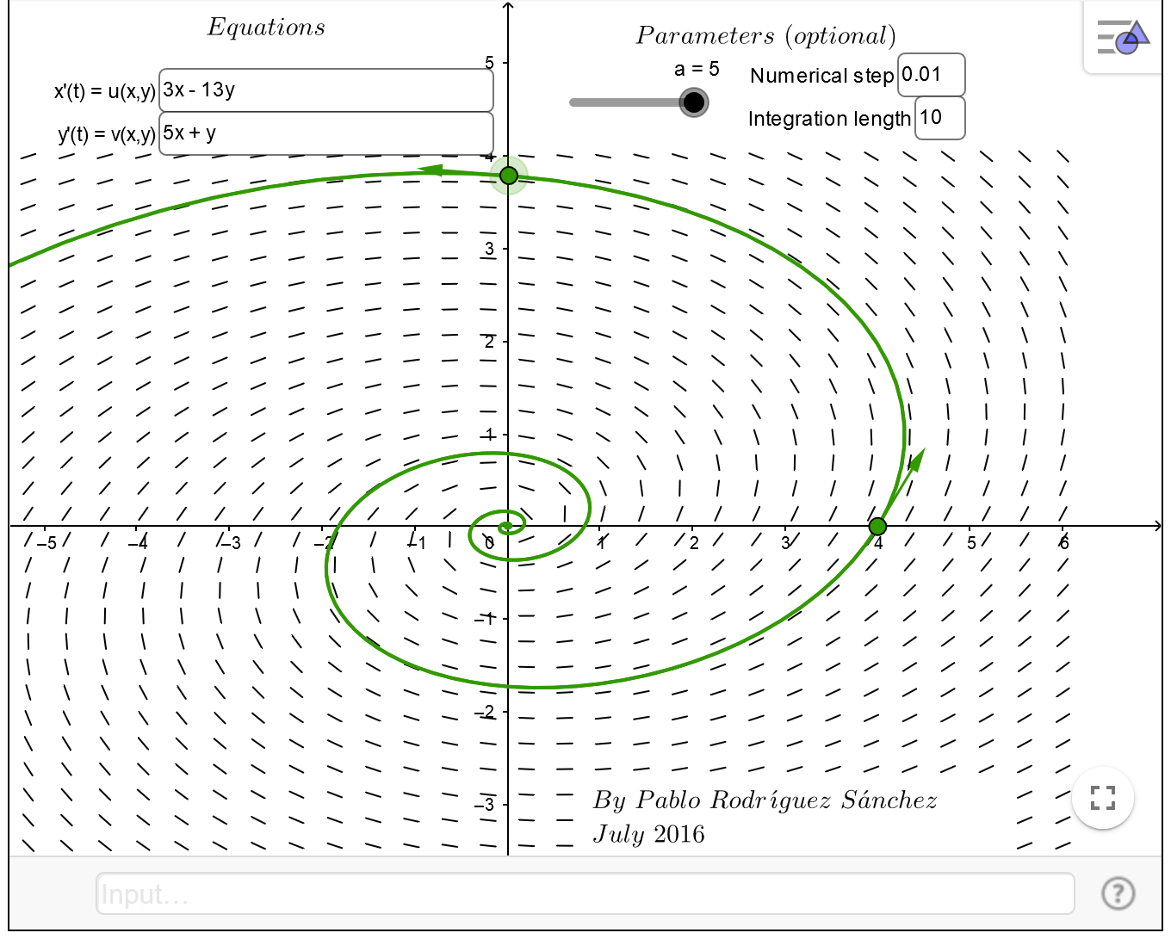
https://www.geogebra.org/m/abg8NJzF

Slide 6
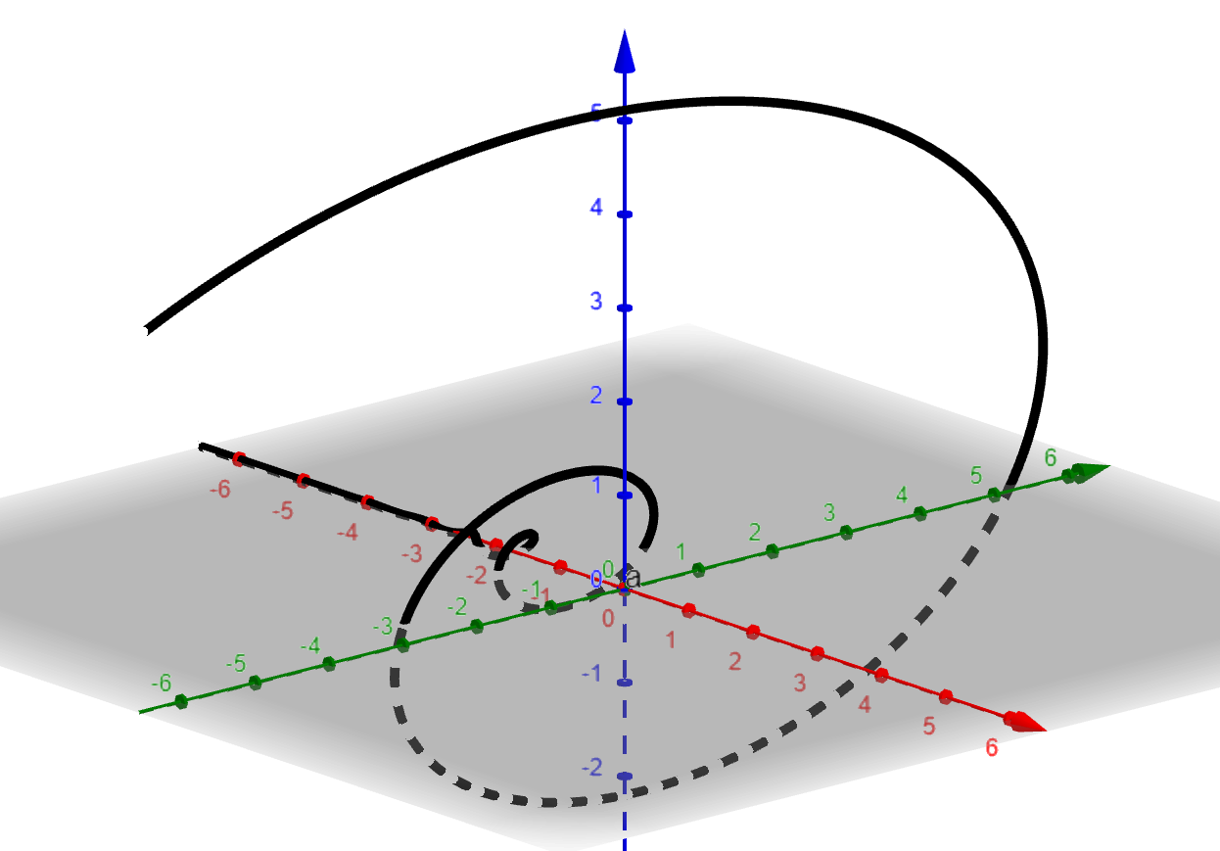
https://www.geogebra.org/3d

Slide 7
https://www.geogebra.org/m/abg8NJzF
https://www.geogebra.org/3d
(t,ℯ^(2 t) (cos(8 t)-8 sin(8 t)),ℯ^(2 t)*5 cos(8 t))

Slide 8
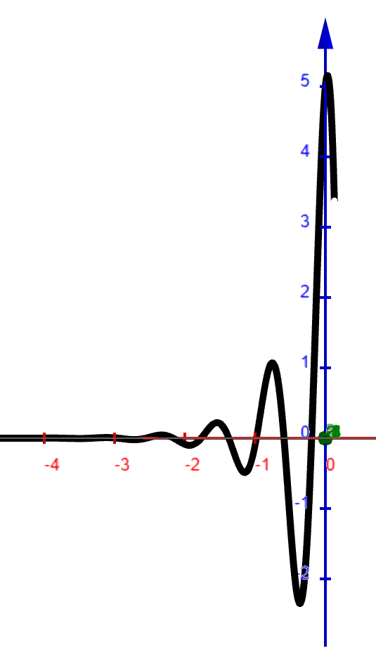
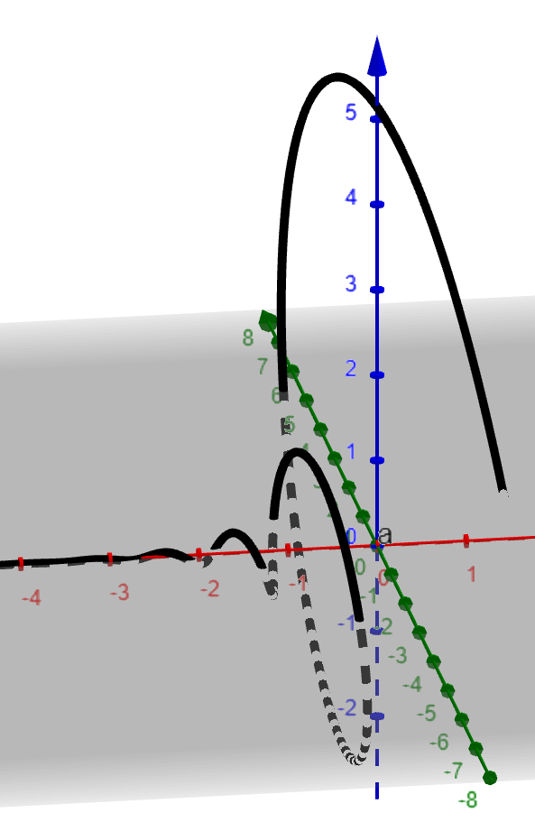

Slide 9
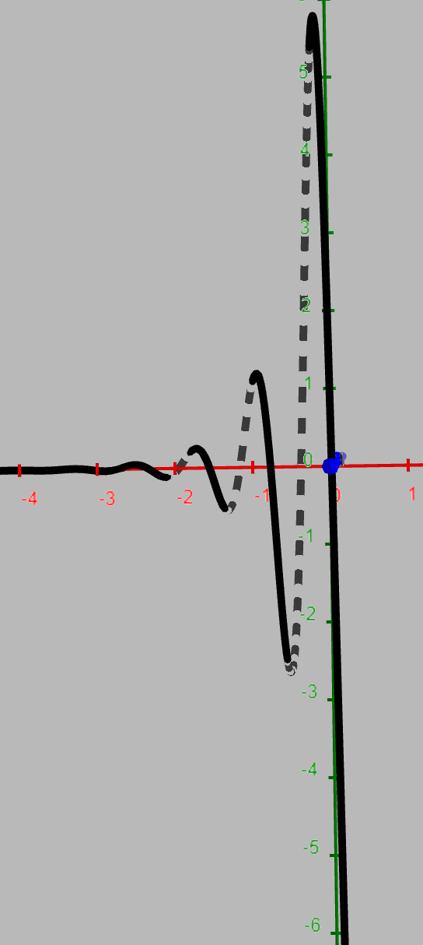
(t,ℯ^(2 t) (cos(8 t)-8 sin(8 t)),ℯ^(2 t)*5 cos(8 t))

Slide 10
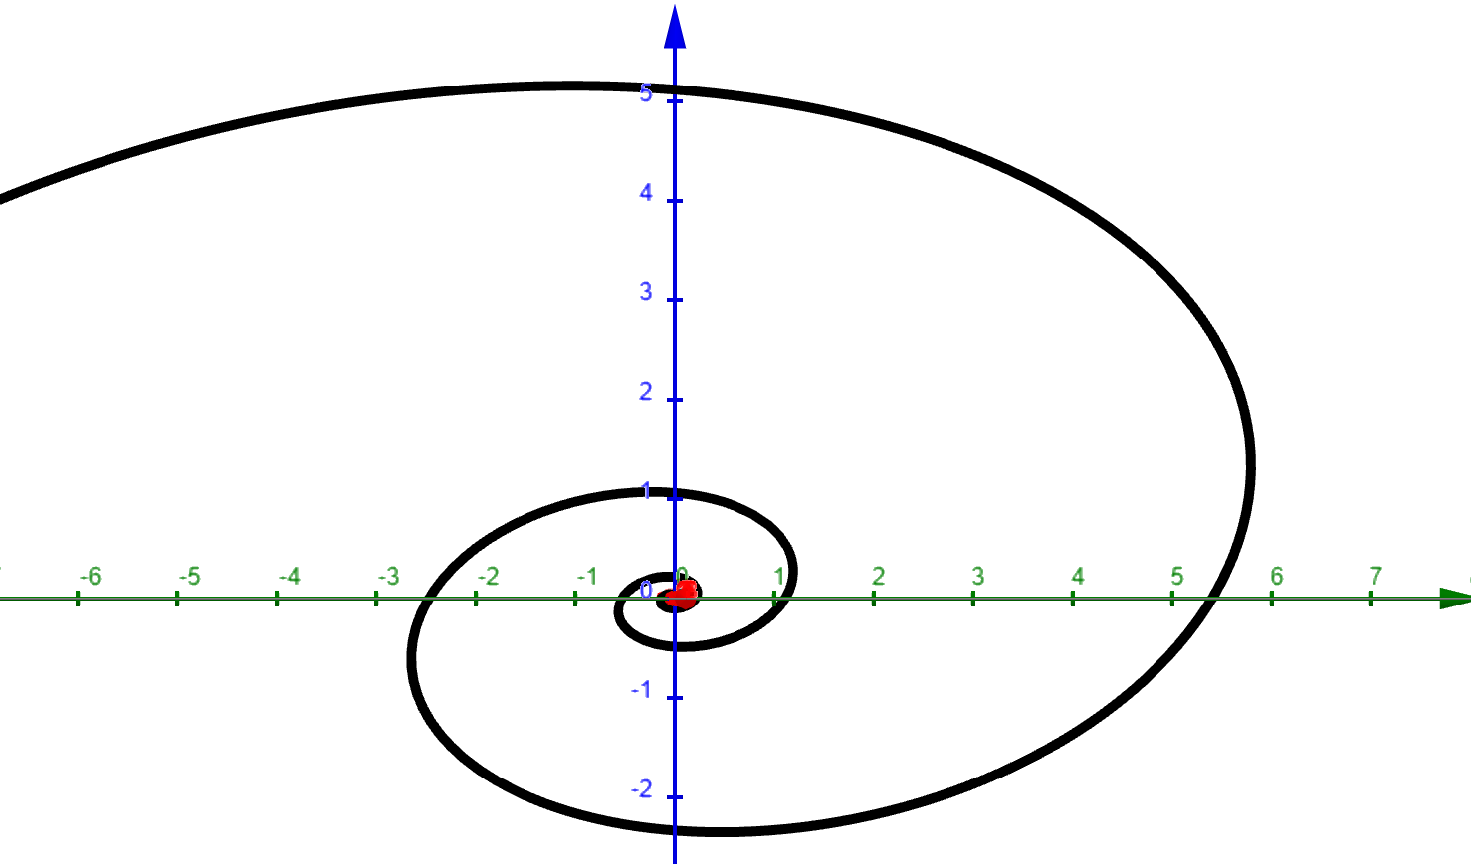
Positive t axis comes out of plane toward you.

Slide 11
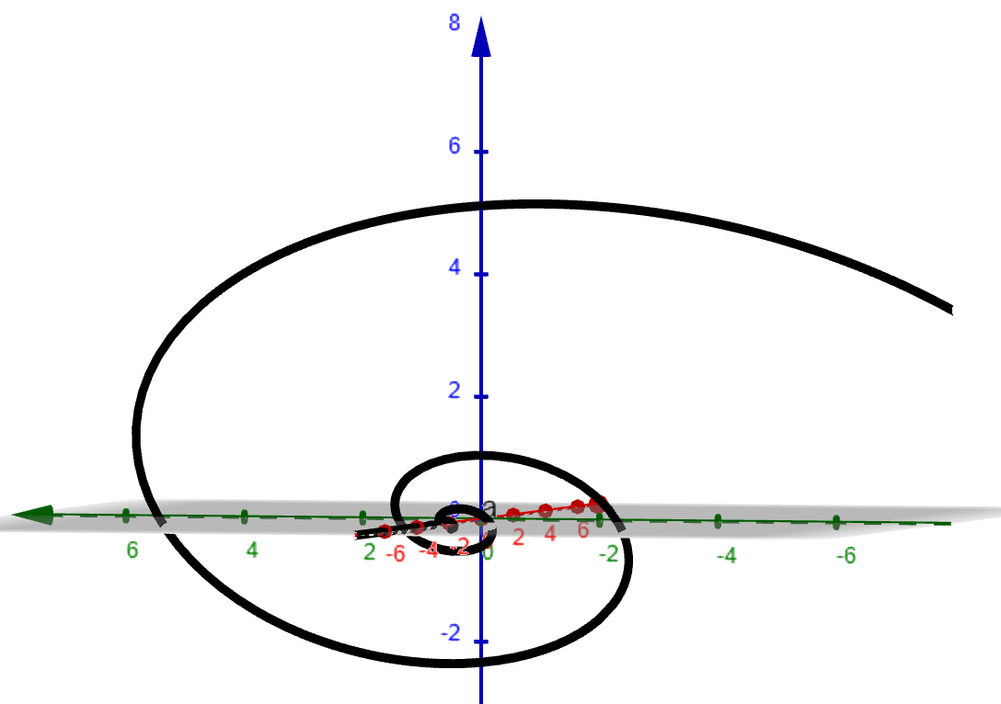
Negative t axis comes out of plane toward you.

Slide 12
https://www.geogebra.org/m/abg8NJzF

Slide 13
Graph

Slide 17
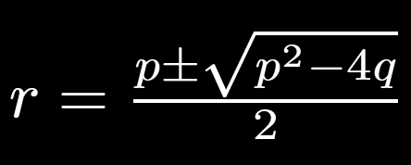
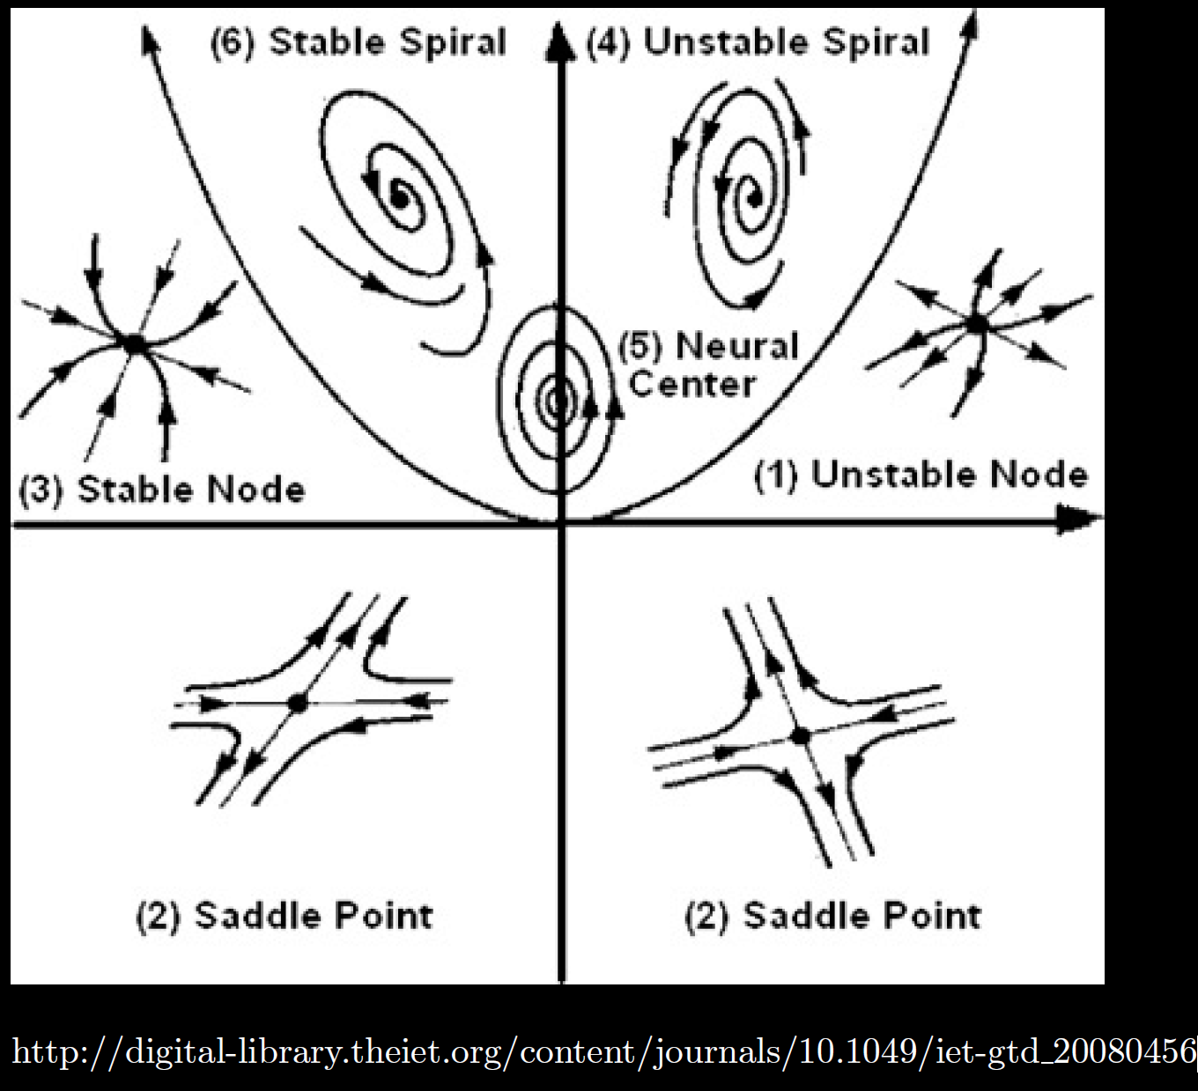

Slide 18
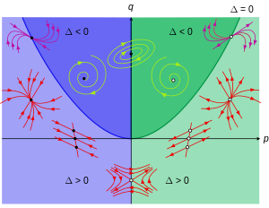
https://en.wikipedia.org/wiki/Phase_plane

Slide 19
Mostly ignore first column as it includes
Test student and other grade(s) not part
of final calculation.
Excel can’t do math, highest grade is
< 100%

Slide 20
Exam 1
Exam 2

Slide 21
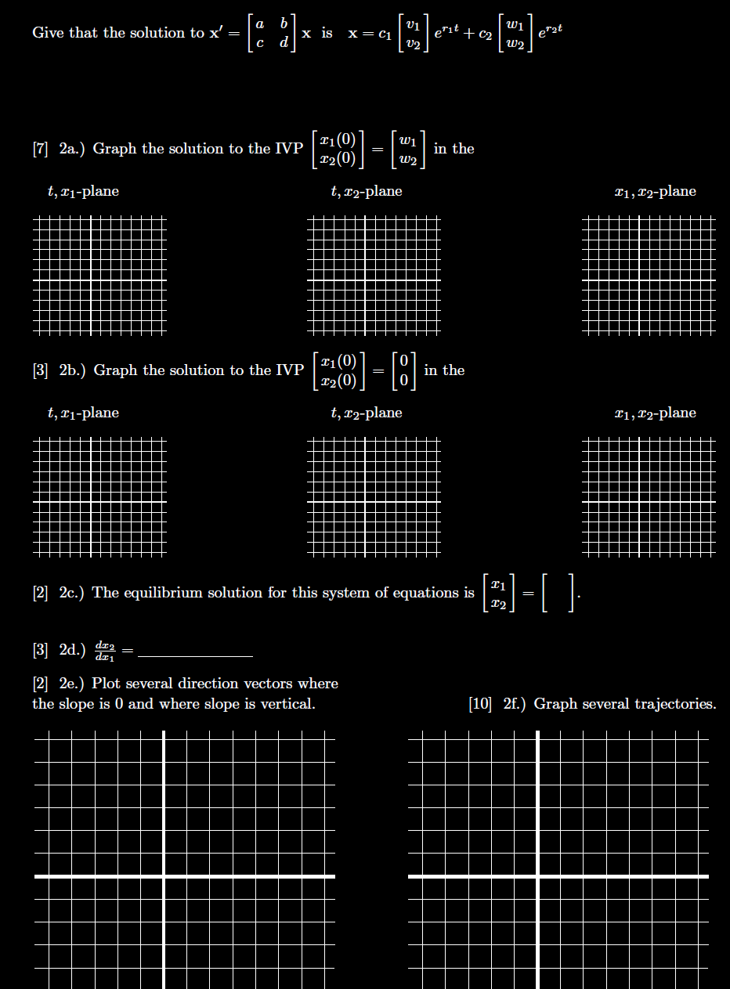
Quiz next week could be like this or could be completely different.
https://homepage.math.uiowa.edu/~idarcy/COURSES/100/SLIDES/hw10graphs.pdf

